Slide 1
Fracking and Texas Water Resources: Case Study in the Barnett Shale
Dana Lazarus, GIS in Water Resources, Dec. 3, 2013

Slide 2
Outline
Background
Data Source
Methodology
Results
Conclusion / Next Steps

Slide 3
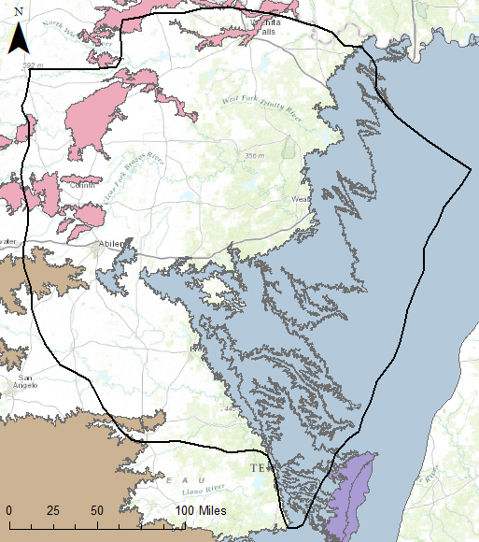
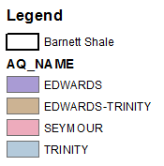
Background:
Major Aquifers in the Barnett Shale

Slide 4
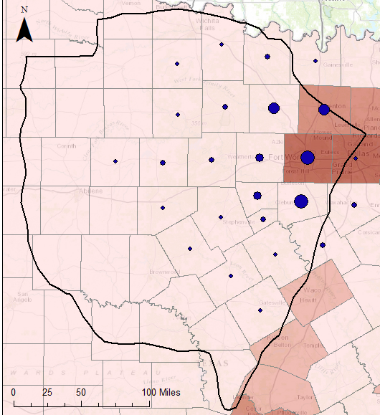
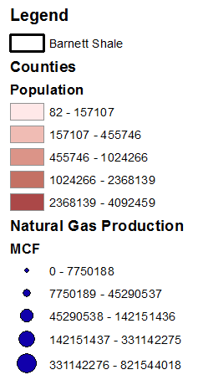
Background:
Population vs. Natural Gas Production
Focus on Tarrant County

Slide 5
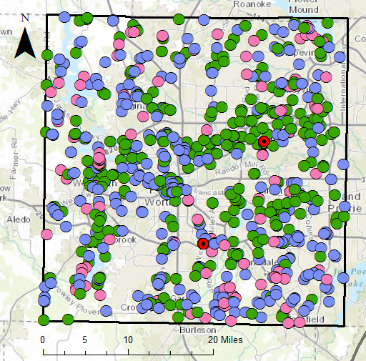
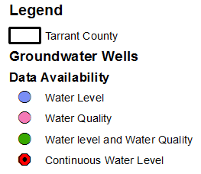
Data Source:
TWDB Groundwater Monitoring Wells
Texas Water Development Board Groundwater Database
Continuous water level data through 2012

Slide 6
Data Source:
Continuous Water Level Monitoring Data

Slide 7
Methodology
Water Level
Interpolate water level across the area based on observations for a single time period
Repeat interpolation for all time periods
Construct time series to evaluate trends over time
Water Quality
Data limited for parameters of interest

Slide 8
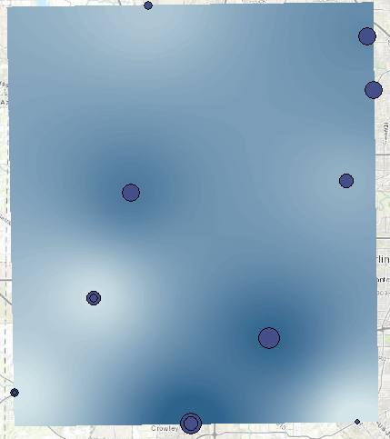
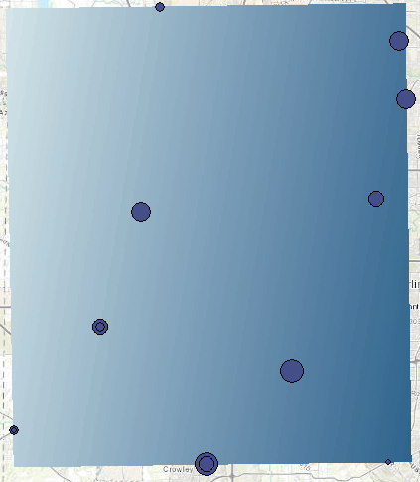
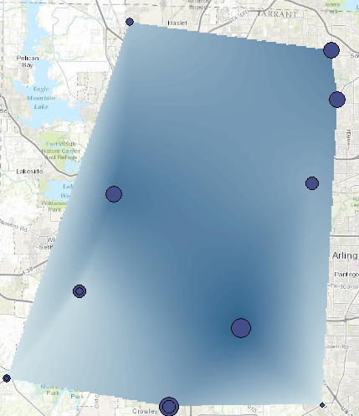
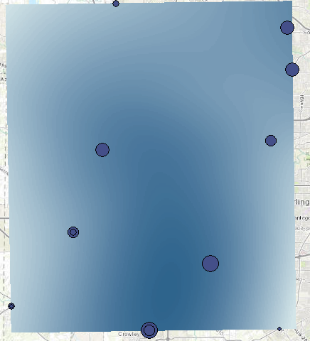
Results:
Interpolated Water Levels for 2012
Inverse Distance
Kriging
Nearest Neighbor
Splines

Slide 9
Results:
Interpolated Water Levels 1993-2012

Slide 10
Conclusion / Next Steps
Water levels experiencing some decline
Can trend be correlated to fracking activity?
Consider other factors
Precipitation, Population, Industry, Agriculture

Slide 11
Thank You!
Questions?

