Slide 1
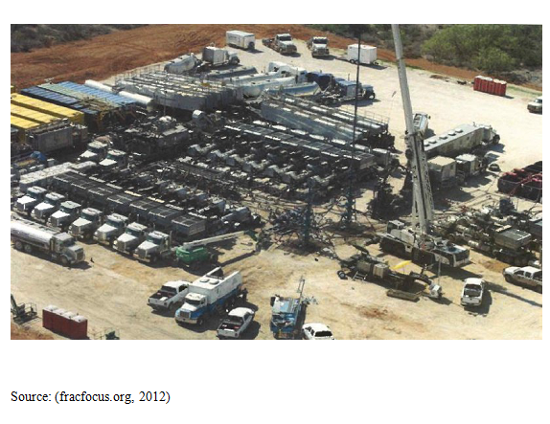
What are the potential impacts to landscapes and first order streams in LaSalle County Texas from exploration, production, and infrastructure development in the Eagle Ford Shale Play?
Jon Paul Pierre, GIS in Water Resources, Fall 2013

Slide 2
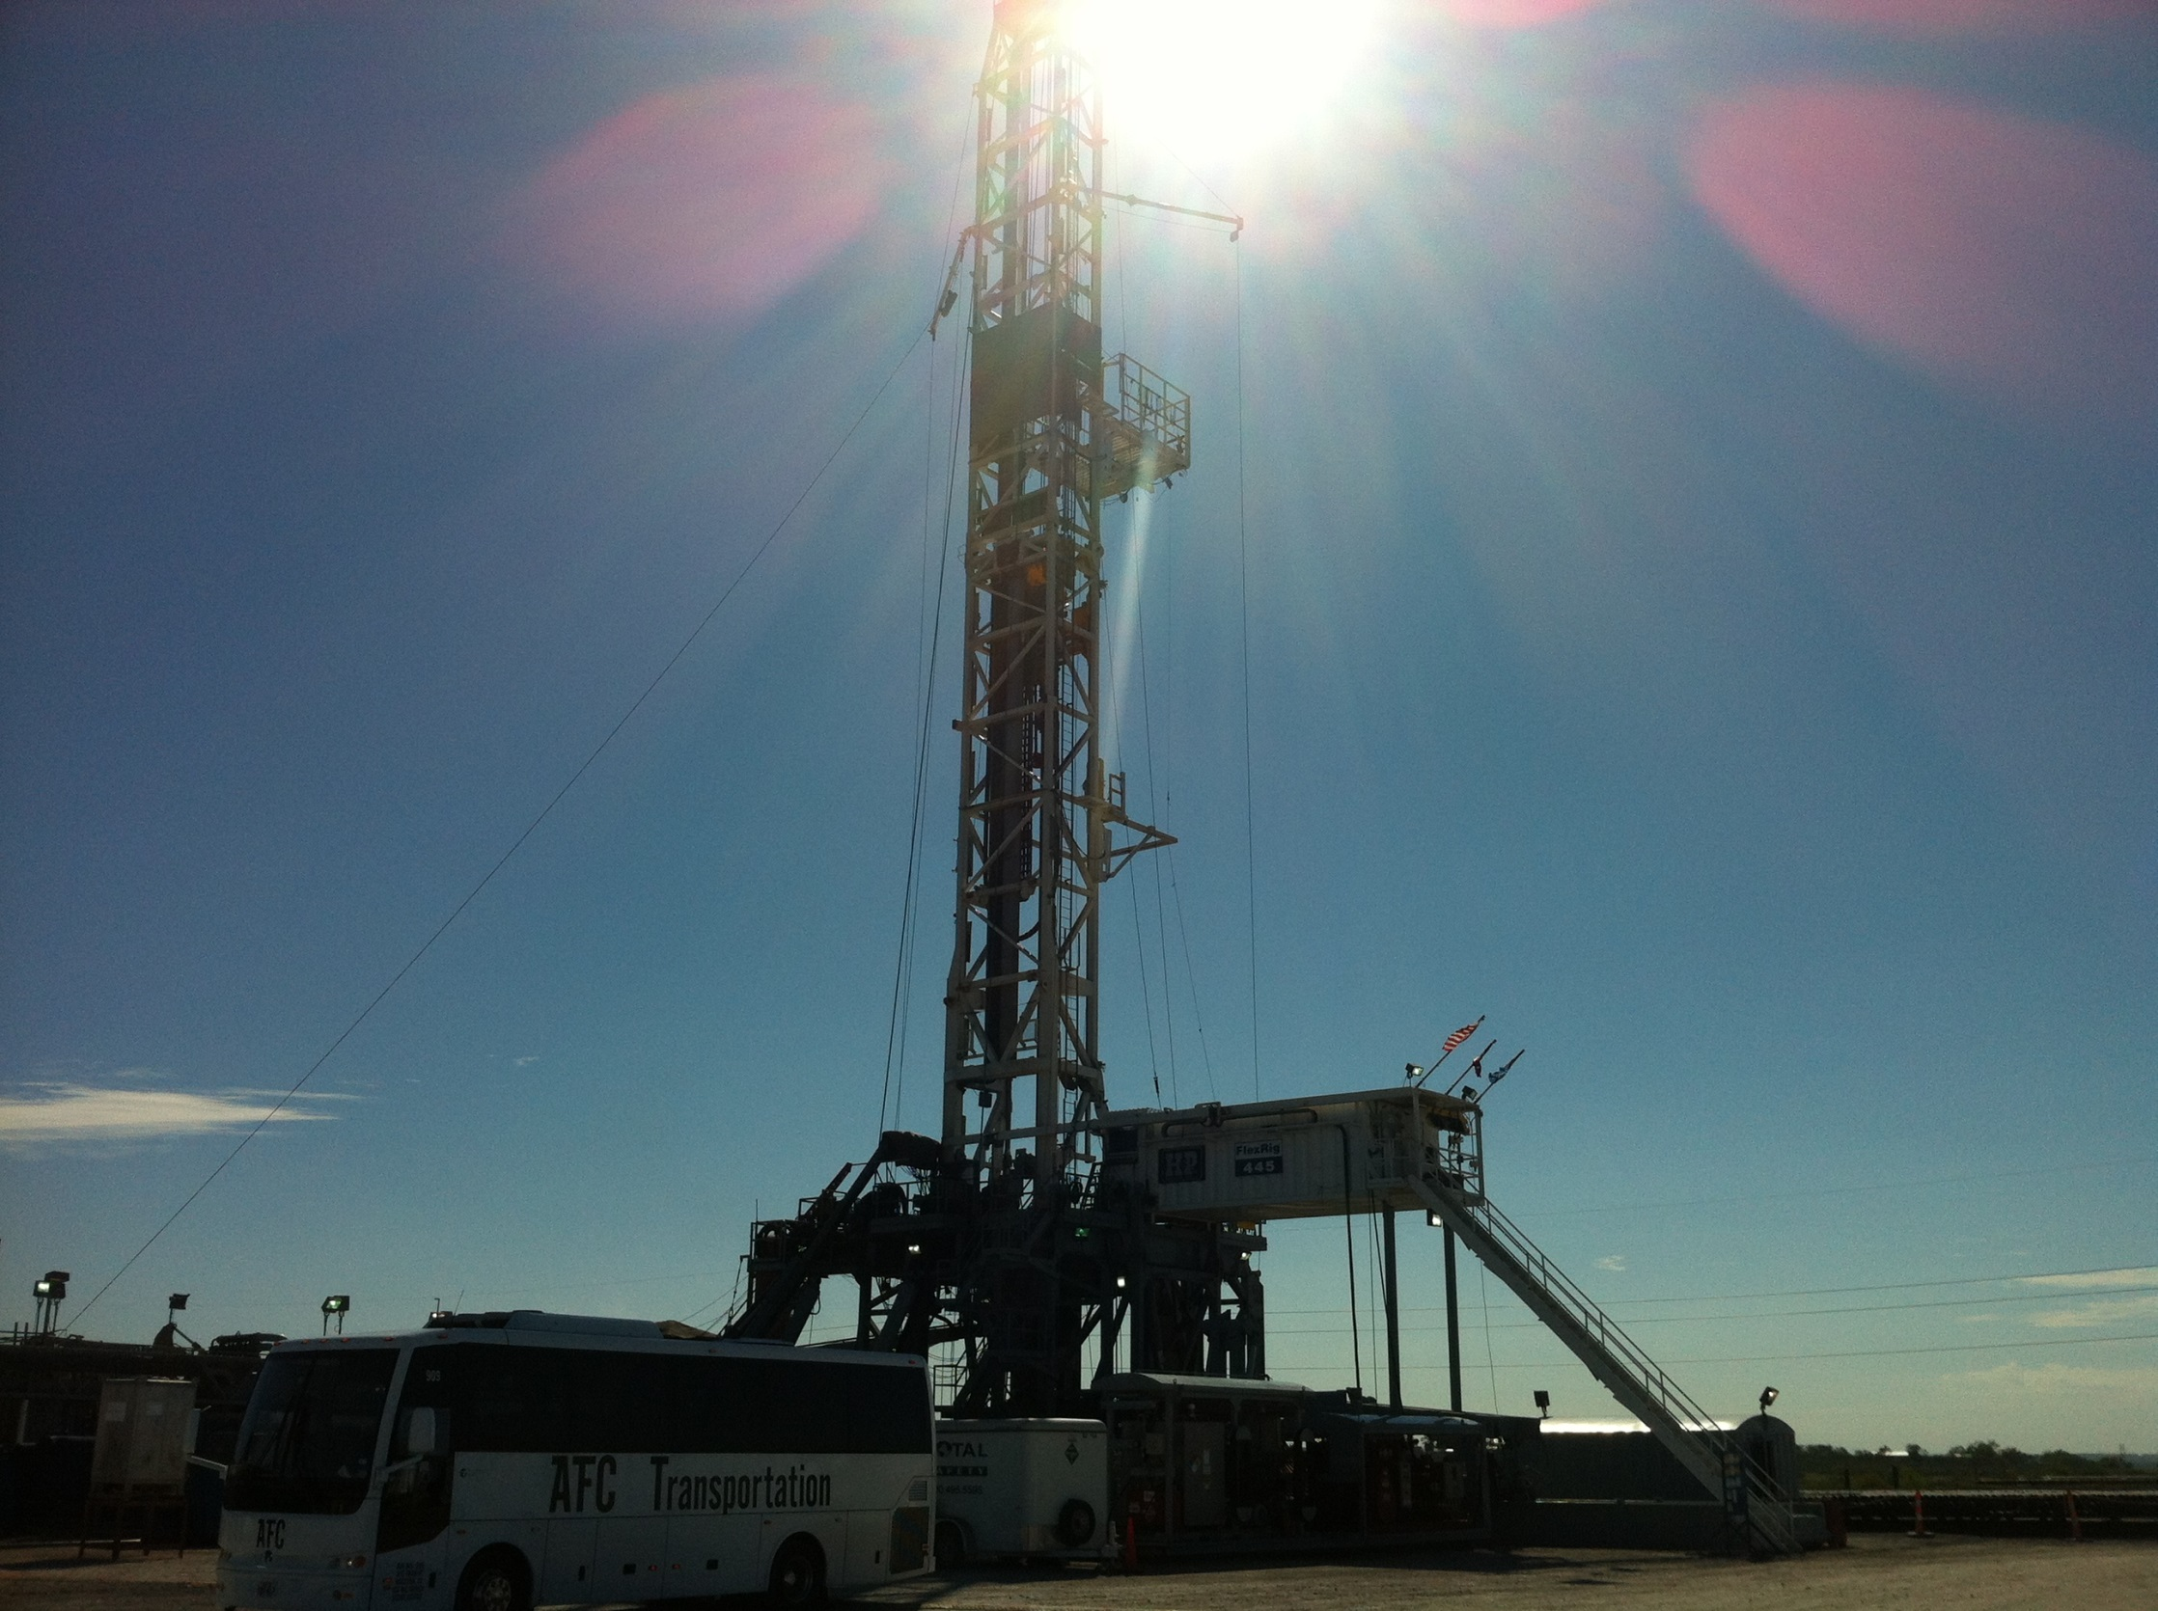
QUESTIONS?
How much landscape fragmentation has occurred in LaSalle County?
Where are the “hot spots” of core forest degradation in LaSalle County?
Where are the “hot spots” of first order stream disruptions in LaSalle County?

Slide 3

Why are landscape fragmentation and first order stream disruptions important?
Land-use change often outpaces the capacity to track effects on land cover and subsequent ecological impacts.
Often left with the task of damage assessment while making little or no contributions to land planning.
As a result, opportunities to protect and preserve vital ecosystem services and biodiversity are missed.
Paleontological findings have demonstrated how species were lost in last few centuries due to anthropogenic disruptions of first order streams in semi-arid climates. (Alados et al., 2011 in semi-arid Mediteranean)

Slide 4
A phenomenal unprecedented pace of
oil and gas activity in the Eagle Ford.
Primarily due to the discovery of liquid rich sections in
the shale play.
Eagle Ford Formation is thickest in LaSalle County.
Oil and gas activity has the highest concentration in
LaSalle County compared to the other 24 counties.

Slide 5
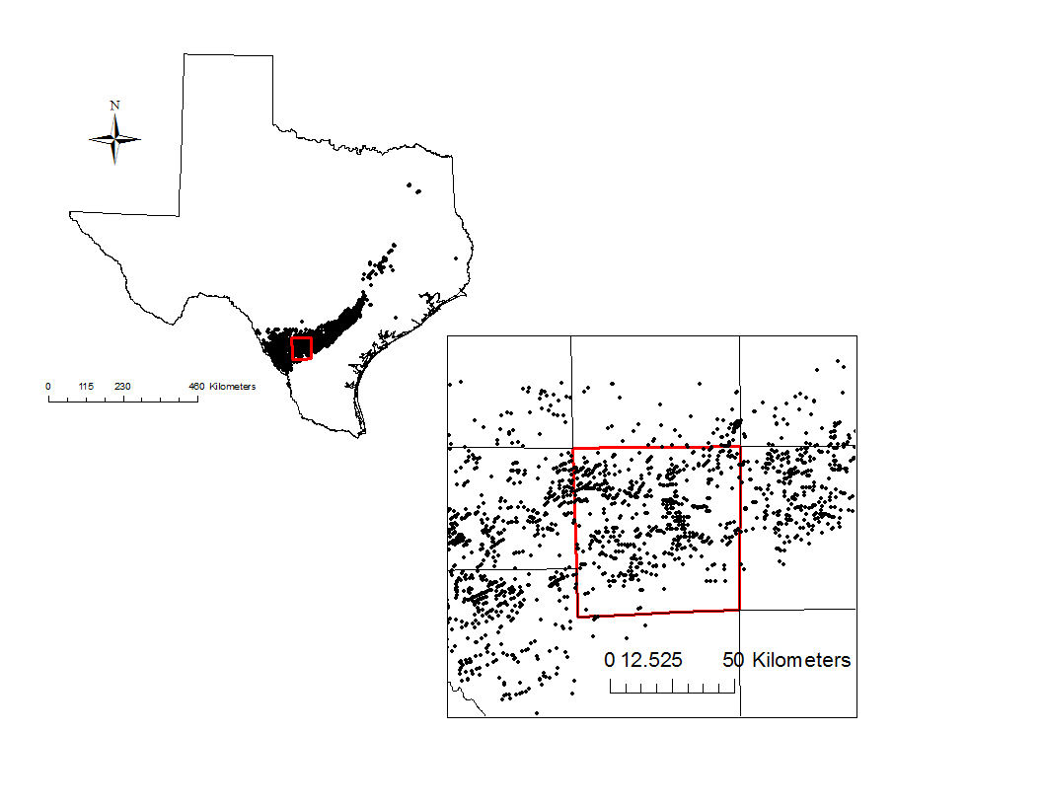
Oil and gas wells in the Eagle Ford Shale Play
Study Area:
Oil and gas wells in LaSalle County

Slide 6
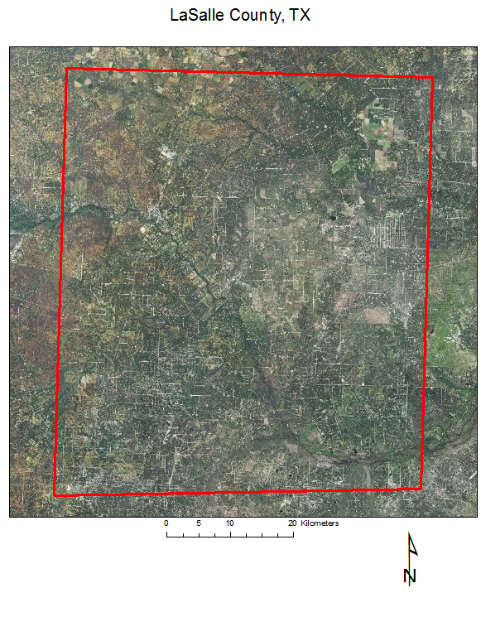

Slide 7
Some Background Facts:
Precipitation ranges from 23cm-48cm/yr
Vegetation biomes consist of a grassland mosaic of mesquite, blackbrush, and blue stem.
Ustic soil moisture regime: (semi-arid)
Dominated by Mollisols, Alfisols, Vertisols, and Entisols
Potential Evapotranspiration ranges from 13cm/yr to 17.5cm/yr
Area of LaSalle County= 3,831km²

Slide 8
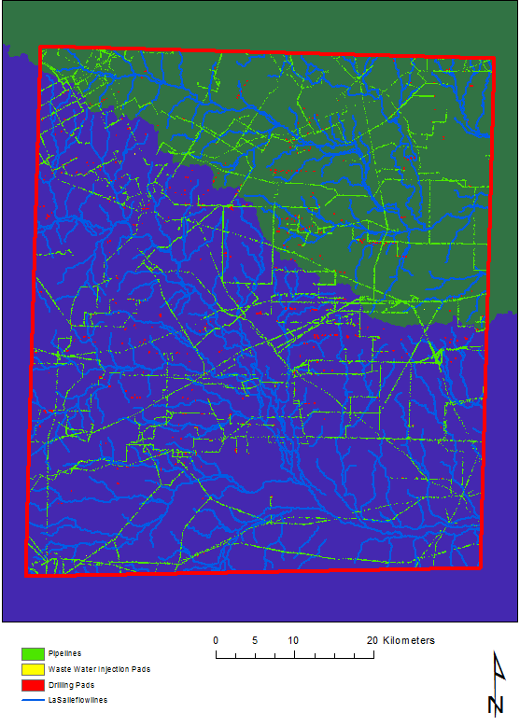
LaSalle County, TX
Two subwatersheds
Within the Nueces
River Basin

Slide 9
Methods:
Datasets Acquired:
Well locations from IHS
SSURGO from NRCS Soil Data Mart
Watershed and Stream delineation from NHDPlus v.2
NAIP from USDA
NLCD from USGS
Pipelines from Railroad Commission of Texas
Third Party ARCGIS tool used:
Landscape Fragmentation Tool V.2 (LFT) from the Center
for Land Use Education and Research- UCONN (Parent and Hurd, 2007)
Datasets Created:
Drilling Pads and wastewater injection pads- outlined manually
Pipeline disturbance extracted through the use of image classification
Open Source Software Used:
Geoda V 1.4.6 from the GeoDa Center for Geospatial Analysis and Computation - ASU

Slide 10
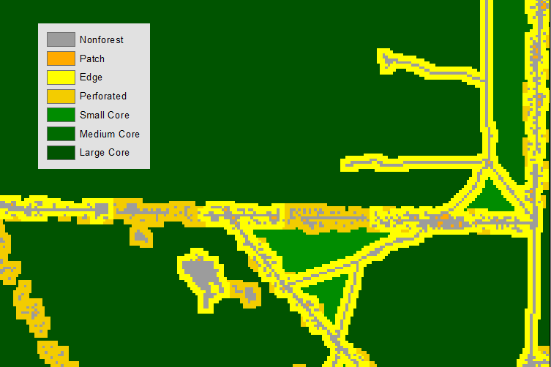
Landscape Fragmentation Analysis:
Baseline (pre-drilling) conditions established using 2001 NLCD coverage
NLCD raster reclassified with 3 classes: disturbed, undisturbed, and water
Reclassified NLCD input into LFT
LFT re-run on cells overlain by increasing levels of E&P infrastructure
  Drilling pads only
  Drilling pads and injection wells
  Drilling pads, injection wells, and pipelines
5. Output reclassified undisturbed area as core, edge, perforated, or patch
as suggested by Vogt et al. (2006)

Slide 11
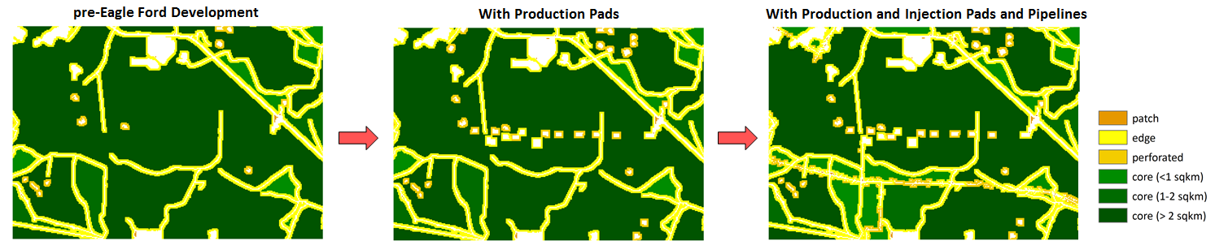
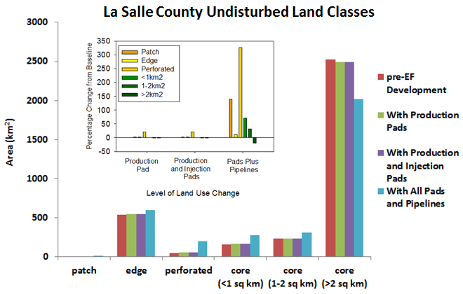
Succession of steps taken in the landscape fragmentation analysis

Slide 12
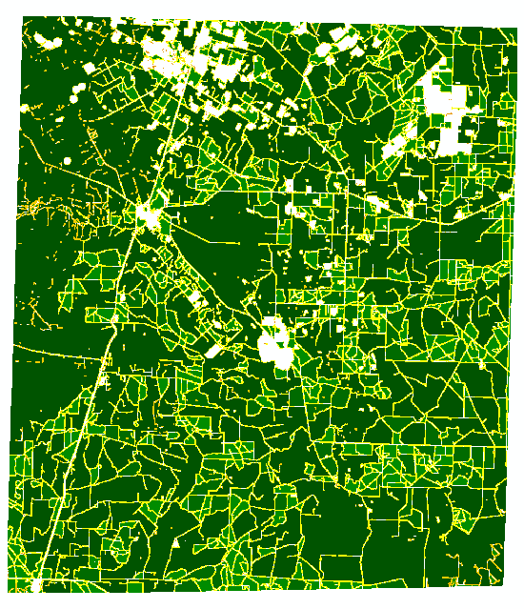

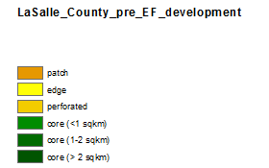

Slide 13
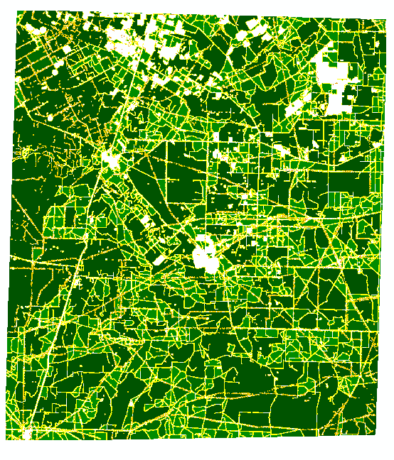
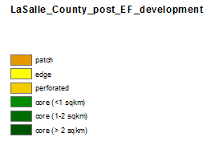

Slide 14
Above each bar is the mean wells per pad and maximum wells per pad, respectively

Slide 15
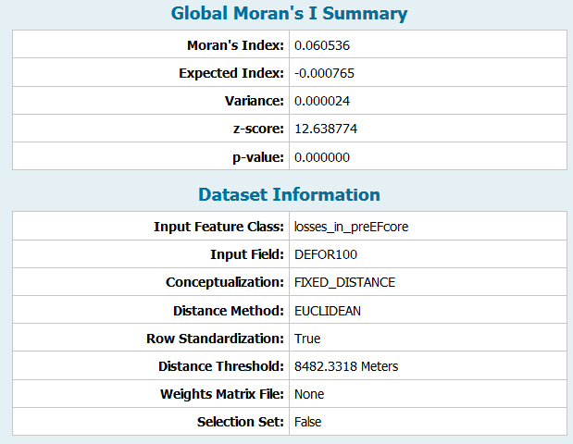
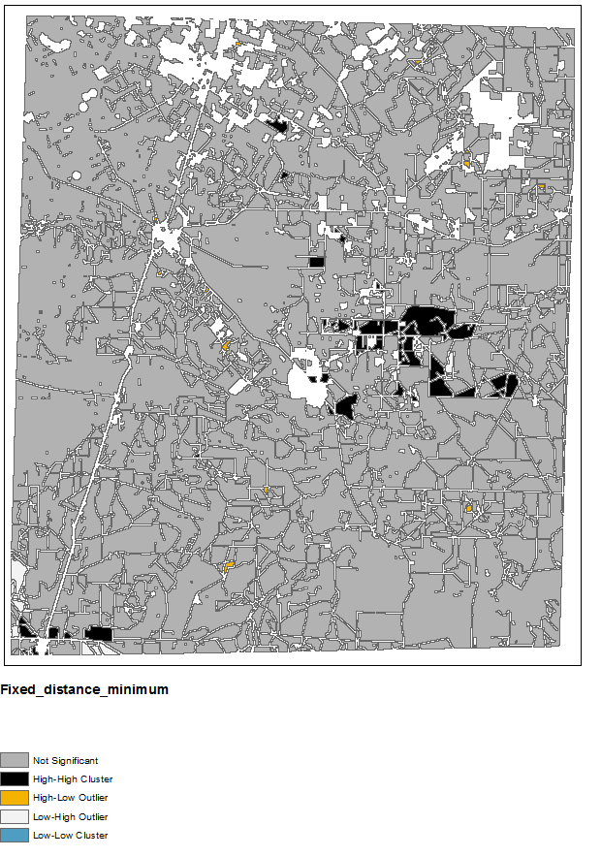
DEFORESTATION-FIXED MIN DIST
Global Moran’s I
LISA-Local Indicators of Spatial Association
+ SAC
Global Z-score of 12.64 indicates there
is a less than 1% likelihood that this
clustered pattern is a result of complete
spatial randomness
Minimum distance threshold
was 8482.33 meters or 5.2 miles
Local analysis is based on
fixed distance with distance threshold
of 8482.33 meters and with row standardization
Notes:
The same as inverse distance

Slide 16
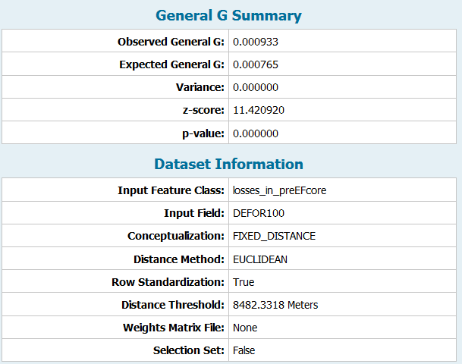
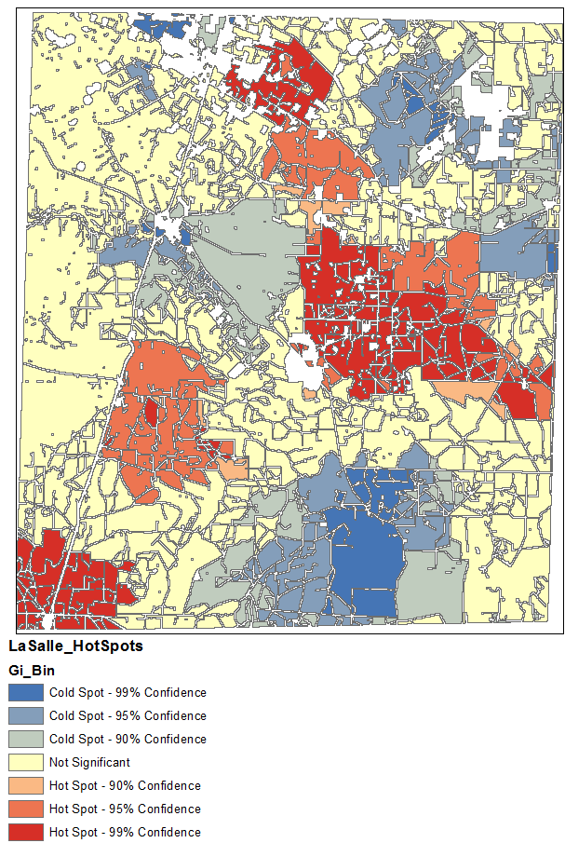
DEFORESTATION-FIXED MIN DIST
General G statistic (Global)
Getis-Ord Gi* Hot Spot Analysis (Local)
H-H clusters
Global Z-score of 11.42 indicates there
is a less than 1% likelihood that this
clustered pattern is a result of complete
spatial randomness
Default minimum distance threshold
was 8482 meters or 5.2 miles
Local analysis is based on
a fixed distance band with minimum distance threshold

Slide 17
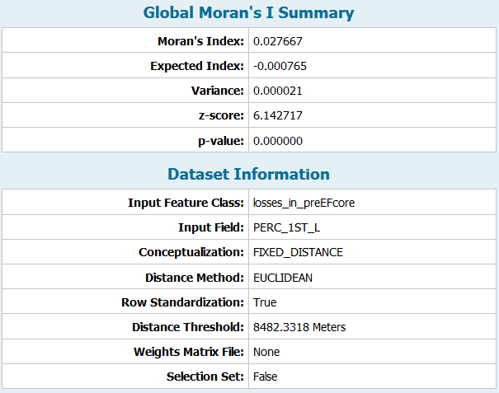
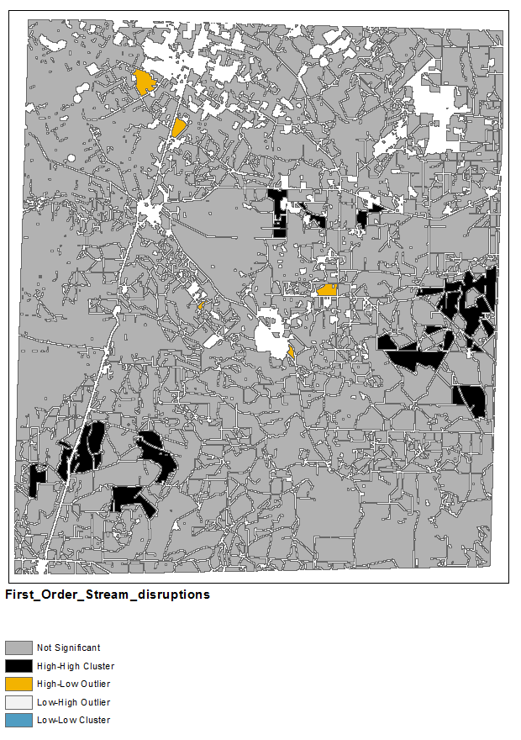
1ST ORDER STREAM LOSS-FIXED MIN DIST
Global Moran’s I
LISA-Local Indicators of Spatial Association
Global Z-score of 6.14 indicates there
is a less than 1% likelihood that this
clustered pattern is a result of complete
spatial randomness
Minimum distance threshold
was 8482.33 meters or 5.2 miles
Local analysis is based on
fixed distance with minimum distance threshold
and with row standardization

Slide 18
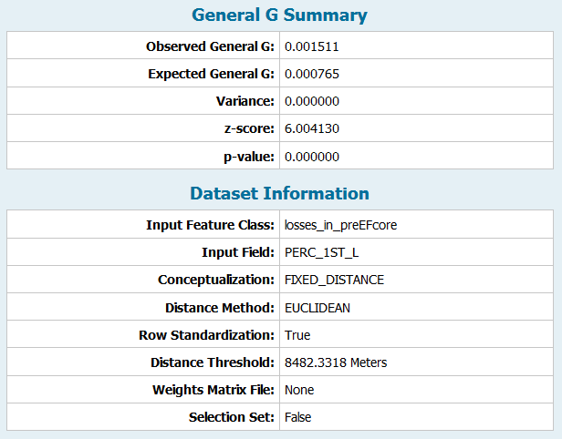
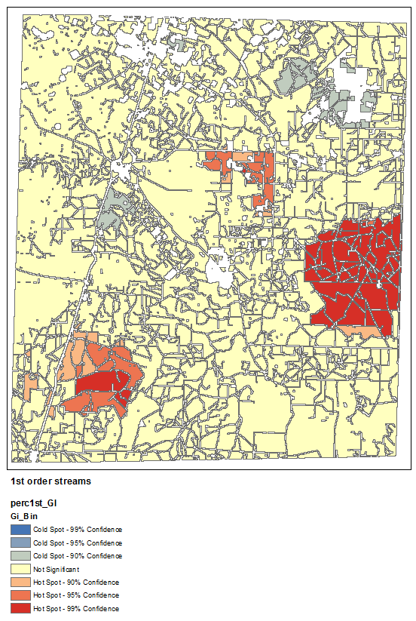
1ST ORDER STREAM LOSS-FIXED MIN DIST
General G statistic (Global)
Getis-Ord Gi* Hot Spot Analysis (Local)
Global Z-score of 6.00 indicates there
is a less than 1% likelihood that this
clustered pattern is a result of complete
spatial randomness
Default minimum distance threshold
was 8482 meters or 5.2 miles
Local analysis is based on
a fixed distance band with minimum distance threshold

Slide 19
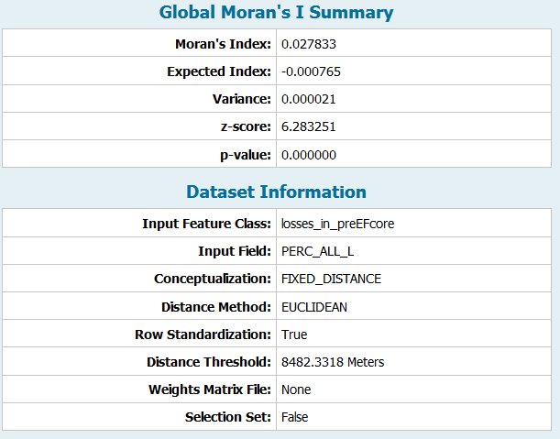
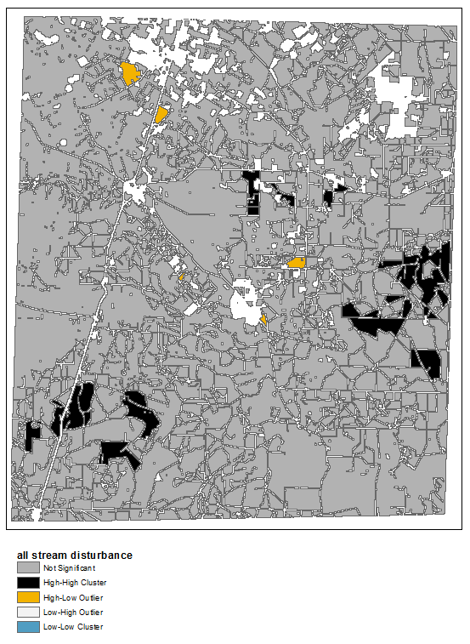
ALL STREAM LOSS-FIXED MIN DIST
Global Moran’s I
LISA-Local Indicators of Spatial Association
Global Z-score of 6.28 indicates there
is a less than 1% likelihood that this
clustered pattern is a result of complete
spatial randomness
Minimum distance threshold
was 8482.33 meters or 5.2 miles
Local analysis is based on
a fixed distance band of 8482.33m
and with row standardization

Slide 20
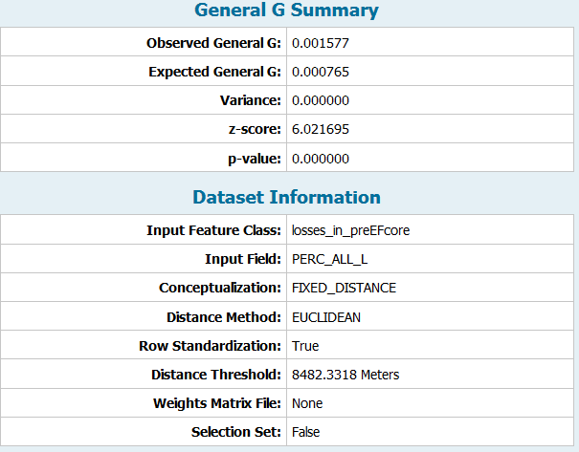
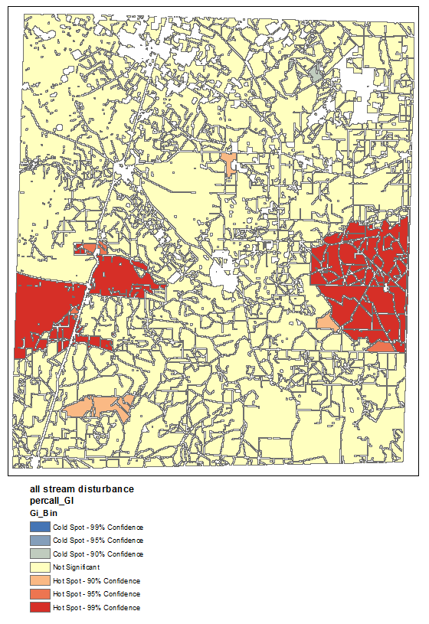
ALL STREAM LOSS-FIXED MIN DIST
General G statistic (Global)
Getis-Ord Gi* Hot Spot Analysis (Local)
Global Z-score of 6.02 indicates there
is a less than 1% likelihood that this
clustered pattern is a result of complete
spatial randomness
Default minimum distance threshold
was 8482.33 meters or 5.2 miles
Local analysis is based on
a fixed distance band with minimum distance threshold

Slide 21
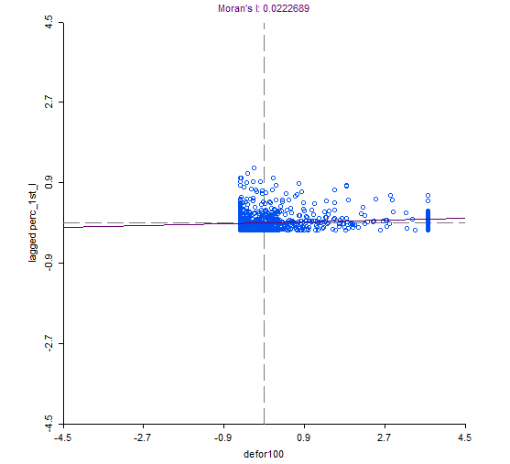
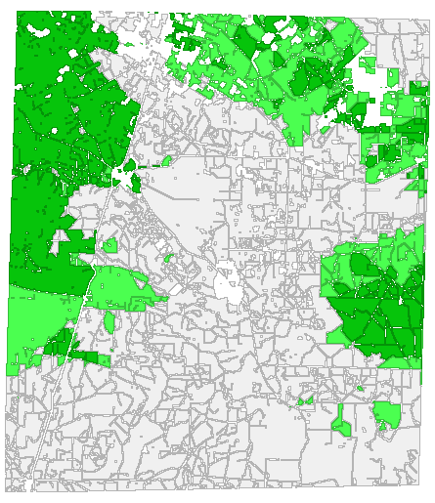
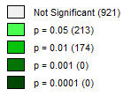
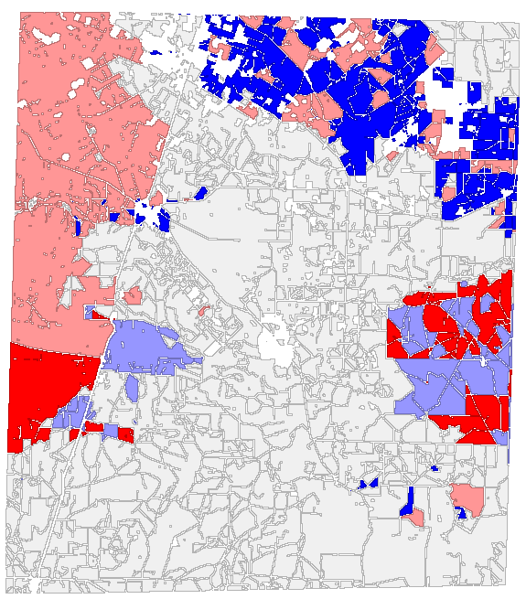
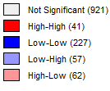
Bivariate LISA-weighted by %deforestation and %area loss of 1st order streams
Cluster Map
L-H
H-H
L-L
H-L
Significance Map

Slide 22
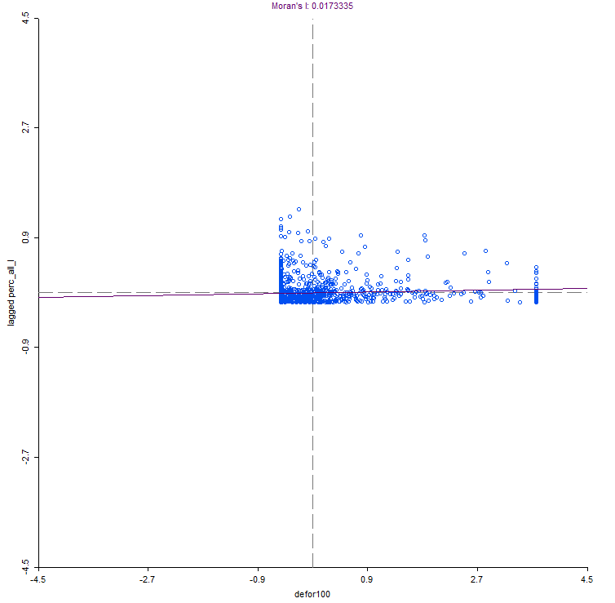
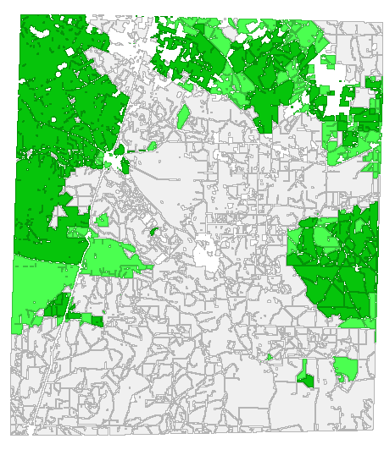
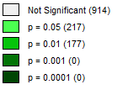
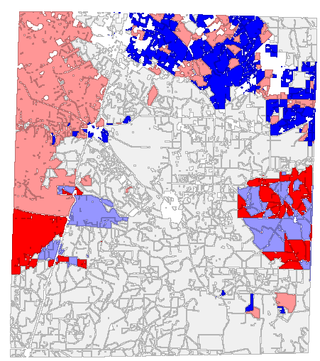
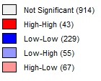
Bivariate LISA-weighted by %deforestation and %area loss of all streams
L-H
H-H
Cluster Map
L-L
H-L
Significance Map

Slide 23
Preliminary Conclusions:
Pipeline infrastructure placement has more of an effect on
landscape and hydrologic fragmentation than drilling and injection
pads
Well to pad density has increased slightly in a 13yr period, but
not to the levels indicated in the literature for other shale
plays (i.e. Marcellus, Barnet)
Spatial statistical analyses may be useful land management tools
for O&G operators

Slide 24
Future Work:
Identify methods to extract road network disturbance created by
O&G activities
Incorporate property boundaries into analyses
Use 2013 NLCD to do regression analysis to determine the overall effect
of fragmentation caused by O&G activity
Determine appropriate distance thresholds for neighborhood analyses
in semi-arid climates from previous literature
Determine appropriate buffer distances from stream networks from
previous literature

Slide 25
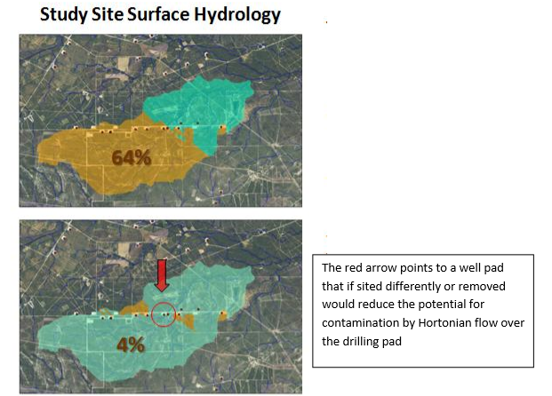
Future Work continued:

Slide 26
Acknowledgements:
Special thanks to:
Dr. Jennifer Miller
Dr. David Maidment
Gonzalo Espinoza
Chuck Abolt

Slide 27
Questions-?

