Slide 1
Geospatial Analysis of the Big Spring, TX Area
Why Direct Potable Reuse Makes Sense
By Gary Shrestha
Notes:
I chose this topic because of the facility that was just started in Big Spring Texas that is the first in the United States to apply direct potable reuse. There are some interesting factors that influenced the decisions on this project and in this region and that’s what I wanted to take a look at.

Slide 2
Types of Wastewater Reuse
Non-Potable Reuse
Watering lawns
Industrial cooling
Indirect Potable Reuse
Aquifer recharge
Reservoir augmentation
Direct Potable Reuse
Treated wastewater is reused as drinking water
Generally considered a “last resort”
Applied recently at Big Spring, TX (Raw Water Production Facility)
Notes:
First I’d like to go over real quick the types of wastewater reuse so you can see where direct potable reuse fits in. First there’s non-potable reuse which is using treated wastewater for applications where it is not consumed by humans like watering lawns, irrigation, and industrial cooling. Taking it a step further towards human consumption is indirect potable reuse. This has already been applied in a few places including Texas and California. In these cases, treated wastewater is pumped into the aquifer to store it and then pumped back out to treat for drinking water. Taking it a final step further is direct potable reuse which is generally considered a last resort. This is where the wastewater effluent is treated to drinking water standards, and this has only recently been applied at the facility in Big Spring, TX which came online back in April of this year.

Slide 3
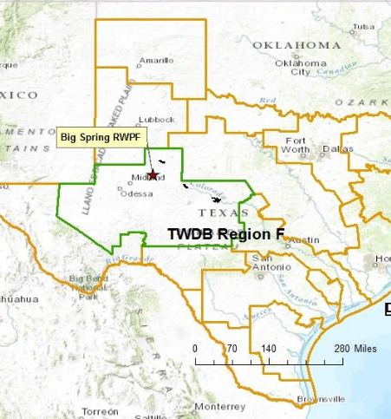
Project Background
The Big Spring Raw Water Production Facility (RWPF) is owned/operated by the Colorado River Municipal Water District (CRMWD)
Certain factors in the region influenced the direct potable reuse initiative
Notes:
For a little bit of background about this project: The Big Spring Raw Water production facility is owned and operated by the Colorado River Municipal Water District which is the main utility that operates within Region F for the TWDB. What’s unique about this facility is that it’s the first of its kind to apply direct potable reuse (also called “toilet to tap”). Direct potable reuse is basically considered a last resort for water conservation, and there’s a lot of public stigma associated with it, so it took them a lot of public convincing and effort to make this project happen. I wanted to take a look at why the utility in this region decided to implement it and what types of benefits they can get from it.

Slide 4
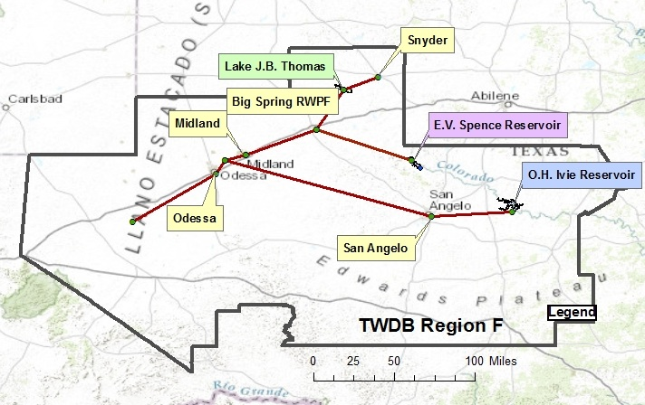
Region F
Notes:
Here’s a map of Region F that CRMWD operates within. I got the shapefiles for the regions and the reservoirs from TWDB and the locations of the city locations from the CRMWD website.

Slide 5
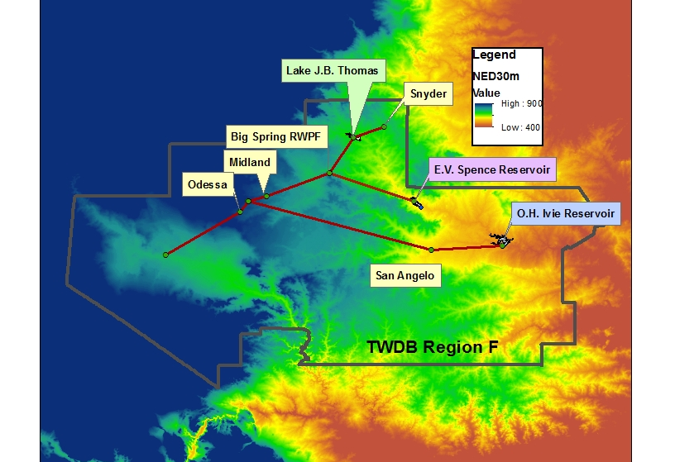
Region F – Elevations
Using NED30m
Notes:
One of the factors that influenced the decision to build facility was the elevations and distances in the area. Here is that last map that is overlayed onto the National Elevation Dataset 30 m layer. So you can see there’s a bit of varying elevation along with piping distance in the region which makes the pumping costs very high. Also you might be able to notice that the reservoirs that are used for drinking water all lie at lower elevations than the cities, so all the water has to be pumped uphill.

Slide 6
Notes:
This graph shows the pipe distance versus the elevation in meters. I got this from using the 3D analysis tool and followed the pipelines to create a point graph. But what you can see is basically all of the cities are located uphill and it takes quite a bit of pumping to get the water there. You can also see why the Ivie reservoir is used less because of the sheer distance it takes to get it to one of the major cities. So there’s not only this problem of pumping water to distance elevated places there’s also the water levels (Show next slide)

Slide 7
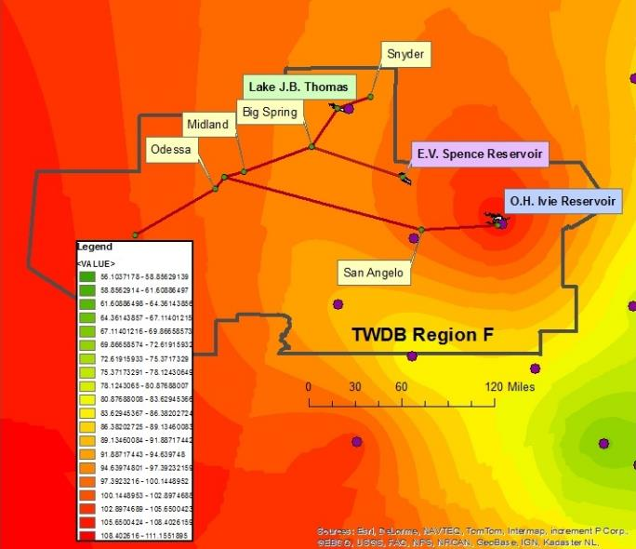
Average Annual Evaporation for 2011
Notes:
Another factor that influences the surface water resources in this region is the evaporation losses in this area. This map shows the average annual evaporation in inches evaporated per year. This map was created using the kriging method and the evaporation gages used in one of our exercises which are the purple dots. I used the zonal statistics tool over Region F to get the mean for the region which is about 98” of evaporation loss per year

Slide 8
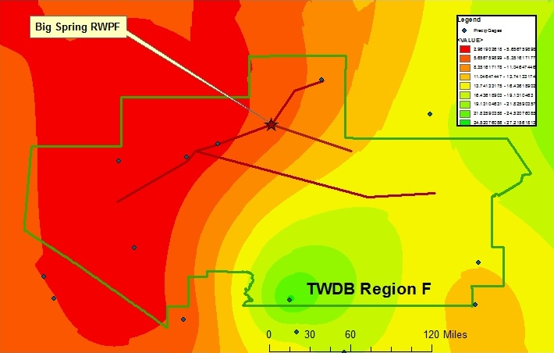
Average Annual Precipitation for 2011
Notes:
This figure shows the average total annual precipitation in mm. The regions were found by using the Kriging method and the precipitation gages represented by the green dots. The average total annual precipitation for Region F was about 70.2 inches using the Zonal Statistics tool. So there’s a pretty big difference between the amount of precipitation and evaporation losses which make it very hard to store water in surface reservoirs in this area. BECAUSE OF THE CLIMATE IN THIS REGION, MUNICIPAL IRRIGATION DEMANDS ARE LOW and NON-POTABLE REUSE WOULD NOT MAKE MUCH SENSE. ALSO BECAUSE OF THE DISTANCES and EVAPORATION, RESERVOIR AUGMENTATION IS NOT AN OPTIMAL CHOICE FOR REUSE.

Slide 9
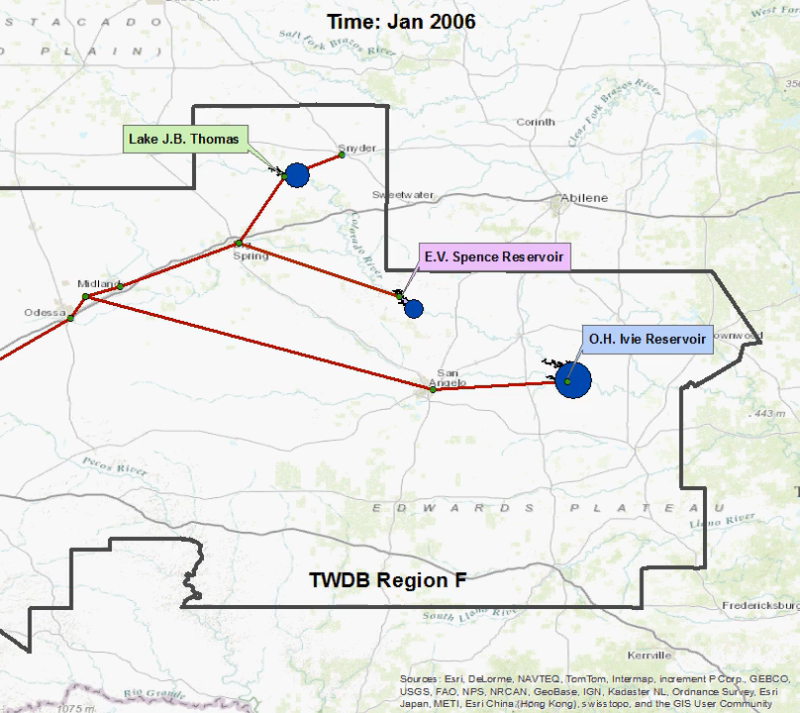
Reservoir Capacity (2006-2012)
Notes:
So another problem besides the energy for pumping (and probably the more important one) is the scarcity of surface water in this area. This shows a monthly time series of the three reservoirs in the region between January 2006 and September 2012. The peak of the drought was around August 2011.

Slide 10
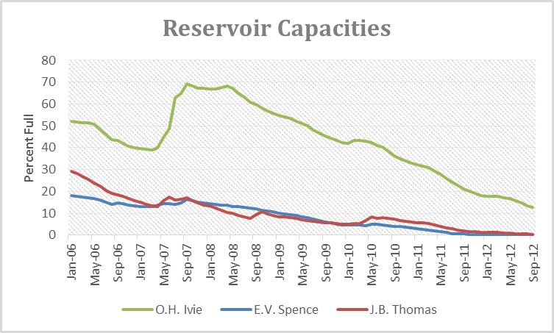
Notes:
This is a graph of the reservoir capacities just to show you in static form.

Slide 11
Energy Comparison and Benefit for Big Spring RWPF
Water From Lake Spence
Big Spring RWPF
4.2 kWh/1000 gal to pump from Lake Spence
0.84 kWh/1000 gal to divert wastewater from Beals Creek
Total: 5.04 kWh/1000 gal
Total: 5.34 kWh/1000 gal to produce water and pump it to the Spence pipeline
Added Benefit: The Big Spring RWPF provides about 0.5 to 1.5 million gallons per day of reclaimed water
Notes:
Here is a energy comparison and benefit for the Big Spring RWPF. This study was actually performed by Freese & Nichols during the planning stage of the project. The biggest savings here is for the resource. The Spence reservoir is already very low, so this project makes sense to try and conserve what is left.

Slide 12
Conclusions
The elevations and distance from the reservoirs makes withdraws energy intensive
There is not much rainfall in the region, and evaporation losses are high
The surface reservoirs have been depleted from years of drought and use
Non-potable reuse and Indirect-potable reuse are not very feasible
Direct potable reuse is the optimal choice for this region to help conserve valuable surface water resources

Slide 13
Questions?

Slide 15
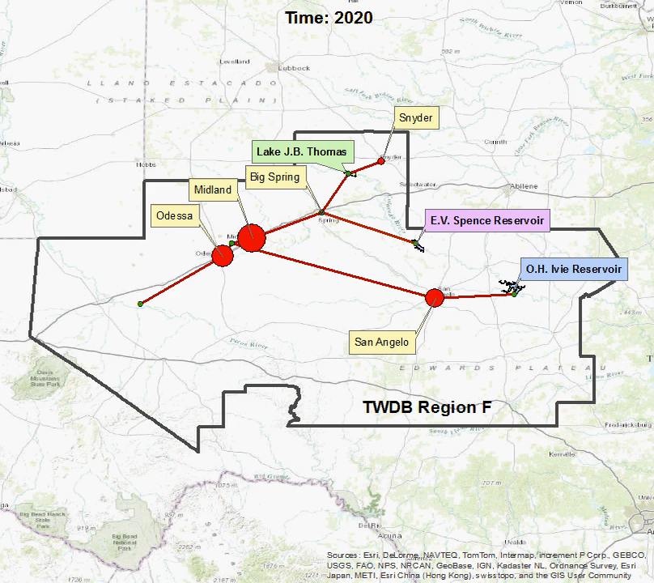
Projected Demand from 2020-2070
Notes:
Another thing I looked at was the demand for the region. I took the data from the TWDB 2012 Water plan. The main idea here is that the demand steadily increases. The major demands in the area are from Odessa and Midland which also have the highest populations.

Slide 16
Notes:
This ends up being about 30 MGD for Midland, 20 MGD for Odessa, and Big Spring has about 5.5 MGD

