Slide 1
Drought Triggers in Barton Springs Segment of Edwards Aquifer
Natalie Ballew
Jackson School of Geosciences, Energy & Earth Resources
LBJ School of Public Affairs
5 December 2013

Slide 2
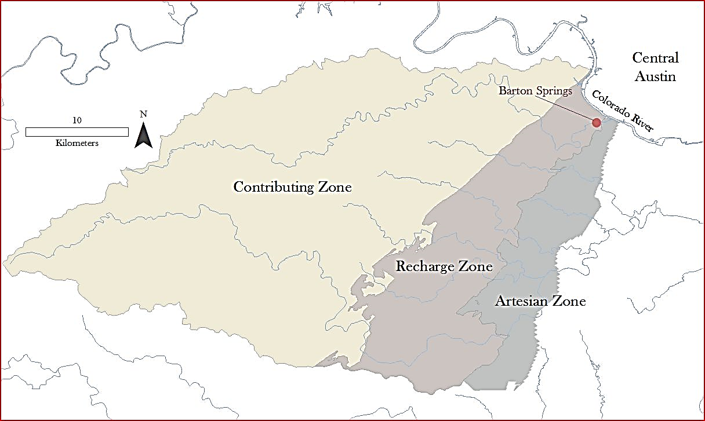
Barton Springs Segment of Edwards Aquifer
Notes:
Naturally discharges several streams Generally, springflows in Texas are reportedly diminishing due to groundwater pumping, but there can be exceptions due to urban recharge. This segment is an urban system with great uncertainty.
How can this uncertainty be used to determine best management?

Slide 3
Barton Springs Segment of Edwards Aquifer
Barton Springs:
  Average discharge – 53 cfs
  Lowest discharge – 11 cfs (1950s)
Austin average pumping – 12 cfs
Increasing population and urbanization
Conflict
  Urban development
  Water users
  Environmentalists
How to plan for sustainable yield given multiple-use interests and drought conditions?

Slide 4
Tool for Groundwater Planning
Demonstrate effects of various management decisions in light of uncertainty
Use map as a tool in decision settings to demonstrate effects of pumping and pumping restrictions on spring flow and volume of water in the segment

Slide 5
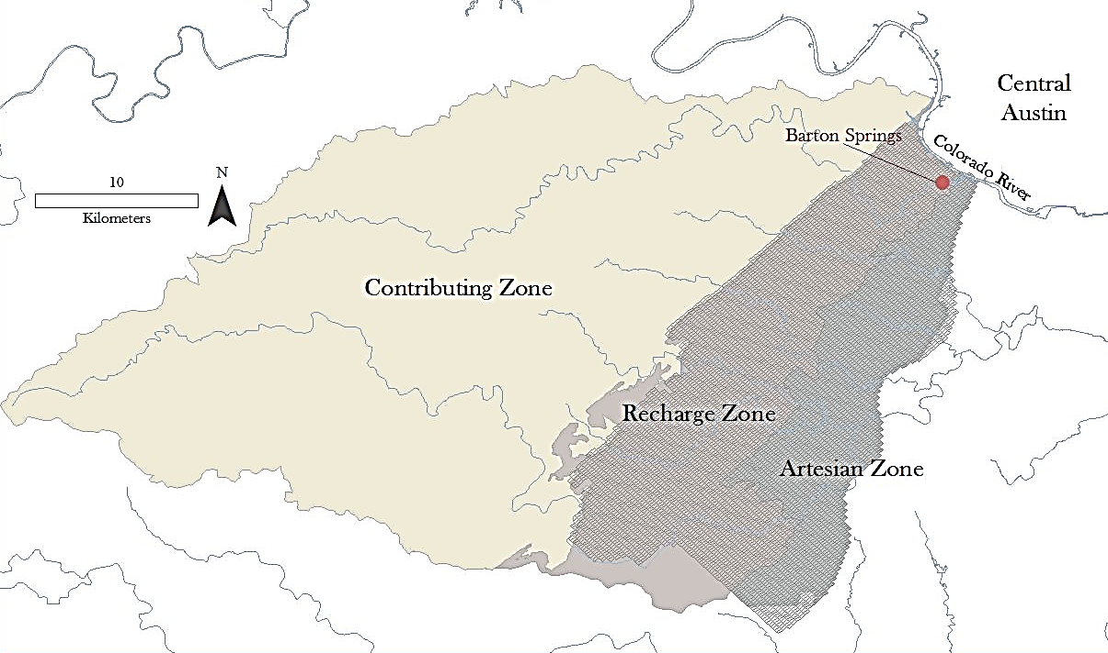
Groundwater Availability Model

Slide 6
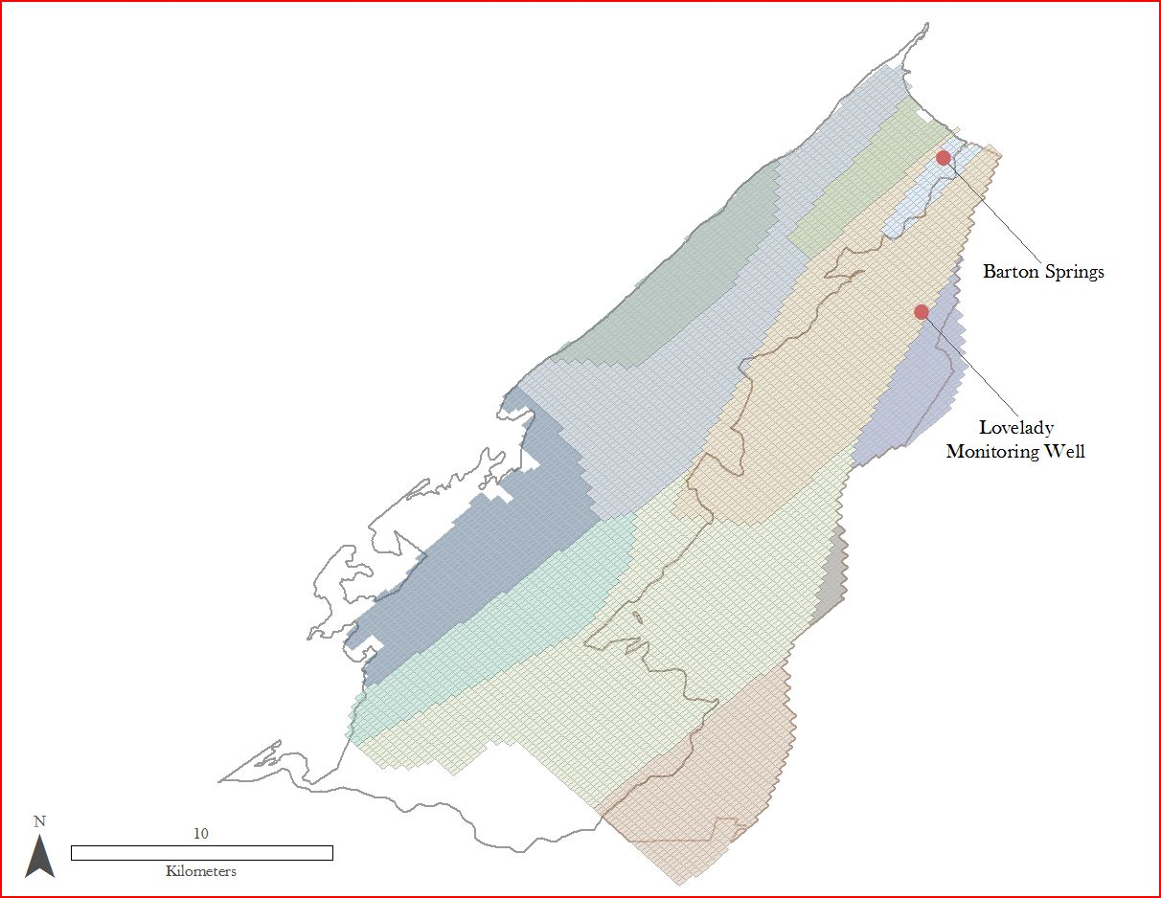
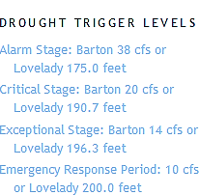
Drought Triggers

Slide 7
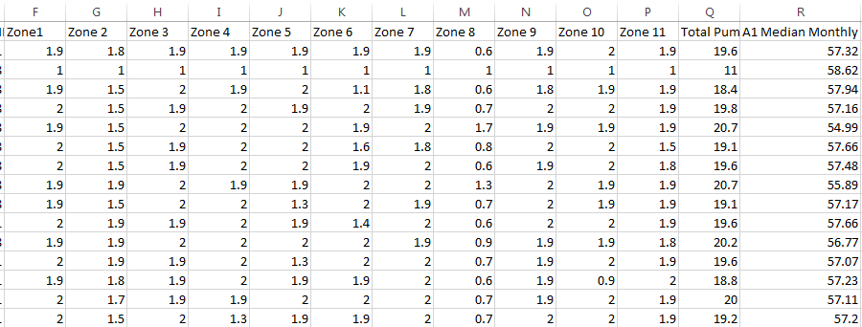
Data

Slide 8
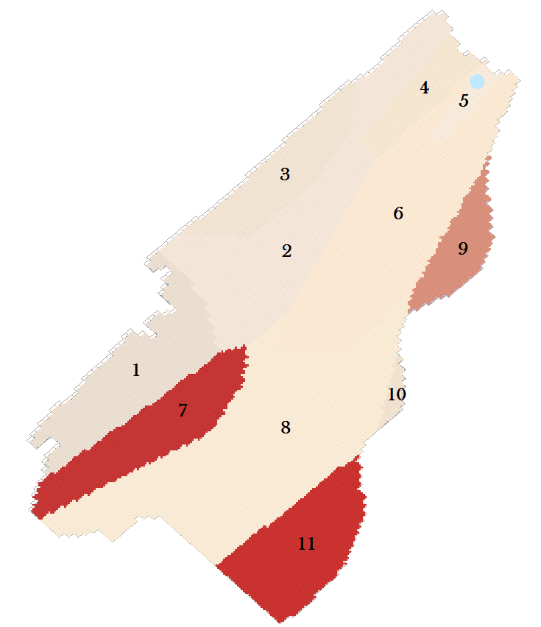
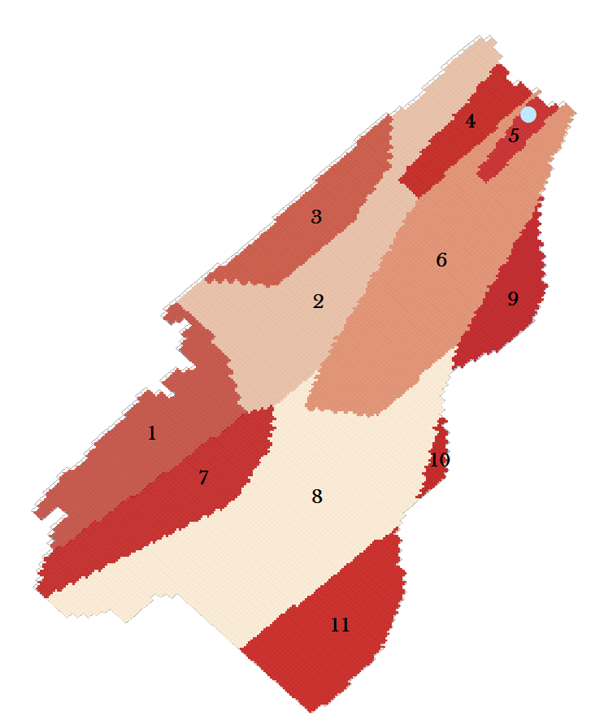
Result

Slide 9
What’s next?
MODFLOW Analyst in ArcHydro Groundwater
Demand Centers, Volume Demand, Urban Density
Monitoring Wells vs Pumping Wells

Slide 10
Questions?
Special Thanks to
Dr. Suzanne Pierce
Earth-Society Systems Research Group
Dr. Maidment & Gil Strassberg

