Slide 1
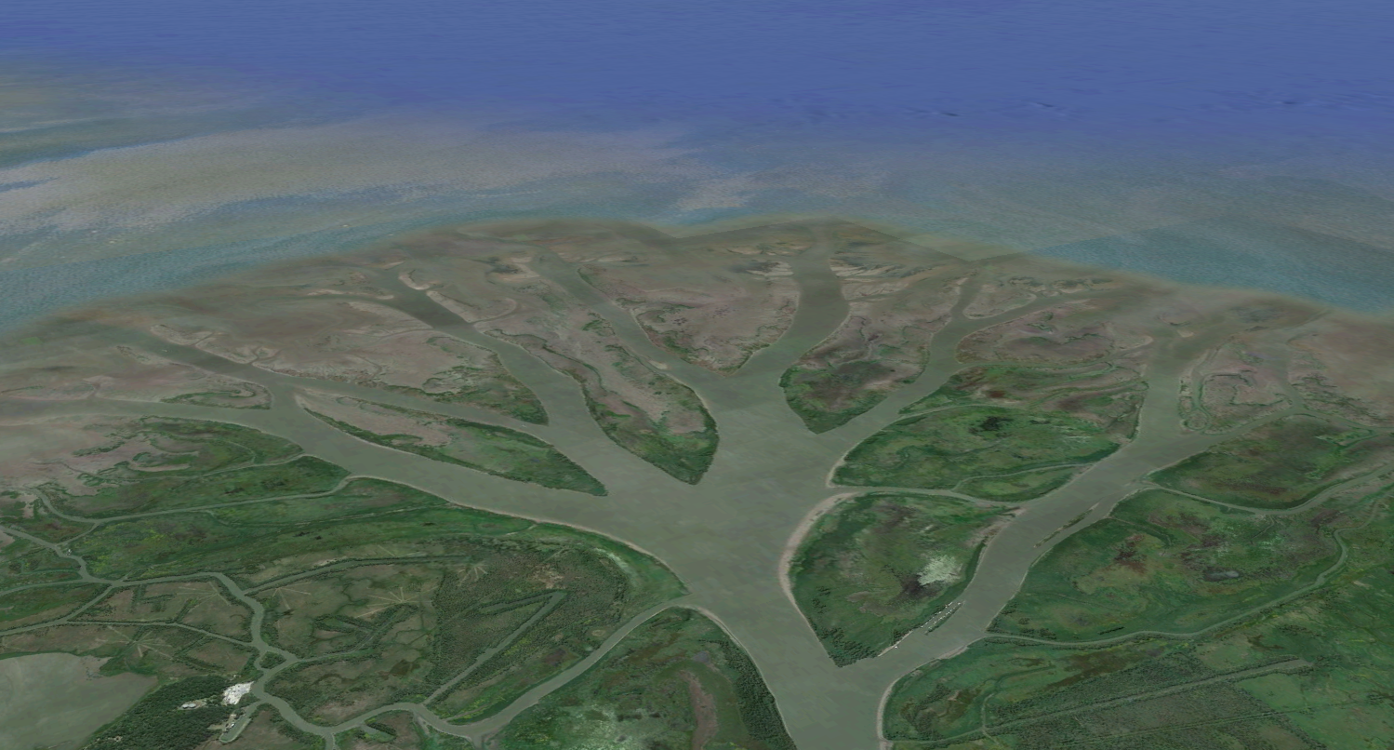

Geographic and Hydrodynamic Analysis of Wax Lake Delta Corey Van Dyk
Progress Report
November 19, 2013
CE 394K
Google Earth
Notes:
-the focus is on method, rather than results

Slide 2
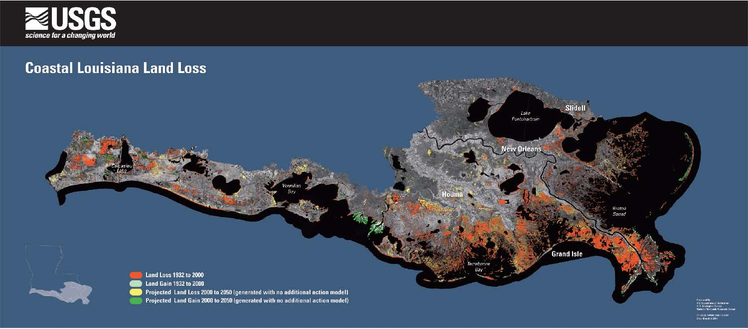
Wax Lake Delta
Past and projected land gain
Understanding important for future delta restoration
Open channel flow (OCF) insufficient to describe hydrodynamics
http://www.nwrc.usgs.gov/factshts/2005-3101/2005-3101-figure1.htm

Slide 3
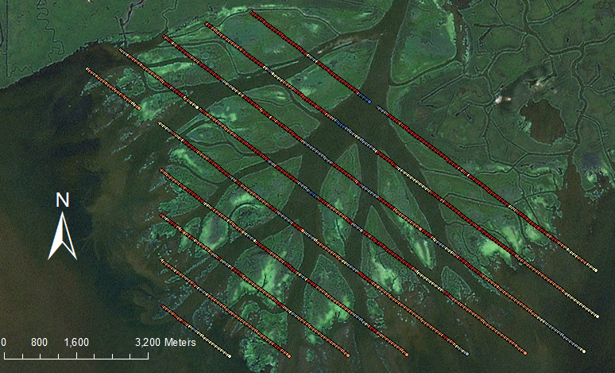
Bathymetric Data
1999 U.S. Army Corps of Engineers Atchafalaya Hydrographic Survey
Transects spaced 800 m apart, sounding every 30 m
Notes:
- Transects approximately perpendicular to flow (note those that aren’t)
Downstream points don’t line up well with image (upstream edges line up with ~0 m depth)
Goal – interpolate, run Man’s numerical model, plot flow field

Slide 4
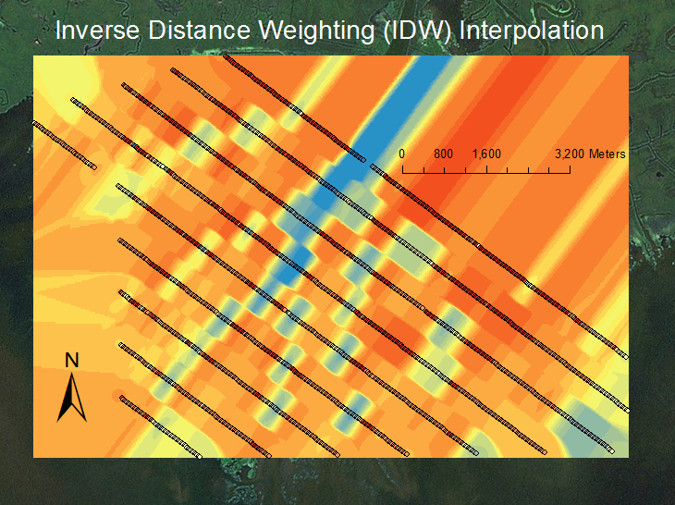
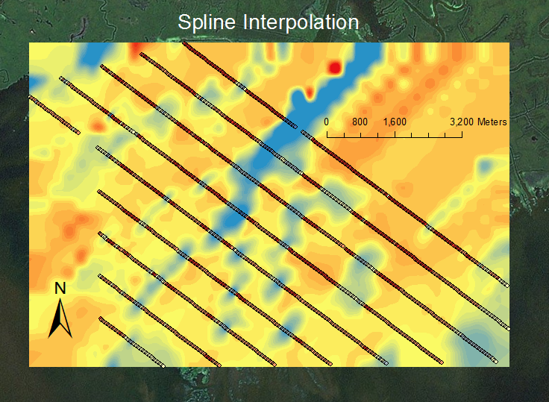
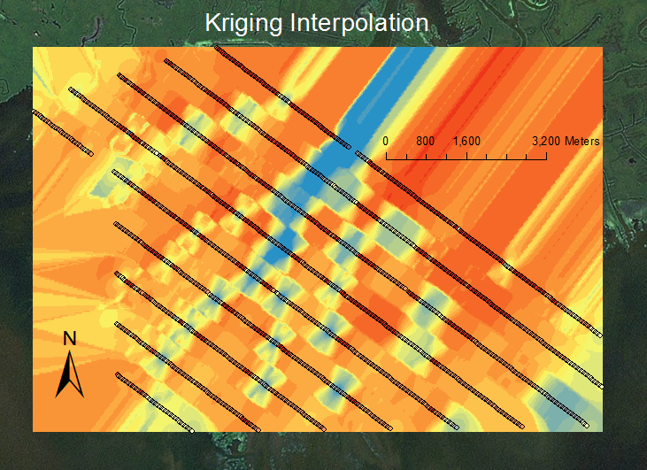
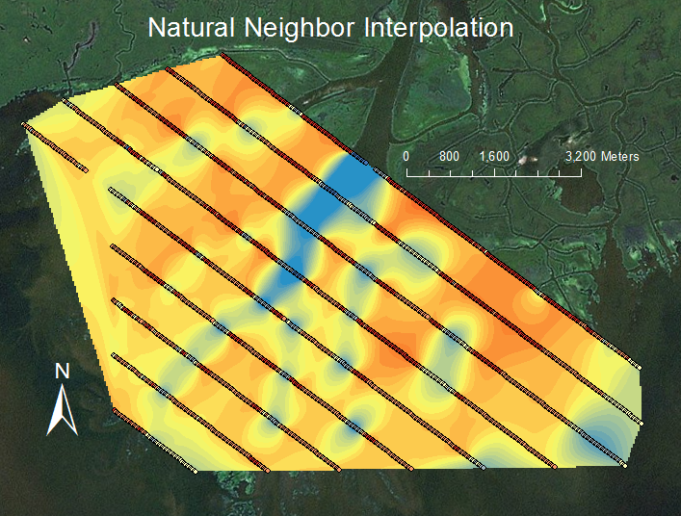
First Interpolations
Notes:
Range from ~-7 m to ~1.4 m
Justify choice; point out work to be done (some channels not represented, inlet/outlets not well-defined)

Slide 5
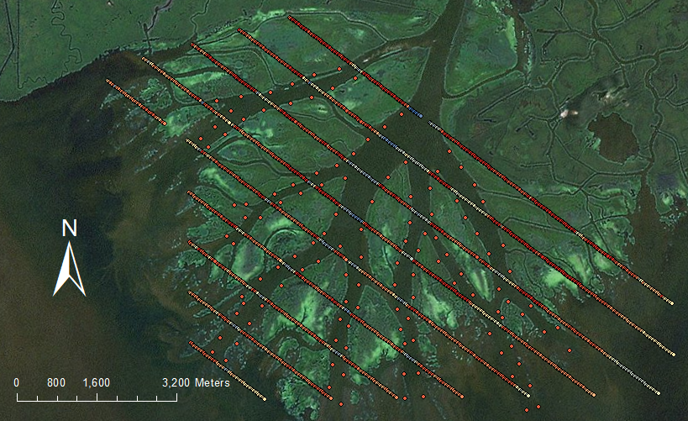
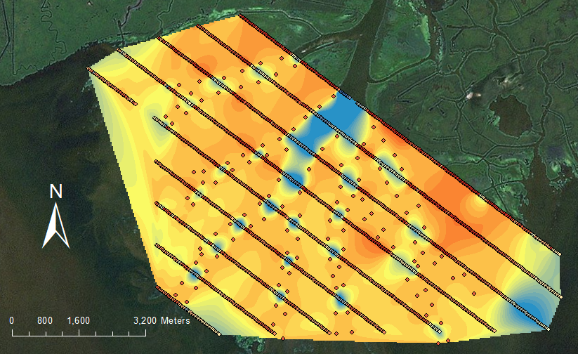
Interpolation Improvement
Notes:
First attempt
Nearest neighbor
Not any better with other interpolation methods

Slide 6
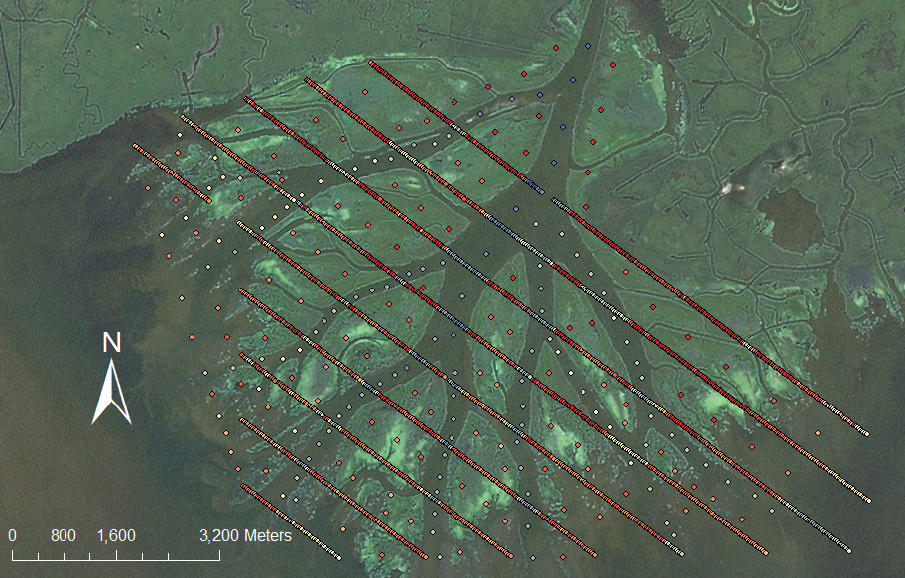
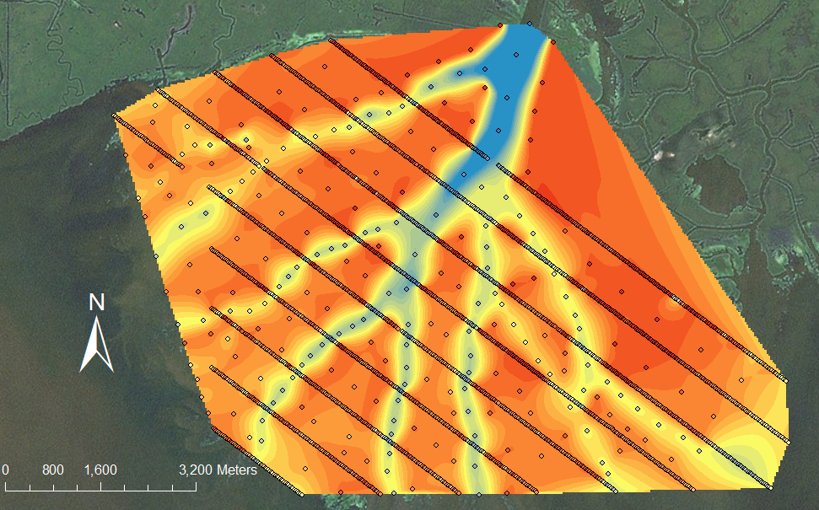
Interpolation Improvement
Notes:
About 12 iterations of adding points, editing depths/locations and running interpolation before I was satisfied enough for this one to be run
Interpolated points – assumed linear (along channel or parallel to channel) changes between transects, which means both USACE data and imagery were used
Southwest points – necessary because the model needs defined outlets; otherwise interpolation would give values estimated from edges of transects, which don’t correspond to actual values (as suggested by imagery)
Inlet points – extrapolated based on image (color) and first-hand knowledge of delta; not perfect, but main purpose is to allow numerical model to run (land acts as fences)

Slide 7
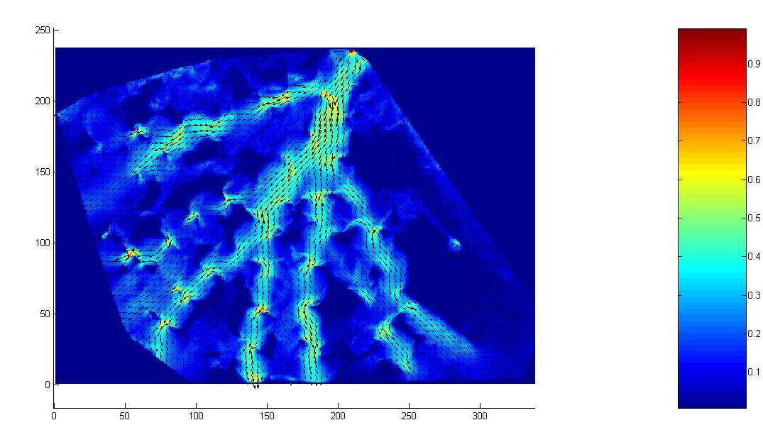
Formulating Flow Field
Bathymetry Raster
Numerical Model
Hydrodynamic Data Field
Notes:
BR-seen in last slide NM-many different kinds; the kind I used is developed by postdoc Man Liang who works in Dr. Passalacqua’s group, and is called a reduced complexity model (RCM) as opposed to the high-fidelity models more commonly used; it takes bathymetry data and uses a “weighted random walk” to determine where the water flows; can also be used to model sediment transport, but here just used for water flux
HDF-shown below, illustrates direction and speed of water flow through the delta

Slide 8
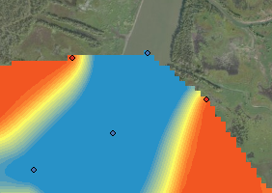
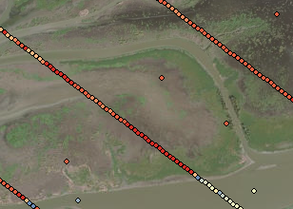
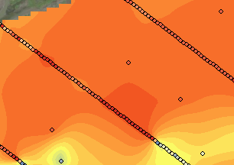
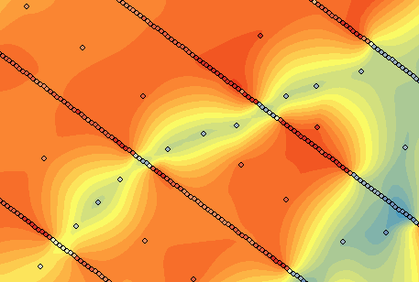
Future Work
Further interpolation improvements
More points in islands
Relocating points for more accurate channel widths
Characterization of geographic data
Island size
Channel width
Channel curvature
Notes:
More points in islands – so channels aren’t rounded, island detail is finer (can illustrate overbank flow into, through islands)

Slide 9
Acknowledgements, Sources
Passalacqua Research Group
Dr. Paola Passalacqua
Dr. Man Liang
Matthew Hiatt
Classmates and Professors in Texas and Utah
U.S. Army Corps of Engineers (USACE) (1999), Atchafalaya River hydrographic survey, 1998–1999: Old River to Atchafalaya Bay including main channel and distributaries, The District, New Orleans, LA.
Shaw, J. B., D. Mohrig, and S. K. Whitman (2013), The morphology and evolution of channels on the Wax Lake Delta, Louisiana, USA, J. Geophys. Res. Earth Surf., 118, doi:10.1002/jgrf.20123.
All pictures without a source are from ArcGIS.

Slide 10
Questions

