Slide 1
Nitrate analysis in the Seine Basin, France
Arielle Mimouni
GIS in Water Resources
11-21-2013

Slide 2
Why Nitrate
Nitrogen-containing compounds are an essential source of nutrients and organic matters
Nitrogen forms : NH4-NH3/NO2-NO3
Oxidation of reduced nitrogen consumes O₂ and causes eutrophication
NH4+ harmful to fish
NO3 can cause Blue Baby Syndrome

Slide 3
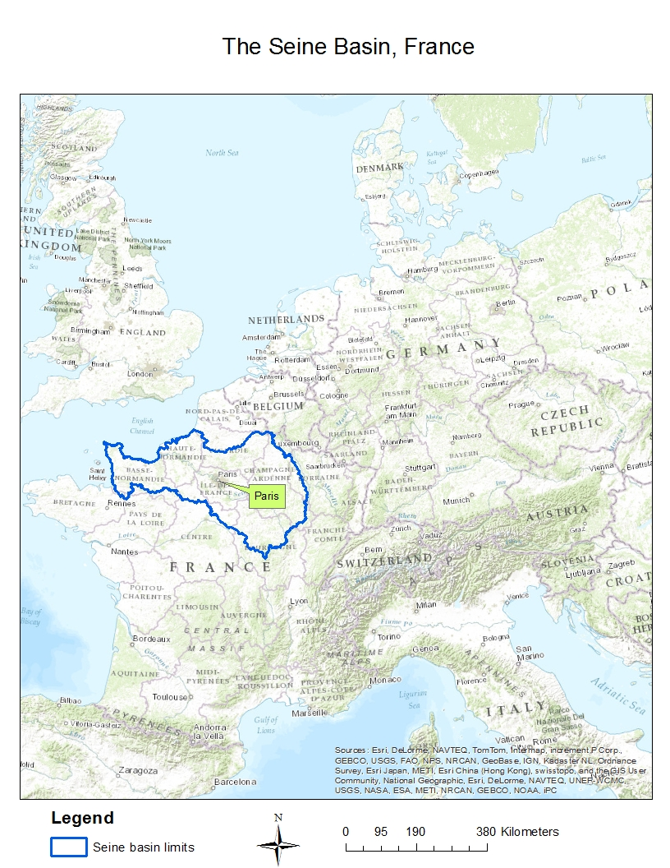
Total catchment area of the Seine : 75000 km²
Length of the Seine :
776 km from Northeastern France to the English Channel

Slide 4

The Seine Basin in France
Paris conurbation : 10 million inhabitants – 2.1 million in Paris
Very urban area in Paris, and intensive agricultural area in surroundings of Paris

Slide 5
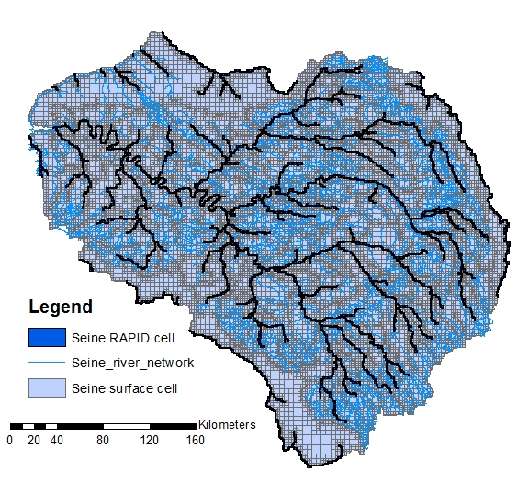
Data
Ahmad Tavakoly has generated daily nitrogen leaching in the Seine for 39 years (1971-2010) and 6481 cells covering the river network
Notes:
Cell = 1 kmx1km
Map from Ahmad

Slide 6
Modeling Nitrogen
Eau-Dyssée : calculates hydrological parameters : flow, runoff, water level…
STICS : calculates water, carbon, and nitrogen within the crop-soil system
Results: nitrogen load to river due to runoff and groundwater
Notes:
Eau-Dyssée : surface water balance (runoff/soil) / ISO (routes surface runoff water flux + RAPID (flow and volume in each cell)+ QTOZ (water level in each cell)
STICS : impact of climate, soil and crop management on plant and environment

Slide 7
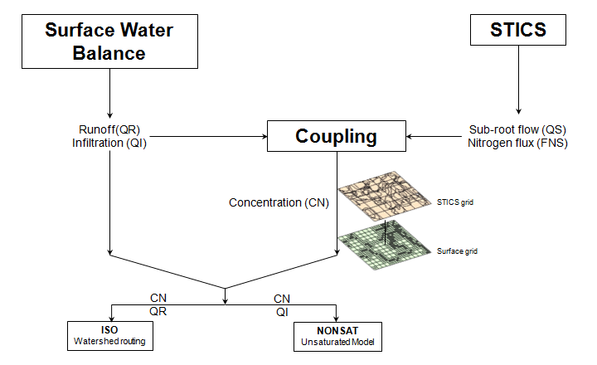
Coupling Eau-Dyssée and STICS
Slide provided by Ahmad Tavakoly
Notes:
Slide from Ahmad

Slide 8
My contribution to the project
Spatial and Temporal analysis of the nitrogen leaching to the river
Study of the possible impacts of wastewater treatment plants effluents on nitrate load to the river
Notes:
Compare point sources and non point sources approach

Slide 9
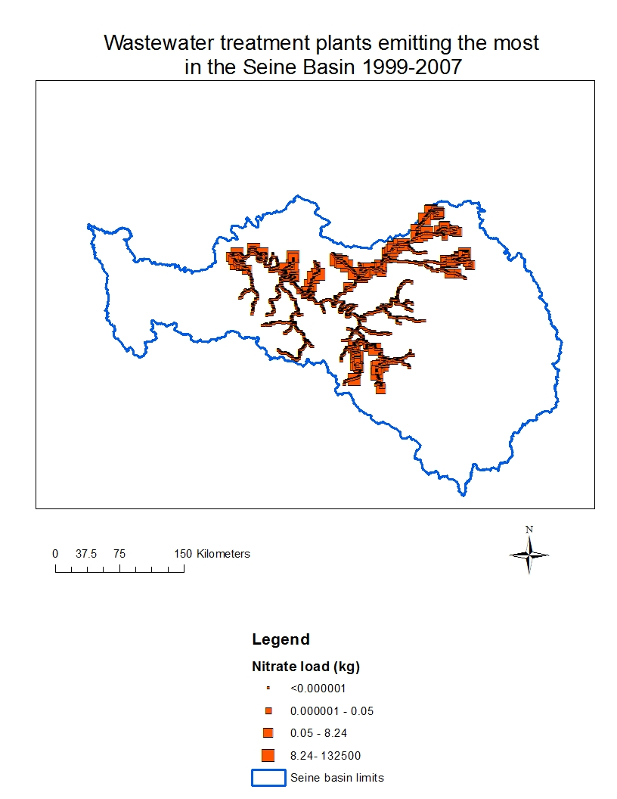
Leaching nitrate in 2009 in the Seine River
January,1st 2009
3000 cells with daily nitrate leaching to represent
Notes:
1,095,000 cells

Slide 10
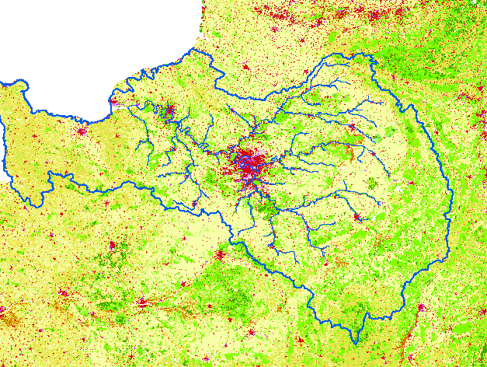
Spatial analysis
High Nitrate loads to the river correspond to intensive agriculture areas
Low nitrate loads for the urban area of Paris
January,1st 2009
Red : urban area
Green : forests
Yellow : agricultural area

Slide 11
Temporal analysis
High surface water runoffs correspond to high nitrate loads to the river

Slide 12
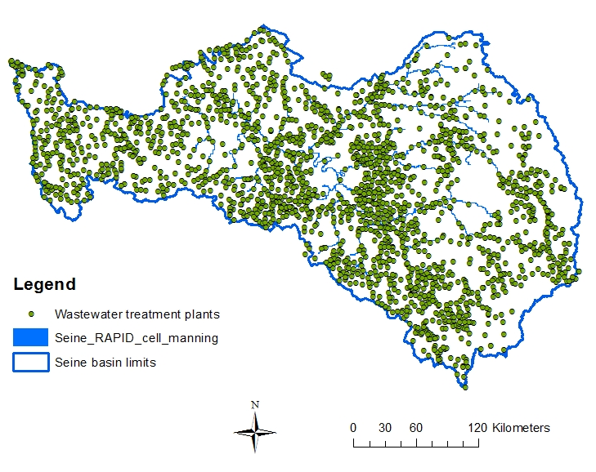
Wastewater Treatment plants in the Seine Basin
2596 wwtp in the Seine Basin

Slide 13
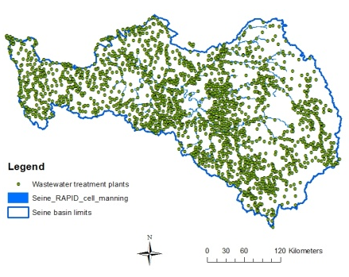
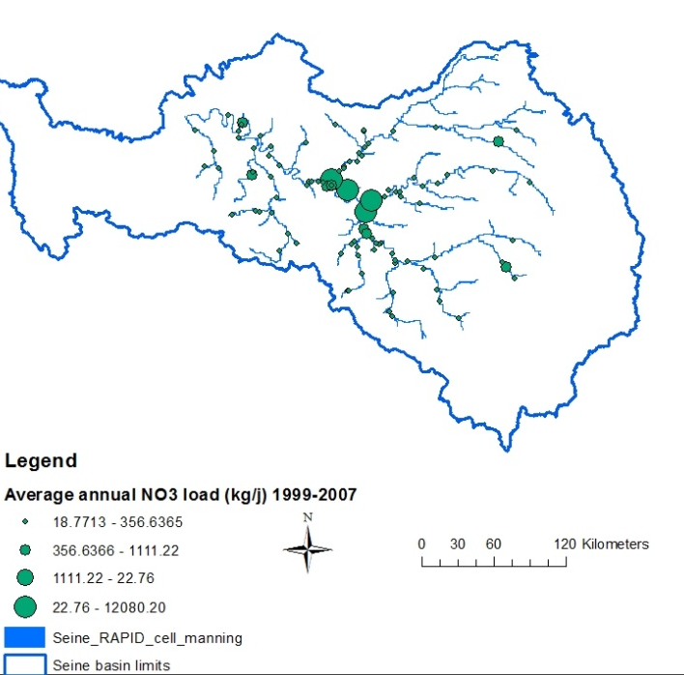
Wastewater treatment plants in the Seine Basin
Selection of relevant data :
If effluent in river (85% of WWTP in rivers/15% in groundwater)
10% largest emitter of NO3
Within 1 km of a river cell

Slide 14
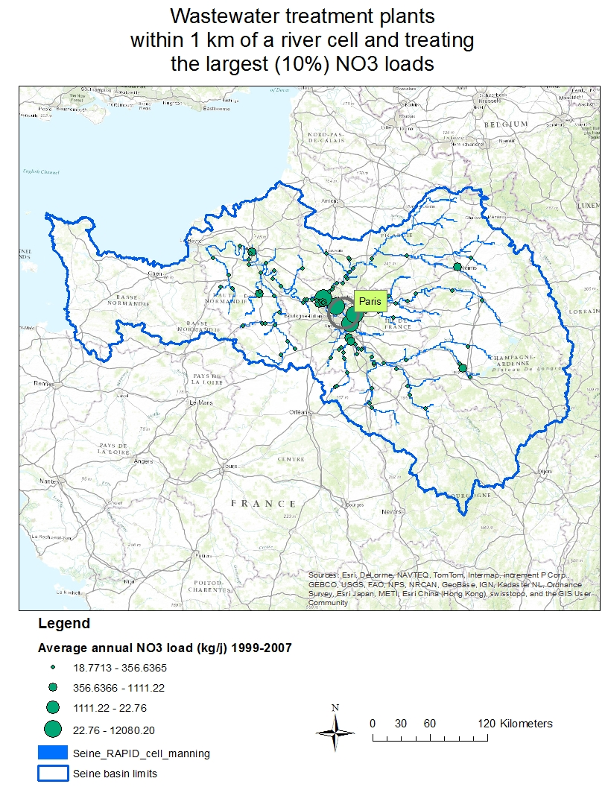
In 1999-2007,
4 WWTP to treat wastewater from Paris
-> Today, Paris: Combined sewerage network :160 km of collectors 10 to 100 m underground collectors leading to WWTP
Outside of Paris area : separate networks : only wastewater goes to WWTP
Notes:
-> system started in 1884 : household waste water, waste water and runoffs collected in sewerage system

Slide 15
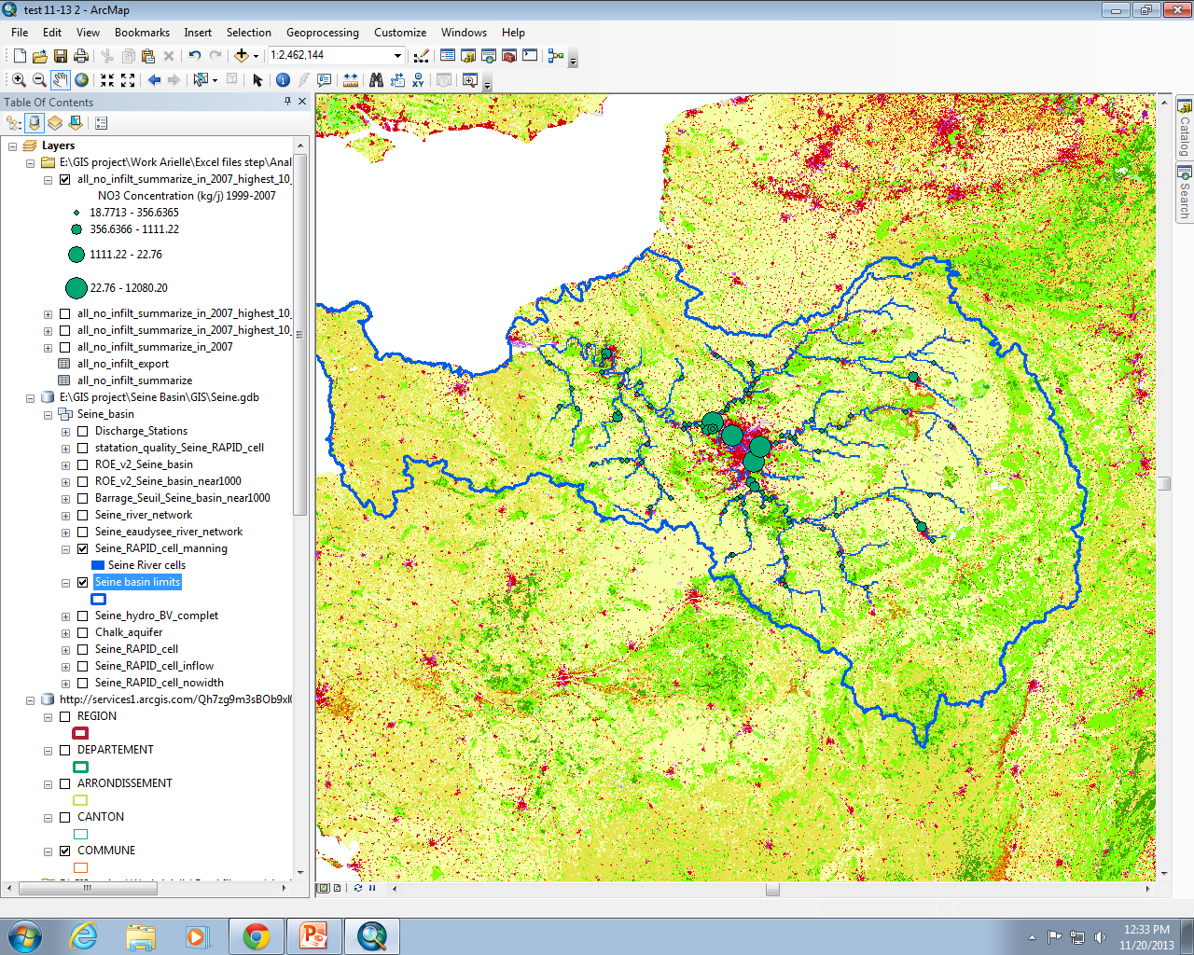
WWTP and Urbanization
Red : urban and industrial areas
Large treatment of NO3 by WWTP corresponds to urban areas

Slide 16
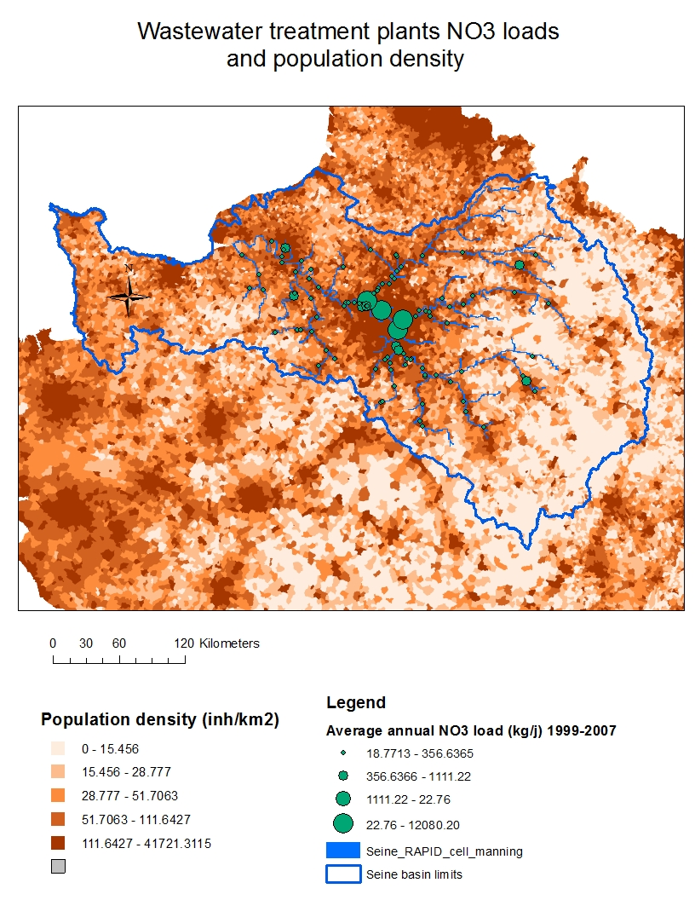
High population density corresponds to high loads of NO3 in WWTP

Slide 17
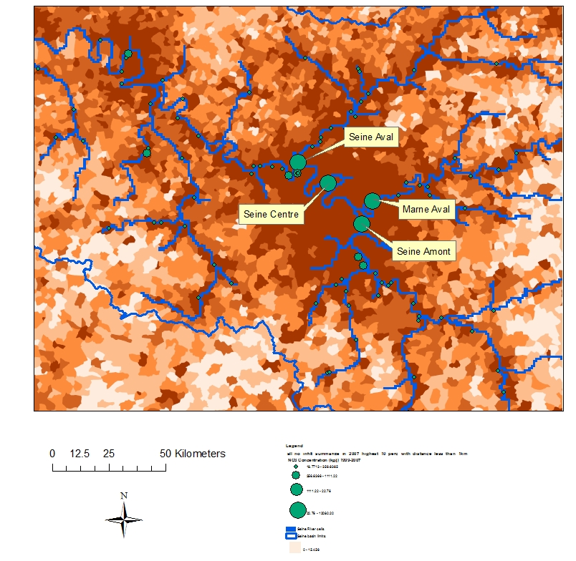
4 WWTP treat influents from Paris :
Seine Aval (downstream)
Seine Centre
Seine Amont (upstream)
Marne Aval
High population density corresponds to high loads of NO3 in WWTP

Slide 18
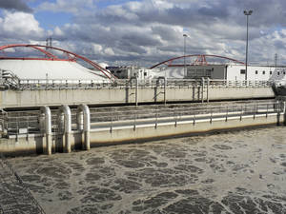
Focus on Seine-Amont
Increase in population in 2006 > increase in nitrate load to the wwtp

Slide 19
Conclusions and Future Work
Conclusions:
Non point sources of Nitrate: (important Paris periphery)
Effects of land use on nitrate loads to the river
Effects of precipitations on nitrate loads to the river
Point sources of Nitrate: (important in Paris area)
- Effects of population density on wwtp nitrate load
Next steps :
Quantitatively analyze the impacts of nitrate loads from wwtp in the river
Formulate recommendations if they need to be taken into account in the overall nitrate modeling

Slide 20
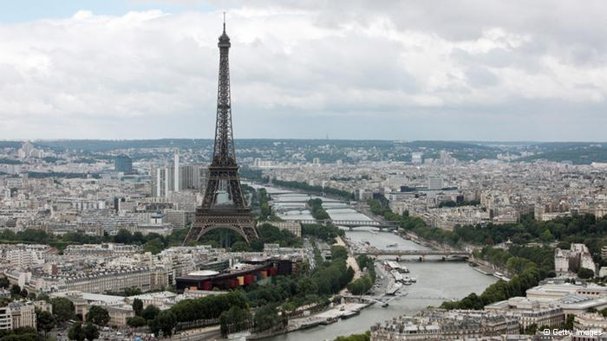
Thank you to Ahmad
Thank you to Carlos and Denny
Questions ?

Slide 21
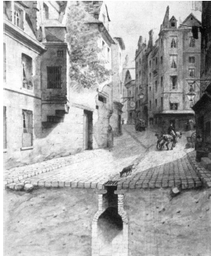
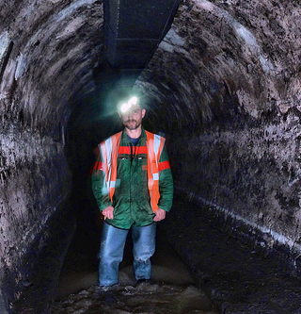
Paris sewage system in the 1884 and today – Collectors of 2.5 to 4 m diameter.

