Slide 1
Water Balance for the Lower Colorado River Basin:
Impacts of Water Efficiency
Bruk Berhanu
11/26/2013
Notes:
Thank you everyone
Introduce self
Mention title of project

Slide 2
In This Presentation…
Introduction of Drought History in Texas
Recent Reservoir Levels
Water Balance Methodology
Preliminary Results
Future Work
Notes:
First we’ll go through a really quick intro into the current drought situation in TX
Then we’ll look at recent reservoir levels show visualize these impacts
Introduce water balanace methodology and data used
Go through some preliminary results and conclusion
Explain future work and close out

Slide 3
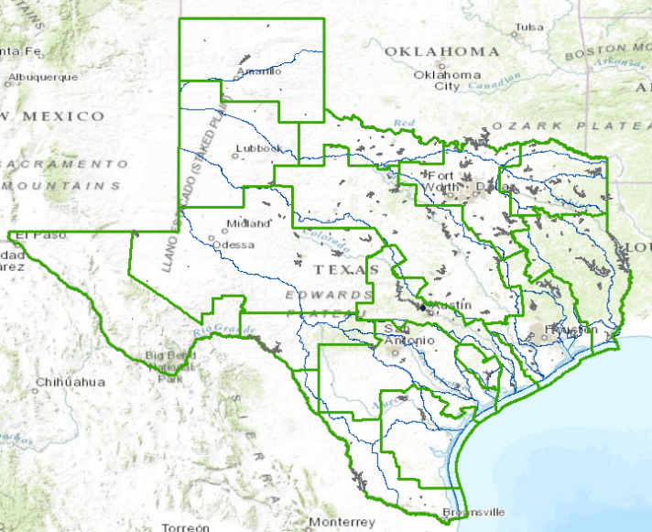
History of Drought In LCR Basin
Highland Lakes provide drinking water for more than one-million people in the Lower Colorado River Basin
  Comprised of (from Northwest to Southeast):
    Lake Buchanan
    Inks Lake
    Lake Lyndon B Johnson
    Lake Marble Falls
    Lake Travis
    Lake Austin
    Lady Bird Lake
Some of the lowest inflows on record in the past 5 years
source: waterdatafortexas.org
Notes:
Introduce lower Colorado River basin and Region K Planning Area
Highland lakes are seven conected reservoirs spanning the lower Colorado river basin
Provide drinking water, recreation, hydroelectric power, and flood control
Though things haven’t gotten as bad as current drought of record was from 1950s, care still needs to be taken to increase water supply
4 of the top ten lowest inflows on record occurred in the past 5 years
Lowest combined Lake Travis and Buchanan levels were 31% in 1952. Currently about 37% full.

Slide 4
2012 State Water Plan
Texas Water Development Board (TWDB) outlines several water management strategies to create more water supply and curb current use. Strategies for Region K (LCR Basin) include:
  New reservoirs
  Water Rights Amendments
  Reuse
  Conservation
With Region K population expected to double by 2060, increases in end-use efficiency technologies will help lower projected water demands
Notes:
TWDB releases an annual state water plan outlining projected demands and water supply
Plan to add 100,000 acre-ft by 2017
Increases in population combined with reduction in irrigation demand will lead to larger share of water demand for municipal purposes
One way to mitigate municipal water use is the adoption of water efficient technologies in the building sector (Toilets, clothes washers, faucet, dishwashers, showerheads, aerators)
This project aims to conduct a water balance for the lower Colorado river basin and assess affects demand reduction through adoption of efficient technologies

Slide 5
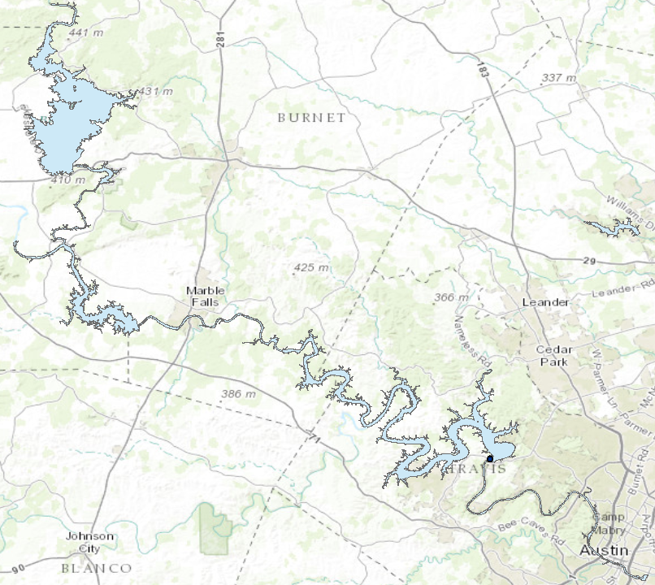
Highland Lakes Reservoirs
Lakes Buchanan, LBJ, Travis, and Austin serve as major storage reservoirs for times of drought.
  Austin and LBJ are mostly kept at constant levels while Buchanan and Travis are allowed to fluctuate
Inks Lake, Lake Marble Falls, and Lady Bird Lake used primarily for flood control, recreation, and hydroelectric power generation
Notes:
Highland Lakes comprised of seven man-made reservoirs that start with lake Buchanan and end in Austin with Lady Bird Lake, supplying water for entire Lower Colorado Basin.

Slide 6
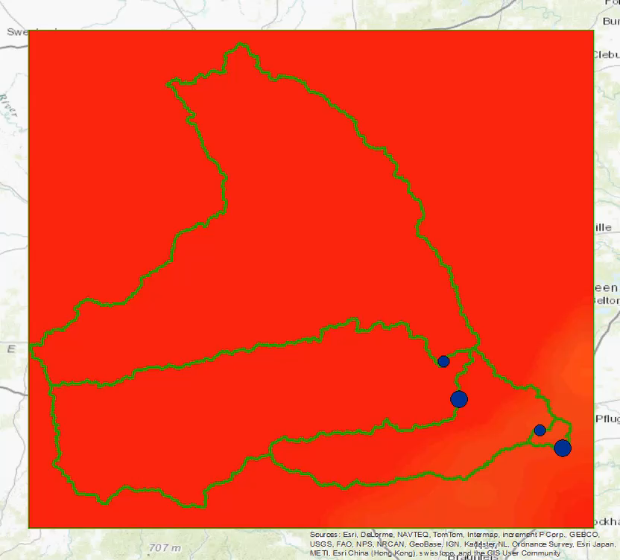
Visualization of Recent Reservoir Levels (2009-Present)

Slide 7
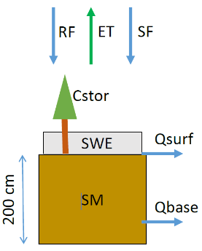
Water Balance Methodology
2 Sources of Data:
  NLDAS
    Change In Storage
      = Precipitation (Snowfall and Rainfall) – Evapotranspiration – Surface Runoff - Baseflow
      = (Sum of Storage Terms @ Time 2) – (Sum of Storage Terms @ Time 1)
  Historic Reservoir Level Data
    Use Elevation-Area-Capacity rating curve to estimate change in storage from monthly water level data
Compare these datasets to resolve discrepancies and gain insight into hydrology of Lower Colorado River Basin and water management strategies.
Notes:
For the water balance, I wanted to compare two sources of data
NLDAS measurements which indicate storage and hydrologic fluxes through drainage areas
Historic reservoir data to correlate fluxes with water management strategies used by LCRA (water release, storage, etc.)

Slide 8
Preliminary Results – Lake Austin

Slide 9
Future Work
Figure out discrepancies between water balance data and historic reservoir levels
  Correlation to dam discharge
Focus on Lake Buchanan and Lake Travis
  Highest variability, Lakes LBJ and Austin are usually kept constant
Incorporate reductions in municipal demand from water efficiency technologies and determine impact on reservoir infrastructure
Notes:
Try to find historic discharge rates for dams.
Switch focus to lake Buchanan and lake travis
Estimate changes in supply infrastructure needed to accommodate reduction in water demand and therefore upstream supply

Slide 10
Thank You!
Questions? ( I hope not!)

