Slide 1
County Level Determination of Fracturing Risk
Final project, CE385K.4
Nick Kuzmyak

Slide 2
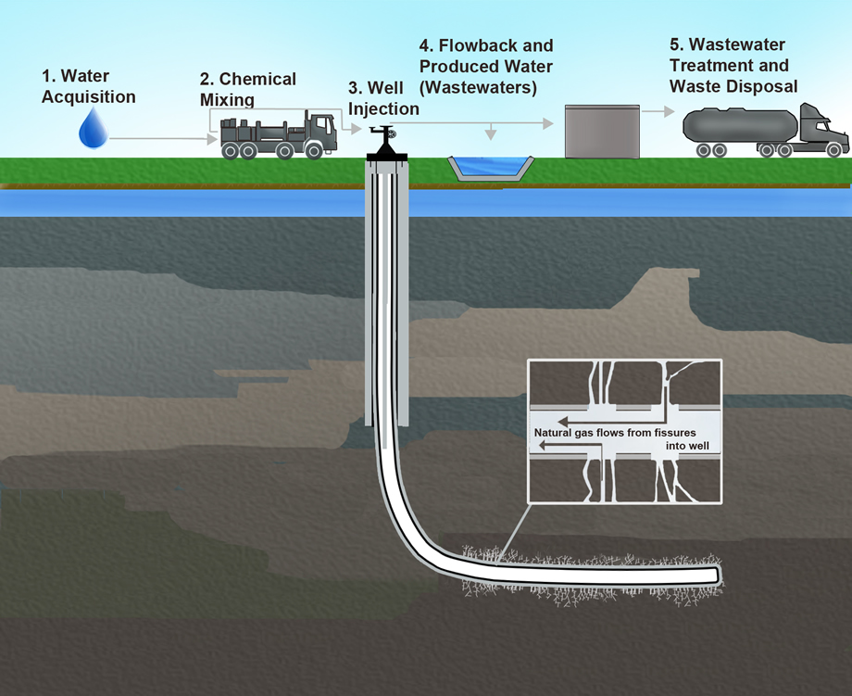
Fracturing in the US
Hydraulic fracturing continuing to expand
Practices steadily getting more refined
  Water treatment/recycling
  Non-traditional water sources
  Microseismic imaging

Slide 3
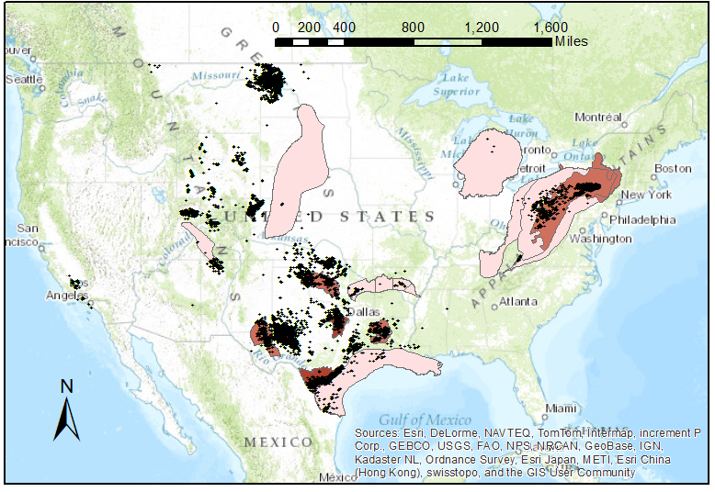
Extent of Shale Plays
Notes:
Note that this doesn’t include other prominent fracking locations like the Bakken formation, the Piceance basin, or anything in the CA central valley or Green River, WY.
The second map includes all frac jobs from the past 3 years, as provided by SkyTruth.

Slide 4
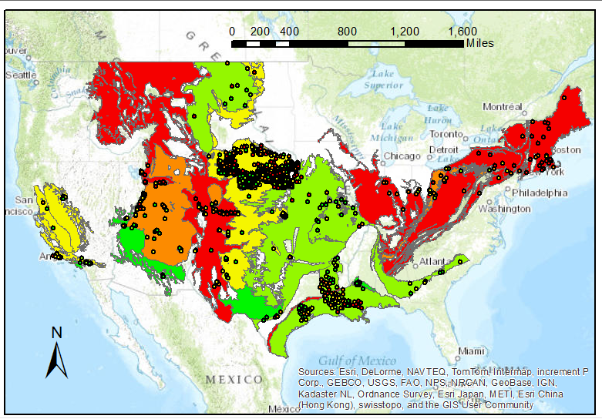
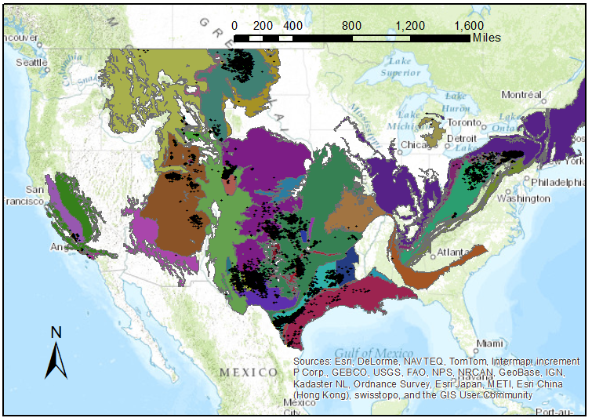
Relevant Aquifers
Notes:
This just shows all of the aquifers in the US – complete coverage. The second picture, however, is all of the aquifers that intersect with fracturing activity over the last 3 years.
The final map is all USGS-monitored GW wells over the past few years, and only the ones that intersect with the aquifers of interest.

Slide 5
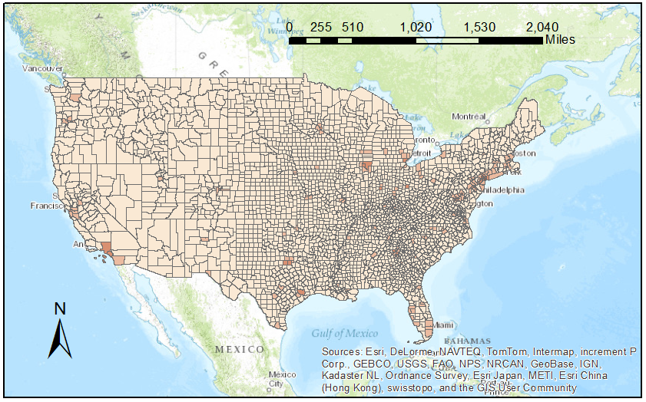
Population Density

Slide 6
Given the background info…
So, what should we be concerned about regarding hydraulic fracturing activity?
  Proximity to large/dense population centers
  Concurrence with aquifers
  Shale plays with high fracking activity
Current goal of project:
  Figure out which counties are the most at-risk
  Determine what legislation is available there
  Be able to target action

Slide 7
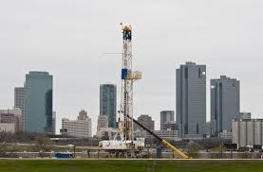
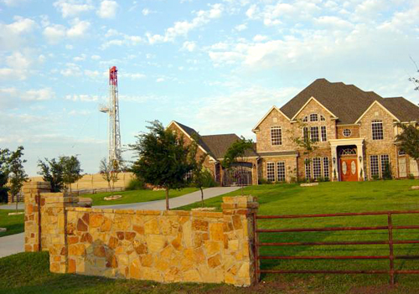
Most At-Risk Counties
A function of weighted factors:
  Aquifer depletion
  Fracturing activity level
  Proximity to densely populated areas
  Others to be added
Notes:
Among the other variables I would like to factor in are environmental justice aspects like GDP per capita for that county, or proximity to national parks/forests.
Photo sources: www.thenewsoutlet.org, ecowatch.com

Slide 8
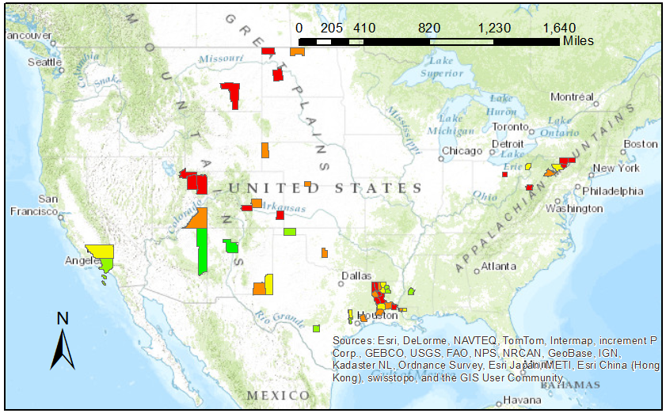
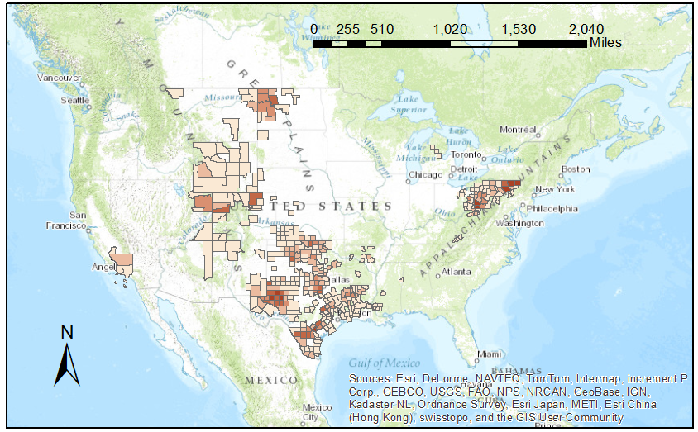
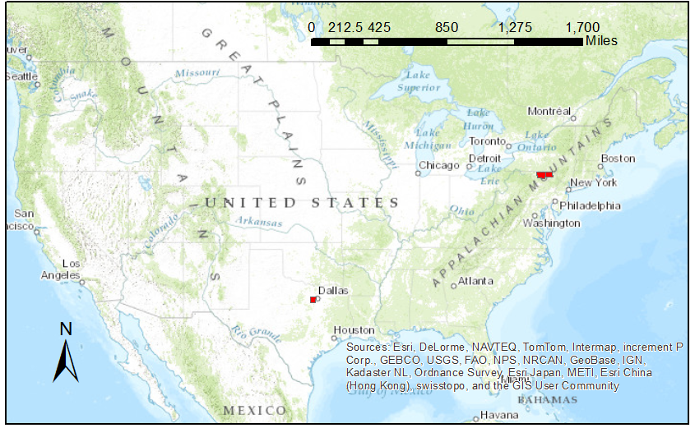
At-Risk Counties: Activity, Density, Aquifer Depletion
Notes:
First map: well density (frac activity) per county.
Second map: Counties that have both fracturing and GW monitoring wells. Red is depleted, Green is increased water levels.
Third map: The most at risk – for now. The four counties I identified as having the worst combination of risk factors. The counties are Bradford and Susquehanna in PA, Tarrant in TX, and Broomfield in CO, indicated in the red circle.
To narrow down those four counties, I compared the county lists for the highest category in each graded factor. From there, I selected the counties that were in multiple lists.

Slide 9
Still To Do
Calculate true areas of polygons to get accurate measures of density
  Wells per square mile
  People per square mile
Create intrapolygon rasters:
  Well density over a shale play
  Well drawdown over an aquifer
  Quantified risk over entire US
Expand “risk equation,” weight factors
Cross-reference at-risk counties with current laws

Slide 10
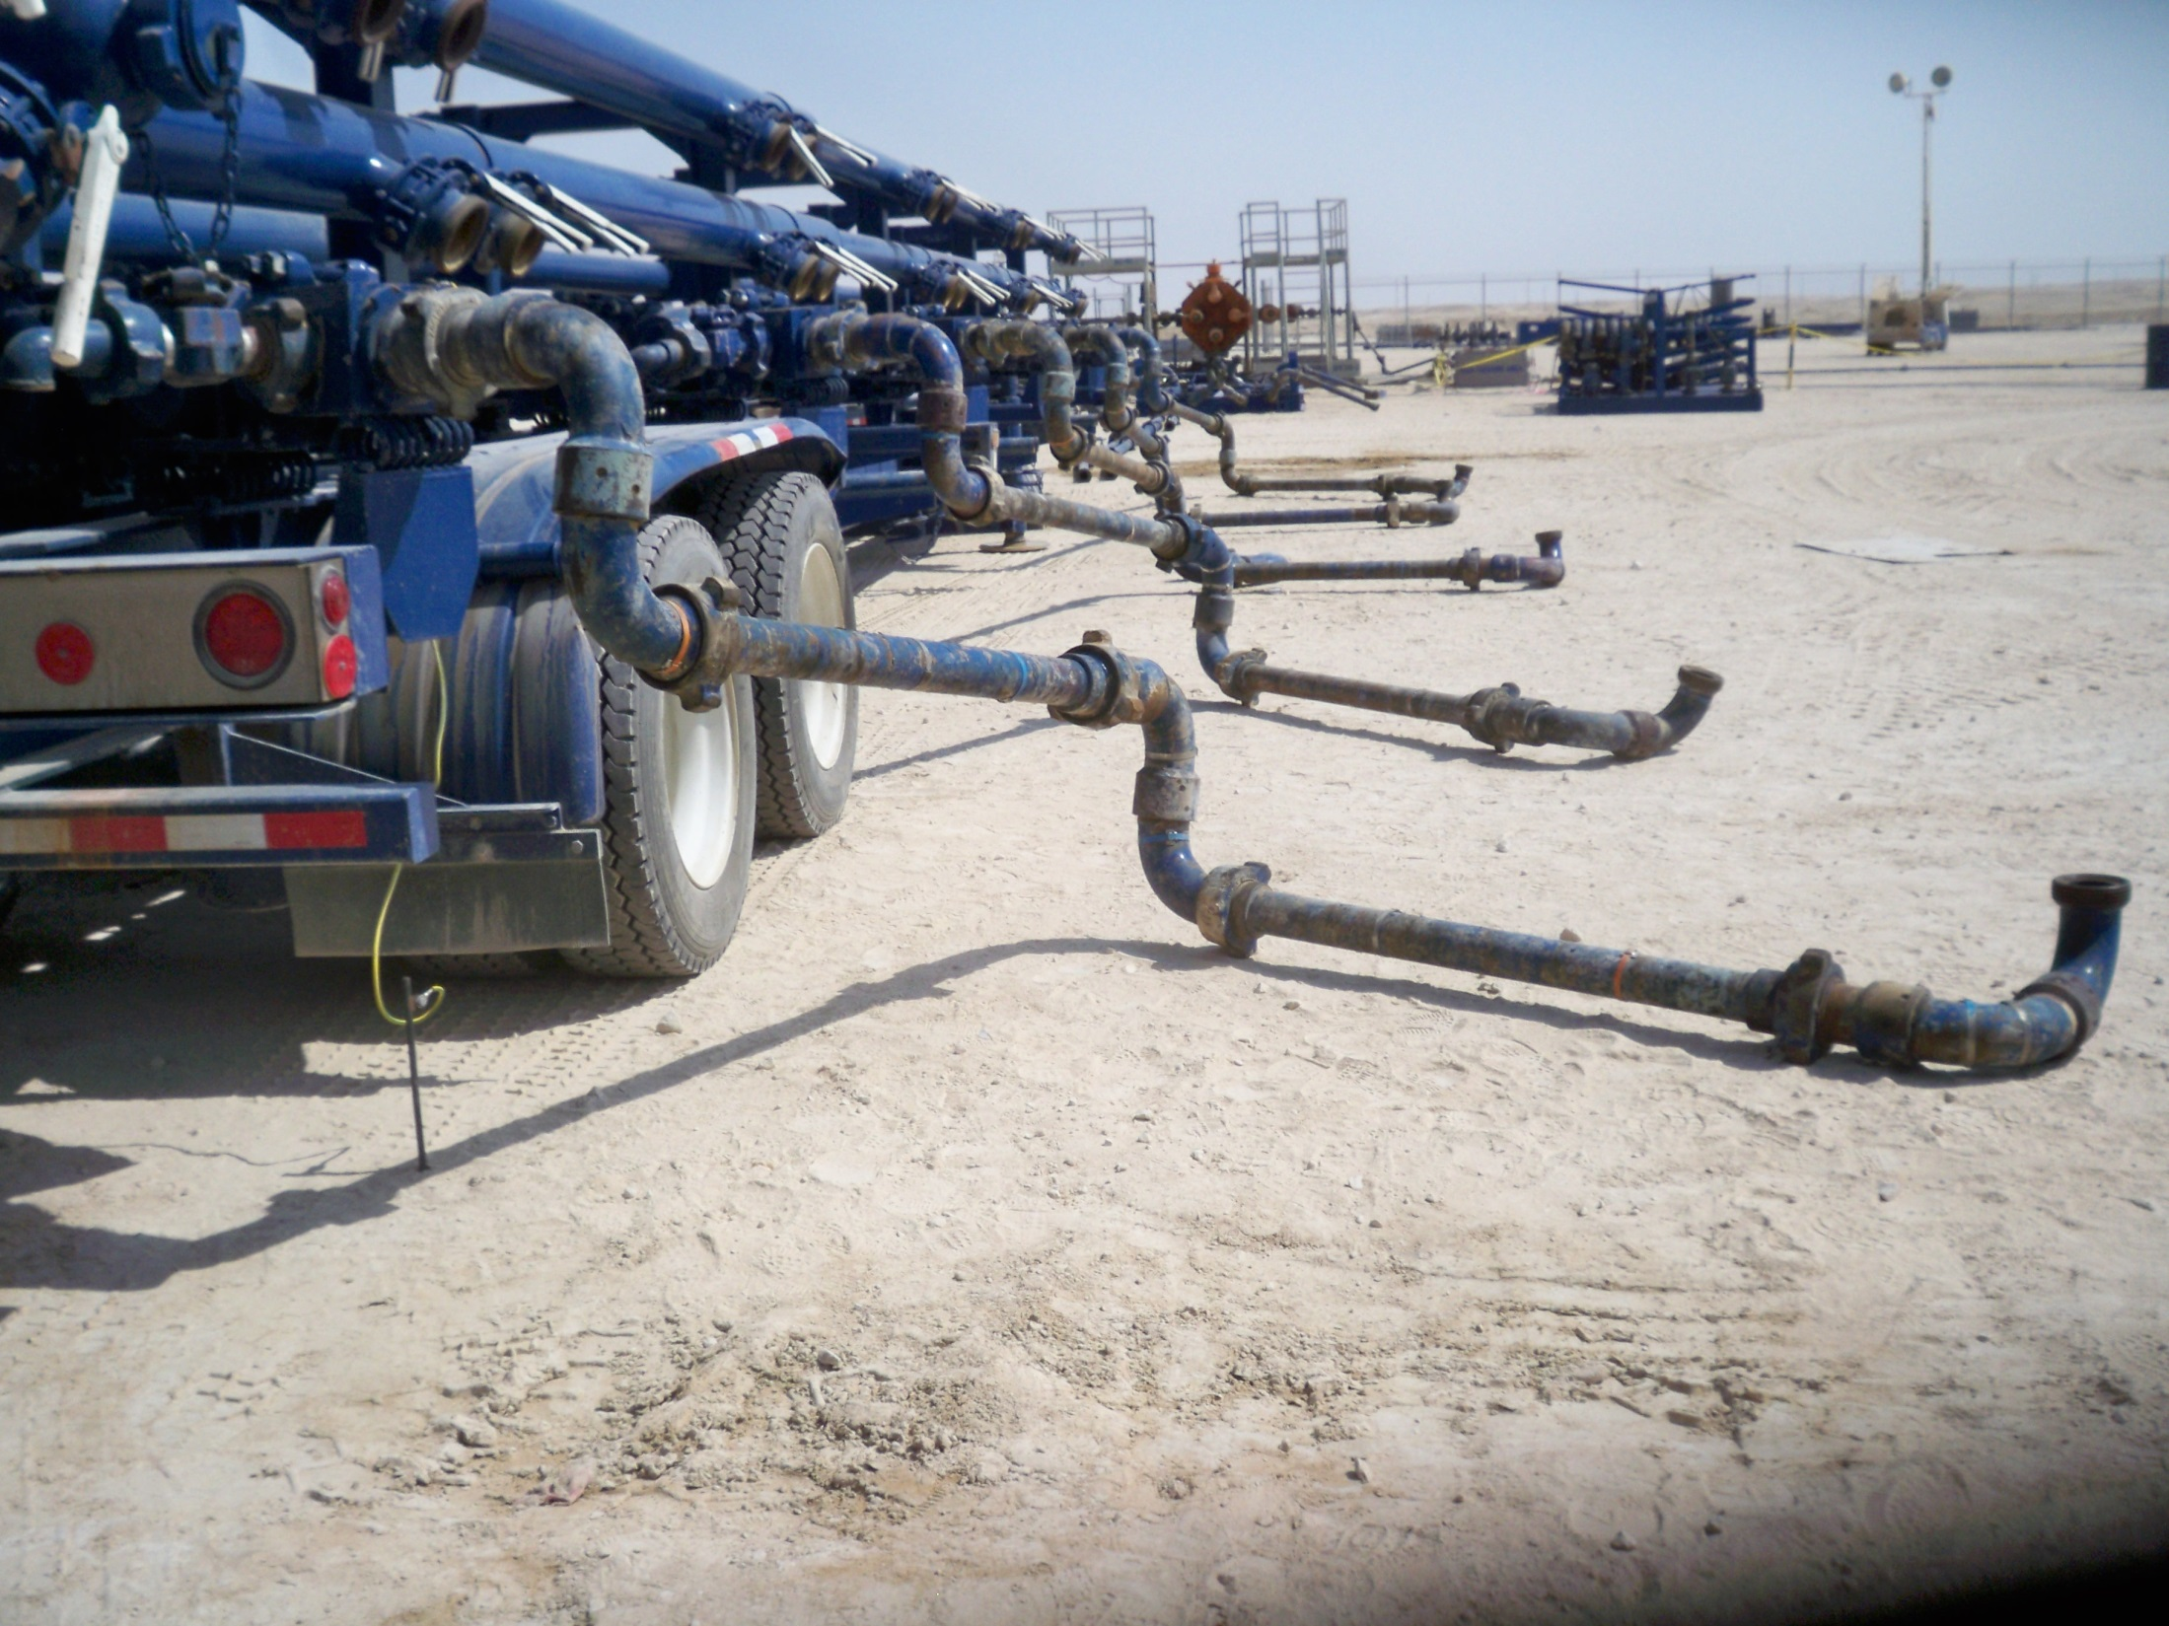
Questions?

