Slide 1
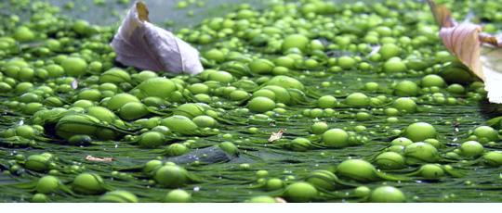
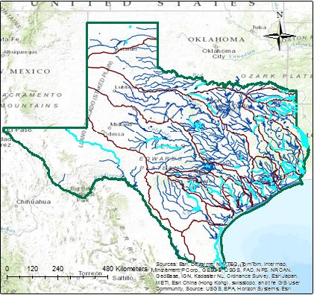
USING GIS AS A TOOL TO OBSERVE TEXAS DISSOLVED OXYGEN IMPAIRMENTS
Jennifer Wang
University of Texas at Austin
Environmental and Water Resources Engineering
Notes:
Hi my name is JW and I’m a 2nd year in the EWRE program. Today I’ll be talking about using GIS as a tool to observe dissolved oxygen impairments in Texas as well as assess potential causes for those impairments.

Slide 2
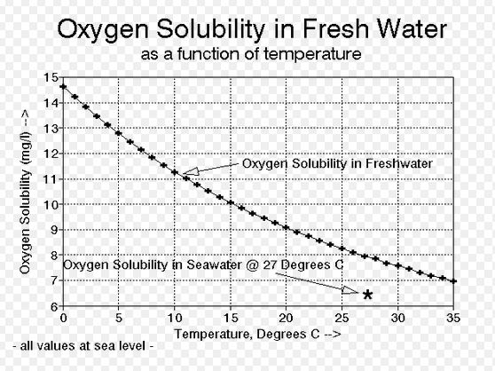
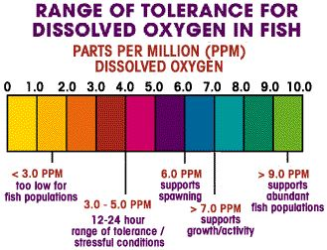
DEPRESSED [DO] LEVELS
60% of all impaired conditions of rivers
Notes:
http://nerrs.noaa.gov/doc/siteprofile/acebasin/html/modules/watqual/wmeutro.htm
Eutrophication is currently the most widespread water quality problem in the nation and accounts for about 60% of the impaired conditions of rivers in the U.S. (Carpenter et al. 1998).
Carpenter, S., N. Caraco, Correll, R. Howarth, A. Sharply, and V. Smith. 1998. Nonpoint source pollution of surface waters with phosphorus and nitrogen. Ecological Applications 8(3): 559-68.
Dissolved oxygen impairments account for 60% of all river impairments in the US, and when the threshold drops below 5.0 ppm or mg/L, that leads to stresses on aquatic life and fish kills. We also know that when temperature increases, less oxygen is soluble in water, so it’s natural to see seasonal and even diurnal swings in dissolved oxygen. However, even at the highest water temperatures, dissolved oxygen would not naturally fall below 6 mg/L, even in the most saline waters.

Slide 3
COMPLEX CAUSES
NATURAL: Temperature, Salinity
vs.
HUMAN: Wastewater + Agriculture OR Salinity
Nutrient (N + P) Increase
Eutrophication, Algal Growth
Algal Death
Microbial Population Increases
BOD Increases
DO Decreases
Notes:
Using GIS to explore both the effect of natural patterns and human impacts on DO levels
HUMAN: When levels are unexplainable by or exceed natural expectations, is there evidence of human impact?
So we know there must be some anthropological causes at play; as nutrient levels increase from wastewater outfalls and agricultural runoff, algal growth increases, along with biological oxygen demand, thus depleting dissolved oxygen. DO is difficult to study because of the complex factors involved, but if we can pinpoint some of the most common links or causes by mapping them, state regulators may be able to develop programs to target specific areas and sources or make predictions about DO behavior.

Slide 4
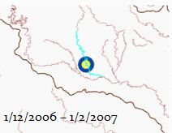
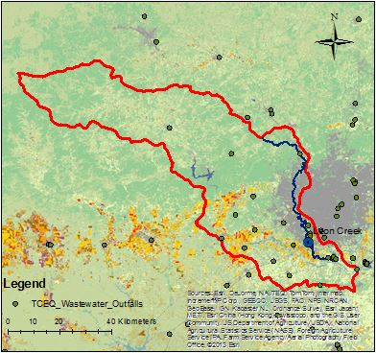
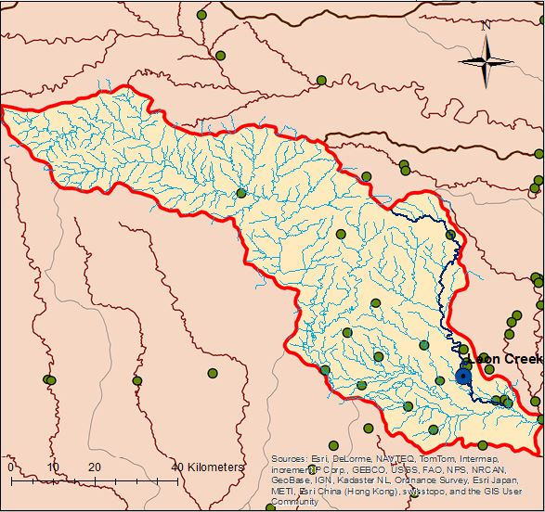
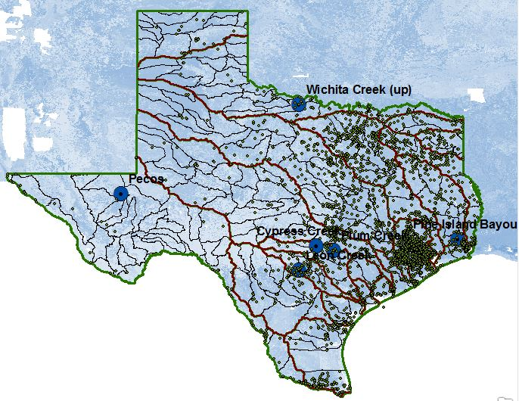
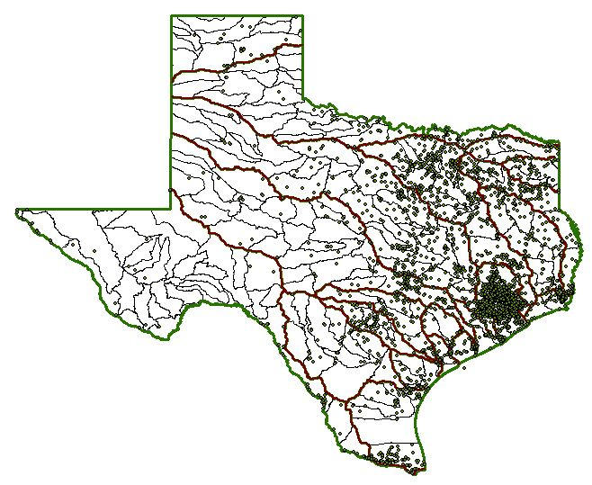
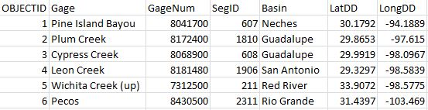
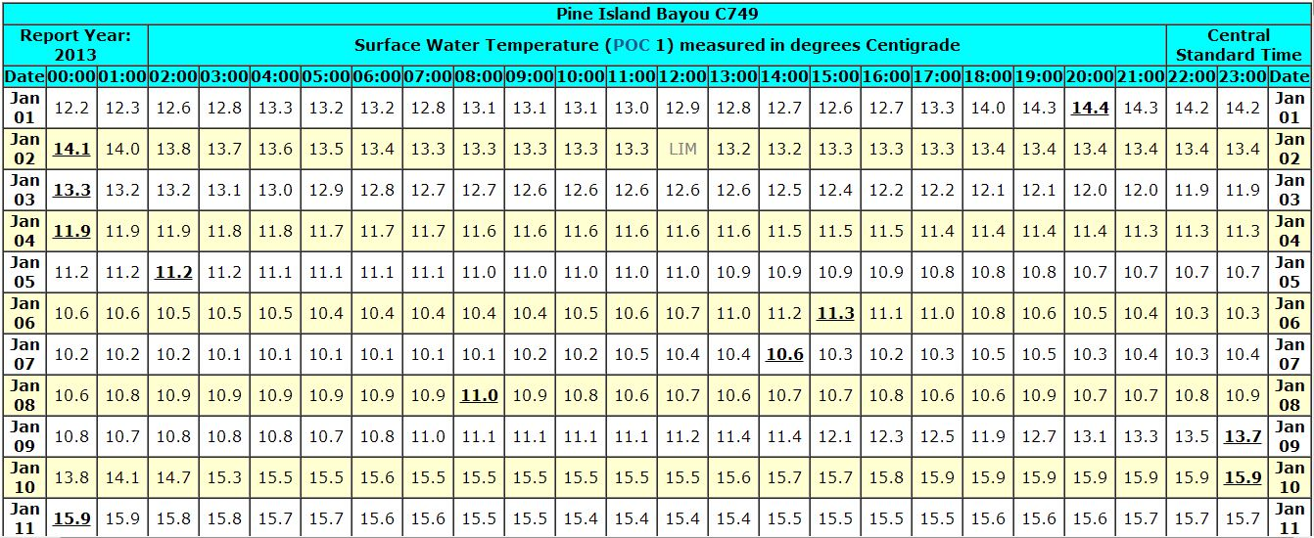
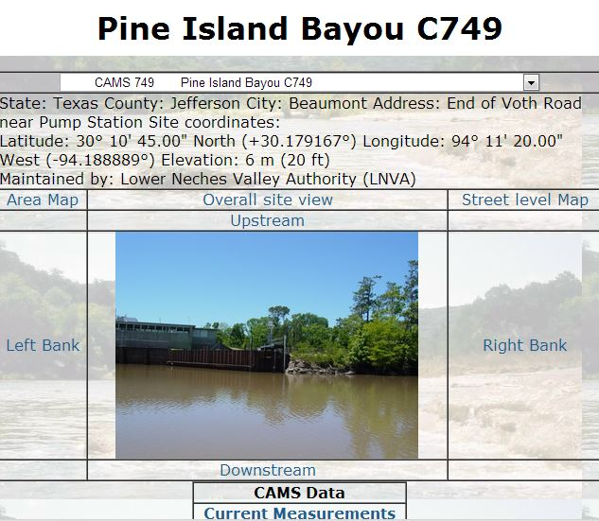
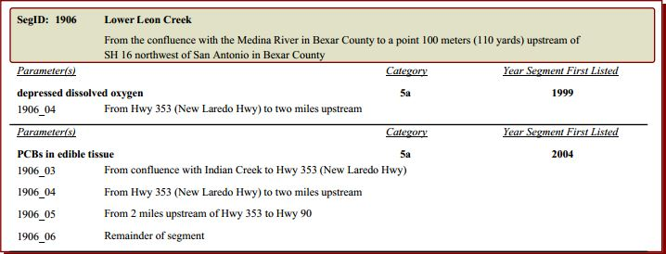
DATA COLLECTION + METHODS
[DO] vs. Temperature Change Video
USCroplands – Land Use
Subwatershed Delineation, NHDPlusv2 Mean Annual Flow
SSURGO – Soil Water Storage
TCEQ Wastewater Outfalls
Gage Coordinates
Hourly Surface Water Temp + DO Concentration in mg/L
TCEQ SWQM CWQM
Texas 303d list
Notes:
Lesser soil water storage could mean less vegetation growth, and therefore less nutrient runoff into streams. Less eutrophication.
Use Thiessen Polygons to determine what regions are flowing to each impaired stream segment and then mean annual flow data to determine how much flow occurs to each impaired stream segment and the number of wastewater outflow points in that region that are then carried downstream to potentially accumulate at the impaired stream region.
Texas 303d list – Impaired Streams
Texas Commission of Environmental Quality (TCEQ)
Continuous Water Quality Monitoring Data (CWQM)
Texas Wastewater Outflows

Slide 5
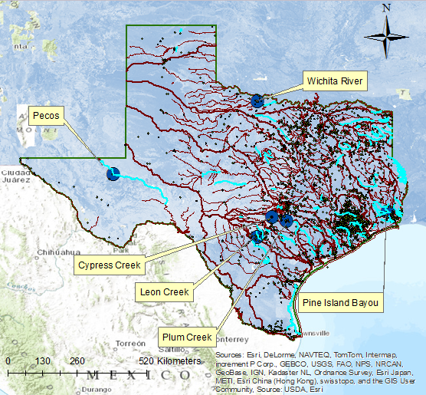
Notes:
…which are pictured here by their stream gages. Of the 6 gages with available data, I chose to focus on two pilot cases with the most continuous datasets: Leon Creek, located in San Antonio, and Pine Island Bayou, located near Houston.

Slide 6
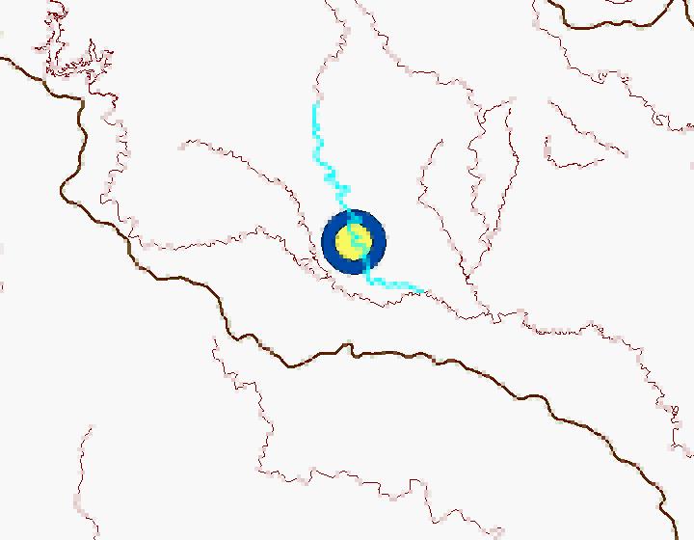
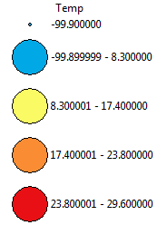
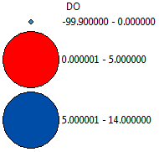
1/12/2006 – 1/2/2007
Notes:
Low DO (red), match with high temp (red/orange). Plot of dissolved oxygen and temperature across three years of available data at Leon Creek. In the time series video, when the large gage turns red, dissolved oxygen is depressed. The inner gage shows the temperature gradient

Slide 7
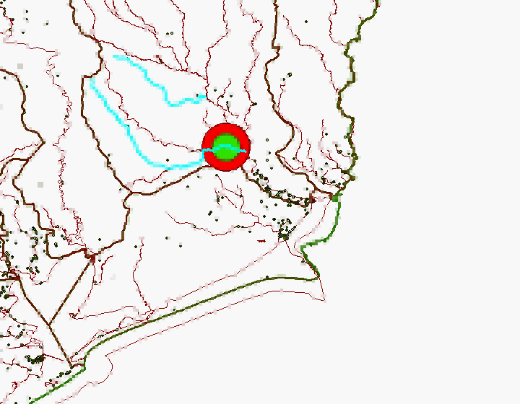
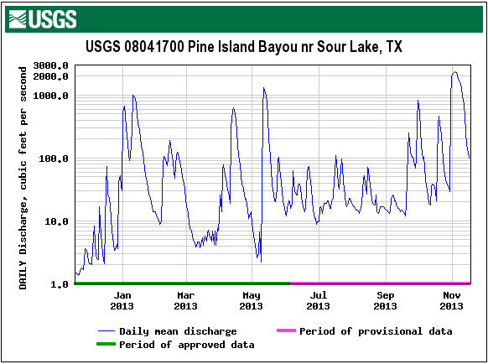
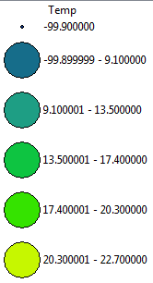
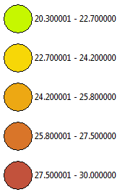
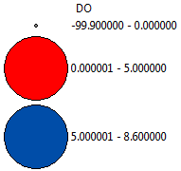
40% = Depressed [DO]
4/16/2013 – 8/14/2013
Notes:
Less water carries

Slide 8
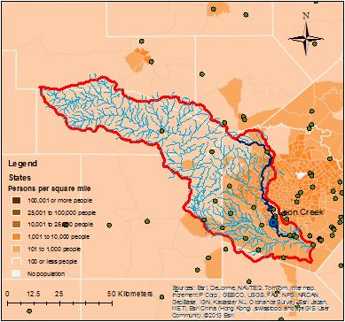
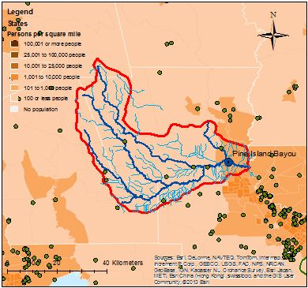
Population Density and Wastewater Outfalls

Slide 9
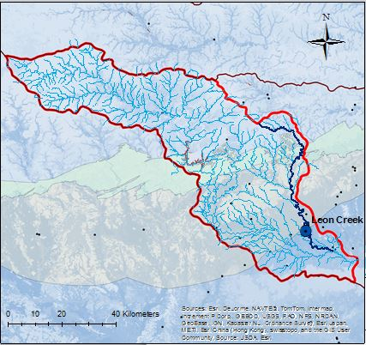
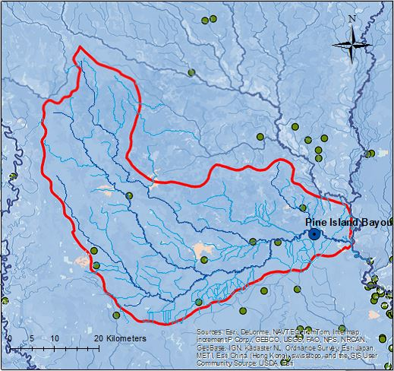
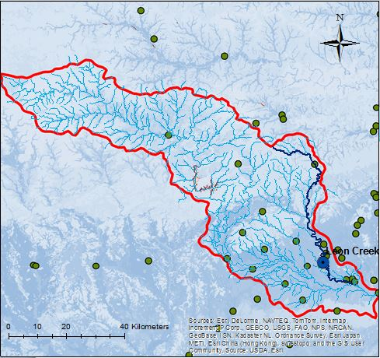
SSURGO - Soil Water Moisture
Notes:
Lesser available soil water storage could be an indication of less

Slide 10
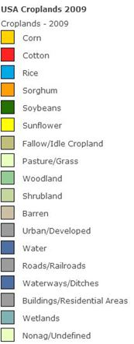
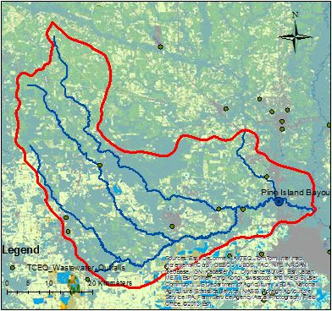
L
A
N
D
U
S
E

Slide 11
Future Work
Automated CWQM for all impaired segments
Wastewater Types and Volumes
  Salinity, N, P
Precipitation Data
  Runoff

Slide 12
Acknowledgements
Drs. Maidment and Tarboton
Carlos Galdeano

