Slide 1
Implications on Land Use from
Automated or Connected Vehicles
Steven E. Polzin, PhD
January , 2014

Slide 2


Prognosticating the Future of Transportation

Slide 3
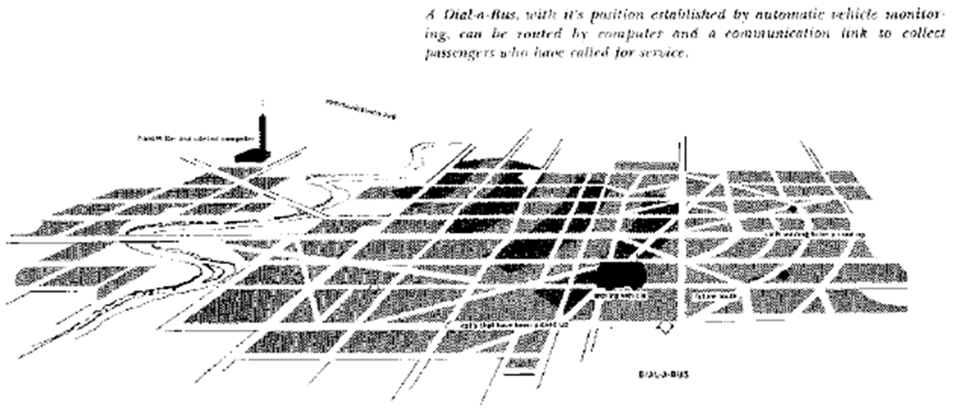
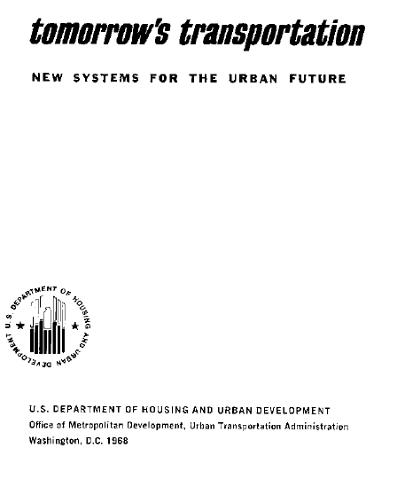
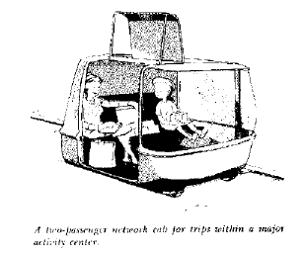
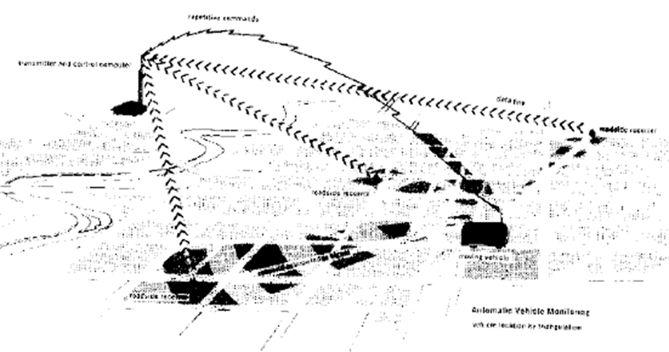
Prognosticating

Slide 5
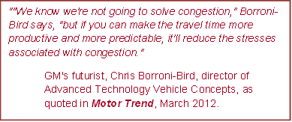
“The benefit of driverless is captured not by the individual car buyer/owner, but by the emerging "mass transit" company that has purchased a fleet of these vehicles for the purpose of making them available to the traveling public on a "per ride" basis. This corporate entity will manage its fleet to best serve its potential customers without incurring a labor cost with each vehicle. Conventional mass transit does something close to this with large vehicle carrying lots of people.
Alain Kornhauser

Slide 6
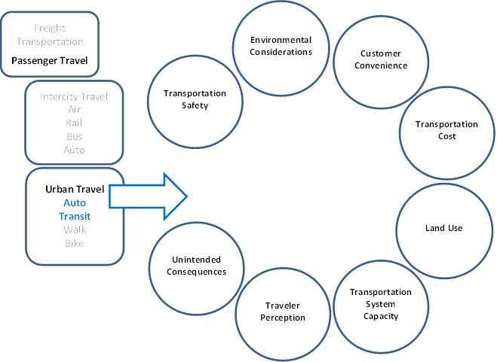
A Framework for Assessing Impacts

Slide 7
Activity Concentration is Premised on Agglomeration Economies
Does ubiquitous communications diminish the value of agglomeration economies and hence concentration of activity?
i.e. if we had teleportation what would the land use pattern be?

Slide 8
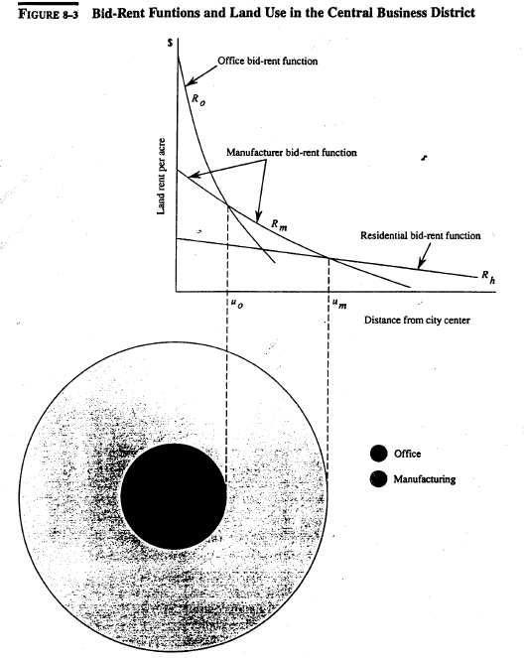
Transportation Land Use Relationship
The economic foundation for the transportation land use relationship is premised on the cost of travel impacting the accessibility and hence value of land

Slide 9
So How Would Autonomous Vehicles impact Travel Costs?
Travel cost components
Traveler time costs
  duration
  value
Travel infrastructure/operations cost
  Vehicle
  Travel way
  Insurance
  O&M

Slide 10
Traveler Time Costs
  Duration (speed)
  Improved logistics minimize time
  Faster speed due to greater capacity
  Time minimized as vehicle driver not required (pick up prescription, drop off child at school, pick up pizza, etc.)
  Travel time certainty improves reducing contingency time in travel.

Slide 11
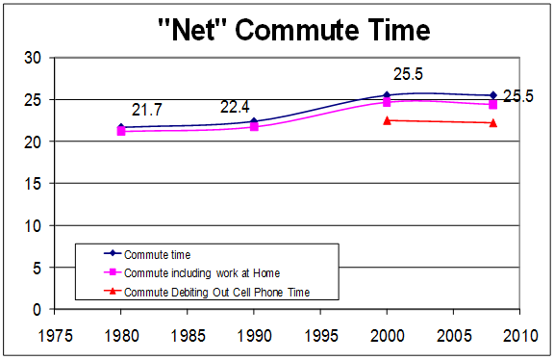
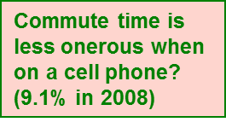
Traveler Time Costs
Value of Time (ability to multitask)
Time available to do other things reduces the time cost.

Slide 12
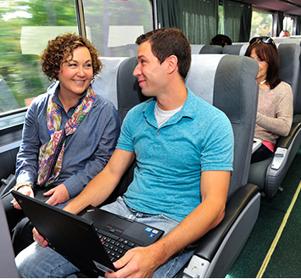
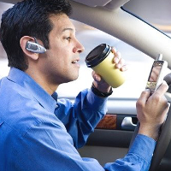
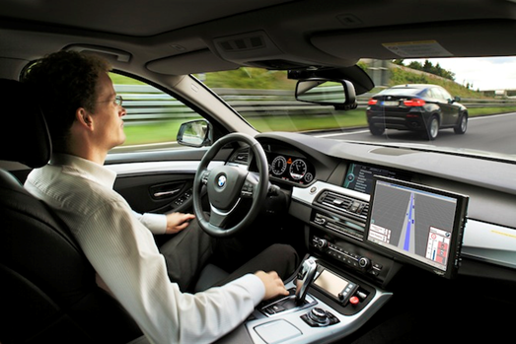
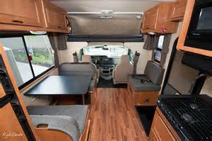
Free up Driver Time?

Slide 13
Travel Infrastructure/Operations Cost
  Vehicle
    Higher cost for technology
    Lower cost from shared ownership
  Travel way
    Higher cost to accommodate technology
    Lower cost as efficient utilizations amortizes cost over higher volumes
  Insurance
    Lower cost from improved safety
    Higher cost due to higher asset liability cost

Slide 14
Travel Infrastructure/Operations Cost
  Operations and Maintenance Cost
    Lower cost for fuel from improved logistics, technology optimization
    Maintenance costs?
    Depreciation/technology upgrades?
    Parking costs? Shared ownership? Offsite parking?
If automated vehicles change the fundamental nature of ownership of vehicles it could significantly affect several factors that influence mode choice and overall travel behavior.

Slide 15
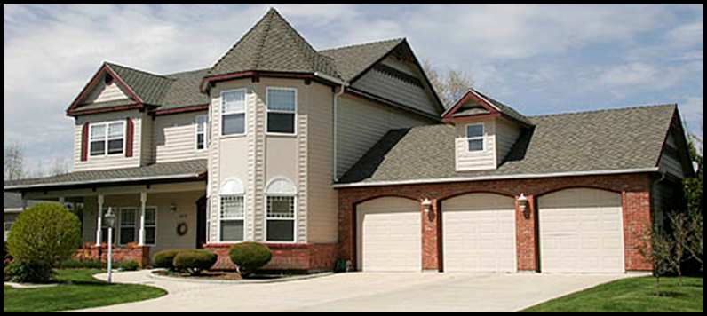

Land Use Impacts
Drive till you qualify
becomes
Nap till you qualify?

Slide 16
Summary Comments
The mechanisms by which autonomous or connected vehicles could impact travel costs are so numerous and complex it is difficult to assess the impacts at this time.
To the extent that land use intensiveness is impacted by travel cost, there are several arguments that costs would go down and development disperse.
Autonomous vehicle enabled higher capacity on existing travel ways could enable more intense development as less land would be required for facility capacity expansion.
Fundamental preferences may be more important than the impact of autonomous vehicles.

Slide 17
I sent the car to get dinner – it should be here soon.

Slide 18
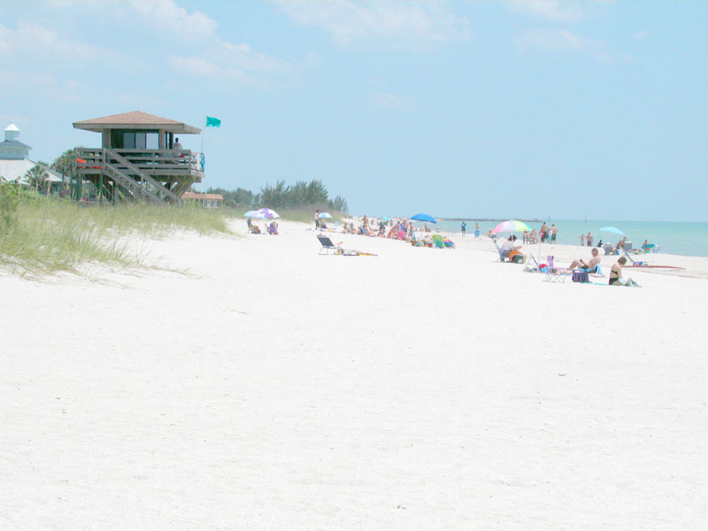
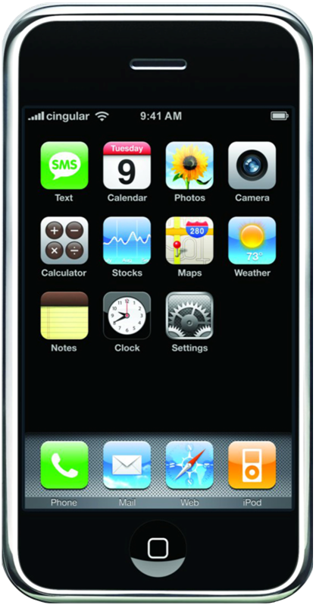
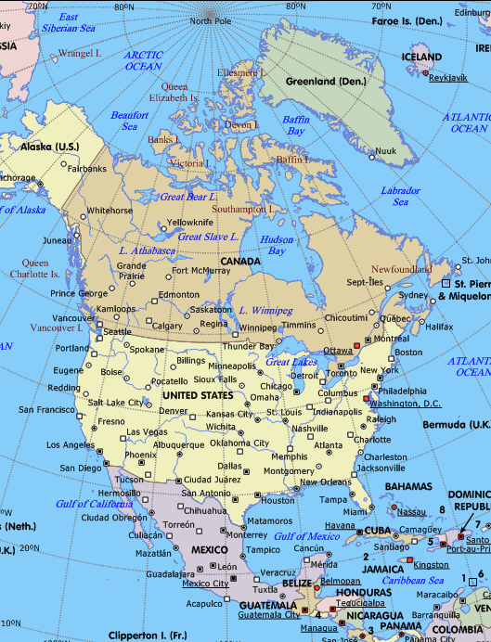




But it might not make any difference
Press to Transport
Apple iphone 9G iOS 13
Personal Teleportation App

