Slide 1
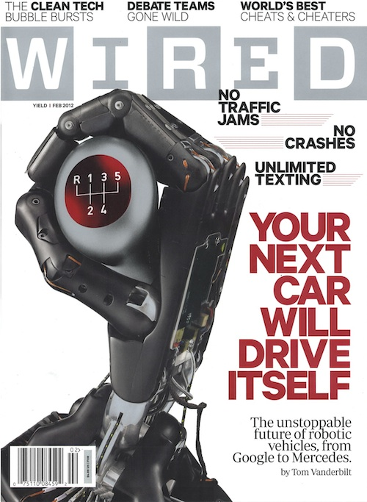

Slide 2
McKinsey: Autonomous Cars One of 12 Major Technology Disruptors
Source: Disruptive Technologies:
Advances that will transform life,
Business, and the global economy
McKinsey Global Institute
May 2013

