Slide 1

General Introduction to Choice Modeling
Chandra R. Bhat
University of Texas at Austin
Notes:
My name is Chandra Bhat. I am the Director of the Center for Transportation Research at the University of Texas at Austin. Welcome to this series of videos on choice modeling. In this first in the series of voice over slides videos, I will introduce choice modeling rather broadly. Subsequent videos will go into additional and specific details.

Slide 2

Introduction: Choice Modeling
A set of tools to predict the choice behavior of a group of decision-makers in a specific choice context.
Notes:
In general, choice modeling refers to a set of tools to predict the choice behavior of a group of decision-makers in a specific choice context. As we will see shortly, the decision-maker may be an individual, a household, a shipper, an organization, or some other decision making entity. At a fundamental level, choice modeling allows us to determine the relative influence of different attributes of alternatives and characteristics of decision makers when they make choice decisions.

Slide 3
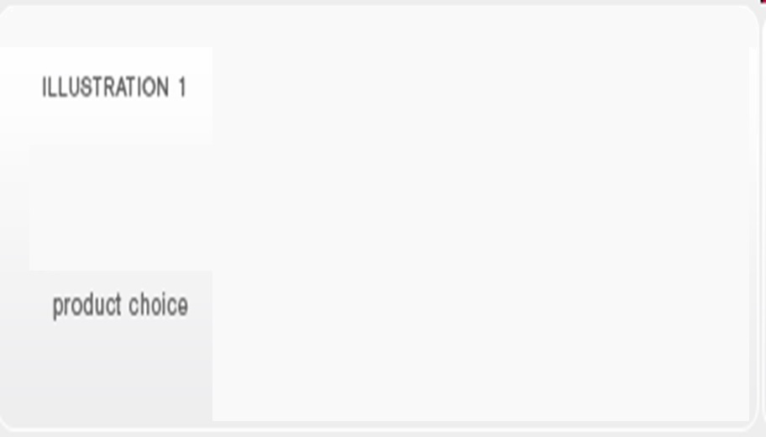
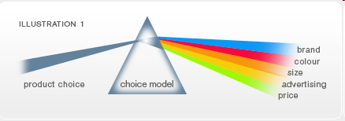
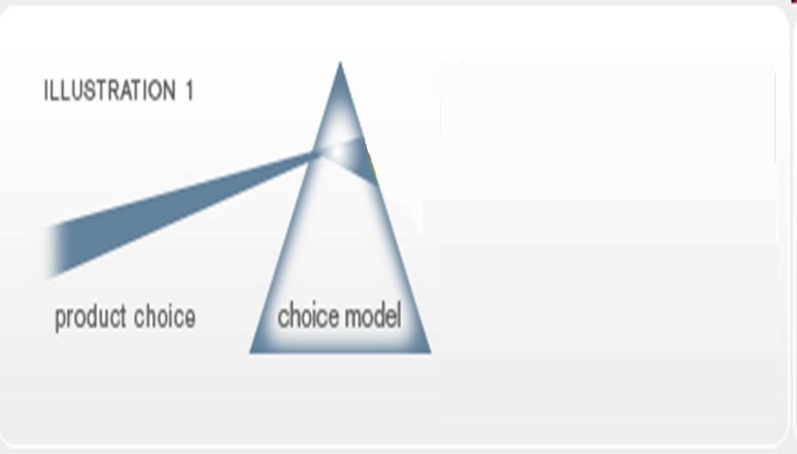
Picture Reference: Future and Simple-Choice Modeling (by Steve Cook and Michael McGee)
http://www.futureandsimple.com/research/choicemodelling/what-is-choice-modelling.html
Notes:
To get a better appreciation of what I mean, I will present a somewhat imperfect, but easy-to-understand, analogy developed by Steve Cook and Michael McGee. Consider that we observe a product choice made by an individual as well as the features of the many products from which the individual chooses the particular product. The features of the many products from which the individual chose the product may include brand name, color, size, advertising, and price. Think of the product choice along with all the features of the products as being a white beam of light that shines onto a transparent glass prism that represents a choice model. Then, the Choice Model, like a clear prism refracting a white beam of light into its component spectrum, will identify the ‘value’ of each component feature manifested in the multi-dimensional feature set represented in the products. More specifically, given the product choice made by an individual from a set of available products, the goal of the estimation phase of choice modeling is to infer how much the individual values each of several features of a product.

Slide 4
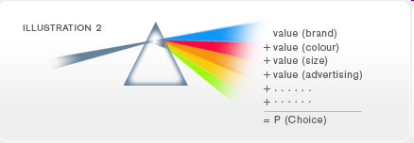
Picture Reference: Future and Simple-Choice Modeling (by Steve Cook and Michael McGee)
http://www.futureandsimple.com/research/choicemodelling/what-is-choice-modelling.html
Notes:
In application, we then use the choice model to combine the valuation of an individual to specified features of a product to predict whether the individual will purchase the product from a wider choice set of products. We will return later again to this concept of application of choice models at the individual-level. Of course, when applied across individuals in the population, the individual-level choice predictions translate to a market share for each product in the market place.

Slide 5
Discrete Choice Models
Discrete choice models can be used to understand and predict a decision maker’s choice of one discrete alternative from a choice set.
Notes:
To summarize, discrete choice models can be used to understand and predict a decision maker’s choice of one discrete alternative from a choice set of alternatives. Such models have numerous applications because many behavioral responses are discrete or qualitative in nature. Indeed, discrete choice models are used in many fields.

Slide 6
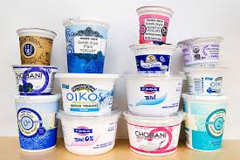

Marketing
Consumer brand choice (Yogurt purchases)
Notes:
In marketing, consumer brand choice is a ubiquitous context for analysis. For example, yoghurt manufacturers and packagers may be interested in what features of their yoghurt, in terms of texture, fat-free or regular, package size, shelving and advertising actions, cost, and even simply the brand name affect consumer choices.

Slide 7
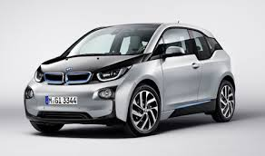
Marketing
Consumer product development
Notes:
Another example in marketing would be in consumer product development, such as in the design of an electric car. What features would be important to consumers? Which population segment is most likely to buy? What is the interplay between the product features and who might buy, and how do I strategize to increase the acceptance of my new product?

Slide 8
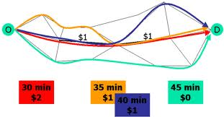

Transportation
How pricing affects route choice
How much is a driver willing to pay
Notes:
In the transportation field, analysts and policy-makers may want to know how pricing affects route choice. Different routes may entail different travel times, travel time reliabilities, and costs, among other characteristics. The analyst may then be interested in knowing whether a driver will select a planned new toll roadway or a current roadway with a new pricing scheme. This has implications for the level of travel time and travel time reliability changes on the priced route and other non-priced routes, as well as for the potential revenues generated. Of interest is also the design of the pricing scheme. Or this can be turned around to ask how much is a driver willing to pay to reduce travel time and increase reliability?

Slide 9
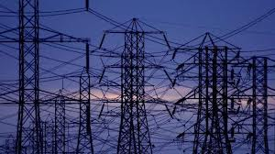


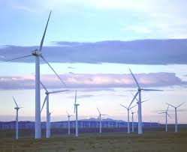
Energy Economics
Notes:
As indicated earlier, the decision maker may not always be an individual consumer. In the field of energy economics, a choice context of interest may be how a city decides on investing its resources to generate more energy. Should the city invest in conventional power grid systems, or in solar power, or in wind energy infrastructure. This choice is likely to be affected by the profile of consumers residing in the city, the current infrastructure in the city, and the cost and possible benefits of each type of energy source investment. Another point to note here is that the city may actually invest in a combination of different energy sources and to different extents, which can be analyzed through what are now referred to as multiple discrete choice models. However, unless otherwise stated, the focus of the early parts of the video course at the site will be on decision agents choosing one alternative from a set of mutually exclusive alternatives.

Slide 10

Environmental Economics
An Angler’s choice of fishing site
Notes:
Another choice phenomenon of interest, but now in the environmental economics field, is an angler’s choice of fishing site, which may be a function of travel cost to the site, any fees at the site, the quality of the water at the site, the variety of fishes at the site, and other aspects of the site and of the angler. In this context, welfare measurement may focus on the result of closing a site or on improving water quality at a site.

Slide 11

Geography
Firm location decisions
Notes:
In geography, an important choice phenomenon that has been modeled is firm location decisions. Here, the firm is the decision maker. The firm’s decision may be based on other similar firms located in the area, other complementary types of firms, the cost of doing business in a location, the availability of talent pool, and accessibility to markets.

Slide 12
Example: Daily activity-travel pattern of an individual
7:30 am
7:35 am
walk
drive
drive
Kid’s School
8:00 am
12:30 pm
7:15 am
12:35 pm
Work
Restaurant
Home
5:00 pm
1:05 pm
6:30 pm
1:00 pm
drive
walk
drive
6:00 pm
5:30 pm
Shop
Notes:
Of course, choice models are used extensively in activity-based travel forecasting platforms. As a simple example, consider the daily activity pattern of a working individual with a child in the household. There are several choice decisions embedded in the individual’s activity-travel pattern illustrated here, including the work timings of the individual, which, in the illustration is from 8 am to 5 pm, whether the person will drive her or his child to school in the morning, if so, the departure time from home, whether or not the person will make a stop at a restaurant during the midday, the departure time from work if there is a stop during the mid-day, and so on.

Slide 13
Application
Use understanding to…
Forecast choices and market shares
Influence choices
Inform policy analysis
Notes:
Well, we have seen many examples of choices in different fields. But now, I would like to come back to the application of choice models. There are at least three aspects to the application of choice models, once they are estimated based on observed choice data. The first is to forecast choices and market shares into the future, because of changing demographic characteristics of consumers and alternative attributes. For example, the aging of the US population can have impacts on the mode and activity participation choices of individuals. The second is to proactively influence choice behavior rather than use choice models simply as a reactive tool. For instance, if a choice model indicates that mixed land-use encourages walking and bicycling, then a development strategy to proactively increase walking and bicycling would be to promote land-use mixing. The third is to inform policy analysis to decide whether to invest in a certain capital investment or not. For instance, in the transportation field, a new bus rapid transit system may provide overall welfare value that has to be compared to its cost. Similarly, in environmental economics, the degradation caused by an oil spill to water quality leads to a loss in value to anglers because of a deterioration in the quantity and diversity of fishes, and assessing this environmental harm is an important component of legal action against the polluter.
Well, that’s it for this introductory video on choice modeling. Have fun with the rest of the videos. Cheers.

