Slide 1

Binary Choice Models
Error structures and Location/Scale Invariance
Naveen Eluru
McGill University

Slide 2


Binary Choice Models
The choice set (C) contains only two alternatives
  Individual n chooses alternative i if and only if:
  Since the analyst does not have full knowledge on decision making process:
j
i

Slide 3
The mathematical form of a discrete choice model is determined by the assumptions made regarding the error terms of the utility function for each alternative.
Specific assumptions in binary choice models:
  Error terms are identically and independently distributed across decision makers
  Error terms are identically and independently distributed across alternatives
  Assumptions above not needed really in binary case, but convenient when extending to multinomial logit case; also variances and covariance, even if present, cannot be identified (detail, not to worry now)
Two common assumptions for error distributions in the statistical and modeling literature:
  Error terms are normal distributed Binary probit
  Error terms are extreme-value (or Gumbel) distributed Binary logit

Slide 4
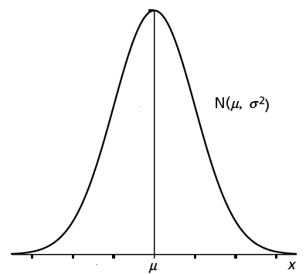
Binary Probit
Assume normal distribution for error terms ε_{DA,n} and ε_{TR,n}
  Also, assume that all error terms have zero means (innocuous normalization)
        “standard normal"

Slide 5
Binary Logit Model
Error terms are extreme-value (or Gumbel) distributed.
  Independently and identically distributed error terms
The pdf and cdf functions for Gumbel G(0,θ):
Scale parameter that determines the variance of the distribution
For ease assume θ=1

Slide 6
Binary Logit Model

Slide 7
Location Invariance
Adding/subtracting a constant to/from both utilities does not affect the choice probabilities; only shifts the functions V_{in} and V_{jn} .
The choice probabilities only depend on the difference in utilities
j
i

Slide 8
Scale Invariance
Similarly, multiplying each alternative’s utility by a positive constant does not affect the choice probabilities.
  But, the variance of the error terms changes!
    Normalize the variance of the error terms (same as normalizing the scale of utility)

Slide 9
Scale Invariance
    Get the standard normal by dividing the equation with standard deviation:
    When we multiply the utility function with a constant λ, the probability remains the same!
    Parameter estimates change (the coefficients are larger by a factor λ)

Slide 10
In summary
Only differences in utility matters
  The absolute level of utility is irrelevant
Overall scale of utility is irrelevant
  The alternative with the highest utility is the same no matter how utility is scaled
  Hence we set it to 1 for ease
j
i

