Slide 1

Maximum Likelihood Estimation
Nazneen Ferdous, Ph.D.
RSG

Slide 2
What do you need to know before starting this session?
Elements of Choice Process
Random Utility Theory
  Basic assumptions
Utility Specification: Deterministic and Random Terms
Binary Choice Models
  Choice probabilities
  Asymptotic Properties of an Estimator

Slide 3
What will you learn in this session?
  What is the Maximum Likelihood Estimation (MLE) method
Assumptions
Steps to undertake a MLE procedure

Slide 4
Maximum Likelihood Estimation (MLE)
A statistical method used for fitting a statistical model to data, and providing estimates for the model's parameters.
Assumptions:
  Random sampling of decision makers.
  Only include individuals with both alternatives available.
The procedure for maximum likelihood estimation involves two important steps:
  Developing a joint probability of the observed sample, called the likelihood function.
    Since we assume errors are independent across decision makers, the likelihood of the entire sample is the product of the likelihoods of the individual observations.
  Estimating parameter values which maximize the likelihood function.

Slide 5
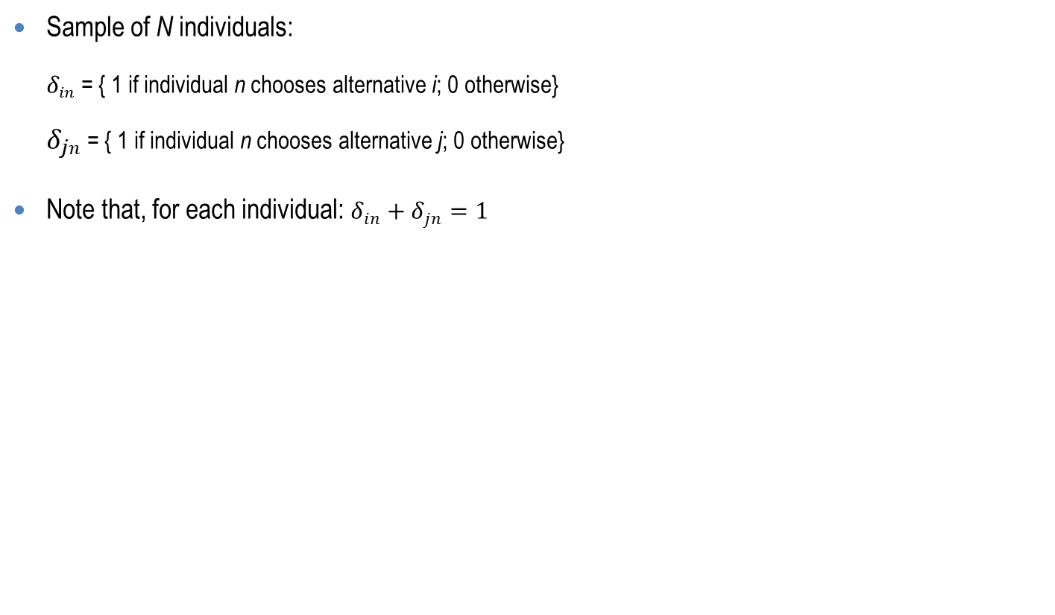

Steps to Implement the MLE Method
Sample of N individuals:
$δ_{in}$= { 1 if individual n chooses alternative i; 0 otherwise}
$δ_{jn}$= { 1 if individual n chooses alternative j; 0 otherwise}
Note that, for each individual: $δ_{in}+δ_{jn}=1$
For single individual n, the likelihood function:
$$L_{n}^{∗}={[P_{in}]}^{δ_{in}}×{[P_{jn}]}^{δ_{jn}}$$
Where $P_{in}$ and $P_{jn}$ are probabilities of individual n choosing alternative i and j, respectively.
For logit model, $P_{in}=\frac{e^{β^{′}X_{in}}}{e^{β^{′}X_{in}}+e^{β^{′}X_{jn}}}$ and $P_{jn}=\frac{e^{β^{′}X_{jn}}}{e^{β^{′}X_{in}}+e^{β^{′}X_{jn}}}$
  Where,
  $X_{in}$ and $X_{jn}$ are vectors of attributes, each containing K values of the relevant variables, and
  $β$ is a vector containing K parameters to be estimated.

Slide 6

Steps to Implement the MLE Method (con’t)
For the entire sample:
$$L^{∗}=\prod_{n=1}^{N}{L_{n}^{∗}}=\prod_{n=1}^{N}{{[P_{in}]}^{δ_{in}}×{[P_{jn}]}^{δ_{jn}}}$$
  Log-likelihood function:
  $$L={log(L}^{∗})=\sum_{n=1}^{N}{{[δ}_{in}logP_{in}}+δ_{jn}logP_{jn}]$$

Slide 7
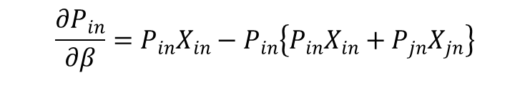
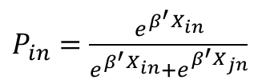
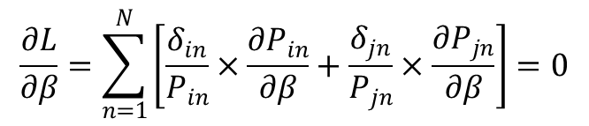
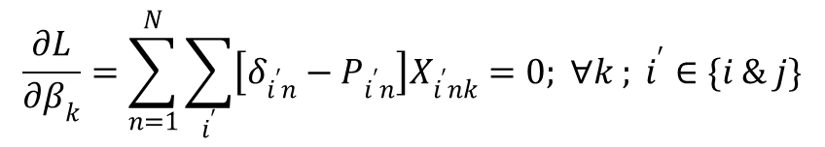

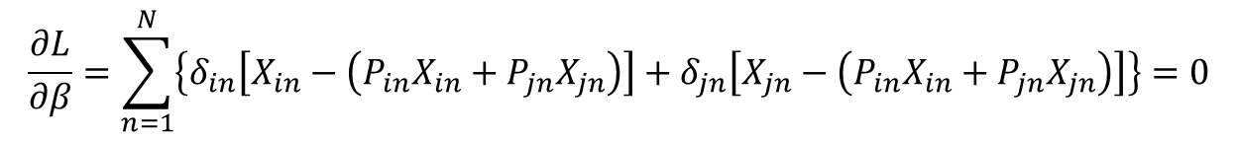
Steps to Implement the MLE Method (con’t)
$$\frac{∂L}{∂β}=\sum_{n=1}^{N}{\left[\frac{δ_{in}}{P_{in}}×\frac{∂P_{in}}{∂β}+\frac{δ_{jn}}{P_{jn}}×\frac{∂P_{jn}}{∂β}\right]=0}$$
………………………………..................(1)
Recall,
$P_{in}=\frac{e^{β^{′}X_{in}}}{e^{β^{′}X_{in}}+e^{β^{′}X_{jn}}}$
$$\frac{∂P_{in}}{∂β}=P_{in}X_{in}−P_{in}\left\{P_{in}X_{in}+P_{jn}X_{jn}\right\}$$
$$\frac{∂L}{∂β}=\sum_{n=1}^{N}{\left\{δ_{in}\left[X_{in}−\left(P_{in}X_{in}+P_{jn}X_{jn}\right)\right]+δ_{jn}\left[X_{jn}−\left(P_{in}X_{in}+P_{jn}X_{jn}\right)\right]\right\}=0}$$
..…(2)
Recall,
$$δ_{in}+δ_{jn}=1$$
$$\frac{∂L}{∂β_{k}}=\sum_{n=1}^{N}{\sum_{i^{′}}{\left[δ_{i^{′}n}−P_{i^{′}n}\right]X_{i^{′}nk}}=0; ∀k ; i^{′}∈\{i \& j\}}$$
…………………………....…(3)

Slide 8


General Shape of a Log-Likelihood Function
$$L$$
(Varies from –∞ to 0)
$$\hat{β}$$

Slide 9
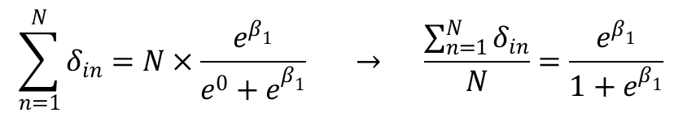
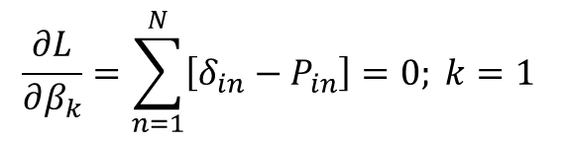
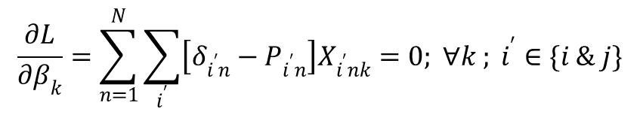

Constant-Only Binary Logit Model
$X_{in}=1$, $X_{jn}=$0
$$\frac{∂L}{∂β_{k}}=\sum_{n=1}^{N}{\sum_{i^{′}}{\left[δ_{i^{′}n}−P_{i^{′}n}\right]X_{i^{′}nk}}=0; ∀k ; i^{′}∈\{i \& j\}}$$
…………………………....…(3)
$$\frac{∂L}{∂β_{k}}=\sum_{n=1}^{N}{\left[δ_{in}−P_{in}\right]=0; k=1 }$$
$$\sum_{n=1}^{N}{δ_{in}}=N×\frac{e^{β_{1}}}{{e^{0}+e}^{β_{1}}} → \frac{\sum_{n=1}^{N}{δ_{in}}}{N}=\frac{e^{β_{1}}}{{1+e}^{β_{1}}}$$
Observed share
Predicted share

Slide 10
Example of Some Software and Additional Information
All software and packages that are capable of estimating binary or MNL models include MLE method.
Example of some software are:
  Biogeme (this is an open source freeware (http://biogeme.epfl.ch/))
  ALOGIT (http://alogit.com/)
  SPSS (http://www-01.ibm.com/software/analytics/spss/)
  R (this is an open source programming language to code your own models (http://www.r-project.org/))
Additional Information:
  Ben-Akiva,M. and S. Lerman (1985), “Discrete Choice Analysis: Theory and Application to Travel Demand”, MIT Press, Cambridge, MA.
  McFadden, D. (1974), “Conditional logit analysis of qualitative choice behavior”, in P. Zarembka, ed., Frontiers in Econometrics, Academic Press, New York, pp. 105–142.
  Train, K. (2009), “Discrete Choice Methods with Simulation”, Cambridge University Press.

