Slide 1

Interpretation
Rajesh Paleti
Parsons Brickerhoff

Slide 2
Important Specification Issues
Only differences in the utilities matter
Not possible to estimate all alternate specific constants and all parameters on decision maker characteristics
Solution: Choose a base or reference alternative
Can be arbitrary and does not affect model quality

Slide 3
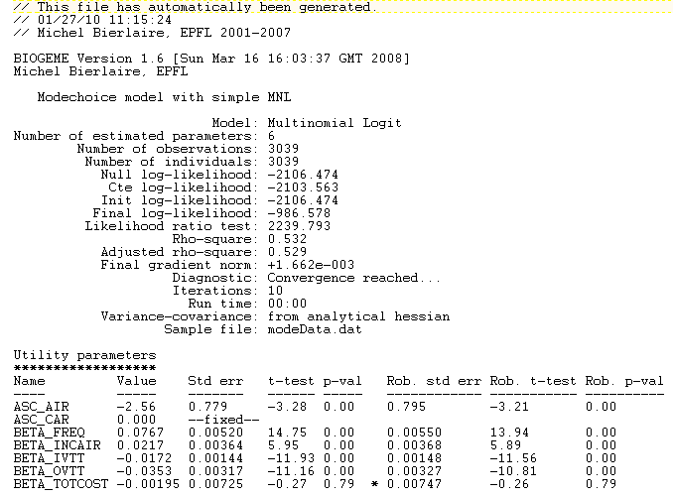
Binary Choice Models: Empirical Specification and Interpretation: Model 1

Slide 4
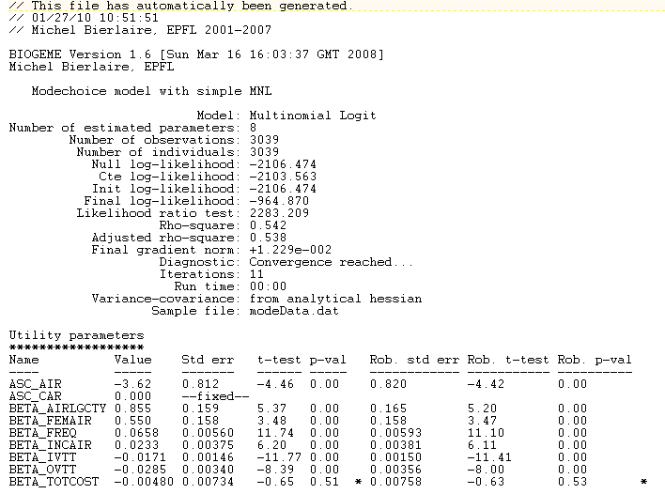
Binary Choice Models: Empirical Specification and Interpretation: Model 2

Slide 5


Binary Choice Models:
Marginal Effects
Marginal effects: The change in the probability that decision maker n chooses alternative i in response to changes in explanatory variables, x_{in}
i; DA
j; TR
Marginal self effect; MSE
Marginal cross effect; MCE
Notes:
One measure for evaluating the response to changes is to calculate the derivatives of the choice
probabilities of each alternative with respect to the variable in question.

Slide 6
Binary Choice Models:
Elasticity Effects
Elasticity effects: Percentage change in the response variable with respect to one-percent change in another variable
Self elasticity
Cross elasticity
Notes:
Elasticity is another measure that is used to quantify the extent to which the choice probabilities
of each alternative will change in response to the changes in the value of an attribute.
Economists often measure responses by elasticities rather than derivatives since elasticities are normalized by/for the variables’ units.
variable. In the context of logit models, the response variable
is the choice probability of an alternative, such as i P , and the explanatory variable is the
attribute ik X .
Estimates of elasticity will differ depending on whether the normalization is at the start value,
final value or mid-point values. This confusion can be avoided by computing elasticities for
very small changes. When the elasticity is computed for infinitesimally small changes, the
elasticity obtained is termed the point elasticity. The expression for point elasticity is given as a
function of the derivatives.

Slide 7
Binary Choice Models:
Aggregate Effects
Notes:
When there is a constant uniform percentage change for x variable for each individual..
Effect of one-percent change uniform variable x on TR share

