Slide 1
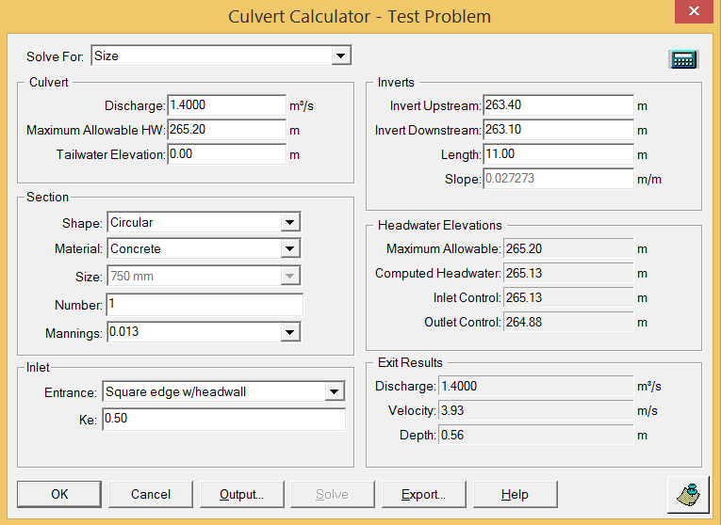
Example Problem: Solve for Size

Slide 2
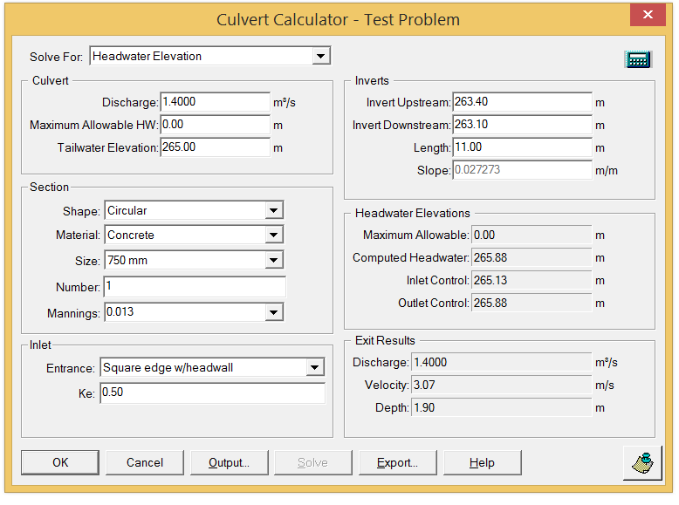
Example Problem: Solve for Headwater

Slide 3
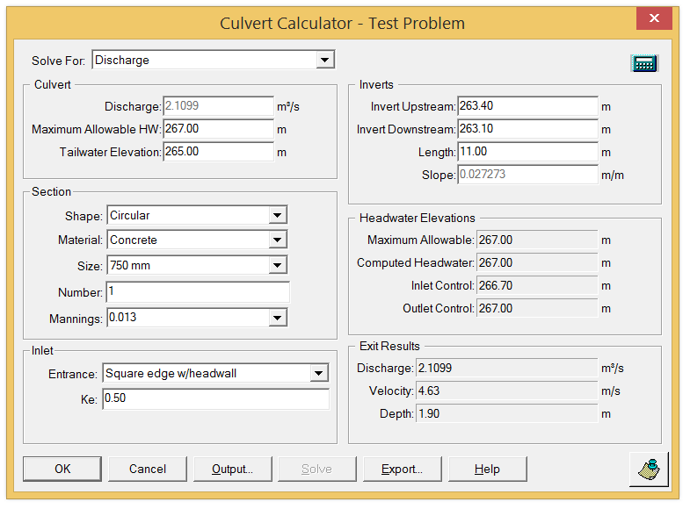
Example Problem: Solve for Discharge

