Slide 1
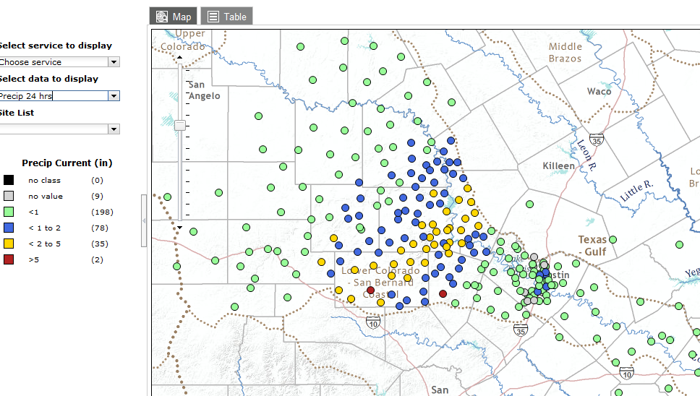
20 March Storm, 24-hr Precip at 1:40AM

Slide 2
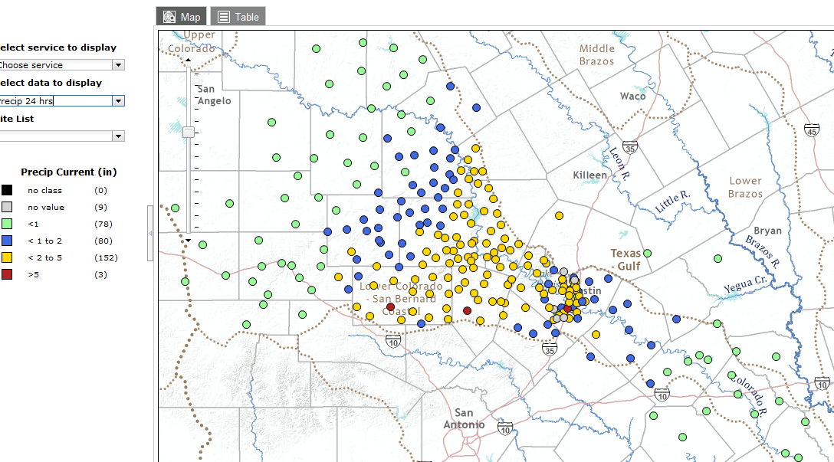
20 March Storm, 24-hour Precip at 5:30AM

Slide 3
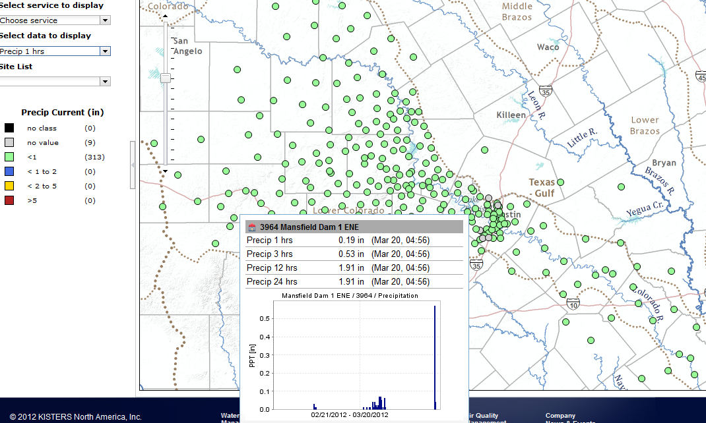
1-hour Precip at 5:30AM

Slide 4
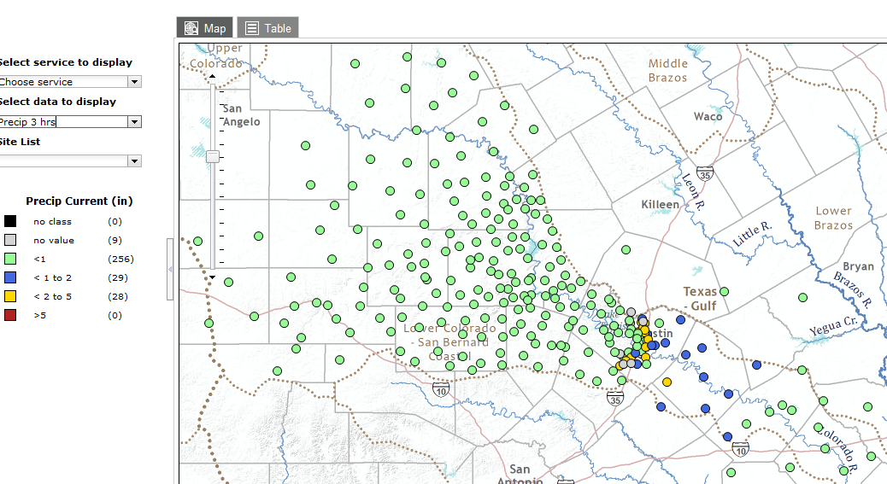
3-hr Precip, 5:30AM

Slide 5
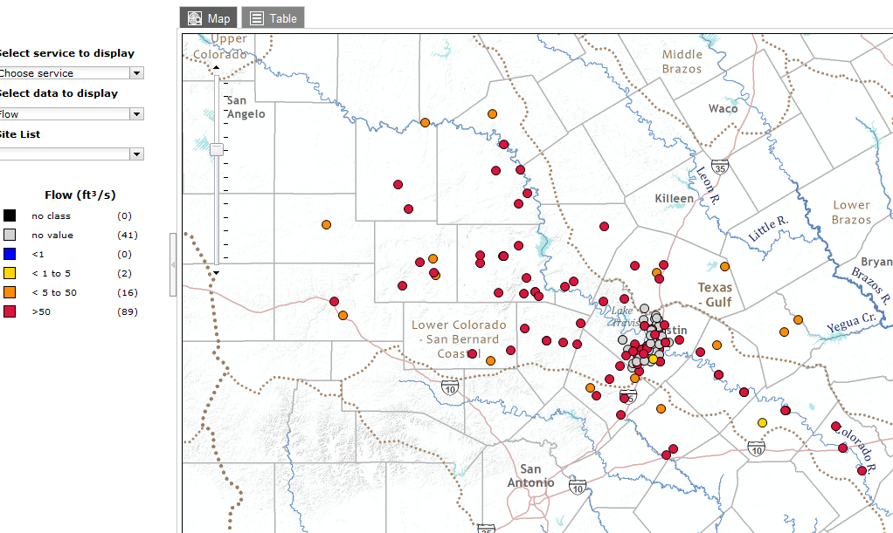
20 March Storm, Flow at 5:30AM

Slide 6
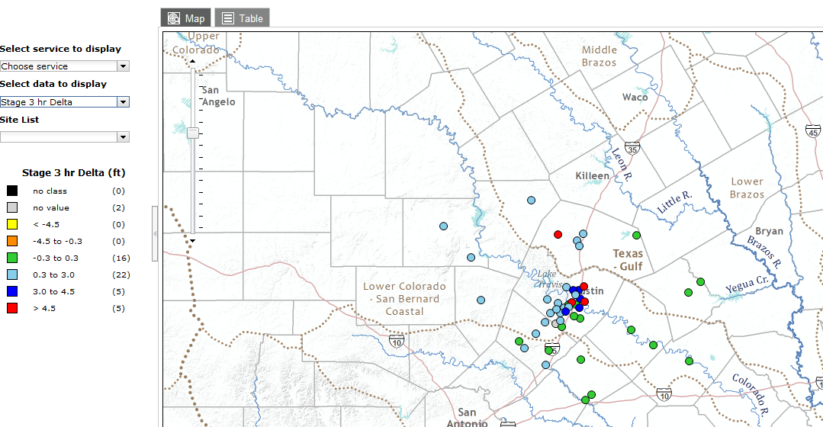
3-hour stage change, 5:30AM

