Slide 1
Responding to drought (and megadrought!) in Texas
Robert E. Mace, Ph.D., P.G.
Texas Water Development Board
March 27, 2012

Slide 2
Outline
How drought impacts water supplies
Dang that drought last year was nasty!
What do we do to prepare for drought?
What will we do if the (real) big one hits?
(Short-term) predictions…

Slide 3
Outline
How drought impacts water supplies
Dang that drought last year was nasty!
What do we do to prepare for drought?
What will we do if the (real) big one hits?
(Short-term) predictions…

Slide 4
How drought impacts water
Less rainfall
  Less runoff
    Less flow in rivers
      Less water in reservoirs
  Less recharge
    Less water in aquifers
      Less flow in rivers
        Less water in reservoirs

Slide 5
How drought impacts water
Less rainfall
  More water use
    Less water in rivers
      Less water in reservoirs
    Less water in reservoirs
    Less water in aquifer
      Less flow in rivers
        Less water in reservoirs

Slide 6
How drought impacts water
More evaporation
  Less runoff
    Less flow in rivers
      Less water in reservoirs
  Less recharge
    Less water in aquifers
      Less flow in rivers
        Less water in reservoirs
Bottom line: reservoirs get hit hard…

Slide 7

How drought impacts water
Men fight house cats while
doing dishes

Slide 8
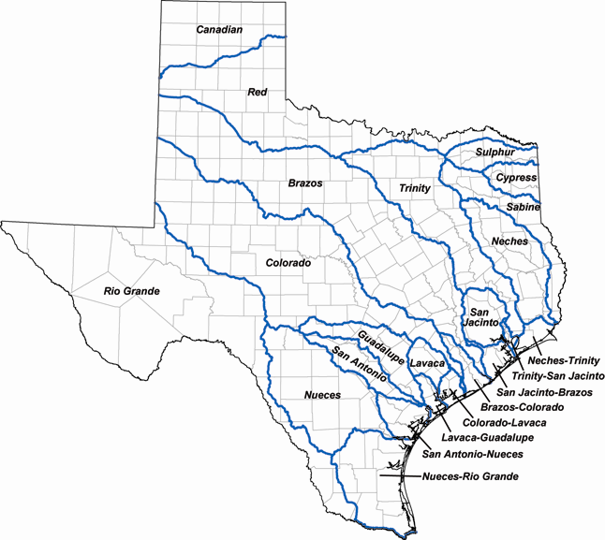
Rivers respond

Slide 9
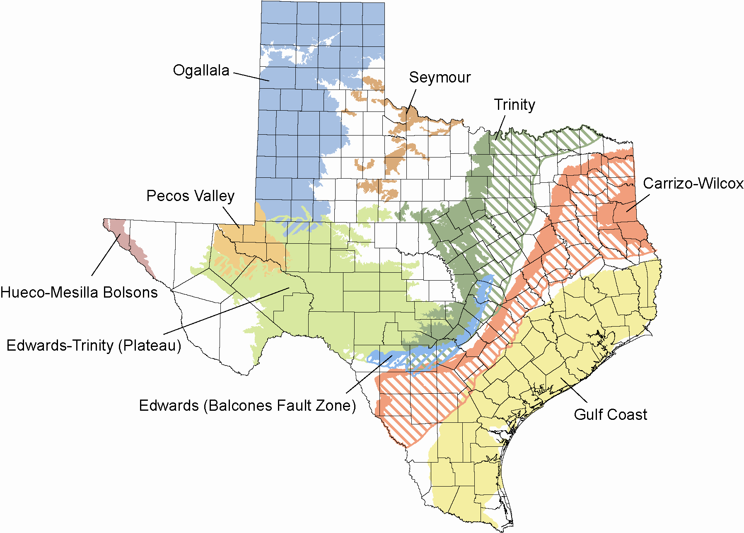
Aquifers might…

Slide 10
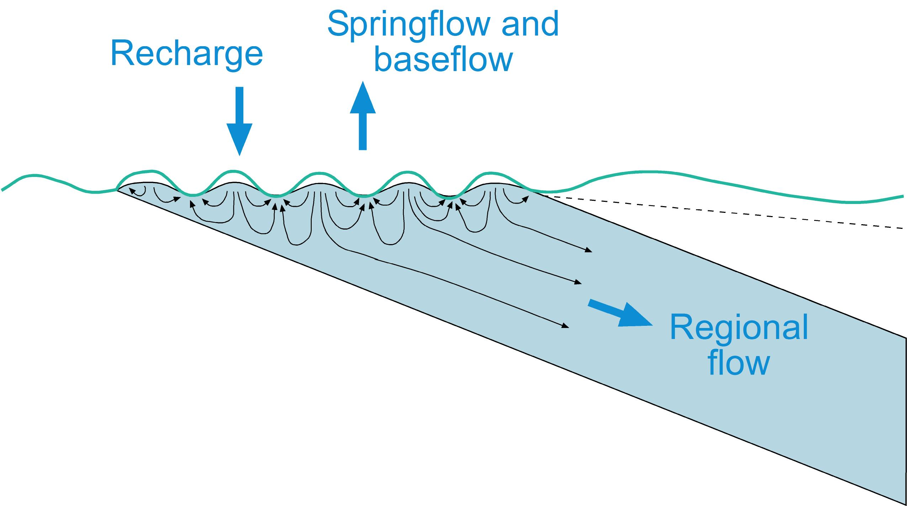
Confined aquifer

Slide 11
Major aquifers

Slide 12
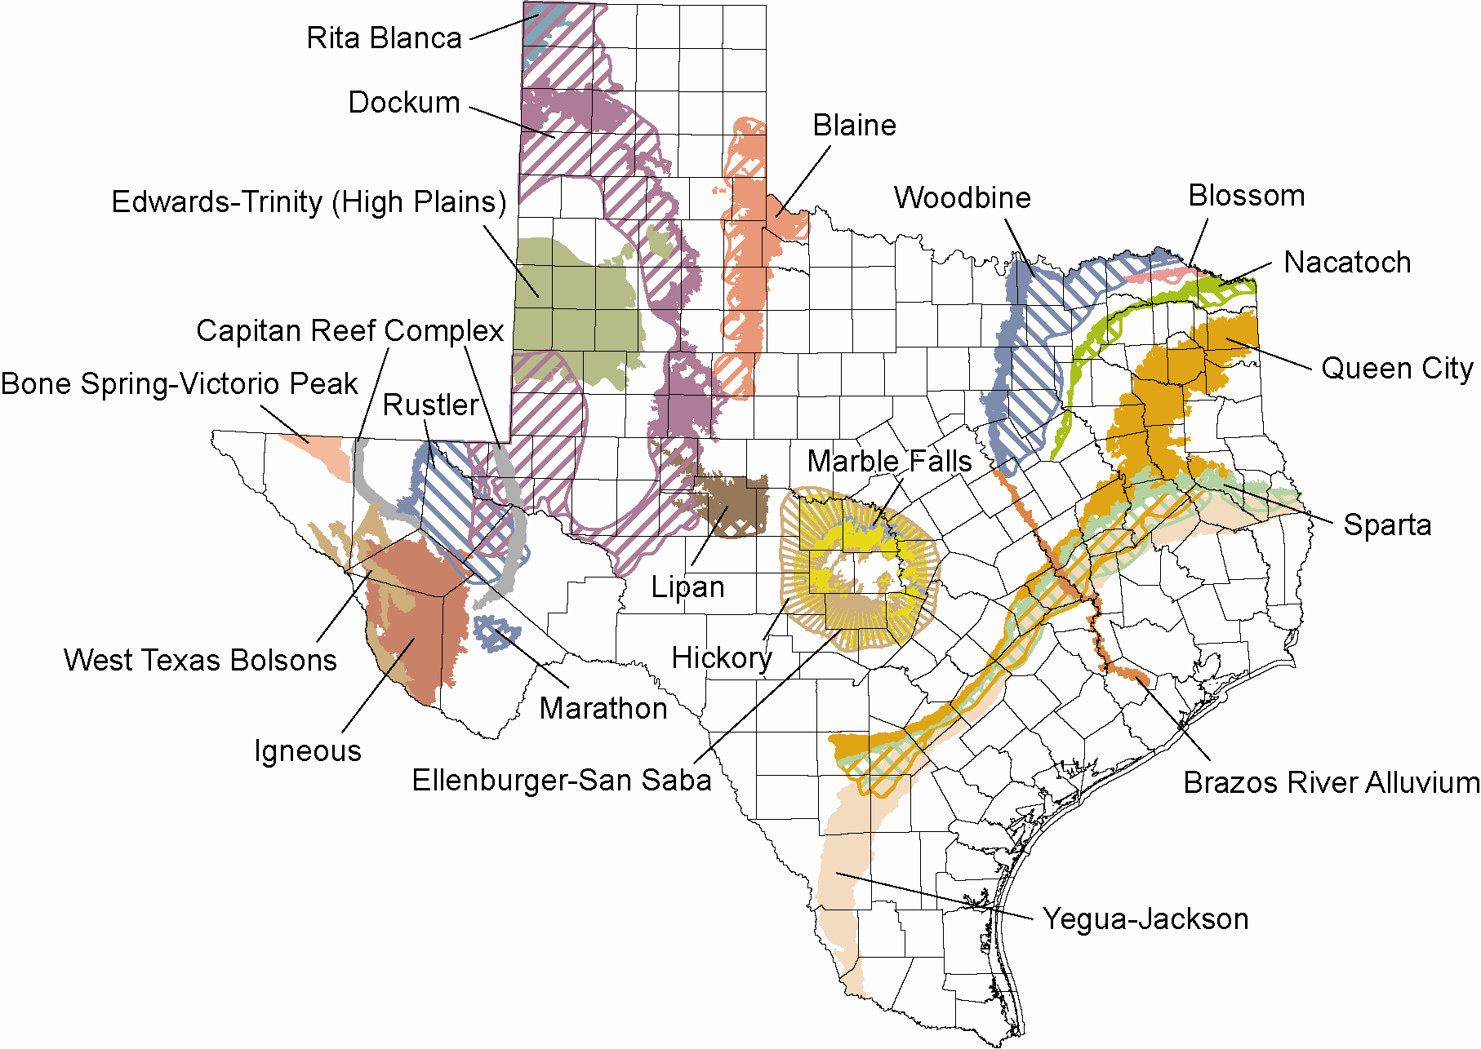
Minor aquifers

Slide 13
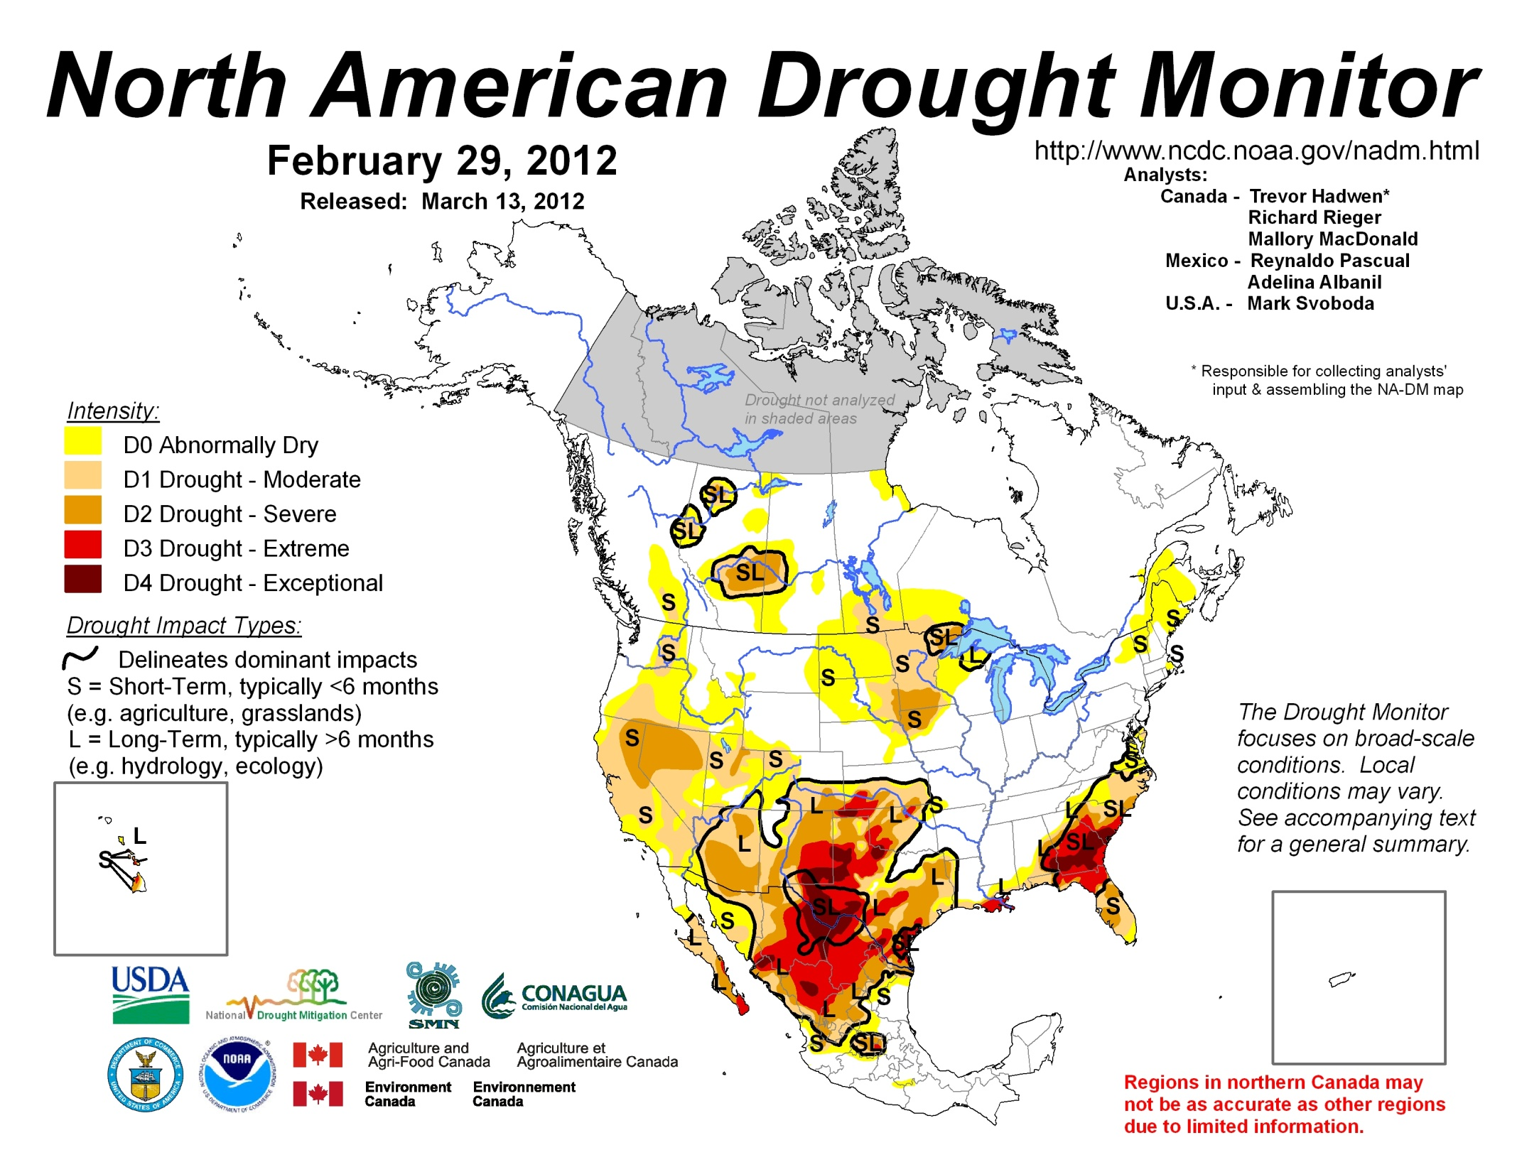

Slide 14
Outline
How drought impacts water supplies
Dang that drought last year was nasty!
What do we do to prepare for drought?
What will we do if the (real) big one hits?
(Short-term) predictions…

Slide 15
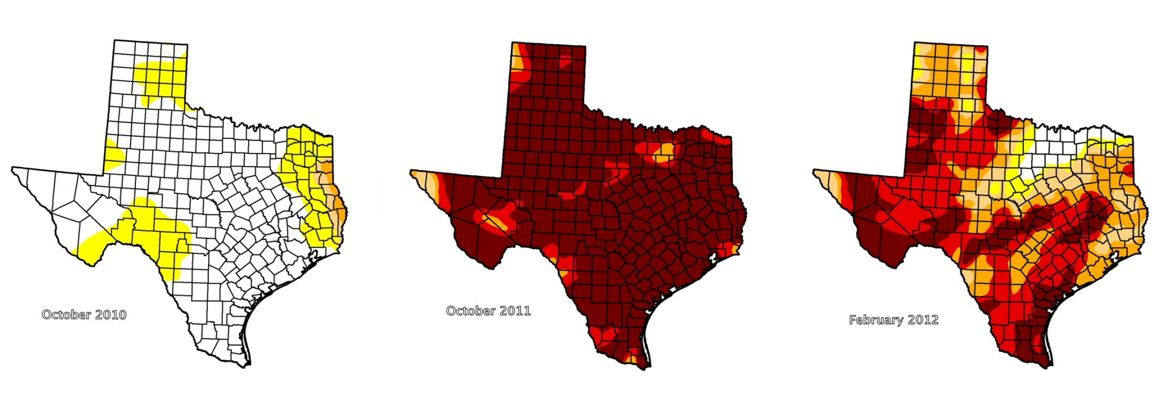

Slide 16
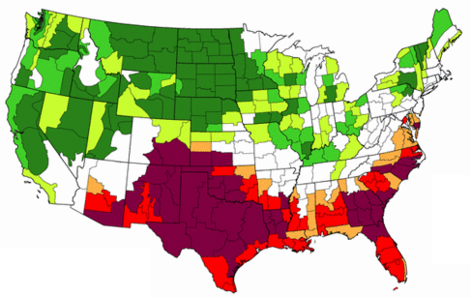
Records
Worst one-year drought on record
Driest period on record
Hottest period on record
Statewide reservoir storage lowest since 1978
at <60%
Ag losses at $7.62 billion
  50% cotton crop lost in West Texas
  Ranchers selling herds
~ 4 million acres burned by wildfires
Rivers with first-time calls on water rights

Slide 17
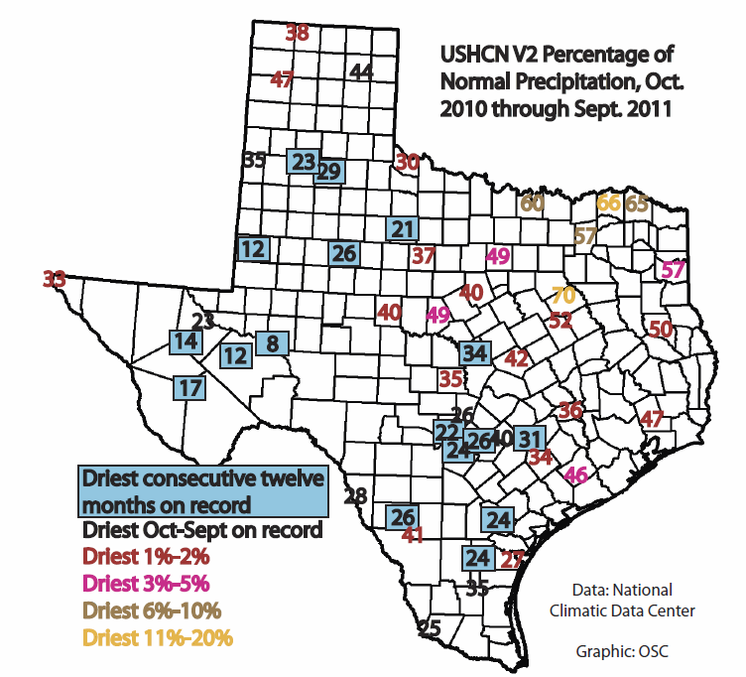

Slide 18
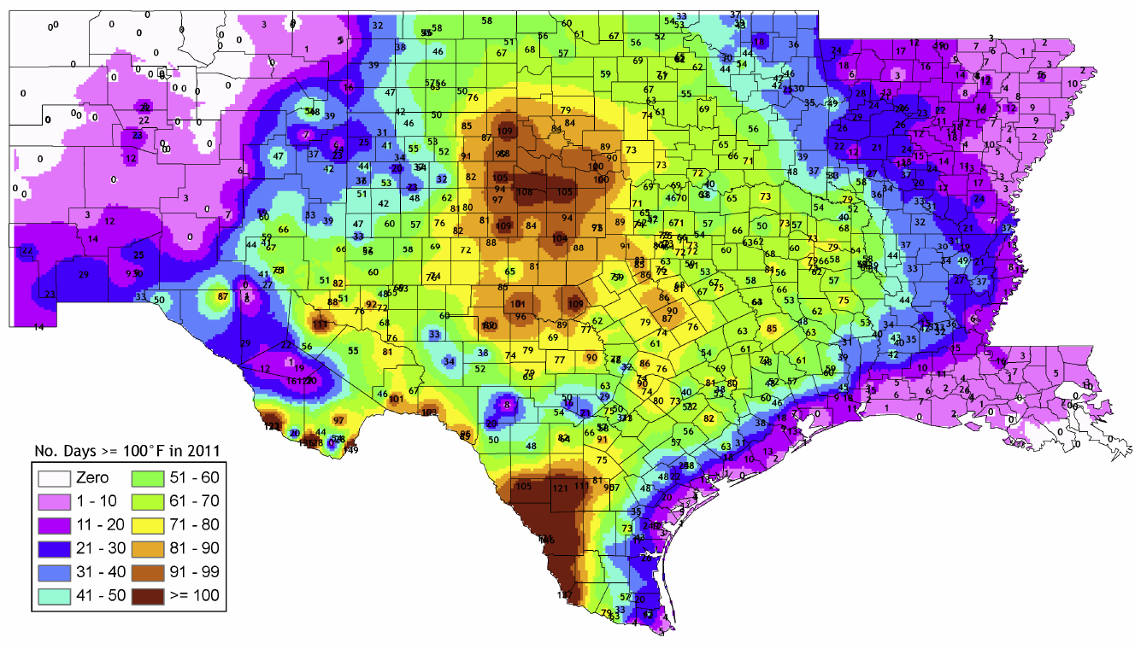
“Heat Misery Index”
from the Office of the State Climatologist

Slide 19
Evaporation higher than normal
for the summer months
13%
43%
10%
23%

Slide 20
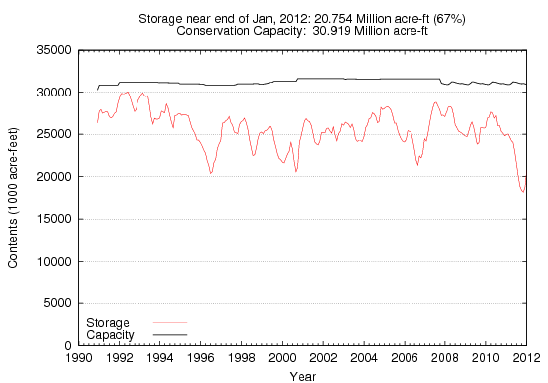
<>
<>
<>
<>
<>
RESERVOIR CONSERVATION STORAGE DATA
Notes:
Update

Slide 21
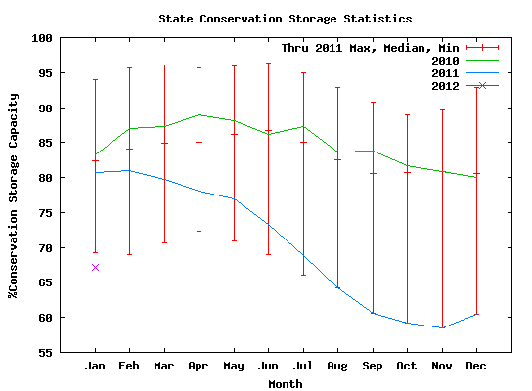
RESERVOIR CONSERVATION STORAGE DATA

Slide 22
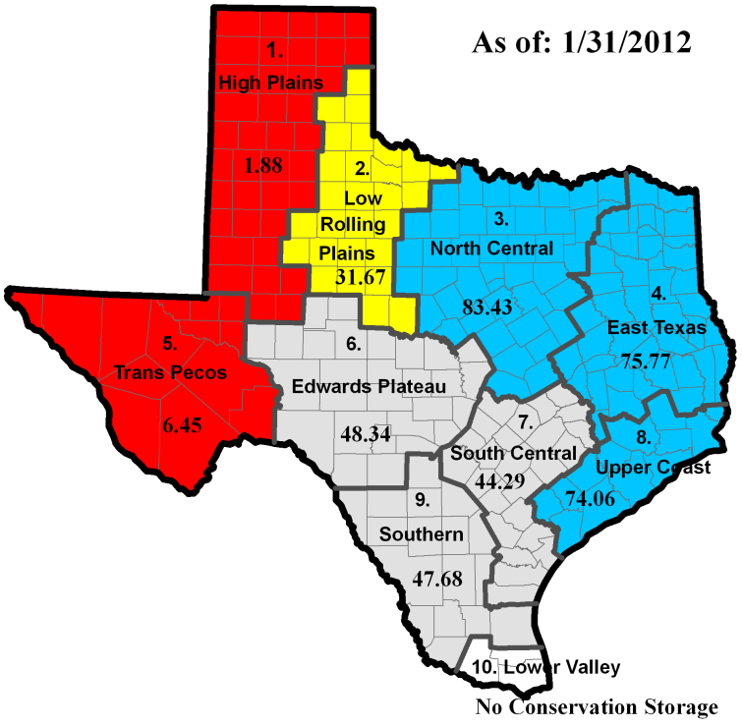

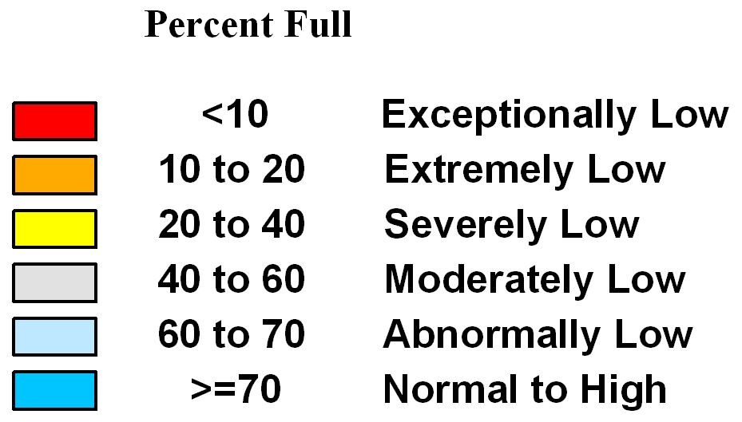


**
Reservoir Storage (% Full)
*
**
*
*
**
Record Low for End of this Month
*
*
Record Low for End of any Month
*
*
*
(Records back to April 1996)
*
*
*
*
*

Slide 23
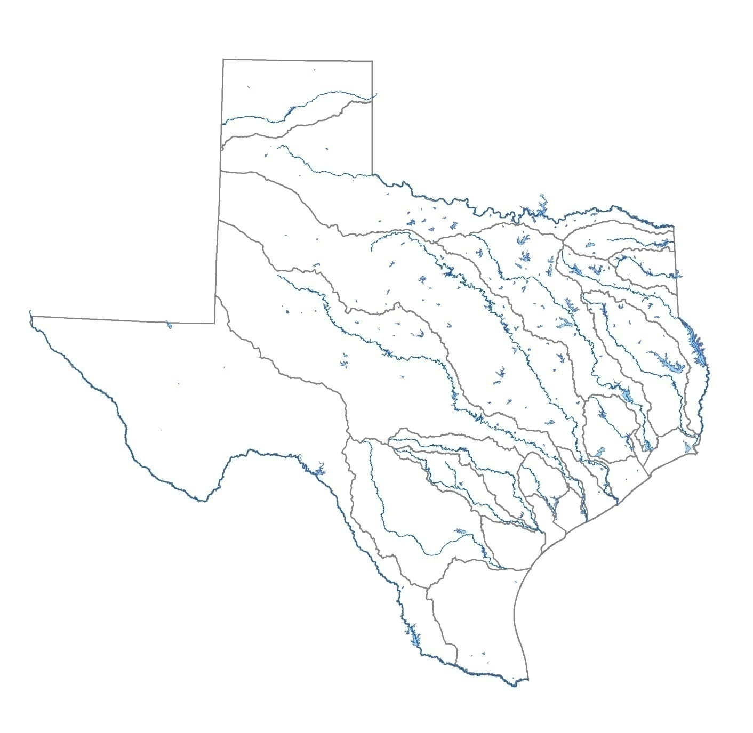
Reservoir Conditions
Meredith 0% (0%,-1%)
Reservoir *Current Contents Change from
Name as a % of Capacity (Last Month, Last Year)
Elephant Butte
17% (+2%,-7%)
Lavon 75% (+23%,-2%)
Toledo Bend
68% (+6%,-4%)
O.H. Ivie
18% (0%,-14%)
Amistad 79% (-2%, -21%)
Travis 35% (0%,-44%)
* Reservoirs showing 0% contents may have water available in dead pool
End of January 2012

Slide 24
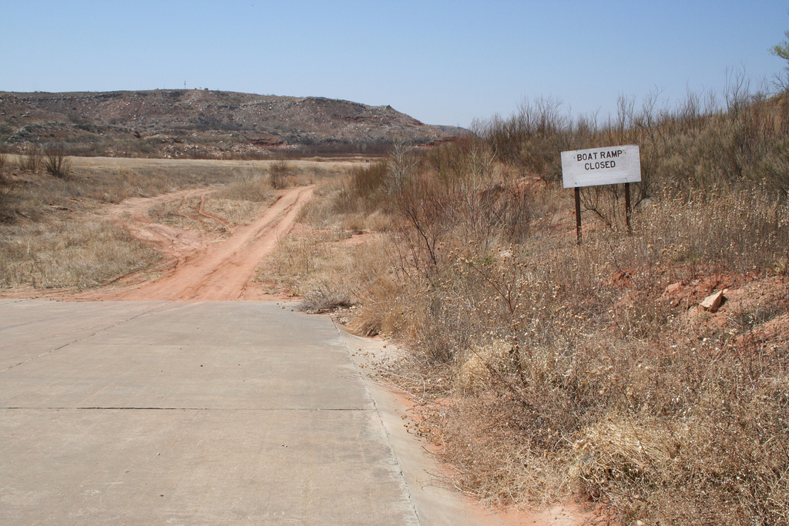
Lake Meredith…

Slide 25
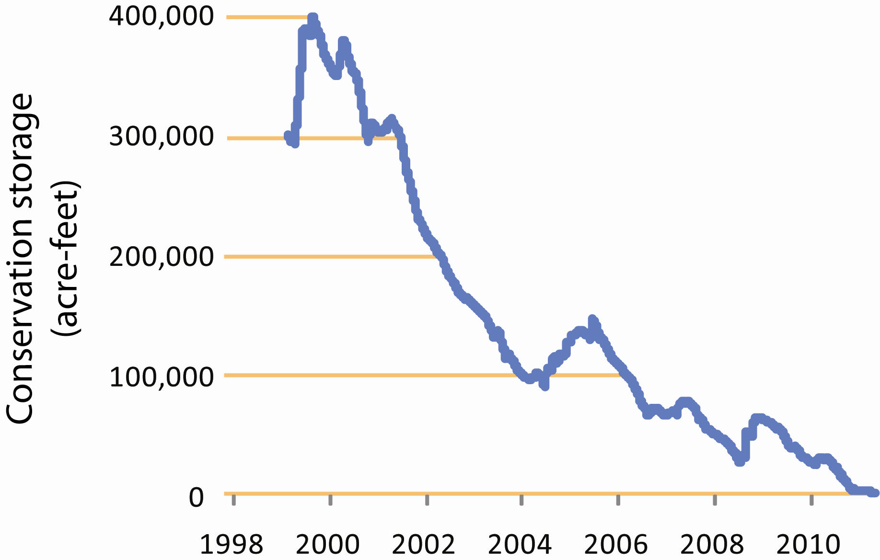
“Lake”
Meredith
Notes:
Although the current drought started in the fall of last year, Lake Meredith seems to be suffering from a longer drought that started in the 1990s.
Officially, the conservation storage, the volume of water available for use, is currently zero.
For your back pocket: Folks don’t fully understand what the cause is. Likely to be due to several issues: less runoff, impacts of groundwater pumping, less inflow from New Mexico.

Slide 26
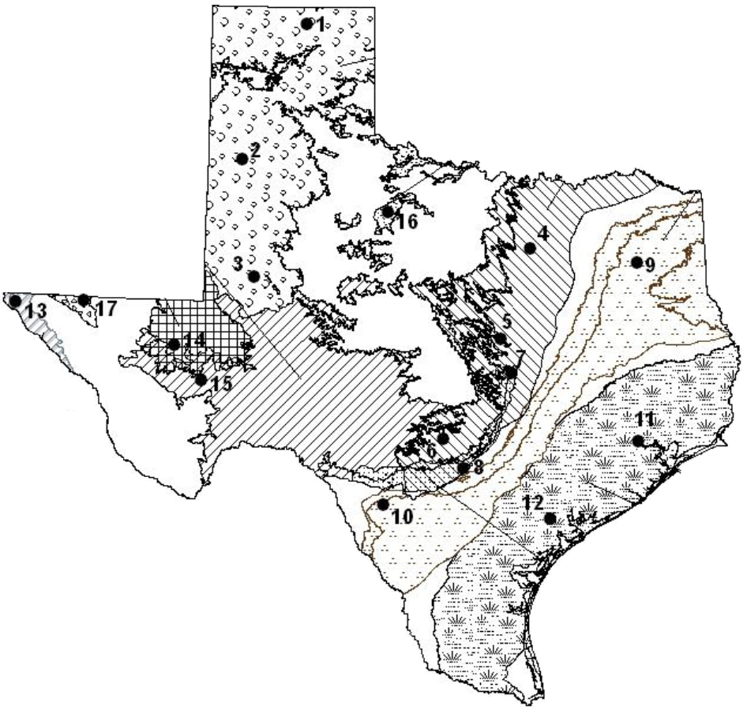
Groundwater Levels in Observation Wells
Ogallala +0.06’, -0.17’
Ogallala -0.08’,-1.45’
Trinity
+3.86’,-0.54’
Trinity
+1.31’, -11.14’
Seymour
+0.2’,-2.18’
Ogallala +0.1’,-2.22’
Carrizo-
Wilcox
+1.63’, -2.37’
Bone Spring-
Victorio Peak
+2.84’,-1.82’
Edwards
-0.01’,-3.18’
Hueco-
Mesilla Bolson
-0.18’,+1.73’
Gulf Coast
+1.29’,-5.03’
Pecos Valley
+.101’,-2.94’
Trinity
+5.75’, -17.05’
Aquifer
Edwards- Trinity
+7.02’,-0.62’
Change from
Last Month,Year
Gulf Coast
+0.9’,-5.66’
Carrizo-
Wilcox
-4.48’,-92.88’
Edwards
+4.38’,-14.77’
End of January 2012

Slide 27

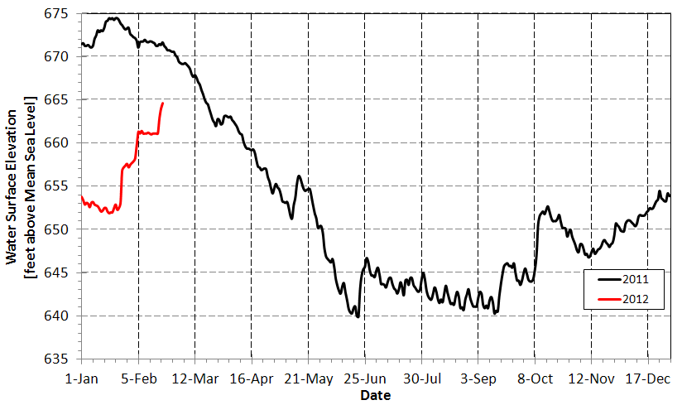
Groundwater Level in J-17 Well
Stage 1
Stage 2
Stage 3
http://www.saws.org/our_water/aquifer/

Slide 28
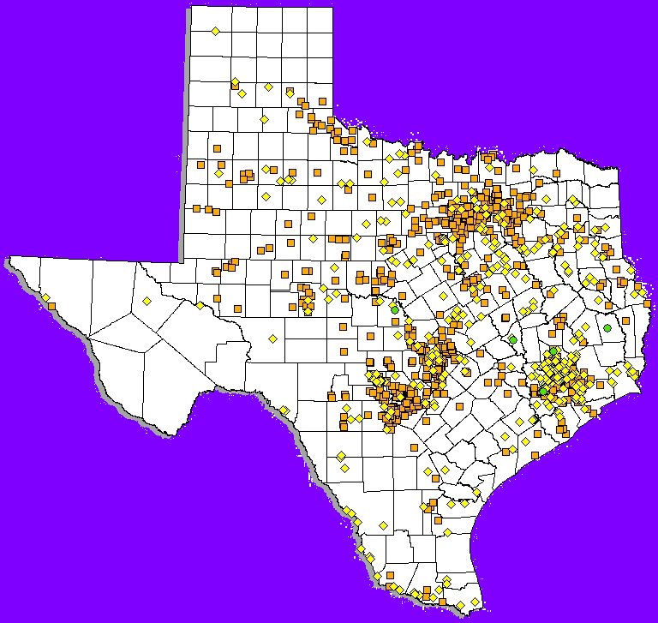
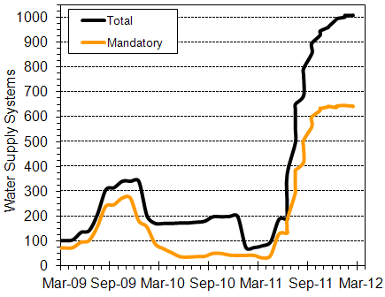

Public Water Supply Systems Affected by Drought
February 16, 2012
Total number of Community water systems affected: 1011
Total number of active Community water systems in Texas: 4715
RESOLVED (4)
WATCH – Voluntary (368)
WATCH – Mandatory (643)
http://www.tceq.state.tx.us/permitting/water_supply/pdw/trot/location.html

Slide 29
Outline
How drought impacts water supplies
Dang that drought last year was nasty!
What do we do to prepare for drought?
What will we do if the big one hits?
(Short-term) predictions…

Slide 30
Here a plan, there a plan, everywhere a plan plan!
Regional water plans
State water plan
Water conservation plans
Drought contingency plans
Drought preparedness plan
State emergency management plan

Slide 32


Slide 33
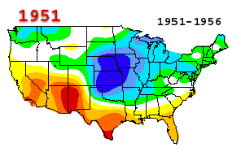
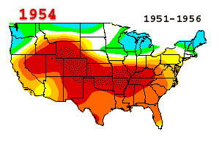
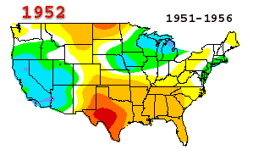
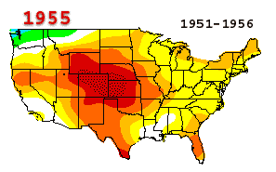

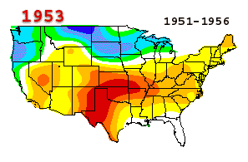
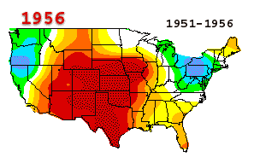
1950s
drought
NGDC/NOAA

Slide 34

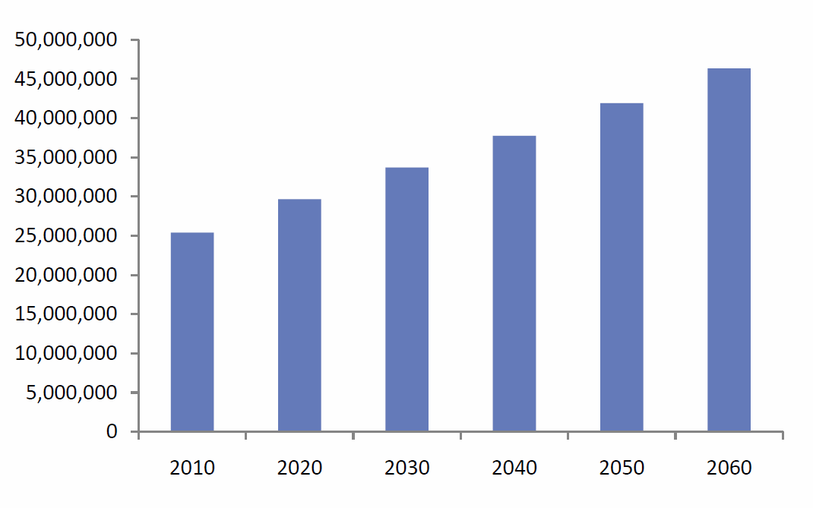
There will be more Texans…
Number of Texans
data from the 2011 regional water plans summary

Slide 35
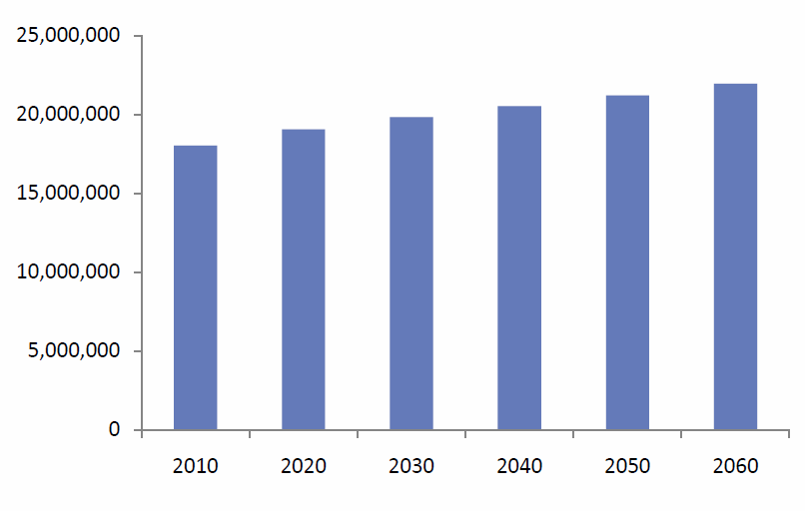
And they will be thirsty…
acre-feet of water demand
data from the 2011 regional water plans summary
Notes:
More water!
You might be surprised to see that although our population is projected to almost double over the next 50 years, our demand for water “only” goes up 22 percent, about 4 million acre-feet (and acre-foot = ~326,000 gallons)
Municipal use is, indeed, expected to almost double over the next 50 years, increasing from 4.5 million acre-feet per year to 7.7 million acre-feet per year;
however, agricultural use is about 60 percent of the state’s total water use, and it’s expected to decrease by 17 percent, from 10 million acre-feet per year to 8.3 acre-feet per year due in large part to the mining of groundwater from the Ogalalla Aquifer.

Slide 36
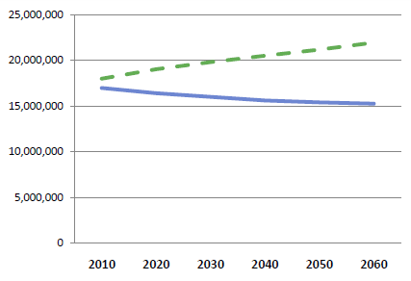
Are we ready for the next drought?
Demand for water
Water we have now
Acre-feet
nope…
Notes:
This graph shows our demand for water compared to water we have now under drought of record conditions.
So are we ready for the next drought of record?
[click] “nope…”
The bad news: we’re not ready. We’re not ready now, and we get less readier [sic] in the future.
Note: Water we have now is water with current infrastructure, i.e. no additional wells, reservoirs, pipelines, etc.
Note: Decreases in “Water we have now” are due primarily to mining water from the Ogalalla but also due to decreases in other aquifers and sedimentation of our reservoirs.

Slide 37
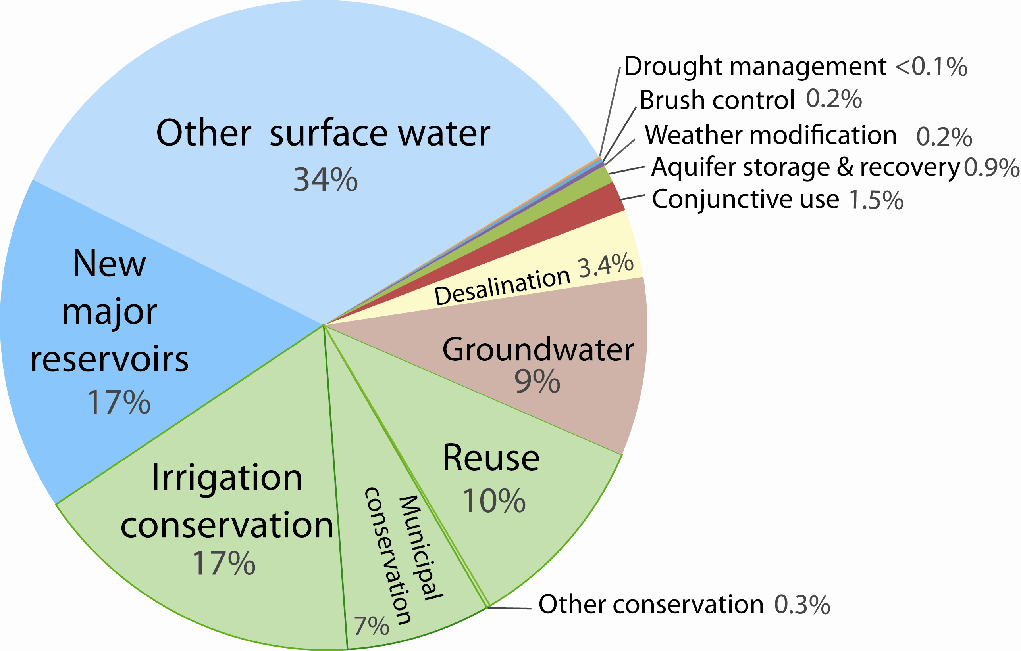
What can we do?
Water
Management
Strategies for
2060
data from the 2011 regional water plans summary
Notes:
The good news: we have a plan!
Through regional water planning, we’ve identified water management strategies to meet many of the water shortfalls (the plan meets all of the municipal shortfalls going forward, ).
This chart shows where that water might come from by 2060.
Background:
decreases in percentage going counter clockwise from top
Other surface water includes pipelines to existing reservoirs and renewal of contracts
Desalination include brackish groundwater (2%) and seawater desalination (1.4%)

Slide 38
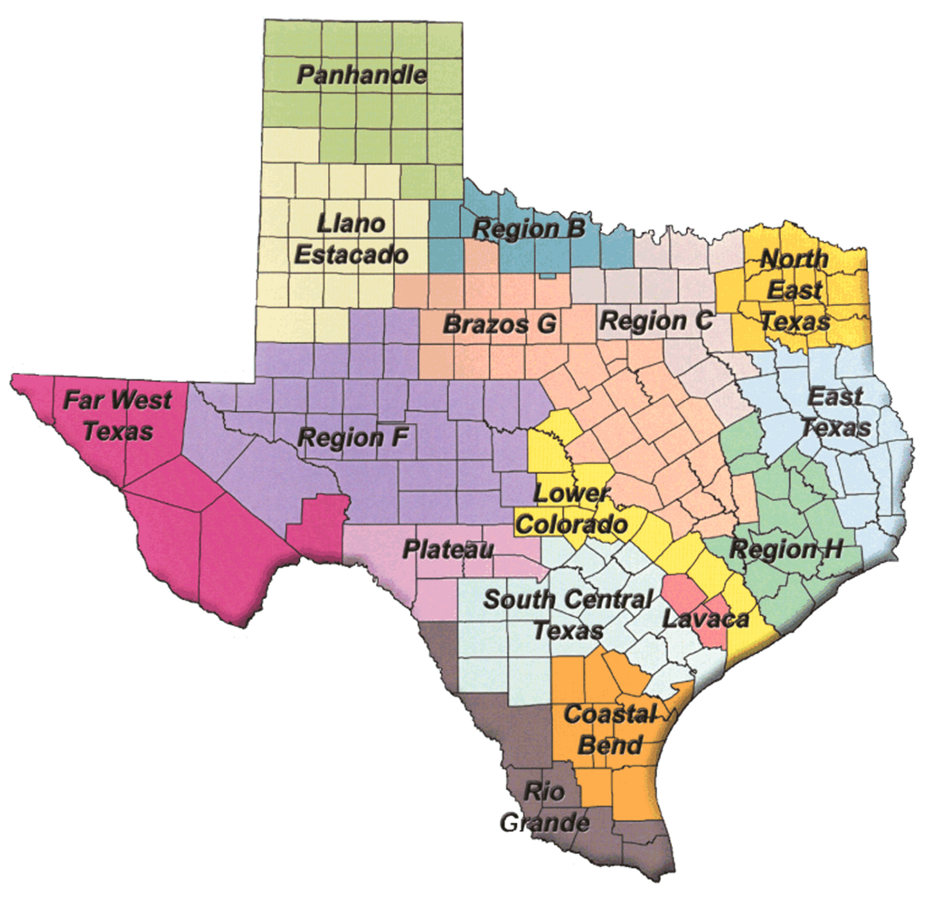

Cost?
billions and billions!
~ $53 billion
$46 billion to meet municipal needs
$27 billion from state to finance and
implement
$16 billion before 2020
$231 billion = total capital costs

Slide 39
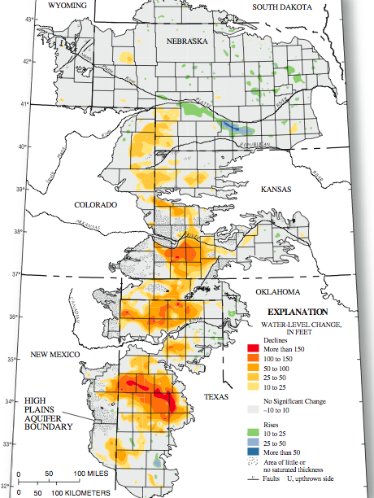
Unmet
Unmet needs…
2,500,000 acre-feet of unmet
needs in 2060
  2,460,000 acre-feet from
  irrigation
    2,100,000 acre-feet from
    Ogallala Aquifer
USGS
Notes:
Note that I said these strategies meet many of the water shortfalls.
Unfortunately, there are not strategies to meet all shortfalls, mostly in the ag sector.
This map shows total water level declines in the Ogallala aquifer.
99% of these declines are due to agricultural pumping.
40% of all water used in Texas comes from the Ogallala Aquifer!
Most of the unmet needs in 2060 (2.5 million acre-feet) are for agriculture (2.46 million acre-feet), and most of that unmet need is for the Ogallala (2.1 million acre-feet), and most of that (2.04 million acre-feet) in the southern part of the Ogallala south of Amarillo.
Ag requires cheap water; unless it’s heavily subsidized (and paid for by someone esle…), the cheap water is pretty much gone…
Like drought, the mining of water in the Ogallala is a creeping disaster: i.e. it is happening and will continue to happen slowly over time.
Farmers impacted will have to convert to dry-land farming or other uses of their land
The major groundwater district in the area (the High Plains GCD) has just instituted rules to require metering of all use and limits on production with the goal of extending the life of the aquifer.
Research is ongoing on developing drought tolerant crops and managing irrigation to maintain or increase yields while using less water.
Note: The Ogallala Aquifer south of Amarillo is very different than the aquifer east and northeast of Amarillo. The aquifer is much thinner to the south and therefore more susceptible to “drying up” (in parentheses because the aquifer doesn’t really dry up: it reaches a point where it is no longer economically viable for irrigated agriculture)
Note: There have been plans to bring the Mississippi and even water from Canada and Alaska (!!!) down to the High Plains of Texas to solve the water issues facing the Ogallala. Very expensive and very politically difficult.

Slide 40
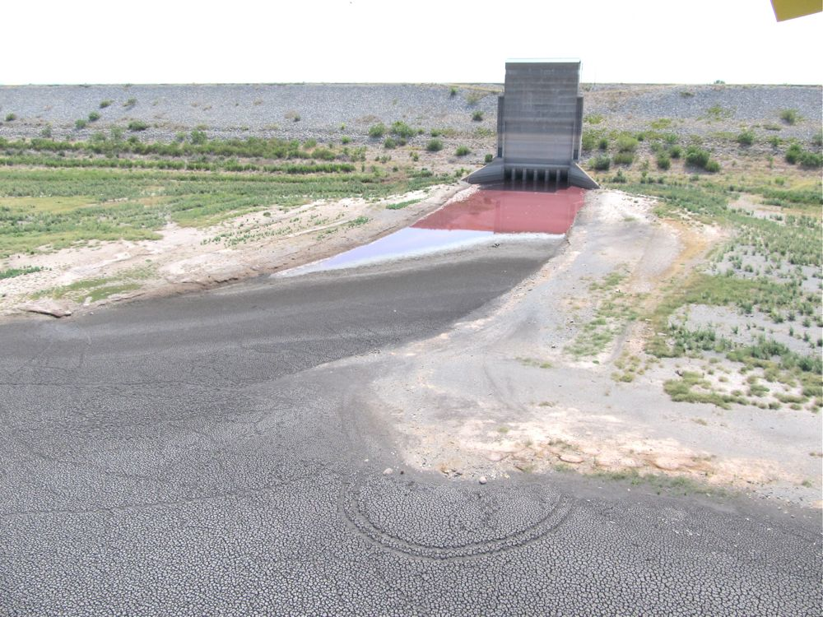
Challenges…
Funding implementation of the water plan
  People want water but they don’t want to pay
  for it…
Regulatory difficulties in moving water
  Surface water
  Groundwater
Protecting future reservoir sites
Implementing water conservation
Not being ready for the next drought…
Notes:
Funding implementation of the plan
People want water but they don’t want to pay for it
Difficult to convince folks to spend money now to get ready for a possible drought in the future
Oftentimes, once the drought it here, it’s too late
It takes decades to build a reservoir
Regulatory difficulties in moving water
Surface water
Junior
Interstate
Groundwater
“Overprotective” groundwater conservation districts (in quotes because it depends on your perspective…)
Protecting future reservoir sites
We lost Lake Fastrill, a potential supply to the Metroplex, over U.S. Fish & Wildlife’s designation of the area as a wildlife refuge
Implementing water conservation
People like their green St Augustine
Half of residential use is outdoor use
During a drought, we may to choose (and some communities are choosing now):
Water for the lawn or water for drinking?
Water for farmers or water for the lawn?

Slide 41
Outline
How drought impacts water supplies
Dang that drought last year was nasty!
What do we do to prepare for drought?
What will we do if the big one hits?
(Short-term) predictions…

Slide 42
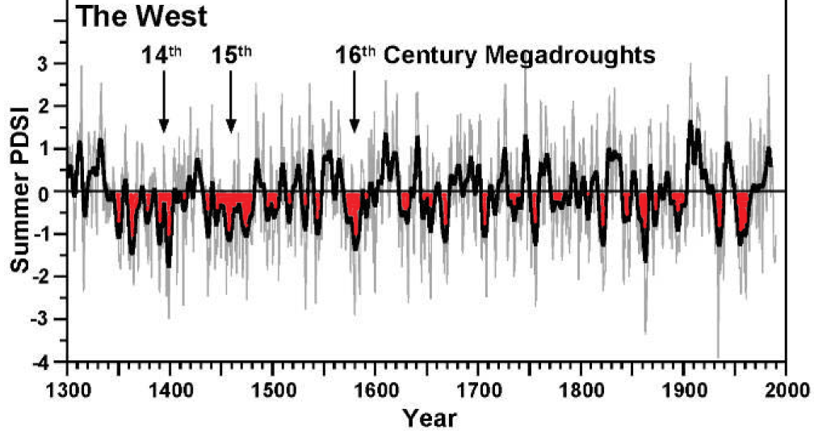
tree rings

Slide 43


Slide 46
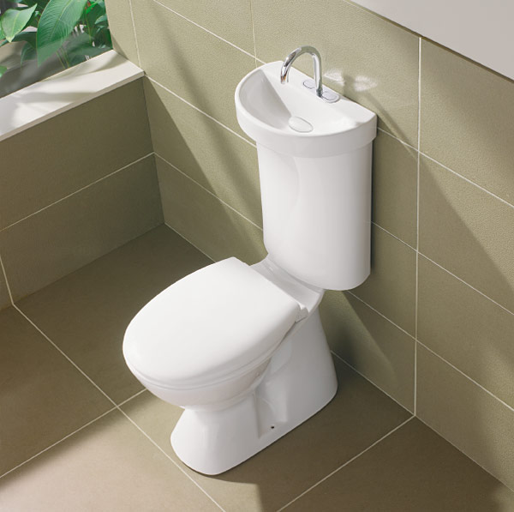
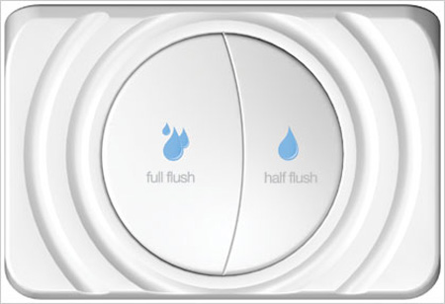
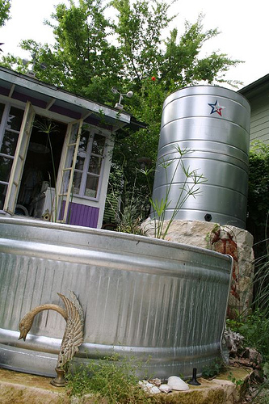
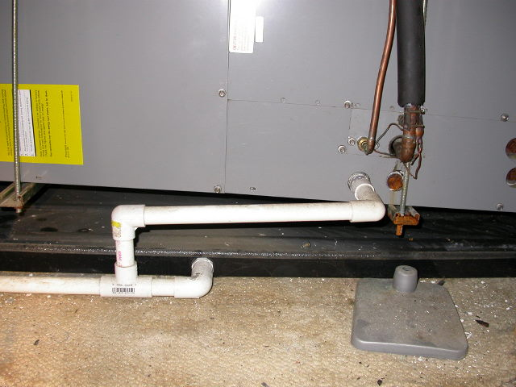
Advanced conservation

Slide 47
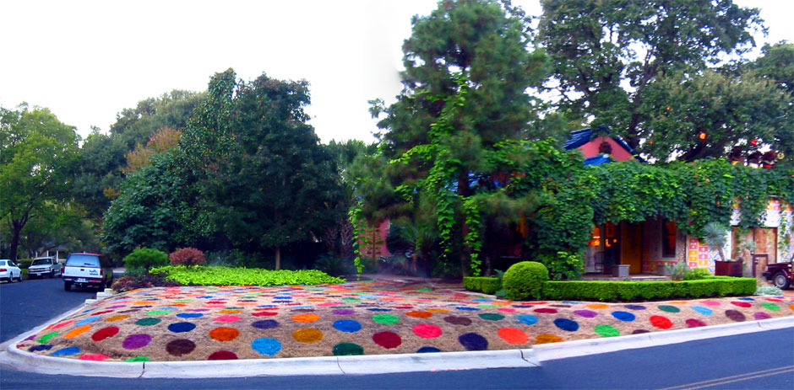

Slide 48
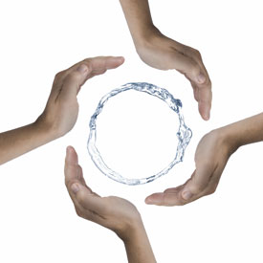


Slide 49
Major aquifers

Slide 50
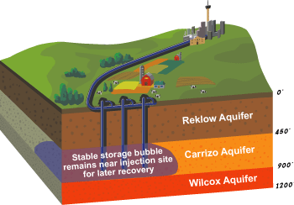

Slide 51


Slide 52
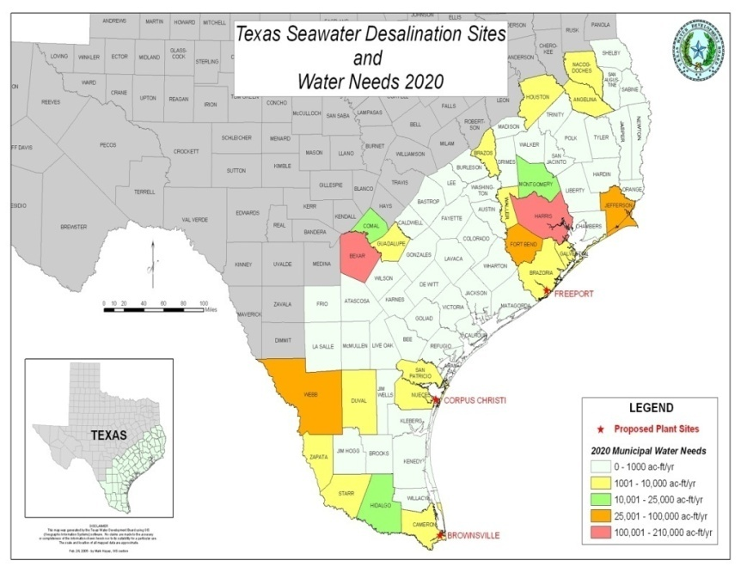

Slide 53
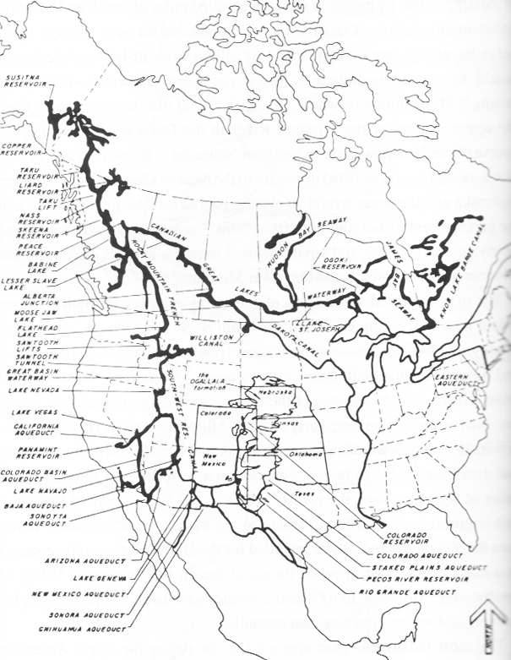
North American
Water and Power
Alliance
1965

Slide 54
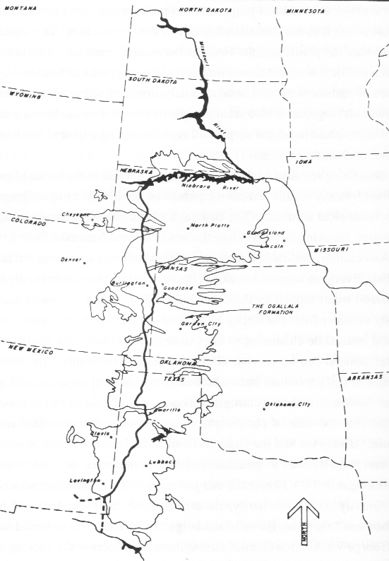
R.W. Beck
& Associates
1967

Slide 55
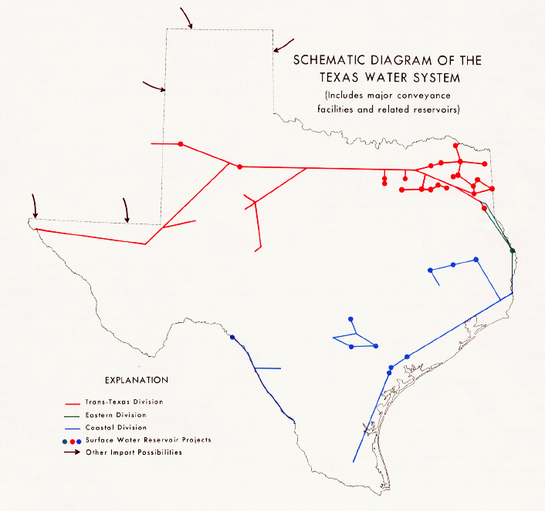
Texas Water
Development
Board
1968

Slide 56
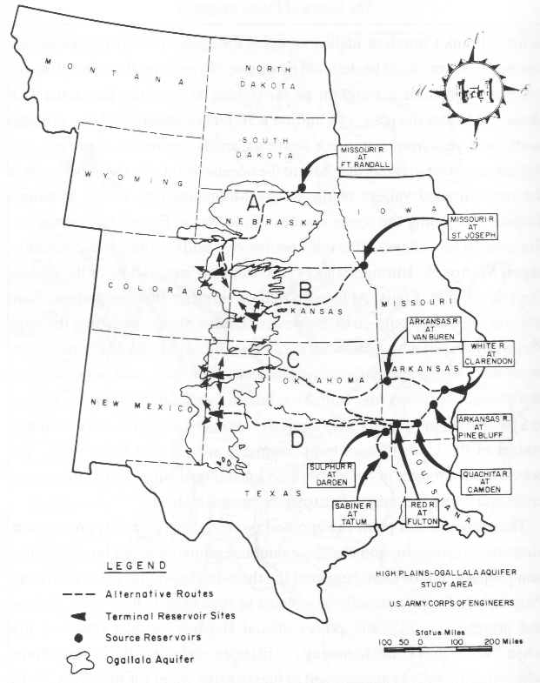
U.S. Army Corps
of Engineers
1982

Slide 57
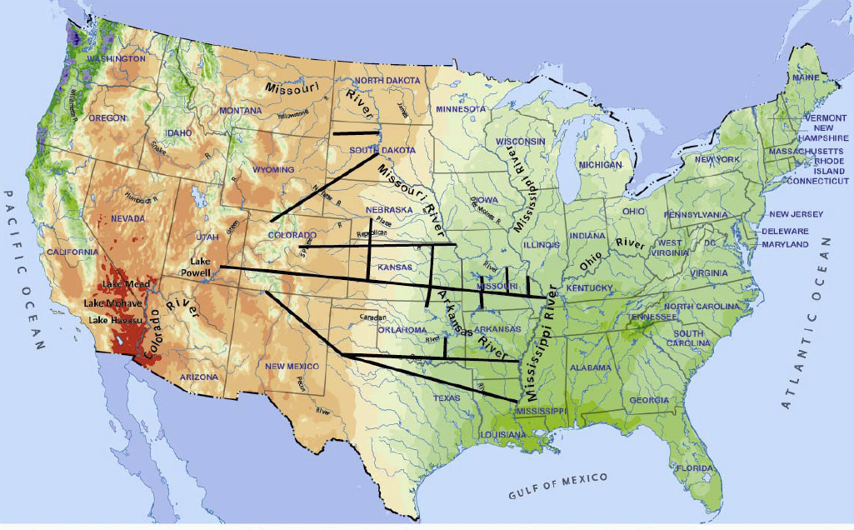
Lawrence Livermore National Laboratories 2009

Slide 58
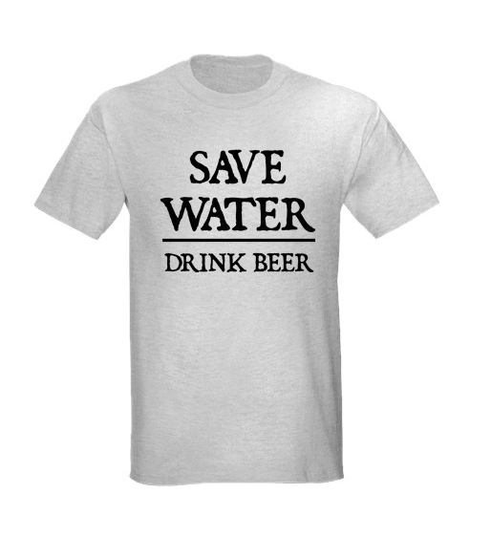

Slide 59
Water in the future…
The cost of water will go up
Water conservation will become more important
  Landscape watering
  Water loss
  Efficient fixtures
Water reuse will increase
Other sources of water (desal) will become more economically viable
Transfers from agriculture to municipal use

Slide 60
Outline
How drought impacts water supplies
Dang that drought last year was nasty!
What do we do to prepare for drought?
What will we do if the big one hits?
(Short-term) predictions…

Slide 62
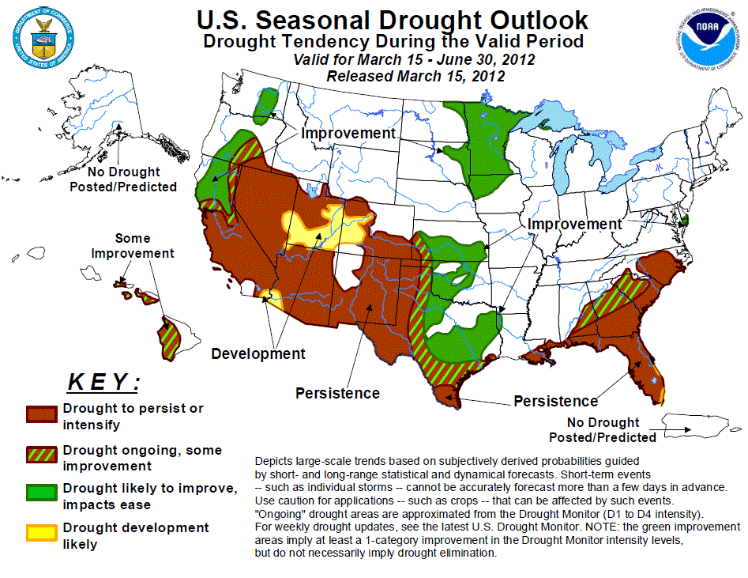

Slide 63
40% chance
of a third La Nina…

Slide 64
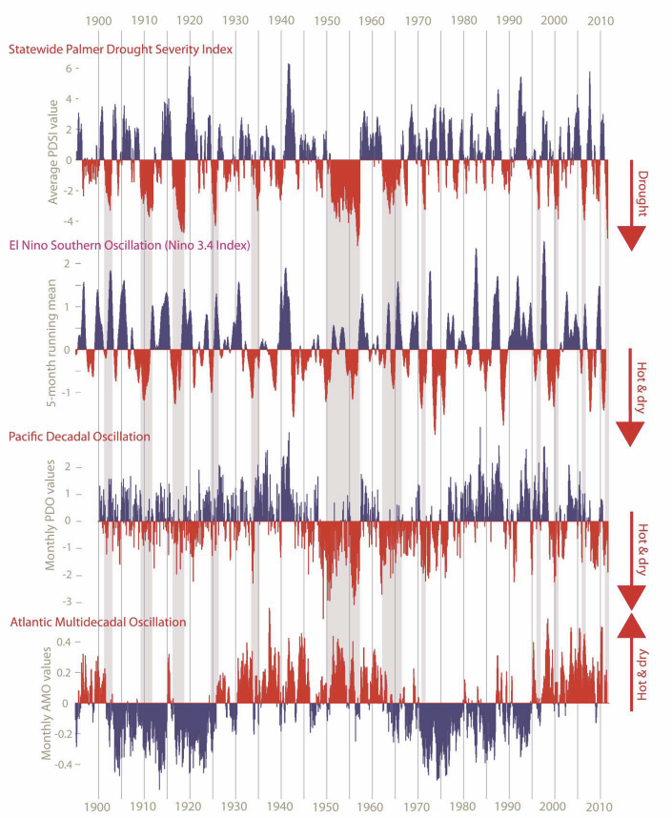

Slide 65


Robert E. Mace, Ph.D., P.G.
(512)936-0861
robert.mace@twdb.texas.gov
www.twdb.texas.gov

