Slide 1
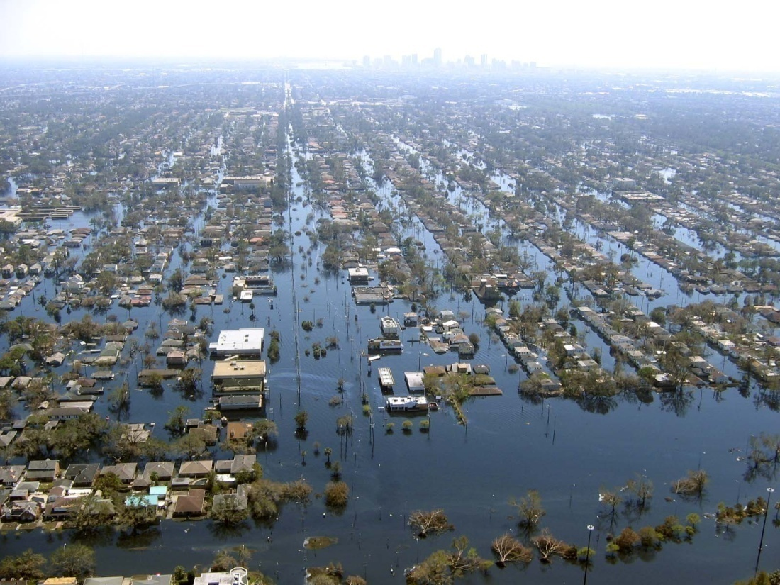
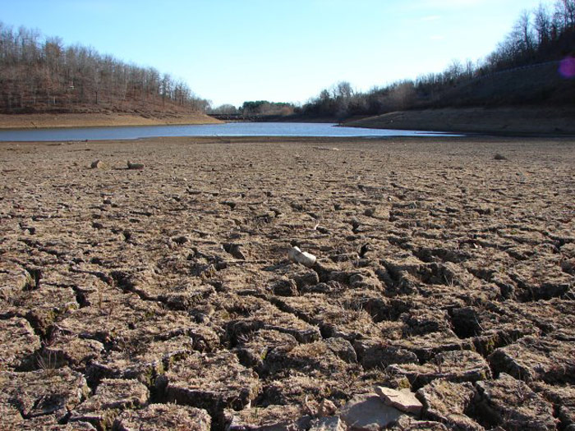
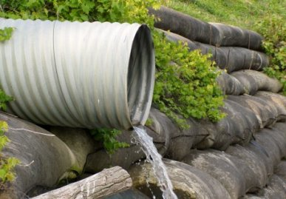
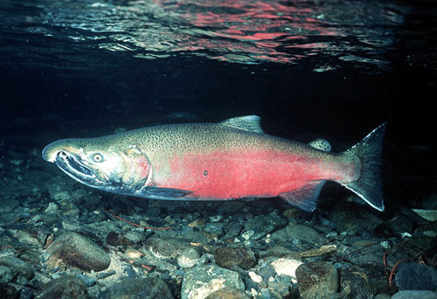
Too little water
Too much water
Water environment
Water quality

Slide 2
Texas Legislative Background
Freshwater inflow needs for bays & estuaries (1980s)
Senate Bill 1: water resource planning & management (1997)
Senate Bill 2: the science bill (2001)
Instream flow data collection and evaluation program
Methodologies to determine flow conditions in Texas rivers and streams necessary to support a sound ecological environment
Senate Bill 3: the implementation bill (2007)
The who, when, and how of eflow implementation in Texas
TCEQ must adopt the recommended standards by June 2011
Notes:
NOTES:

Slide 3
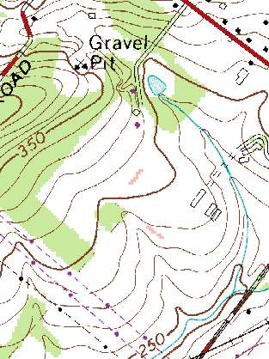
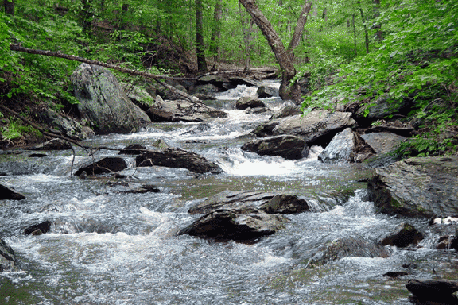
?
3D stream
Blue Line
The study of ecology requires (and adds) complexity and nuance
The real thing

Slide 4
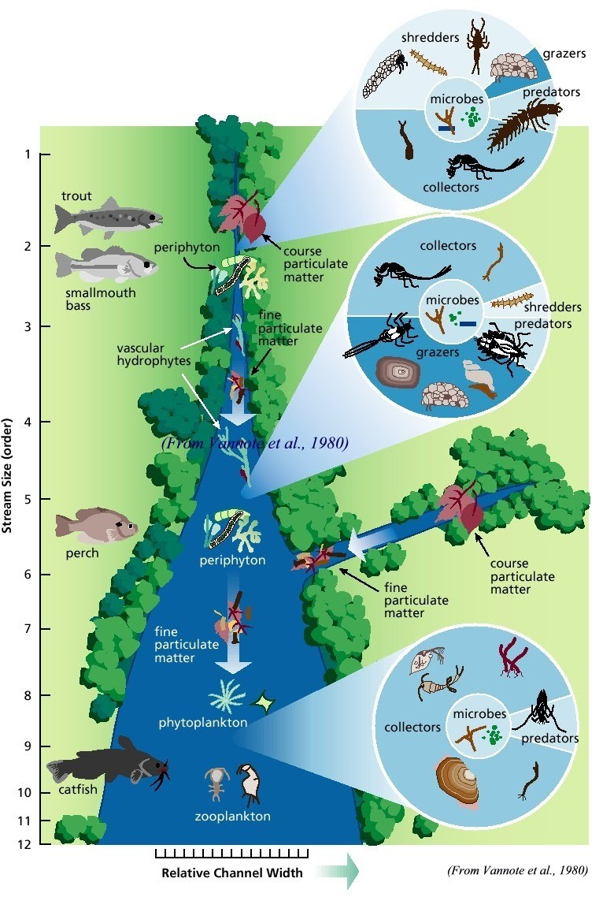
River Continuum Concept
Flow
Biota
Habitat

Slide 5
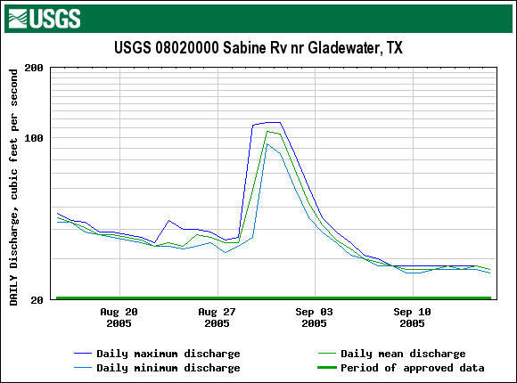
the natural flow regime
Rate of Change
Magnitude
Duration
Timing
Not depicted: frequency

Slide 6
flow components
(NRC 2005)

Slide 7
An example instream flow prescription

Slide 8
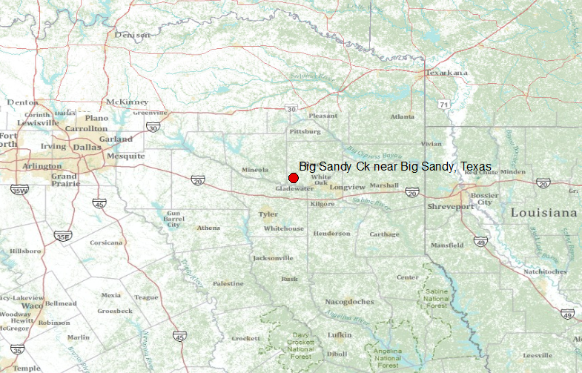
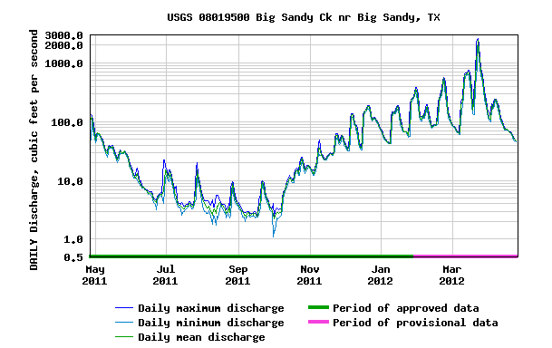
Big Sandy Creek near Big Sandy, Tx

Slide 9
An Environmental Flow Regime
USGS Gage 08019500, Big Sandy Creek near Big Sandy
Season | Subsistence | Base | Pulse
Winter | 20 cfs | 73 cfs | 1 per season Trigger: 358 cfs Volume: 5,932 af Duration: 10 days
Spring | 9 cfs | 33 cfs | 2 per season Trigger: 313 cfs Volume: 5,062 af Duration: 13 days
Summer | 8 cfs | 15 cfs | 1 per season Trigger: 50 cfs Volume: 671 af Duration: 6 days
Fall | 8 cfs | 22 cfs | 2 per season Trigger: 130 cfs Volume: 2,189 af Duration: 9 days
cfs = cubic feet per second , af = acre-feet
www.tceq.com

Slide 10
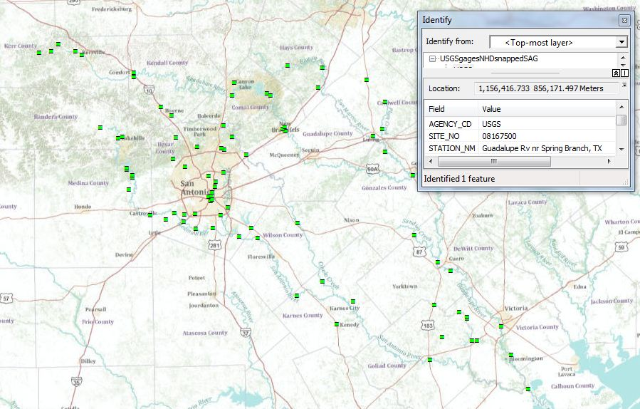
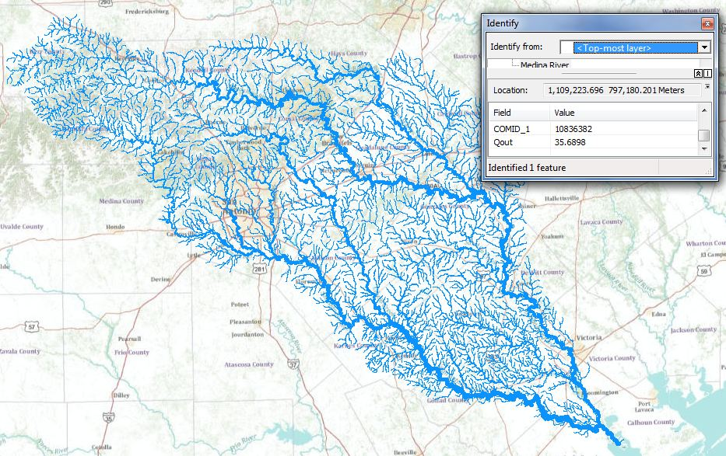
Data Sources
TCEQ Water Rights Points
USGS Gages
NHDPlus

Slide 11
Bringing the Data Together

Slide 12
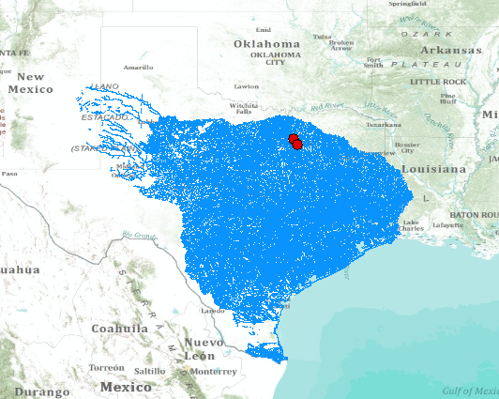
USGS Water Resources Region 12

Slide 13
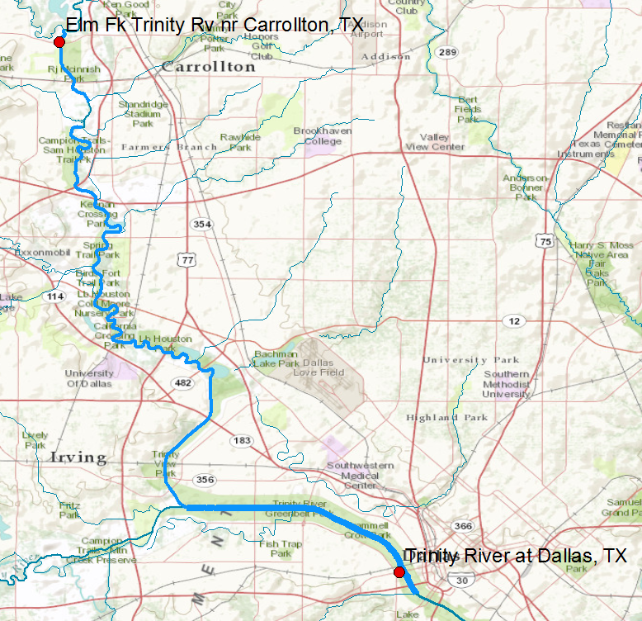
TCEQ’s Need Water Withdrawals Not Near Gages
How to assess the contribution of a withdrawal on a tributary to an environmental flow defined on the main stem river?

Slide 14
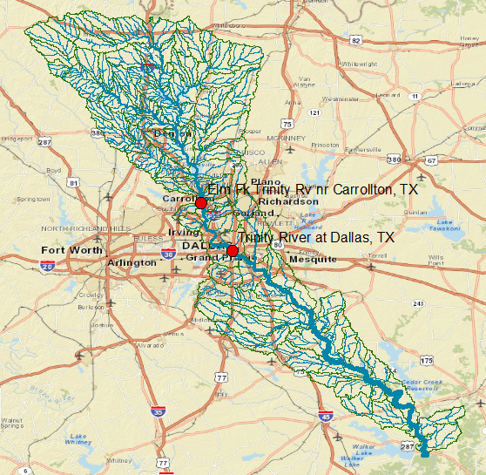
Gages on the Trinity River in the DFW Metroplex

Slide 15
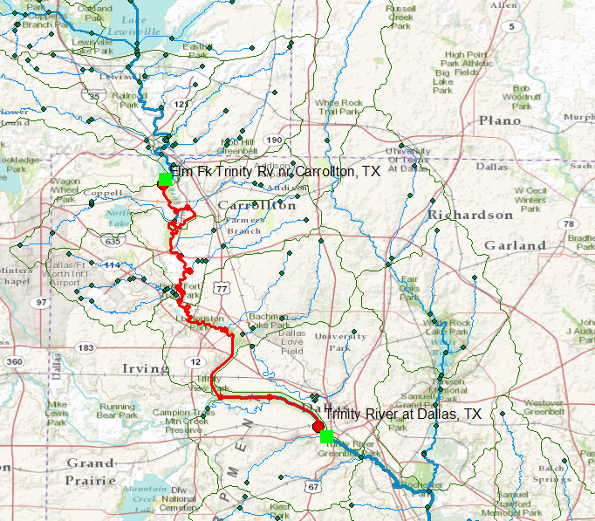
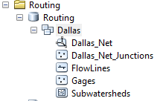
River Reach between Gages

Slide 16
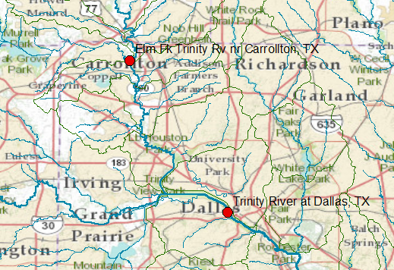
Trinity River Branches
Drainage Area = 2459 sq. miles
Elm Fork
Drainage Area = 6106 sq. miles
West Fork
Trinity River

Slide 17
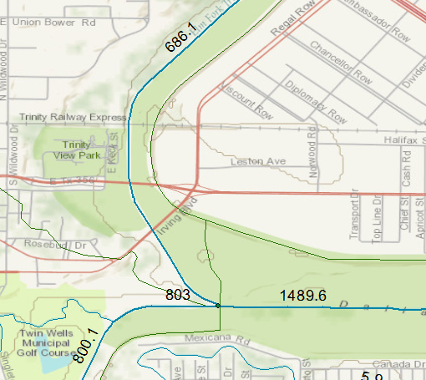
Mean Annual Flows
Elm Fork, 46% flow
West Fork, 54% flow
Trinity River

Slide 18
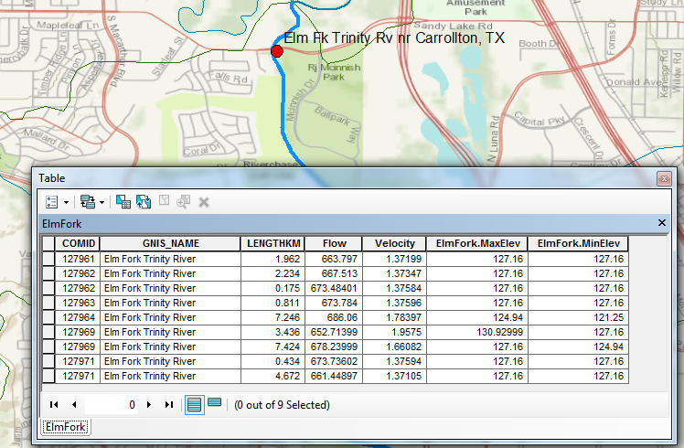
Elm Fork Attributes
Length = 28.39 km Mean Flow = 670 cfs Mean Velocity = 1.52 ft/sec
Max Elev = 130.93 m Min Elev = 121.25m Slope = 0.34m/km or 0.034%

Slide 19
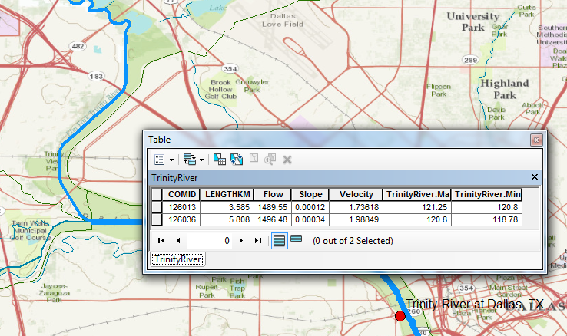
Trinity River Attributes
Length = 9.39 km Mean Flow = 1493 cfs Mean Velocity = 1.86 ft/sec
Max Elev = 121.25 m Min Elev = 118.78m Slope = 0.26m/km or 0.026%

Slide 20
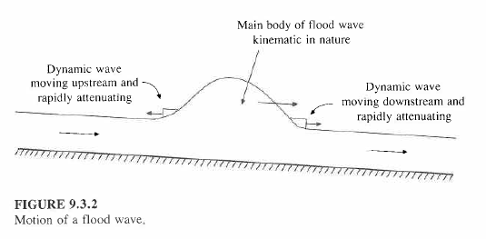
Kinematic and Dynamic Waves

Slide 21
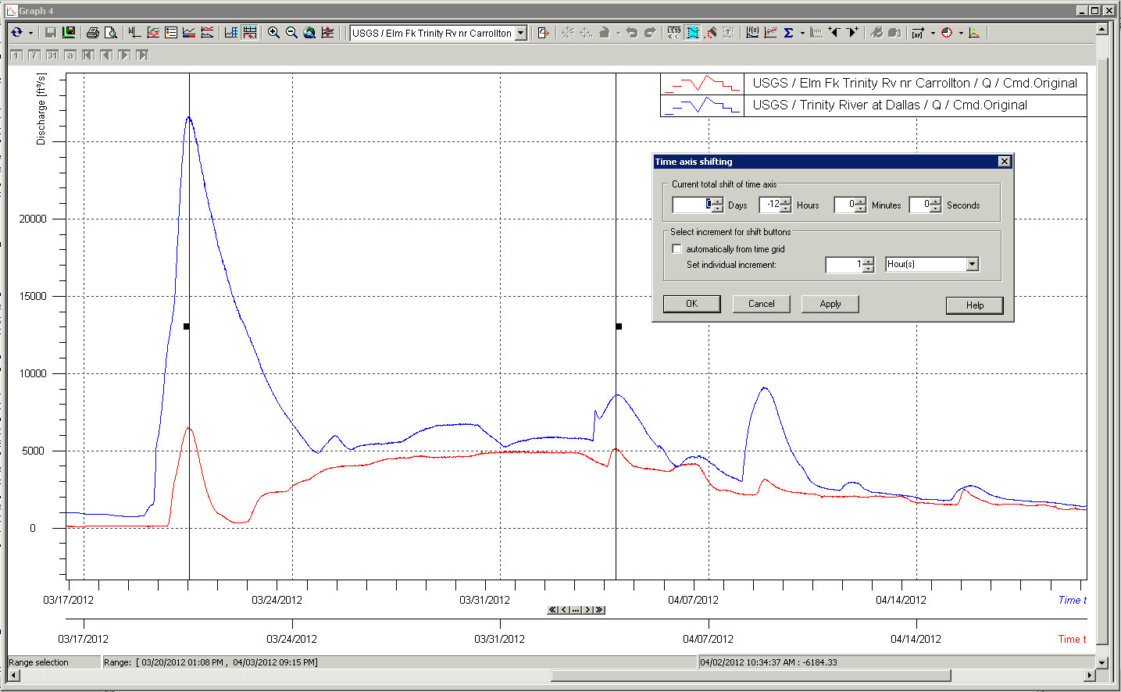
Finding Pulse Lag Times in WiSKI
12 Hours
Trinity River at Dallas
Elm Fork of Trinity River at Carrollton, 12 hours earlier
Two time scales
Image courtesy of Matt Ables, Kisters

Slide 22
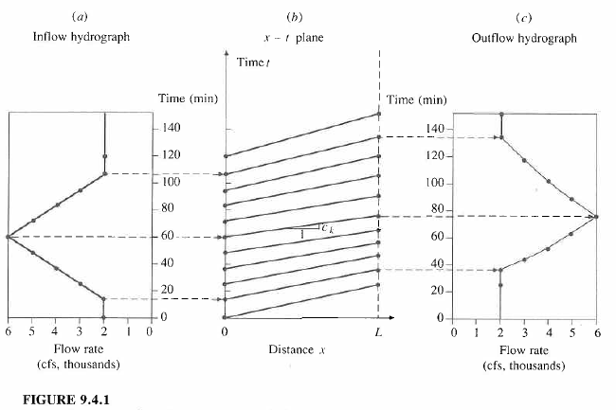
Analytical Solution of the Kinematic Wave

Slide 23
Wave Celerity vs. Flow Velocity
Wave celerity = 5/3 * flow velocity
 | Length (km) | Flow Velocity (ft/s) | Wave Celerity (ft/s) | Travel Time (hours)
Elm Fork | 28.39 | 1.52 | 2.53 | 10.23
Trinity | 9.39 | 1.86 | 3.10 | 2.76
 |  |  | TOTAL | 12.99
Good agreement between travel time based on kinematic wave celerity and that based on time series data comparisons in Wiski.

Slide 24
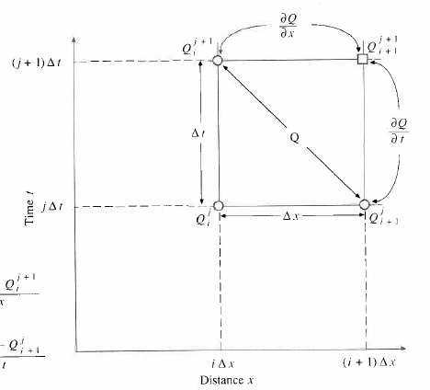
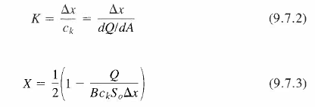
Muskingum-Cunge Method
Kinematic wave plus some dynamic wave effects

Slide 25
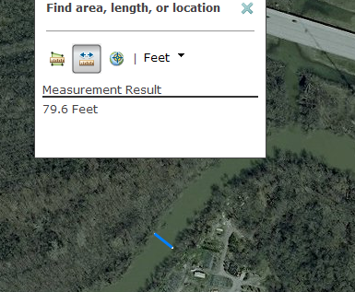
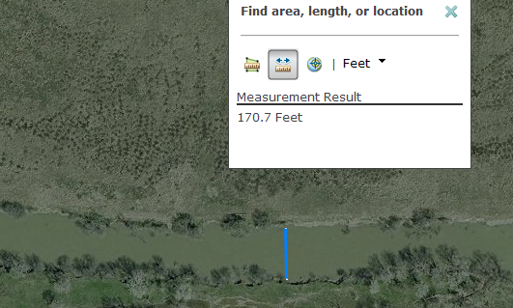
Muskingum-Cunge X Parameter
Using NHD Mean Annual Flow
 | Elm Fork near Carrollton | Trinity at Dallas
Q | 652.7 cfs | 1496.5 cfs
B | 80 ft | 170 ft
c_{k} | 2.53 ft/s | 3.10 ft/s
S₀ | 0.00034 ft/ft | 0.00026 ft/ft
Δx | 93143 ft | 30807 ft
X | 0.449 | 0.323
Using USGSMean Annual Flow
 | Elm Fork near Carrollton | Trinity at Dallas
Q | 841.7 cfs | 1804.3 cfs
B | 80 ft | 170 ft
c_{k} | 2.53 ft/s | 3.10 ft/s
S₀ | 0.00034 ft/ft | 0.00026 ft/ft
Δx | 93143 ft | 30807 ft
X | 0.434 | 0.286
Trinity River
Elm Fork

Slide 26
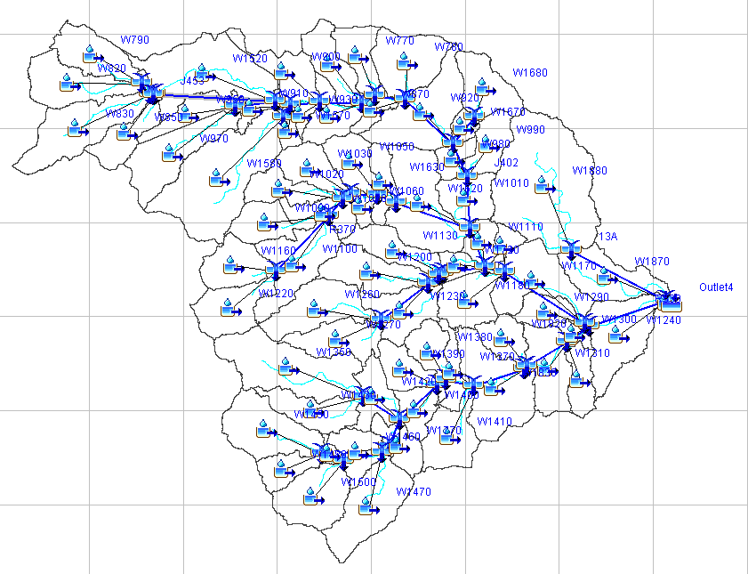
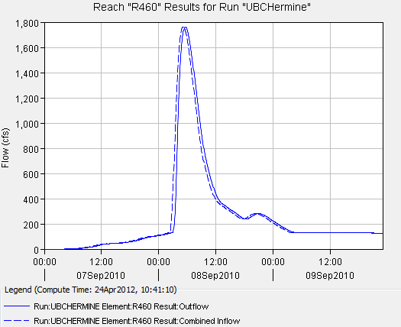
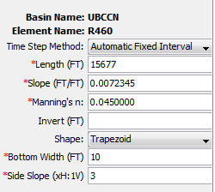
Muskingum-Cunge Method in HEC-HMS
HEC-HMS Model of Brushy Creek in Round Rock
HEC-HMS

