Slide 1
CE 397 Midterm Slides
Review Slides for the Midterm Exam
David Maidment
Spring 2015

Slide 2
What different things about observations do we need to exchange?
Observations and Measurements: Related entities & their associations (OGC AS Topic 20, ISO 19156)
But this is very abstract… we need to create a profile for unambiguous use in hydrologic applications…
GFI_Feature
1
+featureOfInterest
0..*
OM_Observation
GF_PropertyType
+
phenomenonTime
1
+
resultTime
+observedProperty
+
validTime [0..1]
+
resultQuality [0..*]
+
parameter [0..*]
0..*
1
+procedure
+result
OM_Process
Any

Slide 3
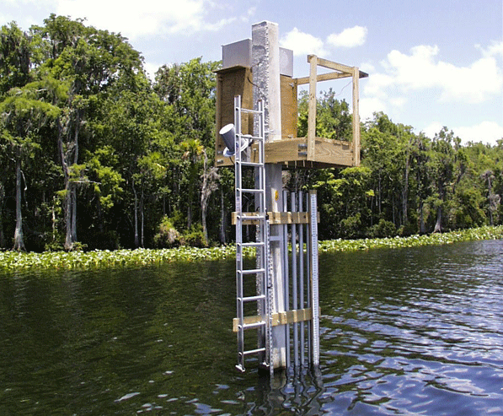
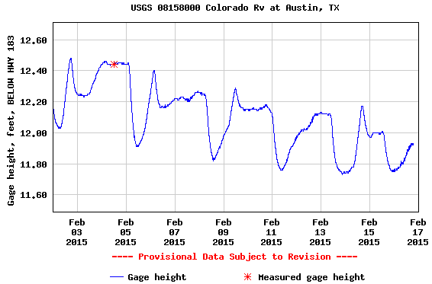
Using OGC O&M model for water level …
(WaterML2 Part 1)
GFI_Feature
Stream Gage
1
+featureOfInterest
sampling feature
River is a
sampled feature
0..*
Stage Height
OM_Observation
GF_PropertyType
+
phenomenonTime
1
+
resultTime
+observedProperty
+
validTime [0..1]
+
resultQuality [0..*]
+
parameter [0..*]
0..*
1
+procedure
+result
Time series of values
OM_Process
Any
Water level measurement
Source: USGS
An Observation is an action whose result is an estimate of the value of some property of the feature-of-interest, obtained using a specified procedure

Slide 4
Workflows
Flood Maps
8
Measured with water level recorder
Extent of inundation modeled in GIS
1
Stage Height
Stage Time Series
Measured with stream flow meter at a point in time
Apply rating curve to convert discharge to stage height time series
7
2
Discharge Value
Rating Curve
Derived from stage vs. discharge measurements over time at cross-section
Produced by hydraulic models & associated with cross-sections
6
3
Rating Curve
Discharge Time Series
Apply rating curve to convert stage height to discharge time series
Modeled by NFIE-Hydro for every NHDPlus Reach
5
4
Discharge Time Series
Typical Case
Flood Forecasting

Slide 5
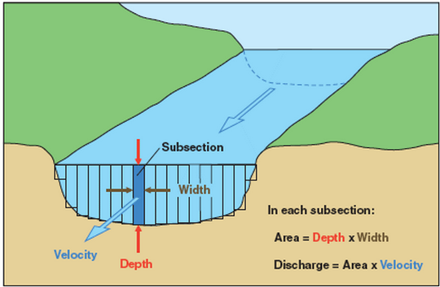
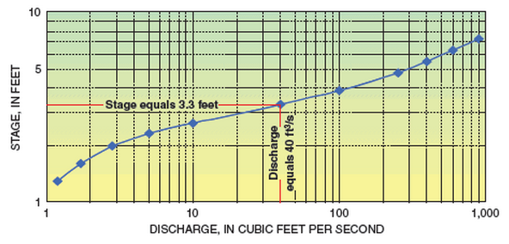
Treating rating curves as a measurement …
(WaterML2 Part 2)
GFI_Feature
Gage Location
1
+featureOfInterest
sampling feature
(Stage, Discharge) pair
0..*
OM_Observation
GF_PropertyType
+
phenomenonTime
1
+
resultTime
+observedProperty
+
validTime [0..1]
+
resultQuality [0..*]
+
parameter [0..*]
0..*
1
+procedure
+result
OM_Process
Any
(Stage, Discharge) tuples
Observation or Conversion Method
Source: USGS
An Observation is an action whose result is an estimate of the value of some property of the feature-of-interest, obtained using a specified procedure
Notes:
Rating curves are developed on infrequent, as-needed basis, by taking direct measurements of depth and flow, and plotting the curve from this data. The curve is then used to convert real-time measurements of depth into real-time values of discharge.
The object of WaterML 2.0 Part 2 is to apply the OGC O&M conceptual model and WaterML XML schema to convey the set of (stage, discharge) values.
Source: http://water.usgs.gov/edu/measureflow.html
See also: OGC 13-021r3 WaterML 2.0 – Part 2.

Slide 6
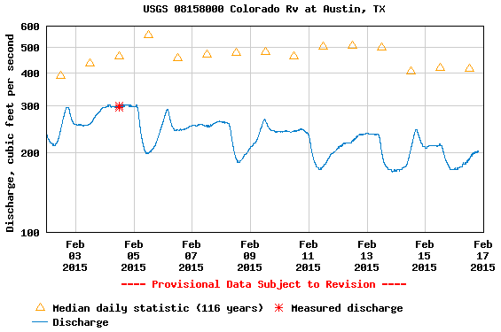
The stream flow can then be determined from the rating curve
(WaterML2 Part 1)
GFI_Feature
Stream Gage
1
+featureOfInterest
sampling feature
River is a
sampled feature
0..*
Discharge
OM_Observation
GF_PropertyType
+
phenomenonTime
1
+
resultTime
+observedProperty
+
validTime [0..1]
+
resultQuality [0..*]
+
parameter [0..*]
0..*
1
+procedure
+result
Time series of values
OM_Process
Any
Flow rate conversion
Source: USGS
An Observation is an action whose result is an estimate of the value of some property of the feature-of-interest, obtained using a specified procedure
Notes:
Graph source: http://waterdata.usgs.gov/nwis/uv?cb_00060=on&cb_00065=on&cb_00065=on&format=gif_default&site_no=08158000&period=&begin_date=2015-02-02&end_date=2015-02-16

Slide 7
Workflows
Flood Maps
8
Measured with water level recorder
Extent of inundation modeled in GIS
1
Stage Height
Stage Time Series
Measured with stream flow meter at a point in time
Apply rating curve to convert discharge to stage height time series
7
2
Discharge Value
Rating Curve
Derived from stage vs. discharge measurements over time at cross-section
Produced by hydraulic models & associated with cross-sections
6
3
Rating Curve
Discharge Time Series
Apply rating curve to convert stage height to discharge time series
Modeled by NFIE-Hydro for every NHDPlus Reach
5
4
Discharge Time Series
Typical Case
Flood Forecasting

Slide 8
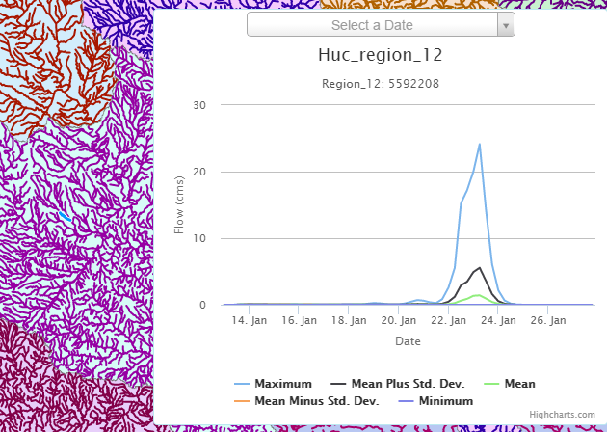
Ensemble Flow Forecast for Reach Catchment 5592208 made on Jan 13, 2015 (15 day horizon) Weather information source: European Center for Medium Range Weather Forecasting (ECMWF). Summary statistics compiled from 50 forecast hydrographs
Source: Jim Nelson, BYU

Slide 9
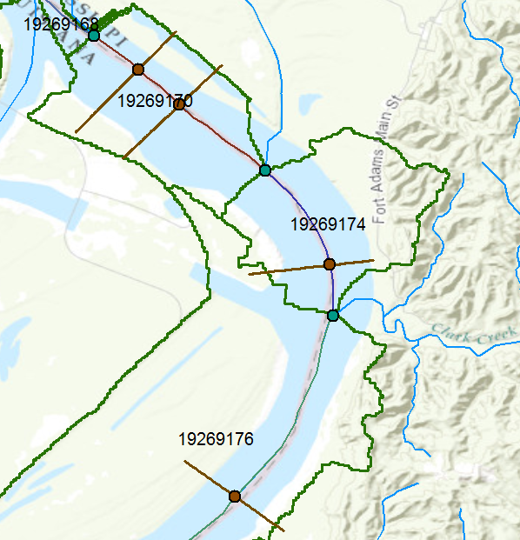
Going from discharge to stage height with simulated rating curves
Monitoring Point on x-section
GFI_Feature
1
+featureOfInterest
(Stage, Discharge) pair
sampling feature
0..*
OM_Observation
GF_PropertyType
+
phenomenonTime
1
+
resultTime
+observedProperty
+
validTime [0..1]
+
resultQuality [0..*]
+
parameter [0..*]
0..*
1
+procedure
+result
(Stage, Discharge) tuples
OM_Process
Any
Conversion Method
Source: USGS
An Observation is an action whose result is an estimate of the value of some property of the feature-of-interest, obtained using a specified procedure
Notes:
We already have rating curves at gages, and we can determine rating curves for any cross-section developed for hydraulic models.
That still doesn’t give us rating curves for all the NHDPlus reaches.
We can work from NED 10m, or LIDAR where available, to extract cross-sections where needed. Accuracy may vary!
Can then take a large-scale hydraulic model (SPRNT) to develop rating curves for all known cross-sections.

Slide 10
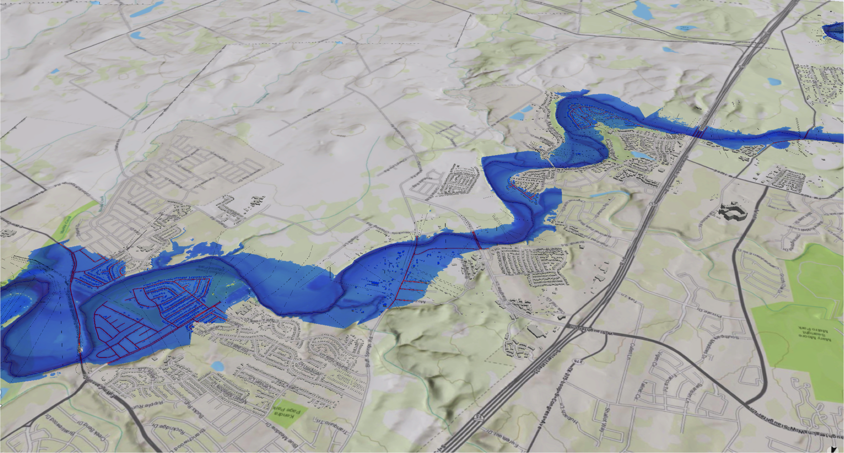
Flood Stage and Inundation

Slide 11
OGC/WMO Hydrology Domain Working Group
7+ Year International Effort – WaterML
(draft pending)
A time series for one variable at one location
Stage-Discharge values for one cross-section
WML2 Part 2 Ratings-Gaugings
Hydrology Domain Working Group formed
OGC at WMO Commission for Hydrology
Sensor Observation Service 2.0
Hydrology Profile
Best Practice
Memorandum of Understanding between the World Meteorological Organization and the Open Geospatial Consortium
Technical Meetings every 3 months
Five Interoperability Experiments (Surface water, groundwater, ratings-gaugings)
Annual week-long workshops
Involvement by many countries
2008
2009
2010
2011
2012
2013
2014
Acknowledgements: OGC, WMO, GRDC, NWS, CUAHSI, BoM/CSIRO, USGS, GSC, Kisters, …….
Notes:
(1) A four-year international effort has been undertaken to reconcile WaterML with international standards;
(2) This effort was initiated with the establishment of an Hydrology Domain Working Group by the Open Geospatial Consortium in September 2008;
(3) An OGC representative attended the WMO Congress of the Commission for Hydrology in 2008
(4) A formal agreement between Secretary General of WMO and President of OGC in 2009 to jointly develop standards for hydrology, climatology, oceanography and climatology;
(5) The joint OGC/WMO Hydrology Domain Working Group was supported by a large work effort, annual week-long workshops, four interoperability experiments for surface and groundwater data exchange, and participation by many countries;
(6) In June 2012, the OGC voted to adopt the revised version, WaterML2 as an international standard for exchange of water resources time series (the first such public standard that has existed);
(7) This Congress to the WMO Commission for Hydrology to whom I am speaking is considering WaterML2 for adoption as an official standard by WMO
(8) WaterML 2.0 Part 2 – Ratings and Gagings is ready for public comment, pending OGC approval to post.

Slide 12
What is Time? … on the web?
ISO 8601:2004[E] – Data elements and interchange formats – Information interchange – Representation of dates and times
Date and time values are ordered from the largest to smallest unit of time: year, month (or week), day, hour, minute, second, and fraction of second. This ordering corresponds to chronological order. This allows dates to be naturally sorted by computer file systems.
Each date and time value has a fixed number of digits that must be padded with leading zeros. (The “format template” in figure below will achieve this in Excel spreadsheets)
Two main formats – (1) a basic format with a minimal number of separators, or (2) an extended format with separators: hyphen between date values (year, month, week, and day) and colon between time values (hours, minutes, and seconds). Local time zone begins with + or – hours from UTC.
http://en.wikipedia.org/wiki/ISO_8601
Date and time expressed according to ISO 8601:
Format template: | yyyy-m-dTh:mm:ssZ
Date: | 2015-02-15
Date and time in UTC: … as Zulu: | 2015-02-15T19:39:11+00:00
 | 2015-02-15T19:39:11Z
Date & time in Austin: with Daylight Savings: | 2015-02-15T13:39:11-06:00 2015-02-15T14:39:11-05:00
Week: | 2015-W07
Ordinal date: | 2015-046

Slide 13
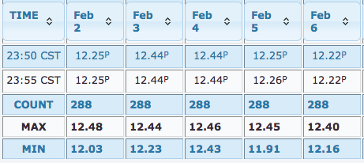
Time–Value Pairs: Building a time series for web exchange
How do you represent time series in a database?
Only precise instants are allowed.
<wml2:time>2015-02-02T23:55:00-06:00</wml2:time>
<wml2:value>12.25</wml2:value>
Notes:
Table source: http://waterdata.usgs.gov/nwis/uv?cb_00065=on&cb_00065=on&format=html&site_no=08158000&period=&begin_date=2015-02-02&end_date=2015-02-16
Graph source: http://waterdata.usgs.gov/nwis/uv?cb_00060=on&cb_00065=on&cb_00065=on&format=gif_default&site_no=08158000&period=&begin_date=2015-02-02&end_date=2015-02-16

Slide 14
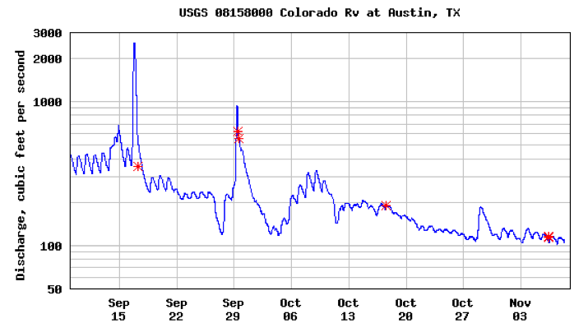
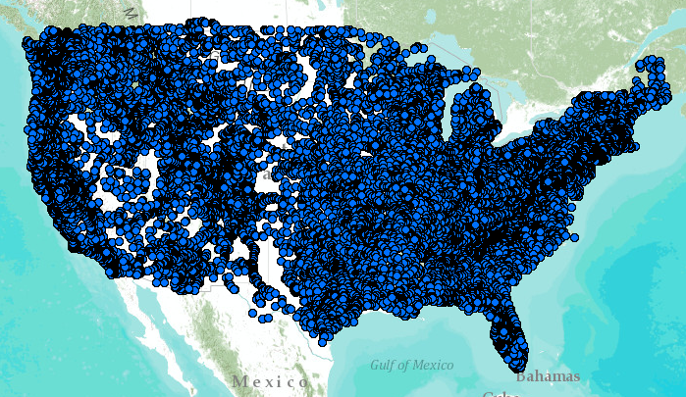
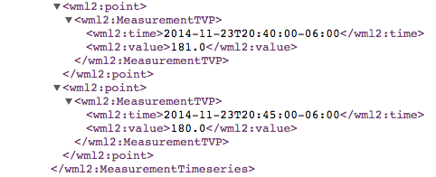
WaterML Web Services CUAHSI, USGS, OGC, WMO…
Water time series data on the internet
24/7/365 service
For daily and real-time data
. . . Operational water web services system for the United States
http://waterservices.usgs.gov/nwis/iv/?format=waterml,2.0&sites=08158000&period=P1D&parameterCd=00060
Notes:
Increasingly, national water data is being published using WaterML to describe time series of observations and model results. This is the current output from the US Geological Survey for one of their tens of thousands of river gauges (this one is on the Colorado River in Austin TX).

Slide 15
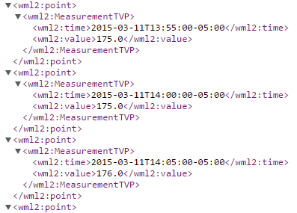
WaterML web services
http://waterservices.usgs.gov/nwis/iv/?format=waterml,2.0&sites=08158000&period=P14D&parameterCd=00060

