Slide 1
Data Integration to Support Water Modeling
David R. Maidment
Waterways Centre for Freshwater Research
University of Canterbury and Lincoln University
21 February 2018
This is Lecture 1 of a course WATR 404/604 presented to students of the
University of Canterbury and Lincoln University.
Dr Maidment’s visit to the Waterways Centre is supported by an Erskine Fellowship
from the University of Canterbury. The help of Jenny Webster-Brown, Julie Clark,
and Suellen Knopick of the Waterways Centre, and Joanne Noble-Nesbitt
of the Erskine Program, is gratefully acknowledged.

Slide 2
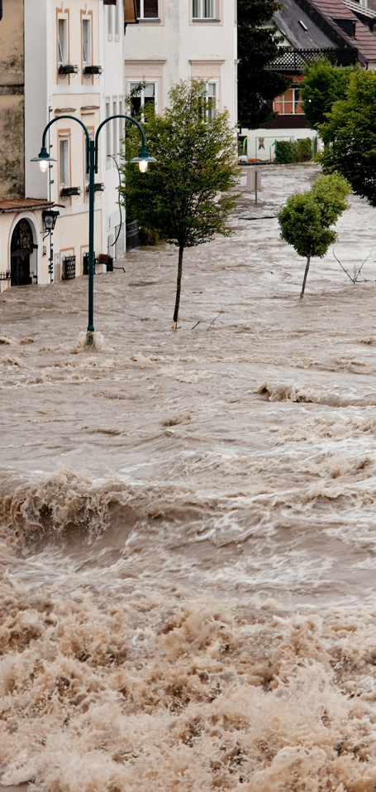
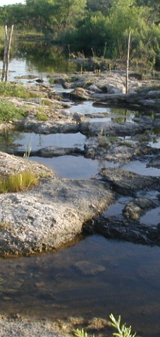
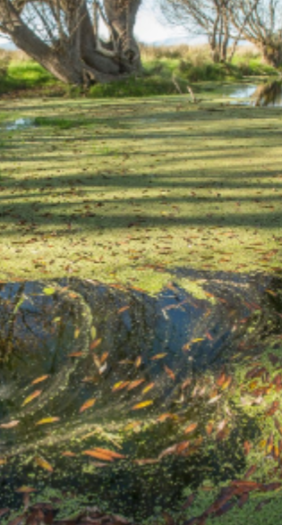
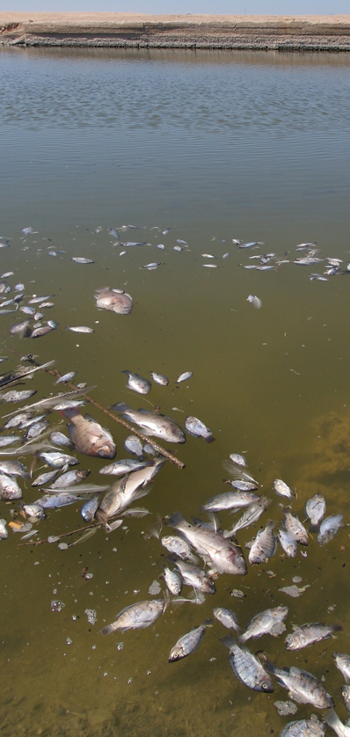
Four water problems to be solved
Flood
Drought
Water Pollution
Ecological Degradation
Notes:
There are four basic problems to be solved in natural water systems:
Flooding – how to characterize and mitigate floods
Droughts – how to assess water availability and define water supply
Dirty water – how to assess water quality assessment and calculate Total Maximum Daily Load estimates
Environmental Issues – how to ensure that there is enough water quantity and quality to support aquatic life?

Slide 3
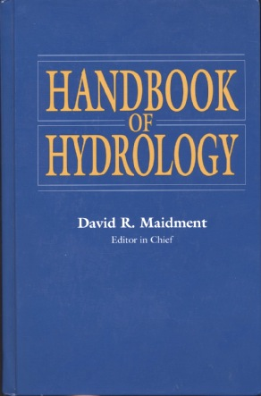
How is new knowledge discovered?
After completing a Handbook of Hydrology, I asked myself the question: how is new knowledge discovered in hydrology?
Deduction
from existing knowledge
By deduction from existing knowledge
By experiment in a laboratory
By observation of the natural environment
Experiment
in a laboratory
Observation
of the natural environment
Notes:
After completing a Handbook of Hydrology, I asked myself the question: how is new knowledge discovered in hydrology?
<Click> to show answers
By deduction from existing knowledge
By experiment in a laboratory
By observation of the natural environment

Slide 4
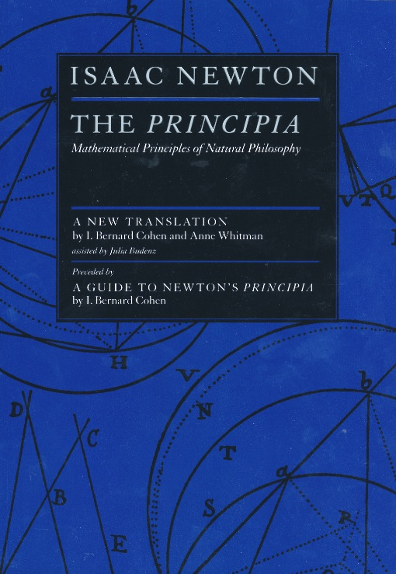
Deduction – Isaac Newton
“The ancients divided mechanics into two parts; the rational, which proceeds accurately by demonstration; and the practical.
It occurs that mechanics is so distinguished from geometry, that what is perfectly accurate is called geometrical, what is less so, is called mechanical. Yet the errors do not come from the art but from those who practice the art.
In this sense rational mechanics will be the science of motions resulting from any forces whatsoever, and of the forces required to produce any motions, accurately proposed and demonstrated.”
Isaac Newton
Trinity College, Cambridge
8 May, 1686

Slide 5
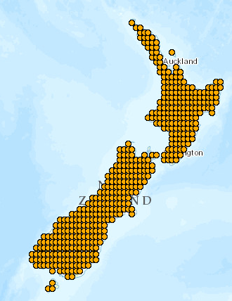
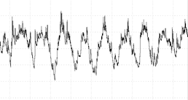
Computer Modeling as Deduction
Deduction
is the classical path of mathematical physics:
  Given a set of axioms
  Then by a logical process
  Derive a new principle or equation
Processes varying in
space and time
Computer Modeling
is a modern equivalent that says:
  Given a set of input data
  Then using an algorithm
  Derive a computational result
Space
Time

Slide 6

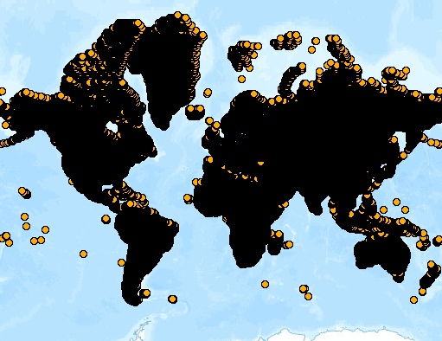
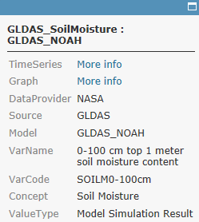
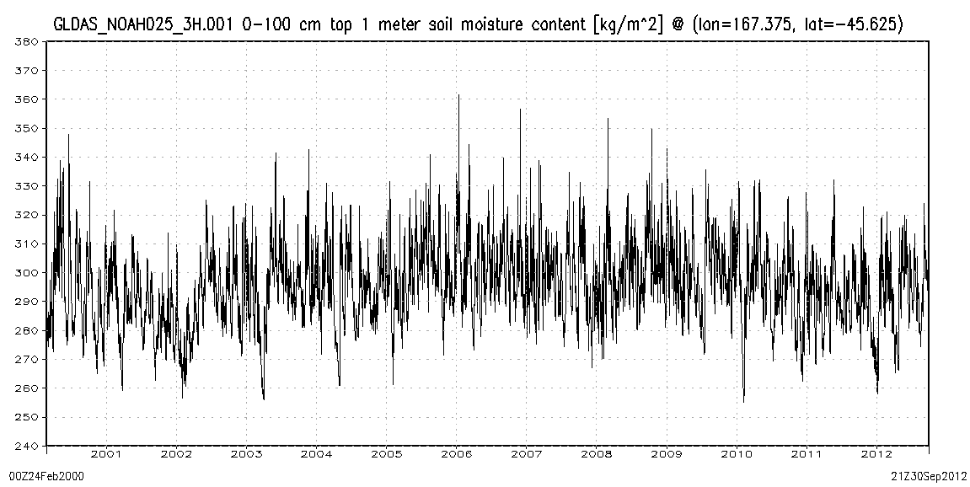
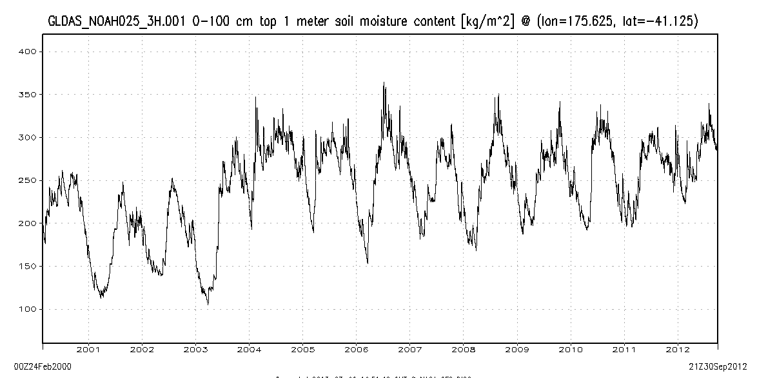
World Soil Moisture from the NASA Global Land Data Assimilation System (GLDAS)
Charts show 3-hourly variation at 37,000 locations of soil water content of the top 1m of soil
Popup on point links to data and chart
New Zealand
¼ x ¼ degree grid
A very wet region with little seasonality
A dryer region with significant seasonality

Slide 7
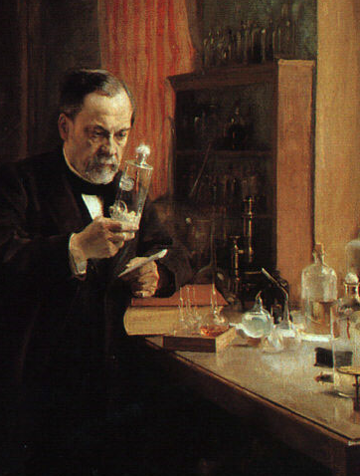
Experiment – Louis Pasteur
Experiment is the classical path of laboratory science – a simplified view of the natural world is replicated under controlled conditions
Pasteur showed that microorganisms cause disease and discovered vaccination
  a foundation of scientific medicine
Laboratory experiments are more for microscale than the macroscale
  hard to conduct at the global scale
Experiment – a simplified view of the natural world is replicated under controlled conditions
Pasteur showed that microorganisms cause disease and discovered vaccination
    a foundation of scientific medicine
Laboratory experiments are more for microscale than the macroscale
Important for water chemistry and microbiology
Notes:
Experiment is the classical path of laboratory science – a simplified view of the natural world is replicated under controlled conditions
Pasteur showed that microorganisms cause disease and discovered vaccination
a foundation of scientific medicine
Laboratory experiments are more for microscale than the macroscale
hard to conduct at the global scale

Slide 8
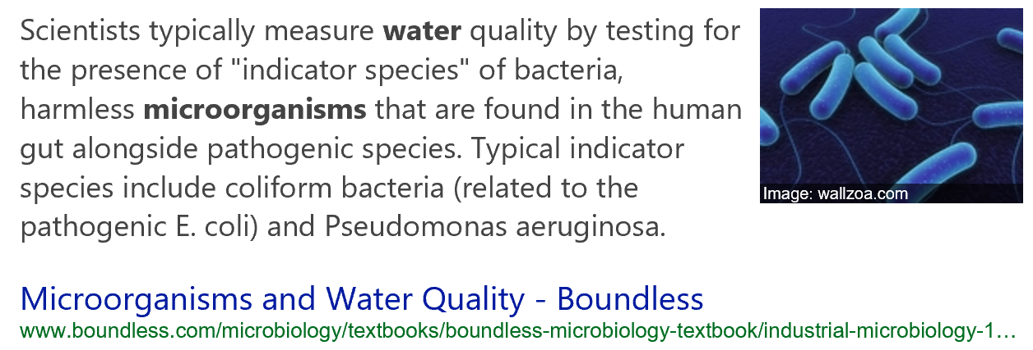
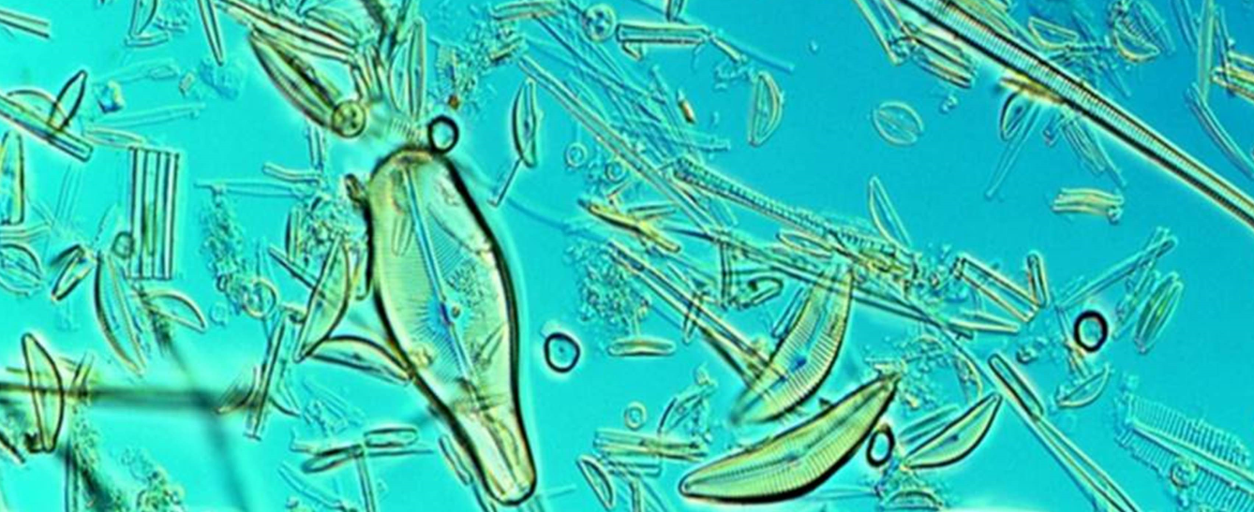
Microorganisms in Water

Slide 9
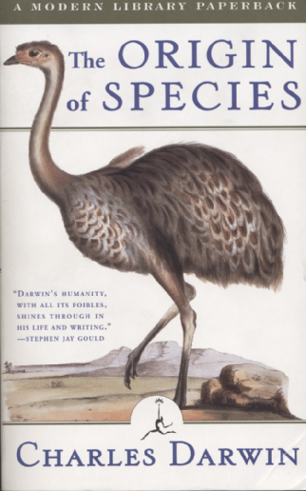
Observation – Charles Darwin
“When on board H.M.S. Beagle, as naturalist, I was much struck with certain facts in the distribution of the inhabitants of South America, and in the geological relations of the present to the past inhabitants of that continent. These facts seemed to me to throw some light on the origin of species -- that mystery of mysteries, as it has been called by one of our greatest philosophers. On my return home, it occurred to me, in 1837, that something might perhaps be made out on this question by patiently accumulating and reflecting on all sorts of facts which could possibly have any bearing on it.
I can here give only the general conclusions at which I have arrived, with a few facts in illustration, but which, I hope, in most cases will suffice.”
Published 24 November,1859
Most accessible book of great
scientific imagination ever written

Slide 10


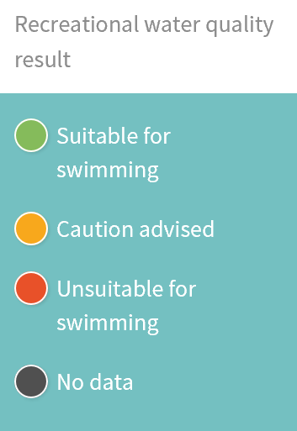
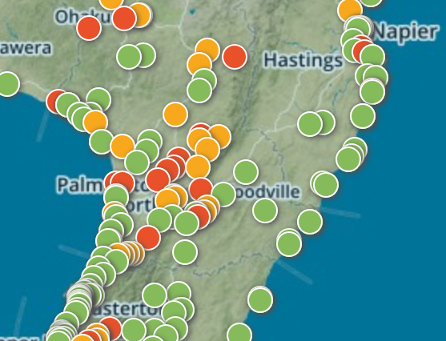
Land Air Water Aotearoa (LAWA)
Observations of Water Quality

Slide 11
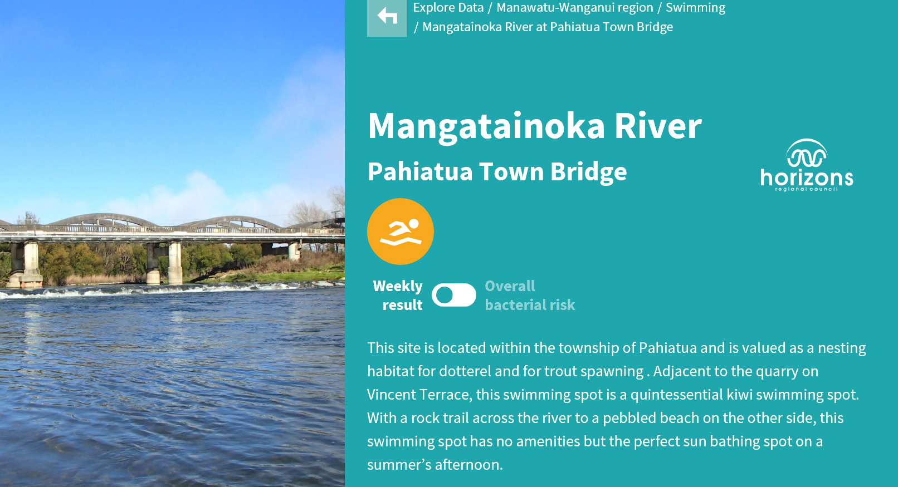
Mangatainoka River at Pahiatua Town Bridge
Can I swim here?
Caution Advised

Slide 12
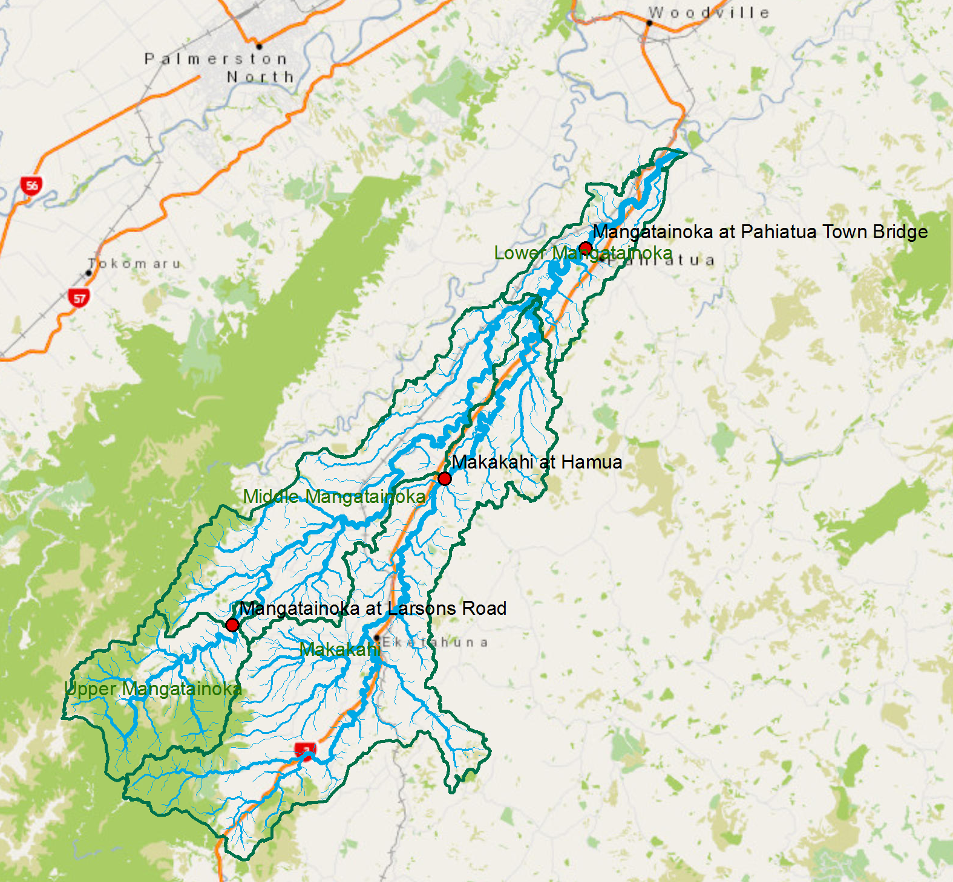
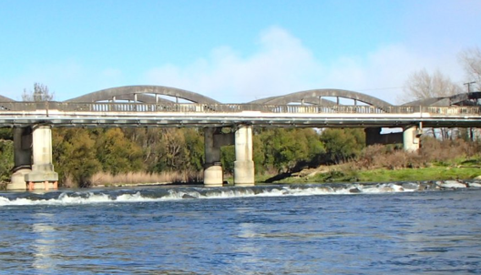
GIS Data for Mangatainoka Catchment
What is upstream of Pahiatua Town Bridge?

Slide 13
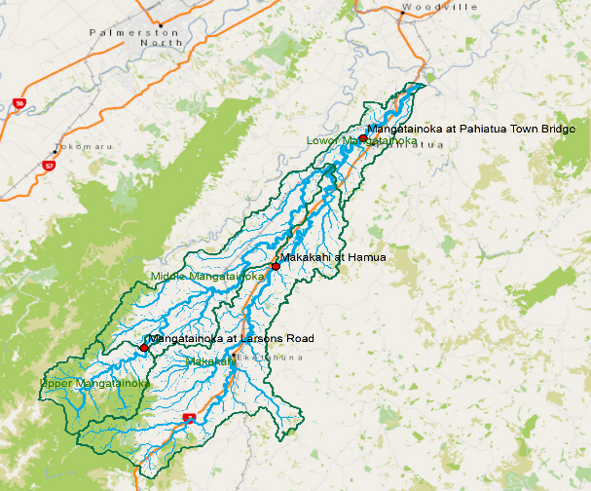
Data Integration to Support Water Modeling
Water Modelling
(space and time)
Geographic Information
Systems (space)
Observational Data
(time)

Slide 14
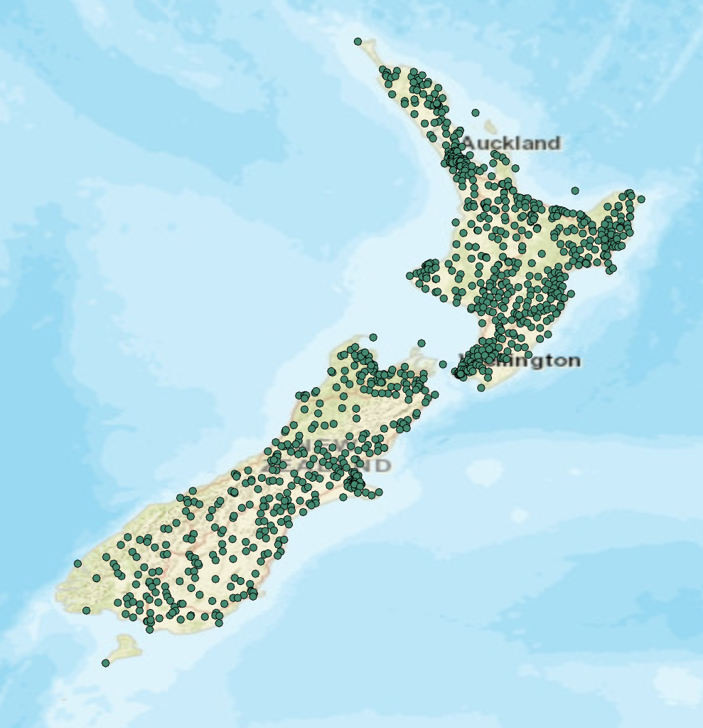
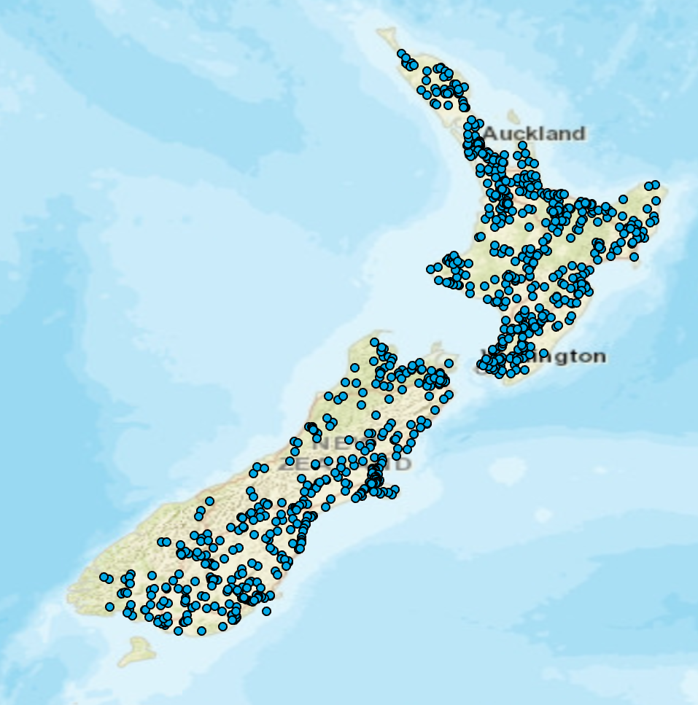
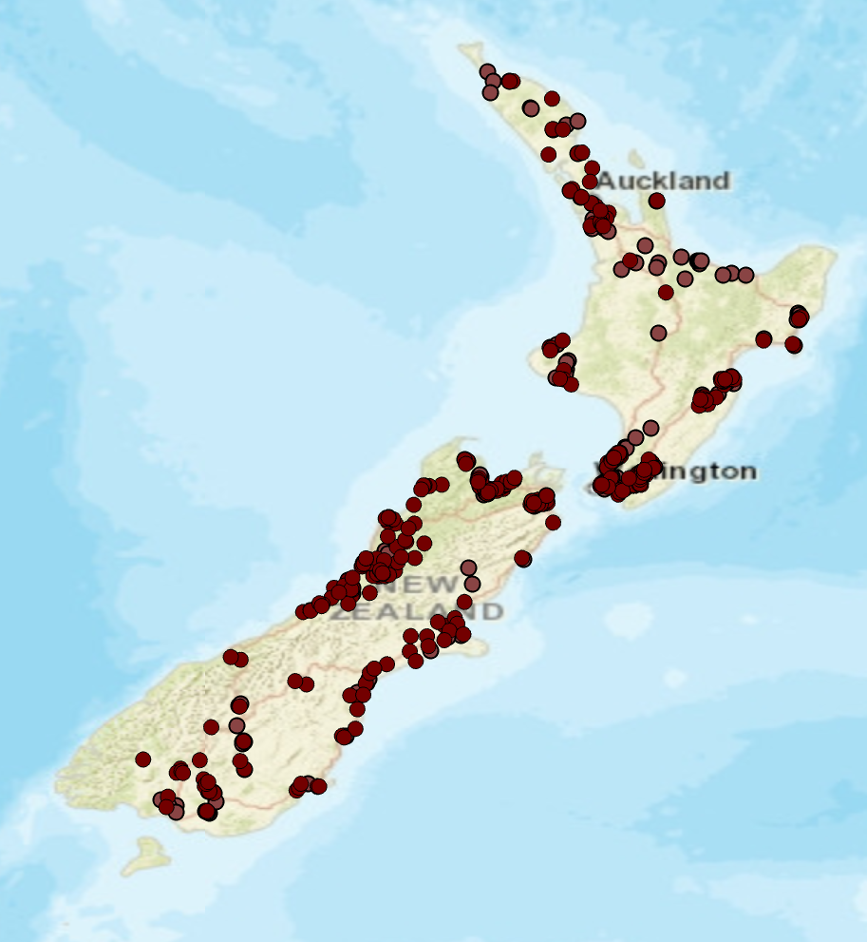

Core Observation Networks for Hydrology
Precipitation
Streamflow
Groundwater

Slide 15
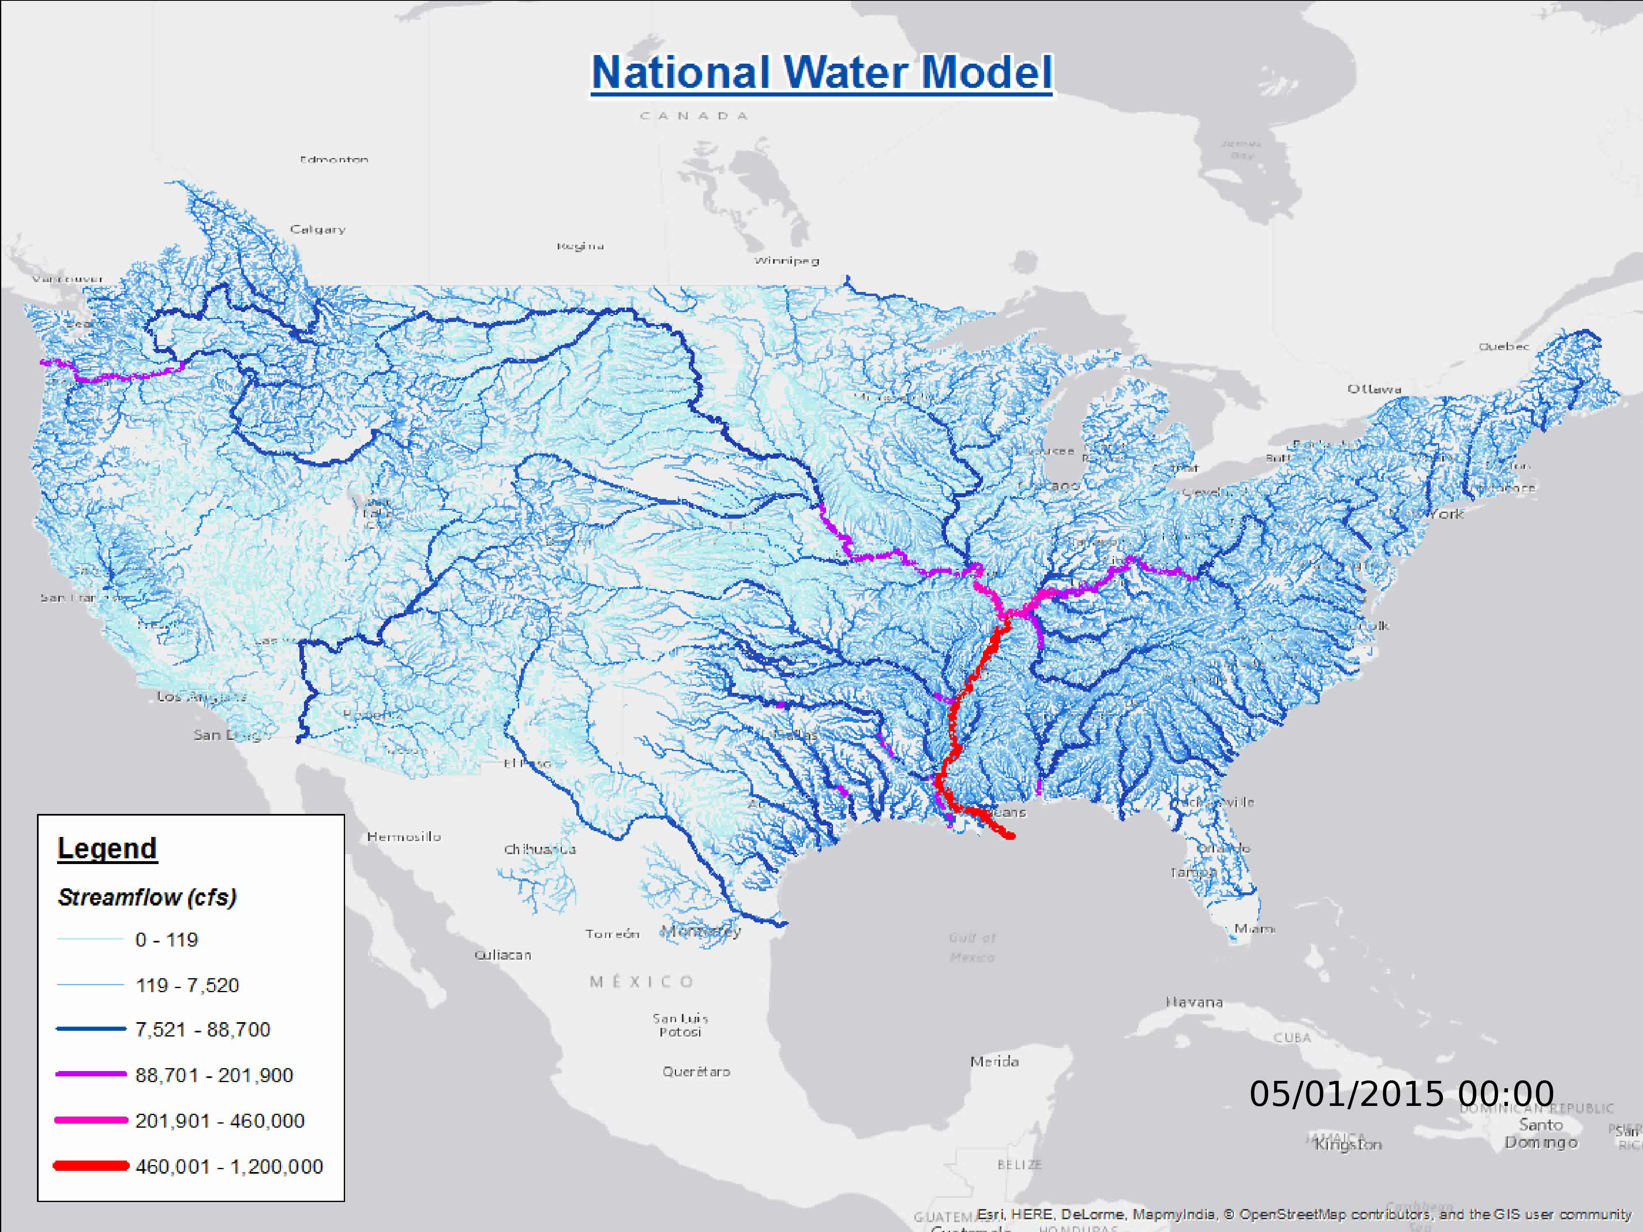
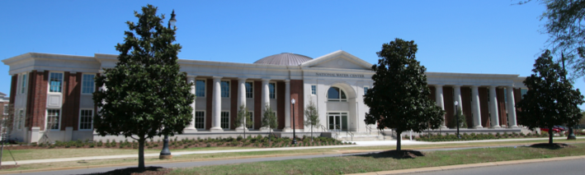
Became operational on 16 August 2016
2.7 million reaches covering 5.2 million Km of streams and rivers
National Water Center
Tuscaloosa, AL

Slide 16
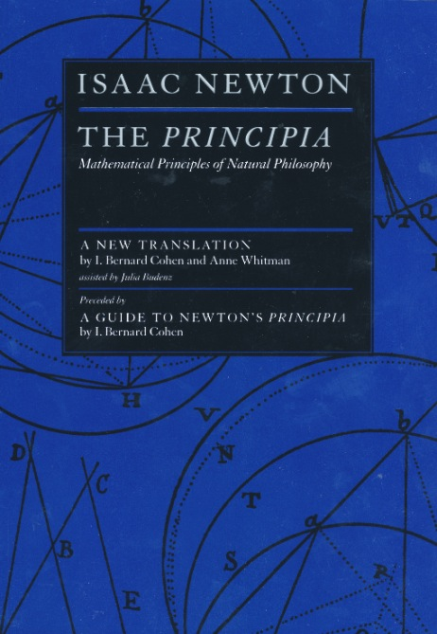
Integrating Modeling and Observations at National Scale in New Zealand
Deduction
Observation
National
Water
Modeling
Precise
but Sparse
Comprehensive
but Approximate

Slide 17

Per Capita Income of New Zealand 1870-2010
Constant $ per capita
(relative scale)
$4 – Now
$2 – Me
$1– My father
Source: Maddison Project, http://www.ggdc.net/maddison/maddison-project/data.htm

Slide 18

Population Distribution of New Zealand
2015: 4.6 million
1915: 1 million
0.6
0.5
0.5
4.0
Almost all population growth during last century
has been in towns and cities

Slide 19
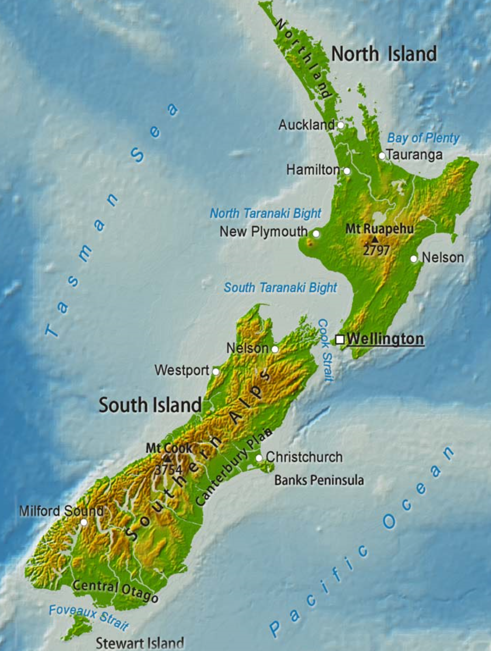
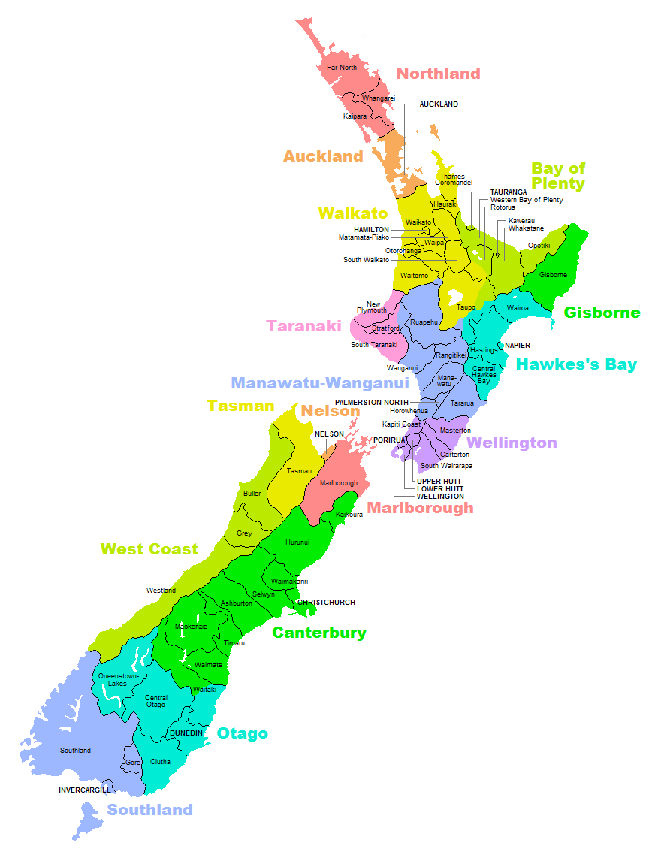
The Challenge for the Environment
(Population x 4.6) X (Per Capita Income x 4) = Economy x 18
Natural environment of New Zealand supports 4.6 times the population
and 18 times the economy that it did 100 years ago

Slide 20
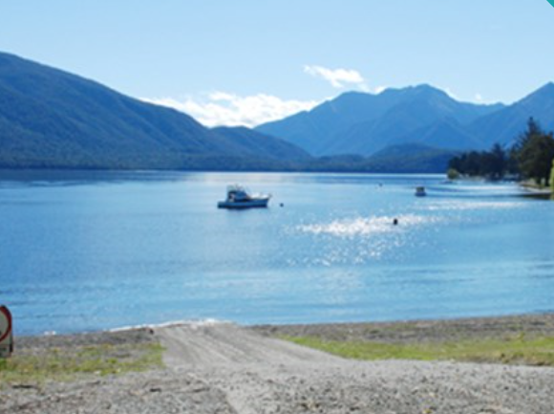
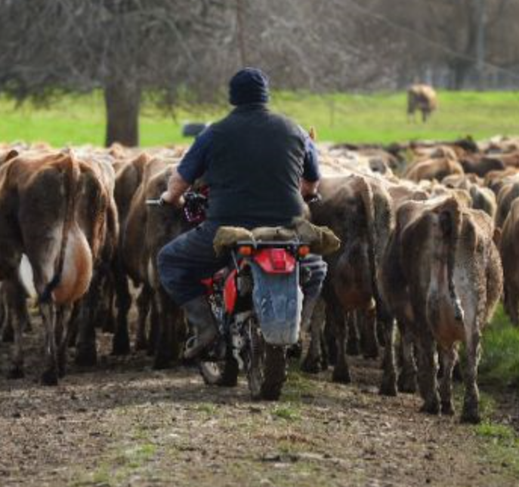
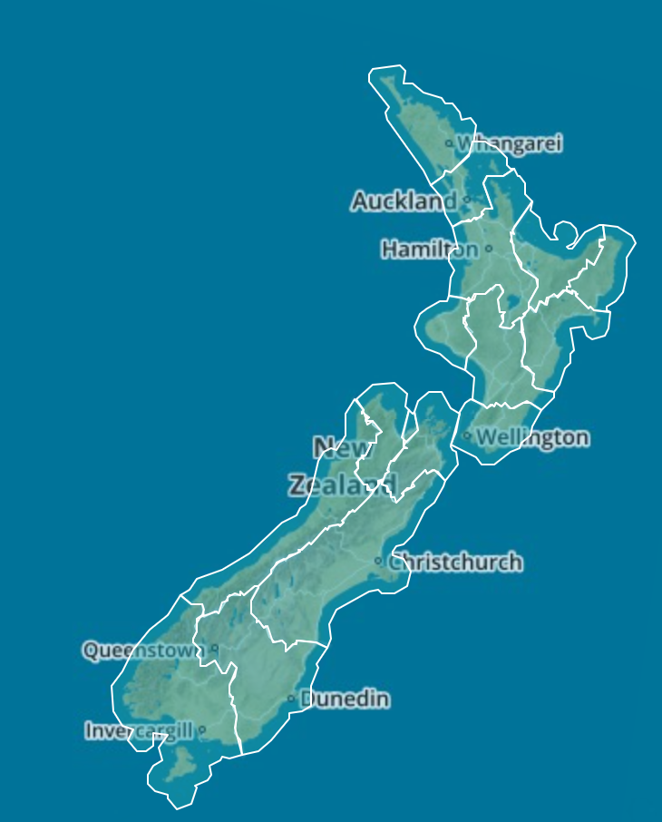
Achieving a balance in New Zealand
National
Agriculture
Environment
Regional

Slide 21
Summary
How is knowledge created?
  Deduction (Newton)
  Experiment (Pasteur)
  Observation (Darwin)
LAWA web site
  Compiled by Local Government Regions
  Comprehensive summary of water conditions
  Can I swim here?
Data integration to support water modeling
  GIS (spatial)
  Observations (temporal)
  Water modeling results (space and time)

