Slide 1

Water Data Services
David R. Maidment
Waterways Centre for Freshwater Research
University of Canterbury and Lincoln University
Brent Watson
Horizons Regional Council
Palmerston North
28 February 2018
This is Lecture 2 of a course WATR 404/604 presented to students of the
University of Canterbury and Lincoln University.
The support of the Horizons Regional Council in enabling Brent Watson to
participate in this class is gratefully acknowledged.

Slide 2
Towards a Global Water
Information System
David R. Maidment
Center for Research in Water Resources
University of Texas at Austin
Acknowledge Leadership of Horizons Regional Council
Michael McCartney, Jeff Watson, Brent Watson, Sean Hodges
Presented to New Zealand Hydrological Society
Palmerston North, New Zealand | 22 February 2013
Adapted from a presentation to 14th Congress of the WMO Commission for Hydrology
Geneva, Switzerland | 9 November 2012

Slide 3


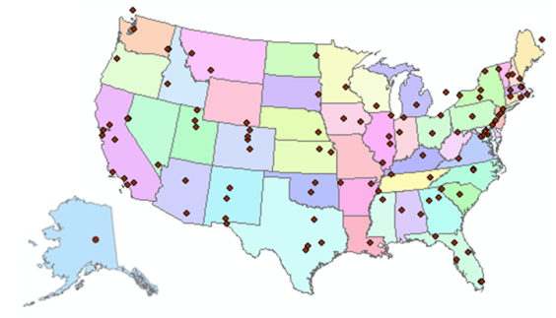
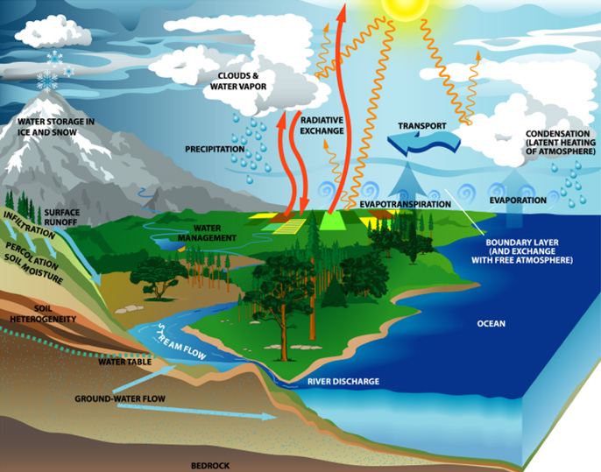
Consortium of Universities for the Advancement of Hydrologic Science, Inc.
www.cuahsi.org
CUAHSI
A consortium representing 125 US universities
Supported by the National Science Foundation Earth Science Division
Advances hydrologic science in nation’s universities
Includes a Hydrologic Information System project
Invented WaterML language for water resources time series
Building an academic prototype system

Slide 4
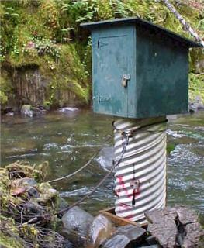
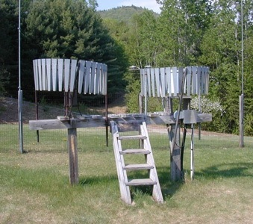
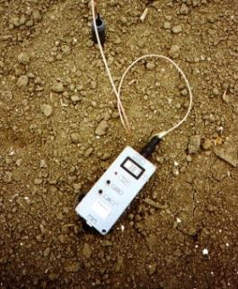
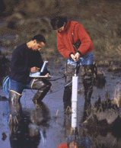
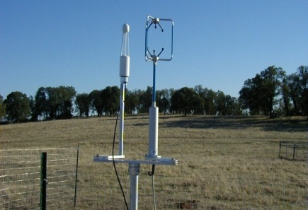
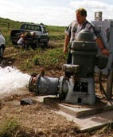
Hydrologic Measurement
Water Quantity
Rainfall
Soil Water
Water Quality
Meteorology
Groundwater
Sampled Data
Time series data at point locations

Slide 5
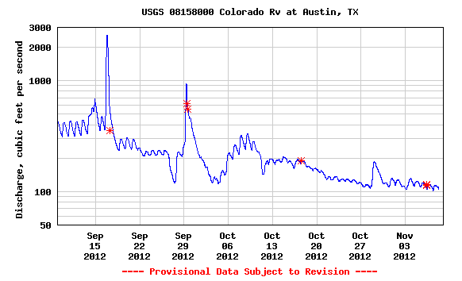
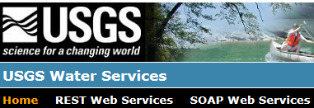
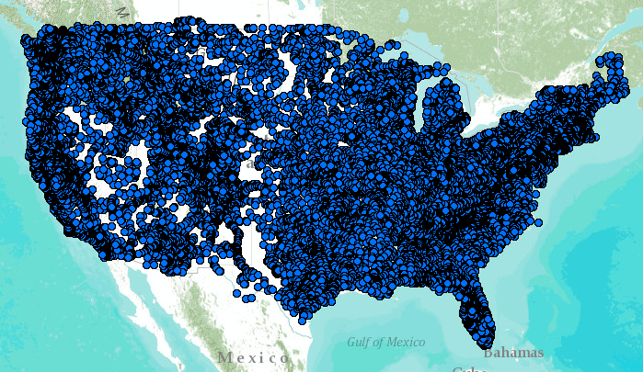
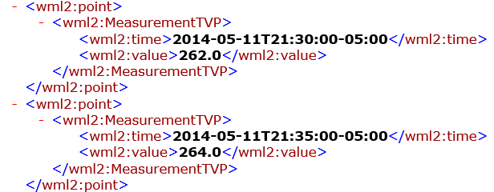
WaterML2 Web Services – US Geological Survey…..
Water time series data on the internet
24/7/365 service
For daily and real-time data
. . . Operational water web services system for the United States
http://waterservices.usgs.gov/nwis/iv/?format=waterml,2.0&sites=08158000&period=P1D&parameterCd=00060

Slide 6
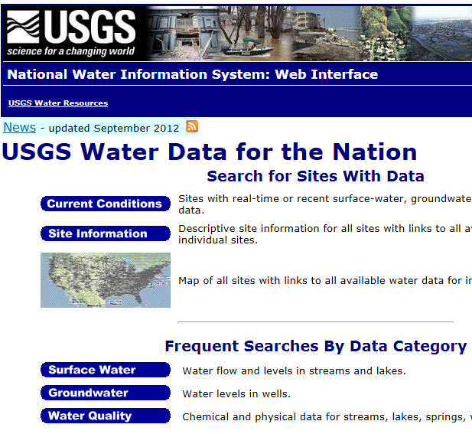
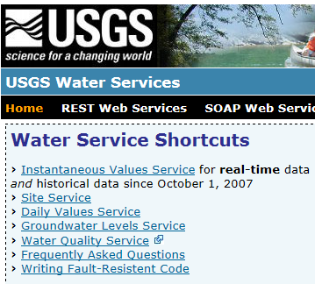
Web Pages and Web Services
Web pages deliver text and images
Web services deliver data encoded in XML
http://water.usgs.gov/
http://waterservices.usgs.gov/

Slide 7
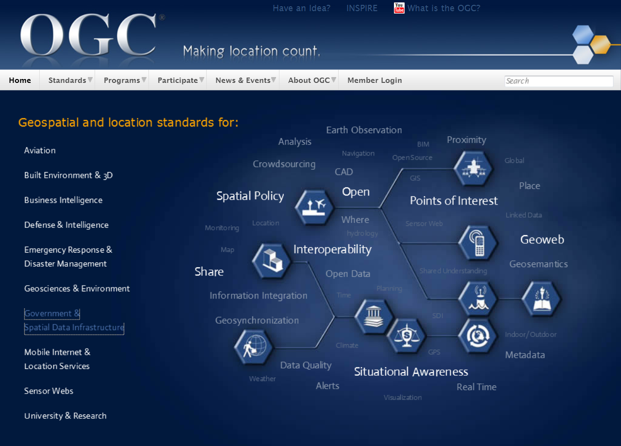
Open Geospatial Consortium
More than 400 companies and agencies globally
. . . Internet data standards for maps and observational data

Slide 8


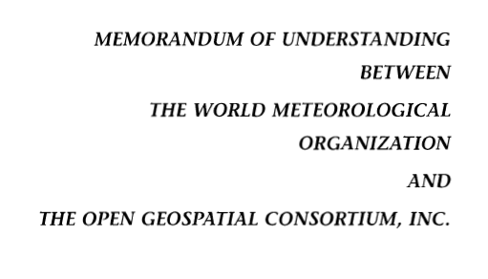

OGC/WMO Hydrology Domain Working Group
12-year effort to define international water data standards
A time series for one variable at one location
Research started by CUAHSI in United States
Technical Meetings Each 3 Months
Four Interoperability Experiments
(Surface water, groundwater, forecasting)
Annual week-long workshops
Involvement by many countries
Adoption
2004
2008
2010
2012
2016
Notes:
(1) A four-year international effort has been undertaken to reconcile WaterML with international standards;
(2) This effort was initiated with the establishment of an Hydrology Domain Working Group by the Open Geospatial Consortium in September 2008;
(3) An OGC representative attended the WMO Congress of the Commission for Hydrology in 2008
(4) A formal agreement between Secretary General of WMO and President of OGC in 2009 to jointly develop standards for hydrology, climatology, oceanography and climatology;
(5) The joint OGC/WMO Hydrology Domain Working Group was supported by a large work effort, annual week-long workshops, four interoperability experiments for surface and groundwater data exchange, and participation by many countries;
(6) In June 2012, the OGC voted to adopt the revised version, WaterML2 as an international standard for exchange of water resources time series (the first such public standard that has existed);
(7) This Congress to the WMO Commission for Hydrology to whom I am speaking is considering WaterML2 for adoption as an official standard by WMO

Slide 9

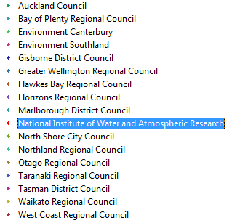
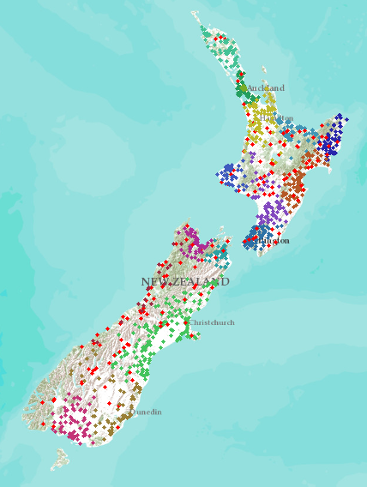
New Zealand – 16 regions
NIWA operates about 20% of 1300 hydrometric stations
Regional authorities operate about 80% of stations
Develop a federated hydrological information infrastructure . . .
. . . linking nationally and regionally collected data

Slide 10
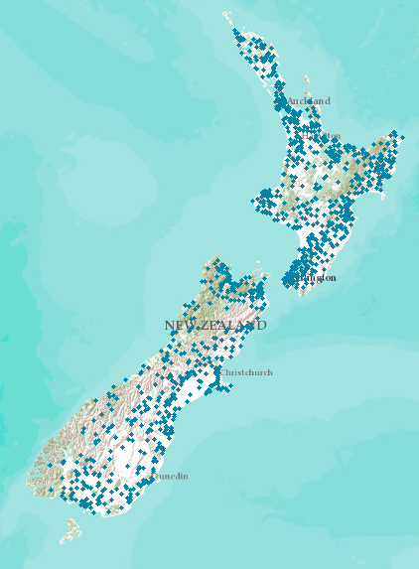
Proposed New Zealand Water Information System
NIWA operates about 20% of 1300 hydrometric stations
Regional authorities operate about 80% of stations
New Zealand
Water Information System
Develop a federated hydrological information infrastructure . . .
. . . linking nationally and regionally collected data

Slide 11
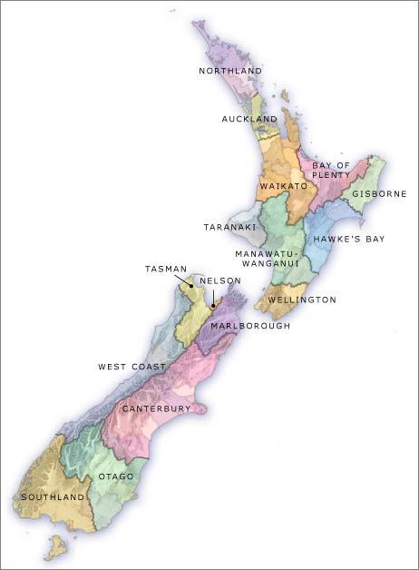


Current State of Play for NZ – all Done!
Local Government
National - CRIs
16
3
SOS2/WaterML2
now
SOS2/WaterML2
now
SOS = Sensor Observation Service
Slide: Brent Watson, HRC

Slide 12
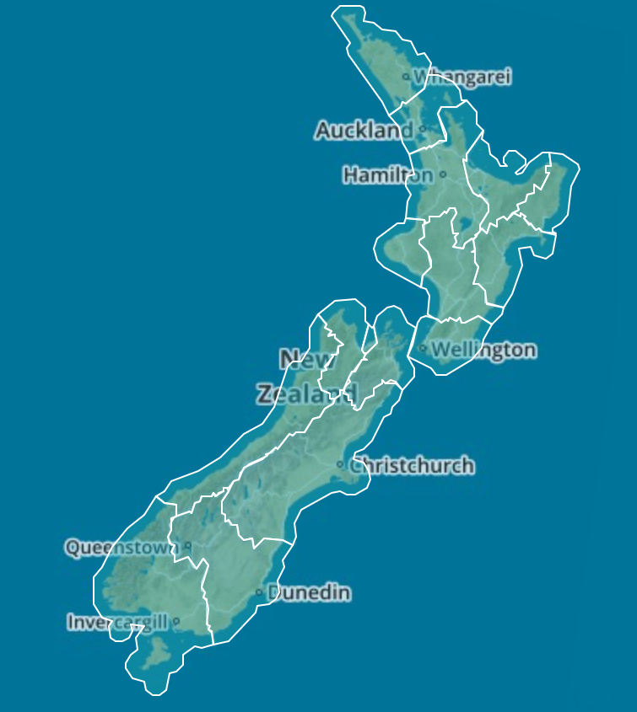
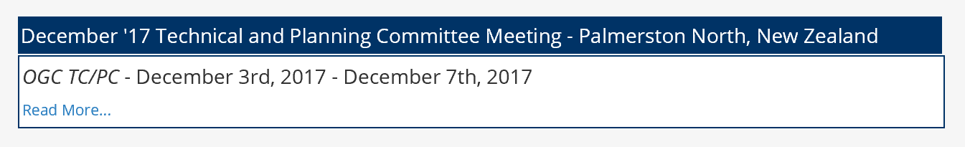

Data Sharing using Open Standards in LAWA
National synthesis without centralizing the data
Each region maintains its own data
Data are accessed through “web services”
Common language for water: WaterML2
Open Geospatial Consortium standards
All information “looks the same” to user
A tremendous technological achievement for New Zealand!!!
Credit: LAEMG, especially Horizons Regional Council
Michael McCartney, Jeff Watson, Brent Watson, Sean Hodges
NIWA, Landcare, Kisters, Hilltop, 52North

Slide 13
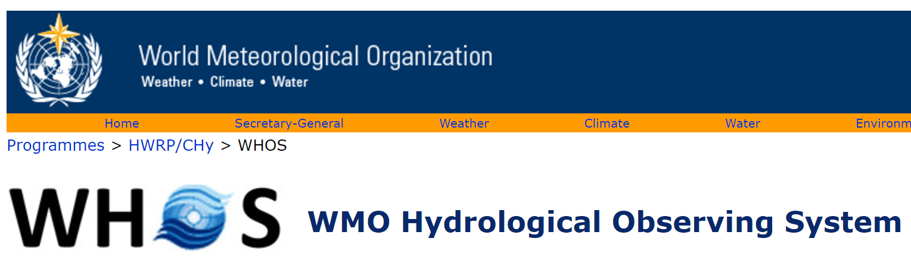
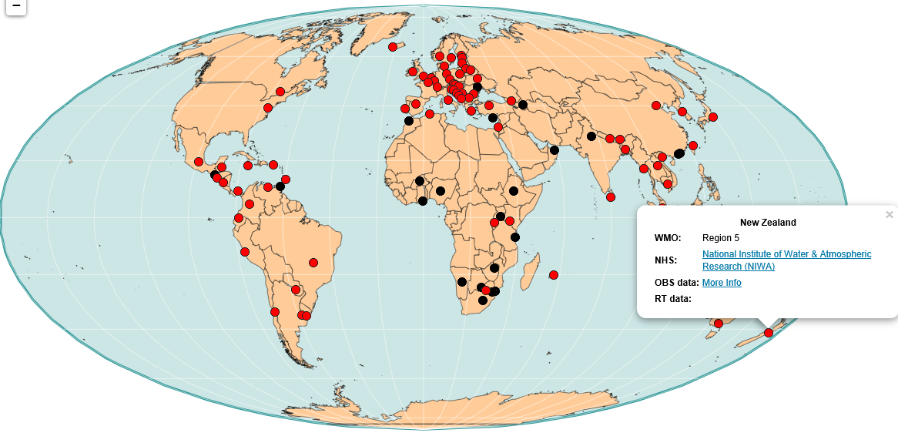
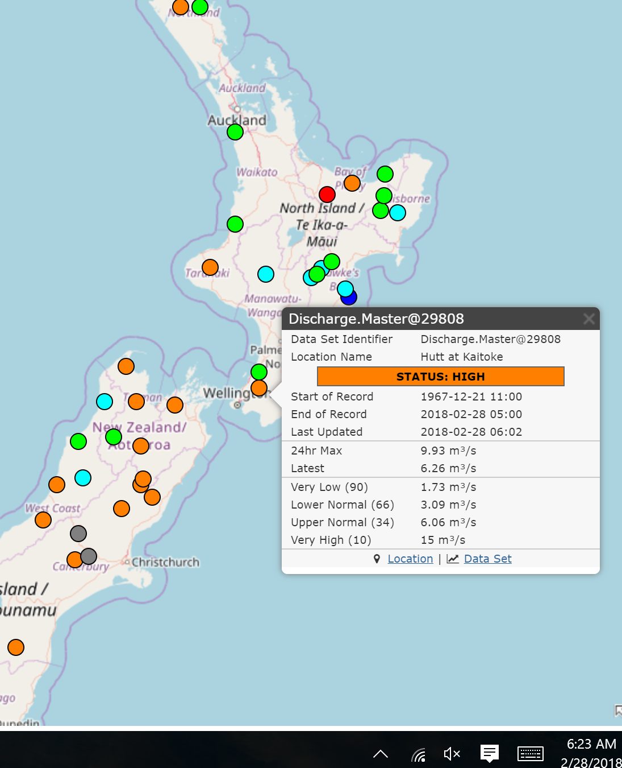
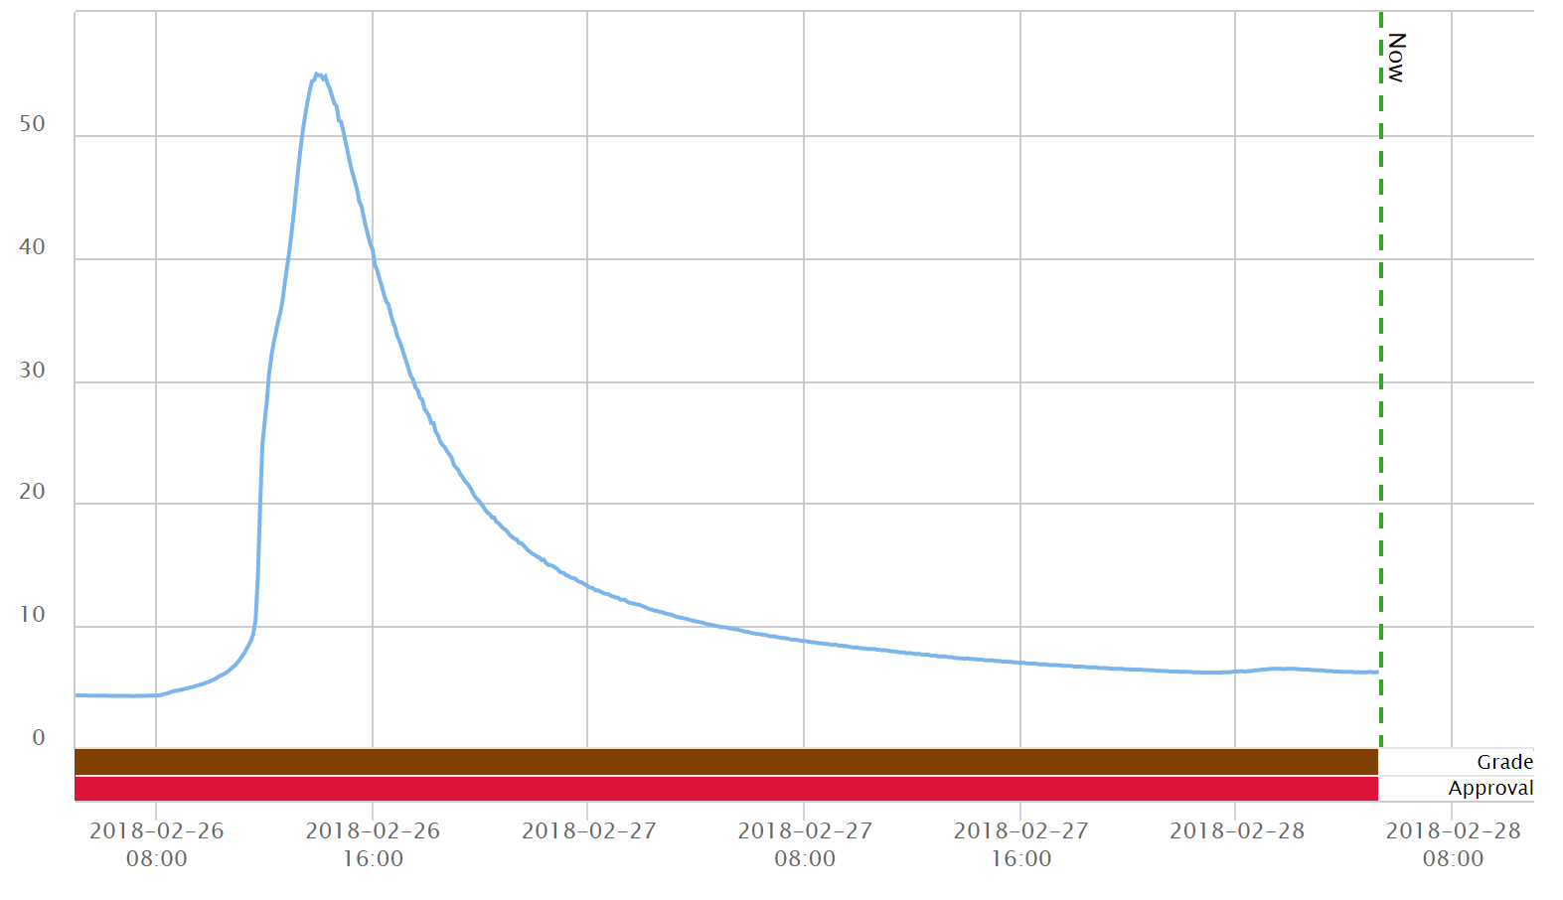
NIWA
New Zealand data globally accessible
Current Flow Data for the Hutt River at Kaitoke
Updated 6:02AM
28 Feb 2018, 6AM
Accessed 6:23AM
http://www.wmo.int/pages/prog/hwrp/chy/whos/

Slide 14

Hydrological data sharing
Modified from:
Seventh Workshop of the WMO/OGC Hydrology DWG
Koblenz, 16 June 2016
The New Zealand experience
Brent Watson
Jeff Watson
Sean Hodges
Horizons Regional Council
New Zealand

Slide 15
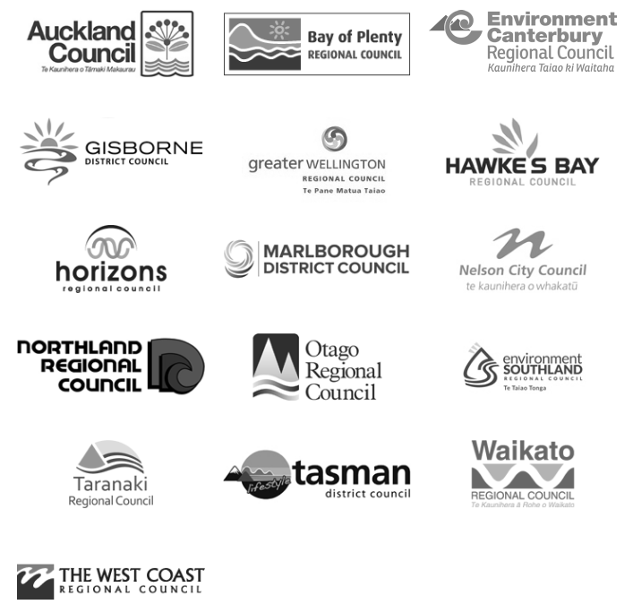


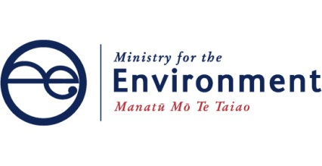









Partners / Providers

Slide 16
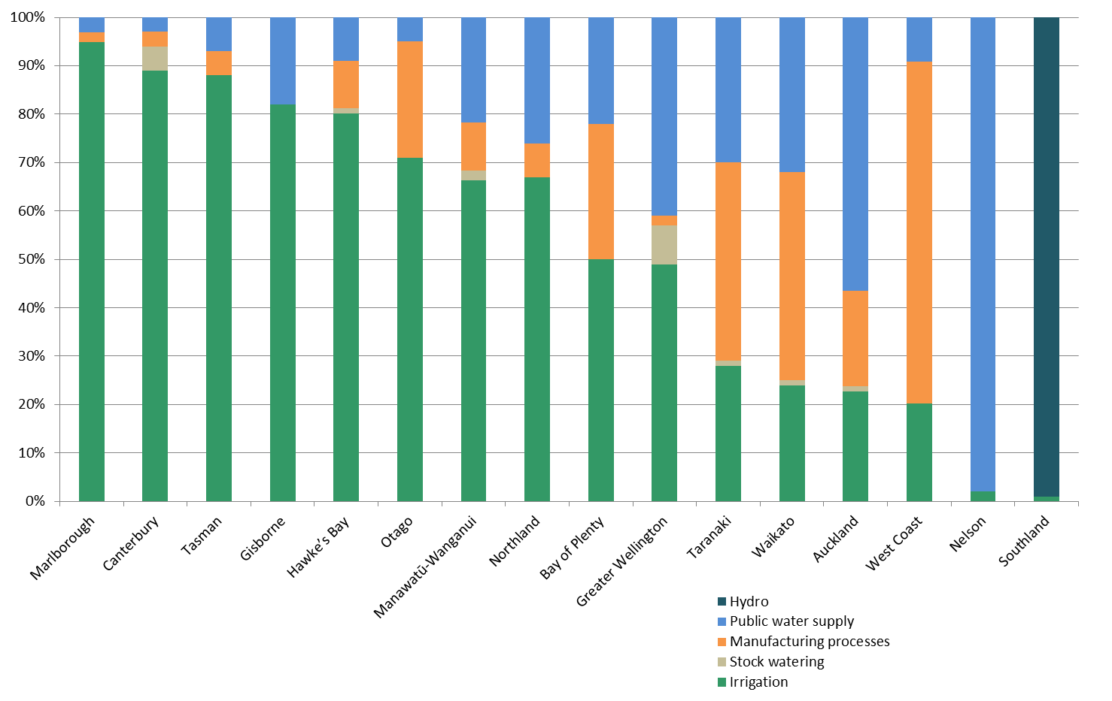
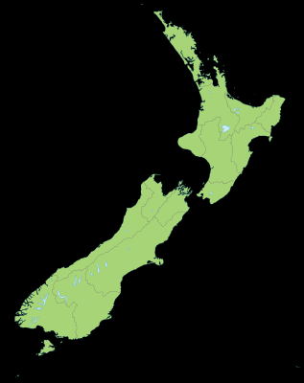
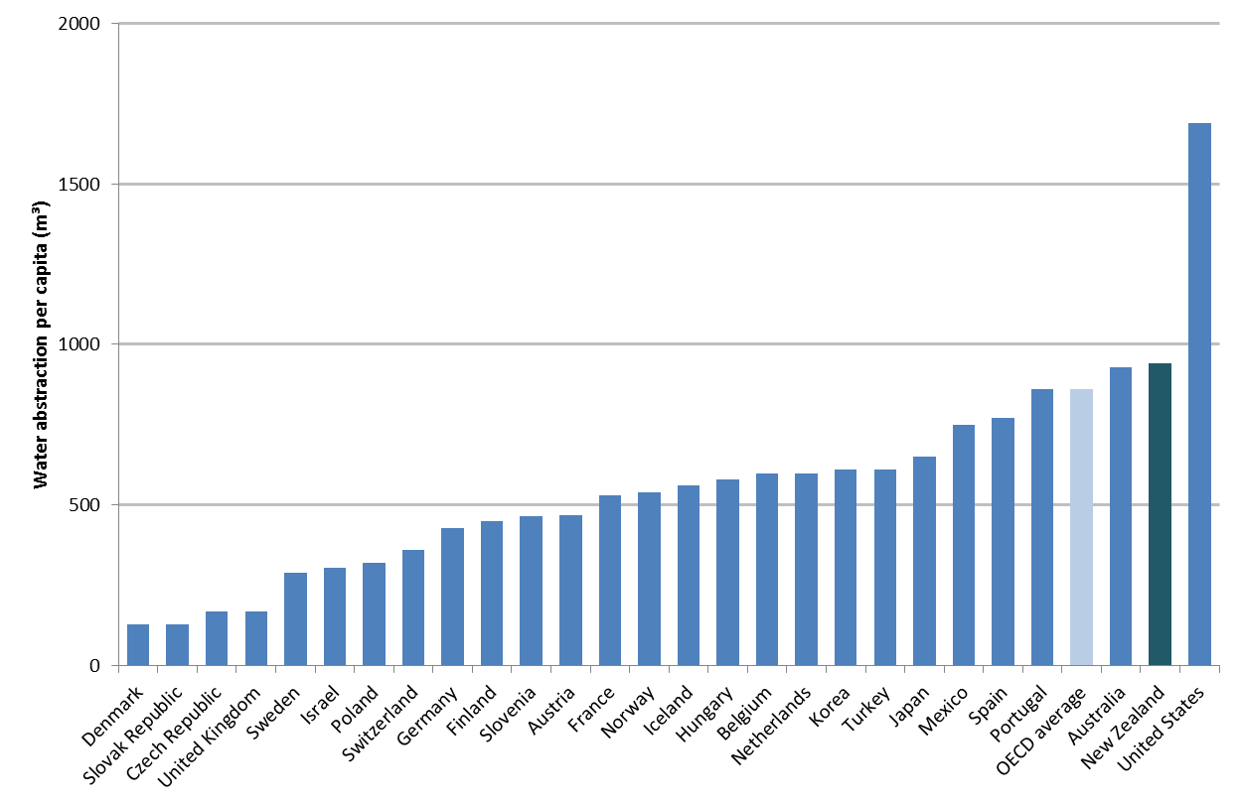
New Zealand Water Abstraction
Ranking of water abstraction per capita for OECD countries in 2007
United States
New Zealand

Slide 17
New Zealand
Resource Management Act 1991
Purposes and principles
Central
government
National environmental
standards
(optional)
National policy statements
(optional)
New Zealand coastal policy statements
(mandatory)
Regional policy statements
(mandatory)
Local
government
District plans
(optional)
Regional plans
(optional)
Regional coastal plans
(mandatory)

Slide 18
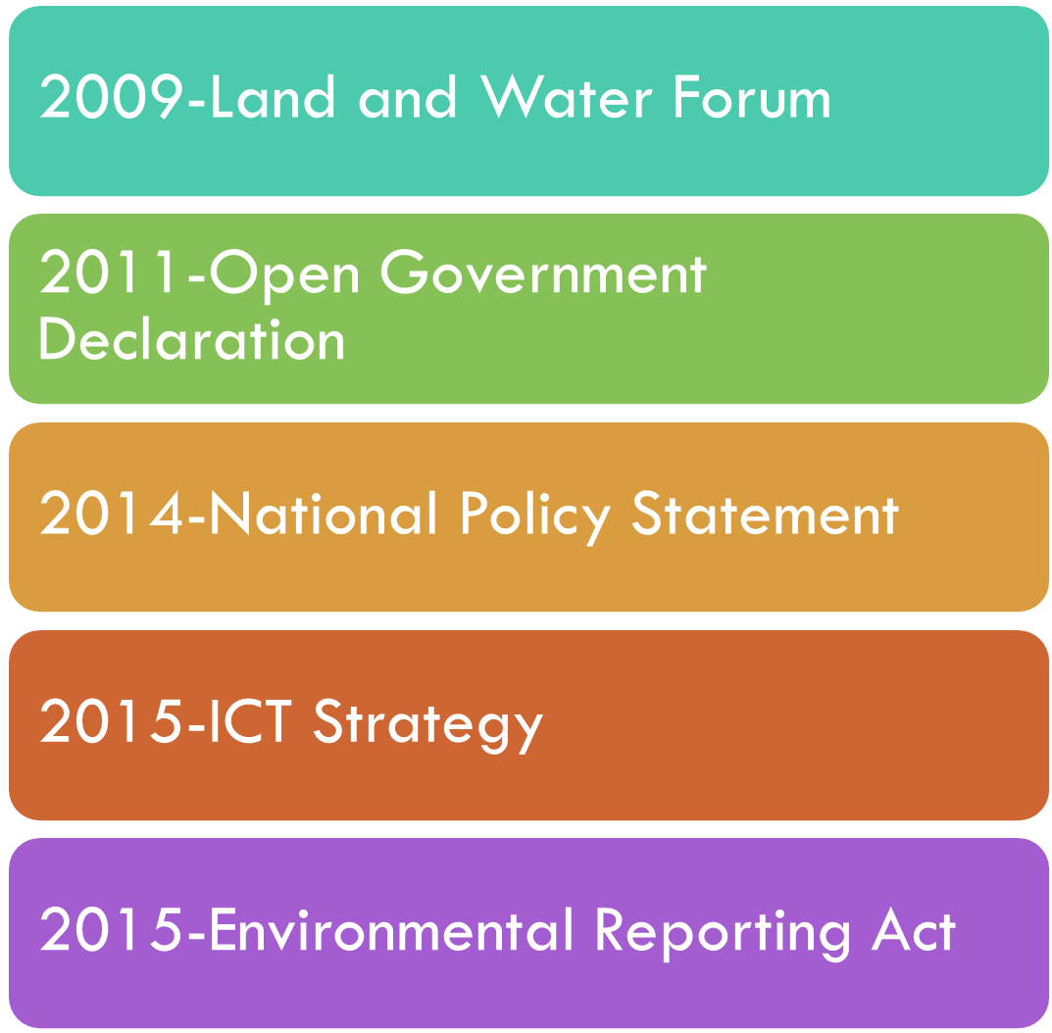
New Zealand Water Policy
The Land and Water Forum brought together a range of stakeholders consisting of industry groups, electricity generators, environmental and recreational NGOs, iwi, scientists, and other organisations with a stake in freshwater and land management.
The government holds data on behalf of the New Zealand public. We release it to enable the private and community sectors to use it to grow the economy, strengthen our social and cultural fabric, and sustain our environment. We release it to encourage business and community involvement in government decision-making.
The NPS-FM provides direction about how local authorities should carry out their responsibilities under the Resource Management Act 1991 for managing fresh water.
The Government ICT Strategy was revised in 2015 to ensure that, in a dynamic technology environment, it can achieve the government’s aim of an ICT-enabled transformation of public services to New Zealanders
The purpose of this Act is to require regular reports on New Zealand’s environment.

Slide 19
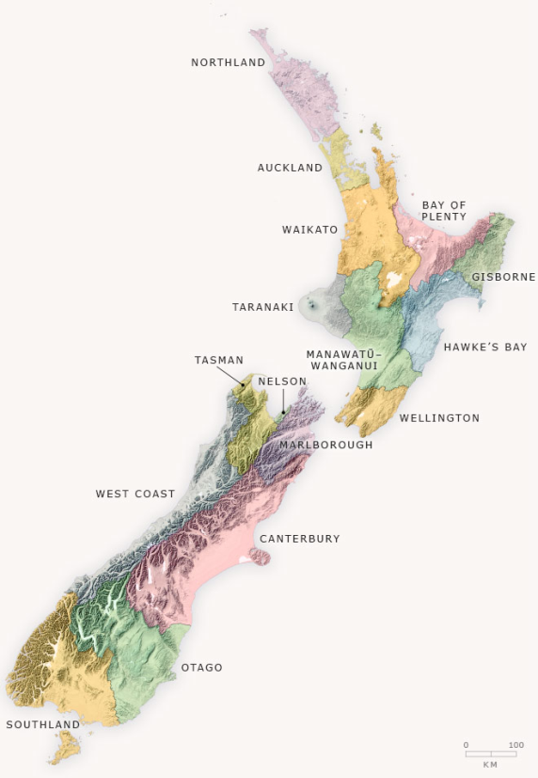
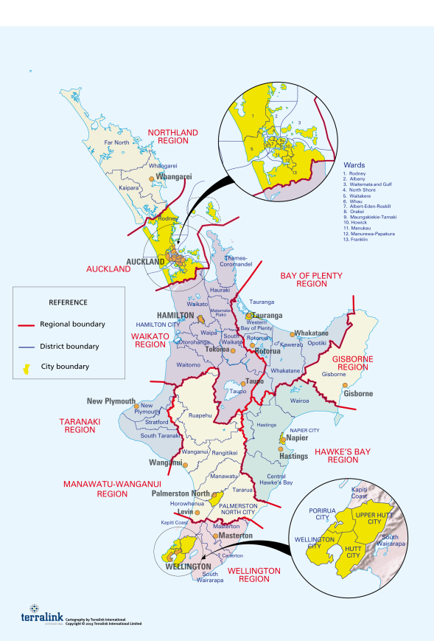
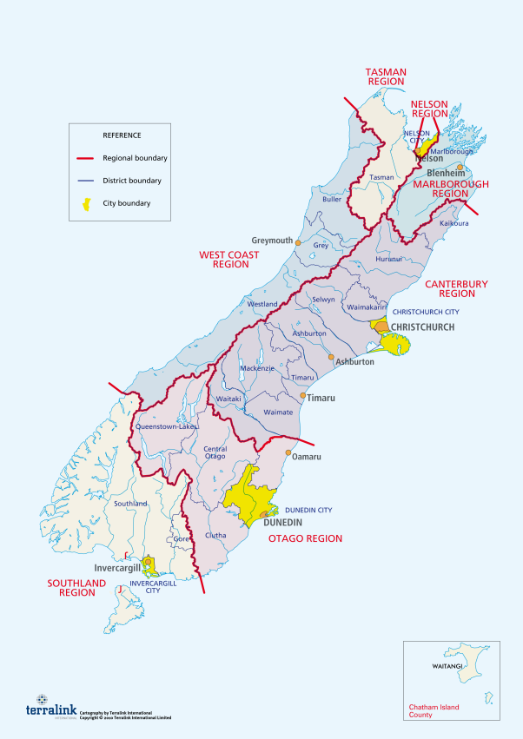
NZ Regional Sectors

Slide 20
Drivers
National Reporting
Consistent data
Reliability

Slide 21
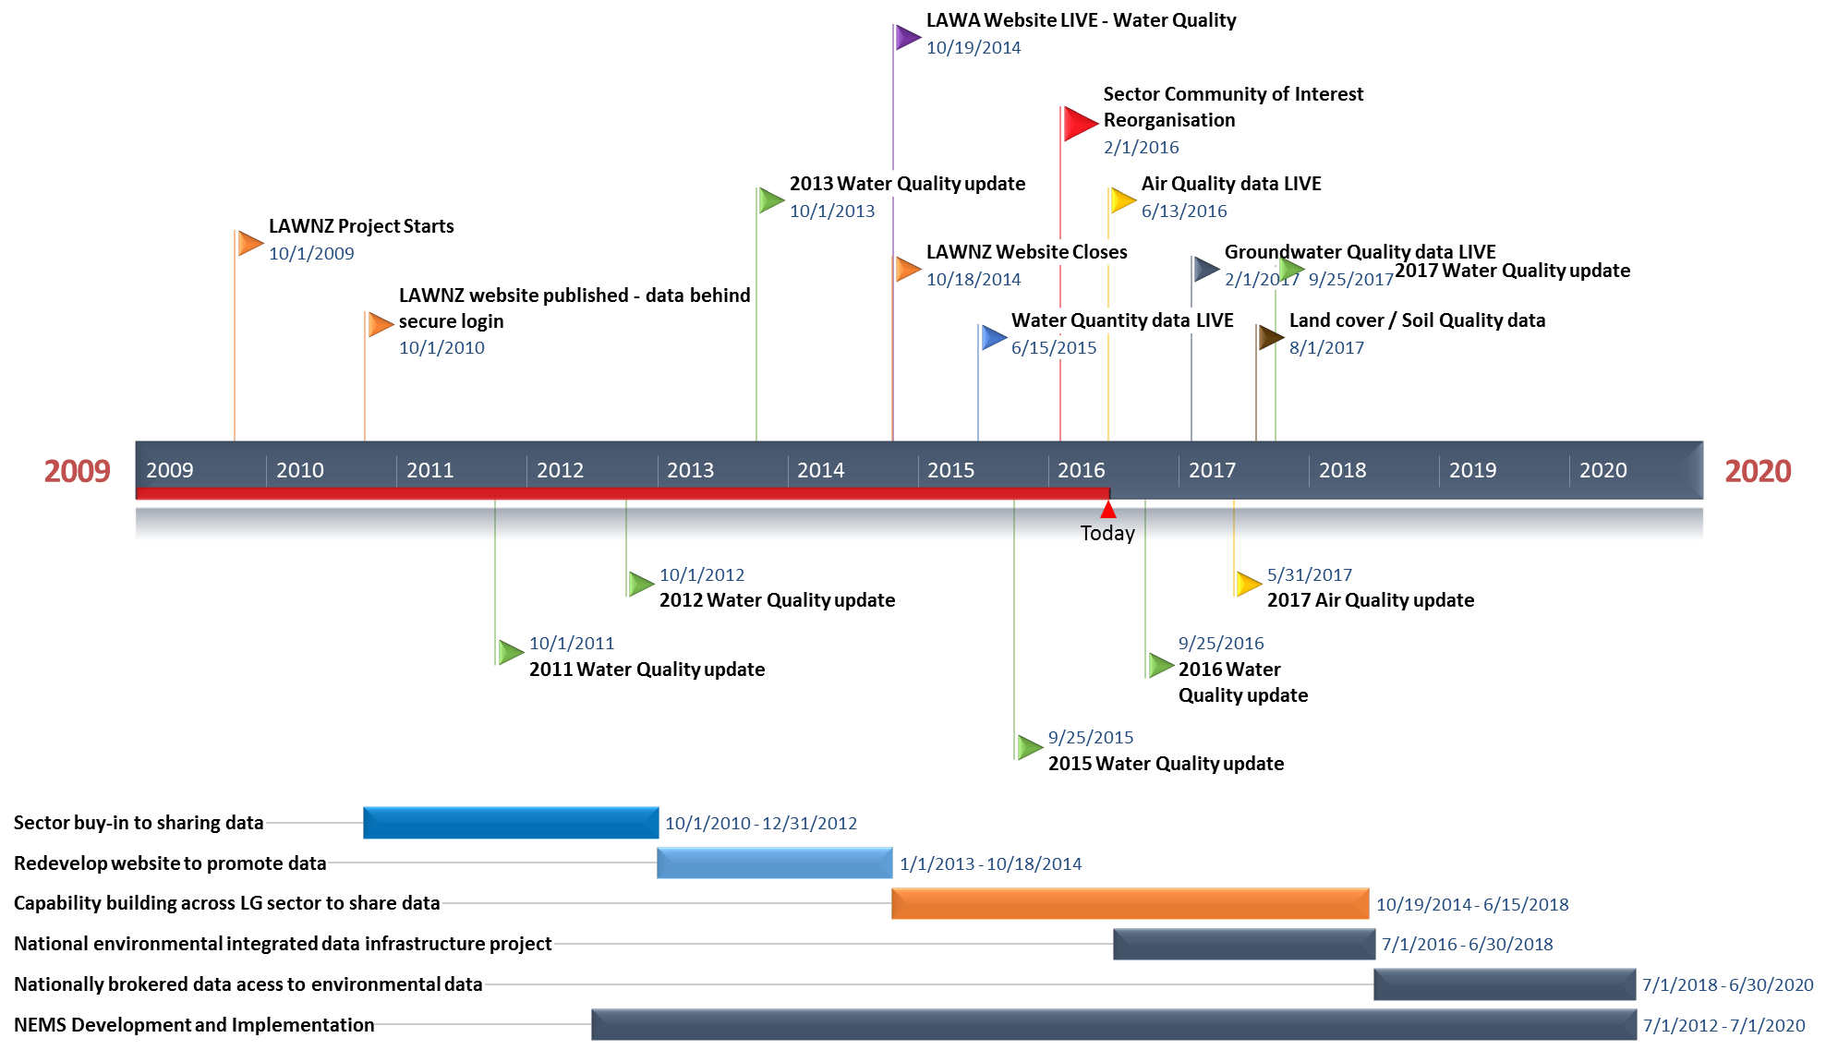
Timeline for Data Federation
LAWN – database&Excel
LAWA – Website on top of services

Slide 22
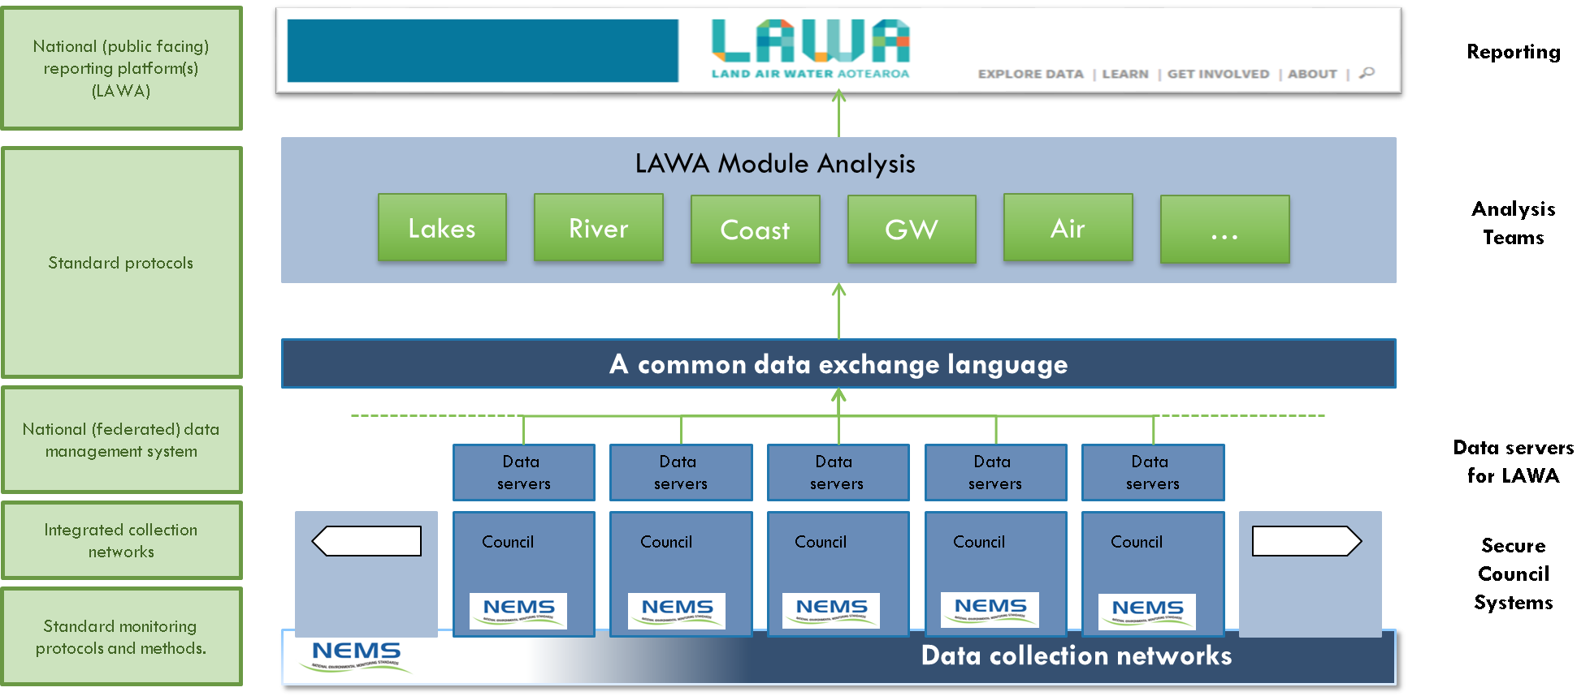
Federated infrastructure

Slide 23
Products in use in regional sector
Hilltop (13)
Kisters (2)
Aquatic Informatics / 52 North (1)
ESRI (16)

Slide 24
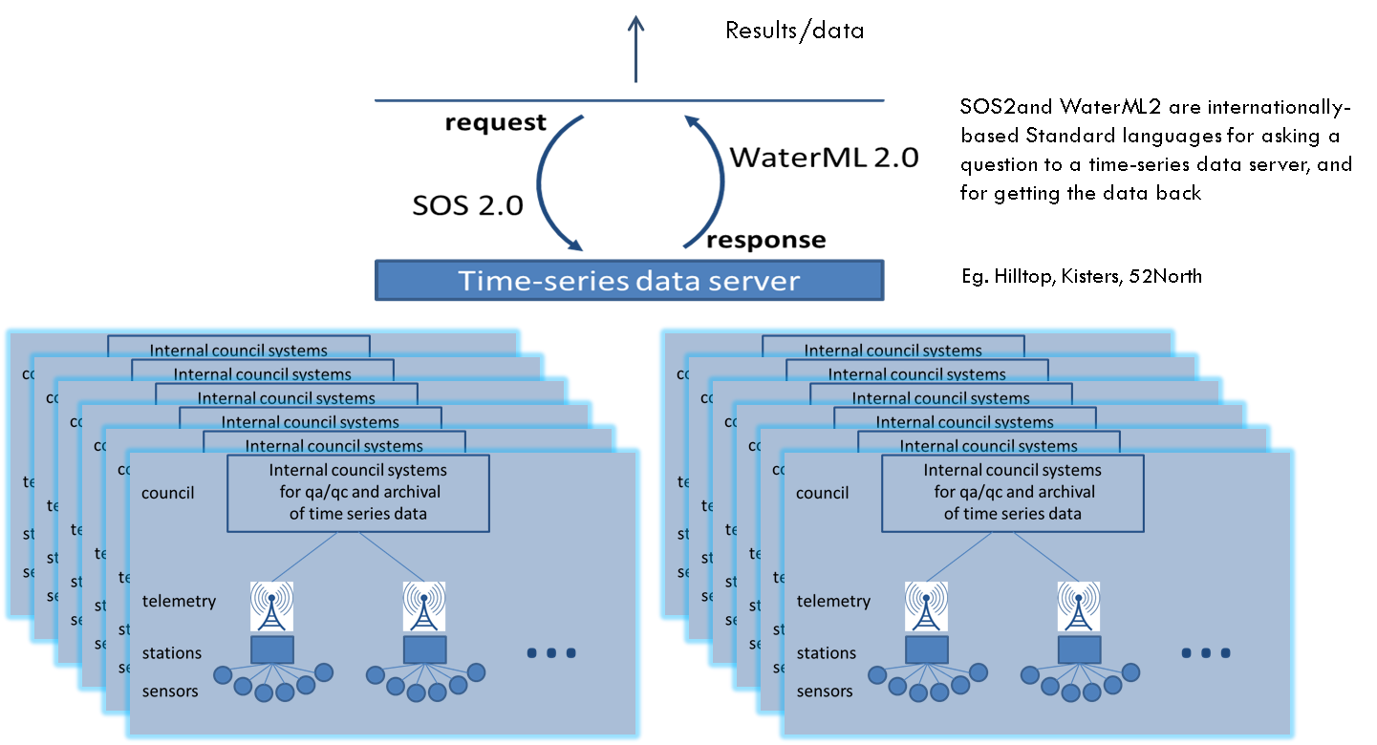
NZ data federation premise
Limitations here
Constraints here – water quality

Slide 25
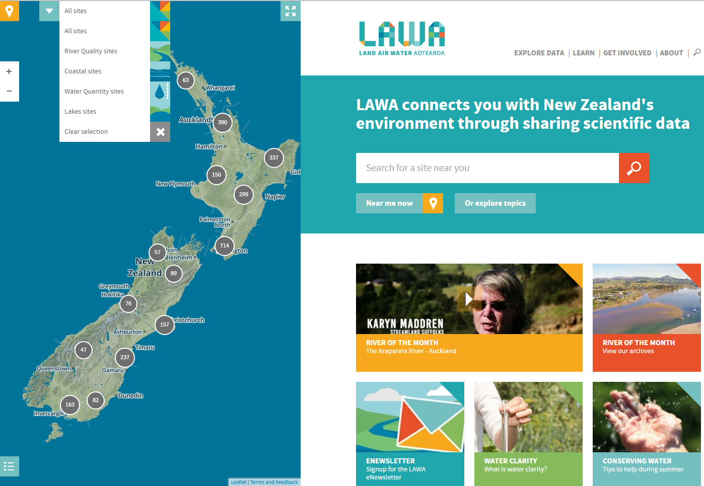
Land Air Water Aotearoa

