Slide 1

NZ’s Digital
River Network
Dr Amy Whitehead
NIWA Christchurch

Slide 2

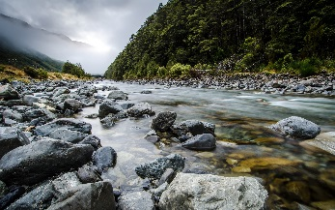
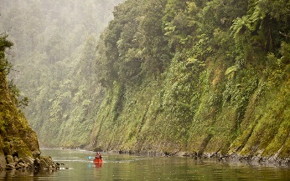
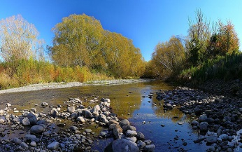
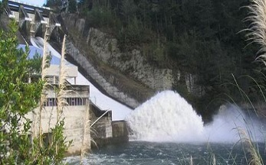
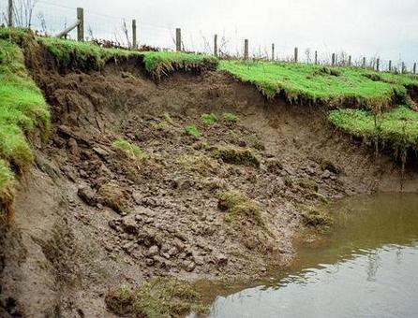
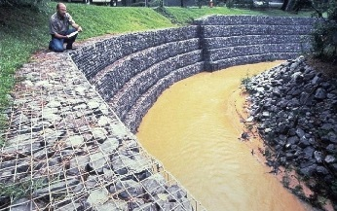
NZ’s Digital River Network
What is it?
Dendritic stream network
  > 576,000 individual reaches
  425,000 km of river
Notes:
425 million km of river

Slide 3
NZ’s Digital River Network
How was it made?
78 | 72 | 69 | 71 | 58
74 | 67 | 56 | 49 | 46
69 | 53 | 44 | 38 | 37
69 | 58 | 55 | 22 | 31
68 | 61 | 47 | 21 | 16
Digital elevation model
Stream network
Flow direction
Watersheds & catchments

Slide 4
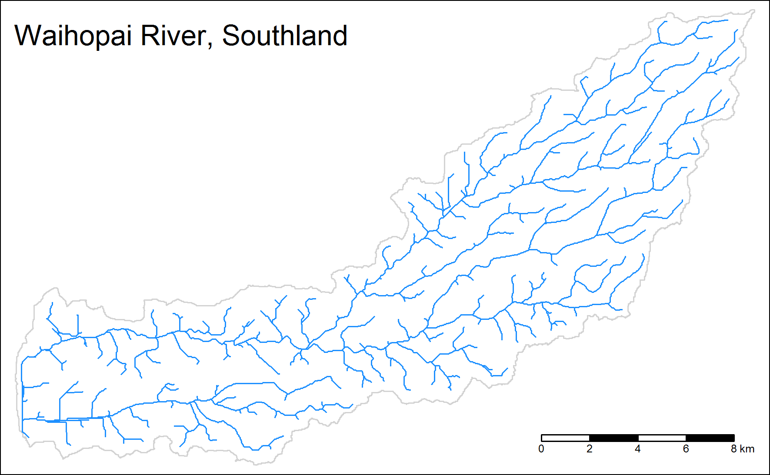
NZ’s Digital River Network
How was it made?
30m digital elevation model
Calculated local and upstream variables for each reach
  Elevation
  Slope
  Rainfall
  Geology
  Landcover
https://www.niwa.co.nz/freshwater-and-estuaries/management-tools/river-environment-classification-0

Slide 5








NZ’s Digital River Network
What is it used for?
Hydrological modelling
Water quality modelling
Classifying river environments
Predicting national river values
TopNet

Slide 6







NZ’s Digital River Network
What is it used for?
Hydrological modelling
Water quality modelling
Classifying river environments
Predicting national river values
TopNet
CLUES
Notes:
Catchment landuse for environmental sustainability

Slide 7


NZ’s Digital River Network
What is it used for?
Hydrological modelling
Water quality modelling
Classifying river environments
Predicting national river values
TopNet
CLUES
REC

Slide 8

NZ’s Digital River Network
What is it used for?
Hydrological modelling
Water quality modelling
Classifying river environments
Predicting national river values
TopNet
CLUES
REC
NZ River Maps

Slide 9
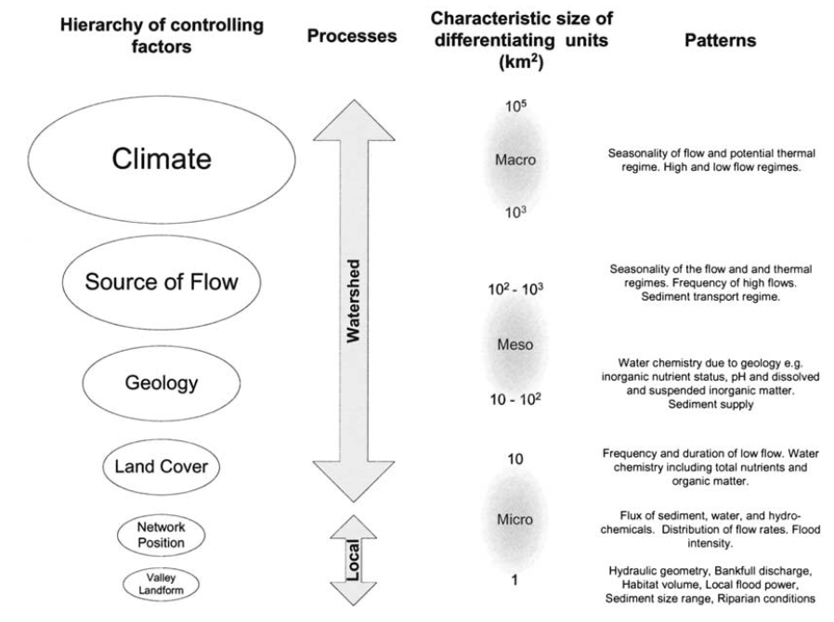
River Environment Classification (REC)
What is it?
Hierarchical system for classifying river environments
  based on factors that control spatial patterns
Snelder, T.H., Biggs, B.J.F., 2002. J. Am. Water Resour. Assoc. 38, 1225–1239.

Slide 10
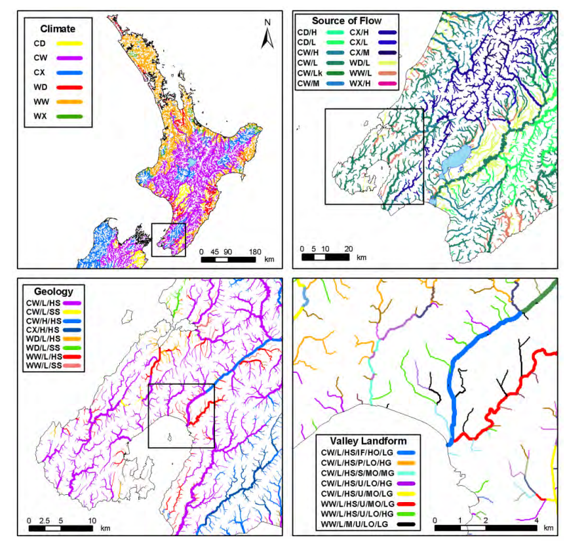
River Environment Classification (REC)
What is it?
Cool – Dry
Cool – Wet
Cool – Very Wet
Warm – Dry
Warm – Wet
Warm – Very Wet
Glacial
Mountain
Hill
Lowland
Lake
Alluvium
Hard Sedimentary
Soft Sedimentary
Volcanic Basic
Volcanic Acidic
Plutonic
High Gradient
Medium Gradient
Low Gradient
Snelder, T.H., Biggs, B.J.F., Weatherhead, M., 2004. REC User Guide.
Notes:
The REC hierarchy consists of six controlling factors (hereafter referred to as factors), which define the six hierarchical levels of the classification. The first four levels group parts of rivers according to similarities in the Climate,
Topography, Geology and Land-Cover of their catchments. The fifth and sixth levels group parts of rivers according to similarities in attributes of the local section of the river network: Network-Position and Valley-Landform.

Slide 11
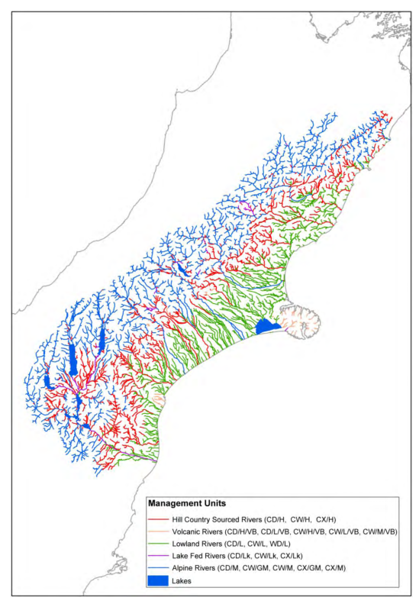
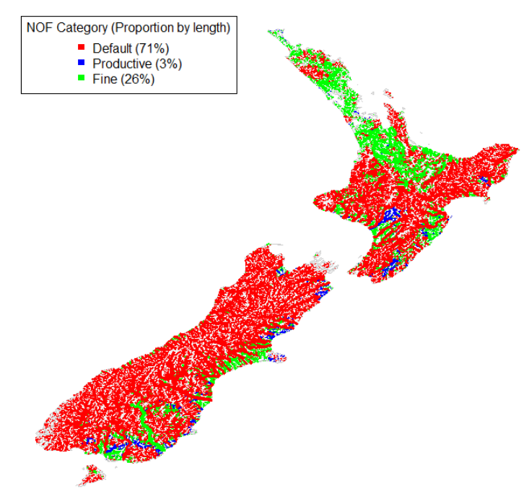
River Environment Classification (REC)
What is it used for?
Defining management units
Setting water quality limits
Climate
Source of Flow
(Geology)
Climate
Geology
No periphyton
Normal periphyton
growth
Rapid periphyton
growth

Slide 12
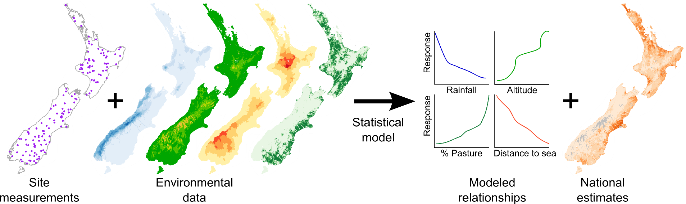
Predicting national river values
Mud
Rainfall
Altitude
Distance
to sea
% Pasture
Notes:
Predictive models showing the existing state Predictions show regional patterns and shouldn’t be used to assess conditions at specific sites. 108 predictive layers identified so far

Slide 13
Predicting national river values
Mud
Rainfall
Altitude
Distance
to sea
% Pasture
Notes:
Predictive models showing the existing state Predictions show regional patterns and shouldn’t be used to assess conditions at specific sites. 108 predictive layers identified so far

Slide 14
Predicting national river values
Mud
Rainfall
Altitude
Distance
to sea
% Pasture
Mud
Notes:
Predictive models showing the existing state Predictions show regional patterns and shouldn’t be used to assess conditions at specific sites. 108 predictive layers identified so far

Slide 15
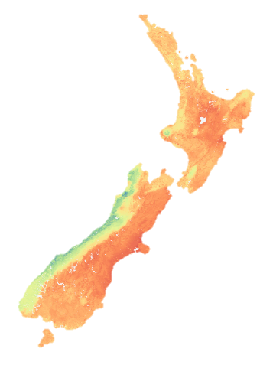
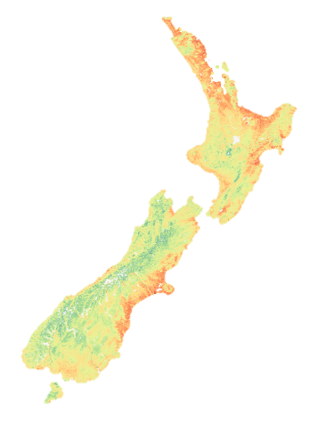
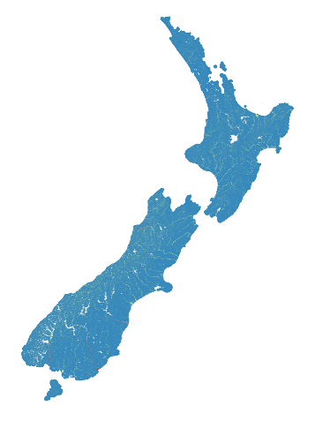
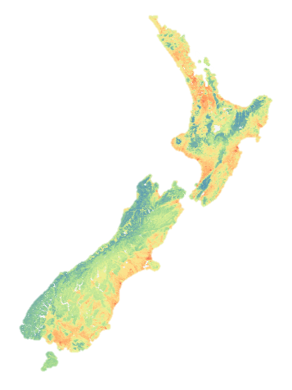
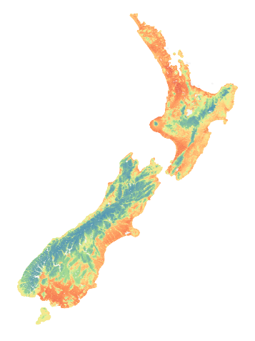
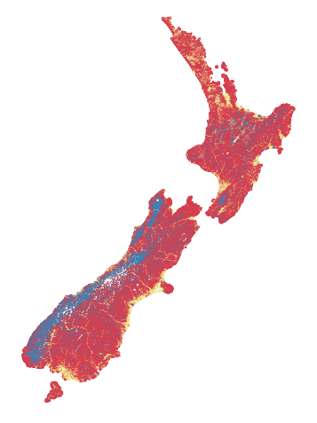
Predicting national river values
Mud
Rainfall
Altitude
Distance
to sea
% Pasture
Mud
Hydrology
Sediment
River width
Invertebrates
Water quality
Fish habitat
Fre3
Cobble
Width at
MALF
MCI
E. coli
Torrentfish
Notes:
Predictive models showing the existing state Predictions show regional patterns and shouldn’t be used to assess conditions at specific sites. 108 predictive layers identified so far

Slide 16

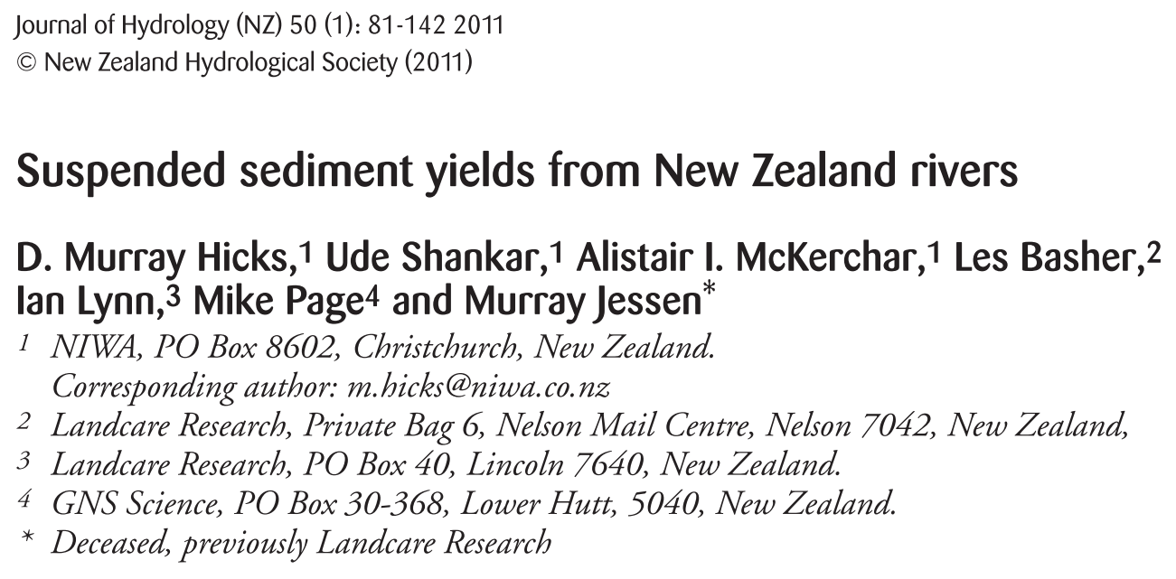

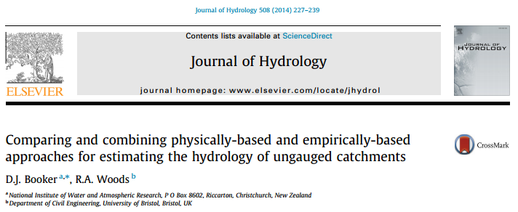
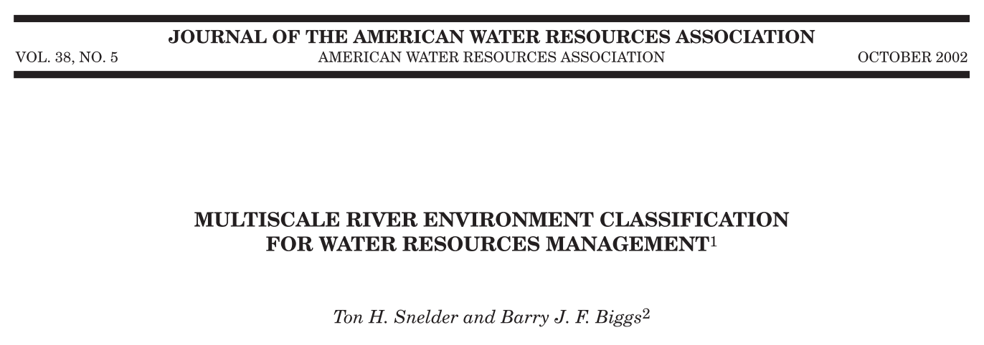
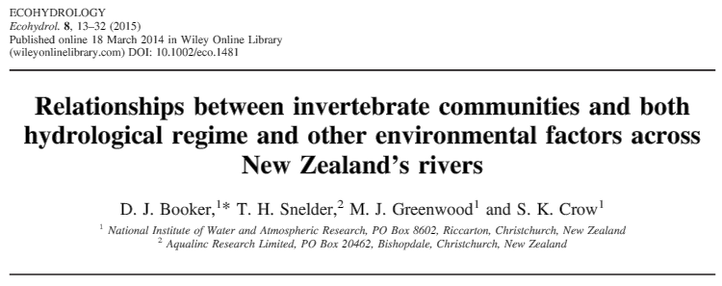
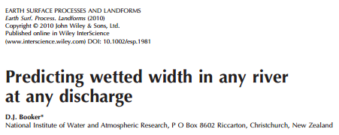
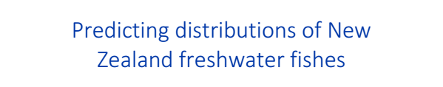
Predicting national river values
Notes:
Published in many papers and reports but no method for making these data available for people to visualise or interrogate (other than terrible figures).

Slide 17
NZ River Maps
A web-based tool to visualise and quantify spatial data for fresh waters
Amy Whitehead
Doug Booker
https://shiny.niwa.co.nz/nzrivermaps/

Slide 18
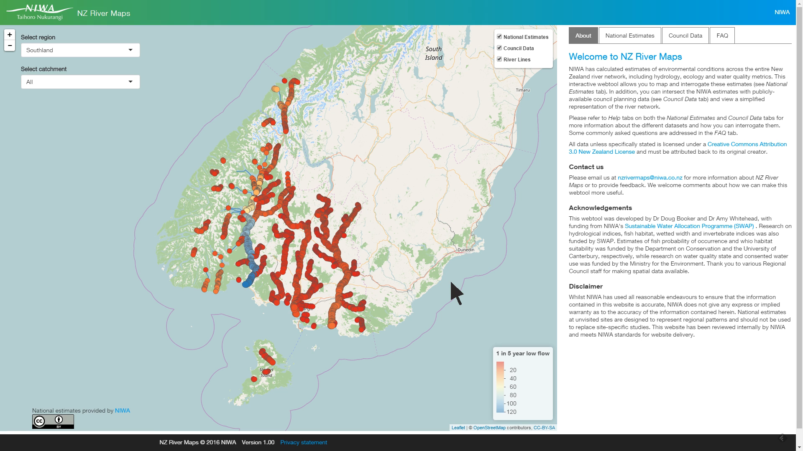

Slide 19


NZ’s Digital River Network
Take home messages
NZ’s digital river network is a dendritic stream network calculated from a DEM
GIS files available from NIWA’s website
The digital river network has been used for
  Hydrological modelling
  Water quality modelling
  Classifying river environments
  Predicting national river values
View national predictions on the digital river network using NZ River Maps
(Search for REC!)
https://shiny.niwa.co.nz/nzrivermaps/

