Slide 1
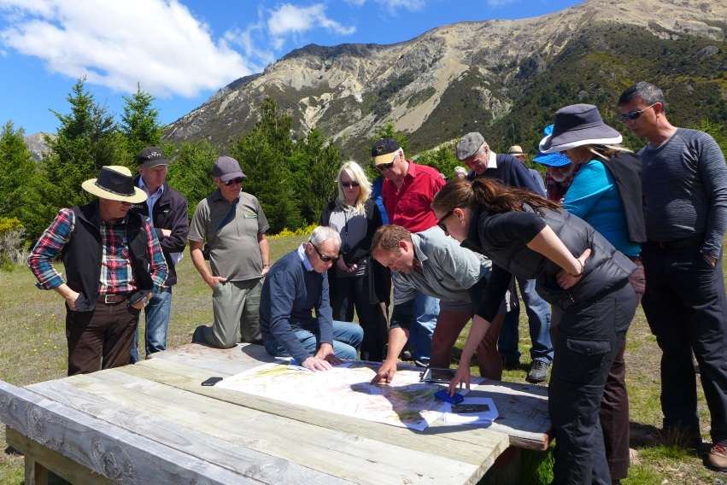
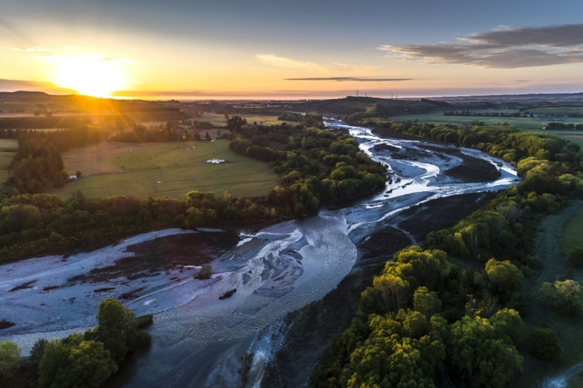
Canterbury’s Water Management Strategy:
Combining Policy, Science & Community
Dr. Stefanie Rixecker
Dr. Tim Davie

Slide 2
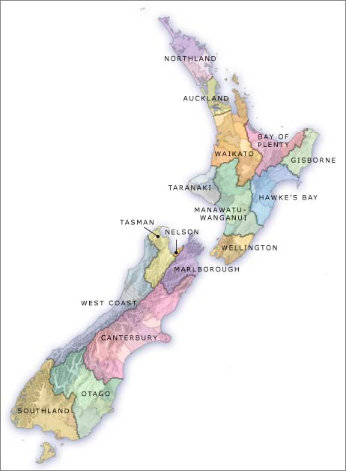
Water management roles & responsibilities
Central Govt: develops national policy
Regional Councils: manage water quality and quantity
Territorial/Unitary Authorities: manage land uses and provide drinking water, stormwater and sewage services

Slide 3
Context for the Canterbury Water Management Strategy (CWMS)
1999-2006
Water availability studies and identification of water storage sites
2008
Canterbury Mayors took ownership and the Canterbury Water Management Strategy was developed
2009-Present
Establishing plans and implementing them across the region

Slide 4
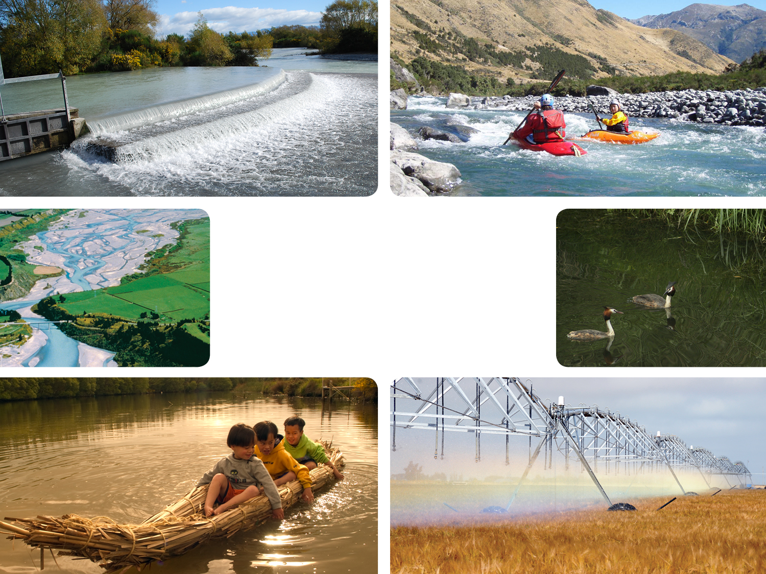

SHARED VISION: to enable present and future generations to gain the greatest social, economic, recreational and cultural benefits from our water resources within an environmentally sustainable framework

Slide 5
The 10 CWMS Targets
Ecosystem Health and Biodiversity
Natural Character of Braided Rivers
Recreational and Amenity Opportunities
Drinking Water
Water Use Efficiency
Kaitiakitanga
Energy Security and Efficiency
Regional and National Economies
Irrigated Land Area
Environmental Limits

Slide 6
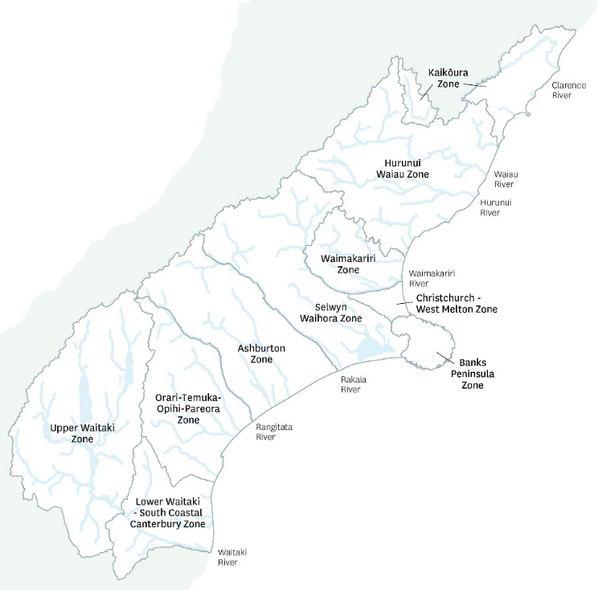
How does the CWMS work?
10 local water management committees
Seek solutions for their own zones

Slide 7
COLLABORATIVE APPROACH
ENGAGEMENT STAIRCASE
EMPOWER
COLLABORATE
INVOLVE
To place final decision-making in hands of stakeholders
CONSULT
To partner with stakeholders in the decision, including developing alternatives & preferred solution
INFORM
To work directly with stakeholders throughout process to ensure concerns & aspirations are understood & considered
To provide balanced & objective information to assist stakeholders understand problems, alternatives, solutions
To obtain feedback on analysis, alternatives, decisions
Committee decision-making is by consensus:
collaboration amongst committee members & strong engagement critical

Slide 8
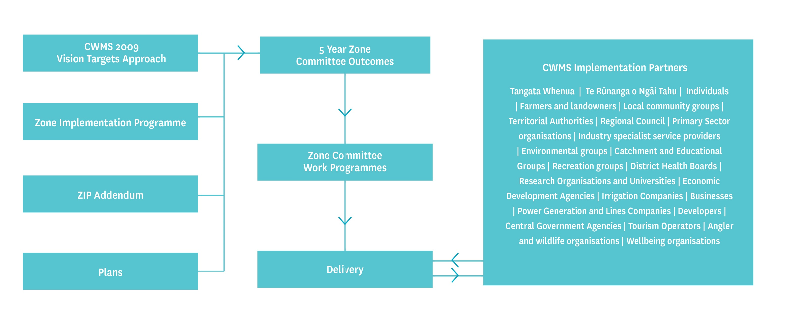
The CWMS in Action

Slide 9
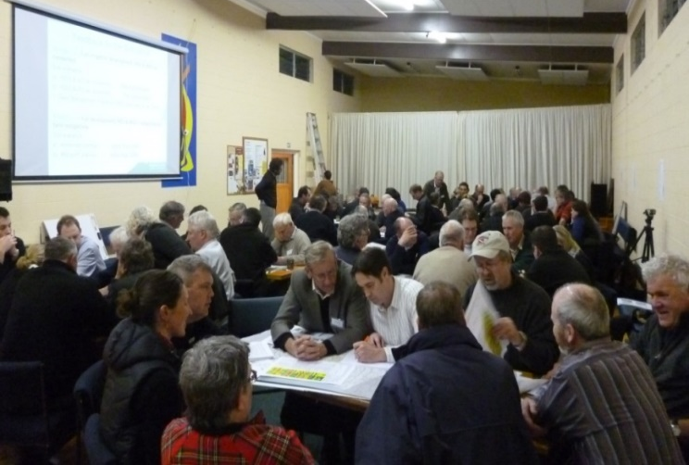
RMA plans: setting limits the collaborative way… cold halls, sausage rolls and success?
Land and Water Regional Plan (2015) and sub-regional plans for each zone (completed or underway)
Setting limits the collaborative way is definitely not business as usual
Engagement of community to develop water & land solutions before plan even drafted
Requires significant time & effort for all
New ways of working for all

Slide 10
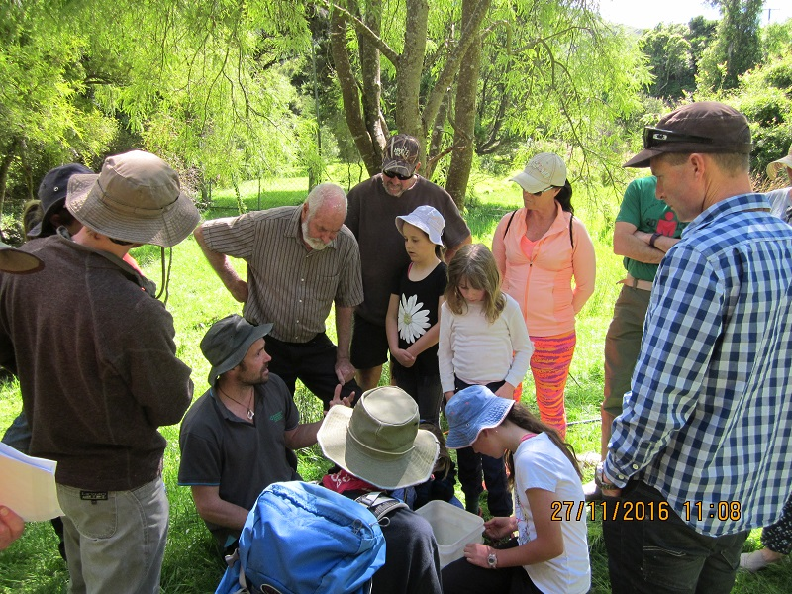
Plans require good science & data
Water quantity
Water quality
Land use
Presented according to:
  Current state
  Future scenarios
The environment needs to be monitored, trends established & outcomes defined

Slide 11
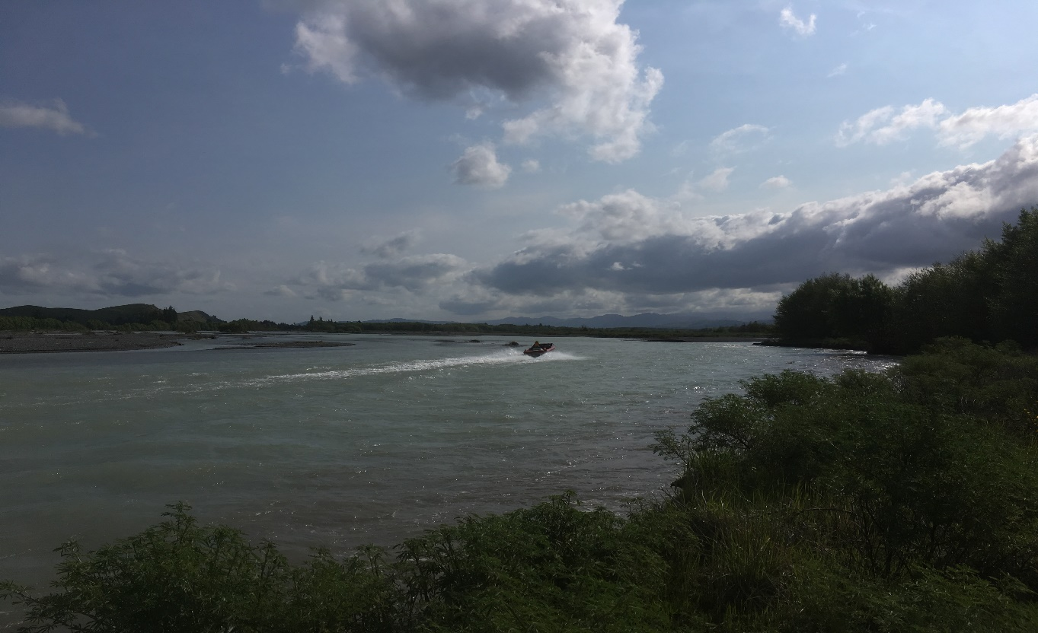
Plans are not infinite – 5 & 10 year intervals
Plans must be assessed on a 5 & 10 yearly cycle
There is an expectation that data and science models can explain improvements and indicate further actions required
How do we secure systematic, credible answers for the next generation?

Slide 12
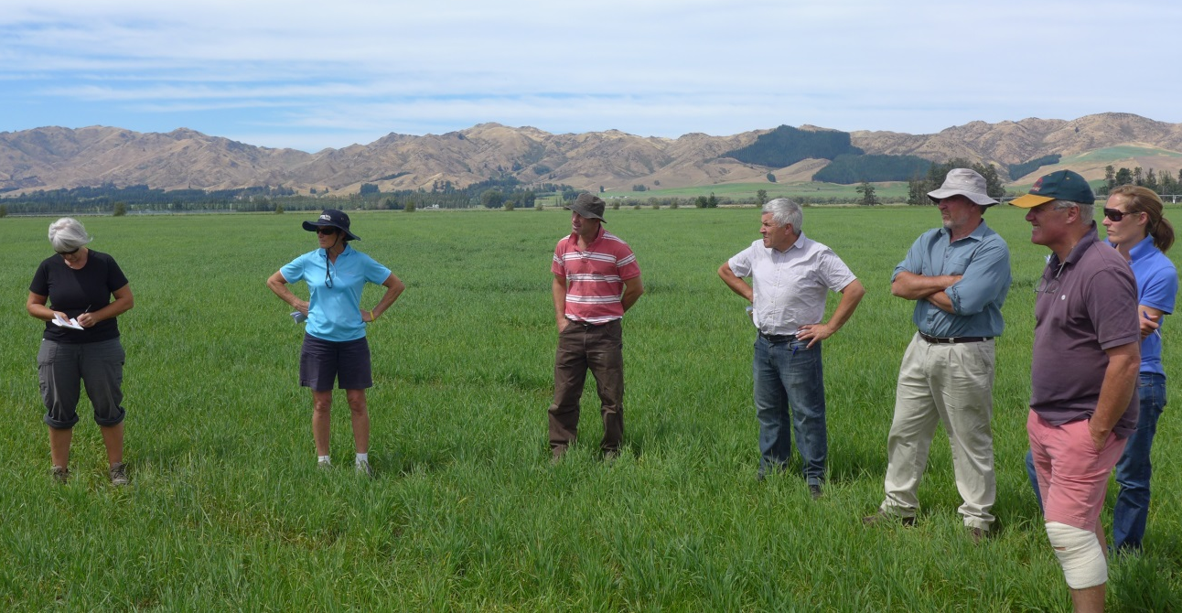
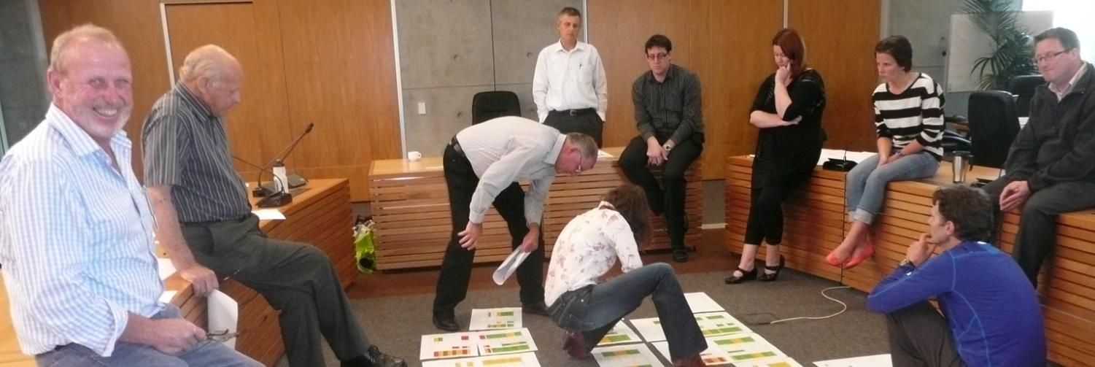
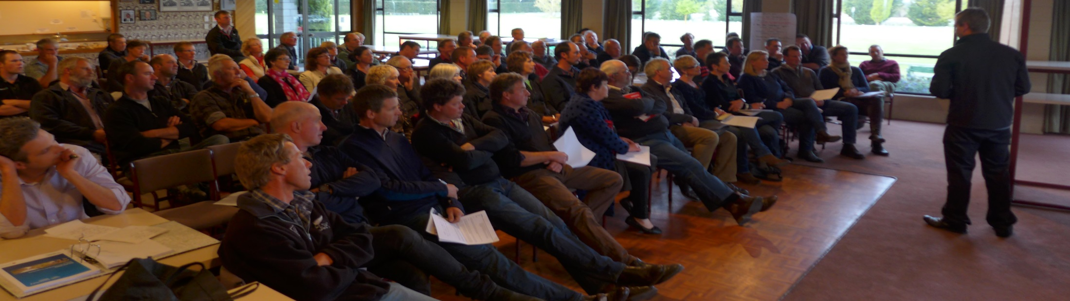
Working with communities

Slide 13
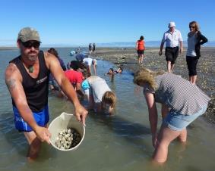
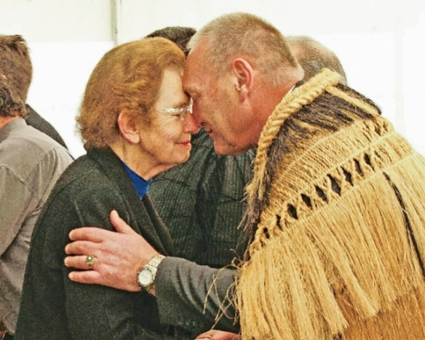
Ngāi Tahu Partnering in CWMS Collaborative Governance
Papatipu rūnanga are on every zone committee
Mana whenua have an interest in all ten target areas
Specific kaitiakitanga target
Practical environmental restoration projects
Ecan now has cultural land management advisors
We still have work to do monitoring and properly aligning with Matauranga Maori indicators – another modelling challenge?

Slide 14
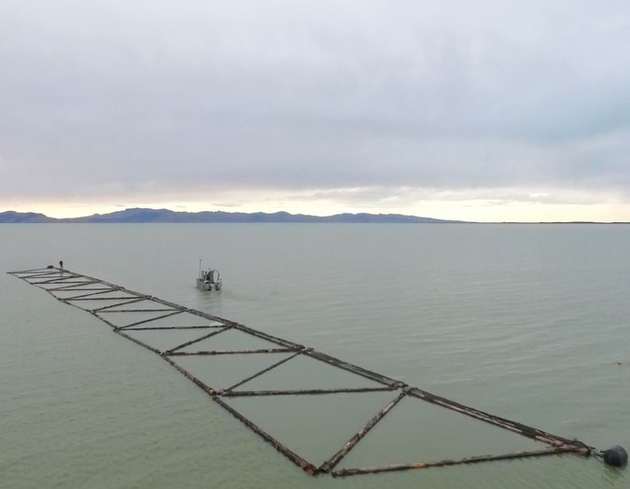
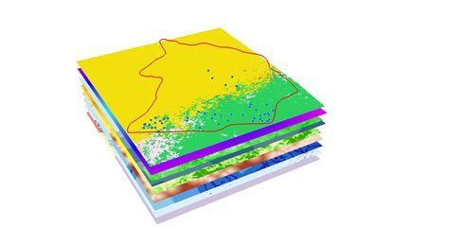
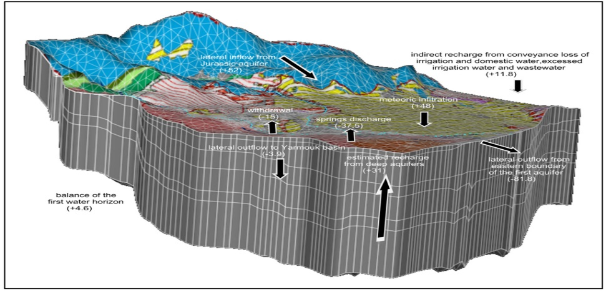
A real-time, hydrologically connected (3D?!) model for Canterbury
Model surface water – quantity and quality
Model groundwater – flow paths, connectivity and change over time; also include GW quality
Have the ability to backcast – based on prior data to show quarterly, seasonal and annual changes over time
Have the ability to show real-time data– what is the current state today? – based on real-time data, including meteorological information
Have the ability to forecast – scenarios & options, warnings etc
Have the ability to connect w/ non-science data (e.g., consents, water metering) and inform adaptive management conditions
Incorporate Matauranga Maori indicators

Slide 15
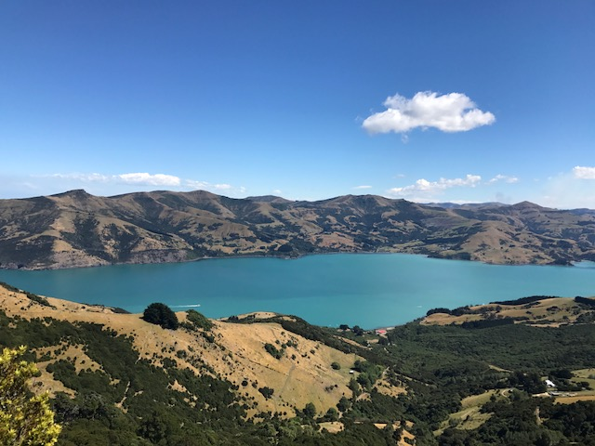
Re-conceptualising Canterbury’s water
Goal: Combining technology, data science and modelling for improved decision-making
Key targets: reduced planning costs, increased certainty and enhanced credibility

Slide 16
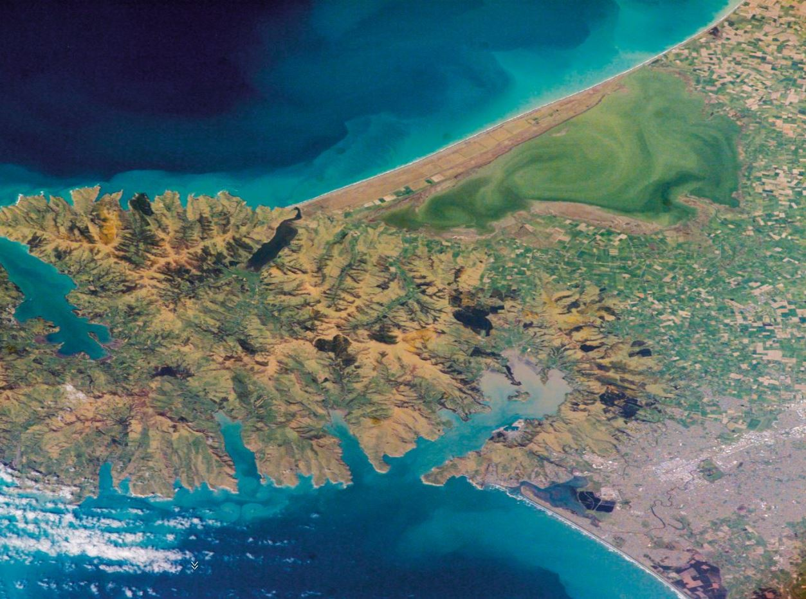
Data-modelling-policy continuum: the Selwyn-Waihora example

Slide 17
Preparation for planning
Zone committee agreed desired outcomes
  Thriving communities and sustainable economies
  High quality and secure supplies of drinking water
  Wāhi tapu and mahinga kai are protected and enhanced
  Te Waihora is a healthy ecosystem
  Hill-fed waterways support aquatic life and recreation
  Enhanced indigenous biodiversity across the Zone
Derive measures for the outcomes
  e.g. Drinking Water outcome
    Average groundwater nitrate-N concentrations in comparison with ½ Maximum Allowable Value (MAV)
    Exceedances of MAV
    Bacterial contamination of groundwater
    Nitrate-N concentrations in surface waters
    Cost of deepening wells

Slide 18
Using monitoring data and modelling
What is the current state?
  What are the current monitoring data telling us about whether we are currently:
    supporting aquatic life and recreation
    Providing high quality drinking water
Series of modelled scenarios to explore possible futures
  Baseline (current & consented land use allowing lag times)

Slide 19
Modelled scenarios
Series of scenarios to explore possible futures
  Baseline (current & consented land use allowing lag times)
  An extra 30,000ha of irrigated land
  Achieving a TLI of 6
  Full on-farm mitigation (max feasible)
  Solutions packages (mixture of above)
Requires a sophisticated model that can deal with:
  GW-SW interaction
  Link to a lake water quality & ecology model
  Water quality and quantity
  Land use change across catchment
N.B. the first four scenarios were not options
  About exploring possible futures

Slide 20
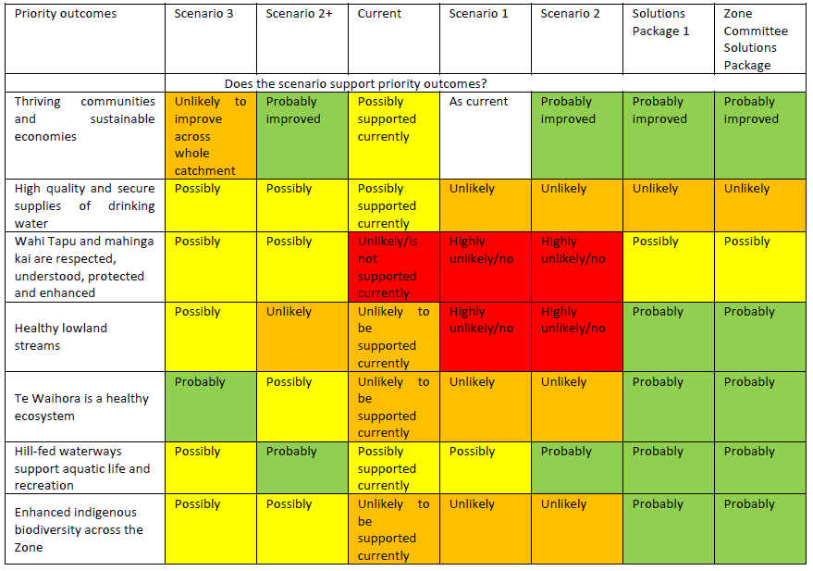
Outcome of scenario modelling

Slide 21
Outcome of scenario modelling

Slide 22
Solutions package – improved flows
Substantial raising of minimum flows for lowland streams in 2025 (15-20% increase)
  Helped, but not dependent on, Central Plains Water replacing deep groundwater takes with alpine-sourced water takes
Water transfer requires that 50% of consent is returned to environment
  Central Plains water users can’t trade water consent

Slide 23
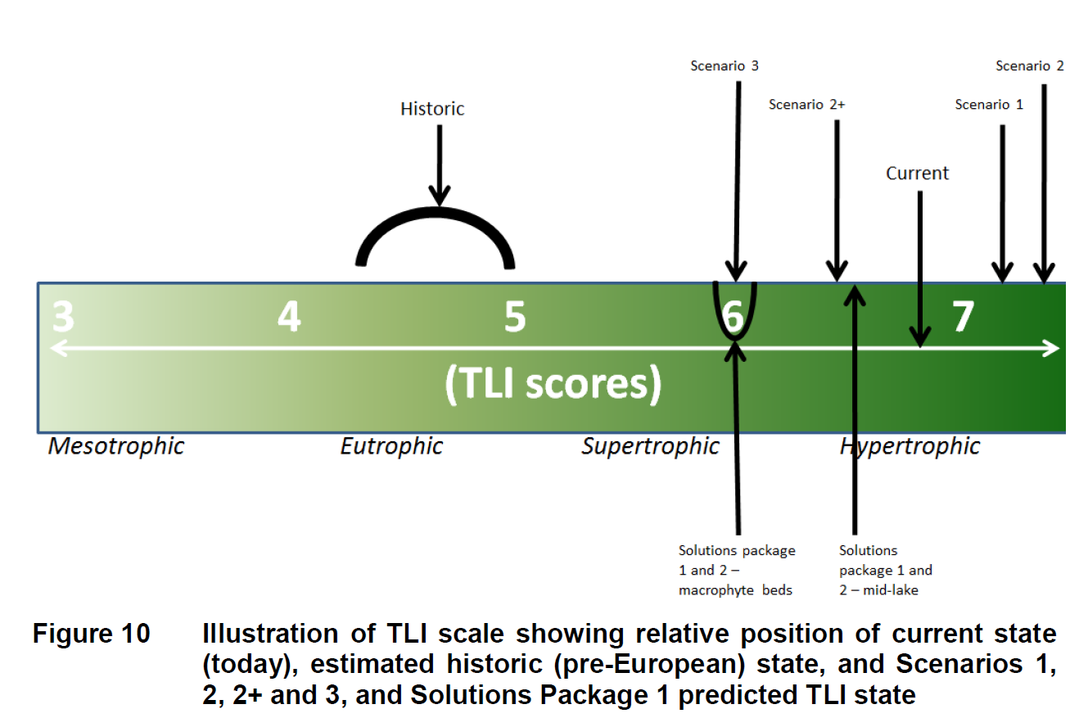
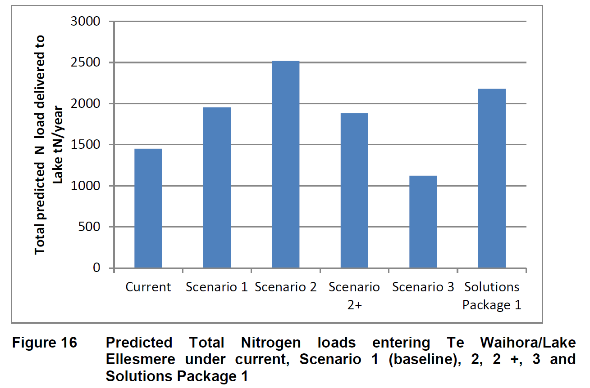
Solutions package – lake water quality
Root zone nitrogen loss of 4830 tonnes/year from farming
  This requires a 14% reduction over and above Good Management Practice (30% for dairying, 5% for arable)
  Not all of this nitrogen will reach the lake
Increasing wetlands across catchment will further reduce N (and P) loads
  20% reduction with 593 ha of wetland

Slide 24
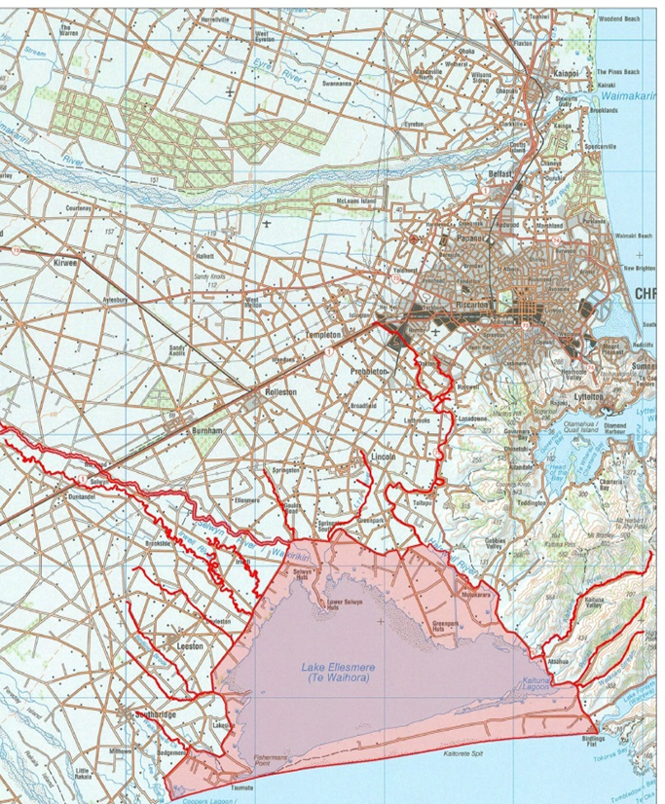
Solutions package - other
Cultural Values Land Management Area
  Land users close to lake must consider cultural values in Farm Environment Plans
Increased flows and reduced N load to keep instream N concs below toxicity limit
Greatly improved riparian habitat across catchment
Plan reviewed after 10 years

Slide 25
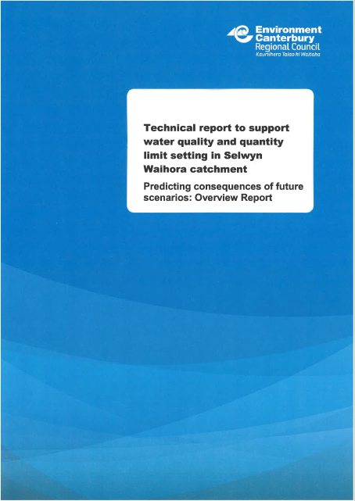
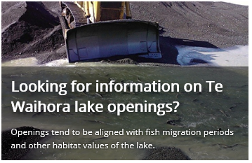
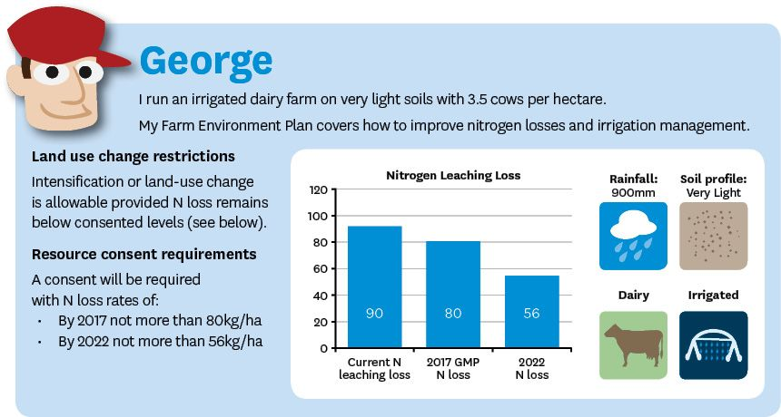
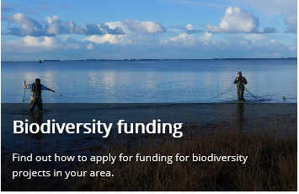
Information available on ECan website under Canterbury Water and Selwyn-Waihora zone

Slide 26
