Slide 1
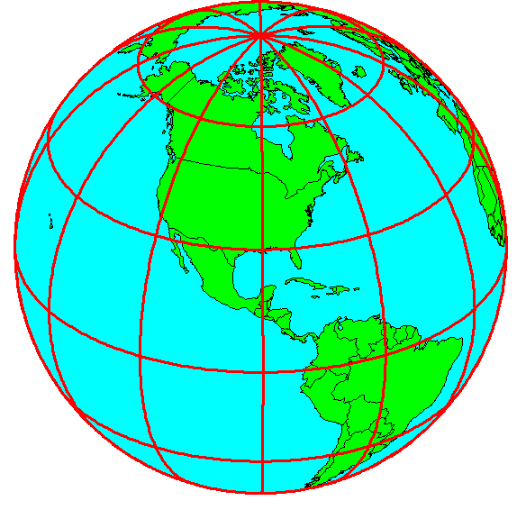
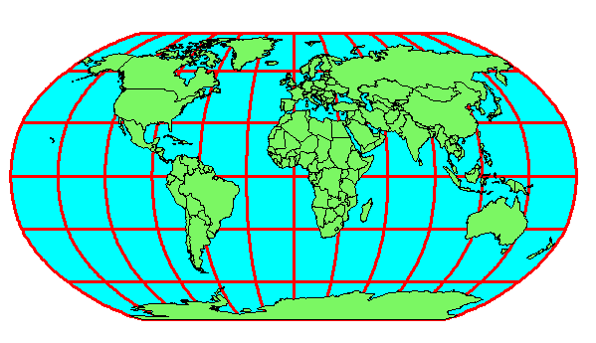
Earth to Globe to Map
Map Scale:
Map Projection:
Representative Fraction
Globe distance
Earth distance
Scale Factor, k
Map distance
Globe distance
=
=
(e.g. 1:24,000)
(e.g. 0.9996)

Slide 2
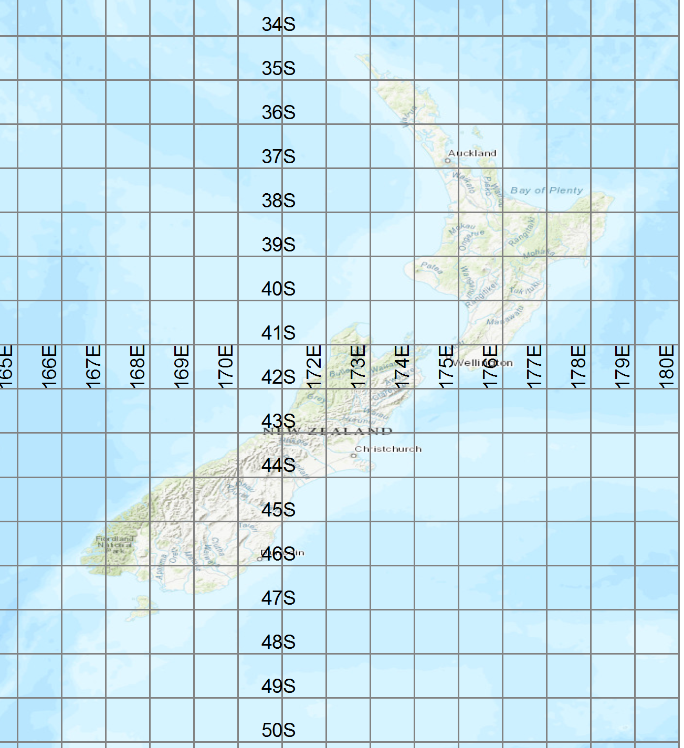
Extent of New Zealand
34°S to 48°S
Central Meridian
166°E to 179°E

Slide 3
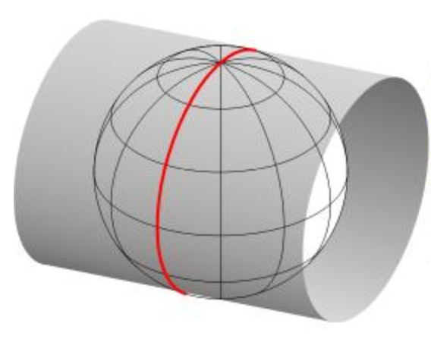
Transverse Mercator Projection
A cylinder surrounding the earth and touching it on one Meridian
For New Zealand, this meridian (line of constant longitude) is 173°E

Slide 4
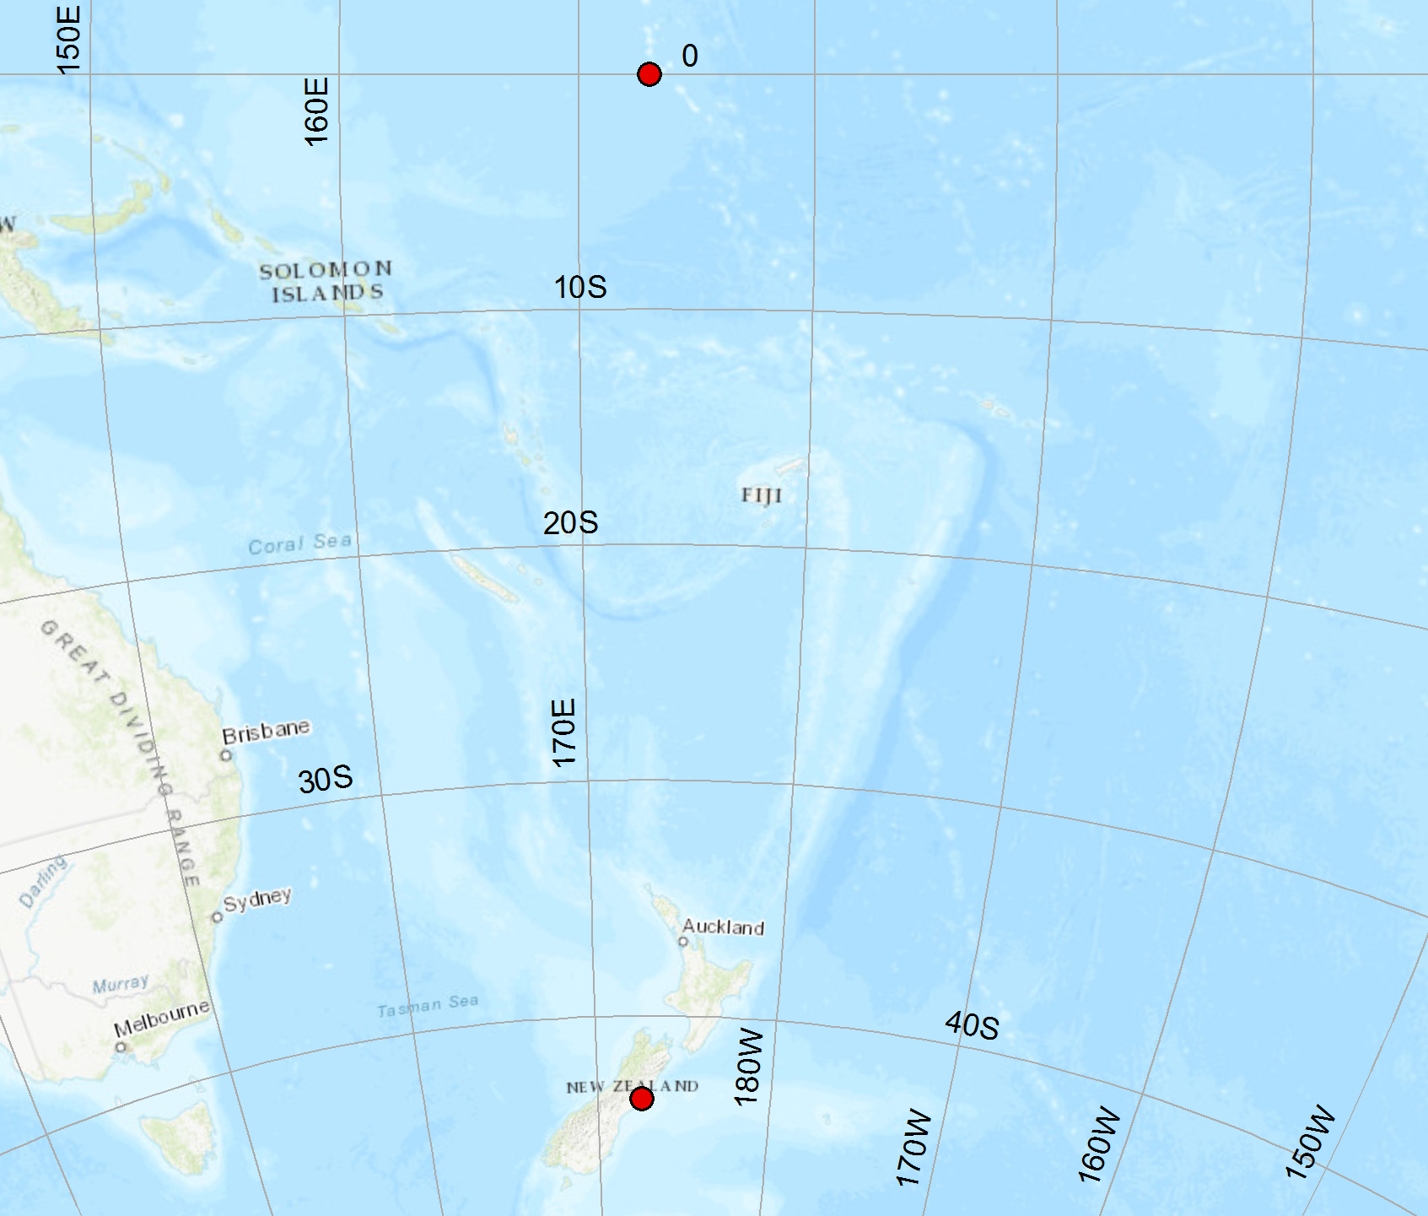
New Zealand Transverse Mercator Projection (NZTM)
(0°, 173°E)
(1600000, 10000000)
Origin:
Latitude = 0°
Longitude = 173°E
False Easting (X) = 1,600,000
False Northing (Y) = 10,000,000
Latitude of Origin = 0°
Central Meridian = 173°E
UC Engineering Building
(1566365, 5181181)

Slide 5
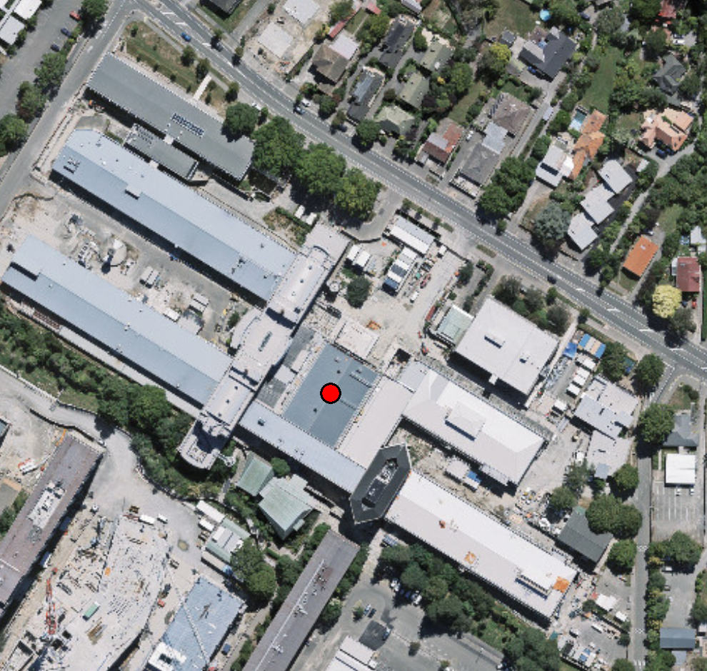
UC Engineering Building
NZTMX =1566365
NZTMY = 5181181

Slide 6
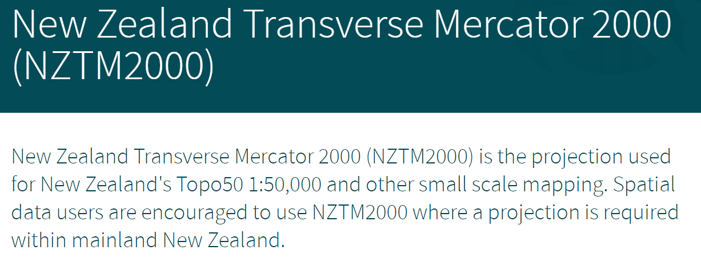
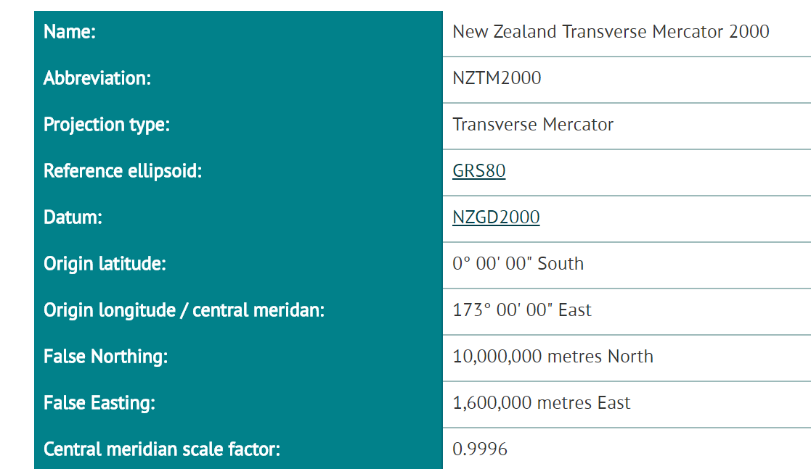
Establishes horizontal location as (X,Y) coordinates
https://www.linz.govt.nz/data/geodetic-system/datums-projections-and-heights/projections/new-zealand-transverse-mercator-2000

Slide 7
Representations of the Earth
The Geoid is a surface of constant
gravitational potential
Sea surface
Ellipsoid – NZ uses
a standard ellipsoid
called GRS80
Earth surface
Geoid

Slide 8
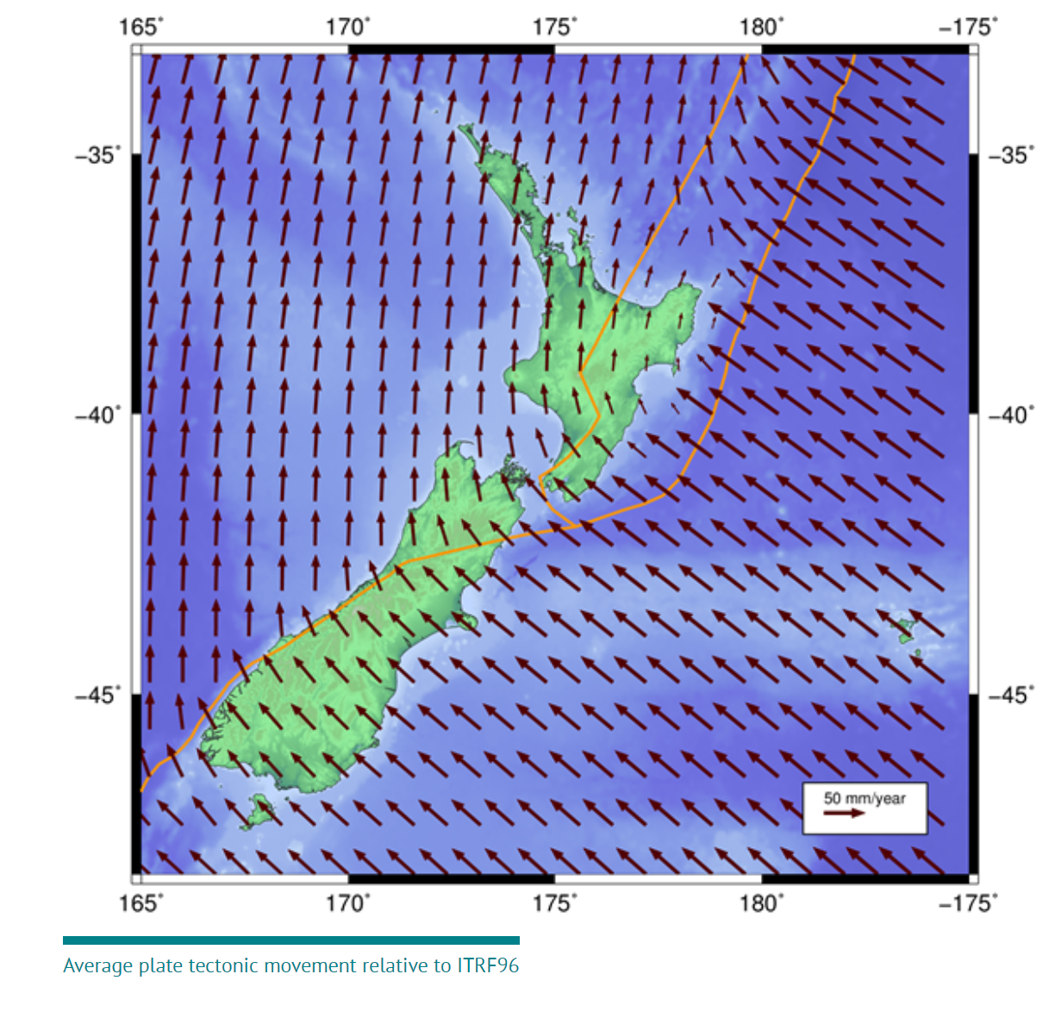

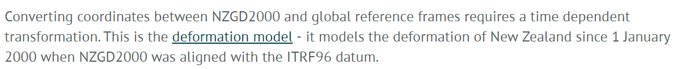
Plate Tectonic Movement

Slide 9
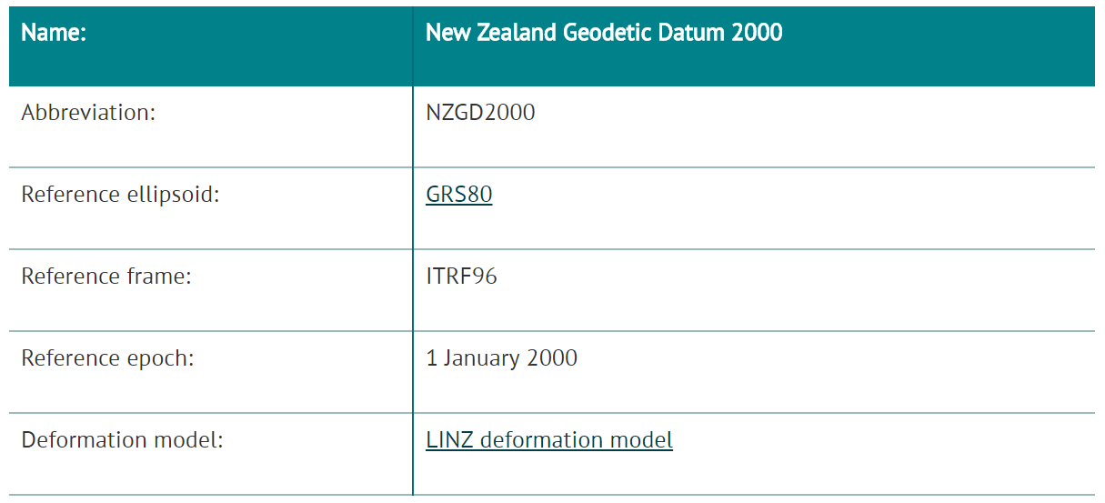
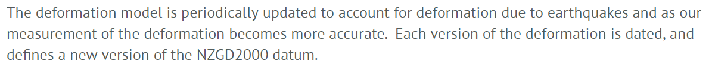
New Zealand Geodetic Datum
Establishes vertical location as Z-coordinate

Slide 10
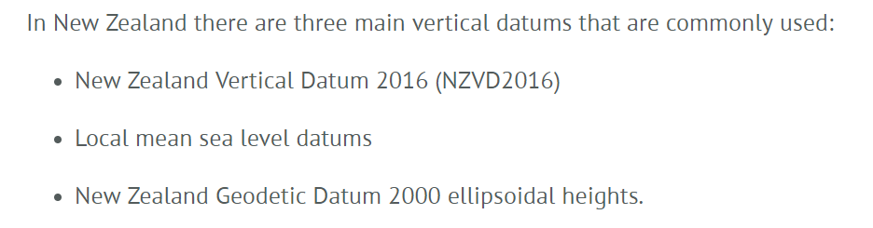
NZ Vertical Datums
Orthometric heights: produced using a Geoid (NZVD2016)
(these are “true” heights for water flow)
Tidal heights: derived from tide gages—related to sea level
Ellipsoidal heights: produced by GPS on GRS80 ellipsoid
(abundant data)

Slide 11
