Slide 1
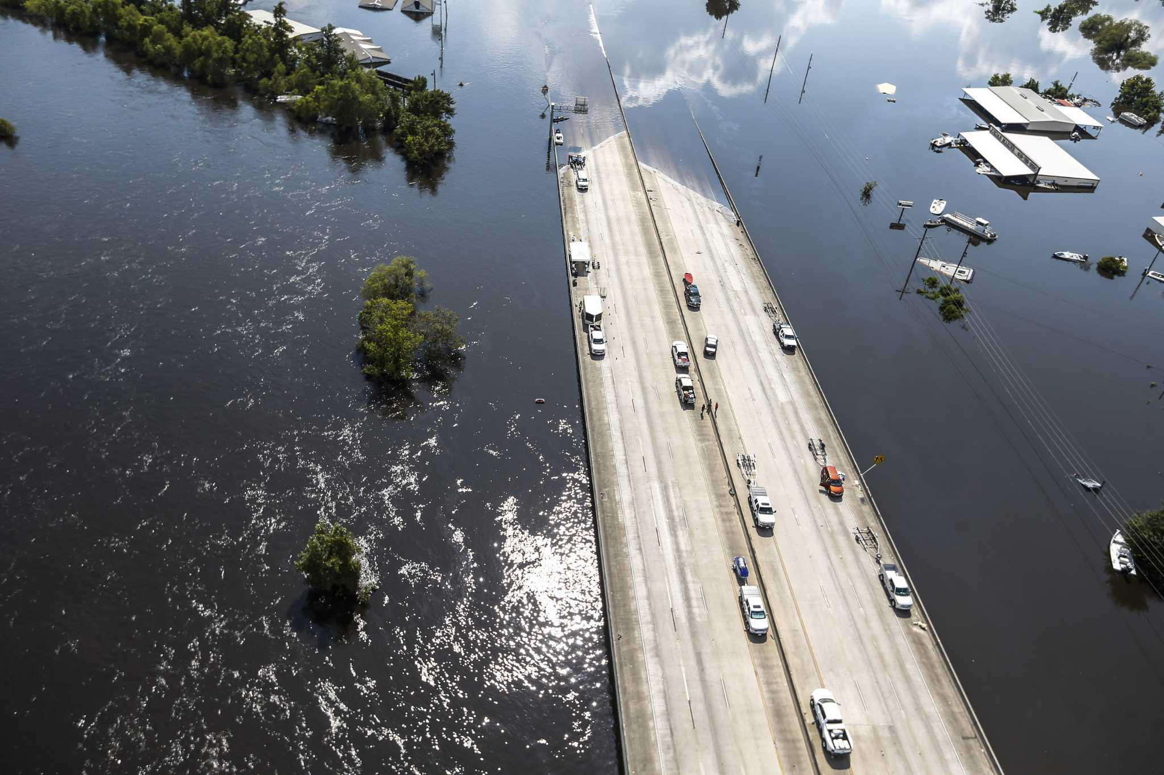
TxDOT Project 0-7095-01
Flood Assessment System for TxDOT (FAST)
Quarterly
Review
8 July 2026
The University of Texas at Austin
US Geological Survey
KISTERS
ESRI
Notes:
Allison

Slide 2
  TxDOT Project Management Committee (PMC)
Rose Marie Klee – Lead Advisor
TxDOT DES - H&H Section Director
Matthew Heinze – Lead Advisor
TxDOT MNT – Maintenance Support Section Manager
Jadé Adediwura – Project Manager
TxDOT RTI – Research Project Manager
Chris Henry
TxDOT MNT – Deputy Director
Omar DeLeon
TxDOT MNT/AUS – Acting Deputy District Engineer/Director of Maintenance
Allison Wood
TxDOT DES / Huitt-Zollars
Jared Browder
TxDOT MNT – TxMAP Specialist
Mauricio Moreno
TxDOT ITD – Information Security Architect
Mark Wallace
TxDOT AUS – Bridge Engineer
ChunHo Lee
TxDOT BRG – Geotechnical Engineer
Notes:
Allison

Slide 3
  TxDOT Technical Project Management Team (TPMT)
Rose Marie Klee – Lead Advisor
TxDOT DES - H&H Section Director
Allison Wood
TxDOT DES / H&H Engineer – Deputy PM
Notes:
Allison

Slide 4
  TxDOT Technical Stakeholders
Matthew Heinze – Lead Advisor
TxDOT MNT – Maintenance Support Section Manager
Chris Rizzo
TxDOT MNT – Field Support Services Branch Manager/ Deputy Emergency Management Coordinator
Mauricio Moreno
TxDOT ITD – Information Security Architect
Jared Browder
TxDOT MNT – TxMAP Specialist
Priscillo Campos
TxDOT ITD – Management Analyst
Mysti Tran
TxDOT ITD – IT Planning & Admin System Branch Manager
Alonzo Balderaz
TxDOT ITD – GIS Development & Maintenance Lead
MJ Jackson
TxDOT ITD – Management Analyst
Aiko Neill
TxDOT ITD – IT Contract Management Branch Manager
Jason Henderson
TxDOT ITD – GIS Systems Architect
Lisa Ramirez
TxDOT ITD – Contract Administrator
Notes:
Allison

Slide 5
  Project Advisory Committee
NOAA National Weather Service
NOAA Weather Forecast Office
Fernando Salas
National Water Center, Geo-Intelligence Division
Jonathan Brazzell
Regional Hydrologist, Lake Charles Office
Derek Giardino
National Water Center, Geo-Intelligence Division
Katie Landry-Guyton
Regional Hydrologist, Houston/Galveston Office
Carson Pruitt
National Water Center, Geo-Intelligence Division
US Army Corps of Engineers
Jason Johnson
Hydrologist-in-Charge, West Gulf River
Forecast Center
Brent Higginbotham
Chief, Water Resources, Ft. Worth District
TxDOT H&H Section
State and Local Agencies
Ab Maamar-Tayeb
Davis Magenheimer
Edra Brashear
Sara Armendariz
Zenia De Leon
Harrison Smith
Abtin Hamedani
Stephanie Castillo
Jeff Linder
HCFCD
Jorge Urquidi
City of Austin, FEWS Team
Peter Smith
former TxDOT Director TPP
Christina Bryant
City of Austin, FEWS Team
Sam Marie Hermitte
TWDB, Water Science Conservations
Chris Wright
Williamson County
+ TxDOT Project Management Committee
Notes:
Allison

Slide 6


  Project Deliverables
Project Management
Organization, Coordination,
Reporting, and Communication
Dr. David Maidment
Kristine Blickenstaff
FAST Layers
Gauges
Research
Task 2
Flood Map Services
Task 4
Flood Transportation Geodatabase
Task 5
Flood Data
Services
Task 3
Flood Decision Support Gauges
Task 6
Forecast Data Analytics
Flood Map
Development
Flood Map Delivery
Field Mapping
Flood Emergency
Response Exercises
Road Elevation Model
Stream Hydrography
Road Inundation
Span Bridges
Bridge Class Culverts
Low Water Crossings
Bridge Warnings
Flooded Road Inundation
Flood Impact Assessment
Data Assimilation Implementation
Transportation Flood Impact Simulation
Gauge Operation and Maintenance
Gauge Calibration
RQ30 Flood Decision Support Toolbox Sites
Velocity – Stage Height Interaction
Synthetic Rating Curves
Probability of Road Overtopping
Assimilation in Space and Time
Regional Error Assessment
Notes:
Tim

Slide 7
  Project Management Plan Update – Oct 2025 to June 2026
Conducted training exercise / AUS & HOU
  AUS – Waco, San Antonio, Bastrop, SOC, Austin, Kerrville, H&H
  HOU - Houston, Montgomery, Beaumont, Bryan, Yoakum
Complied feedback from AUS & HOU
Ft Worth (July 28th) scheduled
FAST Layers
Flood Map Services
Flood Data Services
Prepped FAST for training exercises
Created Landing Page
Refactored & optimize FAST
Flood Transportation Geodatabase
Recomputed all 25 Districts bridges by Oak Ridge
O&M of the 80 RQ-30 sites – routine field trips, run levels, and streamflow measurements​
Data management and analysis of incoming sensor data – assess new approach and tools to improve efficiencies of gage calibration​
Worked on installation of updated power-supply and secondary telemetry equipment at select sites
Completed assessment of RQ-30 sites to be added to the FDST and prepared the synthetic rating curve publication for submittal to the journal
Gauges
Flood Decision Support Gauges
Research
Forecast Data Analytics
Forecasting accuracy assessment initiated and ongoing for entire FAST domain (Texas-Gulf Coast region)
FAST rainfall-runoff model developed and tested across Texas Hill Country
Notes:
Tim

Slide 8
  FAST
Notes:
Tim

Slide 9
  What is FAST
A website and service that gives predicted warnings and real-time updates about flooding on the Texas transportation network.
“An emergency response tool that helps TxDOT proactively plan for and respond to flood threats.”
Notes:
Tim

Slide 10
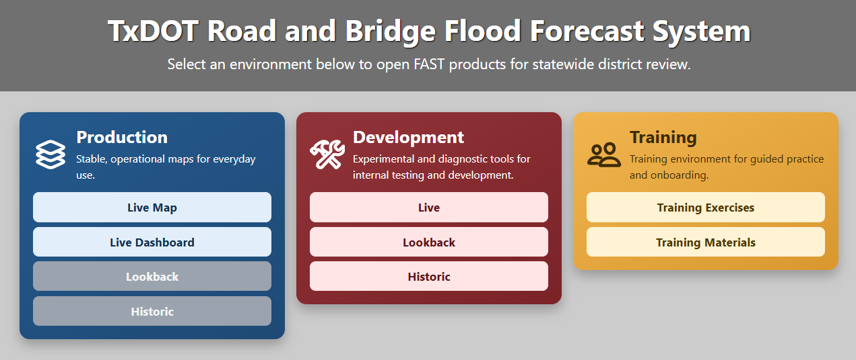
  Live Demo
https://bridges.txdot.kisters.cloud/
Notes:
Tim

Slide 11
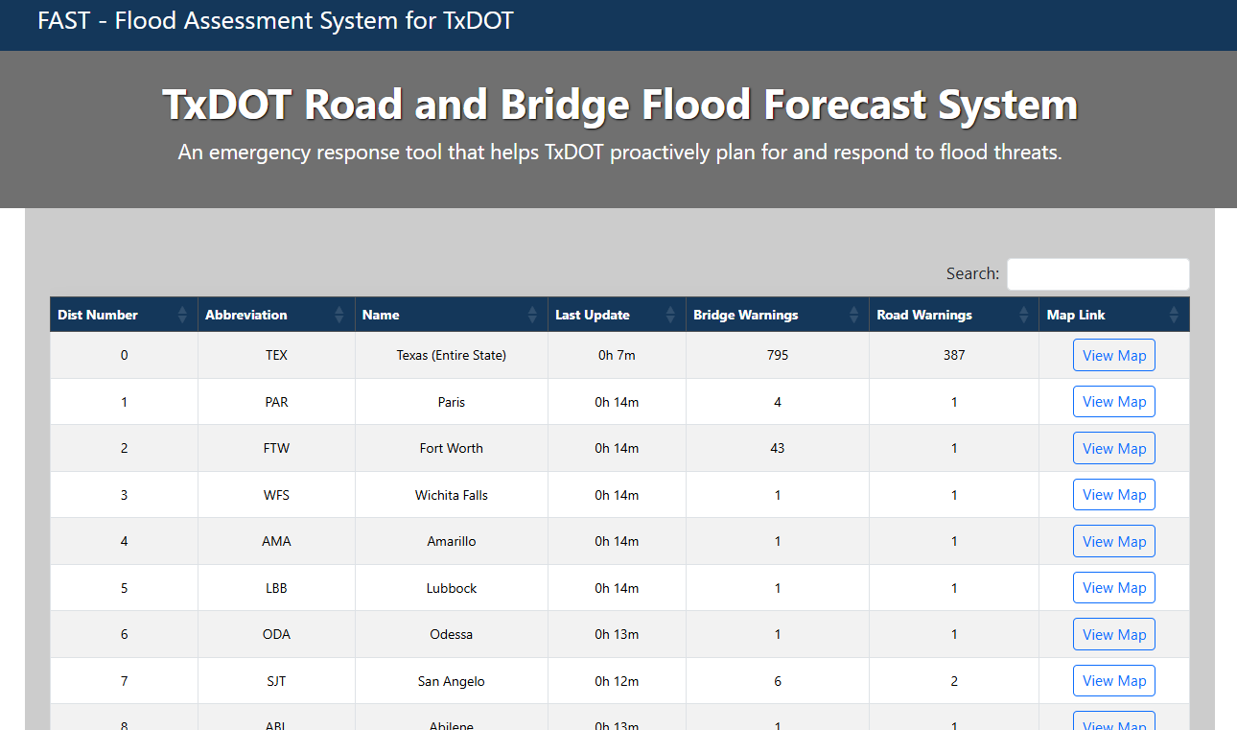
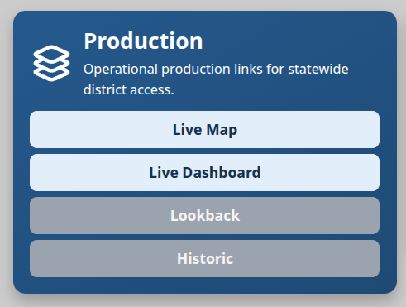
How do I
access FAST?
Notes:
Tim

Slide 12
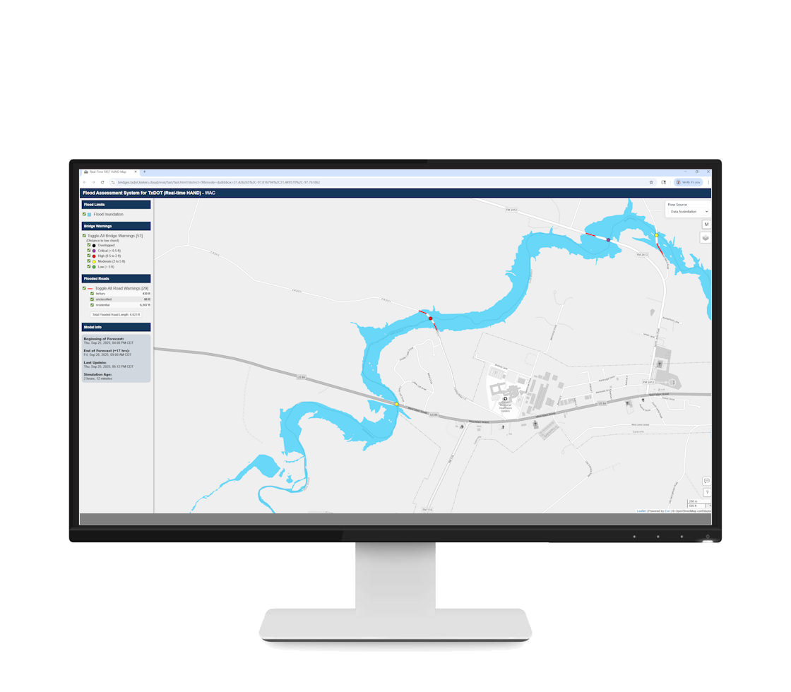
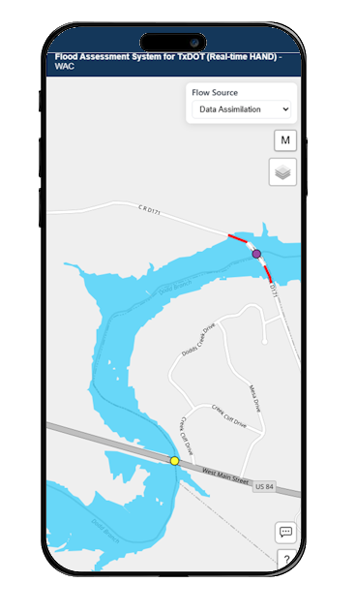
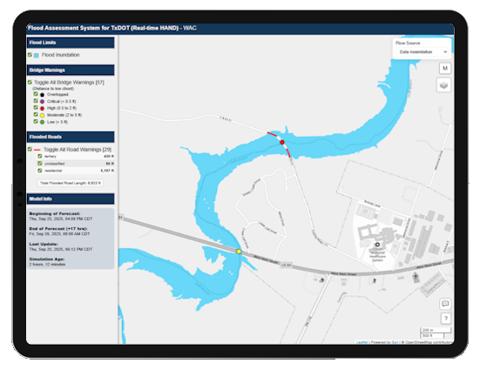
Devices:
Note: TxDOT staff must not use mobile applications while driving. Always focus on the road and follow all state and agency safety regulations
Notes:
Tim

Slide 13
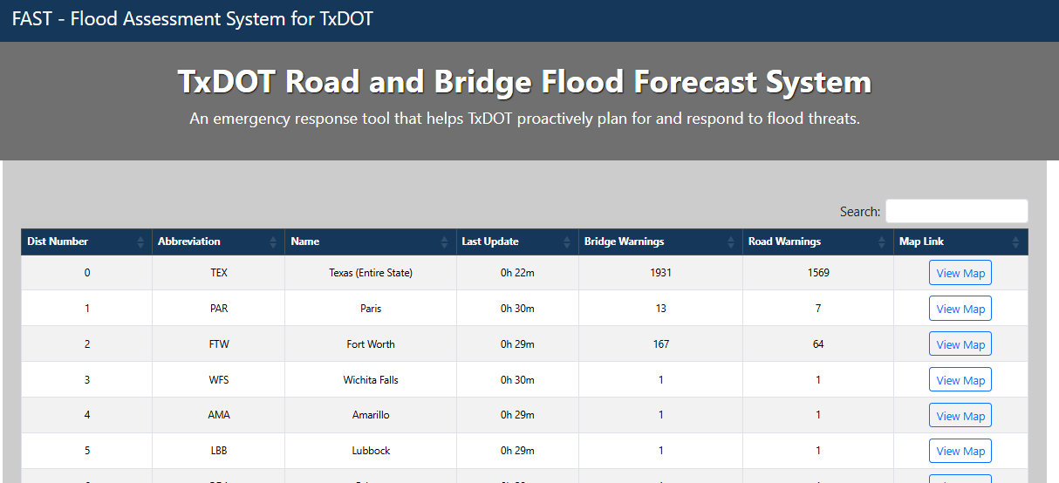
Navigate the dashboard:
1
All columns are sortable
How long since flood information was updated
4
2
1
2
3
Count of bridge warnings and road warnings impacted by forecasted flooding
3
4
Type to search
5
5
Click to view given row’s map
Notes:
Tim

Slide 14
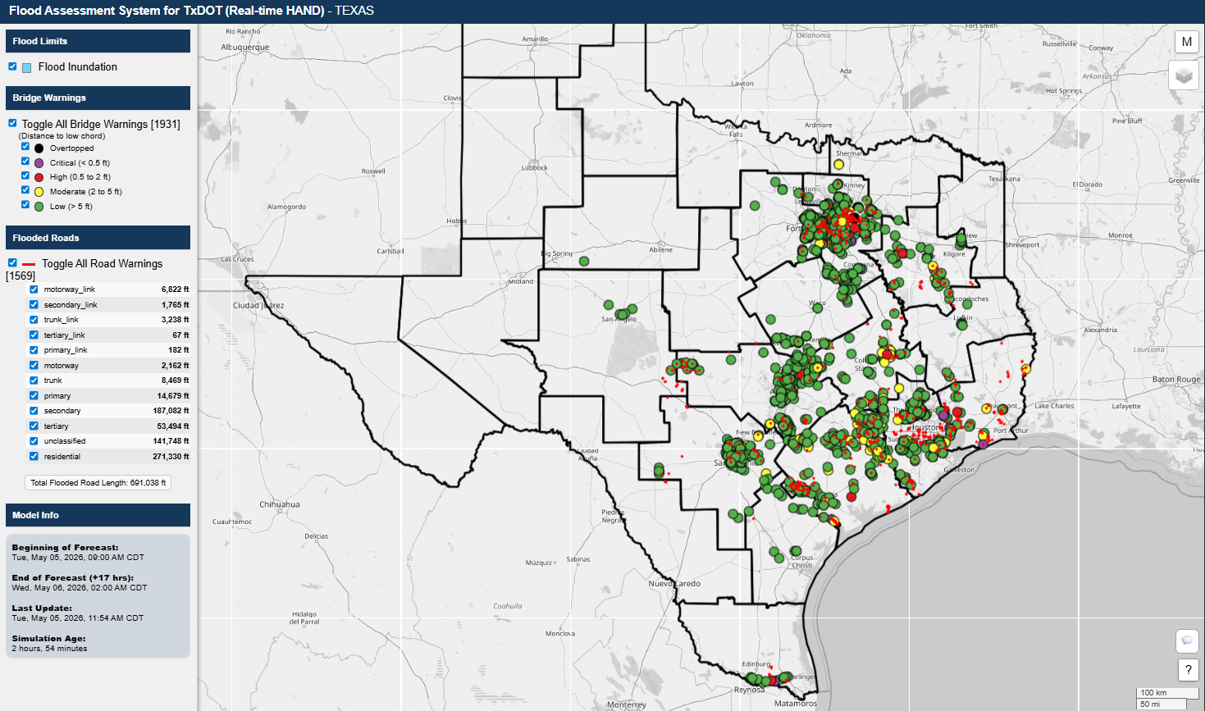
Statewide
Map
Notes:
Tim

Slide 15
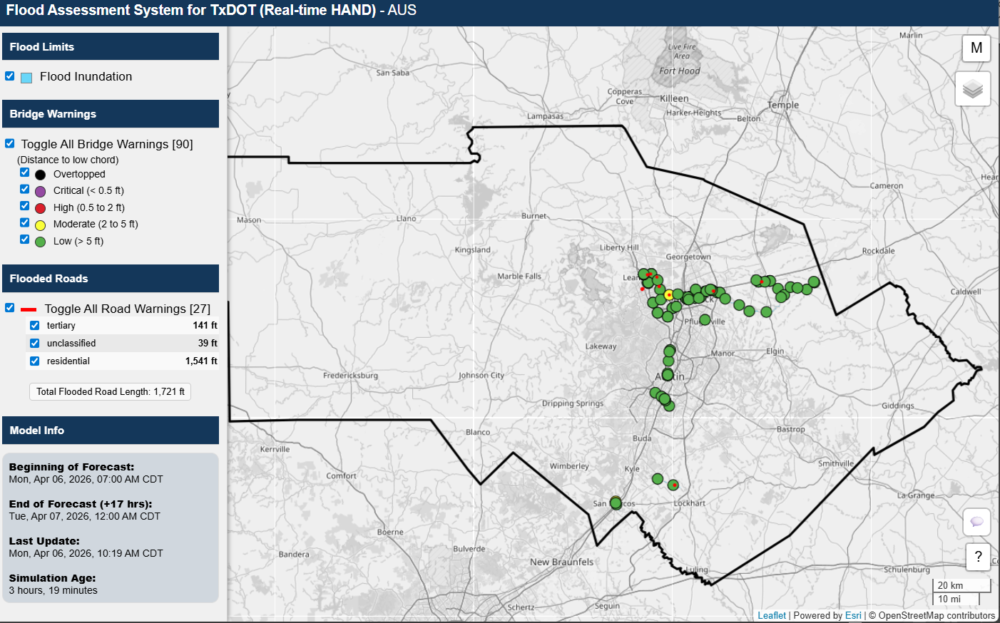
My district’s
map
Notes:
Tim

Slide 16
Map Options:
Toggle menu ‘sidebar’ on/off
Flood layers with toggles
c
3
1
Basemap and
Overlay map options
4
Flood forecast model information
Provide user
feedback
2
5
6
Disclaimer Pop up
Notes:
Tim

Slide 17
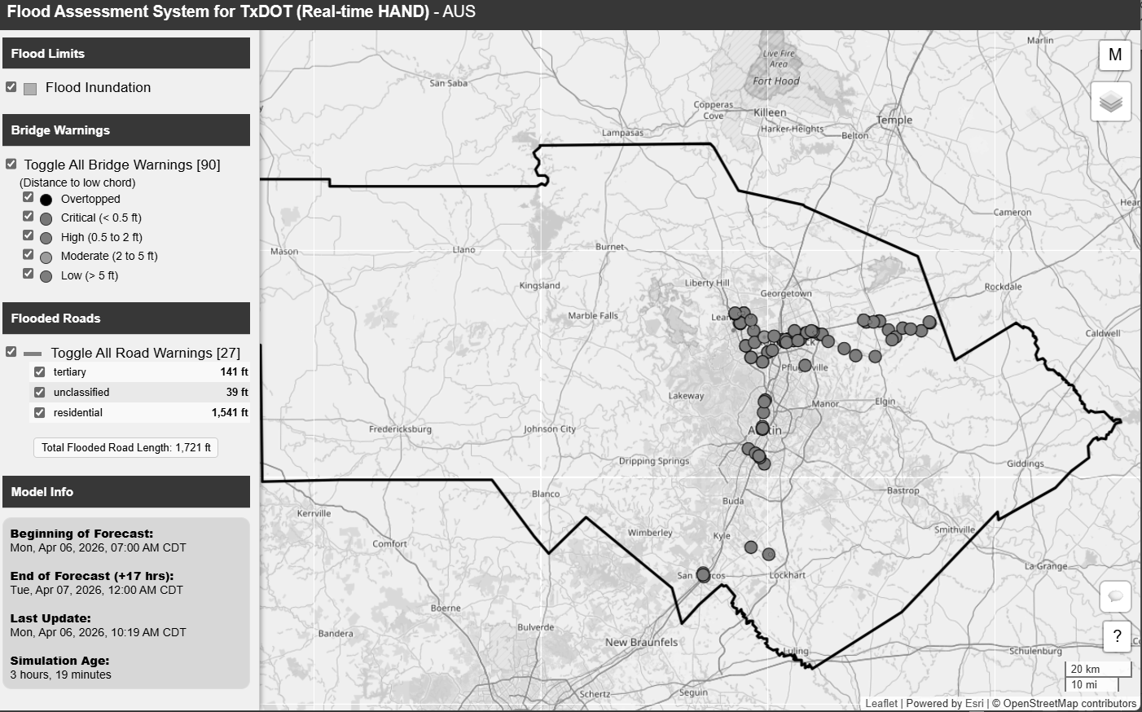
Model Info:
1
Most current flood forecast provided by
National Weather Service
2
Last hour in that forecast
3
Time when this FAST webpage was loaded
or refreshed
4
How old the forecasted data are in this webpage
2
Flood forecast model information
Notes:
Tim

Slide 18
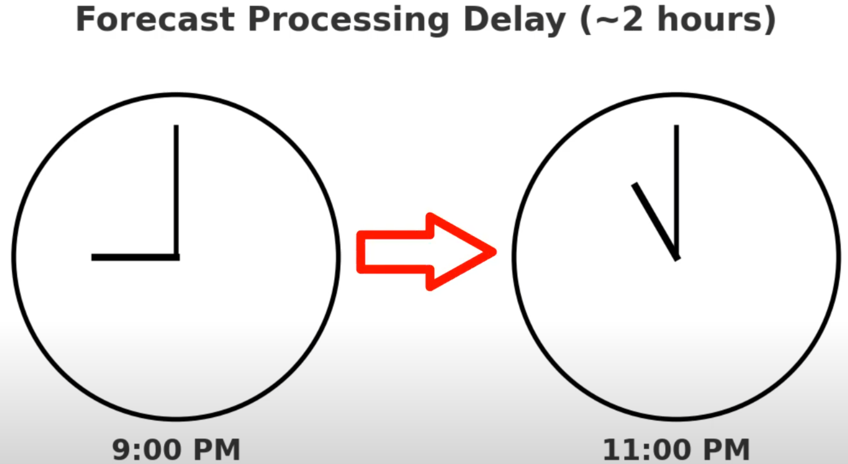
Why are the forecasts old:
The National Water Model forecasts run on supercomputers and need time to gather, process, and check huge amounts of weather and river data, so the forecast results are usually available about 2+ hours after the current time.
How old the forecasted data are in this webpage
4
Notes:
Tim

Slide 19
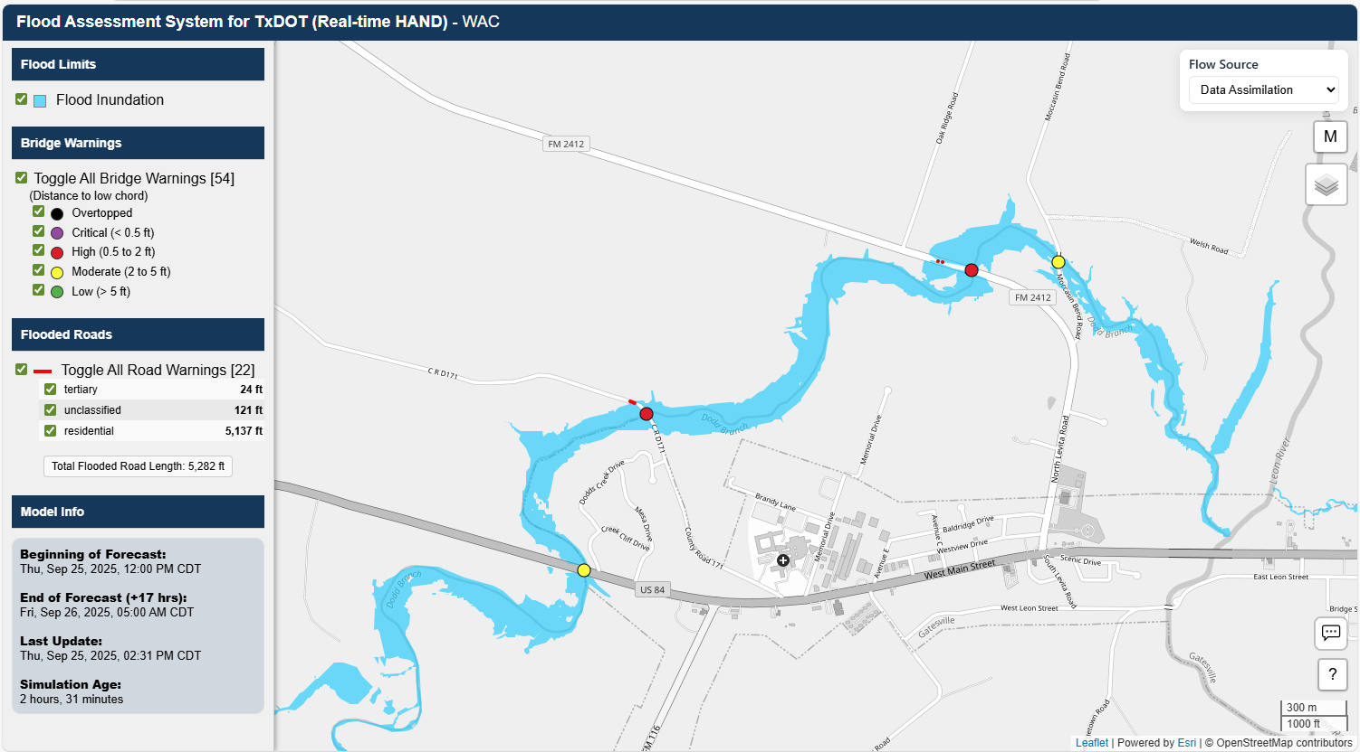

Flood Inundation Warnings:
Maximum flooding
limits expected in
“forecast window”
1
Notes:
Tim

Slide 20
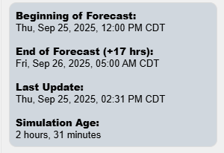
Most current flood forecast provided by National Weather Service
What are these warnings:
FAST warnings point out the highest river levels that could happen at each location in the next 18 hours. If a FAST warning shows up, it means that spot could see flooding during that forecast window.
The forecasts are updated every hour with a completely new 18 hour look ahead.
Forecast Window
Last hour in that forecast
Notes:
Tim

Slide 21
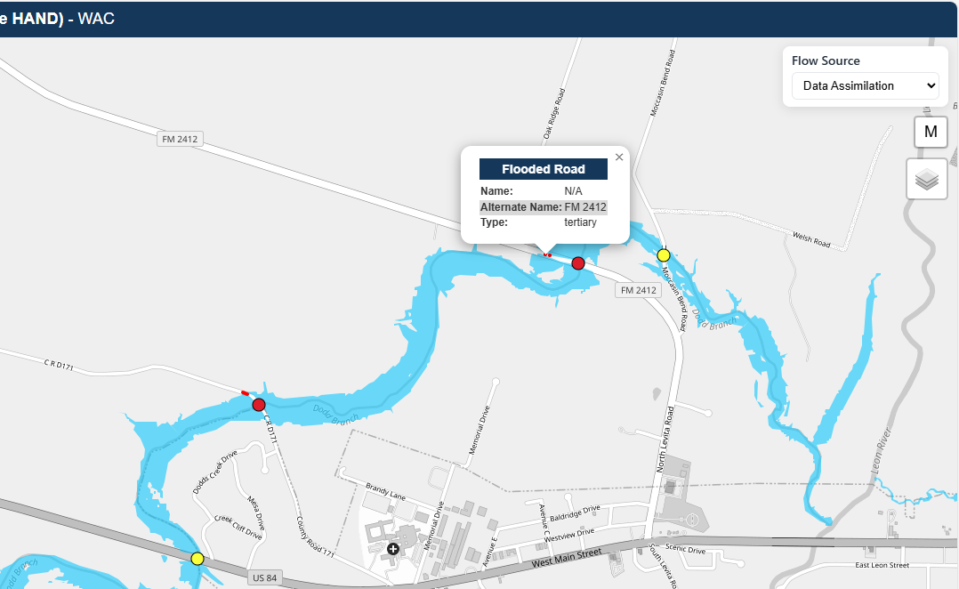

Road Warnings:
N Levita Rd
Select flooded road
line for pop-up
1
Notes:
Tim

Slide 22
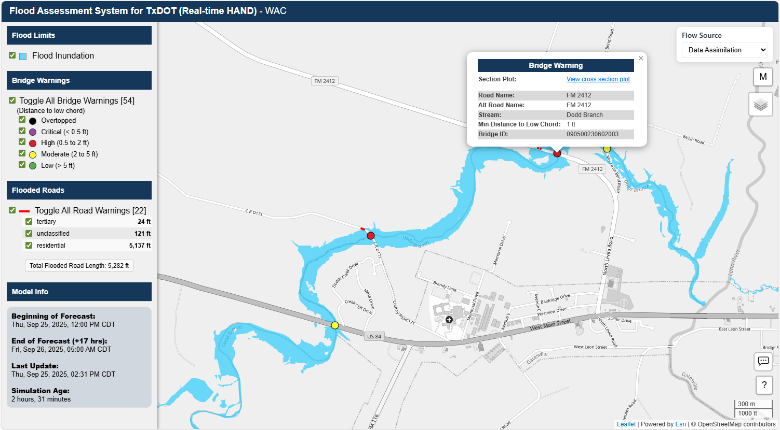

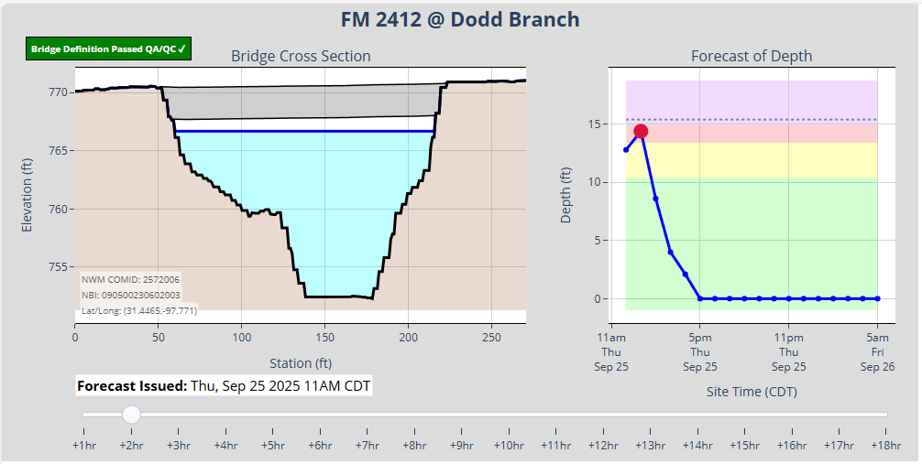
Bridge Warnings:
Click “View cross section plot” – open in a new browser tab
2
c
Forecasted stage (water surface) each hour on bridge
4
Select bridge warning point to get pop-up
1
3
Move slider to animate forecast
Notes:
Tim

Slide 23
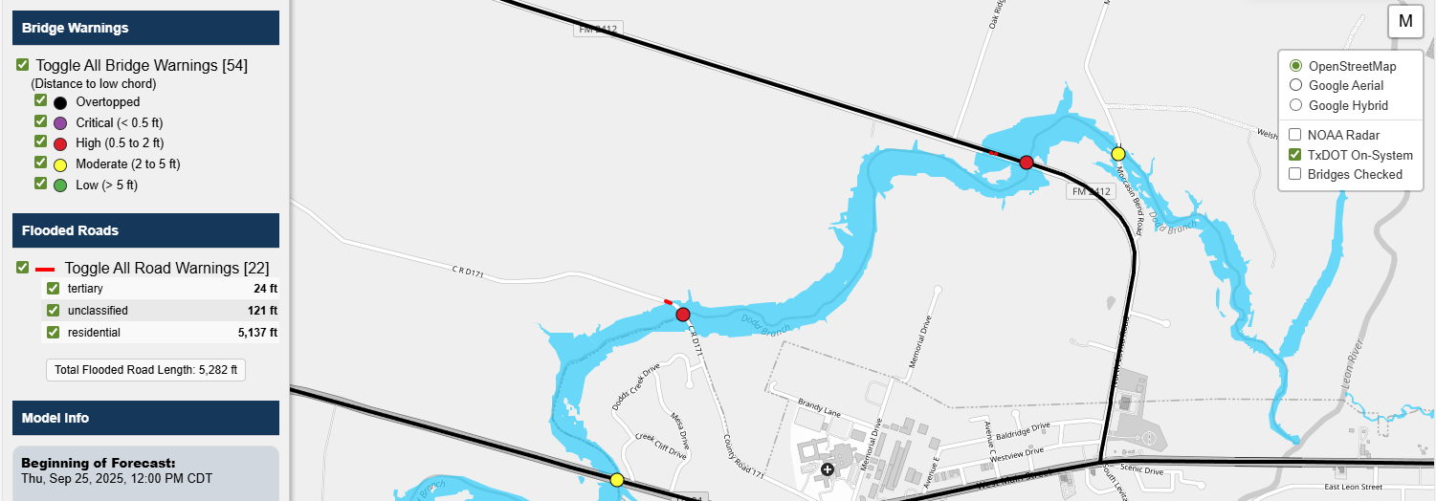
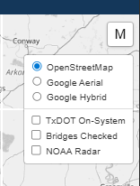

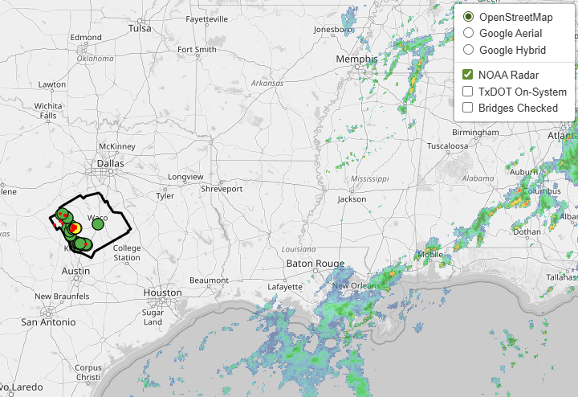
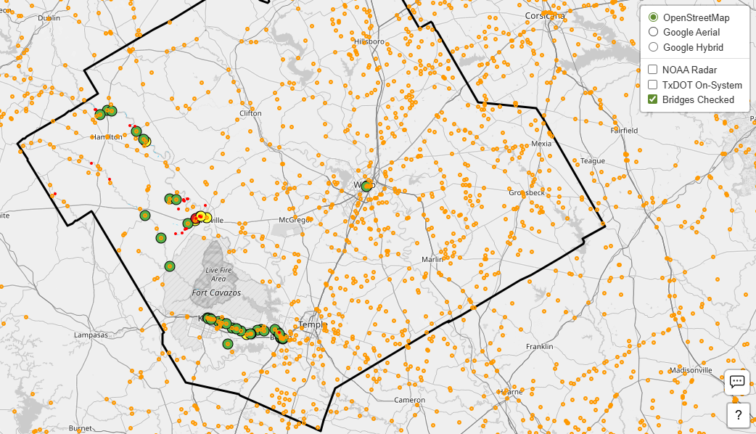
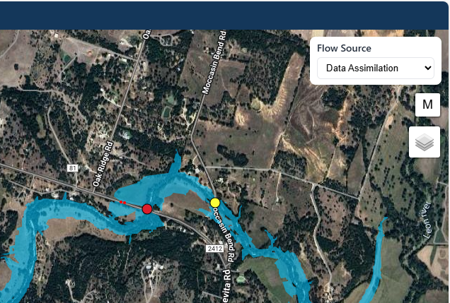
Base maps and overlays:
Overlay: TxDOT On-System (Roads)
c
Base Map: OpenStreetMap
Overlay: NOAA Radar (Live)
Overlay: Bridges Checked
i.e. where forecasts are evaluated
Base Map: Google Hybrid
Notes:
Tim

Slide 24
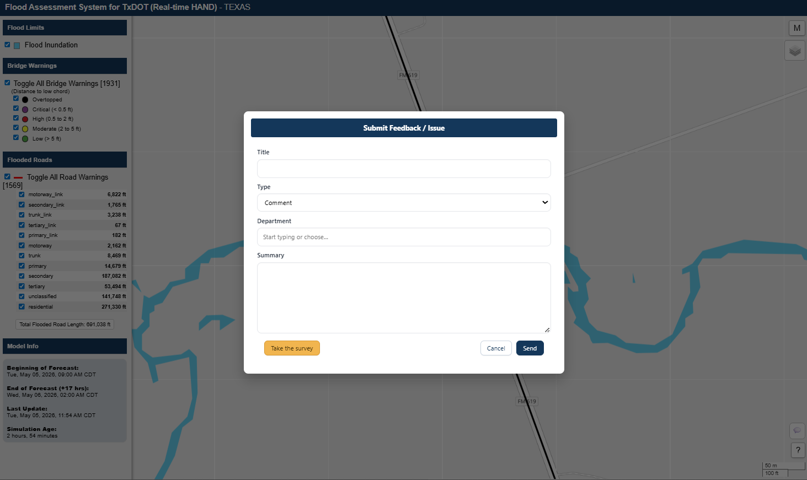

Providing
Feedback:
Populate form & submit
2
Select Feedback Button
1
Notes:
Tim

Slide 25
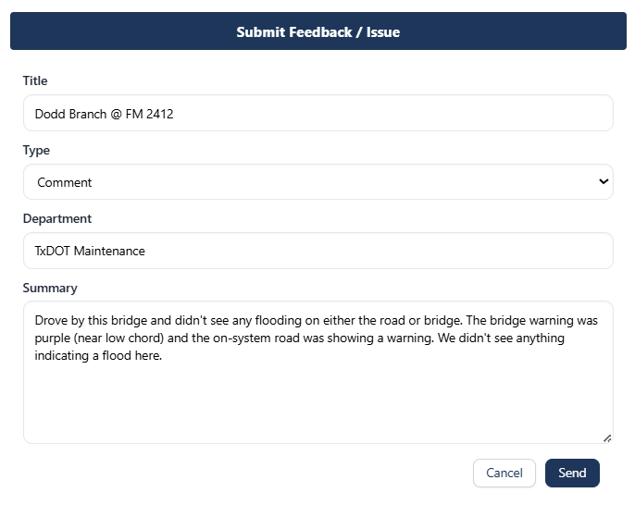
The system automatically records the map area you’re viewing and the time you make your comment, so you don’t need to enter these details—but you can if you want. Adding your username isn’t required, but it’s encouraged.
Sample Feedback:
Types of Comments we are looking for:
“forecast at this important bridge is missing”
“flood inundation limits in this area seem too big”
“roadway geometry is off”
“I wish the system could do …”
“System failed to load / crashed”
“I love / hate this tool”
Notes:
Tim

Slide 26
Providing
Feedback:
Opens Survey
3
Notes:
Tim

Slide 27
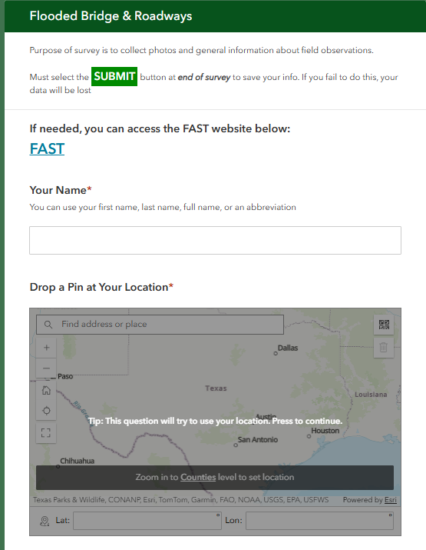
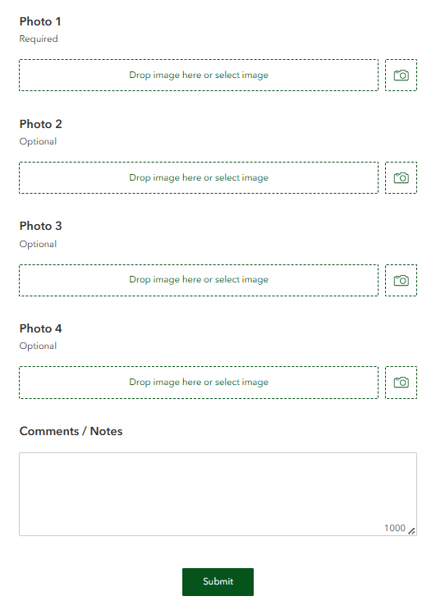
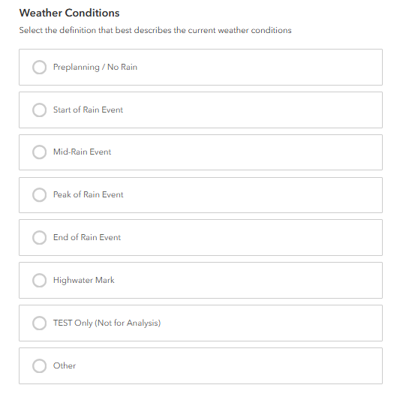
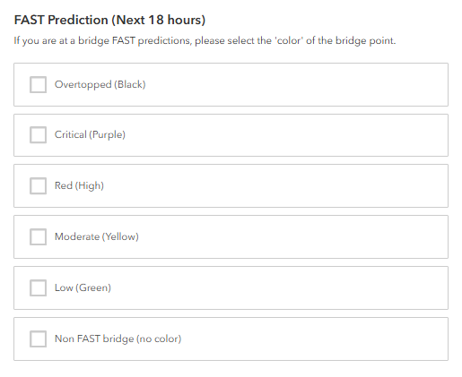
Sample
Survey:
Purpose is to allow the user to log additional information about a flooding location and upload photos
Hit SUBMIT to complete survey and record your information
Notes:
Tim

Slide 28
How accurate is this system:
The FAST system provides estimates of river and flood conditions, but it isn’t always exact. Its predictions are based on weather forecasts and other information, which can change, so actual river levels may end up higher or lower than the warning suggests.
The FAST forecast updates every hour, so warnings will change. A warning might appear one hour, disappear the next, and then come back later as the latest data changes.
Notes:
Tim

Slide 29
Limitations:
Forecasted road and bridge flooding results are subject to limitations. Issues may include:
  missing or misaligned roads, bridges, or streams
  (2) incomplete or outdated terrain data
  (3) simplified floodplain modeling assumptions
  (4) limited forecast range.
Forecasts may not capture backwater effects, local ponding, or flash flood timing. Results should be considered estimates and SHALL NOT be used as official guidance.
Notes:
Tim

Slide 30
  Training Exercises
Notes:
USGS

Slide 31
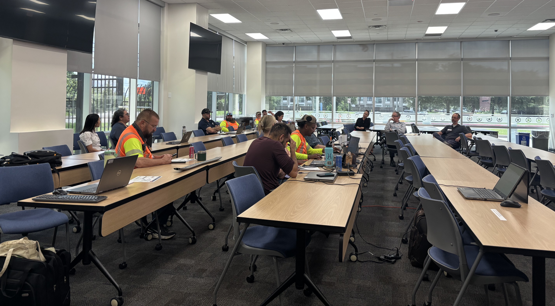
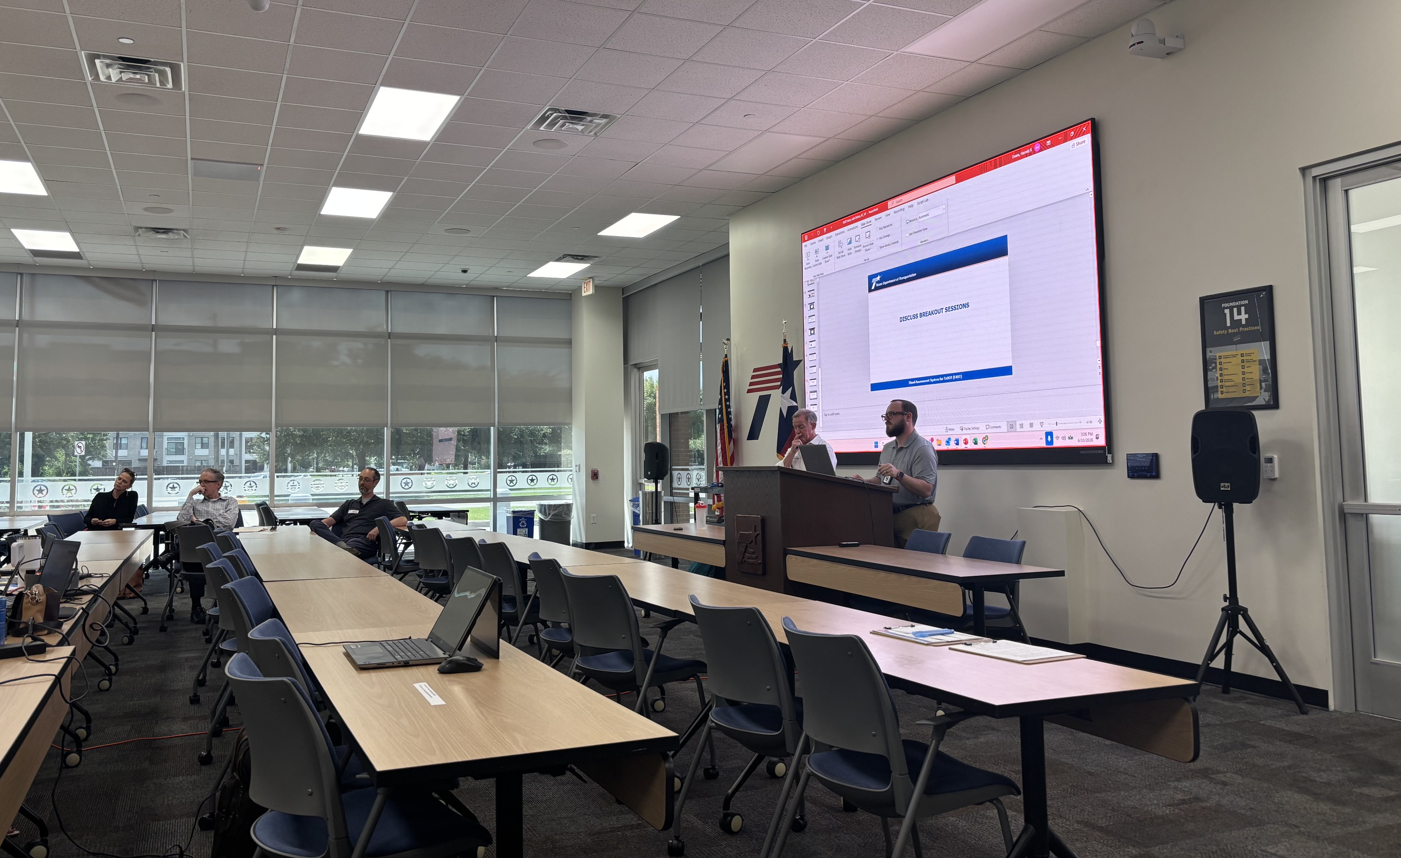
  FAST Training Exercises
AUS Exercise
June 2, 2026 / 9-12pm
Districts: Waco, San Antonio, Bastrop, SOC, Austin, Kerrville, H&H
Number of Participants: 28
Number of Feedback Surveys: 24
HOU Exercise
June 10, 2026 / 1-4pm
Districts: Houston, Montgomery, Beaumont, Bryan, Yoakum
Number of Participants: 21
Number of Feedback Surveys: 11
FTW Exercise
July 28, 2026 / 1-4pm
Districts: Ft Worth, Dallas, Wichita Falls, Waco, Paris
Notes:
Harry

Slide 32
  Feedback
Overall Likes:
Ease of use
State-wide situational awareness
Ability to predict impact on roads & bridges
Historical view
Overall Requests:
Separate On/Off System bridges & Roads
Improve delay in Forecast
Filtering
Street Names
Notification
Overall Dislikes
Delay in forecast
No ability to filter on/off system bridges & roads
Want TxDOT street types
Need better street labeling
Overall Improvement Ideas:
Include scour bridges
Symbology changes (no black)
Real-time forecast
Improved historical functionality
Accuracy
Customization
Feedback –Team will categorize all the feedback from the exercises. From there, will determine which ones are actionable and then seek guidance from TxDOT on prioritizing the actionable list.
Notes:
Harry

Slide 33
  FAST Application
Notes:
USGS

Slide 34
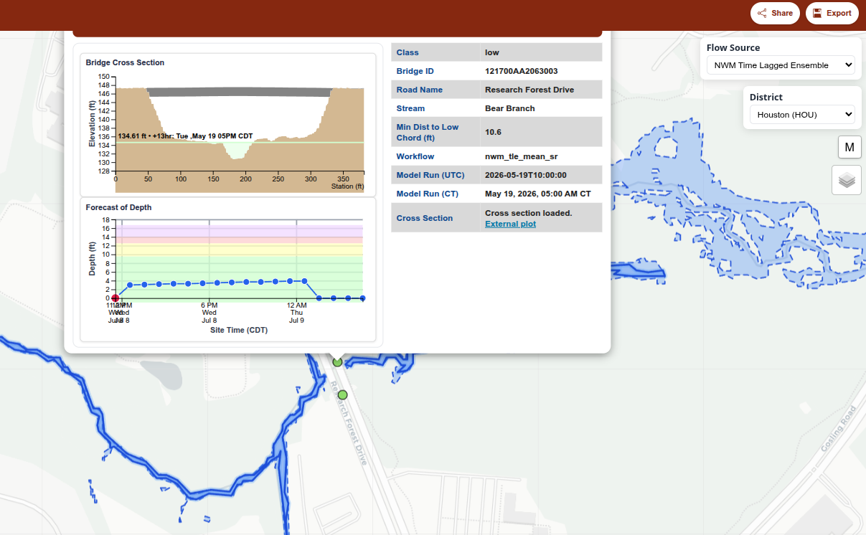
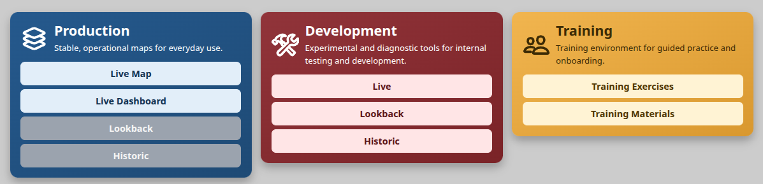
  FAST Updates – Web Application
Map updates:
  Lookback of past 24 hours
  Simulation mode
  Embedded cross section plots
Separate deployments of FAST:
  Evaluation (Production)
  Development
  Training
New products:
  Time-Lagged Ensemble forecasts – min/mean inundation maps.
  Export functionality

Slide 35
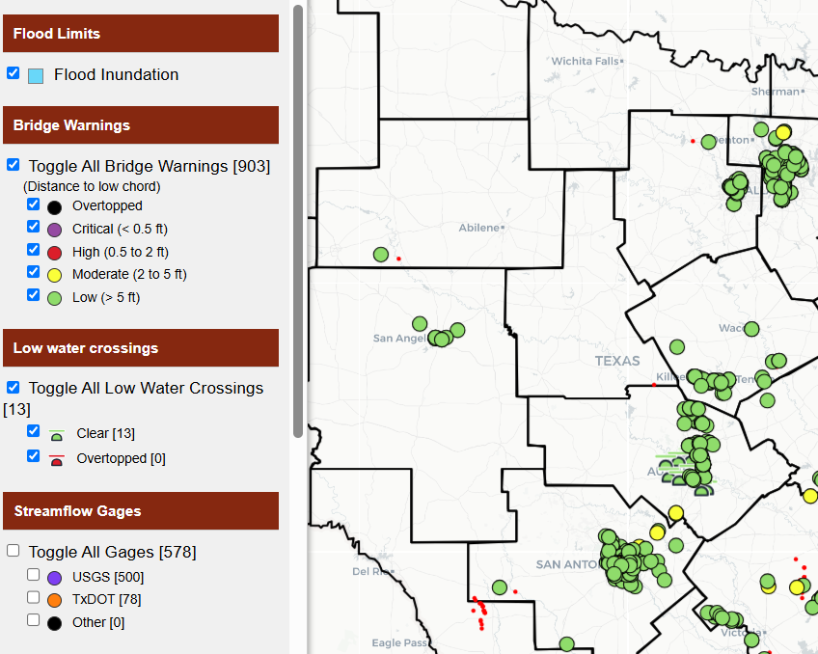
  FAST Updates – Backend
Compute time-lagged ensembles
  Min / Mean / Max for the next 12 hours
Implement first set of low water crossings
Performance improvement:
  Separate Input / Compute / Output tasks
  Use scalable workers for FAST layer generation and dispatching
  Use FlatGeoBuf output format.
  Javascript-based interactive cross-section plotting
  Increased concurrency of different products and IO

Slide 36
  Discussion
Notes:
Allison

Slide 37
  Gauges – USGS
Notes:
USGS

Slide 38
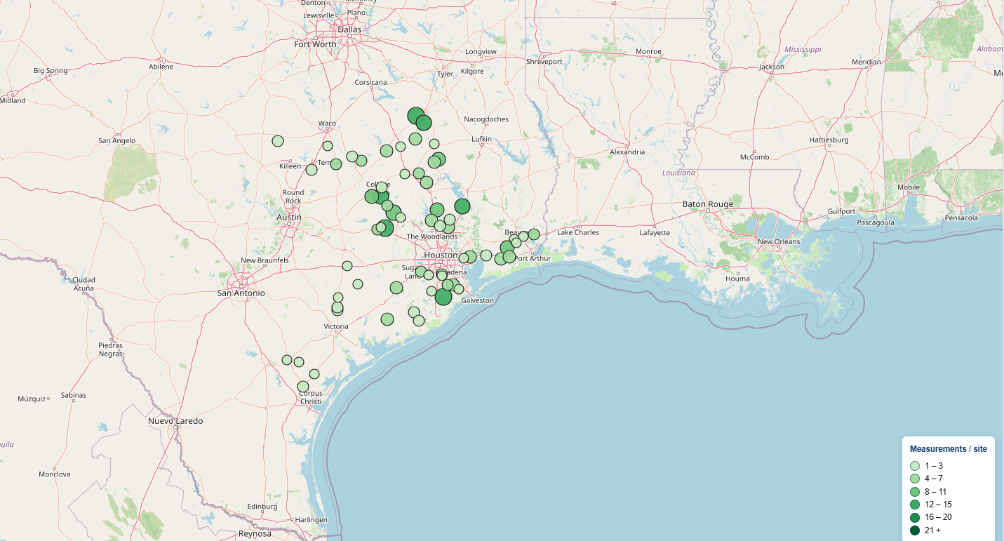
  USGS – RQ-30 Measurements
RQ-30 Measurements Updates
  As of June 2026, 338 ADCP Measurements have been completed at RQ-30 sites
  At least 45 sites have fully calibration-quality data, and most sits have multiple measurements

Slide 39
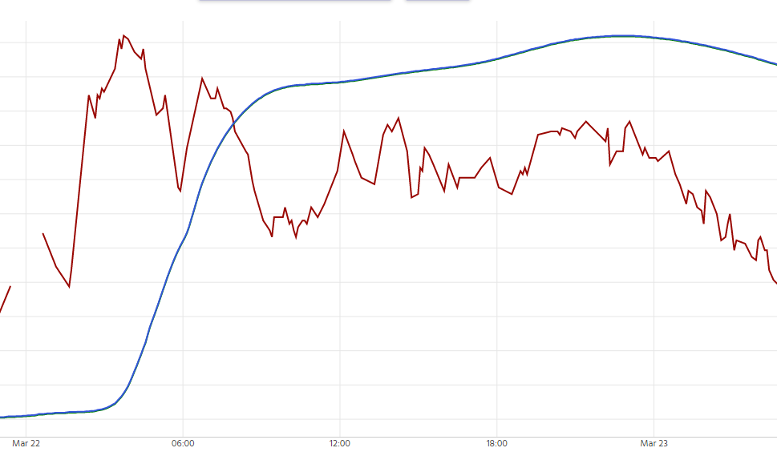
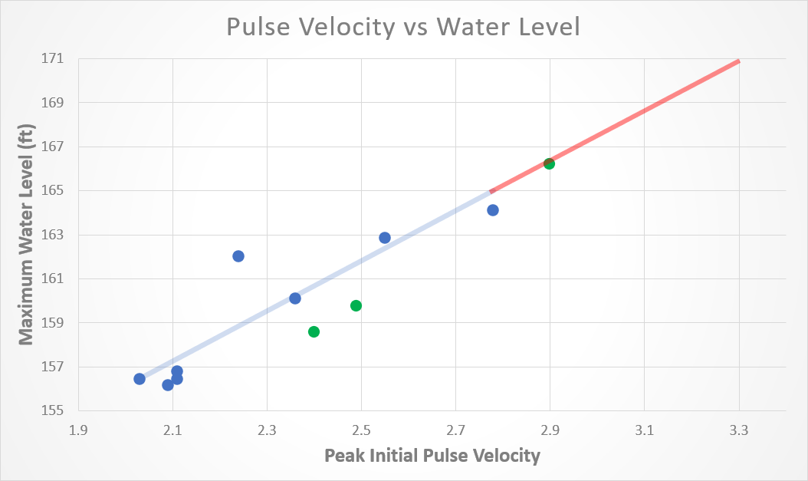
  USGS – RQ-30 Measurements
New Year Ck at FM 1155 nr Chappell Hill, TX
Guadalupe Rv at Comfort, TX
19 hours
6 hours
8.02 | 5.73 | 50 min
9.01 | 6.21 | 25 min
10.04 | 17.21 | 190 min
10.22 | 9.19 | 65 min
14.76 | 34.87 | 105 min
8.85 | 6.99
9 | 10.99

Slide 40
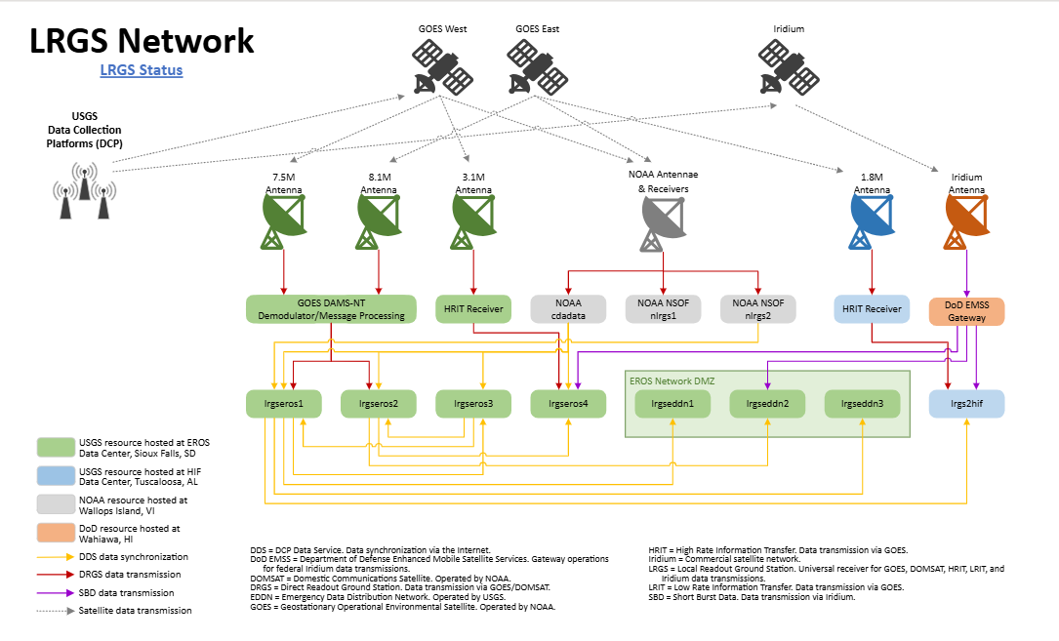
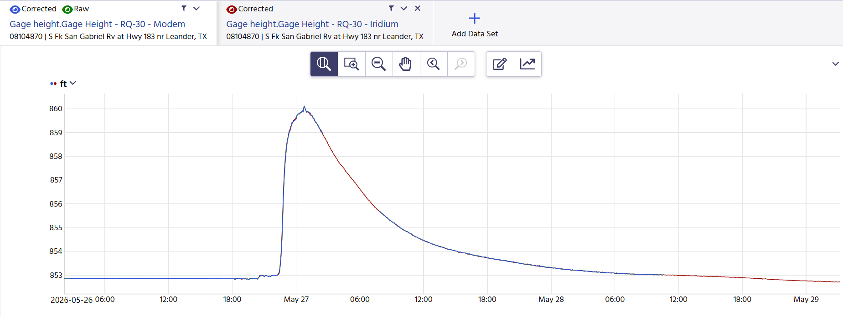
  USGS – Equipment Updates
RQ-30 Equipment Updates
  21 Sites updated with XLIINK
  16 Fully updated to Iridium transmission

Slide 41
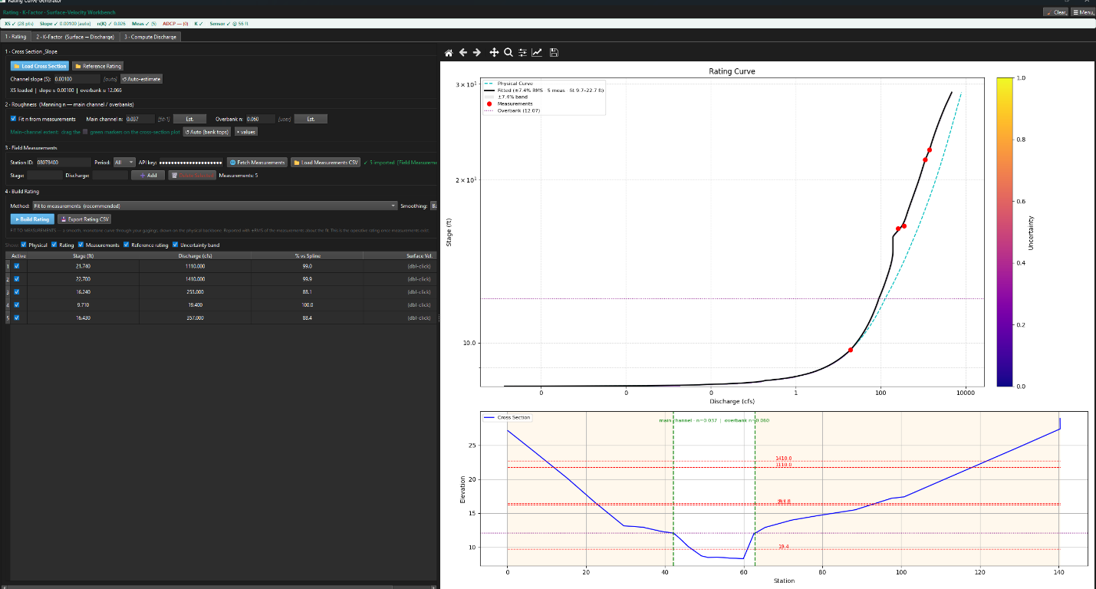
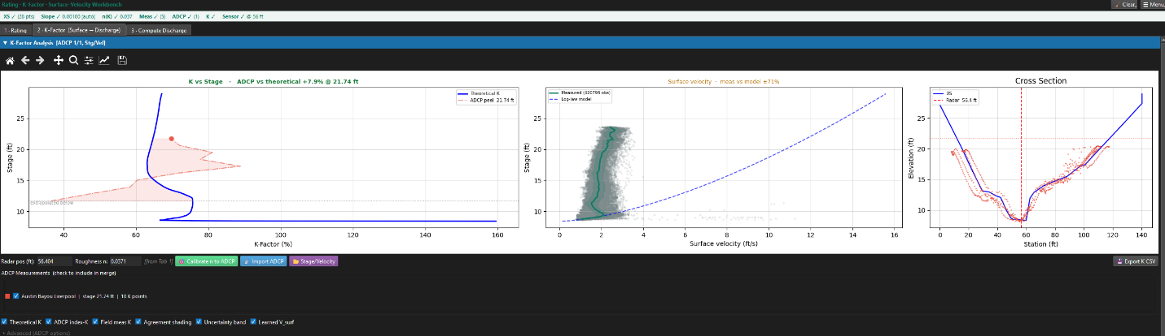
  USGS – K-Factor Calibration Tool
Automated RQ‑30 calibration workflow built and in testing
Single tool integrates cross sections, ratings, ADCP, and validation
New method derives stage‑varying k‑factors from one ADCP transect
Early results match commercial tools and look promising

Slide 42
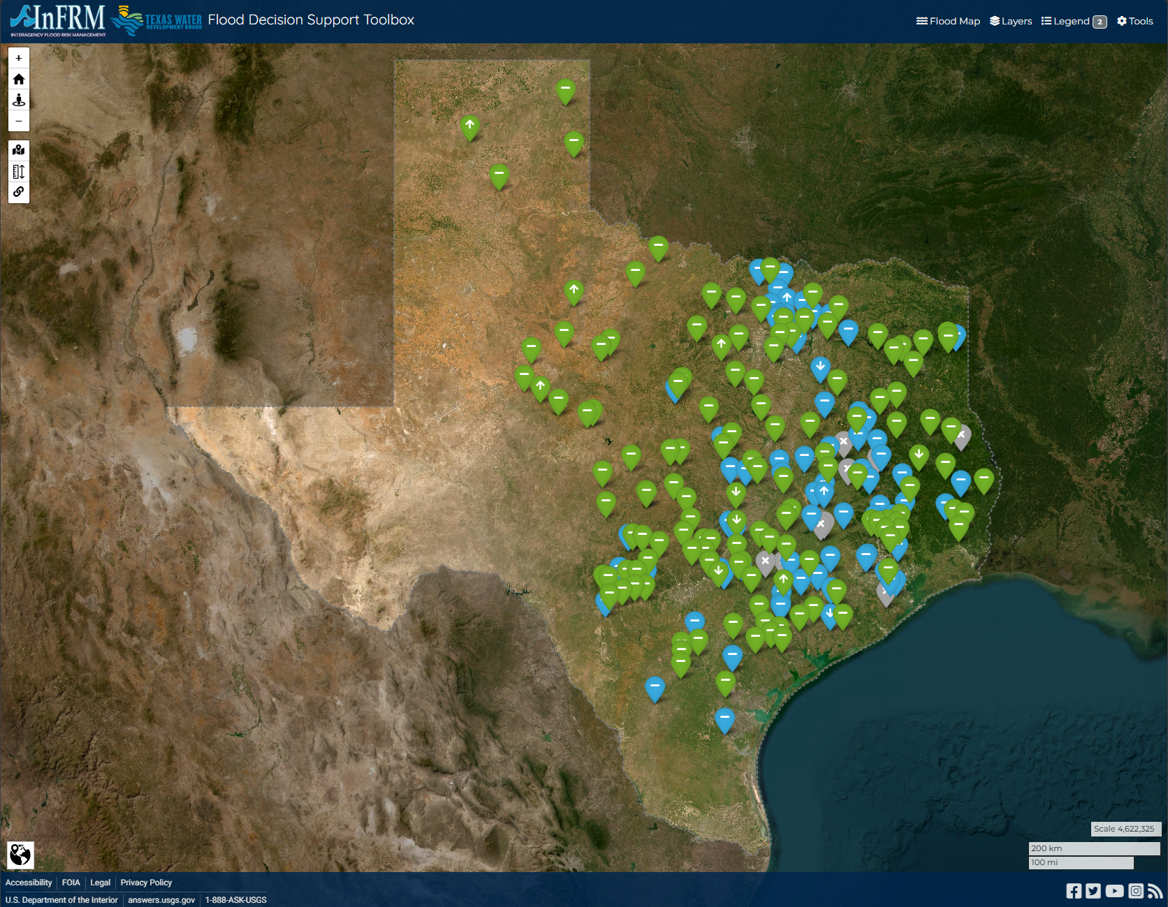
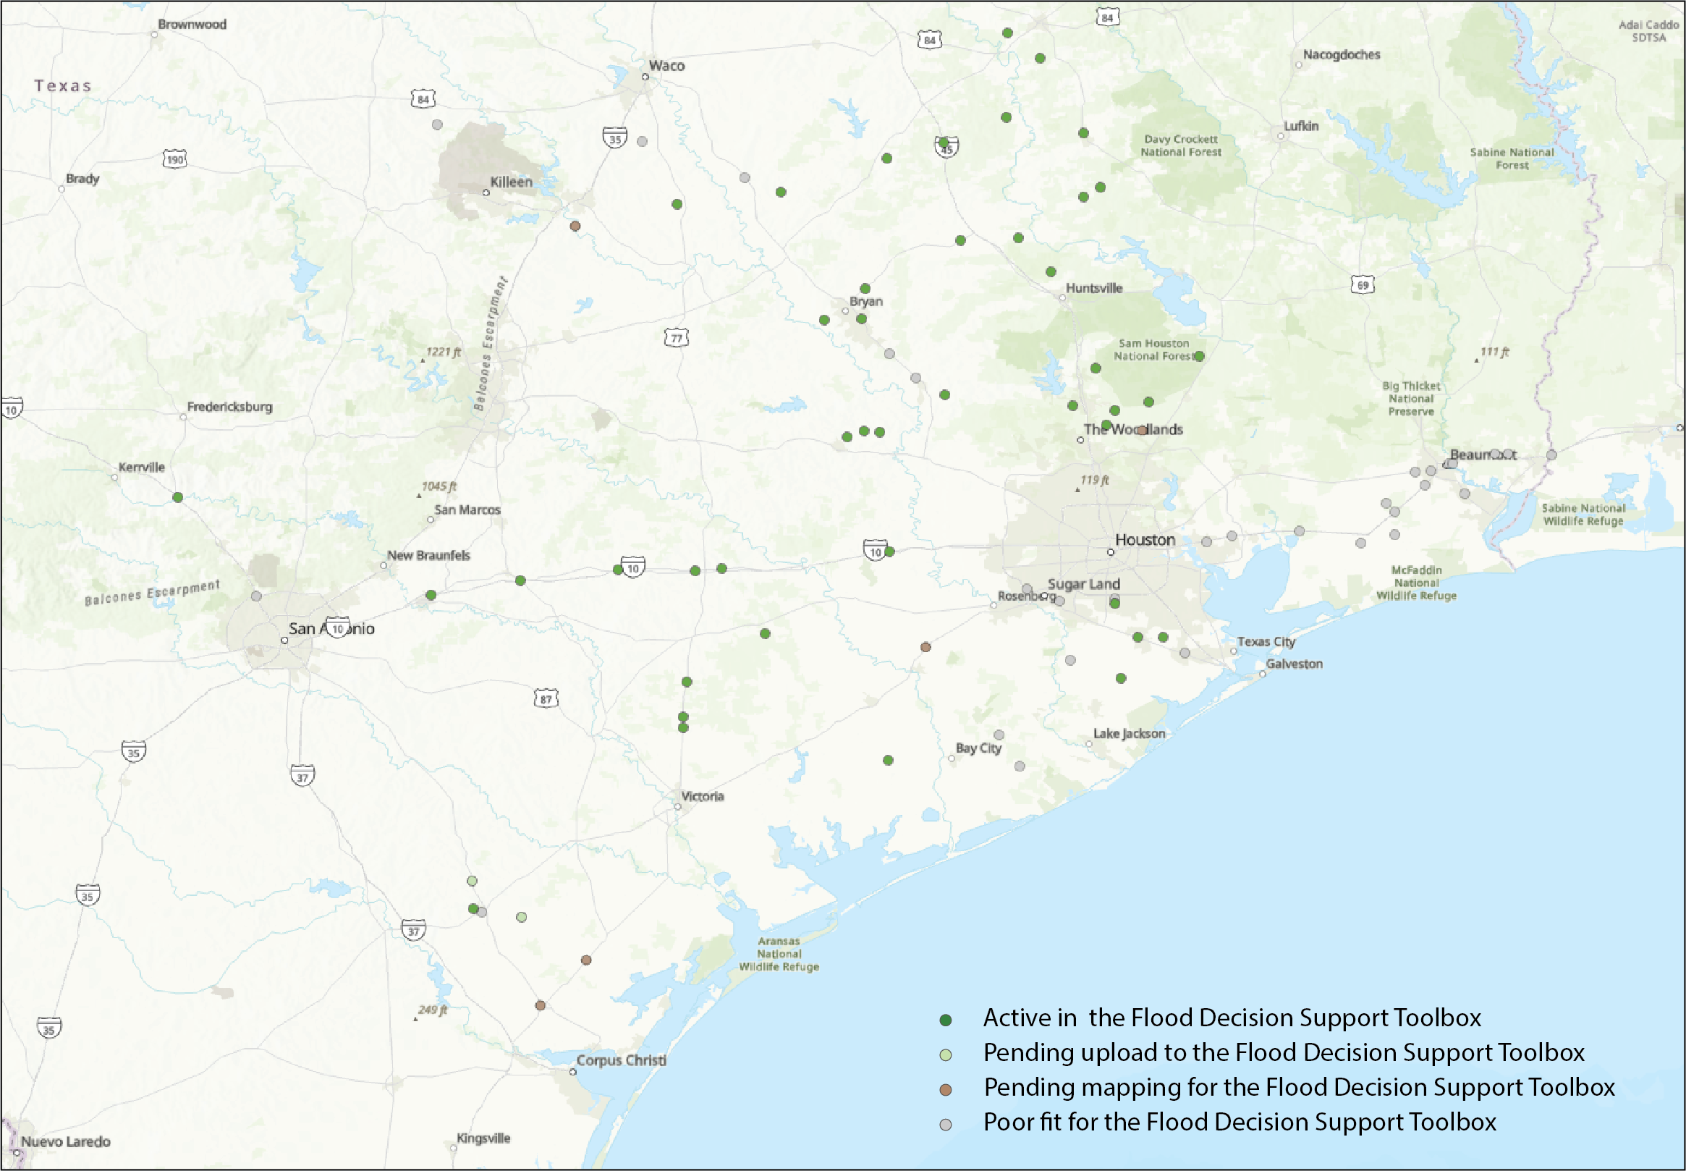
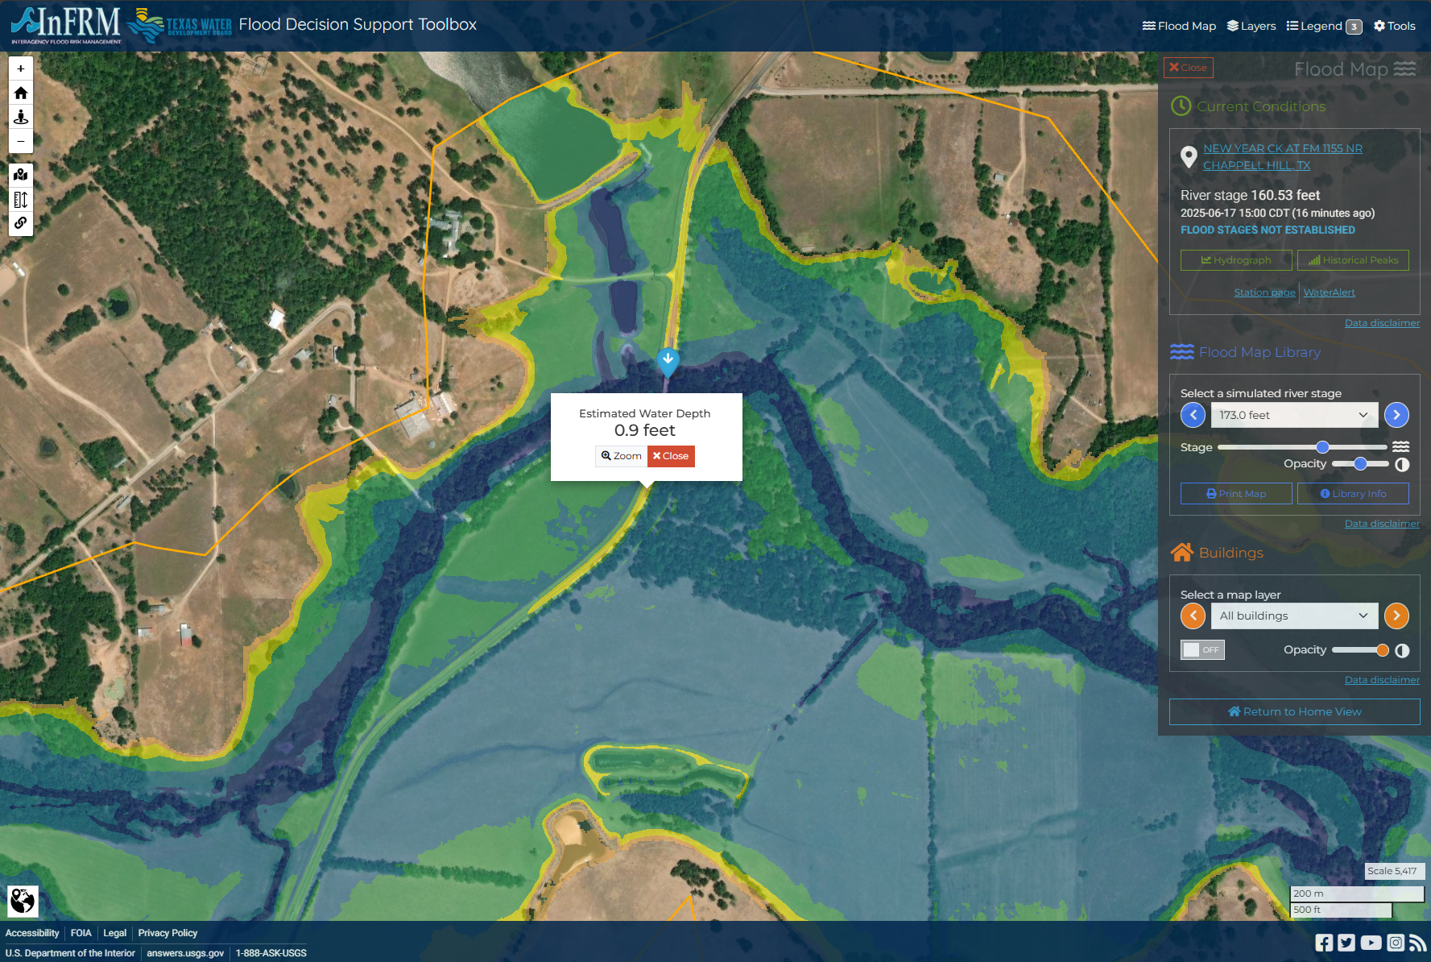
  USGS – Flood Decision Support Toolbox (FDST)
RQ-30 Sites in the FDST
All Sites have been evaluated
  42 Active
  3 Pending upload
  1 Pending review
  34 Currently Poor Fit

Slide 43
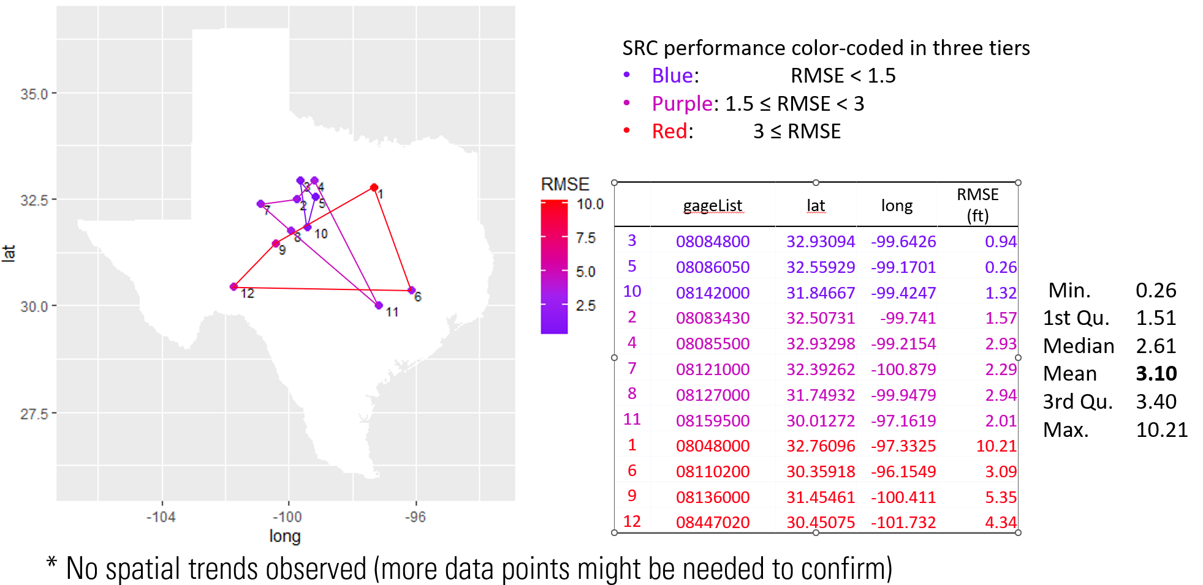
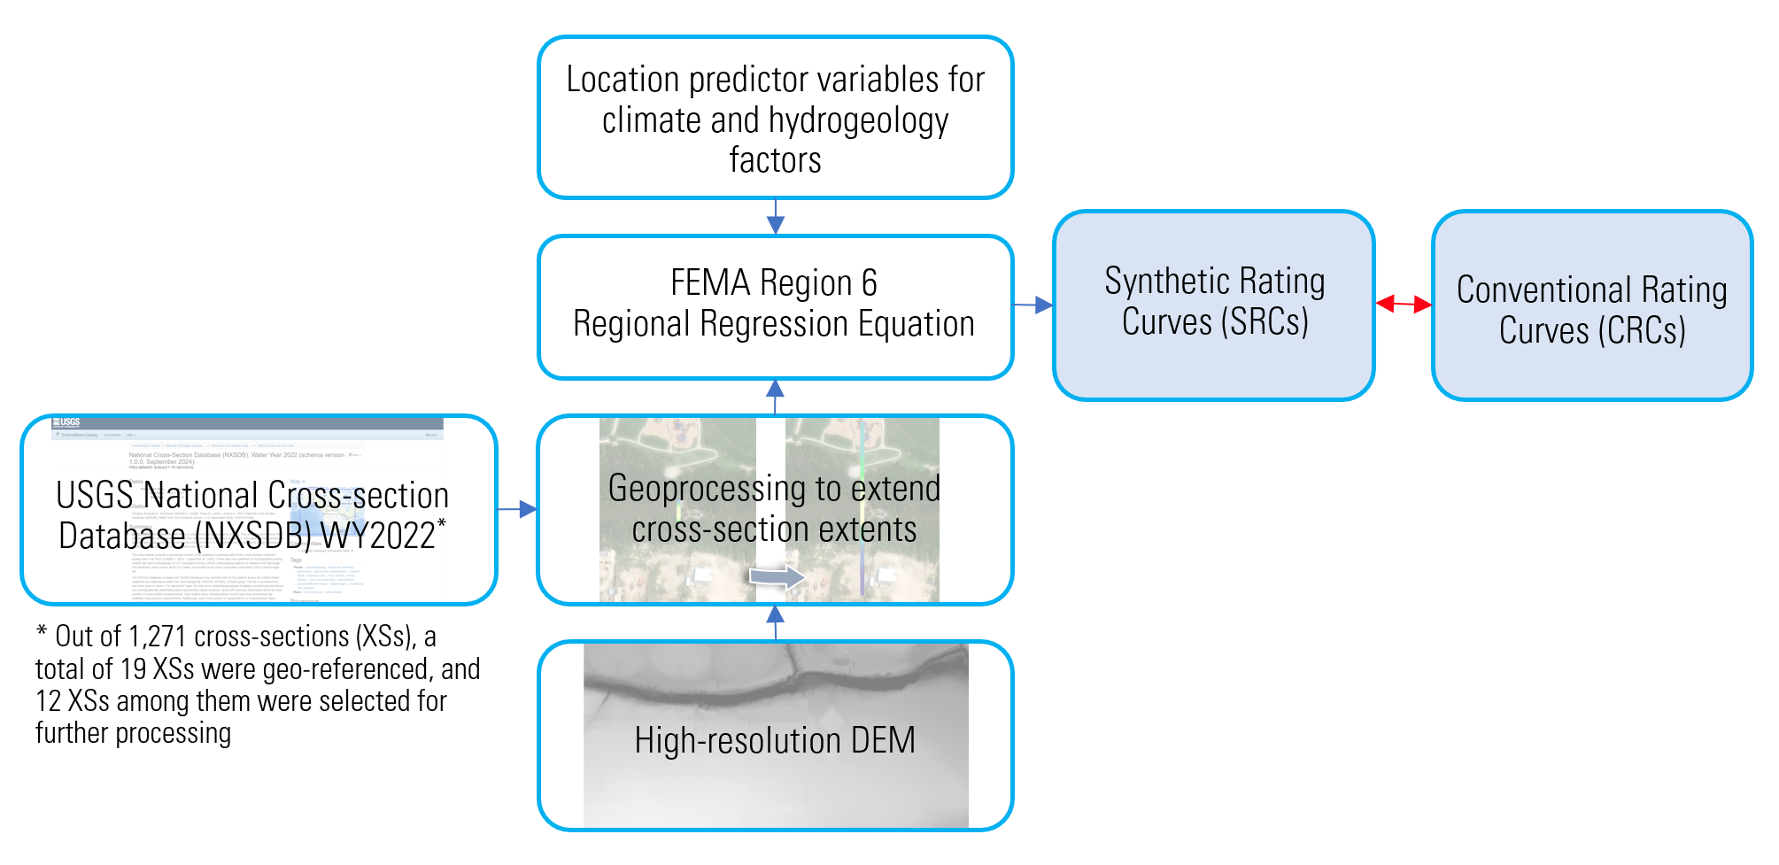
  USGS – Synthetic Rating Curve
  Evaluation Complete
    Statewide HAND comparison
    12 Traditional USGS streamgage comparisons
    Engineered channels and sites with downstream controls are not suitable
    No spatial variability
  Currently completing USGS Peer Review

Slide 44
  Transportation Geodatabase
Notes:
USGS

Slide 45
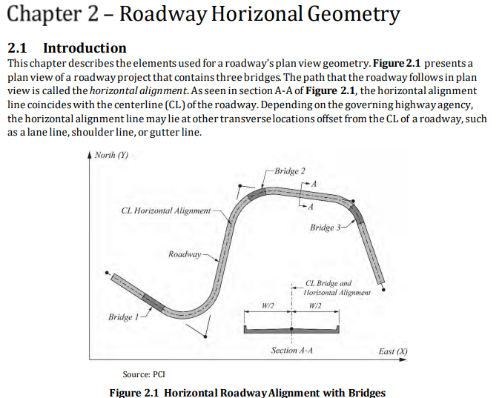

  Building a New Road and Bridge Line Model
https://www.fhwa.dot.gov/bridge/pubs/hif22034.pdf

Slide 46
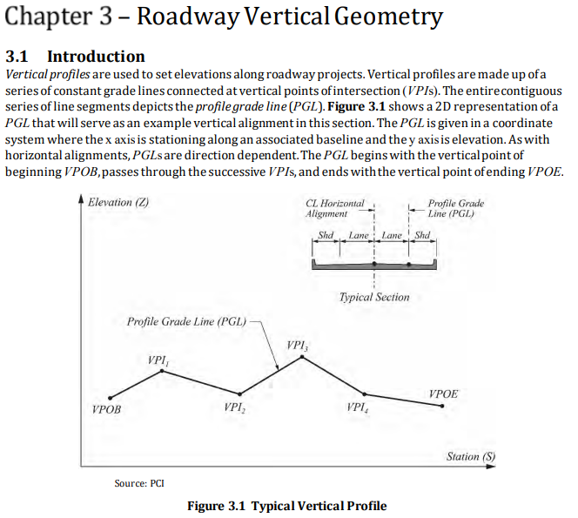
  Building a New Road and Bridge Line Model
https://www.fhwa.dot.gov/bridge/pubs/hif22034.pdf

Slide 47
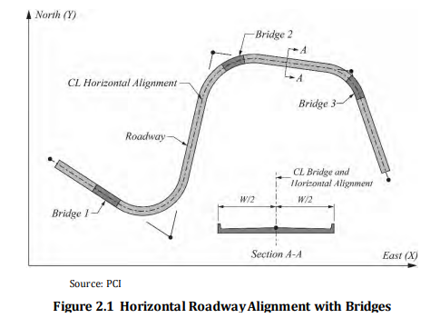
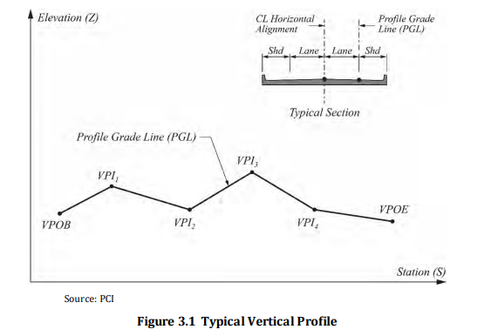
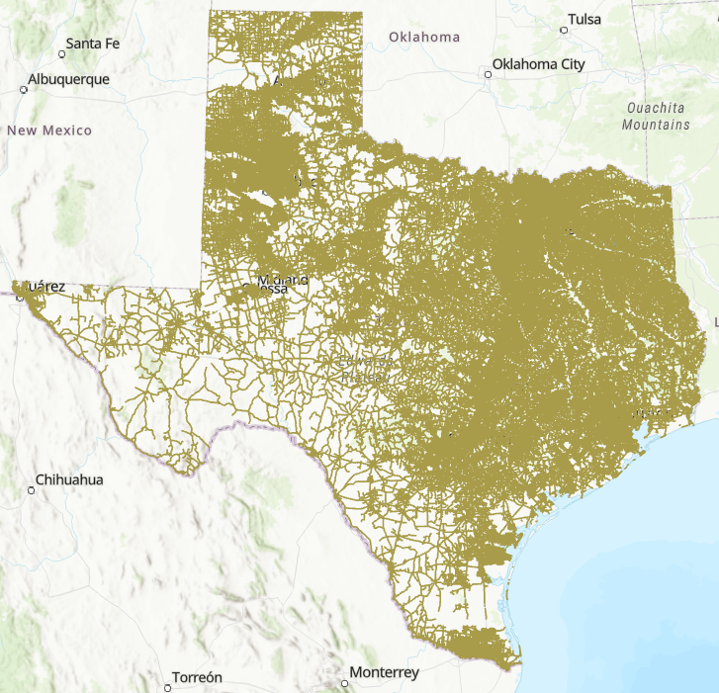

  The End Result: A 3D “Road Grade Line”
  with Bridges Included for Texas
Road Grade Line (x,y,z)

Slide 48


  Road and Bridge Datasets for TxDOT Districts
https://cfim.ornl.gov/data/t/bxw/alpha10/
State-wide coverage
(first draft)

Slide 49



  3D Road Grade Line for this Bridge
A point every 3m along the road

Slide 50



  Bridge on SH 136 NB over the Canadian River, Amarillo District

Slide 51


  Research
  Accuracy assessment
Matt Bartos
Assistant Professor
Harsha Venkataraman
Graduate student

Slide 52

  Forecasting accuracy assessment
Forecasting skill was previously assessed for San Antonio and Guadalupe river basins (68 gages)
We have now extended that assessment to the Texas-Gulf Coast HUC2 region (606 gages)
Goal: Evaluate skill of discharge forecasts under Nudging, Kalman Filtering, time-lagged ensembles

Slide 53




Example discharge timeseries under Open-Loop, Nudging, and Kalman Filter
No DA
Nudging
Example site on Guadalupe river
Kalman Filter
Initial assessment focused on 5/2023

Slide 54



  Current accuracy metrics considered
Continuous ranked probability score
‘Within bounds’ score
$$CRPS=\frac{1}{N}\sum_{t=1}^{N}{\int_{−∞}^{∞}{{\left[P\left(Q_{t}<q\right) −1\left(q −Q_{obs}\right)\right]}^{2} dq}}$$
$$WBS=\frac{1}{N}\sum_{t=1}^{N}{I [Q_{obs,t} < max(Q_{i,t})]}$$
Fraction of time observation is less than the maximum forecast value
(For a discrete set of M ensemble members):
$$CRPS=\frac{1}{N}\sum_{t=1}^{N}{\sum_{i=1}^{M}{|Q_{i,t}−Q_{obs,t}|}+}\frac{1}{N}\sum_{t=1}^{N}{\sum_{i=1}^{M}{\sum_{j=1}^{M}{|Q_{i,t}−Q_{j,t}|}}}$$
Mean absolute error
Forecast spread

Slide 55



  Results: absolute forecast error (CRPS)
No DA
Skill improvement
Nudging
Nudging
Higher worse
Lower better
Kalman Filter
Kalman Filter
Skill improvement

Slide 56


  Results: fraction of time observation is within forecast bounds
Over all gages, the observation is within the forecast bounds about 80% of the time
Nudging Better
KF-Corr Better
Fraction of time forecast in bounds

Slide 57
  Research
  Improved hydrologic modeling
Matt Bartos
Assistant Professor
Harsha Venkataraman
Graduate student

Slide 58

  Purpose-built hydrologic model for FAST
Motivation
Solution
NWM forecasts are the primary limiting factor for timeliness and accuracy of forecasts
NWM forecasts have an inherent 2-hour delay, which limits flash flooding predictions
Use of NWM infiltration/runoff model precludes the use of enhanced rainfall data products (e.g. TTU data) that could improve forecasts.
Custom hydrologic model based on a continuous-time Green-Ampt scheme.

Slide 59

  Hydrologic modeling skill assessment
What is the overall accuracy of the hydrologic model?
Green-Ampt hydrologic model for San Antonio / Guadalupe river basins forced with 10 years of AORC gridded rainfall data. POLARIS soil parameters used.
Generated runoff and baseflow were routed through Muskingum routing model
Resulting discharge compared against 10 years of stream gauge data at outlet of San Antonio river basin
USGS Gage 08188570

Slide 60




Hydrologic skill before calibration is comparable to NWM
2020
2021
2022
USGS Gage 08188570
2023

Slide 61

Discharge in stream network
with rainfall field overlay

Slide 62



Comparison with measured discharge
USGS Gage 08167200
Guadalupe River near Bergheim
(In upper Guadalupe river downstream of Kerrville)
Gage vs. Model with AORC forcing
Gage vs. Model with provided forecast

Slide 63



  Parallel Considerations
Hill Country Flooding, July 2025
$78 million legislative investment in flood forecasting, data and sirens
Main impact on TxDOT: Austin, San Antonio and San Angelo Districts
Texas Institute for Hazard Risk and Readiness (TIHRR) formed at Schreiner University in Kerrville
Contains a Flood Data, Intelligence and Training Laboratory
TxDOT Districts

Slide 64



NWS Public Flood Services
  Parallel Considerations
Precipitation (past and future)
Streamflow (probability of overbank flow)
Inundation Mapping (current conditions, next 5 days)
River Forecast Center points (Action, Minor, Moderate, Major)
Flood warnings

Slide 65



  FAST and the NWS Forecasting System
Flows and Mapping from NOAA
FAST/srf_18hour_max_inundation_extent
FAST/srf_18hour_max_road_flooding
FAST/srf_18hour_bridge_warnings_time_profile
Flows from NOAA, mapping from TxDOT
Short Range Forecasts
(Maximum for 18 hours ahead)
Flows and Mapping from NOAA

Slide 66



NOAA FIMPact Services
  Parallel Considerations
These services require permission from NOAA to be accessed
Compares predicted and measured stage height at USGS gauges

Slide 67
  Discussion
Notes:
Allison

Slide 68
  Closing Comments
Notes:
Allison

