Slide 1
Matlab and WaterOneFlow WebServices
James Seppi
CE394K Hydrology, Spring 2010
University of Texas

Slide 2
Contents
Introduction
Products
Example Analysis
Conclusions
To-Do

Slide 3
Background
WaterOneFlow web services
GetSites
GetSiteInfo
GetVariables
GetValues
WaterML
HIS Central
HydroServer
(WaterOneFlow)
WaterML Clients
Matlab Client

Slide 4
Background - Matlab
Sophisticated computational software
Supports scripting and object-oriented programming
Can access Java libraries in new versions
Web Services
createClassFromWsdl(wsdl_uri)
Error?
GUIDE for making simple GUIs

Slide 5
Products – WaterML Parsers
Input
Parse
WaterML File
Matlab struct
Output
M-file Script
M-file Scripts
parseSitesXML.m
parseSiteInfoXML.m
parseVariablesXML.m
parseValuesXML.m
Work with both WaterML 1.0 and 1.1
Produce Matlab structs
Can be used independently or scripted together

Slide 6
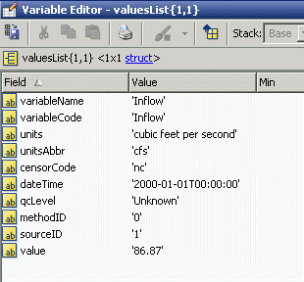
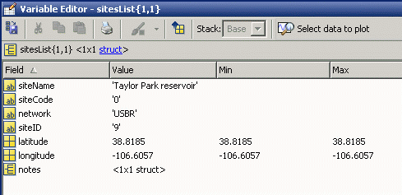
Products – HydroMatlab
Matlab GUI program
Utilizes WaterML parsers
Fetches data from WaterOneFlow services
Writes data to Matlab workspace and text files

Slide 7
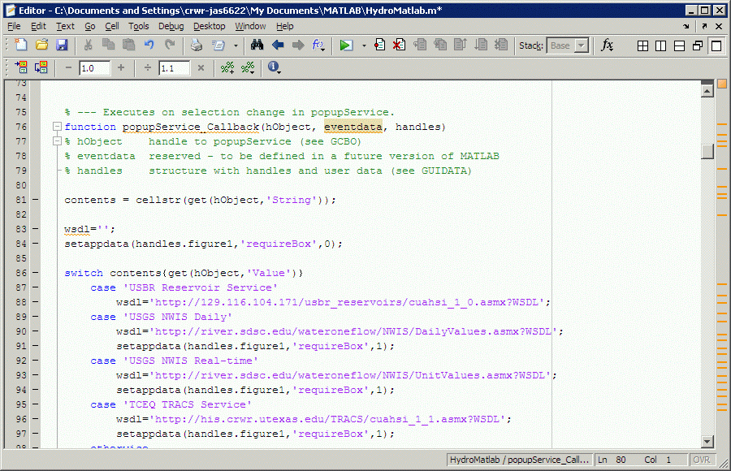
HydroMatlab

Slide 8
Execution Path
Select WaterOneFlow Service
Create Web Service Proxy Class
GetSites (optional)
Select Site (or enter code)
GetSiteInfo
Select Variable (or enter code)
GetValues
Plot Values
Out: sitesList struct
Out: seriesList struct
Out: Values struct

Slide 9
HydroMatlab

Slide 10
HydroMatlab

Slide 11
HydroMatlab

Slide 12
HydroMatlab

Slide 13
HydroMatlab

Slide 14
HydroMatlab

Slide 15
HydroMatlab

Slide 16
HydroMatlab

Slide 17
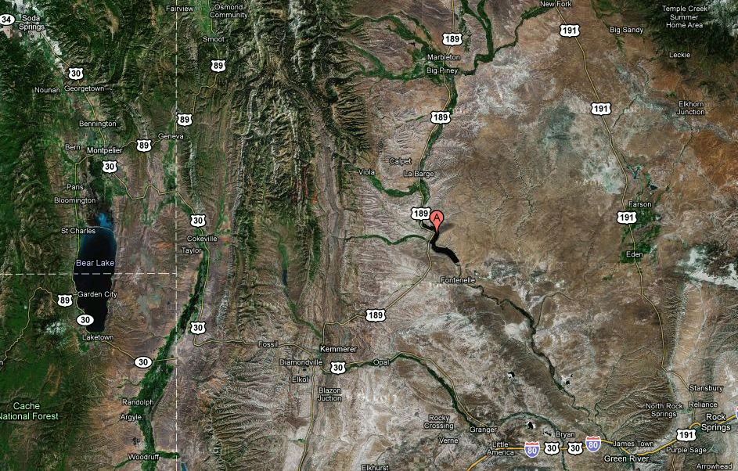
Example with HydroMatlab
USBR Service by Solaleh & Tim
Fontenelle Dam in Wyoming
Retrieved values with HydroMatlab
Inflow, Release, Evaporation time series
3,700 values each (10 years)
Simple Balance Calculation
ΔStorage = Inflow – Evaporation – Release
Storage_{i} = Storage_{i-1} + ΔStorage_{i}

Slide 18
Example with HydroMatlab

Slide 19
Conclusions (so far)
Matlab is not so great for connecting natively to web services
Built-in proxy class didn’t work out-of-the-box
Luckily we have other products like HydroExcel and HydroDesktop
Matlab is good/fast at complex calculations and large data sets
HydroMatlab is a good example project

Slide 20
To Do
Add more services to the list
Maybe change to use a configuration file
Clean up & comment code
Document struct outputs
Enhance example with a more extensive analysis
Flow routing
Report!

Slide 21
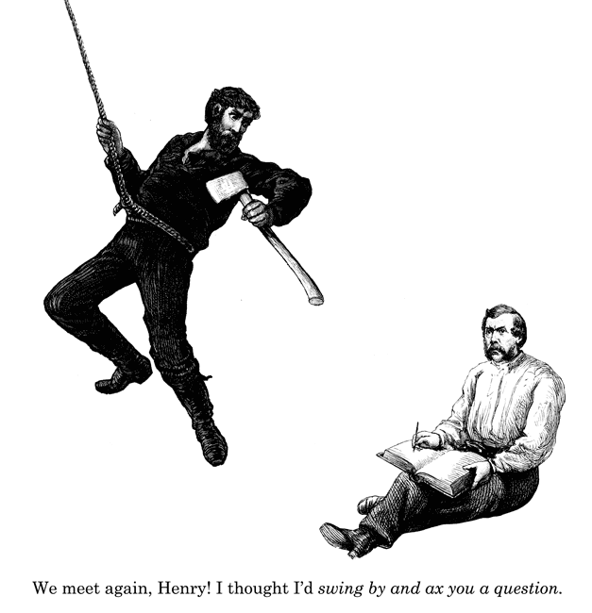
Questions?

