Slide 1
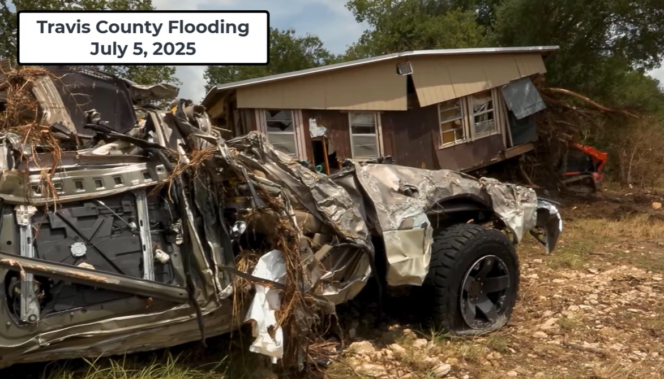
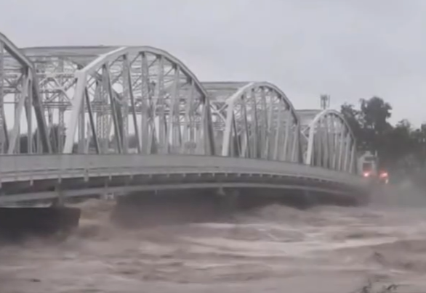
Flood Emergency Response at TCSO
Presented by David Maidment and Andy Carter
Center for Water and the Environment, University of Texas at Austin
and Matt Ables, KISTERS
Travis County Sheriff’s Office
29 January 2026

Slide 2

What has happened since we met last?
We met on 9 December 2024
Formed a collaboration between UT and TCSO – Kristen Dark, Jon Culin, Shannon Jurik
Summer Institute project at National Water Center in Tuscaloosa, AL (Seven graduate students, David Maidment, Kelsey McDonough)
Major flood on 5 July 2025
Flood Assessment System for TxDOT (FAST) running state-wide in August 2025
Writing GeoWater book with ESRI Press
Paper presented at Fall Meeting of American Geophysical Union

Slide 3

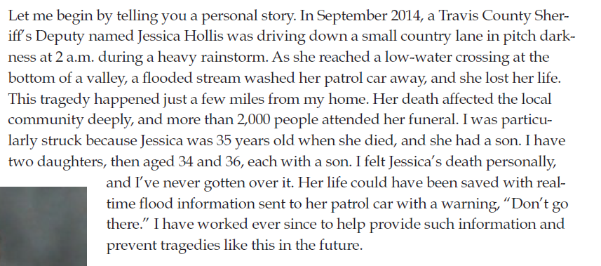
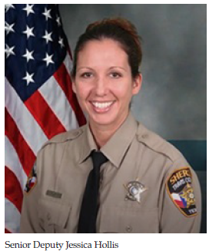
GeoWater Book – to be published by ESRI Press later this year
… Deputy Hollis story is part of the introduction to the book

Slide 4

FAST Video
https://youtu.be/ny3iVy8yzns

Slide 5
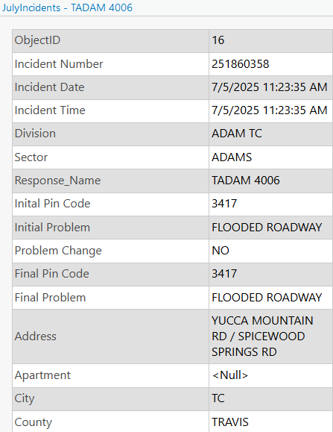
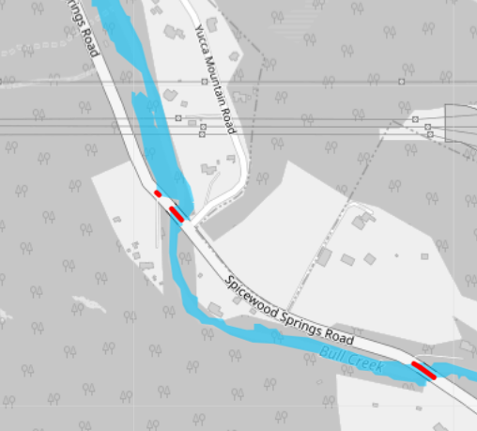
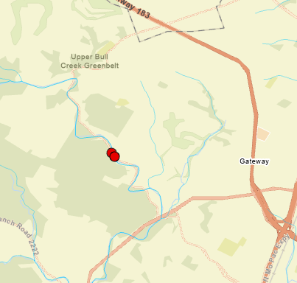
TCSO Flooded Roadway Incident Report
TCSO Incident Report
Flood Mapping in FAST

Slide 6
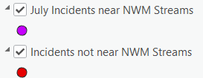
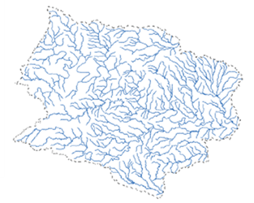
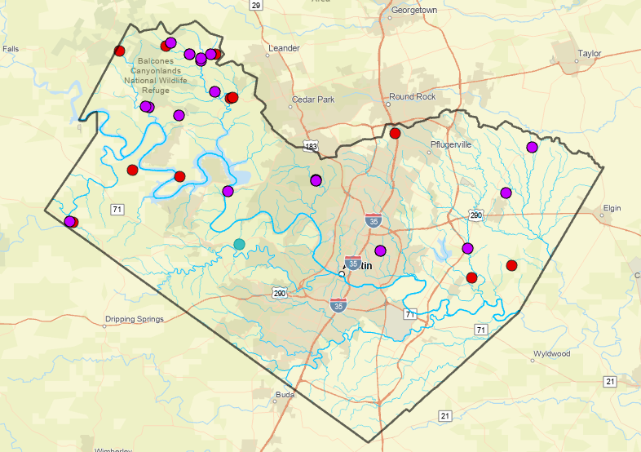

Summer Institute students tested feasibility of forecasting on densified streams
National Water Model Stream Reaches (~900)
22 (65% of total)
12
A Densified Stream Network (~ 38,000 reaches)
Many but not all flood incidents are on streams forecast by the National Water Model

Slide 7



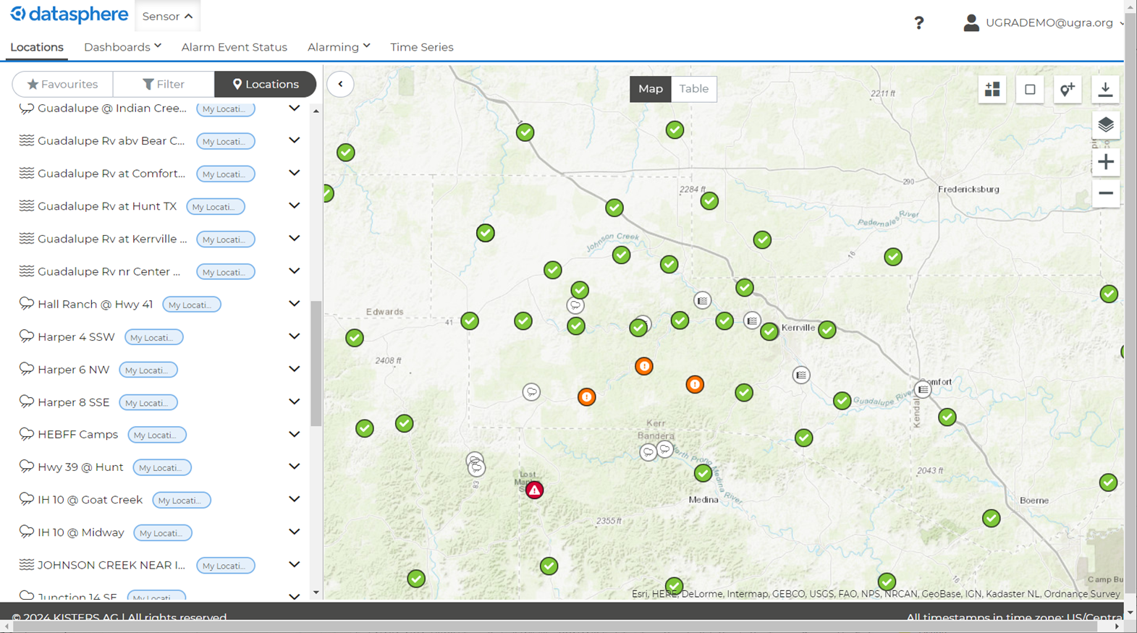
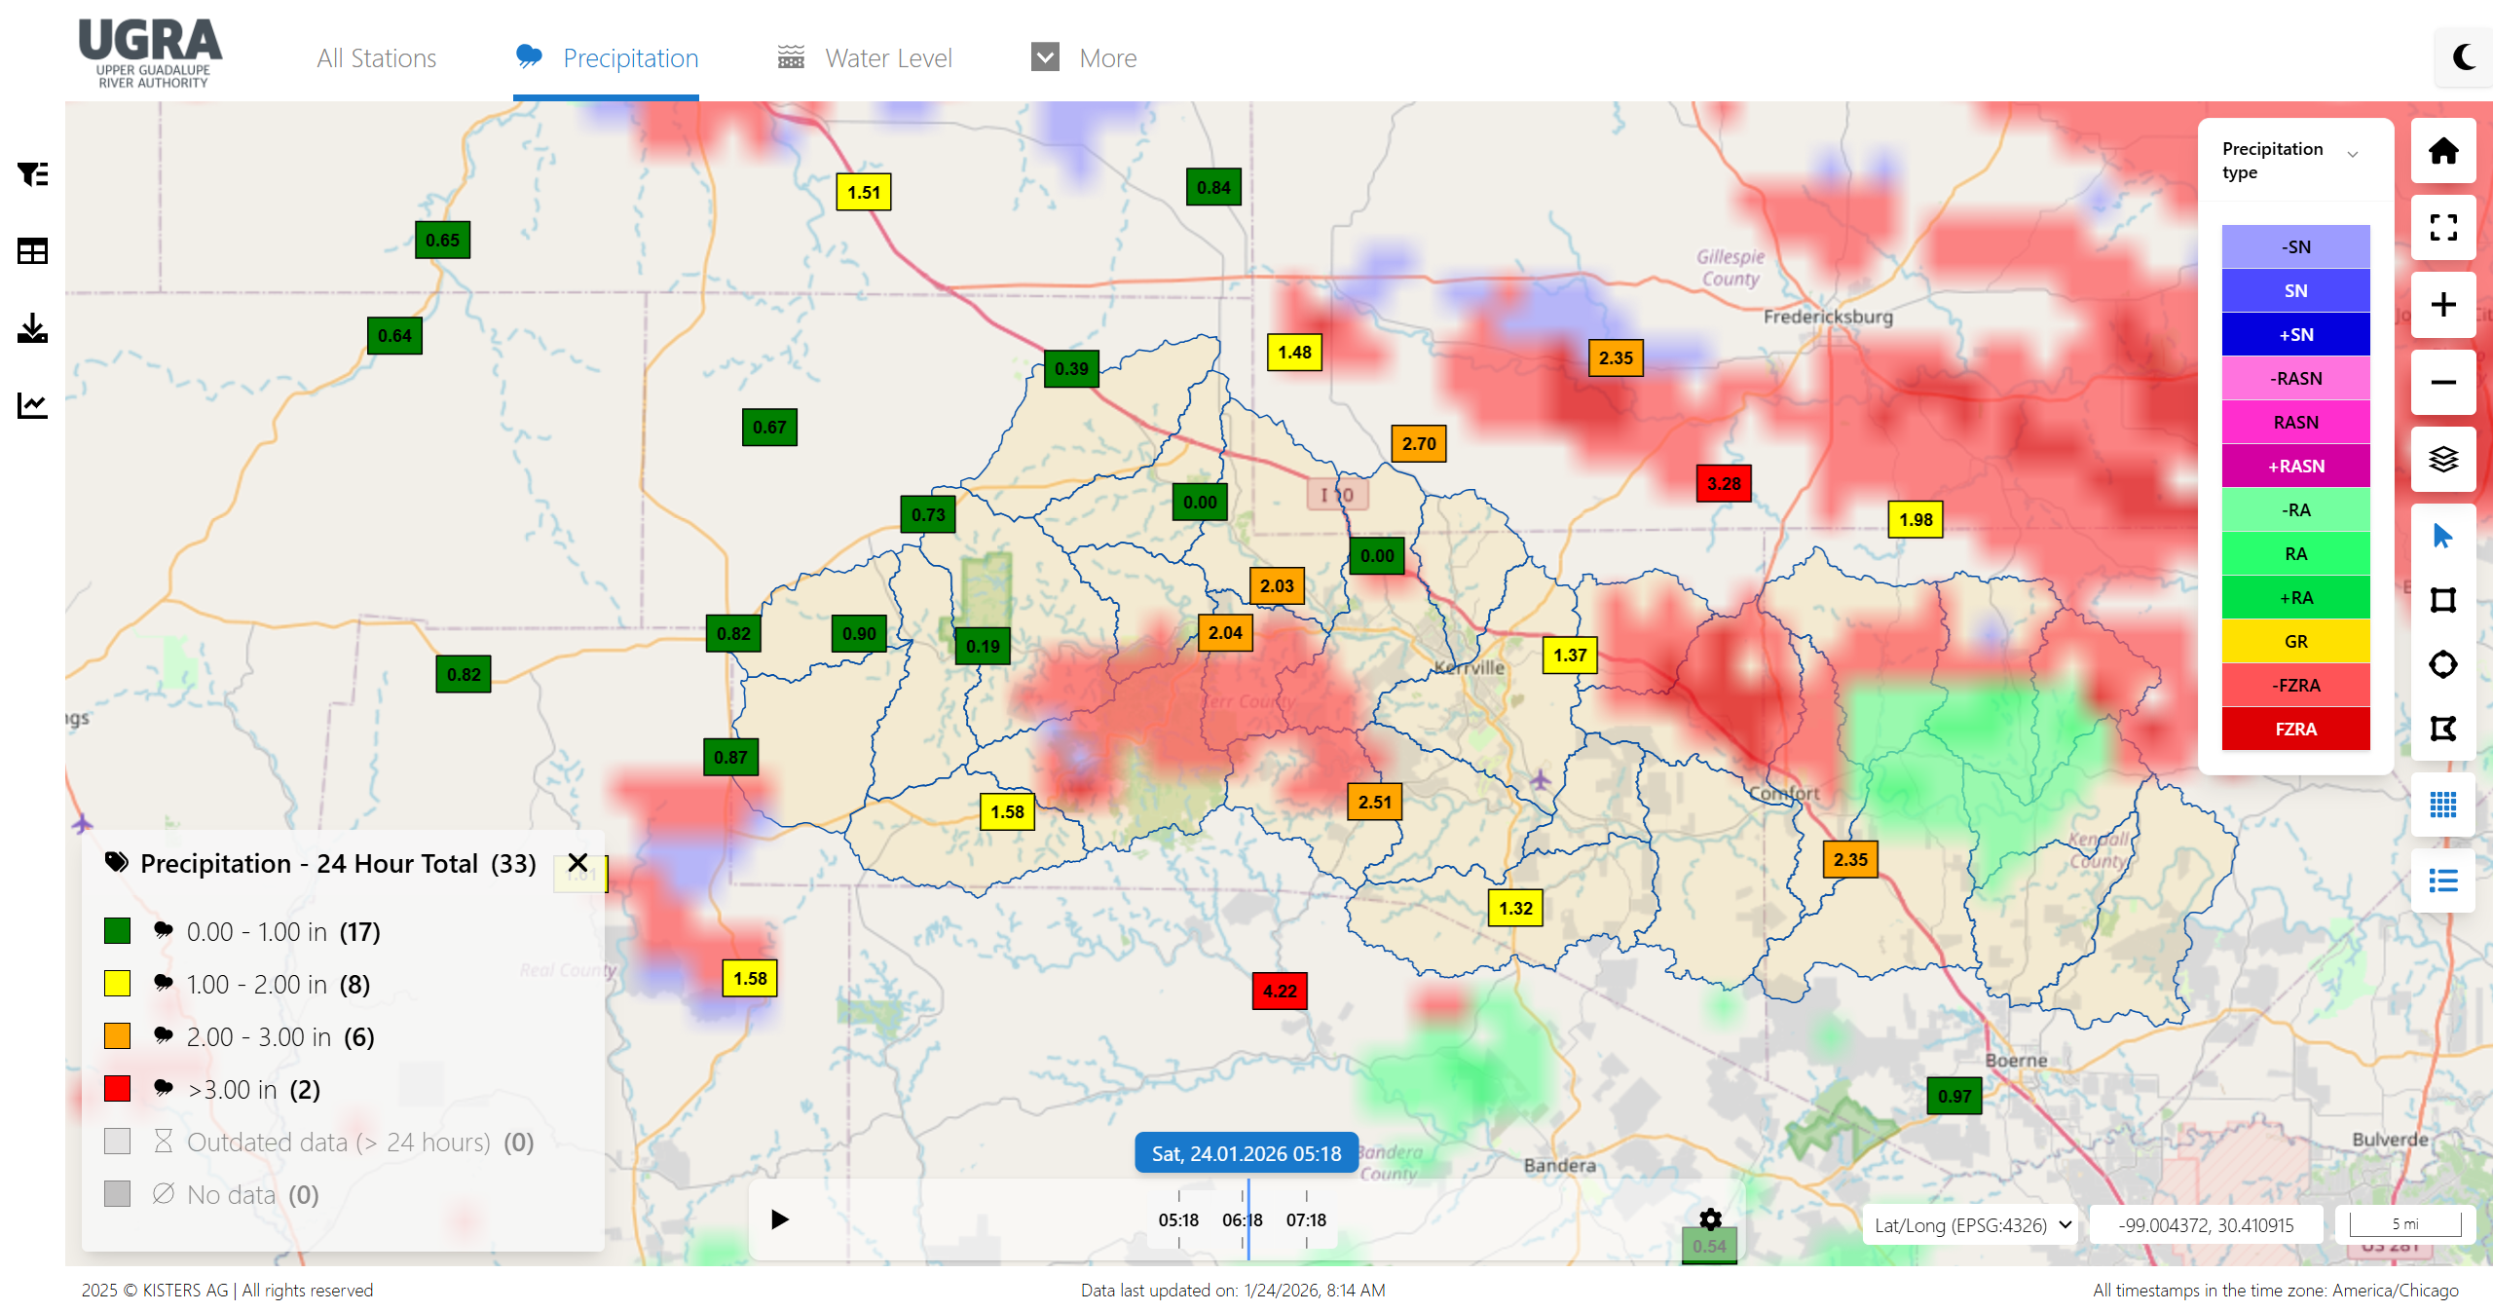




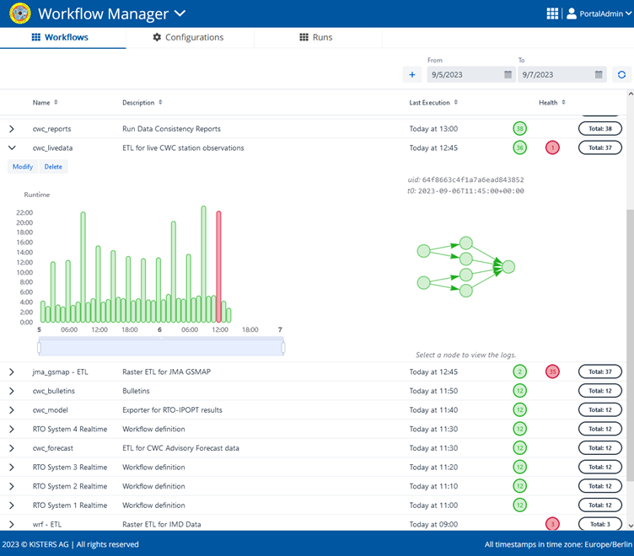

FAST runs in the KISTERS Datasphere
Web Applications
Cloud Database
Extract - Transform - Load
Integration of rainfall and water level gauges for the Upper Guadalupe River Authority (UGRA)
Other Sources
KISTERS Analytics Engine

Slide 8
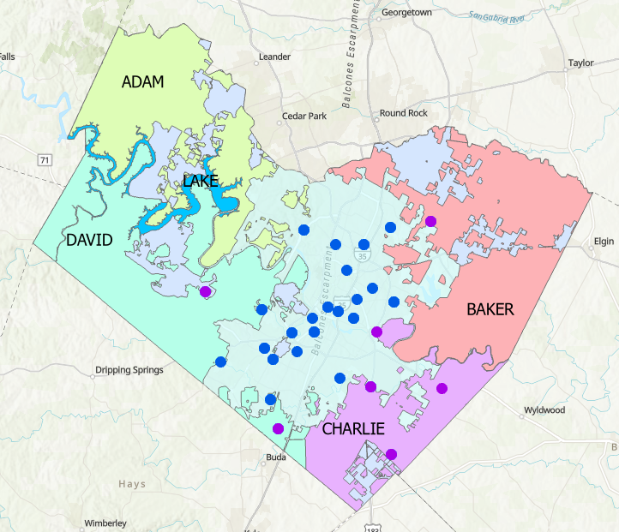
Stream Gauges in Travis County
There are 22 USGS stream gauges in Travis County
Travis County is required by Texas Senate Bill 3 to install flood gauges and sirens for flood warning
TCSO Sector | Number of Stream Gauges
ADAM | 0
BAKER | 1
CHARLIE | 4
DAVID | 2
Total for TCSO | 7

Slide 9
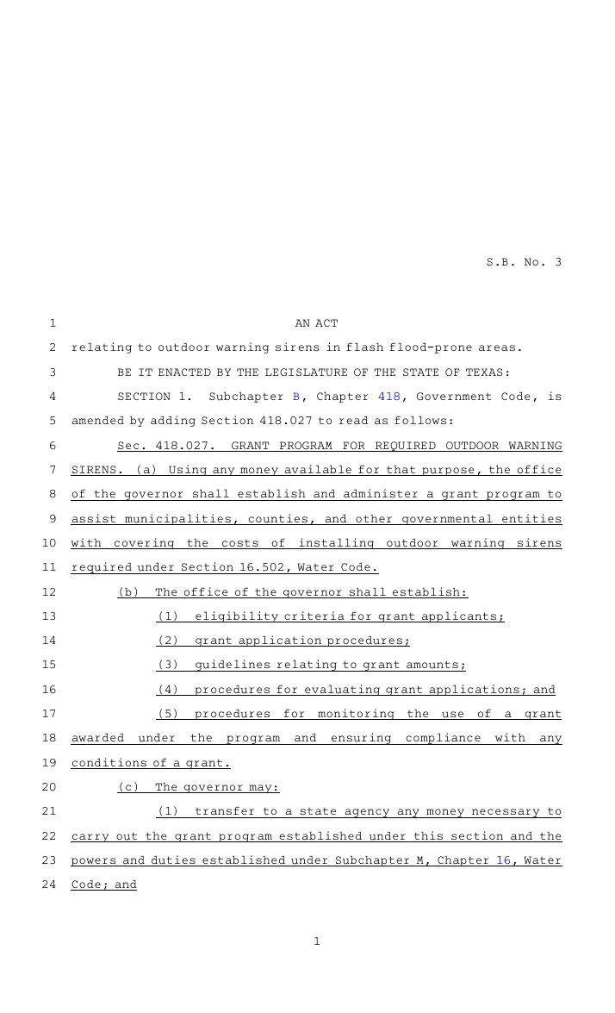
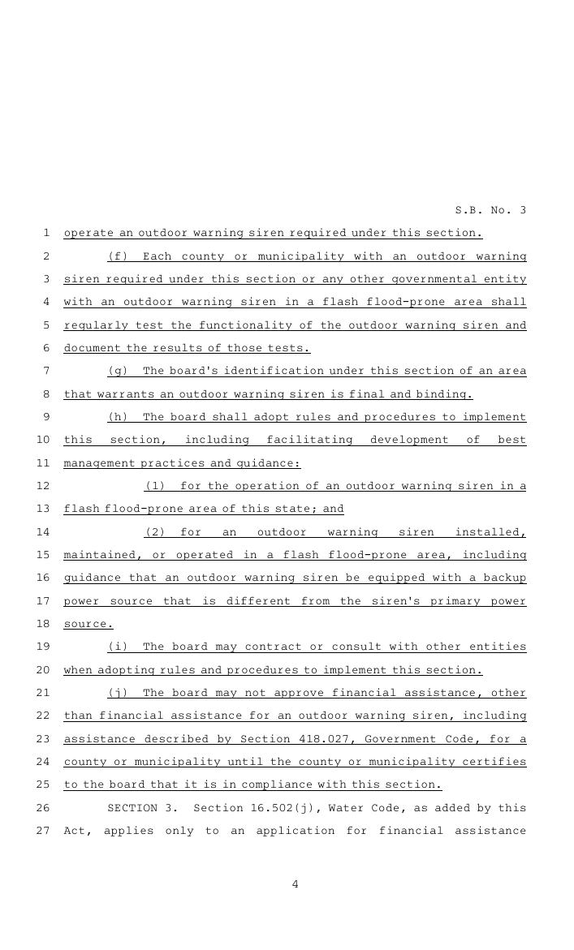
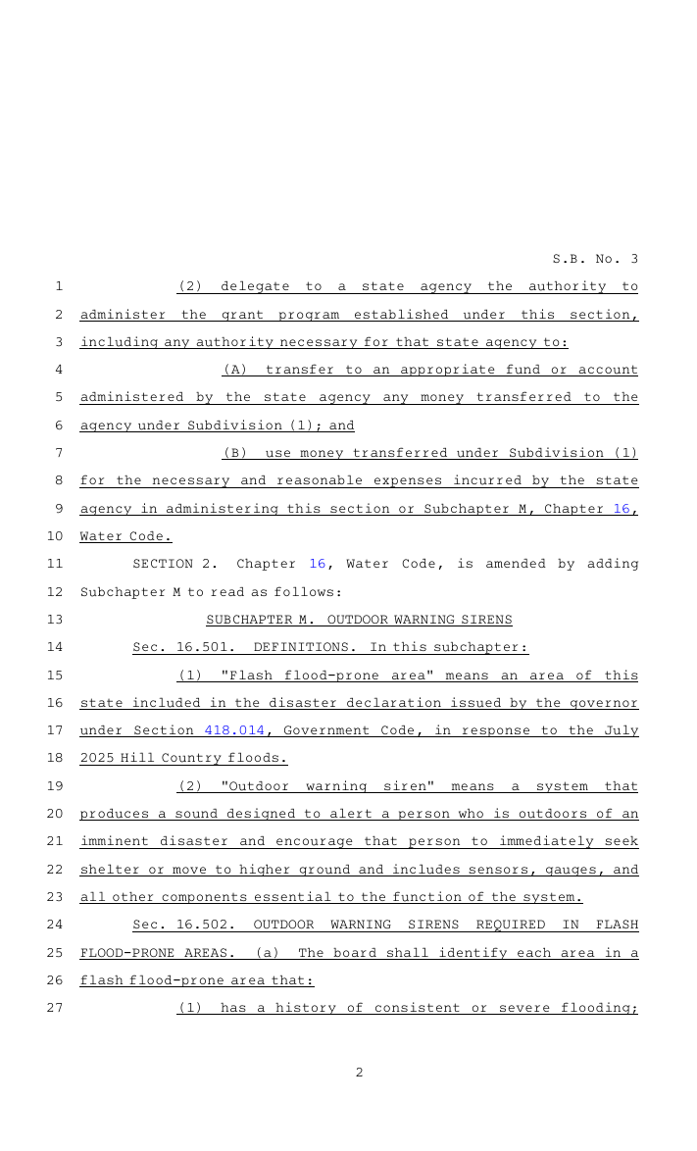
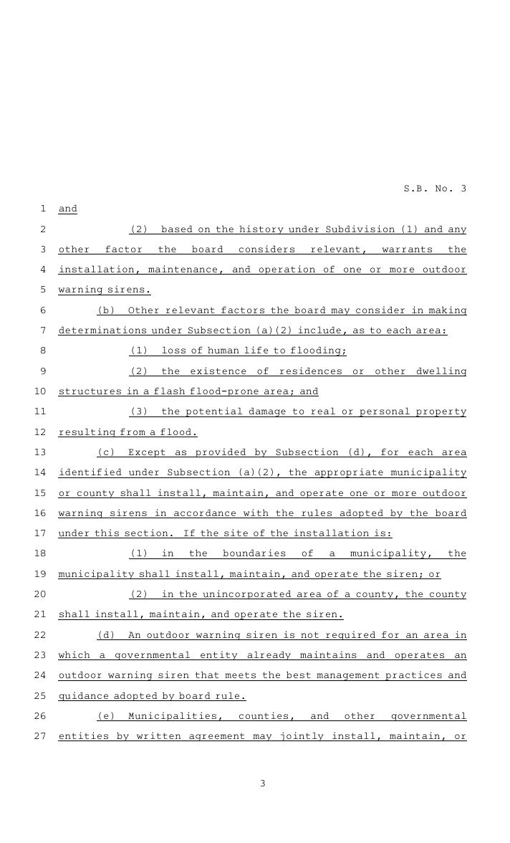

Texas Senate Bill 3
Texas Senate Bill 3
2025 -- 89th Legislature 2nd Special Session
Cities and counties in designated flood-prone areas must install, maintain, and operate outdoor warning sirens.
The Texas Water Development Board (TWDB) must develop best practices and guidance for using these sirens.
The TWDB must set rules for outdoor warning systems in flash flood-prone areas.

Slide 10
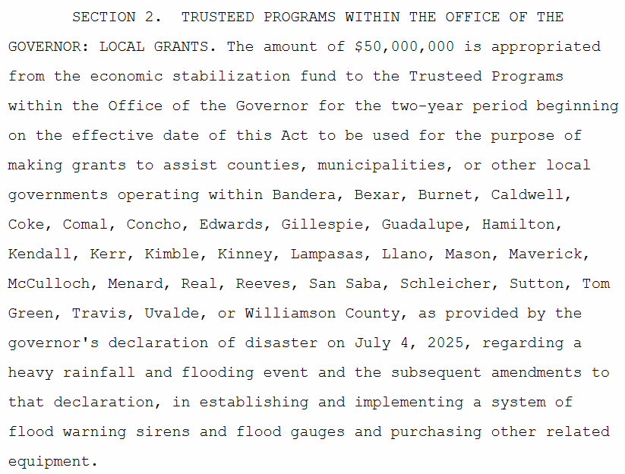
Texas Senate Bill 5
Texas Senate Bill 5
2025 -- 89th Legislature 2nd Special Session
Allocated $50M for the execution of SB3
Impacts 30 counties across Texas
$1M per county (+ ~$250k additional if justified)
TWDB to administer grants (County Liaison)

Slide 11
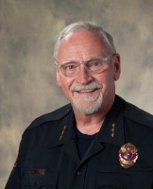
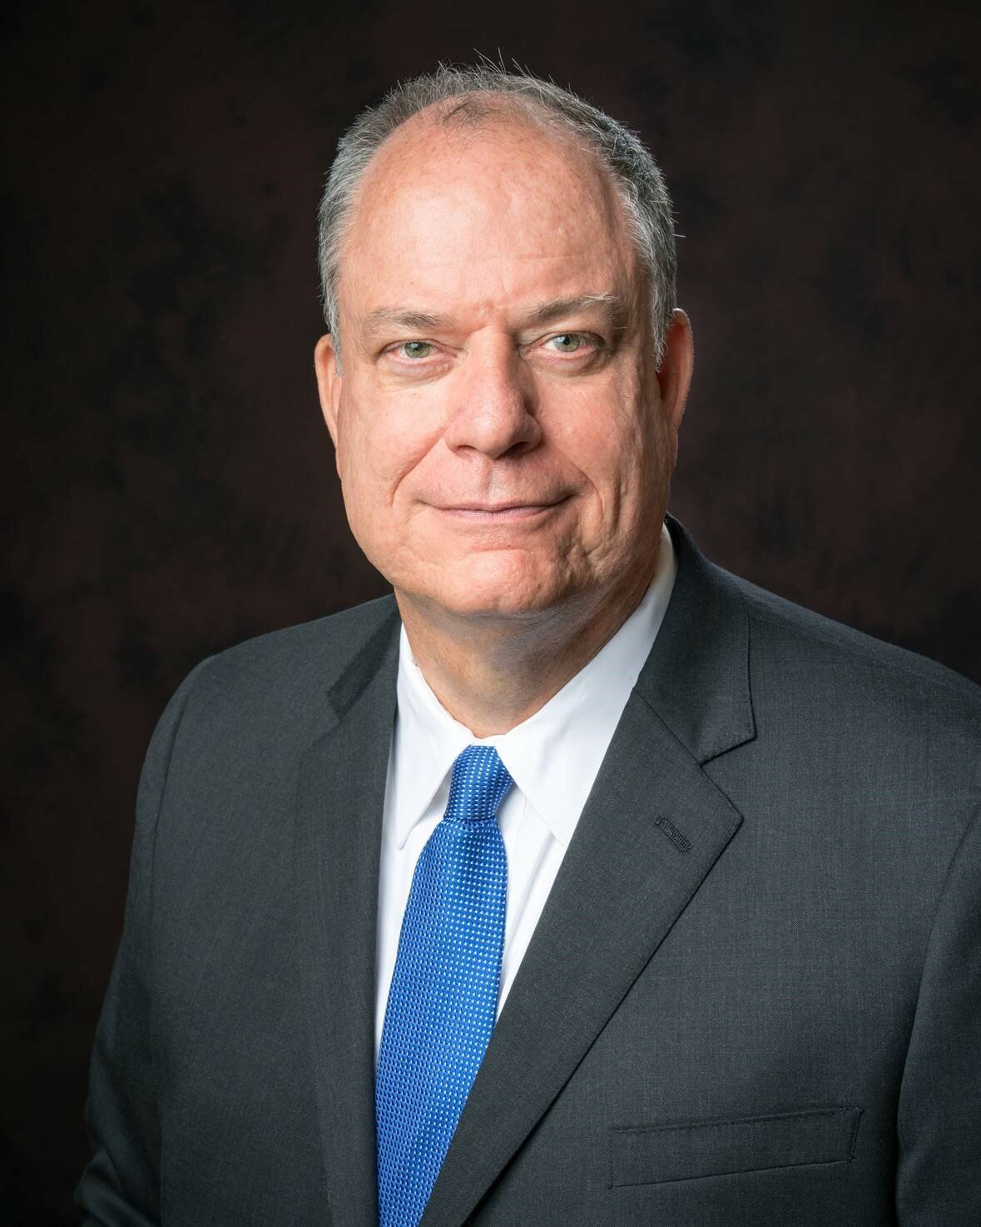
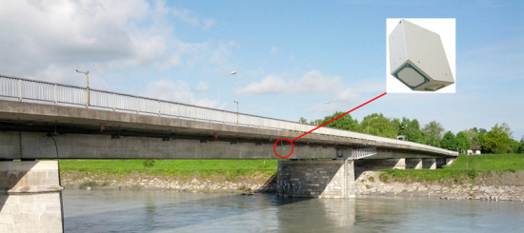
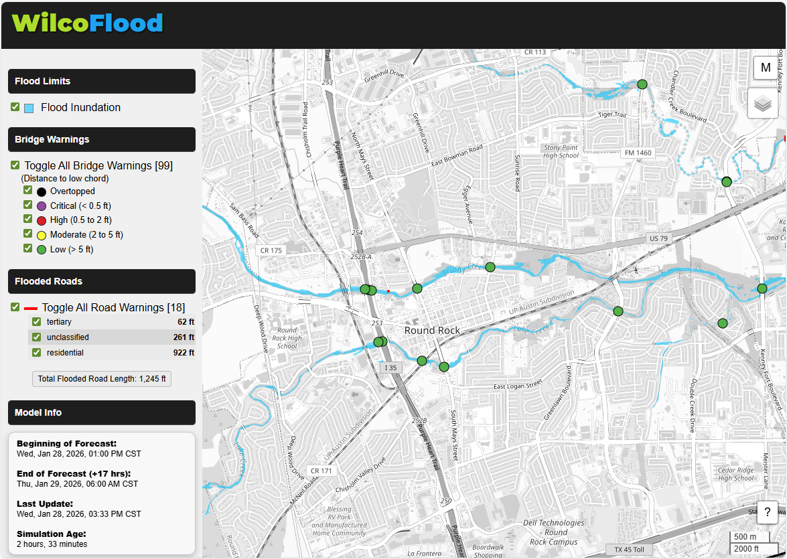
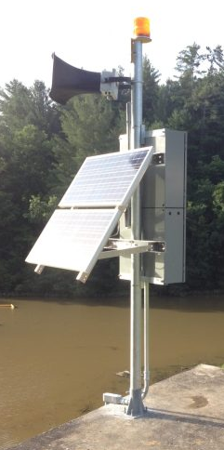

Williamson County’s Approach
Gage Installation -- Contactless RQ-30
Autonomous Flood Warnings and Forecasts (upgraded to use County’s detailed flood models)
with flash flood response
Cell push notifications
Flood Sirens
Integrated Flood Warning and Response Framework

Slide 12
What’s important to Travis County Sheriff’s Office during a flood?
Prediction (where is it likely to flood)
Severity (how bad do we think the flooding is going to be)
Impact (who and what will this flood impact)
Access and Egress (will we be able to respond and do we have the ability to evacuate)
Resource Allocation (where to tactically stage and deploy assets)
Any Others??

Slide 13
Ask of Travis County Sheriff’s Office
Advocacy
Senate Bills 3 and 5 allocate more than $1 million to Travis County for a system of flood warning sirens and flood gauges. These tools are necessary, but on their own they provide limited protection and situational awareness. We request that Travis County consider allocating a portion of these funds to integrate the new gauges into a real-time flood forecasting and mapping system.
By combining gauge data with predictive flood models and live mapping, the County can expand beyond point-based alerts to area-wide, time-based forecasts. This integration would improve public notification, help first responders understand where flooding is developing and where access is still possible, and support more effective deployment of emergency resources.

