Slide 1
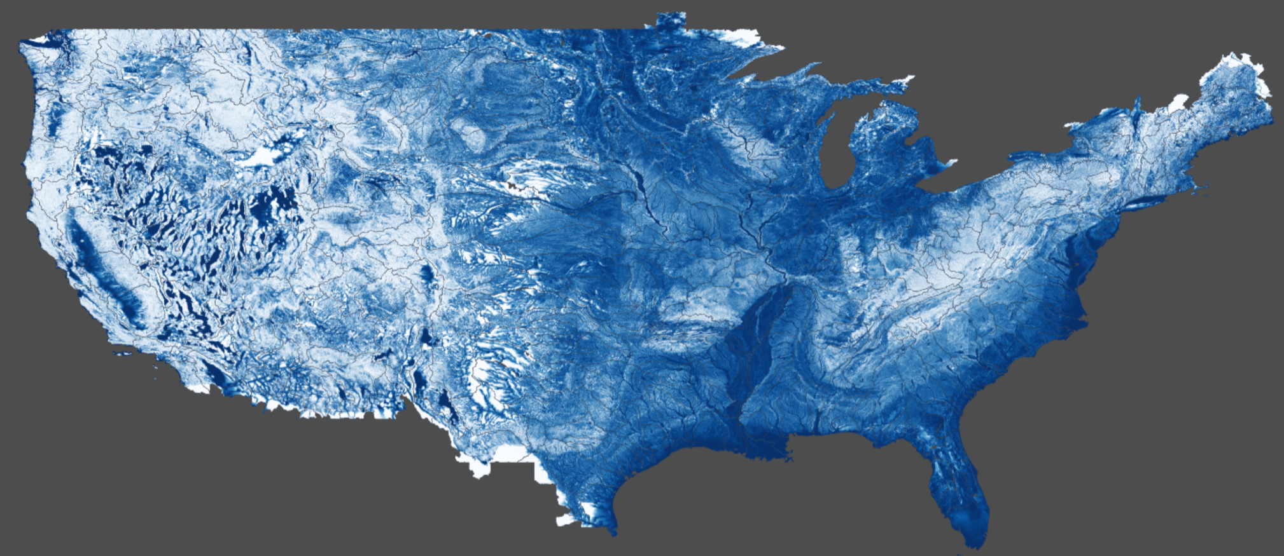
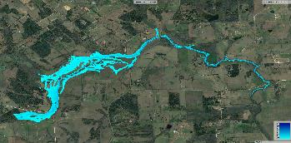
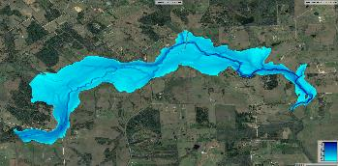
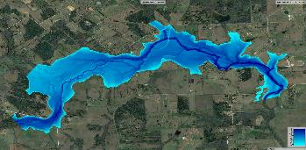
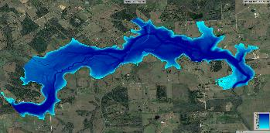
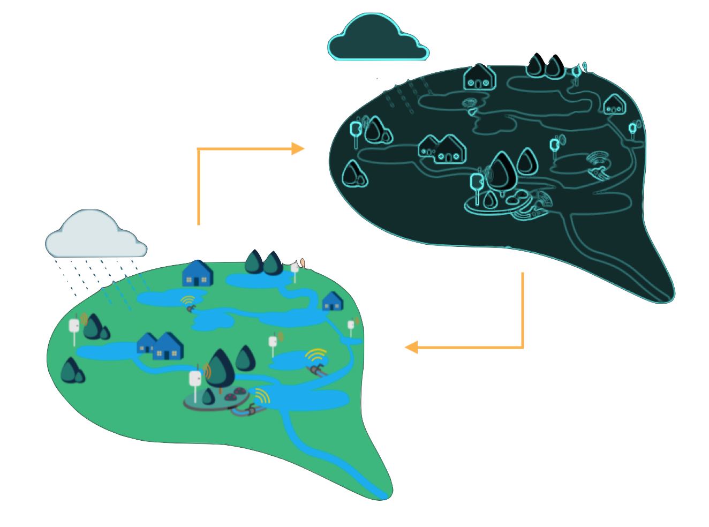
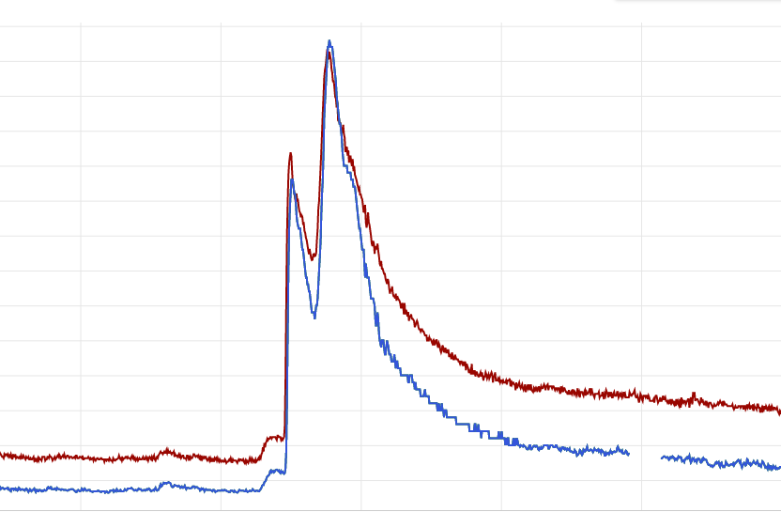
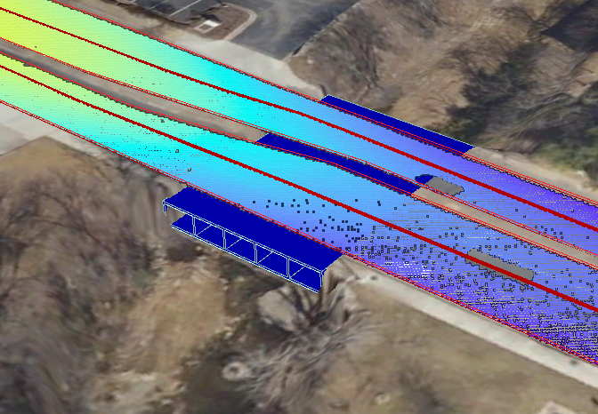
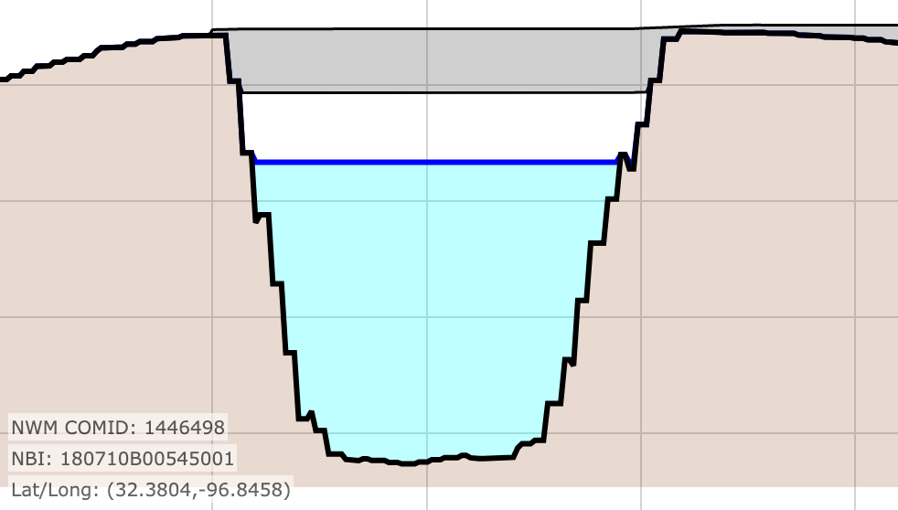
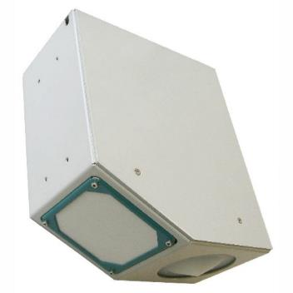
Architecture for a flooded road information system
Modeled discharges
Visualization
Discharge estimates
Roadway flood depth
forecasts
Hydrologic model
Inundation geometries
Data assimilation
Web services
Bridge and roadway geometries
Discharge measurements
Stream gage network
Emergency response

Slide 2

Part 1: Flood hydrology and data assimilation
Modeled discharges
Visualization
Discharge estimates
Roadway flood depth
forecasts
Hydrologic model
Inundation geometries
Data assimilation
Web services
Bridge and roadway geometries
Discharge measurements
Stream gage network
Emergency response
Matt Bartos
UT Austin

Slide 3

Part 2: Flood hydraulics and web services
Modeled discharges
Visualization
Discharge estimates
Roadway flood depth
forecasts
Hydrologic model
Inundation geometries
Data assimilation
Web services
Bridge and roadway geometries
Discharge measurements
Stream gage network
Emergency response
Andy Carter
UT Austin

Slide 4
Flood forecasting starts with a hydrologic model…
Modeled discharges
Visualization
Discharge estimates
Roadway flood depth
forecasts
Hydrologic model
Inundation geometries
Data assimilation
Web services
Bridge and roadway geometries
Discharge measurements
Stream gage network
Emergency response

Slide 5
Flood forecasting starts with a hydrologic model…
1. hydrologic model
Modeled discharges
Visualization
Discharge estimates
Roadway flood depth
forecasts
Hydrologic model
Inundation geometries
Data assimilation
Web services
Bridge and roadway geometries
Discharge measurements
Stream gage network
Emergency response

Slide 6
Hydrologic modeling questions:
What are the basic model components required to translate rainfall forecasts into streamflow forecasts?
What rainfall forcing data would you use?
What model(s) or equation(s) would you use for simulating infiltration and runoff dynamics?
What model(s) or equation(s) would you use for simulating discharge in the channel network?

Slide 7
A basic framework…

Slide 8



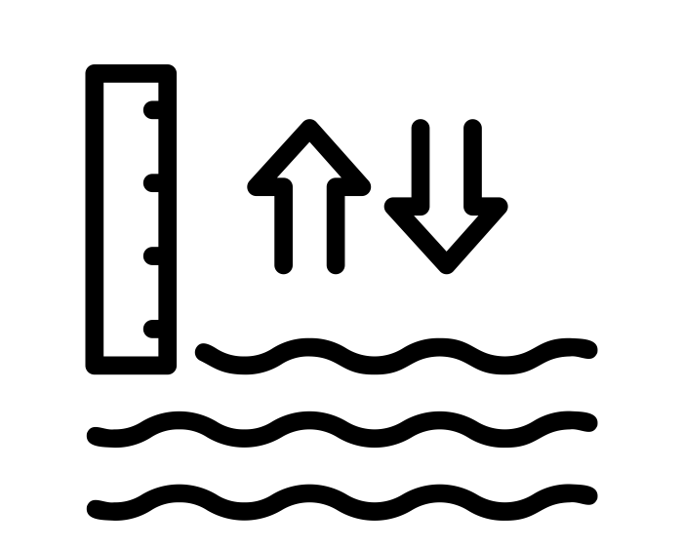

Rainfall forcings
Infiltration / runoff modeling
Streamflow routing
Hydrologic model
Data assimilation
Discharge forecasts

Slide 9
Rainfall forcings
Infiltration / runoff modeling
Streamflow routing
Hydrologic model
Data assimilation
Discharge forecasts

Slide 10
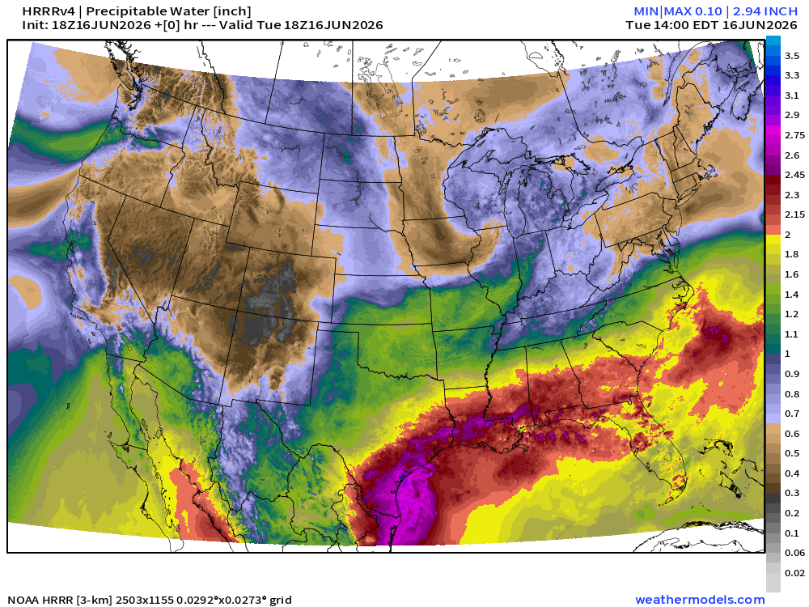
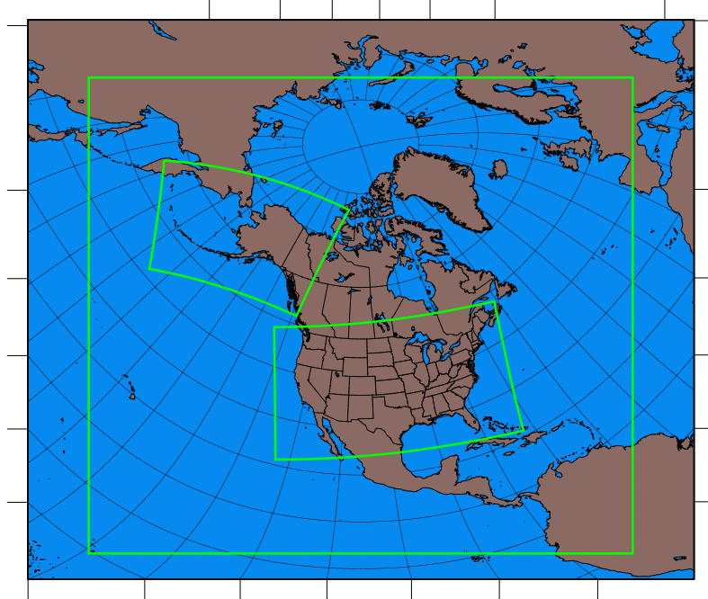
Gridded rainfall forcings
Forecast products
High-resolution rapid refresh (HRRR): 3km hourly gridded rainfall with 3km radar data assimilated every 15 minutes. 18-hour forecast every hour. 48-hour forecast every 6 hours.
Rapid refresh (RAP): 13km hourly gridded rainfall with 13km radar data assimilated. 18-hour forecast every hour.
Multi-radar / multi-sensor (MRMS): Provides nowcasts by combining models with radar and surface/air observations. Resolution of 1km every 2 minutes.
Retrospective
RAP
HRRR
Analysis of record for calibration (AORC): 1km hourly gridded rainfall derived from multiple data sources, including NEXRAD and GDAS.
HRRR

Slide 11
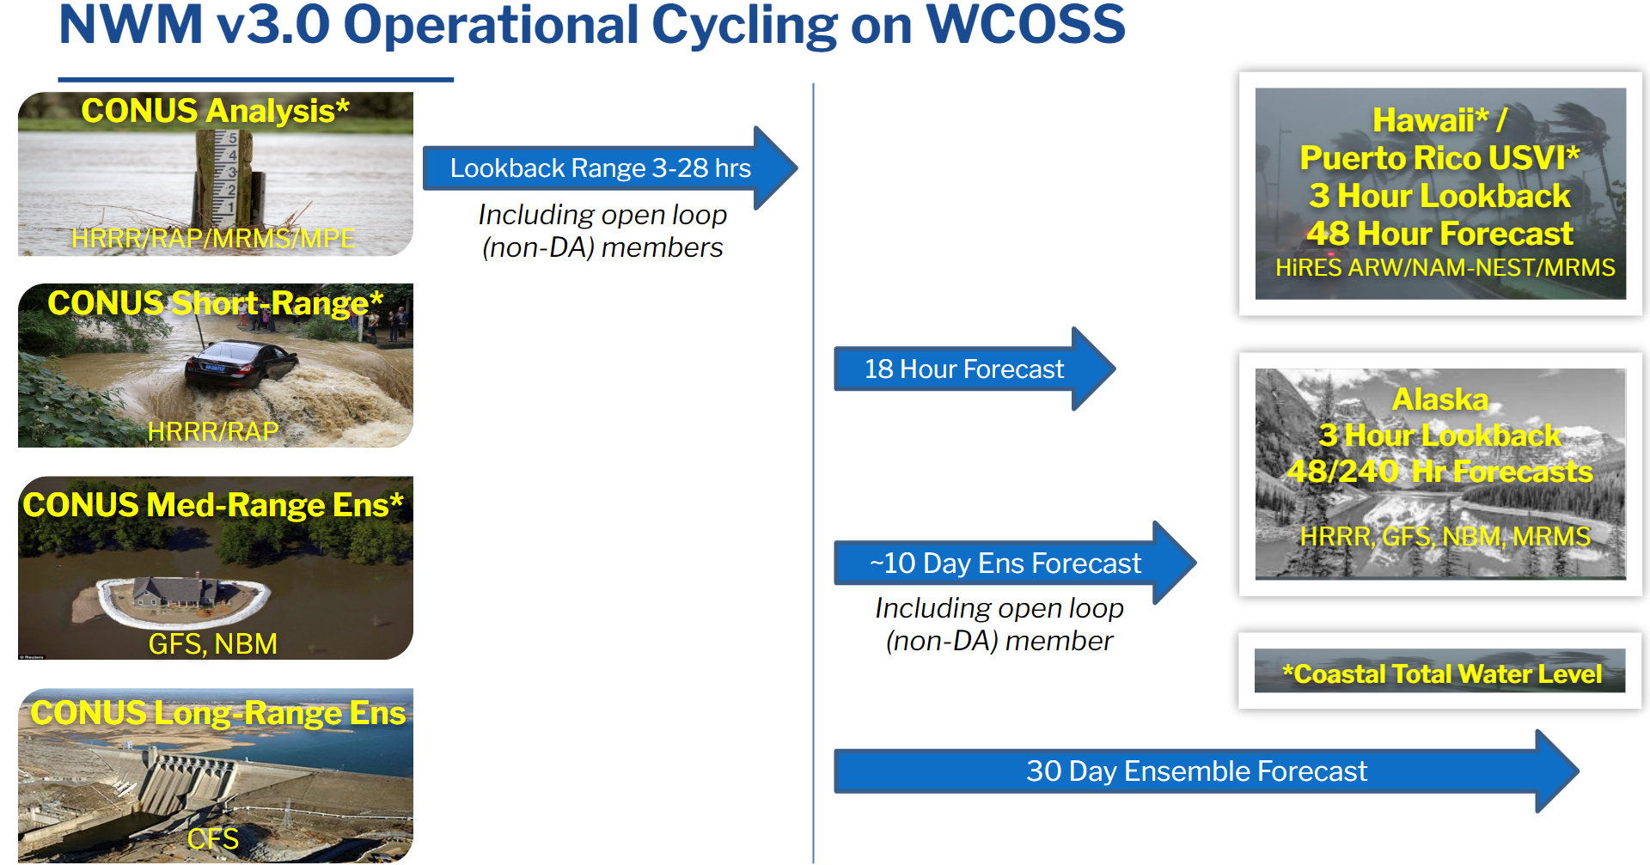
For the FAST system, 18-hour HRRR forecasts are sourced from the National Water Model

Slide 12
For the FAST system, 18-hour HRRR forecasts are sourced from the National Water Model
(Longer-horizon forecasts are generally not accurate enough for real-time response)

Slide 13
Choosing rainfall data:
Do you need forecasts or just nowcasts?
If you need forecasts, how far into the future? (1 hr, 18 hr, 48 hr…?)
At what time scale must emergency response decisions be made?

Slide 14
Rainfall forcings
Infiltration / runoff modeling
Streamflow routing
Hydrologic model
Data assimilation
Discharge forecasts

Slide 15
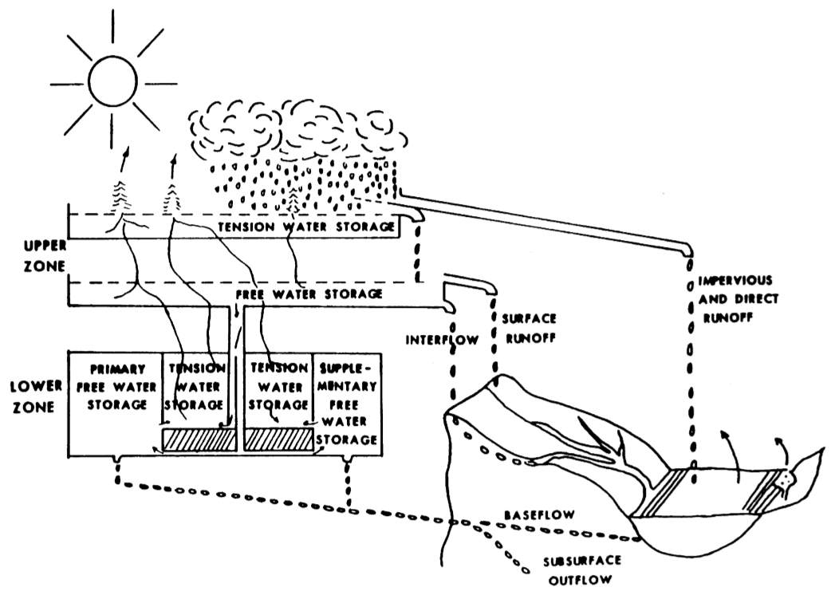
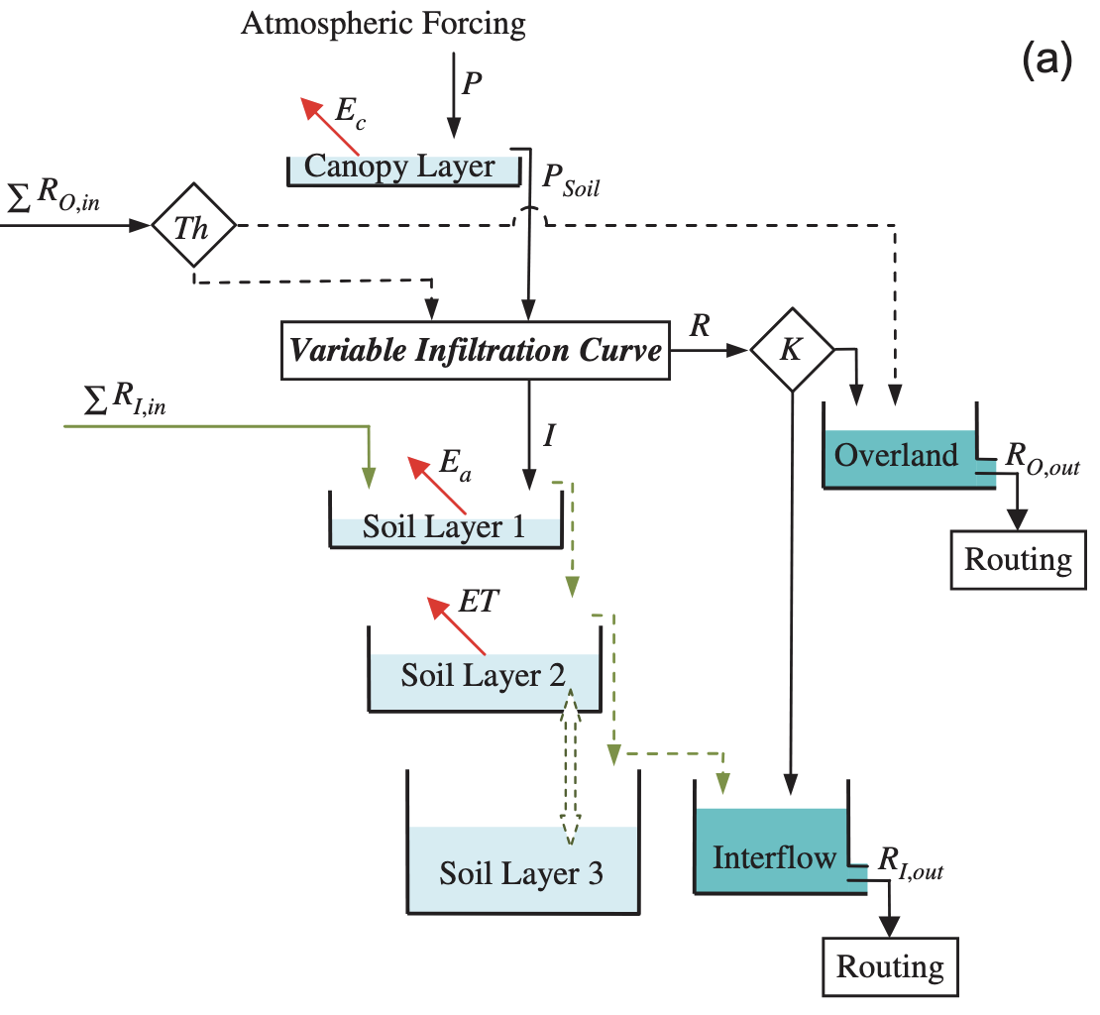
Infiltration and runoff models
SAC-SMA model
Commonly-used models for flood forecasting:
SAC-SMA: Conceptual model used within NWS River Forecast Centers to produce forecasts of stream discharge and stage. Divides soil into multiple ‘buckets’ with tension and free water zones to emulate real-world runoff, baseflow, and evapotranspiration dynamics. Runoff is divided into 5 different components contributed by 5 layers. Represents runoff primarily through saturation-excess mechanisms (best suited for humid catchments).
CREST: Conceptual model developed by the University of Oklahoma and NASA. Amenable to remote sensing datasets. Also uses multiple buckets to represent soil dynamics, but does not explicitly represent tension and free water components. Uses a variable-infiltration capacity (VIC) curve to determine the portion of the watershed that is contributing to runoff (generally suited for saturation-excess runoff in humid catchments).
CREST model

Slide 16
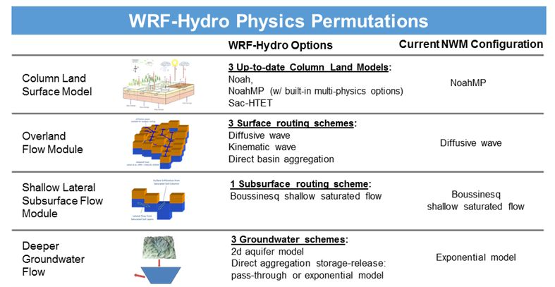
For the FAST system, we use the WRF-Hydro modeling system as implemented in the National Water Model
Infiltration
Runoff
Ground-water

Slide 17
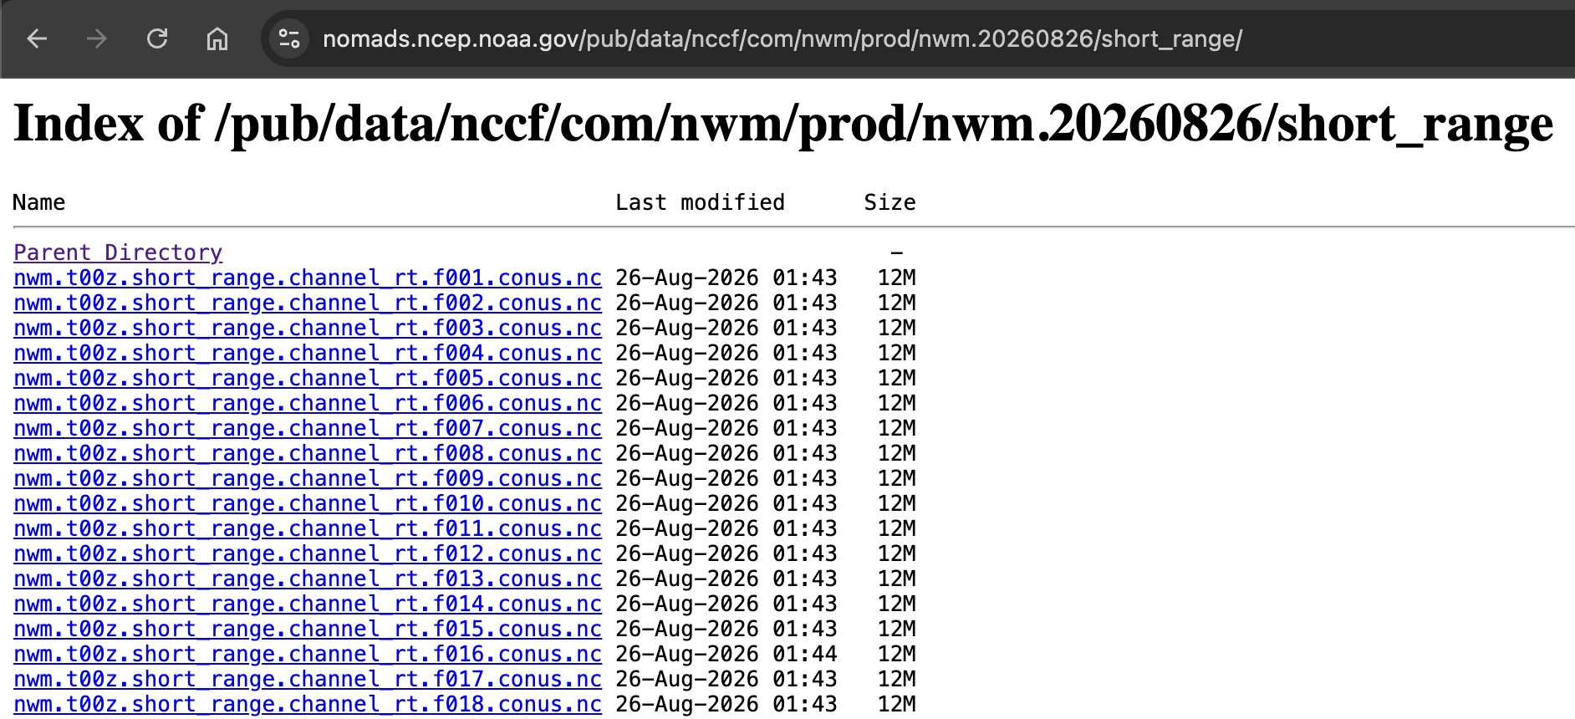
Runoff outputs are available for the Continental US via the NOMADS NCEP HTTP service

Slide 18
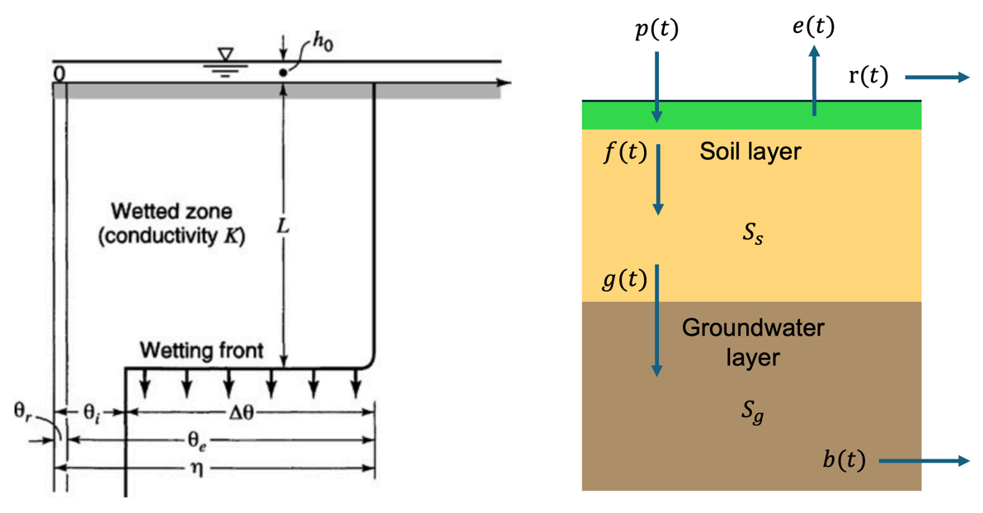
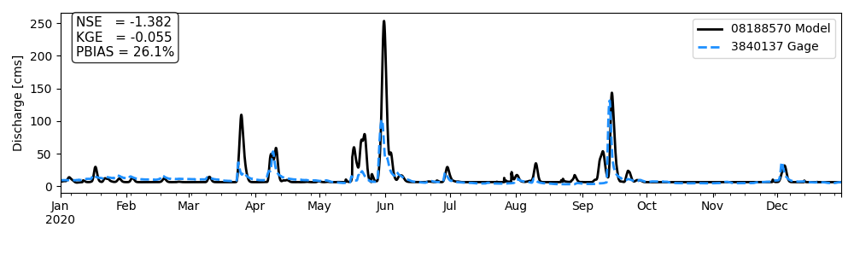
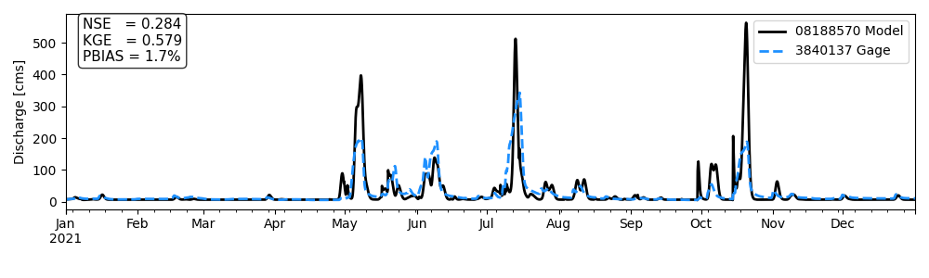
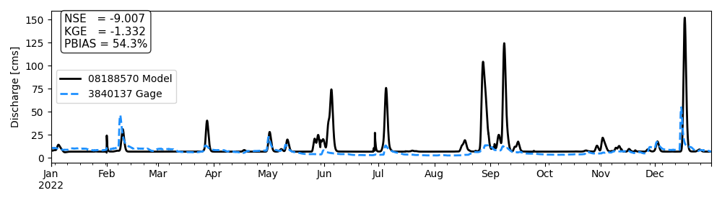
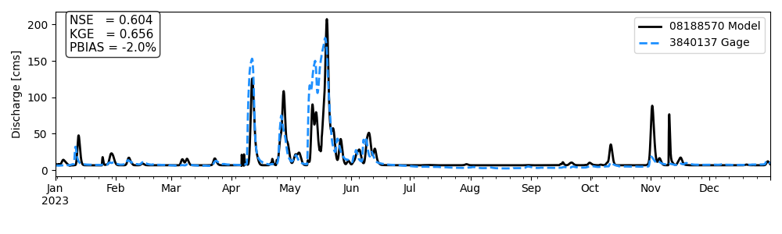
For arid regions in Central / West Texas, the FAST system is testing an infiltration-excess model based on Green-Ampt with soil recovery
2020
2021
2022
2023
Green-Ampt infiltration
2-layer water balance

Slide 19
Choosing an infiltration and runoff model:
Are there existing calibrated models for your domain?
Is flooding primarily driven by infiltration-excess or saturation-excess runoff? (e.g. arid vs. humid)
What soil parameter data are available for your domain? (e.g. SSURGO, POLARIS, drilling logs)?

Slide 20
Rainfall forcings
Infiltration / runoff modeling
Streamflow routing
Hydrologic model
Data assimilation
Discharge forecasts

Slide 21
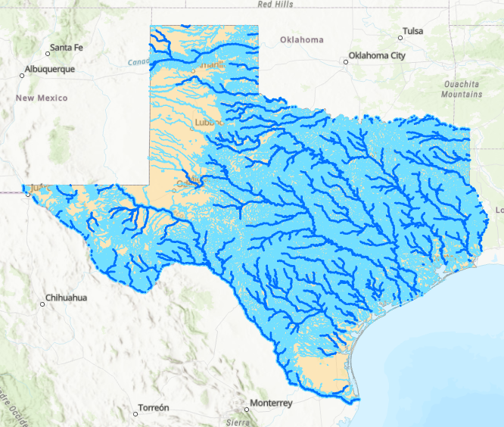
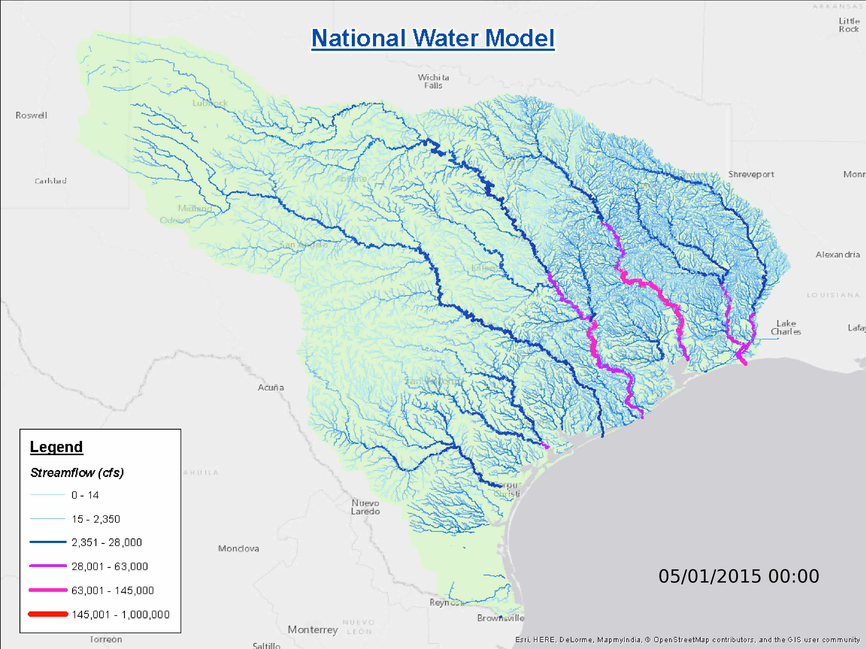
Forecasted runoff must be routed through the drainage network to generate discharge forecasts

Slide 22




Stream network routing models
Commonly-used models for channel routing:
Muskingum: Linear, unidirectional routing model. Each channel is parameterized by a travel time (K) and attenuation factor (X) that define the transport of the wave.
Muskingum-Cunge: Nonlinear, unidirectional routing model. Allows travel time (K) and attenuation (X) to vary depending on the discharge and depth of water.
Kinematic wave: Nonlinear, unidirectional routing model. A simplification of the Saint-Venant equations for unsteady flow considering only frictional and gravitational forces.
Diffusive wave: Nonlinear, bidirectional routing model. A simplification of the Saint-Venant equations considering frictional, gravitational, and hydrostatic forces.
$$Q_{j+1}^{t+Δt}=α_{j}Q_{j}^{t+Δt}+βQ_{j}^{t}+χQ_{j+1}^{t}+γq_{j}^{t}$$
$$Q_{j+1}^{t+Δt}=α_{j}(Q)Q_{j}^{t+Δt}+β(Q)Q_{j}^{t}+χ(Q)Q_{j+1}^{t}+γ(Q)q_{j}^{t}$$
$$\frac{∂h}{∂t}+αh^{5/3}\frac{∂h}{∂x}=q$$
$$\frac{∂A}{∂t}+\frac{∂Q}{∂x}=q ;$$
$$\frac{∂h}{∂x} − S_{0}+S_{f}=0$$

Slide 23







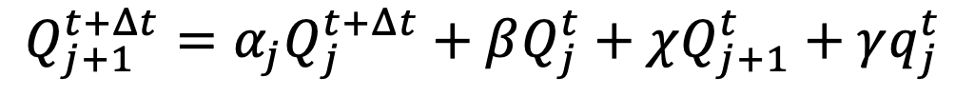

For FAST, streamflow routing is based on the Muskingum model
Governing equation for a single reach:
$$Q_{j+1}^{t+Δt}=α_{j}Q_{j}^{t+Δt}+βQ_{j}^{t}+χQ_{j+1}^{t}+γq_{j}^{t}$$
Wedge storage
$$Q_{j}$$
Prism storage
Outflow at next timestep
Inflow at next timestep
Inflow at previous timestep
Outflow at previous timestep
Lateral inflow
$$Q_{j+1}$$
$$χ=\frac{K\left(1−X\right)−Δt/2}{K\left(1−X\right)+Δt/2}$$
$$α=\frac{KX+Δt/2}{K\left(1−X\right)+Δt/2}$$
Two parameters:
$$K:$$
Flood wave travel time in reach [s]
$$γ=\frac{Δt}{K\left(1−X\right)+Δt/2}$$
$$β=\frac{KX−Δt/2}{K\left(1−X\right)+Δt/2}$$
$$X:$$
Wave attenuation (from 0 – 0.5)

Slide 24
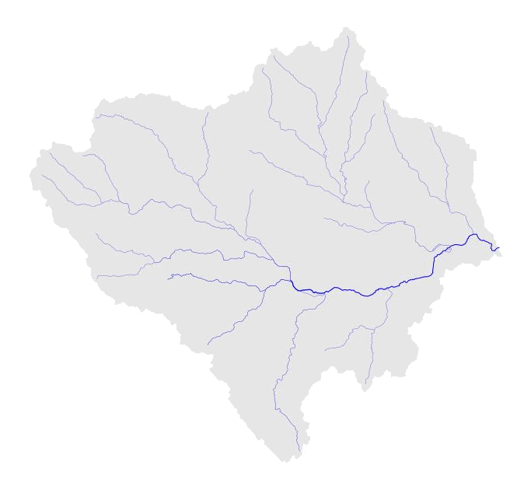
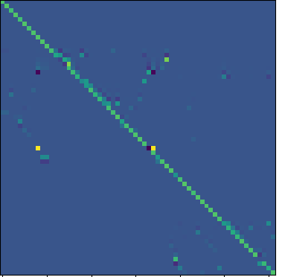
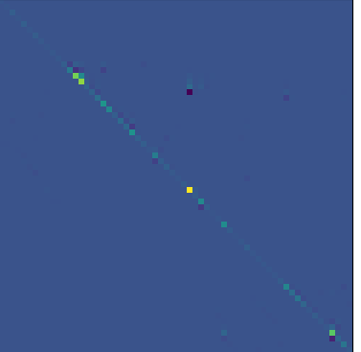
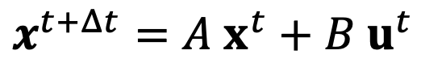
For a large system of reaches (NHD), we can express the Muskingum model in terms of a large matrix equation
Muskingum Method, single reach:
State-space simulation
$$Q_{j+1}^{t+Δt}=α_{j}Q_{j}^{t+Δt}+βQ_{j}^{t}+χQ_{j+1}^{t}+γq_{j}$$
Muskingum Method, all reaches (state-space form):
$$x^{t+Δt}=A x^{t}+B u^{t}$$
=
x^{t}
+
u^{t}
x^{t+Δt}
A
B
Muskingum model is forced by runoff inputs from National Water Model

Slide 25
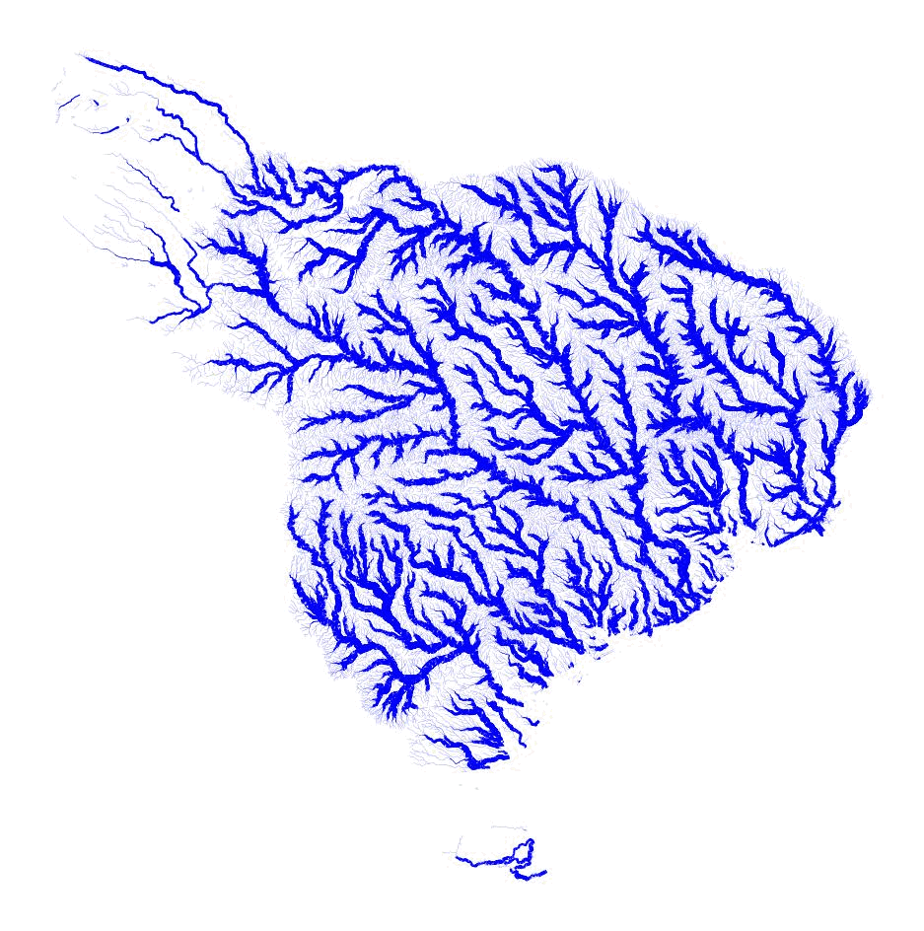
The result is a fast model that simulates 18-hour discharge forecasts for all of Texas in less than 3 seconds

Slide 26
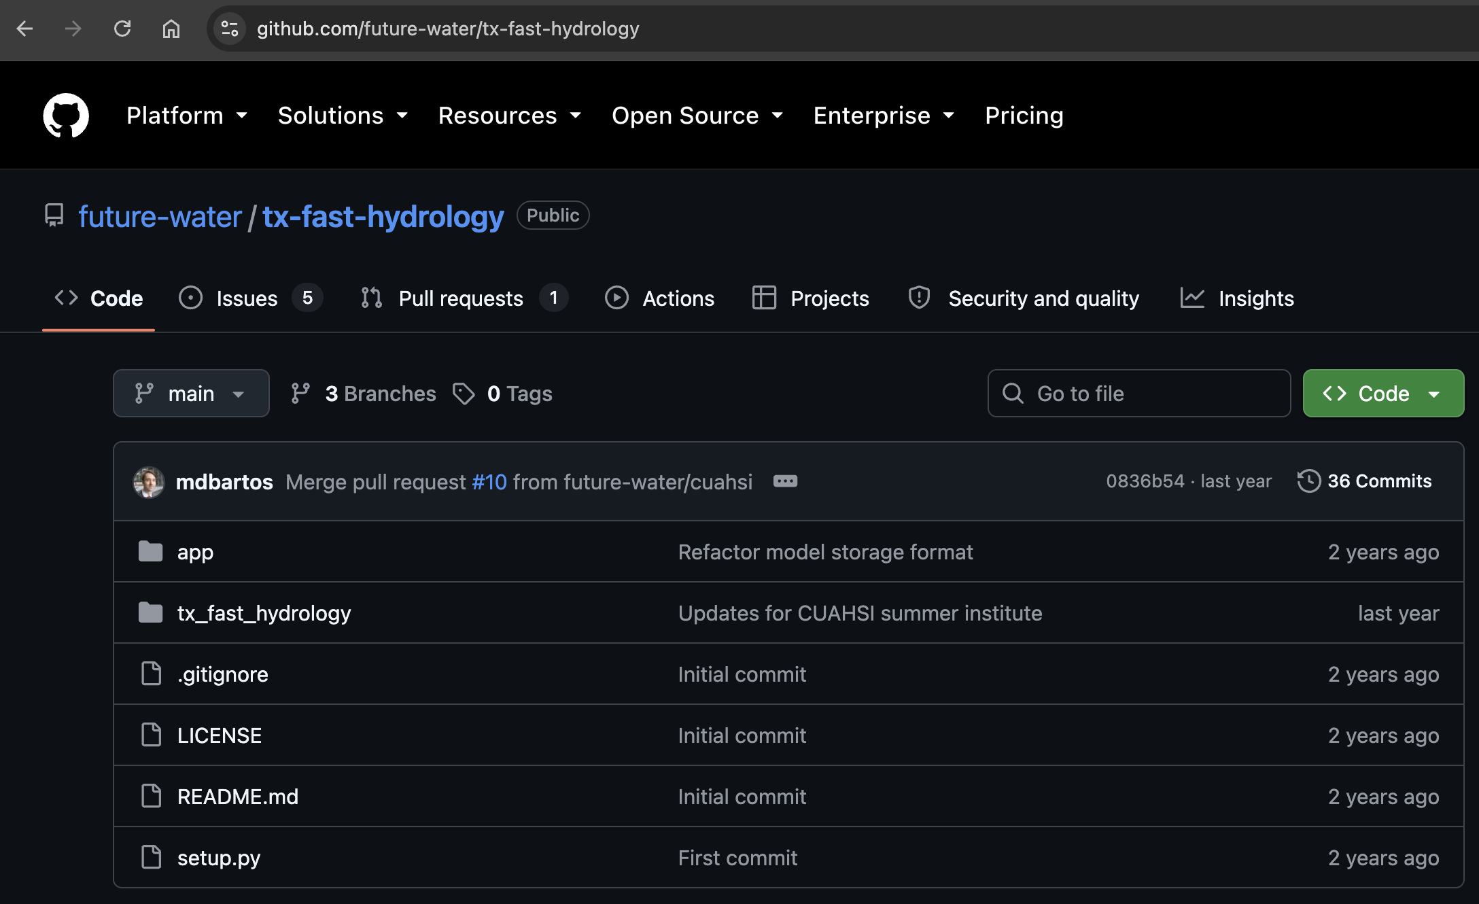
FAST routing code available via GitHub

Slide 27
Choosing a routing model:
Are backwater effects important or is it possible to use a unidirectional model?
Is it important to represent nonlinearities in wave behavior?
What is the size of your model domain and how quickly do you need the model to run?

Slide 28
Rainfall forcings
Infiltration / runoff modeling
Streamflow routing
Hydrologic model
Data assimilation
Discharge forecasts

Slide 29
Data assimilation questions:
Why do we need data assimilation?
If you were tasked with fusing gauge data into a model (assuming no prior knowledge) how would you do it?
Are there any potential issues with your proposed approach?

Slide 30
Data assimilation (DA) combines sensor data with a dynamical model…
sensor
model
…to improve estimation and forecasting of system states (like depths and discharges)

Slide 31
Why do we need data assimilation?

Slide 32
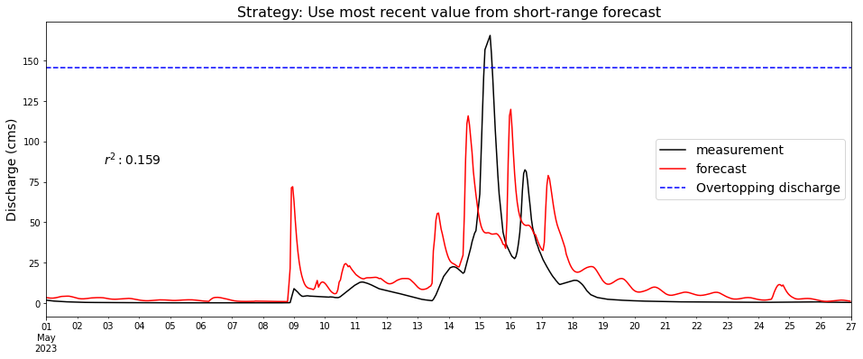
short answer: modeled forecasts are not reliable

Slide 33
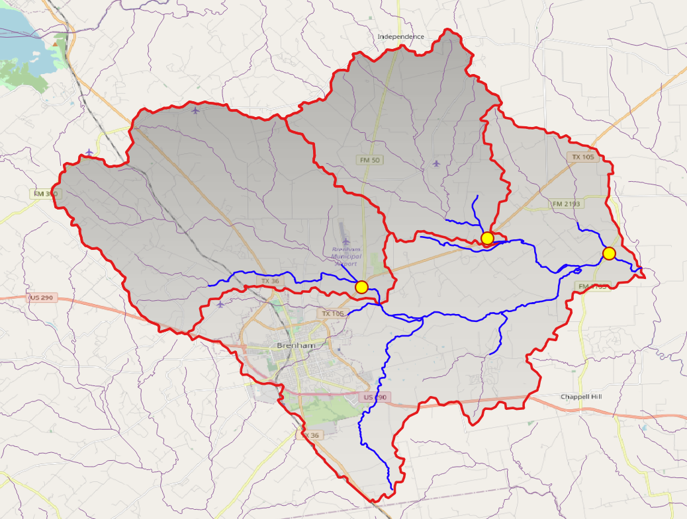
real overtopping event in new year creek
390 km²

Slide 34
real overtopping event in new year creek
USGS stream gage

Slide 35
real overtopping event in new year creek
USGS stream gage
overtopping discharge
overtopping location

Slide 36
real overtopping event in new year creek
USGS stream gage
NWM short-term forecast
(1-hr lead time)
overtopping discharge
overtopping location

Slide 37

real overtopping event in new year creek
real overtopping occurred on 5/15 and 5/16…

Slide 38
real overtopping event in new year creek
But NWM forecast misses the main peaks…

Slide 39
real overtopping event in new year creek
…and introduces five different false alarms

Slide 40
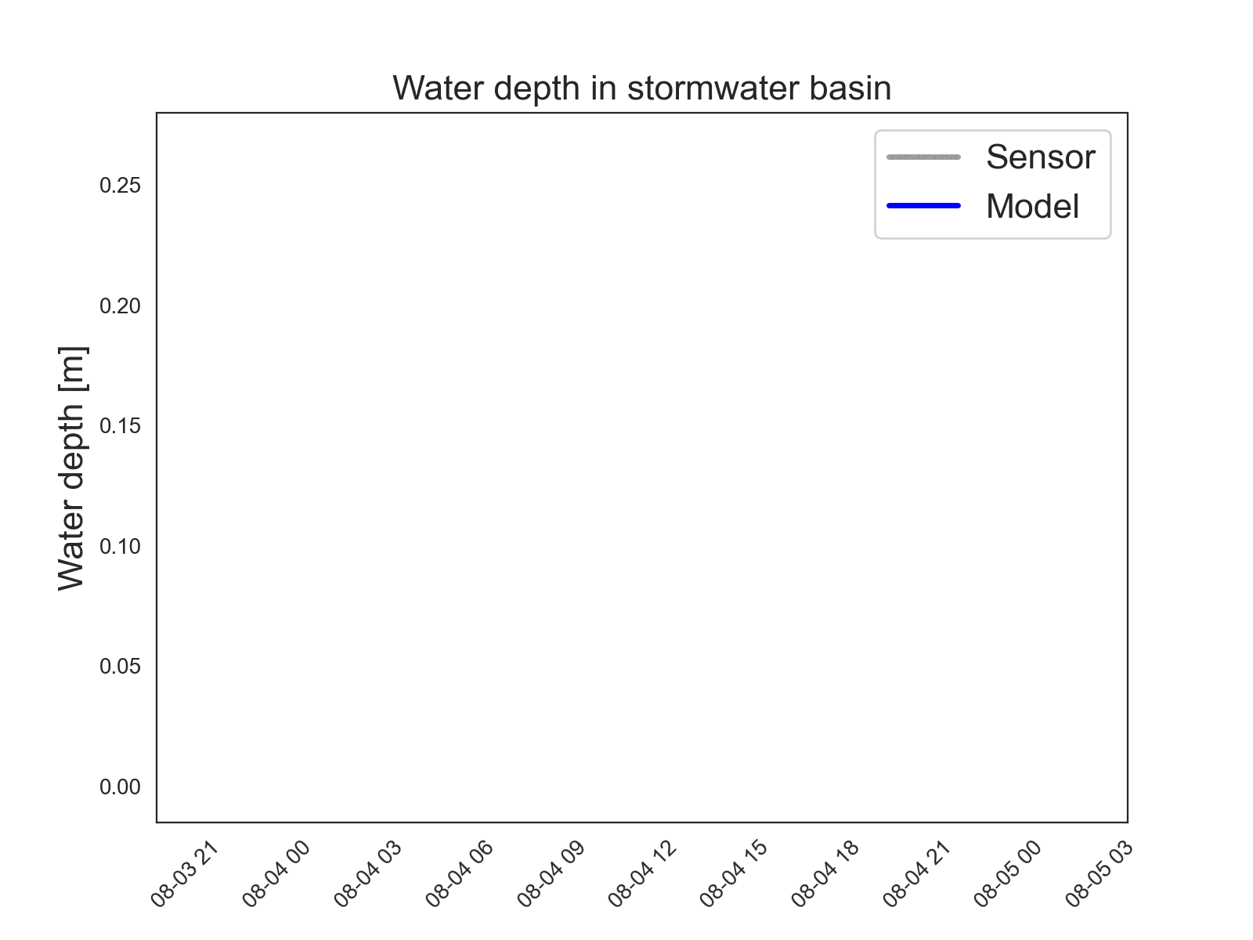
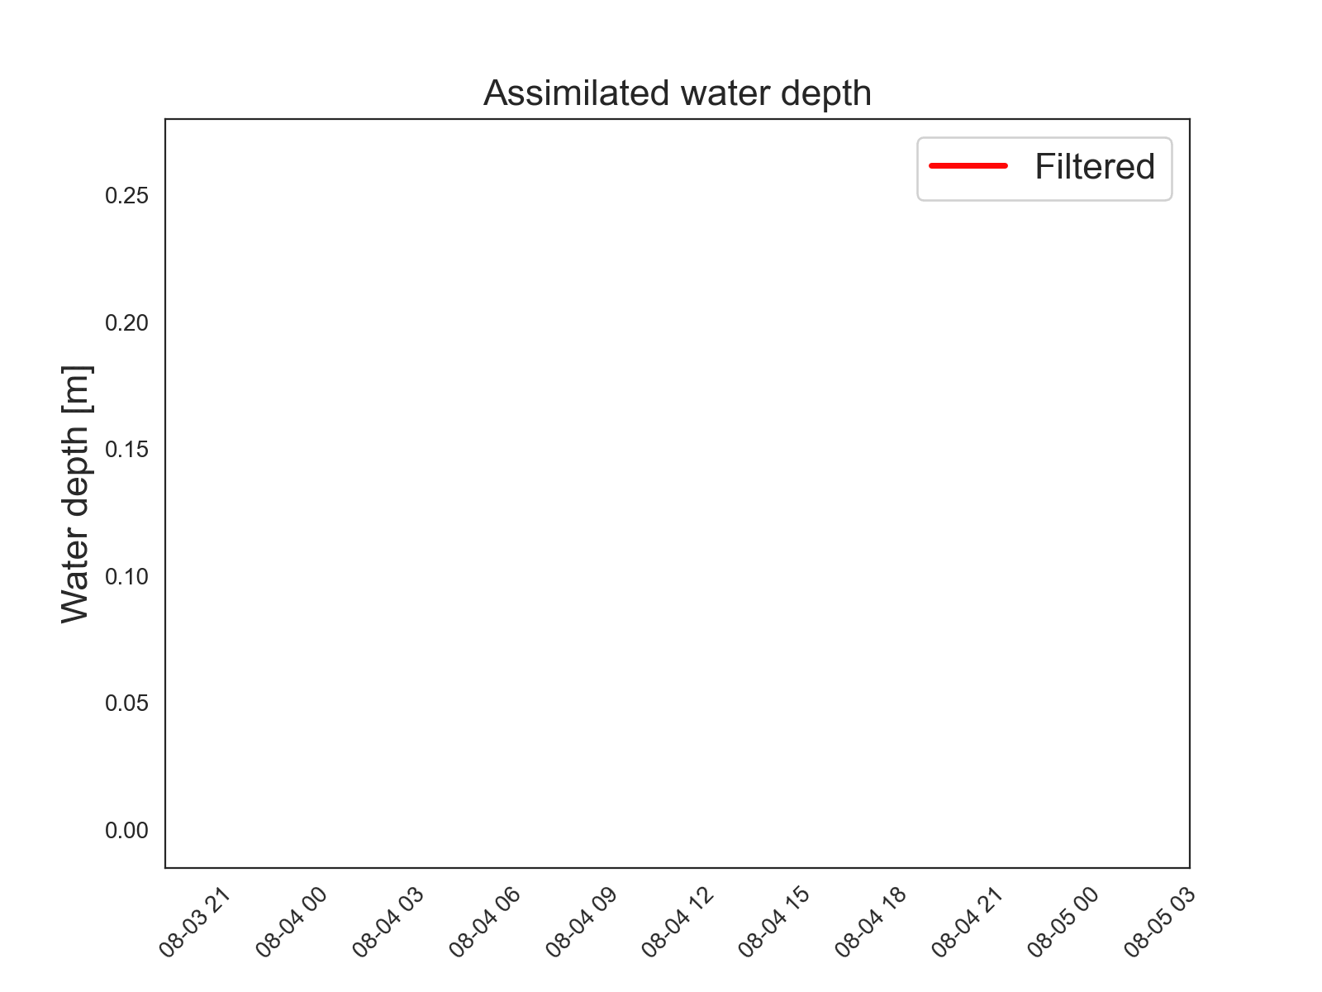
To correct this problem, we can fuse discharge data from sensors into the routing model…
Measured + modeled depths
Assimilated depth
…to ensure that estimated discharges are accurate at the start of each forecasting window

Slide 41
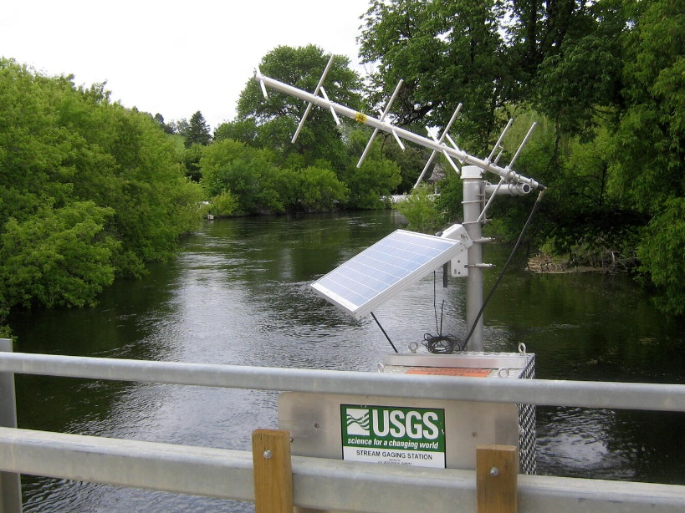
NWM uses a DA approach called
‘Nudging’…
…which effectively inserts discharge observations into the model
Gauge reads 50,000 cfs
National Water Model (NWM)
calculates 100,000 cfs at in river
Oops… only 50,000 cfs will be in the NWM
downstream of the gauge

Slide 42
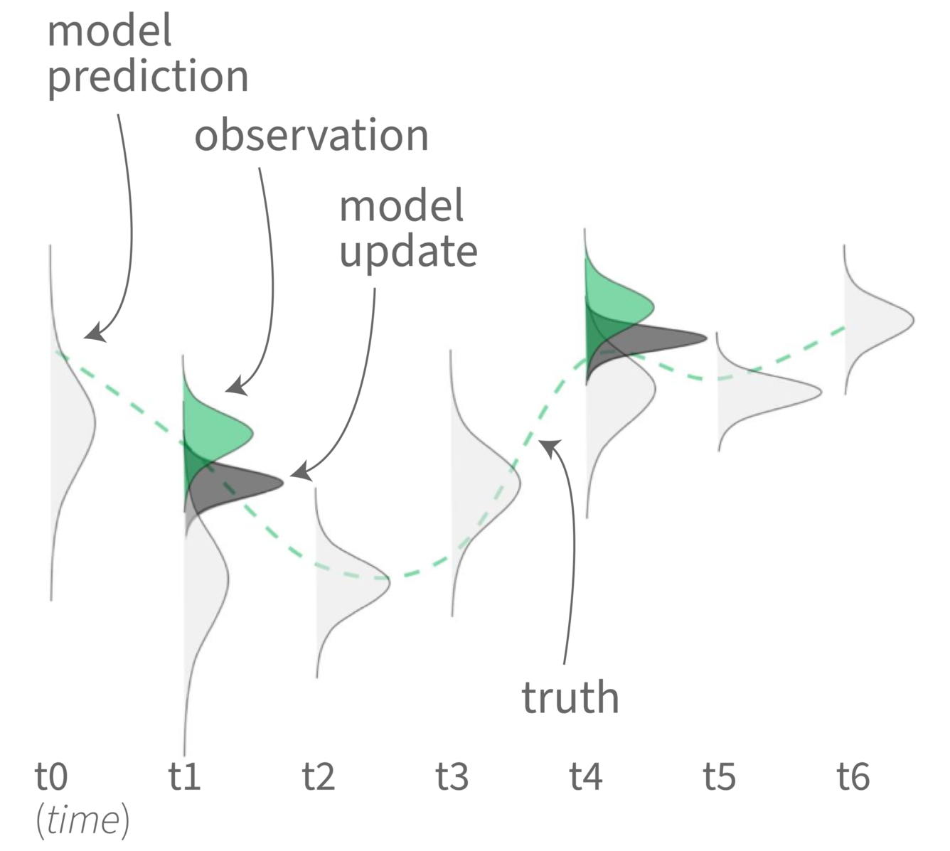
Data assimilation approaches:
Variational data assimilation (3DVAR/4DVAR): Common in numerical weather prediction. Minimizes an objective function defined in terms of the difference between estimated and observed states. 3DVAR incorporates 3 spatial dimensions while 4DVAR incorporates a time dimension.
Kalman Filtering / Smoothing: Data assimilation method common in control theory and numerical weather prediction. Minimizes the mean squared error between observations and the estimated system states. Kalman Filtering estimates the current state based on past and present observations. Kalman Smoothing estimates current and past states based on past and present observations. Kalman Smoothing is equivalent to 4DVAR.
Nonlinear Filters: Various filtering approaches exist for nonlinear systems, including Extended Kalman Filtering (EKF), Ensemble Kalman Filtering (EnKF), and Particle Filtering (PF). Many of these approaches are based on ensembles of models (EnKF, PF).

Slide 43
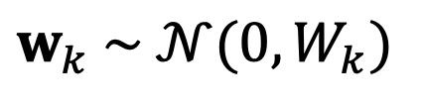
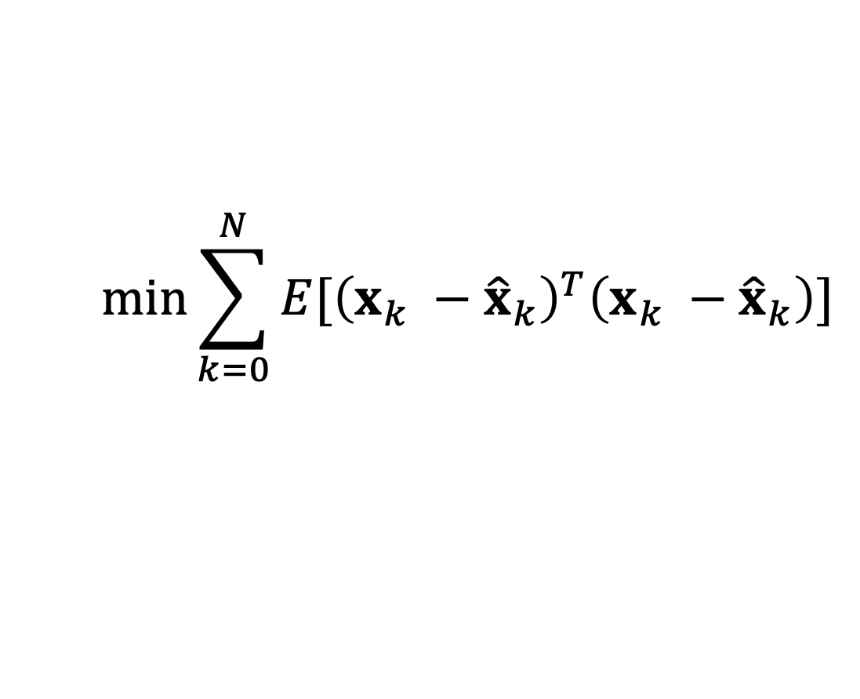

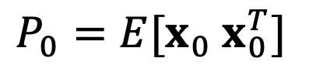
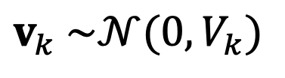
The FAST system applies an optimal DA approach for routing called Kalman Filtering
$$\min{\sum_{k=0}^{N}{E[{\left(x_{k} −{\hat{x}}_{k}\right)}^{T}\left(x_{k} −{\hat{x}}_{k}\right)]}}$$
minimizes the mean squared error between the true and estimated states at each model timestep
$$L$$
under the following assumptions:
$$w_{k} \sim 𝒩(0, W_{k})$$
The measurement noise is Gaussian with known covariance W_{k}
$$v_{k} \sim 𝒩(0, V_{k})$$
The process noise is Gaussian with known covariance V_{k}
$$P_{0}=E[x_{0} x_{0}^{T}]$$
The initial error covariance is known

Slide 44
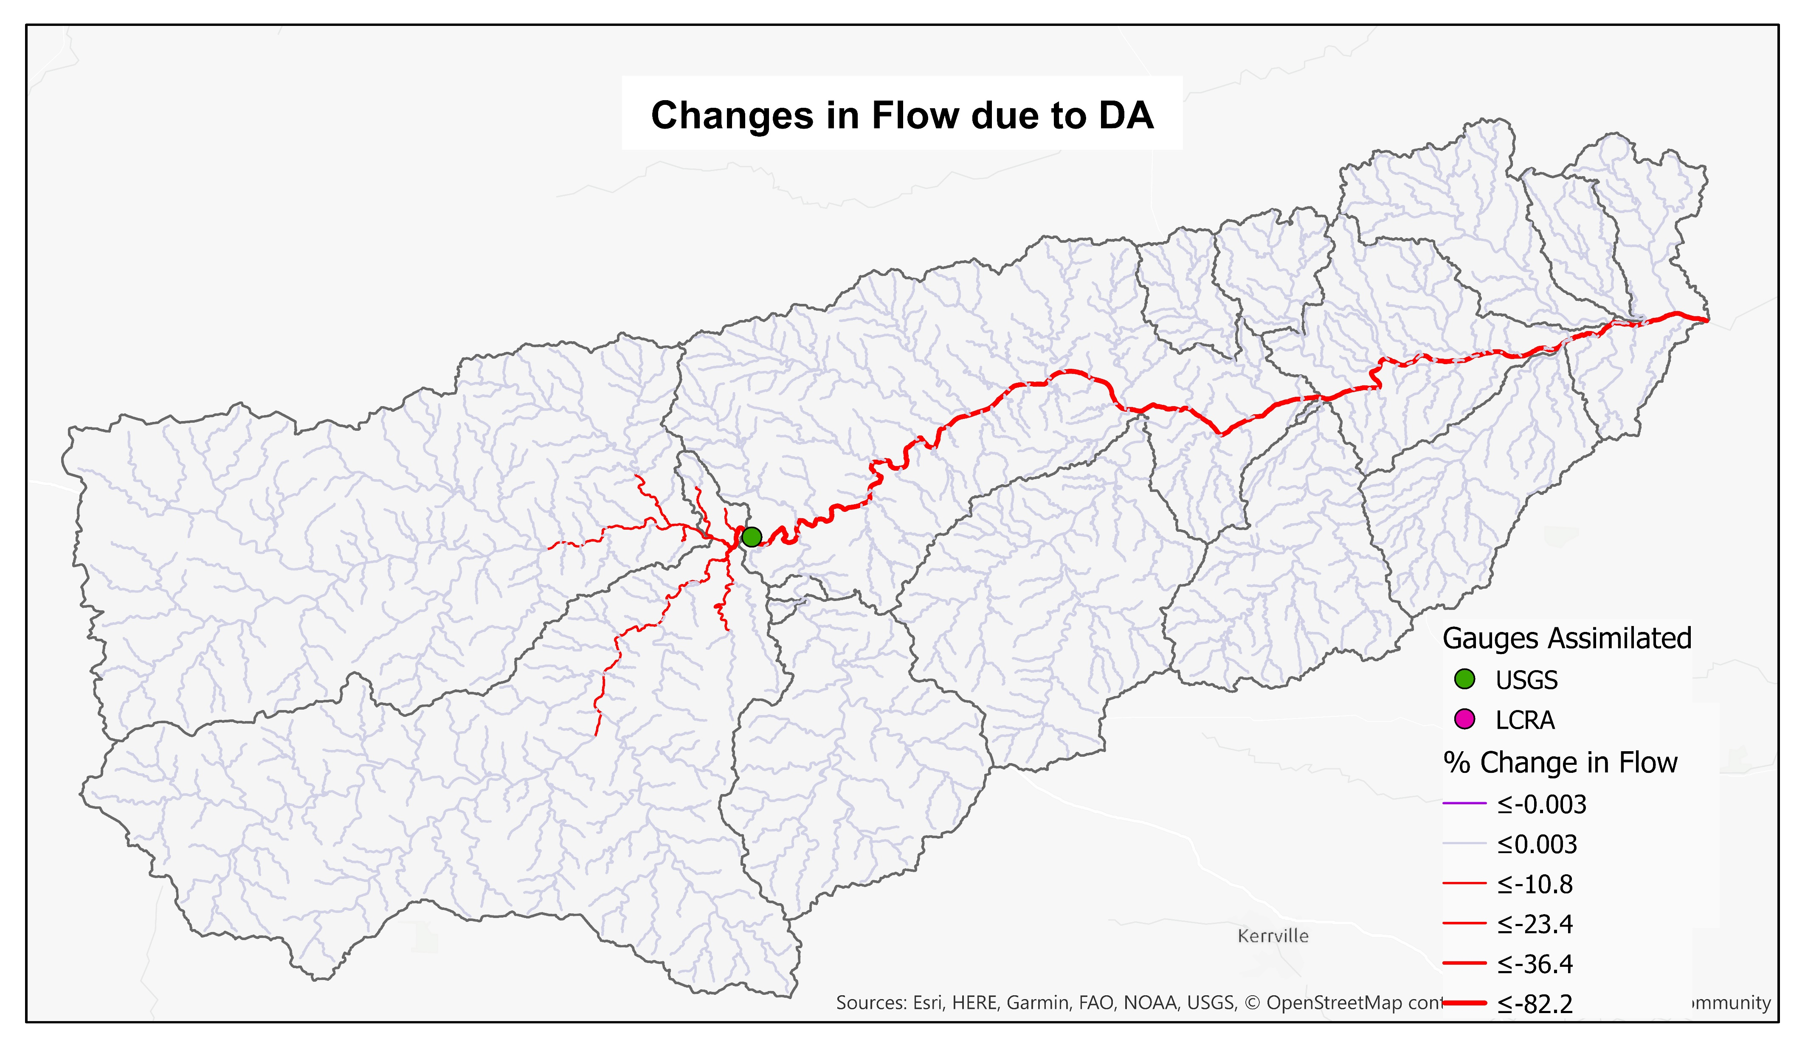
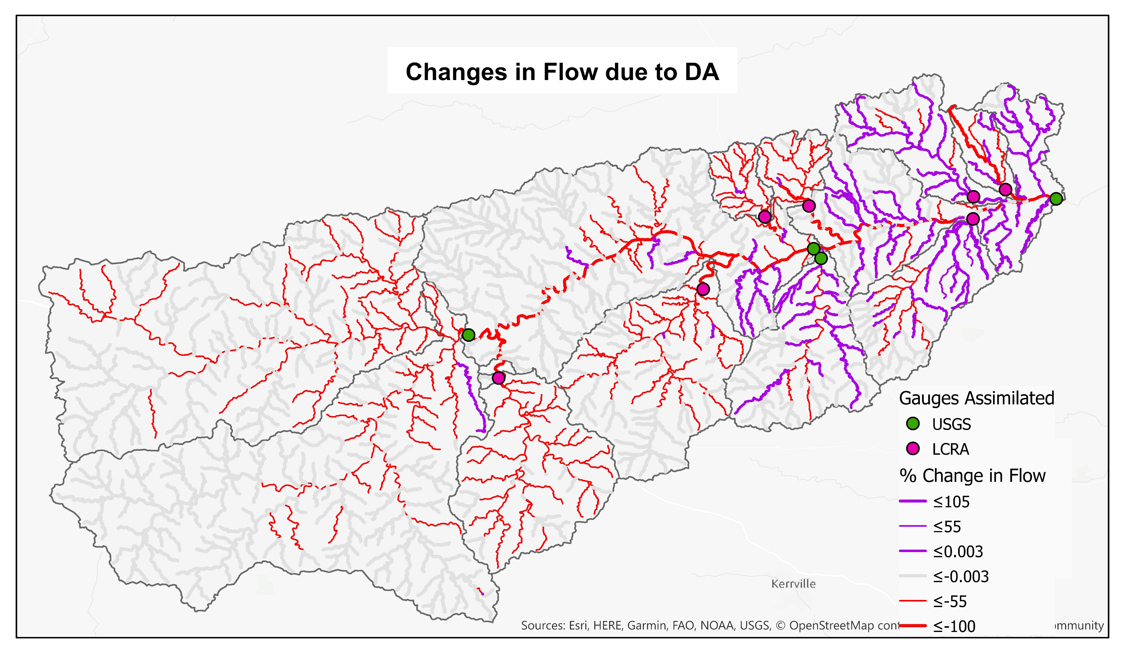
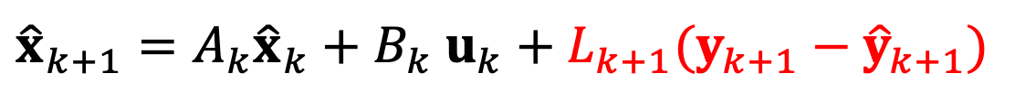
In essence, Kalman Filter applies an optimal ‘correction’ to the runoff input at the start of each forecast window
$${\hat{x}}_{k+1}=A_{k}{\hat{x}}_{k}+B_{k} u_{k}+L_{k+1}(y_{k+1}−{\hat{y}}_{k+1})$$
(open-loop model)
(correction)
11 gauges
1 gauge

Slide 45
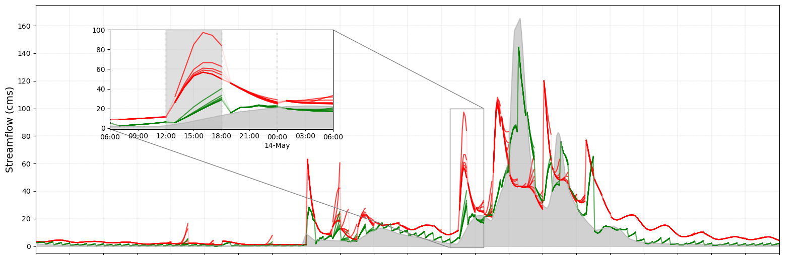
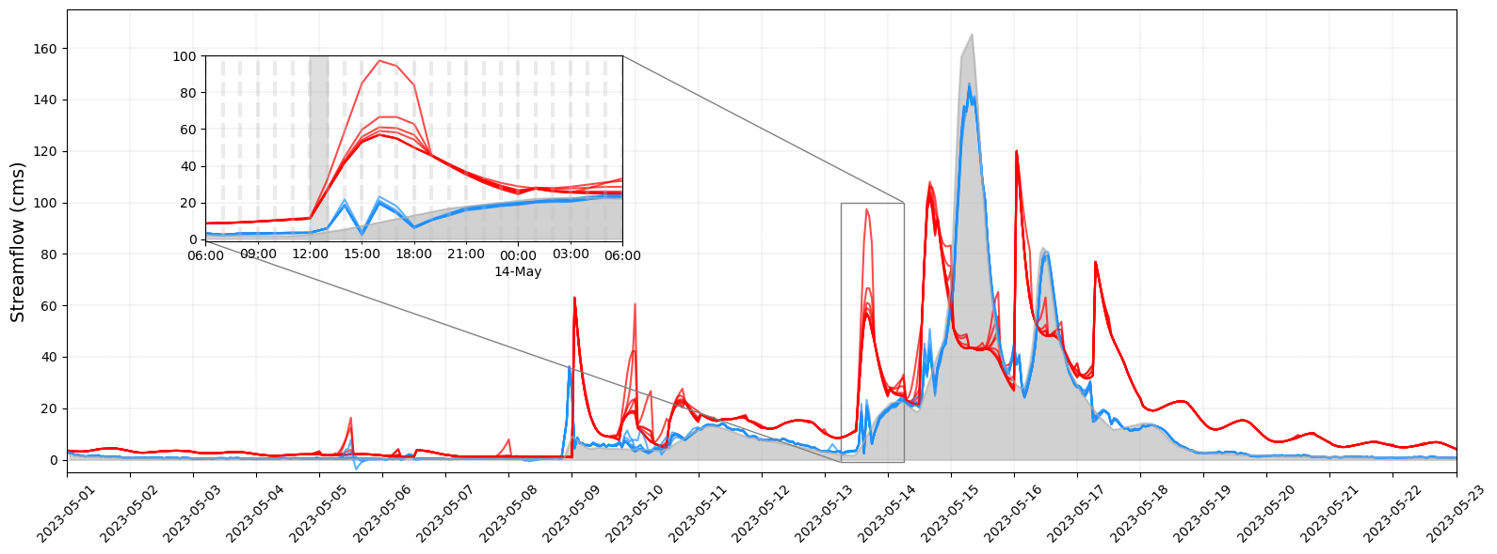
Result:
(a)
NWM
KF (6h)
USGS sensor
Forecasts at 6-hour lead time
(b)
NWM
KF (1h)
USGS sensor
Forecasts at 1-hour lead time

Slide 46
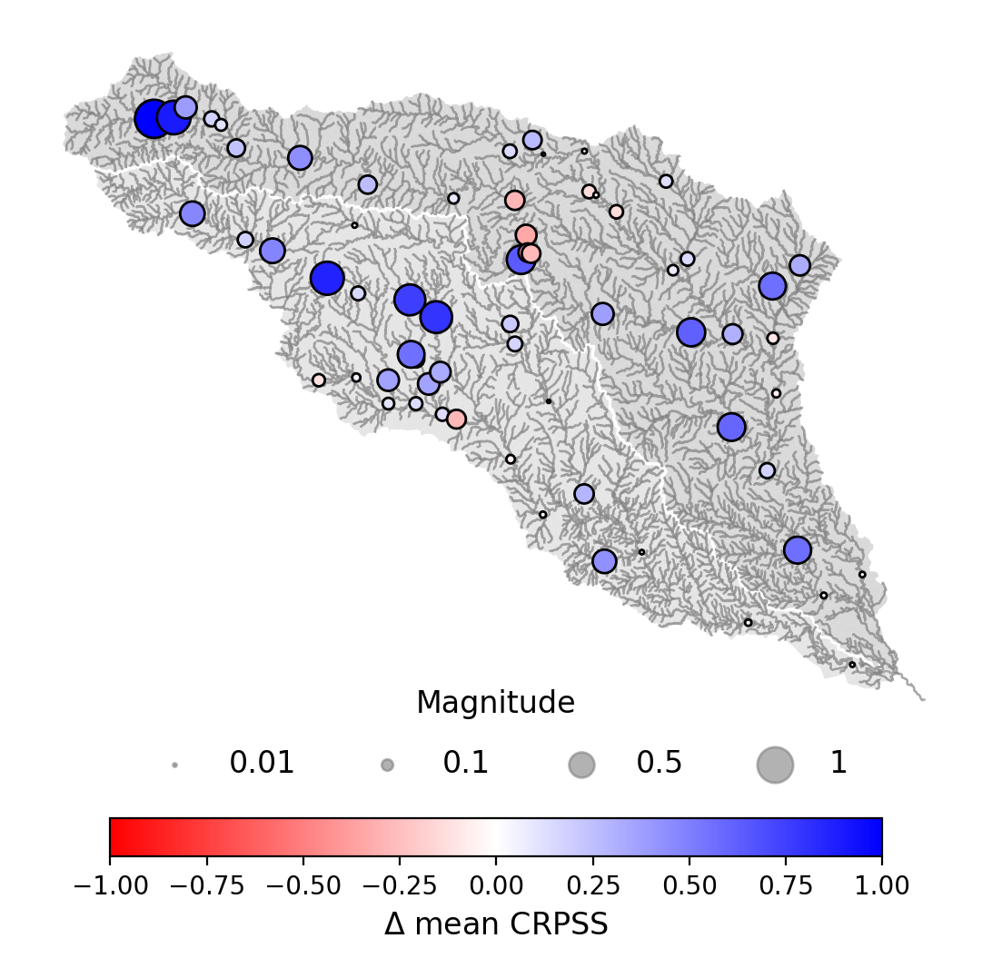
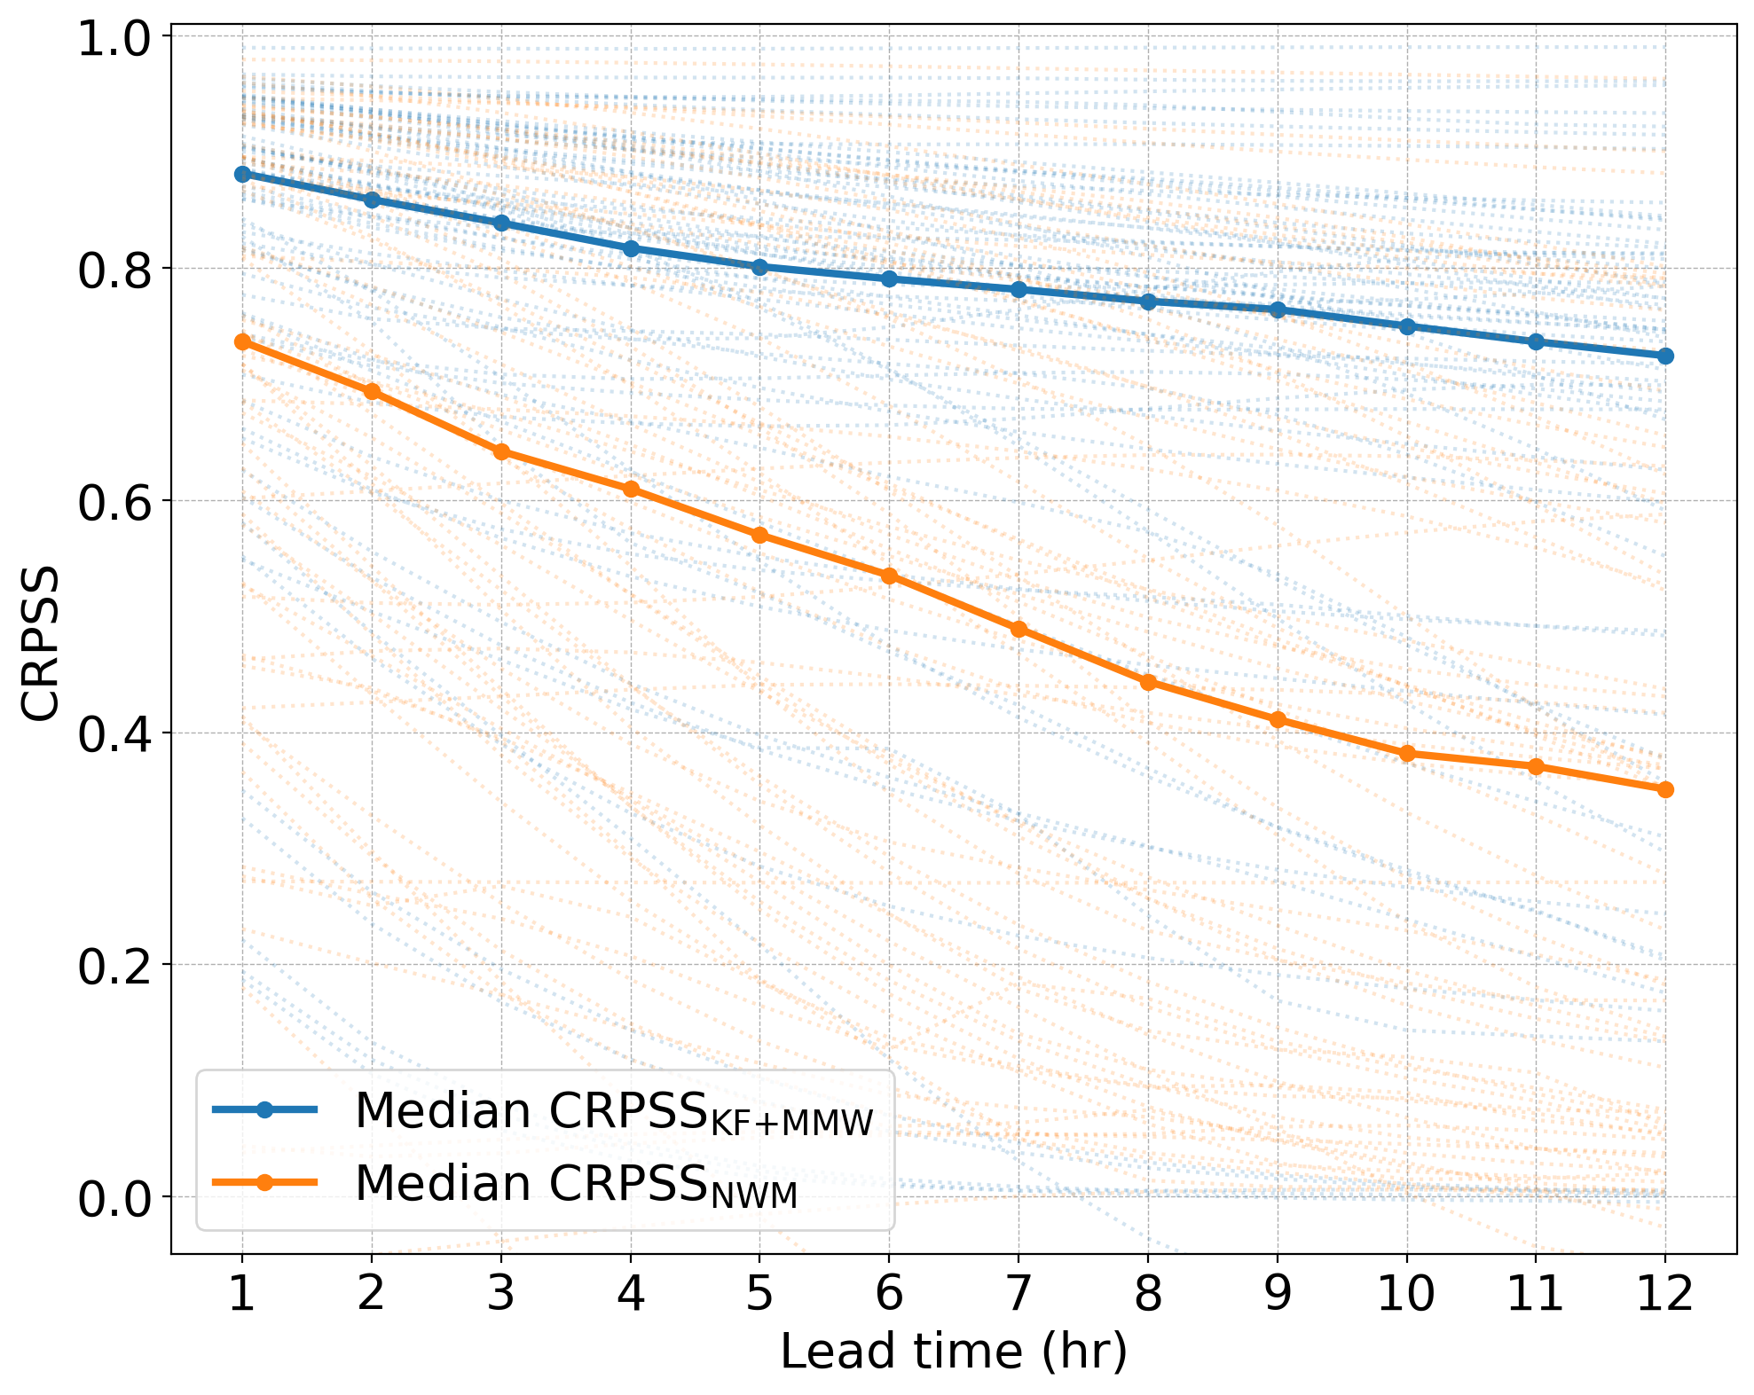
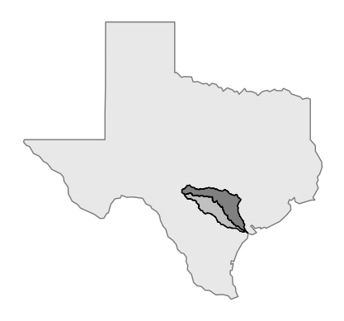
Kalman Filtering significantly improves discharge forecasts compared to nudging
(perfect score)

Slide 47
Choosing a data assimilation approach:
Is your system linear or nonlinear?
Do you care primarily about forecasting or prediction at ungaged locations?
Is the error in your model primarily due to parameter uncertainty or forcing uncertainty?

Slide 48



For more info, see:
Oh, J. & Bartos, M. (2025). Flood early warning system with data assimilation enables site-level forecasting of bridge impacts. npj Natural Hazards, 2(1), 64. DOI: 10.1038/s44304-025-00116-0.
Jeil Oh
Graduate Student
Matt Bartos
Assistant Professor

