Slide 1

Evaluation of Surface Velocimetry for Streamgaging
Jody Avant
U.S. Geological Survey
Texas Floodplain Management Association Fall Technical Summit
August 27, 2026

Slide 2
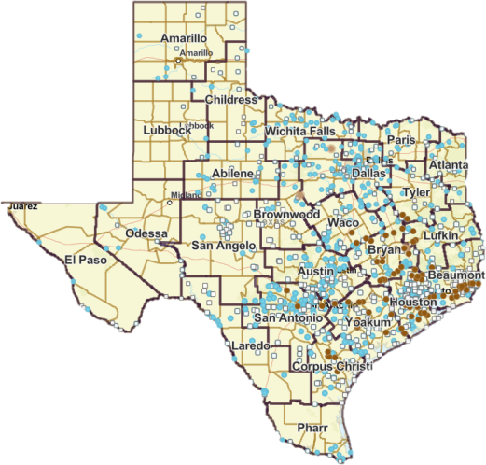
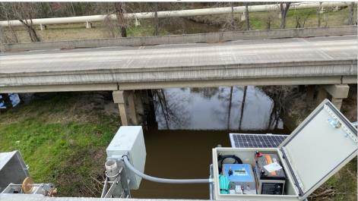
Approximately 800 Traditional
USGS Streamgages now
Supplemented by 80 sites
Evaluating Surface Velocity
Radar Sensors
Notes:
In Texas, the USGS operates 787 stream gages, 80 of which are part of this project.
Putting into perspective

Slide 3
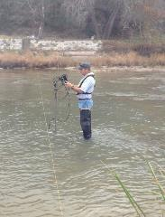
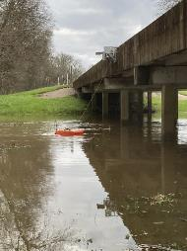
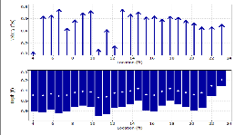
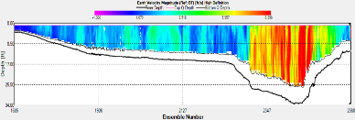
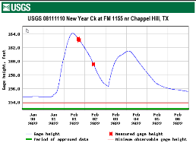
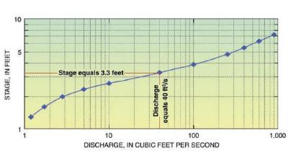
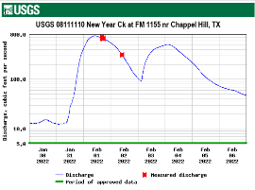
Traditional USGS Discharge Determination
Wading Measurement using Point Velocity Meter
Bridge Deployed Measurement using Acoustic Doppler Current Profiler
Measure and Record
Gage Height Time Series
Discharge Time Series from
Gage Height Data and Rating Curve
USGS Stage-Discharge Rating Curve
Notes:
“ Hydrologic technicians are in a lot of ways ,like a maintenance division. “. We build, we maintain and upgrade gage equipment, and we anticipate impacts to our systems.
Measurements are plotted on a charge vs stage to determine a stage discharge relationship. It takes many measurements to determine this relationship . And it is forever changing based on channel conditions and seasonal changes.

Slide 4
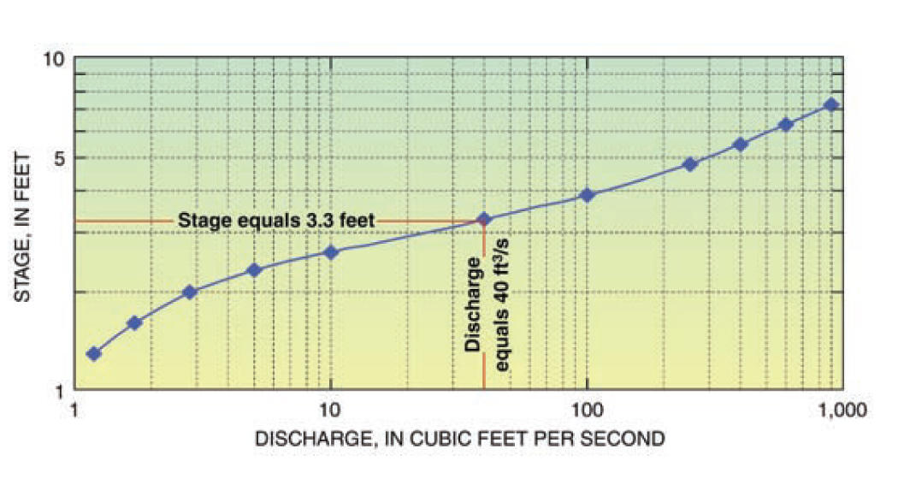
Stage-Discharge Rating Curve used at Tradition USGS Streamgages

Slide 5
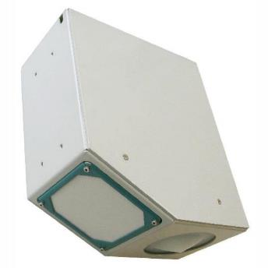
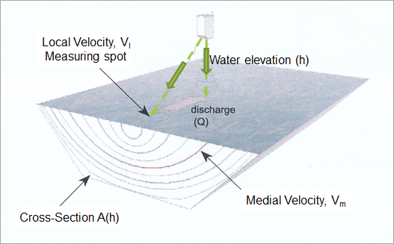

Measurement of Water Elevation and Velocity using Surface Velocity Radar Sensor (Sommer RQ-30 Radar Gage **)
**
** Use of manufacturer names does not imply endorsement by USGS

Slide 6
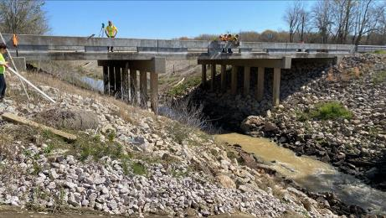
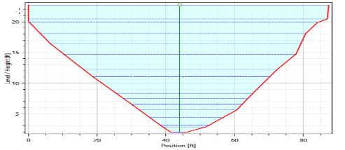
Cross Section Surveying
08041940-Green Pond Gully at FM 365 nr Fannett, TX
Channel geometry in-line with the velocity sensor
Low chord
Bridge deck / road elevation
Sensor elevation
Notes:
Remember q = v*a
This is the Area component

Slide 7
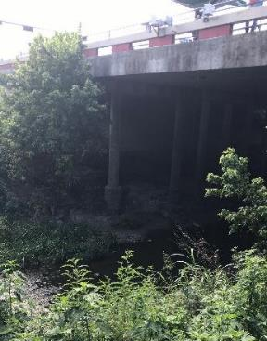
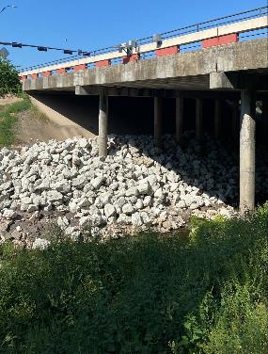
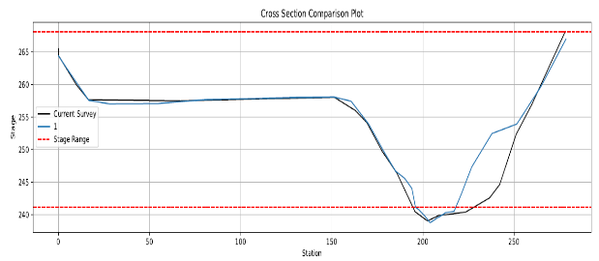
Cross Section Verification
08111051-Carters Ck at FM 60 nr College Station
Main channel shows approximately 30% reduction in area at low flows following the application of riprap on the right bank.

Slide 8
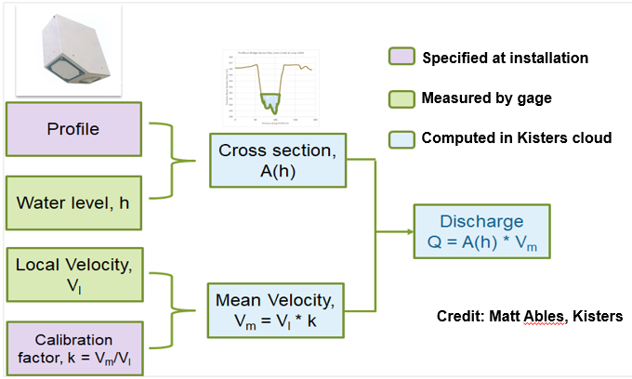
Procedure for Computing Discharge using Surface Velocity Sensor

Slide 9
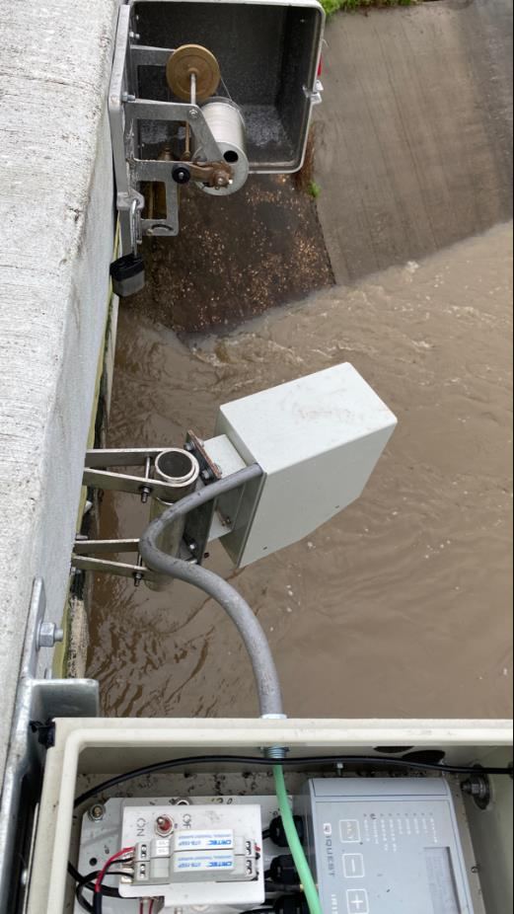
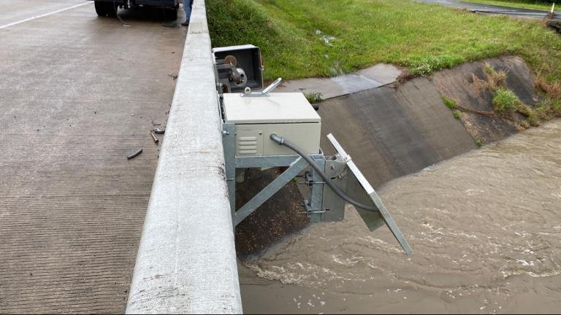
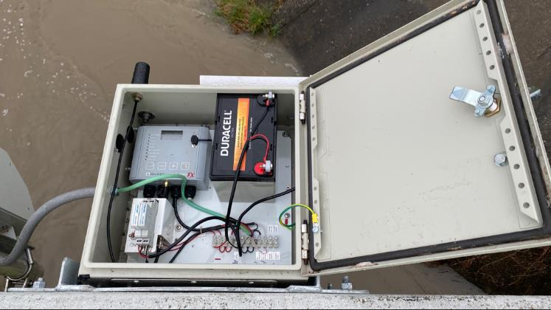
Typical Gage Installation

Slide 10
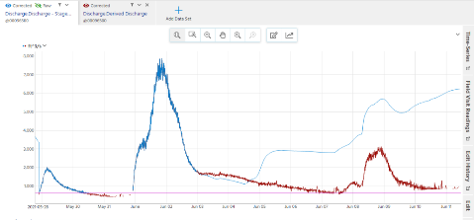
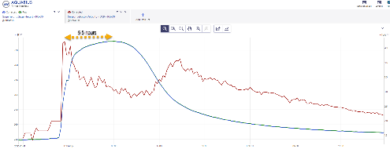
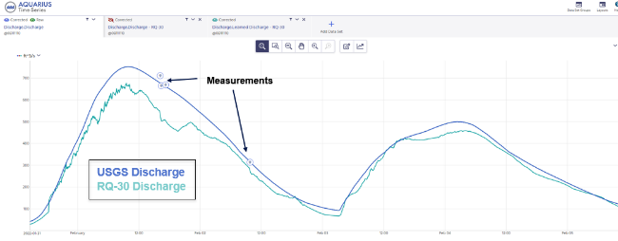
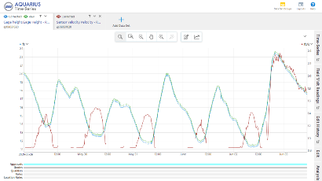
Advantages of Acquiring Surface Velocity Data
Velocity wave prior to high rise event
Variable Backwater in streams
Tidally Influenced Applications
Real-Time Discharge Calculation

Slide 11
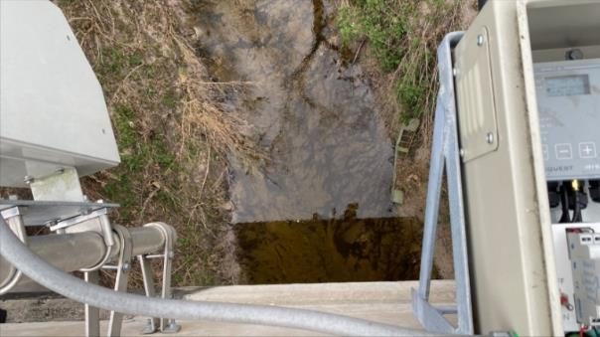
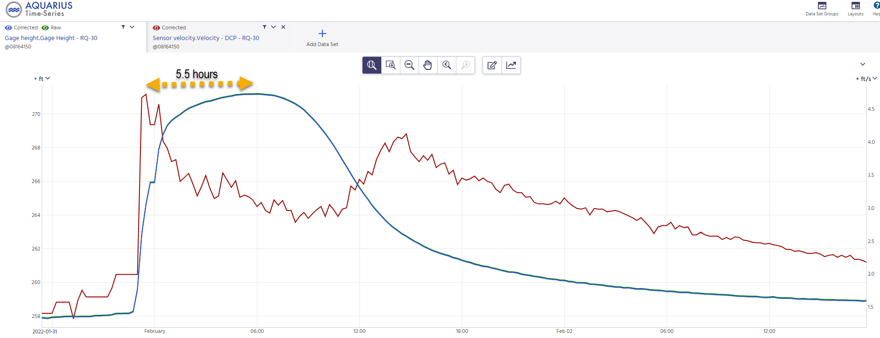
Data Observations – Velocity
08164150 - W Navidad Rv at I-10 nr Schulenburg, TX
Stage ( ft )
Date/time

Slide 12

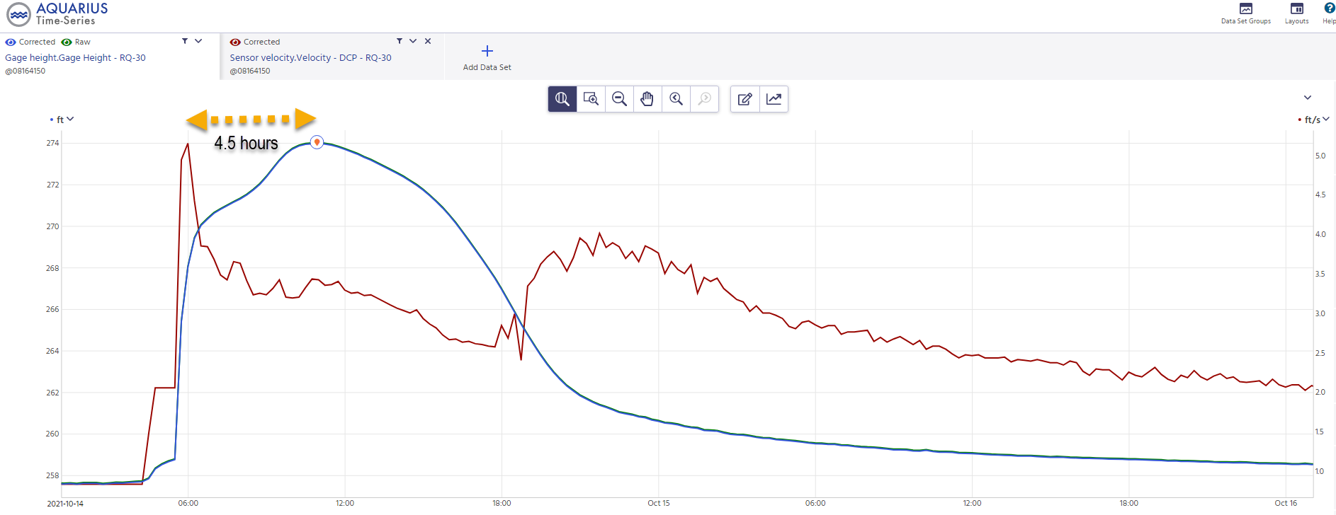
Data Observations – Velocity
08164150 - W Navidad Rv at I-10 nr Schulenburg, TX
Stage ( ft )
Date/time

Slide 13
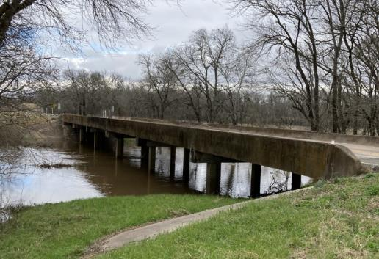
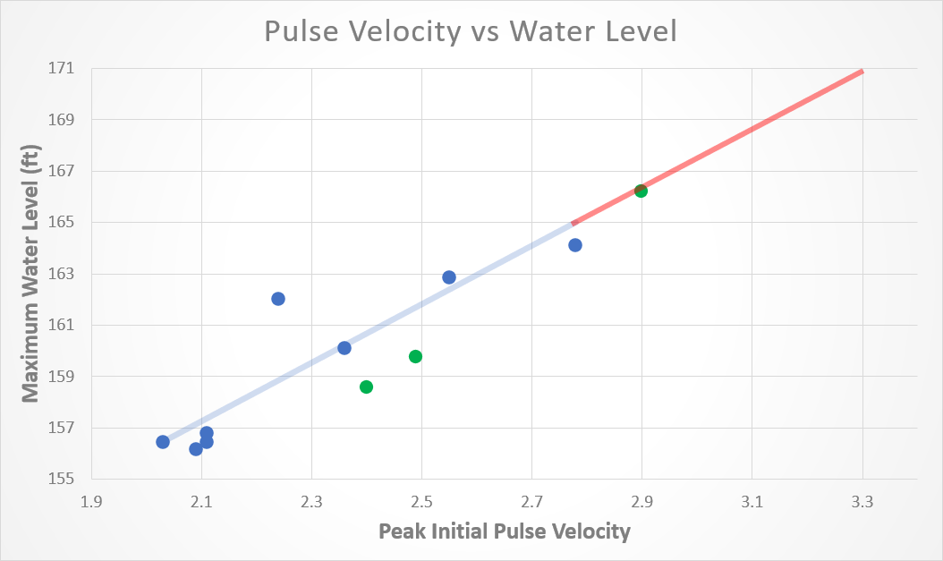
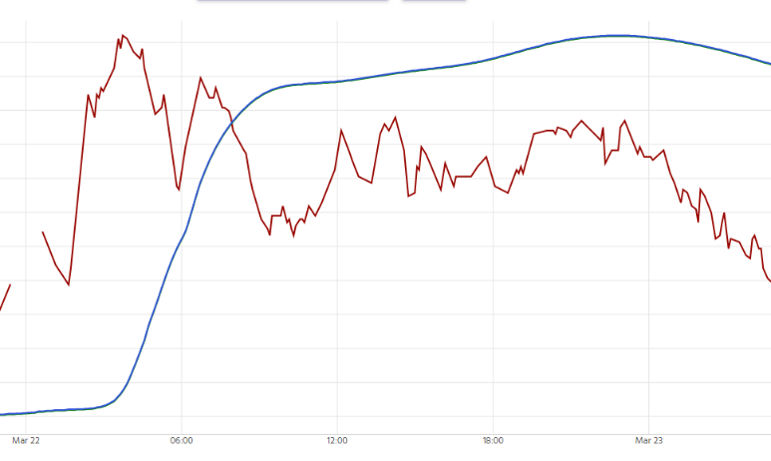
Data Observations – Initial Velocity Wave
08111110 - New Year Ck at FM 1155 nr Chappell Hill, TX
19 hours
6 hours

Slide 14
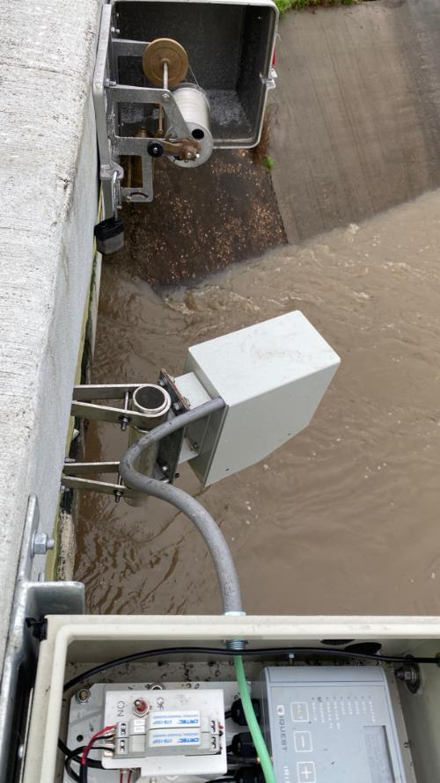
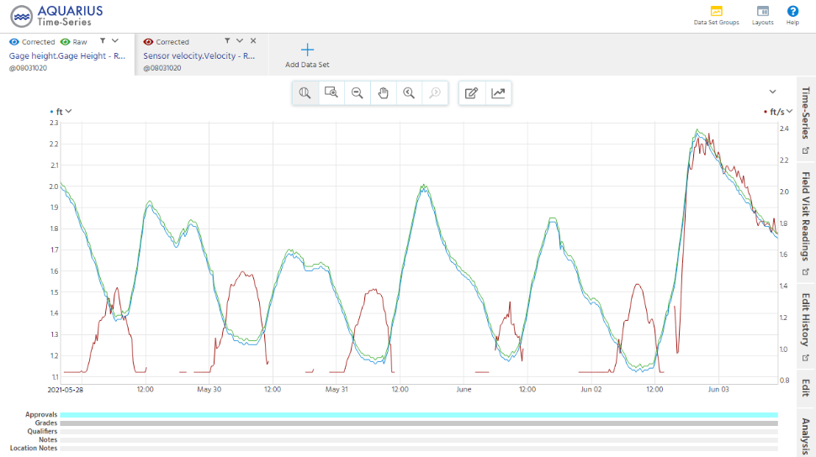
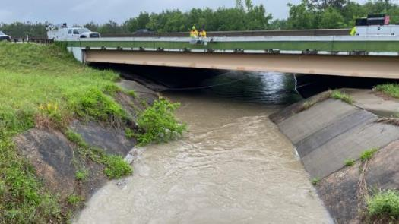
Tidally Influenced Site
08031020 – Cole Ck at I-10 nr Orange, TX
Stage
Velocity
Notes:
As water level rises tidally, the velocity decreases and vice versa

Slide 15
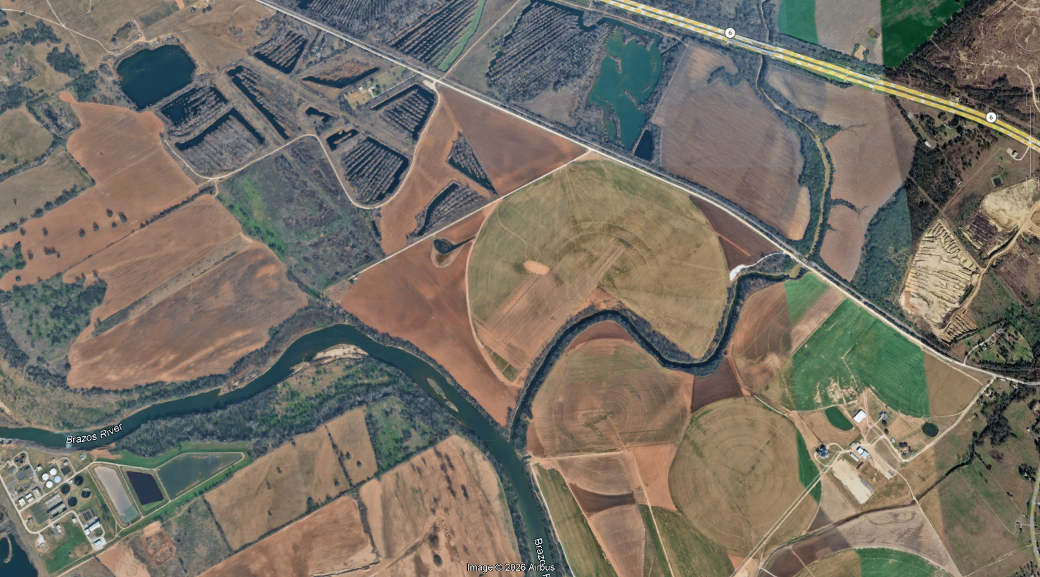
Variable Backwater Effect
08096580 – Tehuacana Ck at Hwy 6 nr Waco, TX
Tehuacana
Creek
Brazos
River
Notes:
As water level rises tidally, the velocity decreases and vice versa

Slide 16
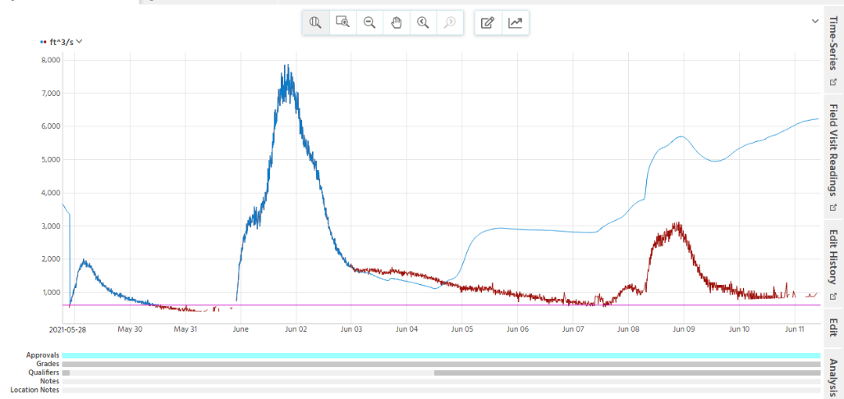
Variable Backwater Effect - Continued
08096580 – Tehuacana Ck at Hwy 6 nr Waco, TX
Discharge ( cfs )
Discharge
Stg/Q
Discharge
by velocity
Date/time
Notes:
As water level rises tidally, the velocity decreases and vice versa

Slide 17
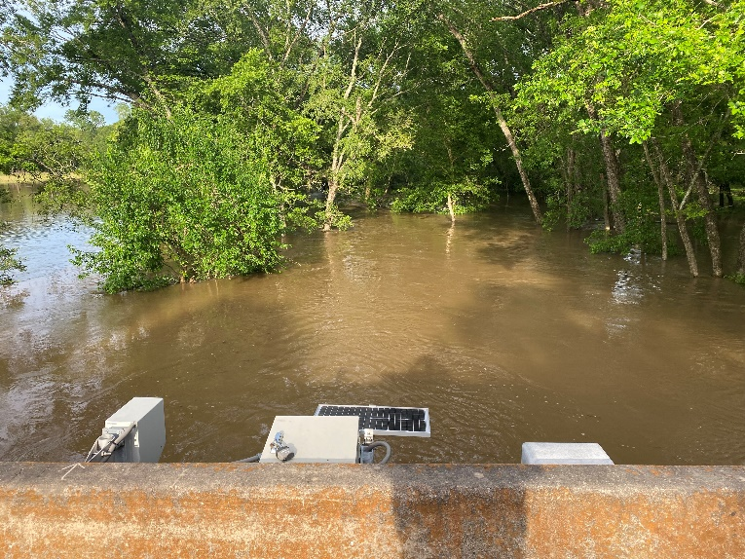
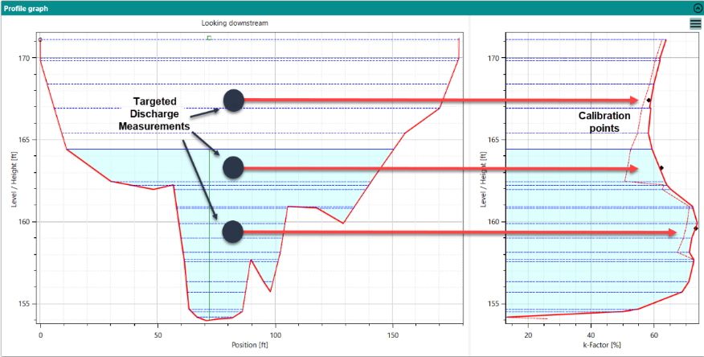
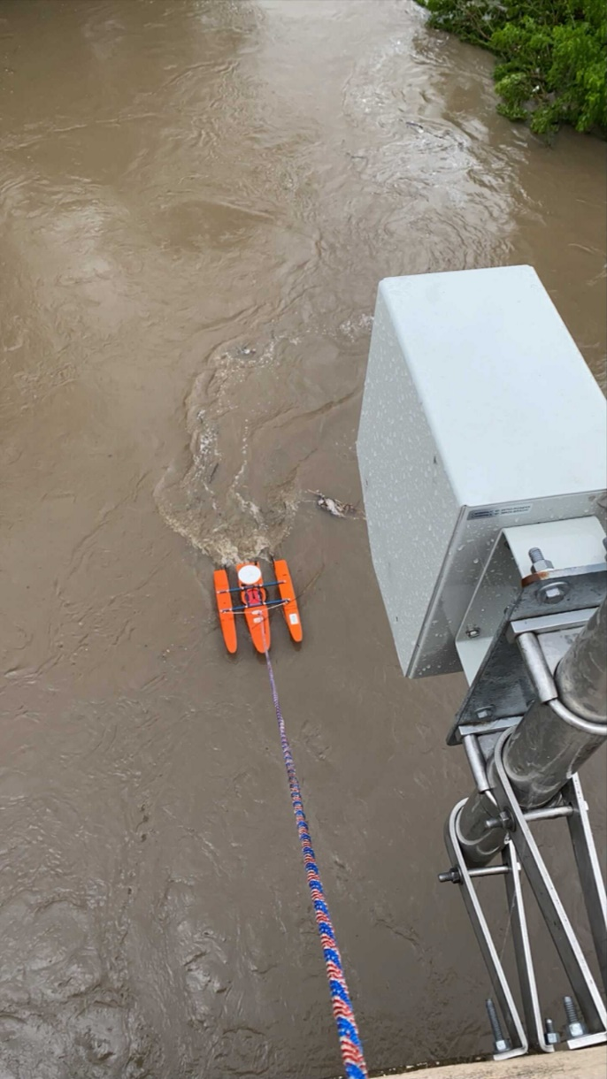
Targeted Calibration of Surface Velocity Sensor
Surface Velocity -> Mean Channel Velocity
Discrete Discharge Measurements at Targeted Gage Heights used to define the “K-factor” Relation – Can mean Fewer Measurements than Traditional Stage-Q Rating
08111110 – New Year Ck at FM 1155 nr Chappel Hill, TX

Slide 18
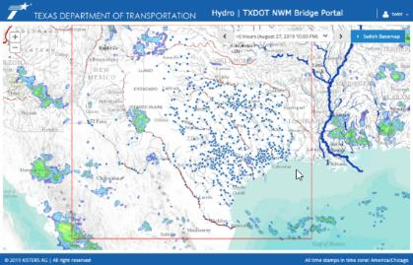
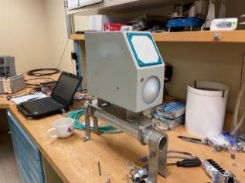
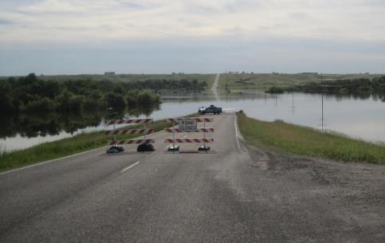
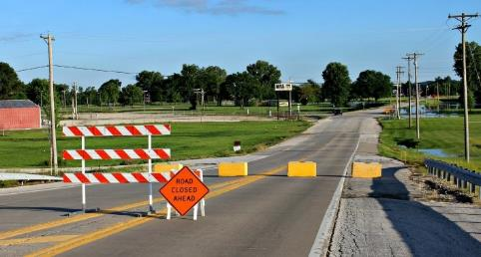
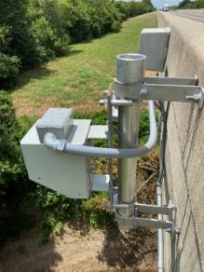
Observations
More gages leads to denser network to assist decision makers
Where method works, comparable discharge computations for ingestion into water models
Availability of “new” parameter of velocity
Notes:
Sufficient data – gauge height and discharge for comparison to the rq30 discharge computation.
Sensors maintain adequate calibration
Speak on Uncertainty.
Uncertainty in discharge and gauge-height time-series data are determined and provide a suitable means for comparison with traditional USGS methods. These comparisons will be the basis of determining whether the equipment and methods are TRL 9, thus, are appropriate for deployment at any TxDOT bridge location

Slide 19

Flood Intelligence in Action:
How InFRM Turns Multi-Agency Science into Basin-Level Decisions
Friday August 28, 2026
TFMA Workshop
By Kristine Blickenstaff, PE
Jon Thomas

Slide 20

InFRM
Interagency Flood Risk Management (InFRM) Team -
FEMA Region 6 - Sponsor
U.S. Army Corps of Engineers (USACE)
U.S. Geological Survey (USGS)
National Weather Service (NWS)

Slide 21





Why InFRM?
Goals
  Integrate information and simplify access to data
  Increase accuracy and timeliness of information
  Provide high resolution information and forecasts
  Enrich stakeholder participation
Mitigate and “inform” flood risk as a team
Collaborating Nationally, Empowering Locally

Slide 22
The Flood Decision Support Toolbox

Slide 23
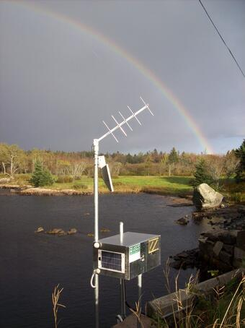
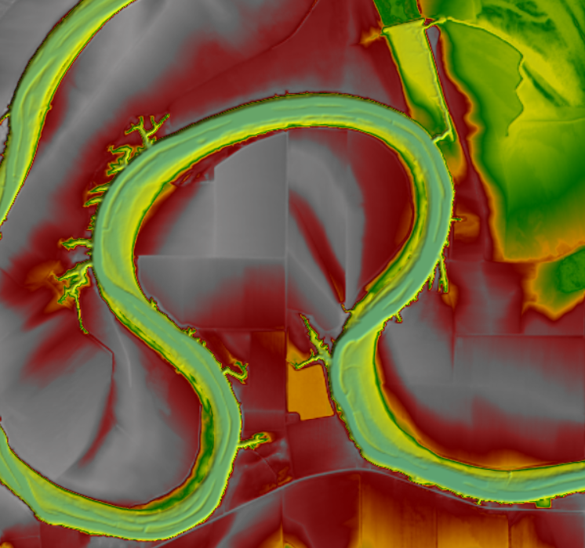
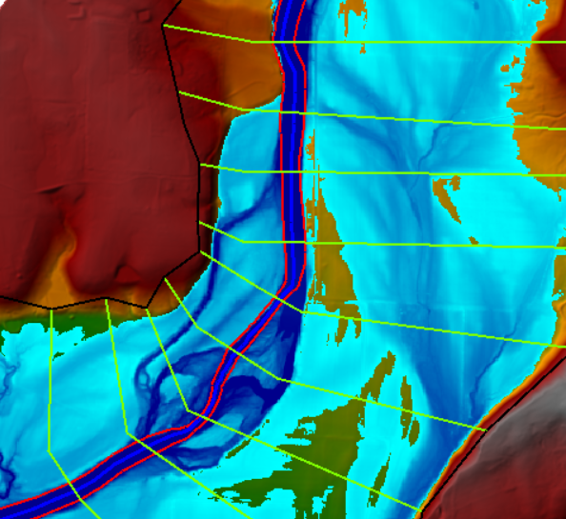
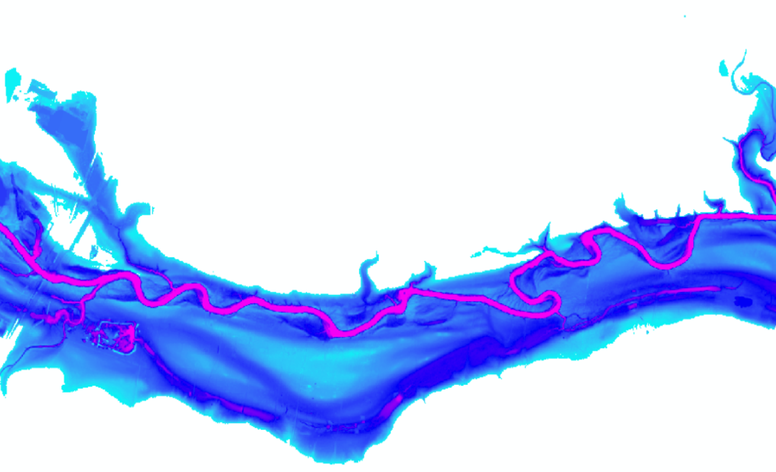
A Formula for Flood Preparedness
Real-Time Streamgage Data
High-Resolution Terrain
Hydraulic Model
Life-Saving Flood Scenario Planning

Slide 24
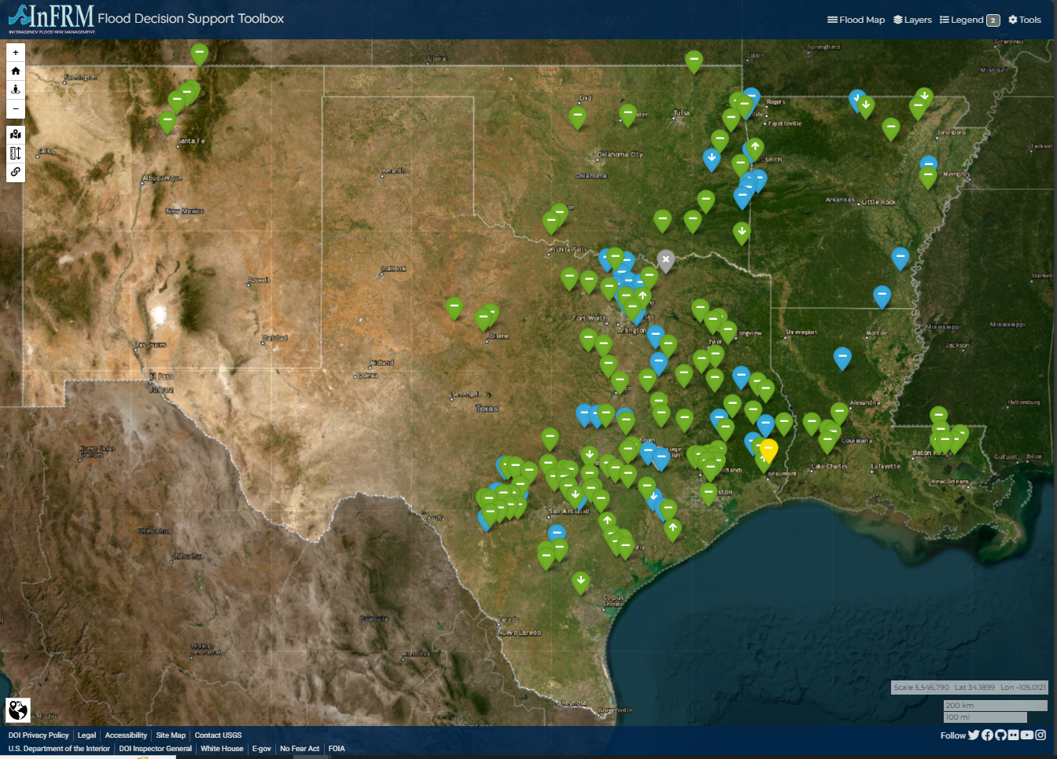
Flood Decision Support Toolbox
  Scenario Planning
  Pre-positioned map libraries
  NWS Flood Categories
  Historical Flood viewing
  Critical infrastructure
  Damage Estimates
  Real-Time Event Response
  USGS Streamgaging
  NWS FIM mapping
  NWS Forecasts
  Weather Conditions
  Transportation Conditions
  Reservoir Conditions

Slide 25
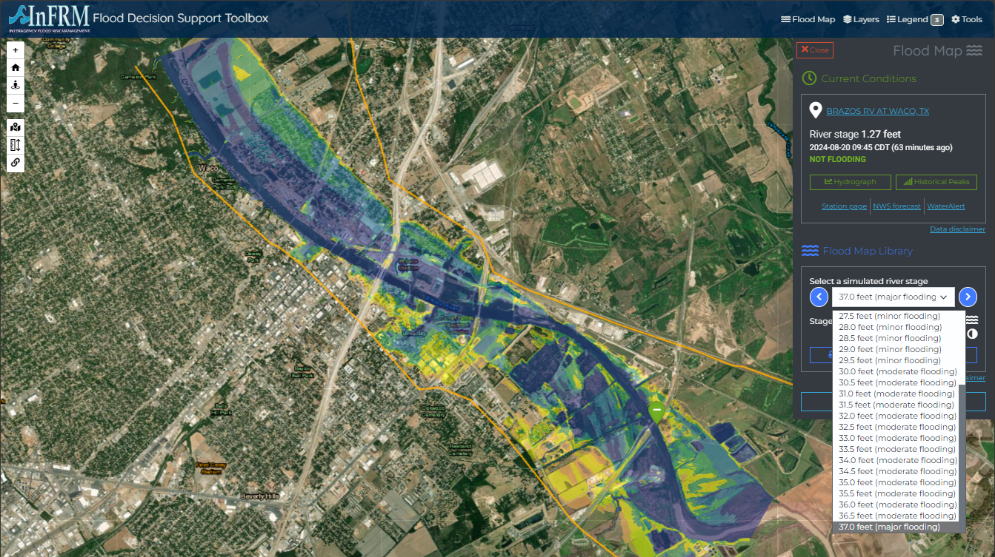

FDST Functionality

Slide 26

FDST Functionality
Select anywhere in the map to view estimated water depth

Slide 27







FDST Functionality
Linked NWS River Forecast
Historical Peaks
Setup WaterAlert

Slide 28


FDST Functionality

Slide 29

FDST Functionality

Slide 30

FDST Functionality

Slide 31

FDST Functionality

Slide 32




FDST Functionality – Texas – TWDB Partnership
Reservoir Conditions
Road Conditions
Critical Infrastructure

Slide 33

FDST Functionality – Texas
Click ‘Report’ to see more details on estimated building damages and estimated costs
Print Map function also summarizes building damage in Texas
NOTE: costs CANNOT be tied back to individual buildings

Slide 34

FDST Functionality – Texas
Texas viewer shows TXDOT road conditions

Slide 35

FDST Functionality – Texas
Reservoir status available through Water Data for Texas (% full and % flood height)

Slide 36

FDST Functionality – Texas
Reservoir status available through Water Data for Texas (% full and % flood height)

Slide 37

FDST Functionality – Texas

Slide 38

FDST Functionality – New Jersey

Slide 39


FDST Functionality – New Jersey

Slide 40

FDST Functionality – New Jersey

Slide 41

FDST Functionality – New Jersey

Slide 42



National Weather Service - FIMs

Slide 43

Uncertainty in Modeling
Highest
uncertainty
“All models are wrong, but some are useful”
Model Uncertainty
  Tier A/B
  Rating Curve RMSE
  Uncertainty in forecasts
  NWS FIMS
Tributary Inflow
Most confidence at gage location
Highest uncertainty

Slide 44

Kristine Blickenstaff, PE
Jon Thomas
Integrated Hydrology + Data Science
USGS
kblickenstaff@usgs.gov
jvthomas@usgs.gov
InFRM.us
webapps.usgs.gov/infrm/fdst/

