Slide 1

Exploring Roads Flooded During a 10% Annual Chance Storm in Bexar County
Trinity Shuler, Yasmin Ramones
10/2/2026

Slide 2
Agenda
Next Generation Flood Warning System
Flooded Road Analysis
Potential New Gauge Locations Risk Assessment

Slide 3
Next Generation Flood Warning System Overview

Slide 4
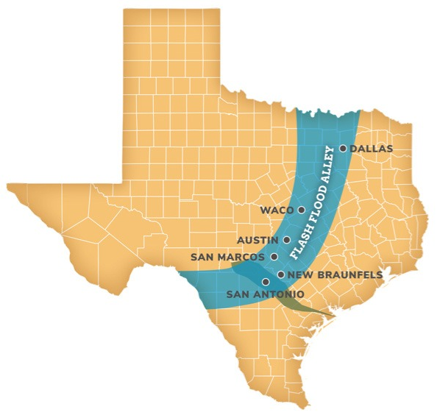
Justification of Need
Bexar County Geographic location
  Intersection of western and coastal plains
  Intense and unpredictable weather
Characteristics that add risk
  Rapid change in elevation (over 1,500 ft)
  Impervious limestone, erosive soils, and steep slopes
  Urban impervious cover
Source: https://www.sariverauthority.org/services/flood-risk/

Slide 5
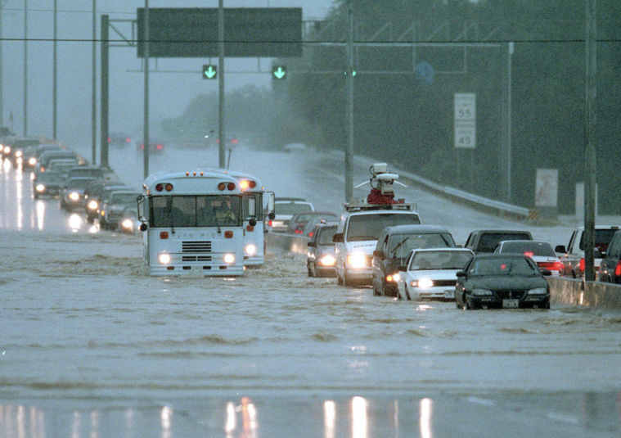
NextGen Goals
Reduce or eliminate water rescues at low water crossings
Leverage technology to improve early warning
Remove structures from floodplain and floodway
Create more resilient systems for future conditions
Notes:
Detect early and more accurately
Warn public in time
Support Emergency response
Keep system reliable

Slide 6
NextGen Flood Warning Program
ELEMENT 1
Engineering Analysis
Flood stages, impact identification, enhanced prediction.
ELEMENT 2
Hardware
Gauge upgrades, cameras, automated arms, O&M, county expansion
ELEMENT 3
Communications
Outreach campaign, navigation apps, OEM coordination, BexarFlood refresh
ADDITIONAL ELEMENT
Sirens
Warning sirens,
TWDB grant.

Slide 7
Flooded Road Analysis

Slide 8
Flooded Road Analysis Goals
  Identify all roads that flood during a 10% annual chance storm
  Identify high risk roads for warning system installation

Slide 9
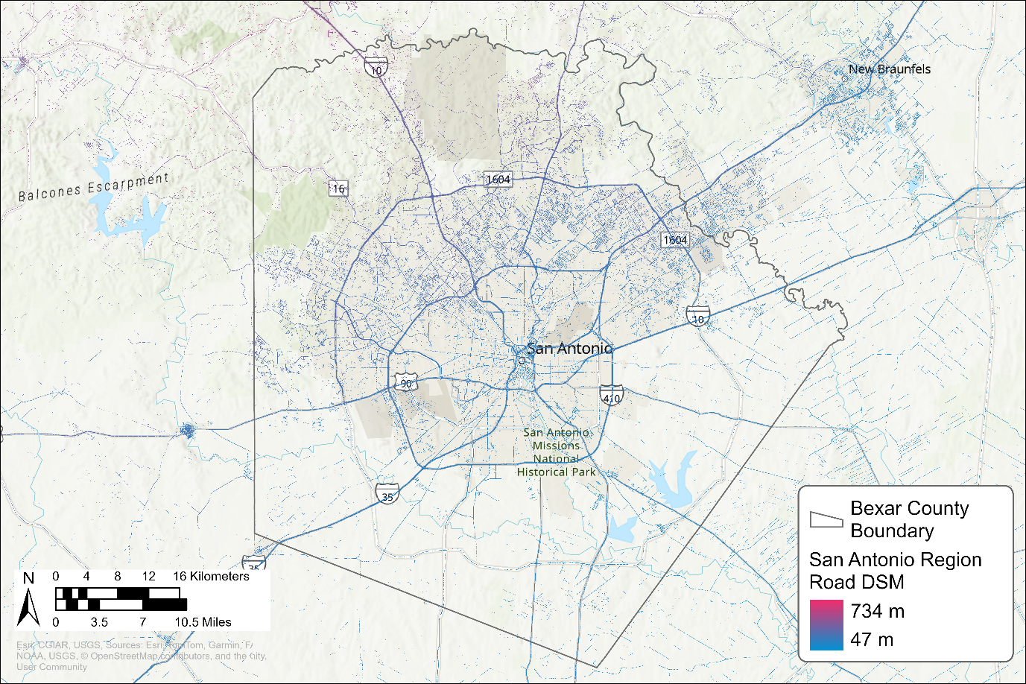
Data Sources
San Antonio TxDOT Region Roadway DSM
  UT Austin & Oak Ridge National Laboratory
Notes:
3m DEM created using Lidar from 2021 by some folks at UT Austin and the Oak Ridge National Laboratory

Slide 10
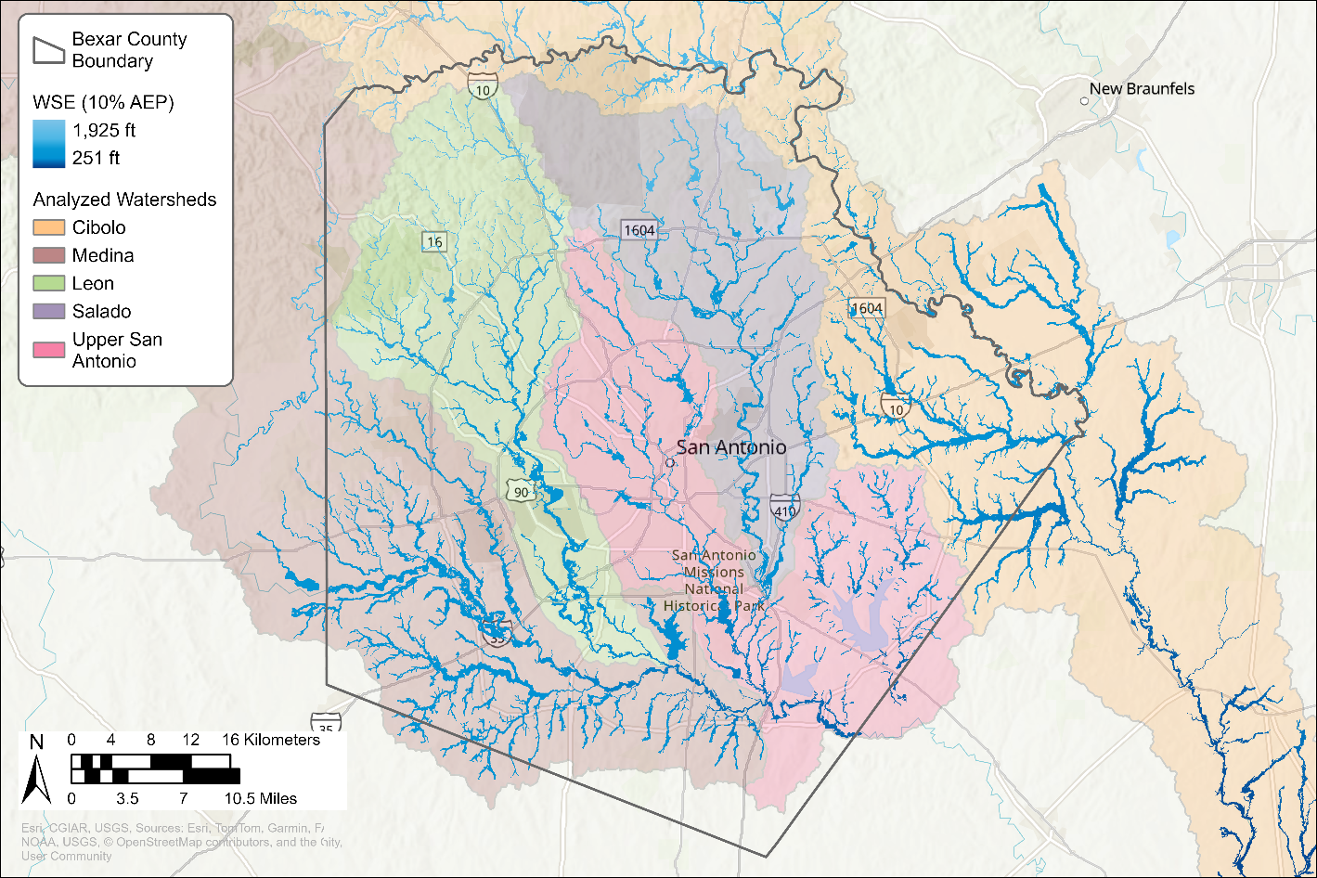
Data Sources
San Antonio Region Roadway DSM
SARA Water Surface Elevations 10% AEP
  FEMA floodplain mapping updates
Notes:
9 WSE layers created during FEMA floodplain mapping updates using Atlas 14 precipitation data

Slide 11
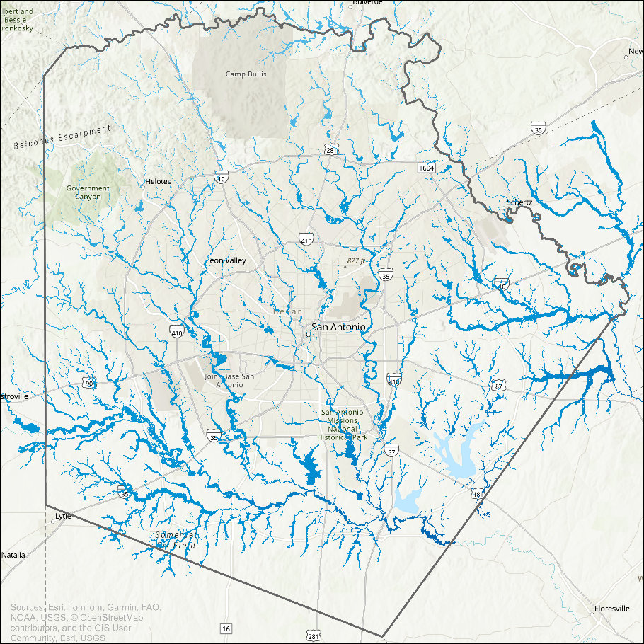
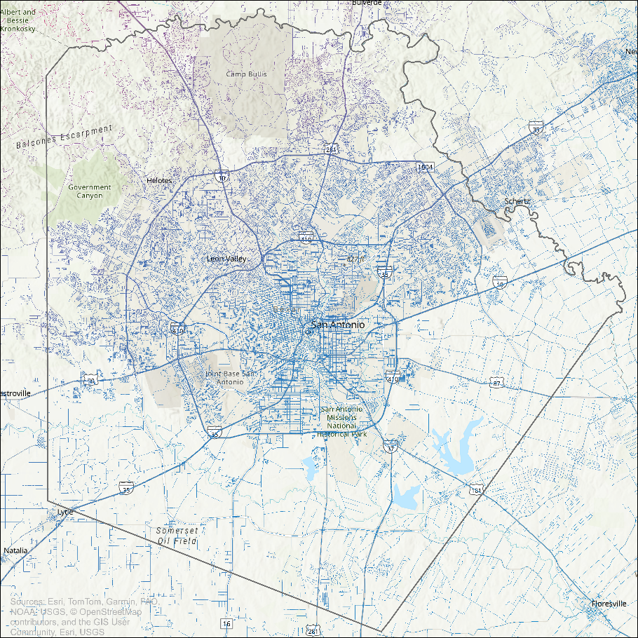
-
=
Water Surface Elevation
(10% storm)
Road Elevation

Slide 12
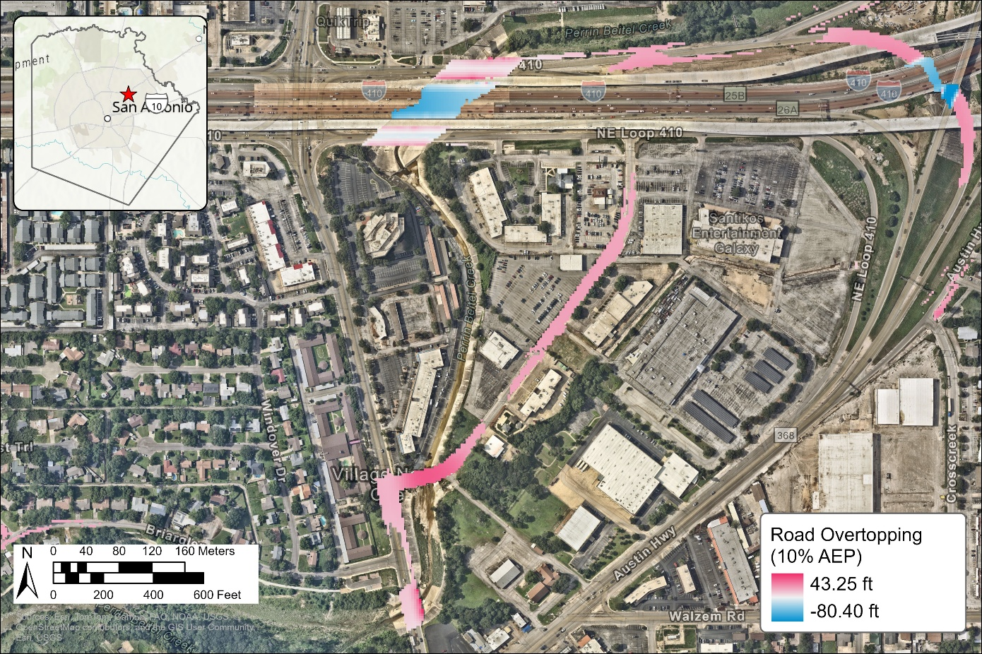

Slide 13
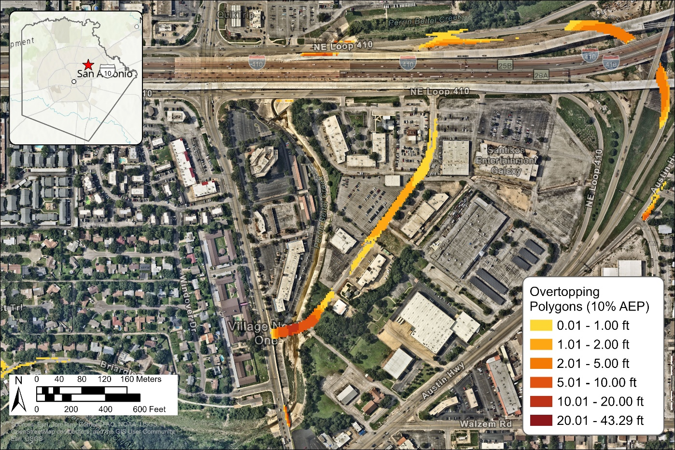

Slide 14
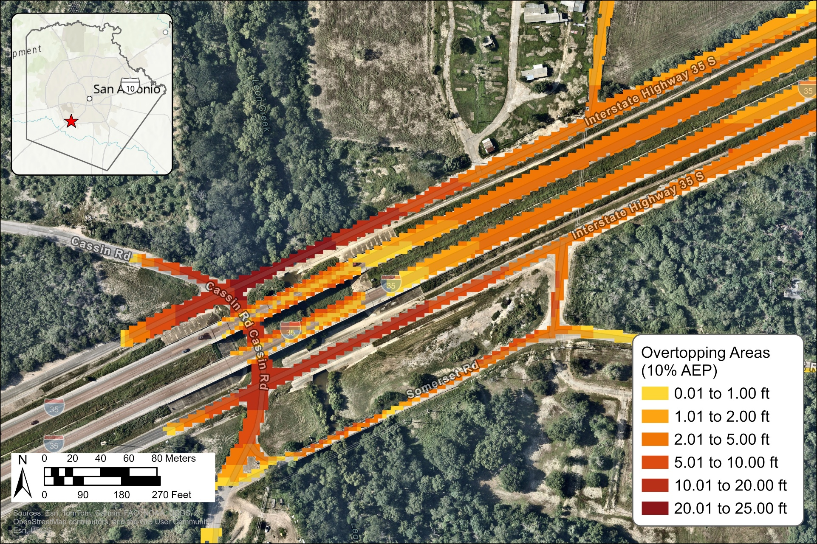
Overall maximum depth of flooding: ~24.22 ft

Slide 15
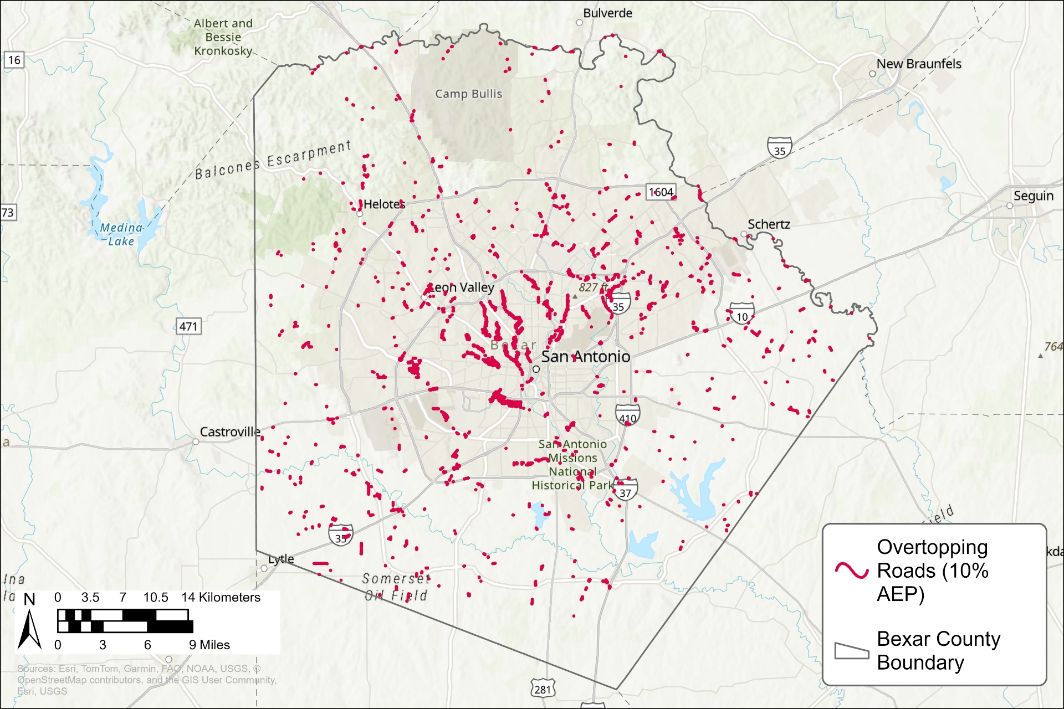
Overall impacted road segments: ~1,542*
*Count depends on road line input and definition of a “road segment”

Slide 16
Road Overtopping Results
0–1 ft
390 roads
1–2 ft
398 roads
2–5 ft
561 roads
5–10 ft
135 roads
10–20 ft
52 roads
20–25 ft
6 roads
Notes:
The analysis identified thousands of locations.
We as a community can’t afford to install and maintain this many sensors. We are looking at a combination of sensor locations and modeling to build the alert and response protocols. We’re using risk-based assessment to select the high water detection site locations.
This is also why the public awareness of the risk of rising water is important.

Slide 17
Challenges
Road elevation change post lidar collection
Distinguishing data on vs. off road
WSE data availability

Slide 18
New Gauge Locations Risk Assessment

Slide 19
Risk Matrix Data Collection
Incident History
Flood Severity
Visibility
Traffic Volume
Rescue calls and fatalities from
Bexar County records
(2007-2026)
Max 10% storm depth and velocity
from hydraulic models
ASD vs SSD ratio —
can drivers stop in time?
TxDOT AADT —
more cars = more exposure
Each factor scored 0–5 · Total score determines Risk Tier

Slide 20
Ranking Factors
Sites ranked from low to extreme risk by:
Factor | Weight
Flood Hazard (depth x velocity) | 0.35
Site visibility (ASD / SSD) | 0.25
Incident history (rescues + weighted fatalities) | 0.25
Traffic volume | 0.15
Total | 1.00
Notes:
UPDATE

Slide 21
Thank you!
Questions?

Slide 22
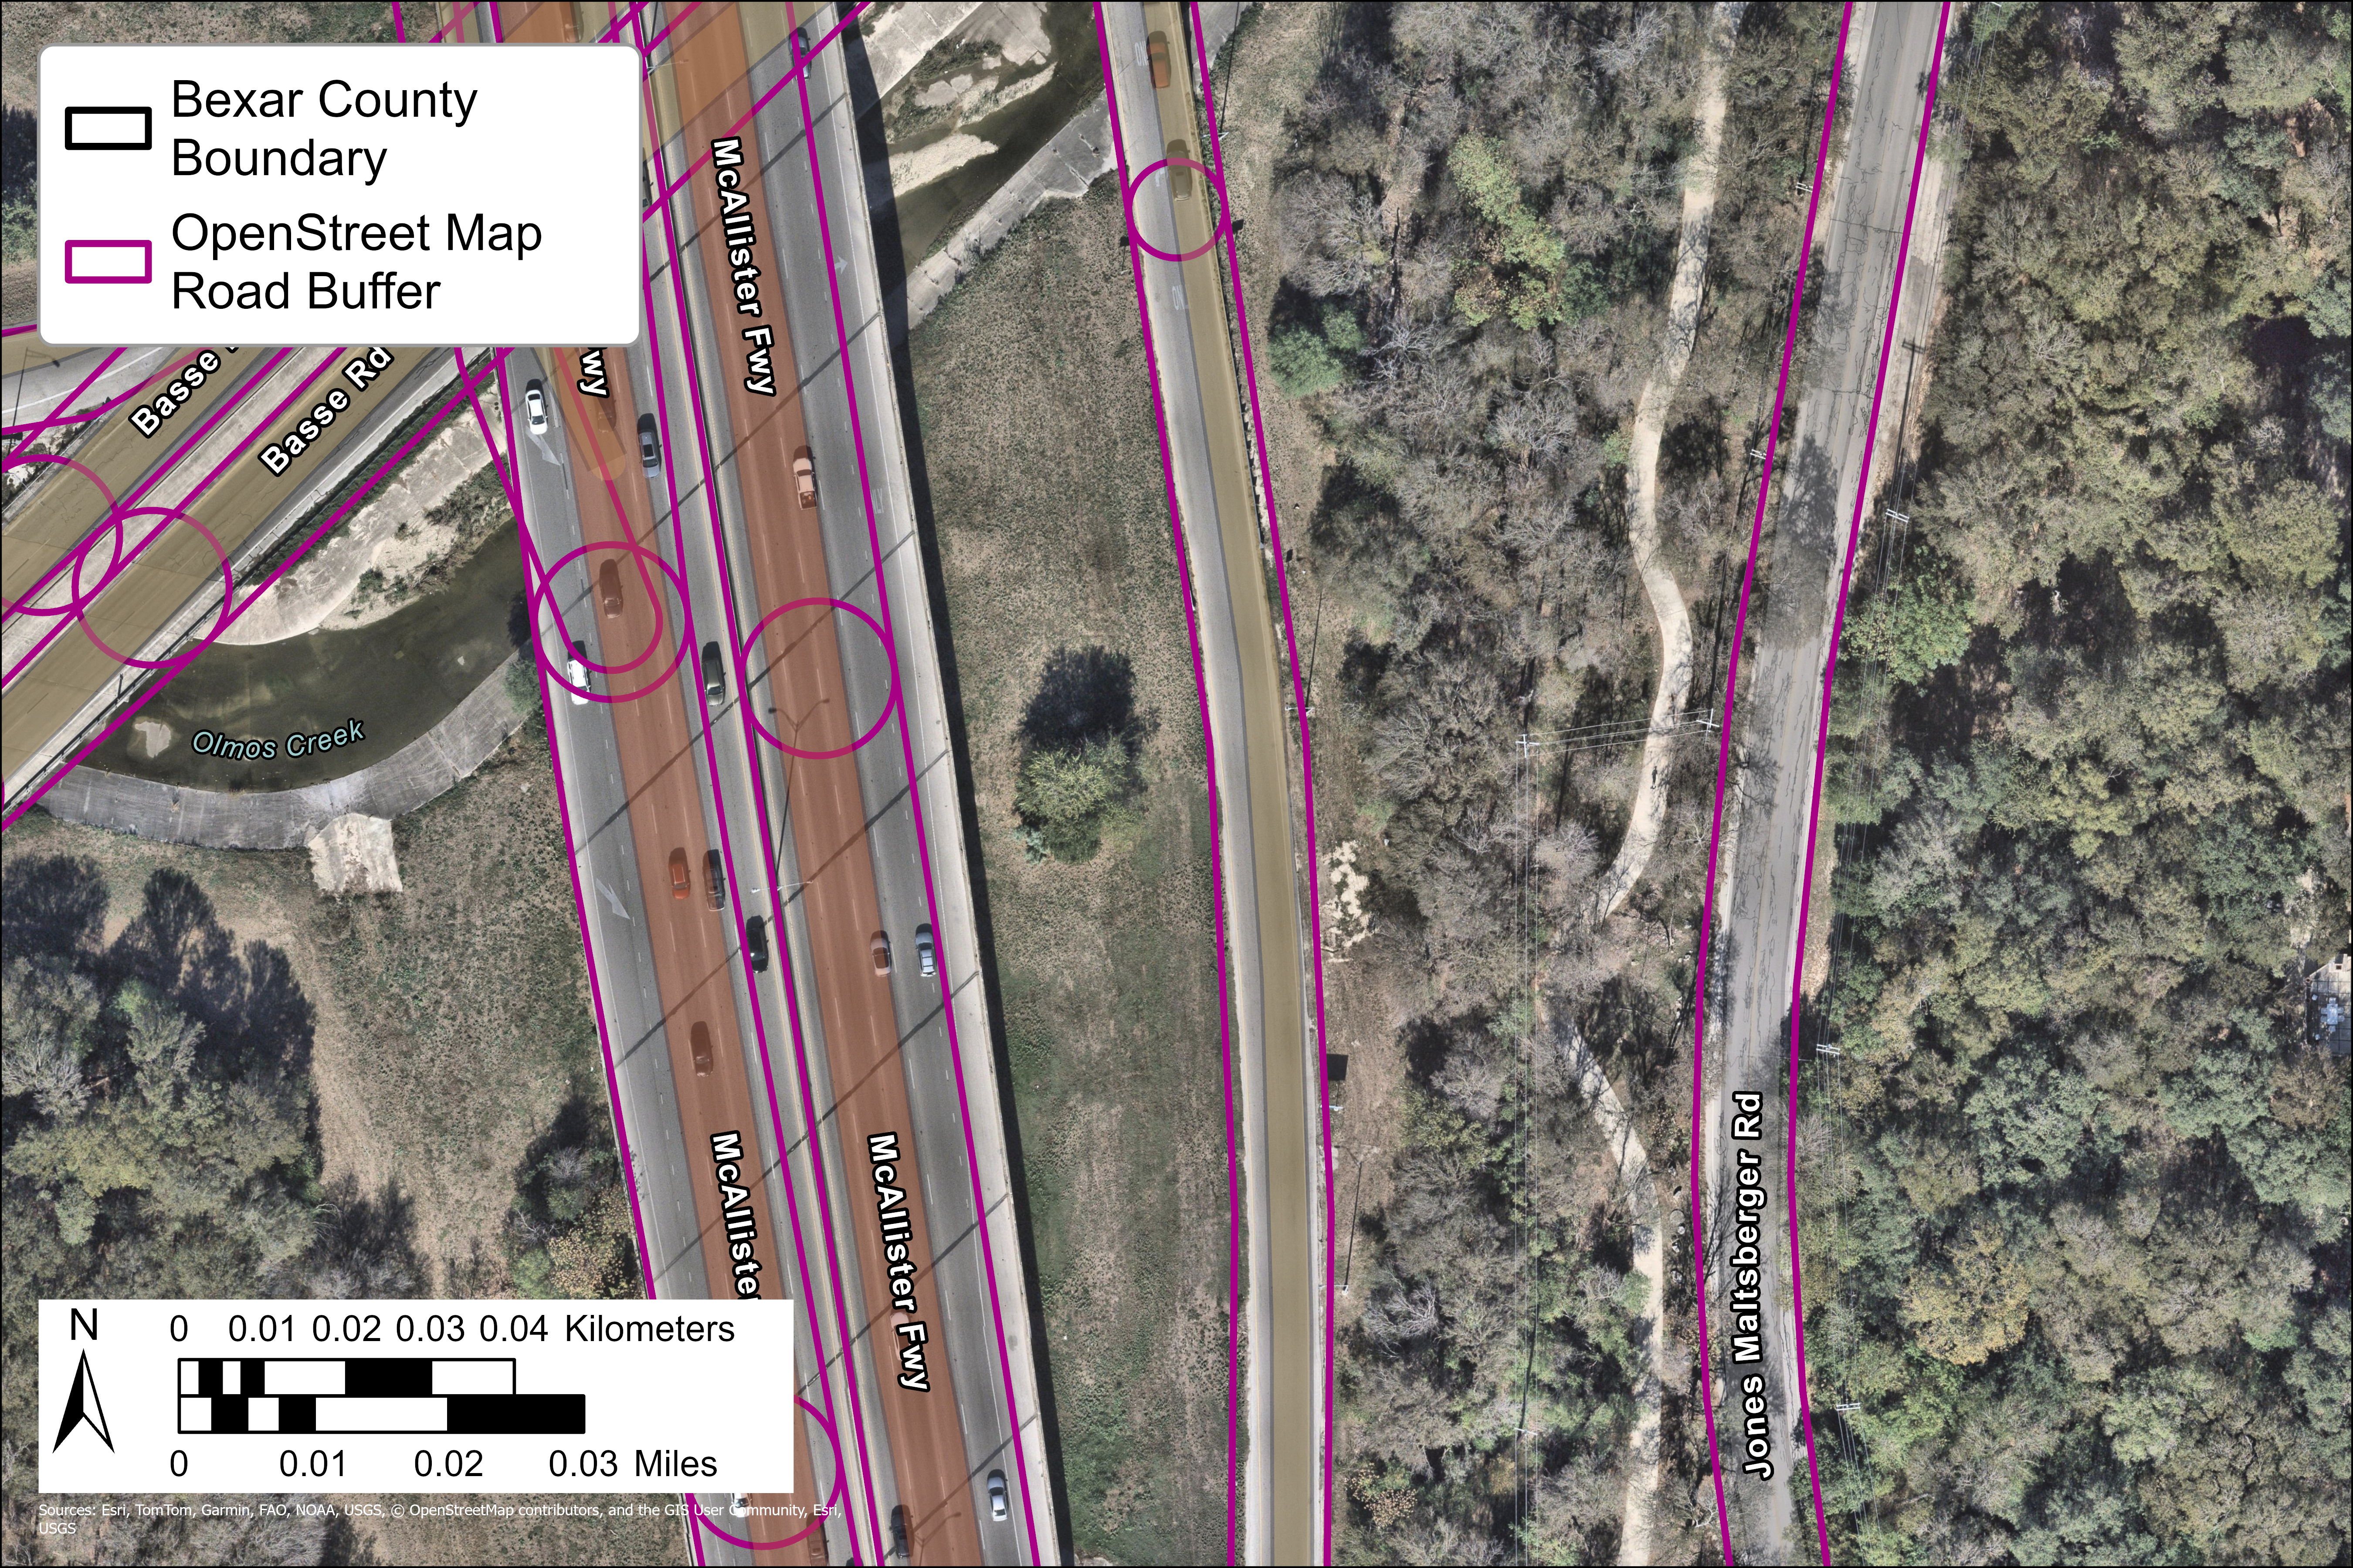
Data Sources
TxDOT San Antonio Region Roadway DSM
SARA Water Surface Elevations 10-yr
OpenStreetMap Road Polygons
16 m
10 m
Notes:
Road polygons created by differentially buffering the OpenStreetMap line layer using the fclass attribute. Larger roads received a buffer of 8m on both sides and smaller roads received a buffer of 5m on each side.

Slide 23
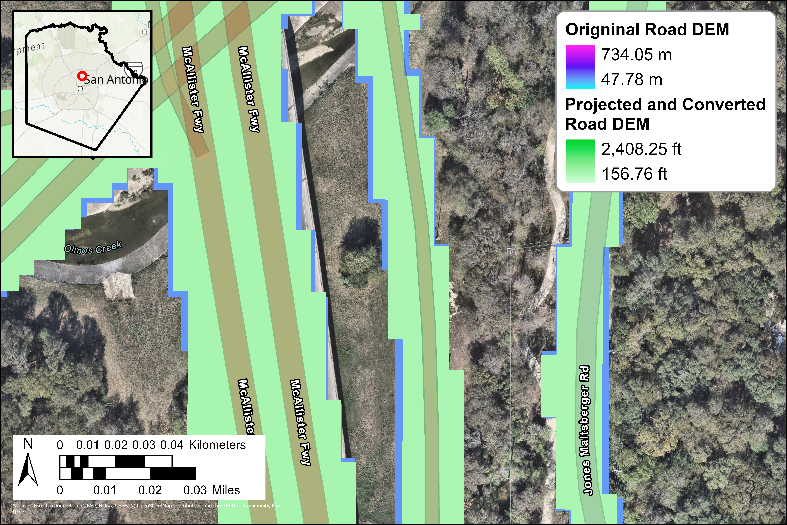
Methods
1. Re-project and convert units of roadway DSM
  Project Raster
  Raster Calculator
Notes:
Had to deal with mis-matched units between road DEM & WSE’s, chose to re-project & convert roads instead of all 9 WSE’s

Slide 24
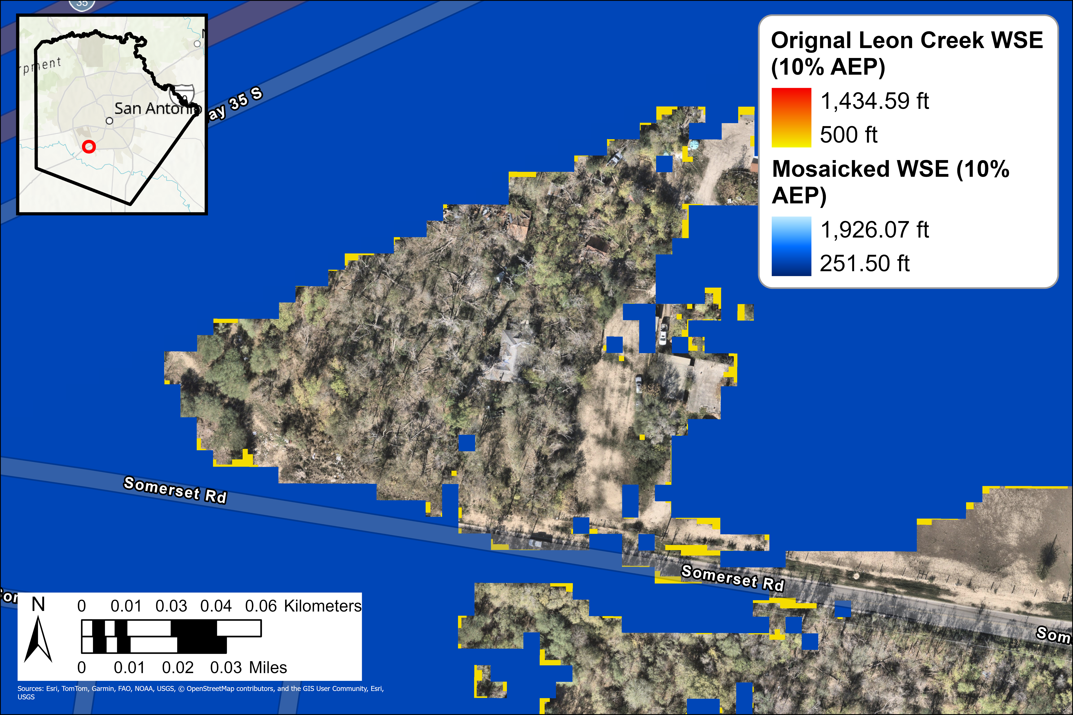
Methods
2. Combine all 9 WSE rasters
  Mosaic to New Raster
Notes:
This is to reduce time of analysis & size up all WSE rasters to 3m (9.8 ft) for apples to apples comparisons between watersheds
THIS SLIDE CAN BE REMOVED FOR TIME

Slide 25
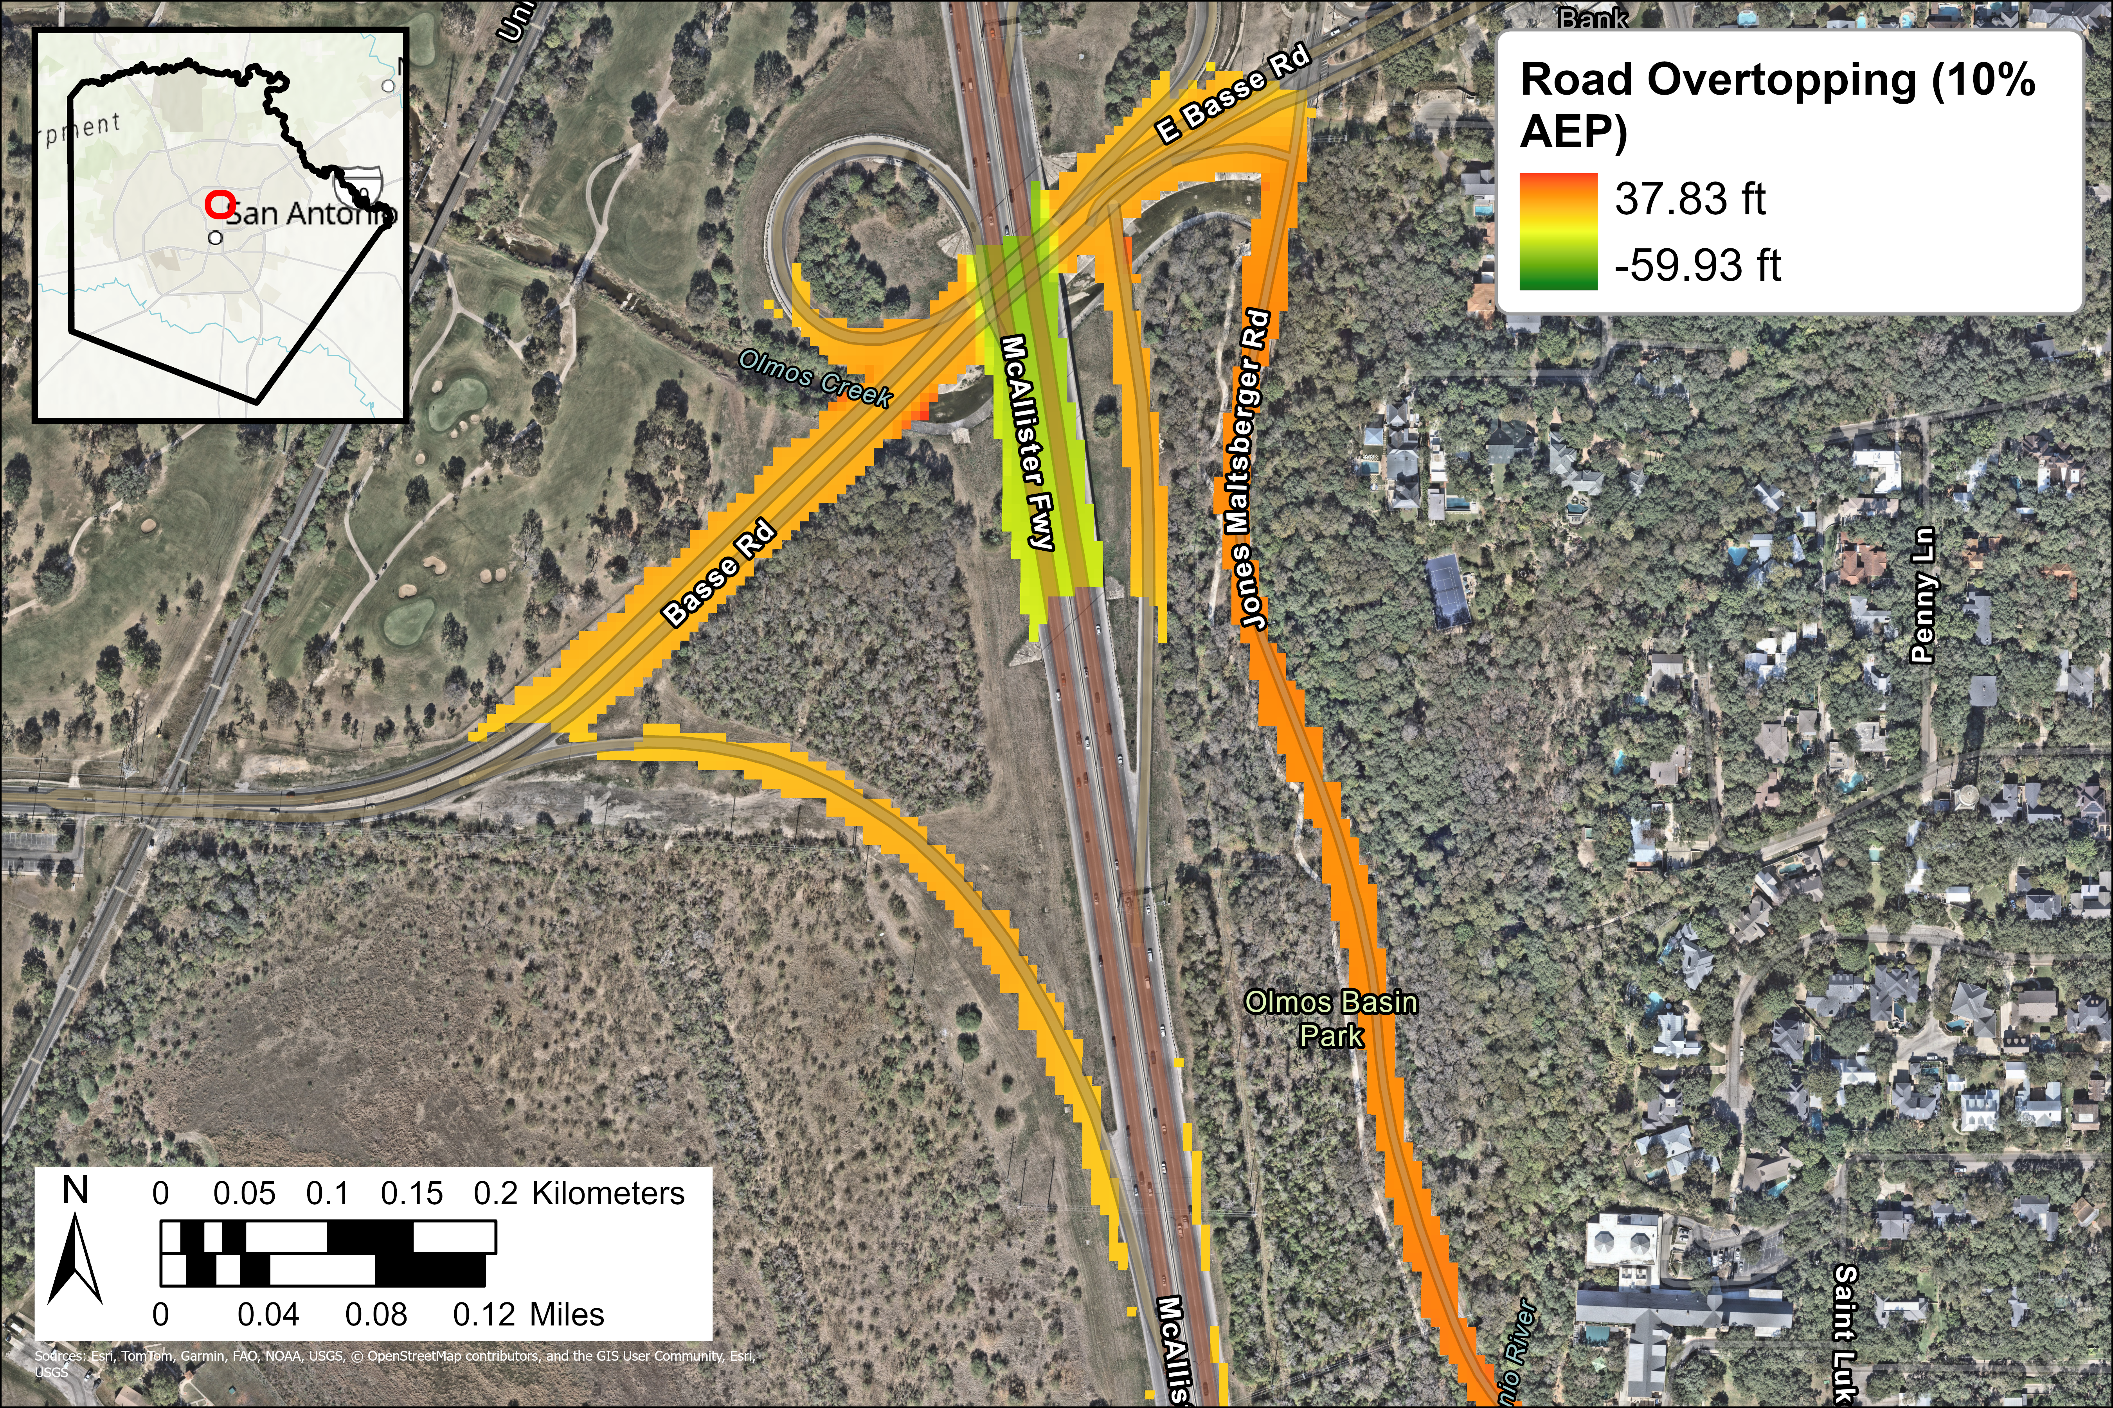
Methods
2. Calculate difference between road DSM and WSE
  Raster Calculator

Slide 26
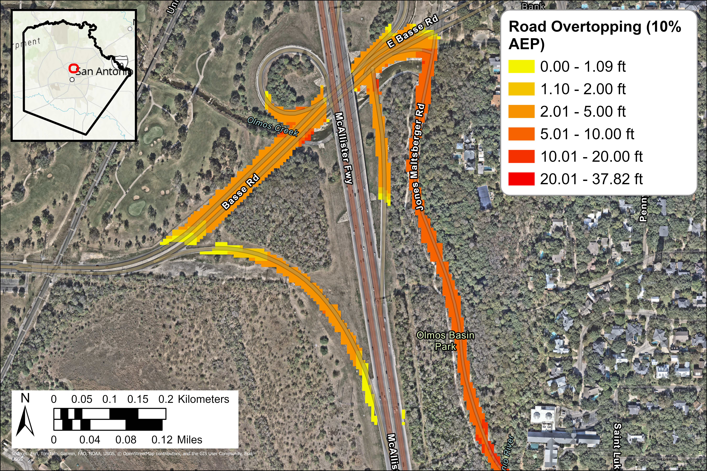
Methods
3. Convert difference raster to polygons
  Raster Calculator
  Int Tool
  Raster to Polygon
Notes:
Easier to use in other next gen analyses such as identification of high-risk areas not covered by a HWDS
Also excluded all values less than or equal to 0
Had to do a couple of extra steps to retain 2 decimal, first use raster calculator to multiply raster by 100, then convert the float values into an integer format, as that’s the only value type accepted by the raster to polygon tool. Then after converting into polygons, I added a new field and divided the integer values by 100 to return the original value.

Slide 27
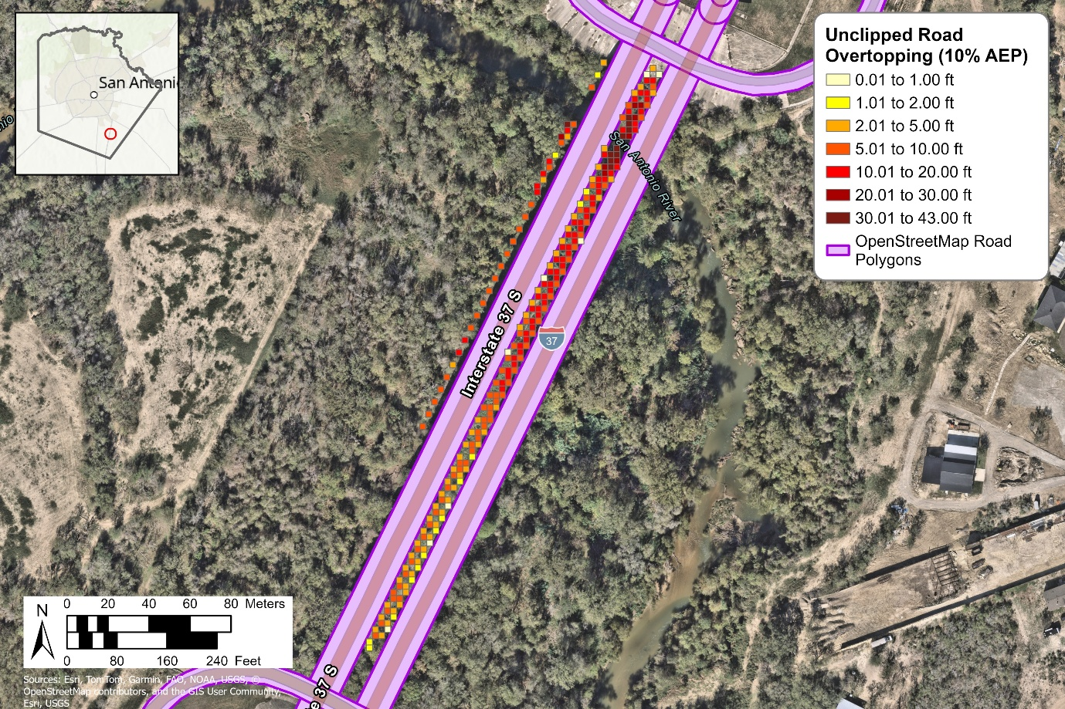
Methods
4. Confine results to roadway
  Clip tool
Notes:
Needed to exclude Lidar points taken in-stream instead of on-road, used rough roadway polygons to accomplish this – helps, but isn’t perfect. Still need to review greatest depths for off-road areas.
-Map of raw polygons prior to clip
-Map of polygons post-clip

Slide 28
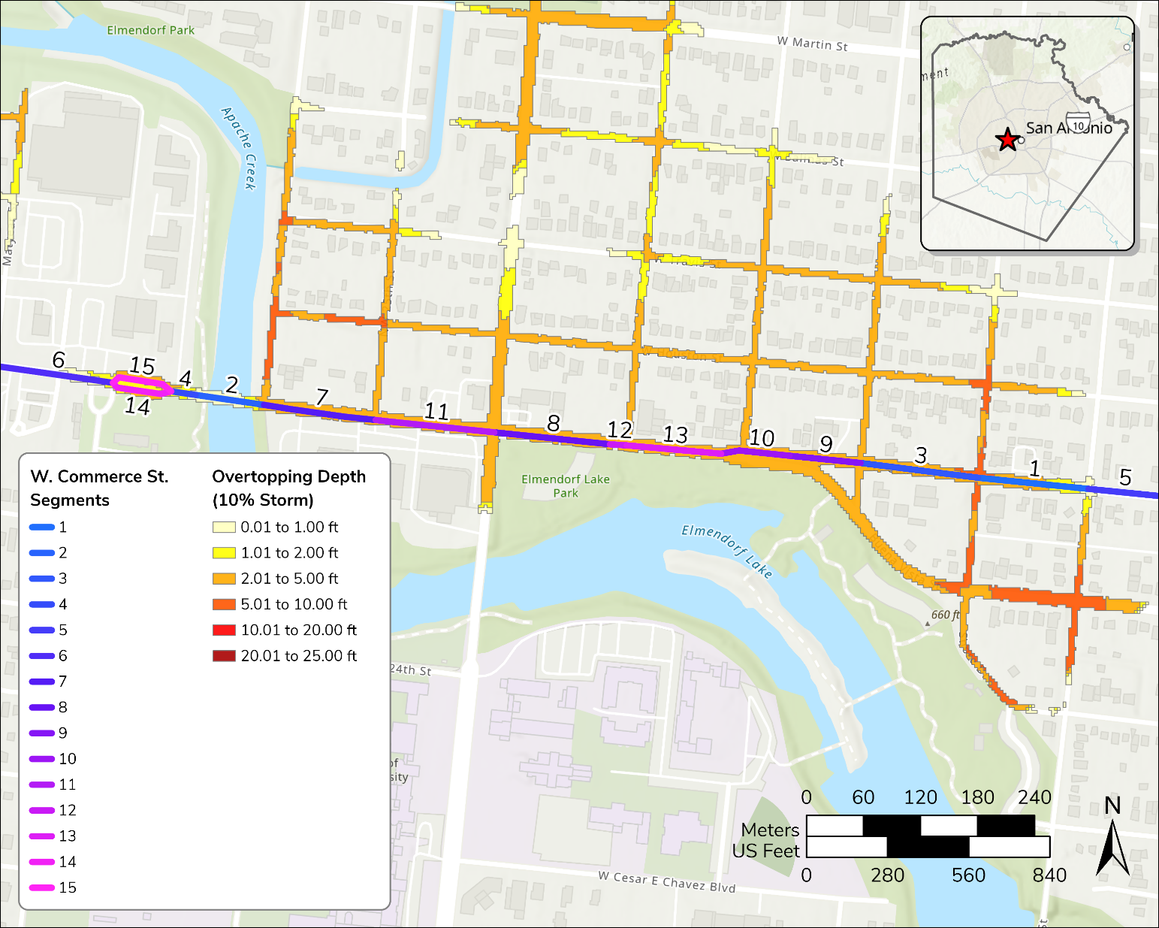
Notes:
RE-MAKE MAP USING NEW DATA

Slide 29
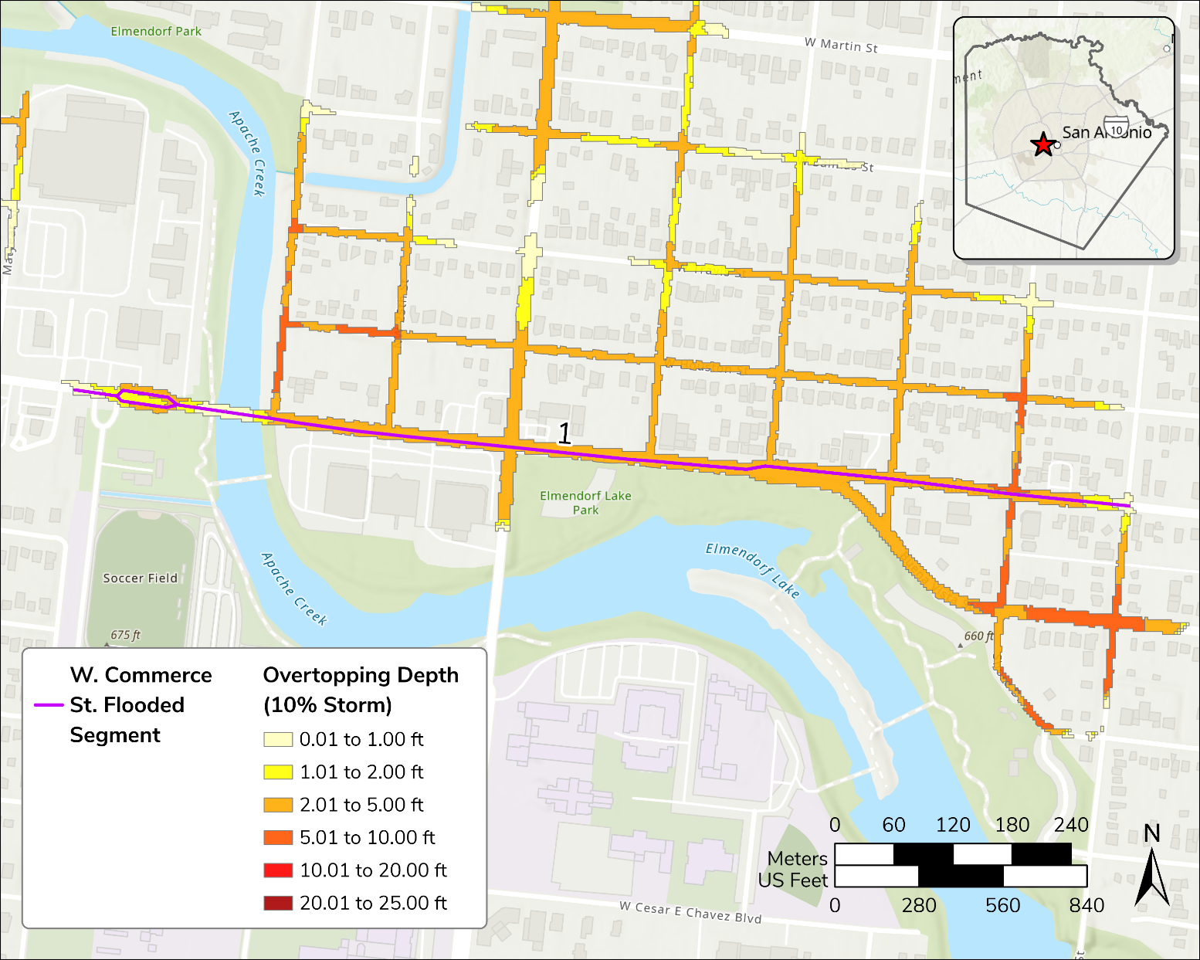
Notes:
RE-MAKE MAP USING NEW DATA

