Slide 1
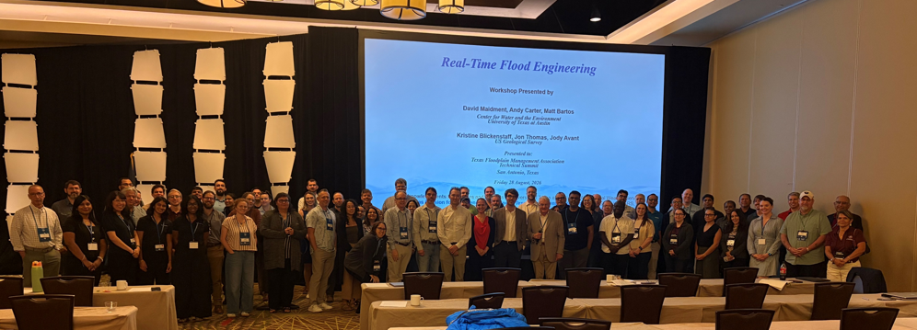
Real-Time Flood Engineering
Presented by David Maidment,
Center for Water and the Environment
University of Texas at Austin
Presented to Texas FLOG/FIM Subcommittee
Friday 4 September, 2026
TFMA Workshop
28 August 2026
UT-USGS
Acknowledgments: Colleagues and students at University of Texas at Austin, NOAA National Weather Service, Texas Division for Emergency Management, Texas Department of Transportation, ESRI, KISTERS

Slide 2
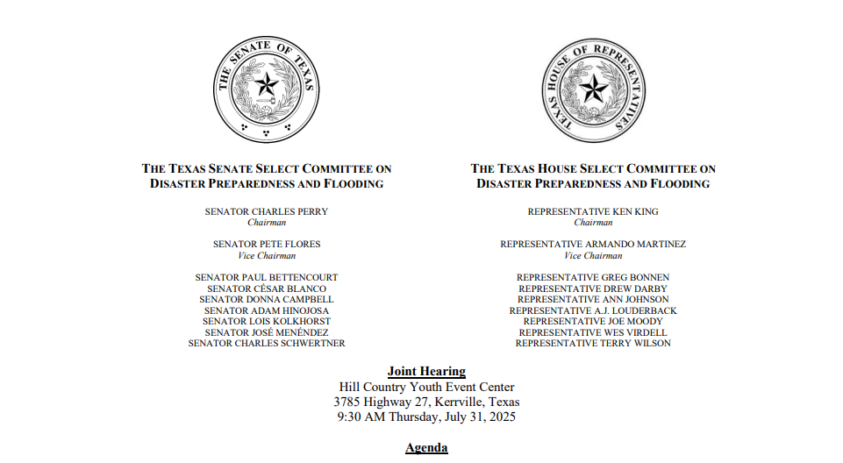

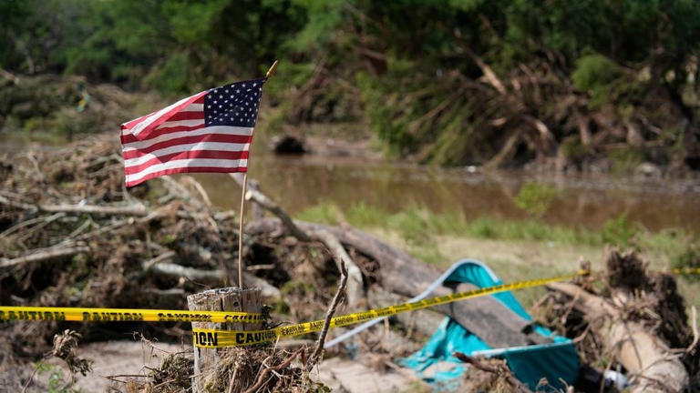
Flood Catastrophe in the Texas Hill Country
Legislative Hearing in Kerrville on
31 July 2025
A failure in flood communications
137 died, including many children
“How can we do better?”

Slide 3
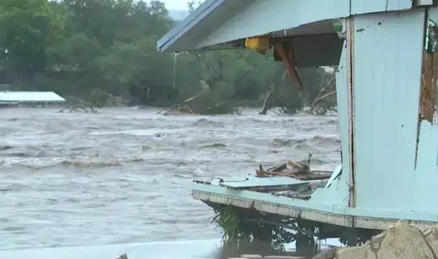
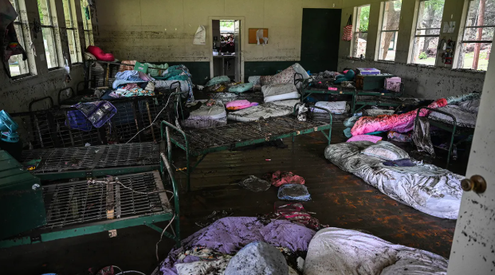
Flood Engineering
Traditional Flood Engineering
Real-Time Flood Engineering
Accurate
Engineer: “I worry if I am wrong”
Accurate, reliable and timely
First responder: “I worry if I am late”
Terrible lesson of 4 July flood at Camp Mystic – the warning was late

Slide 4
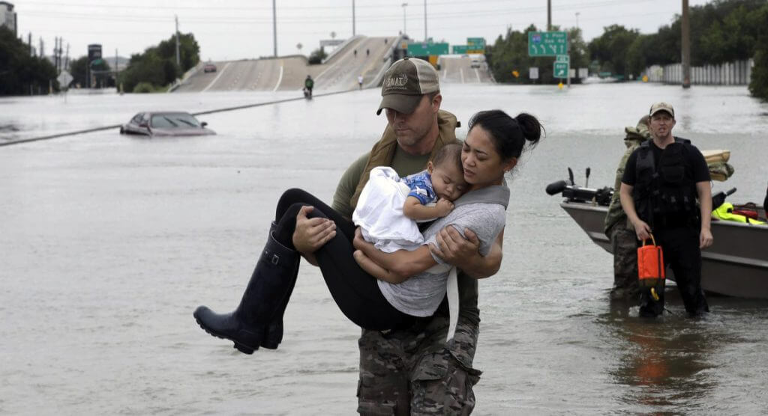
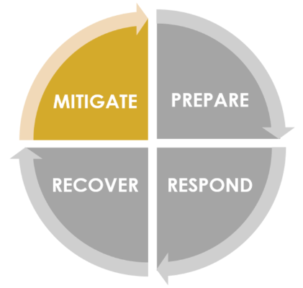
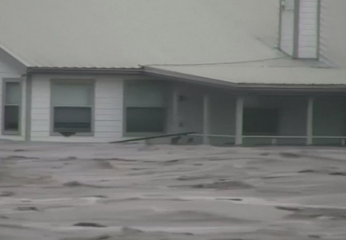
Flood Engineering: Two Approaches
Risk-based flood engineering
Real-Time Flood Engineering

Slide 5
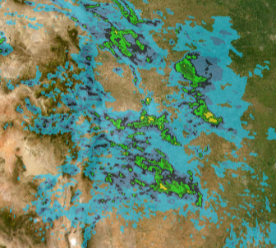
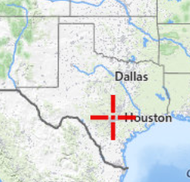
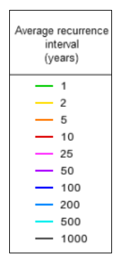
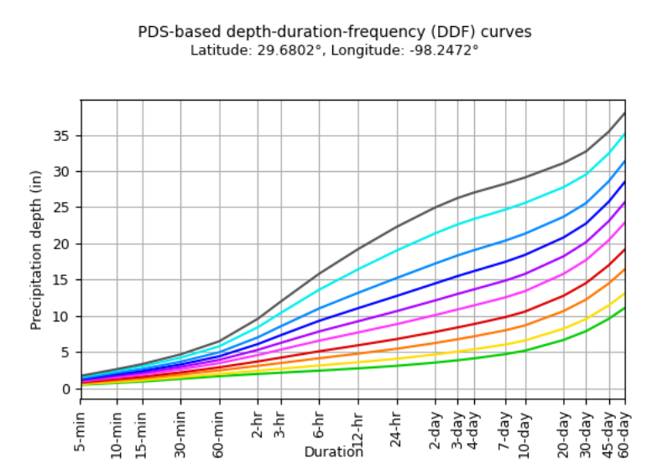
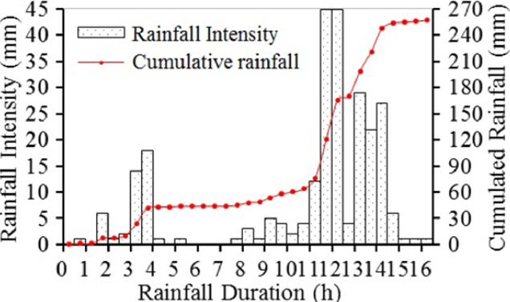
Two Kinds of Rainfall Inputs
Design Storms
Real-Time Storms
Dynamic, moving, spatially complex, uncertain

Slide 6
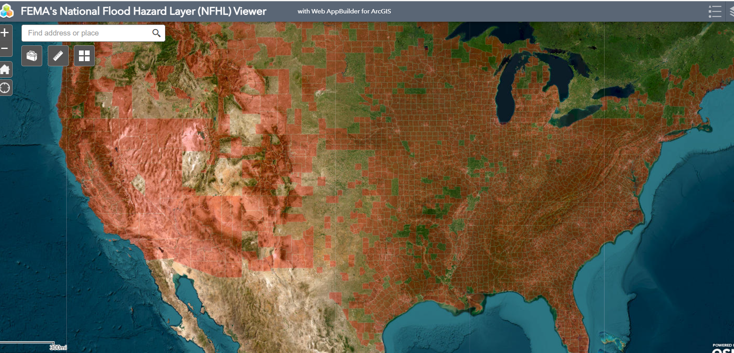
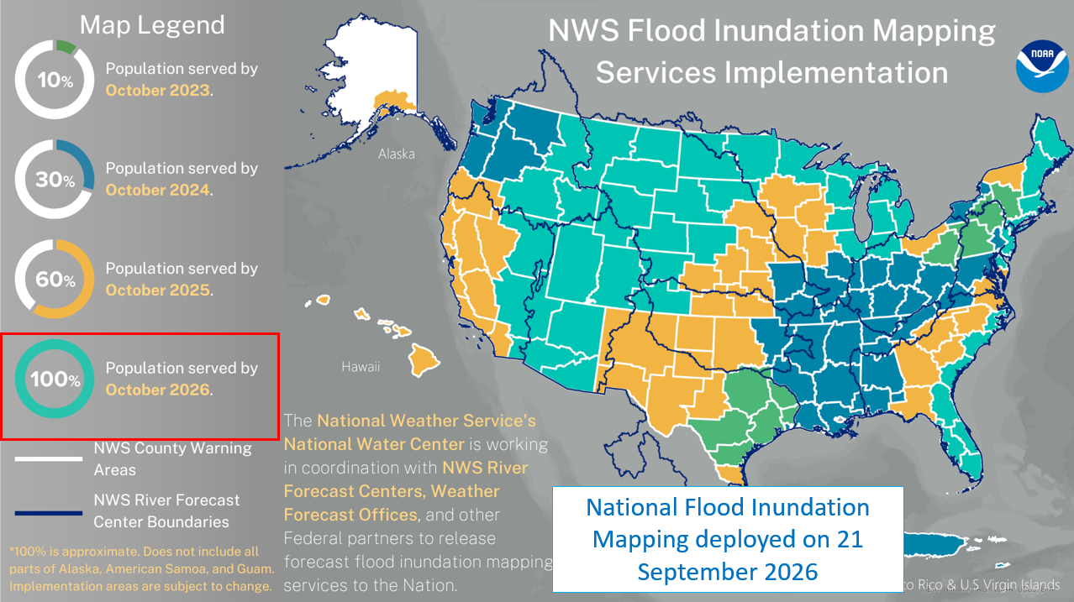
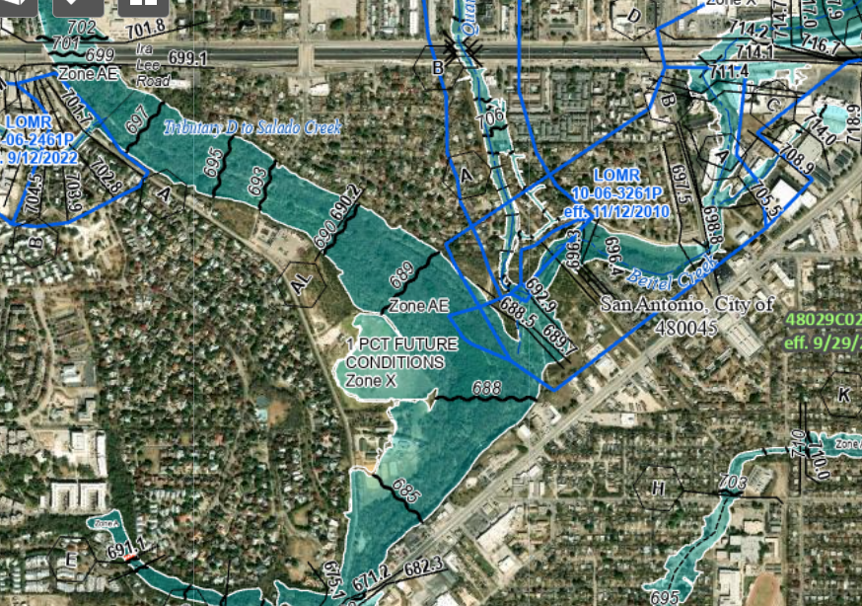
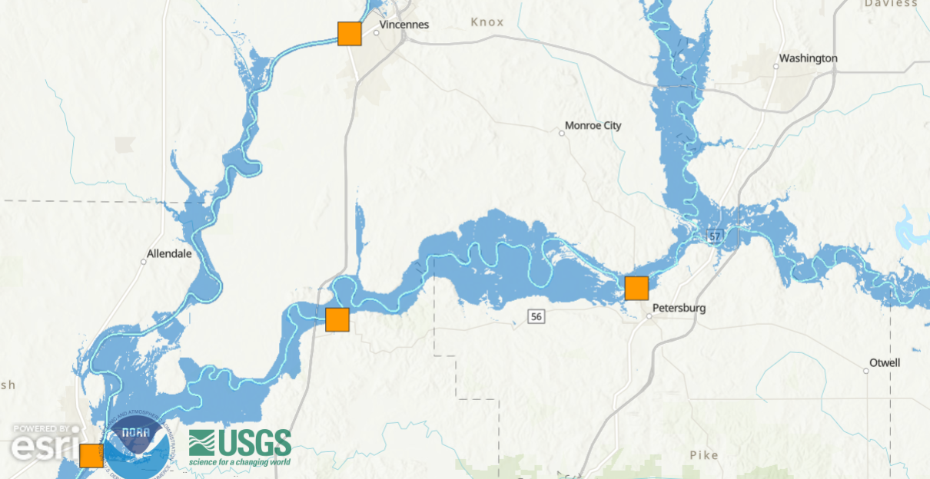
Flood Inundation Mapping – two national systems in the US
FEMA’s National Flood Hazard Layer
NOAA’s Real-Time Flood Inundation Mapping
Salado Creek, San Antonio, Texas
Wabash and White Rivers,
Illinois and Indiana,
23 August 2026

Slide 7
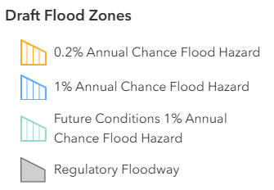
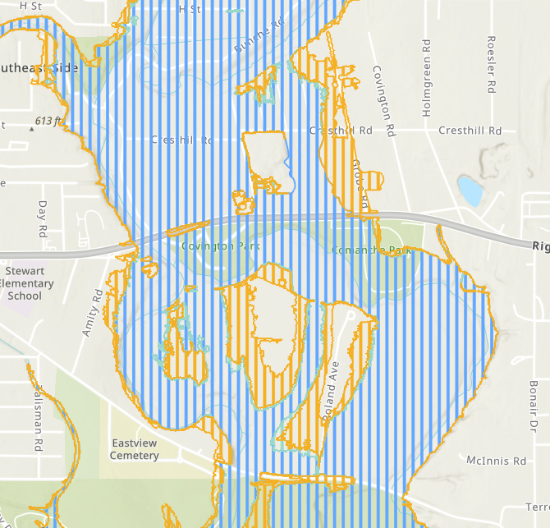
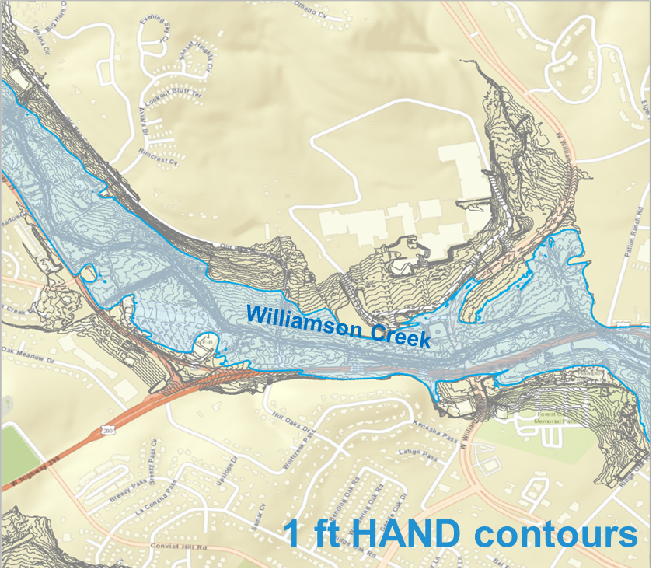

Flood Inundation Mapping (FIM) – two methodologies
Frequency FIMs
FIM Libraries

Slide 8
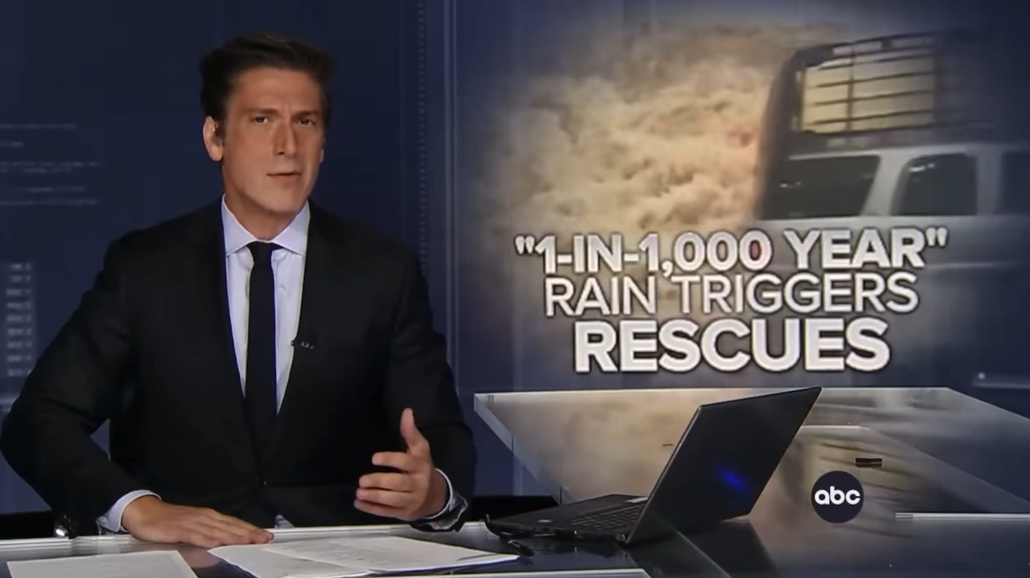

Slide 9

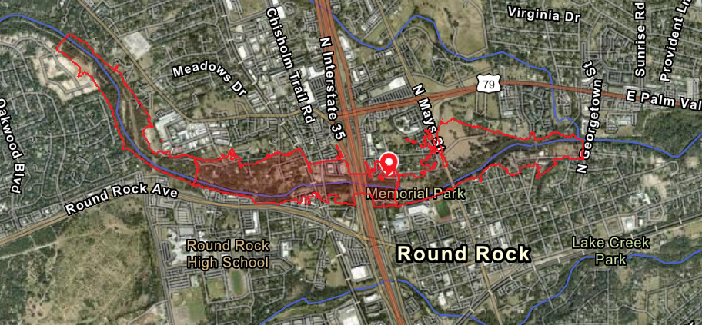
Observational Flood Mapping
https://pin2flood.tdem.texas.gov/
“P2F was a huge hit with the teams, from around the country that responded to the July 4th and 5th flood event in 2025. They all saw the practical applications for the incident managers and simplistic entry for the responders.” Jeff Saunders, Director, Texas Task Force 1
https://www.youtube.com/watch?v=iGNwjI4k4qM
“TDEM has launched an SSO [Single Sign-On] process that allows for access by approved individuals to the Pin2Flood application outside of the TDEM Staff and TXTF Squads who currently have access.” Melissa Ruiz, TDEM

Slide 10


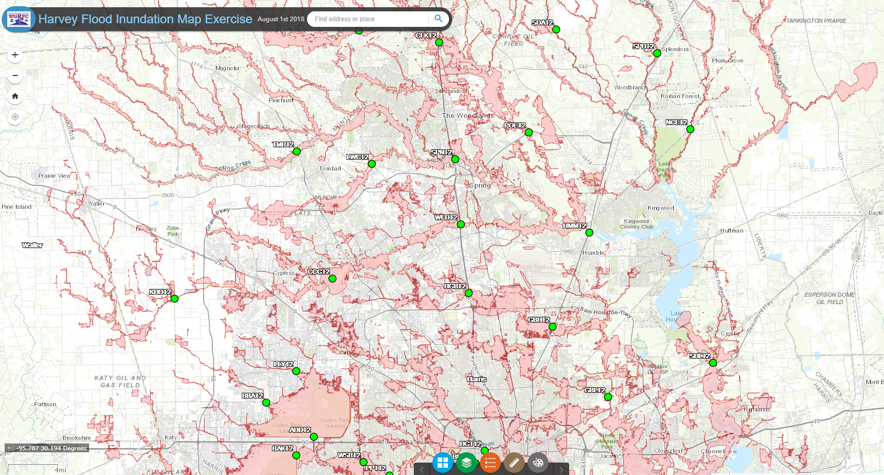
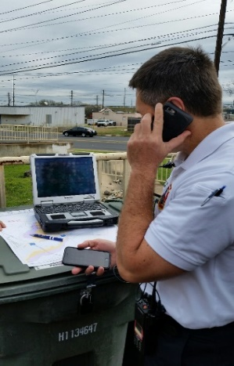
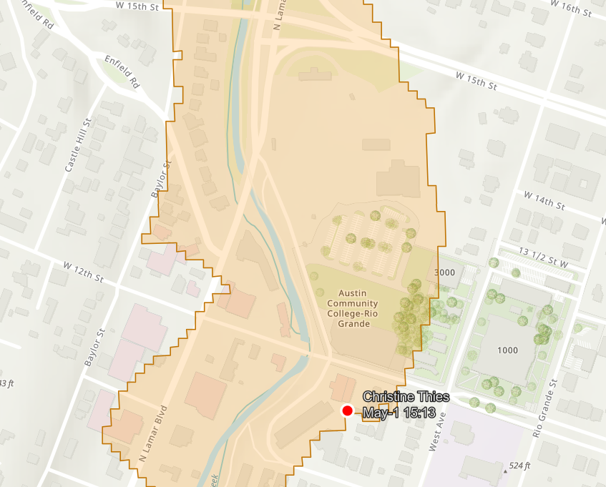

Combining Predictive and Observational Mapping
State Operations Center
Predictive Flood
Mapping
National Water Center
Observational
Flood Mapping
State Operations Center
Local EOC
First responders in field
Emergency Management Flood Project – Pin2Flood
University of Texas Center for Water and the Environment

Slide 11
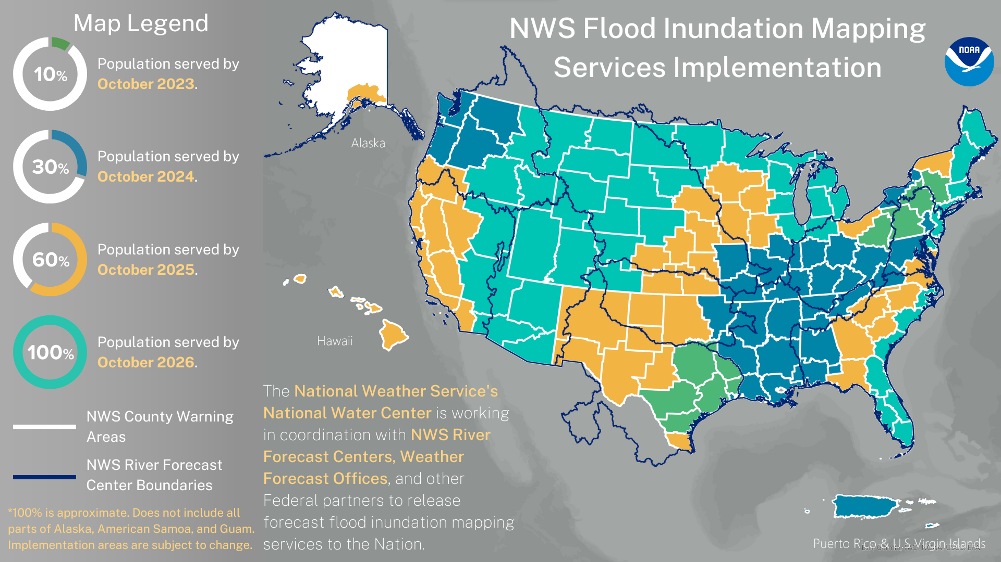
National Flood Inundation Mapping deployed on 21 September 2026

Slide 12
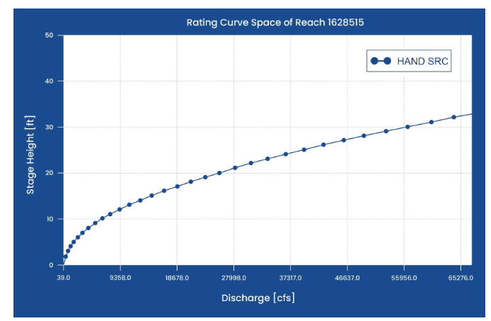
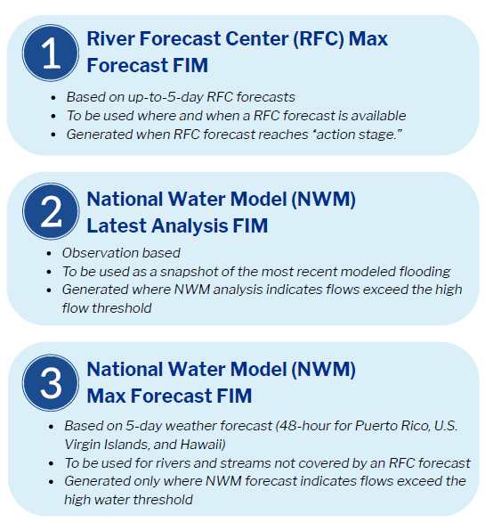
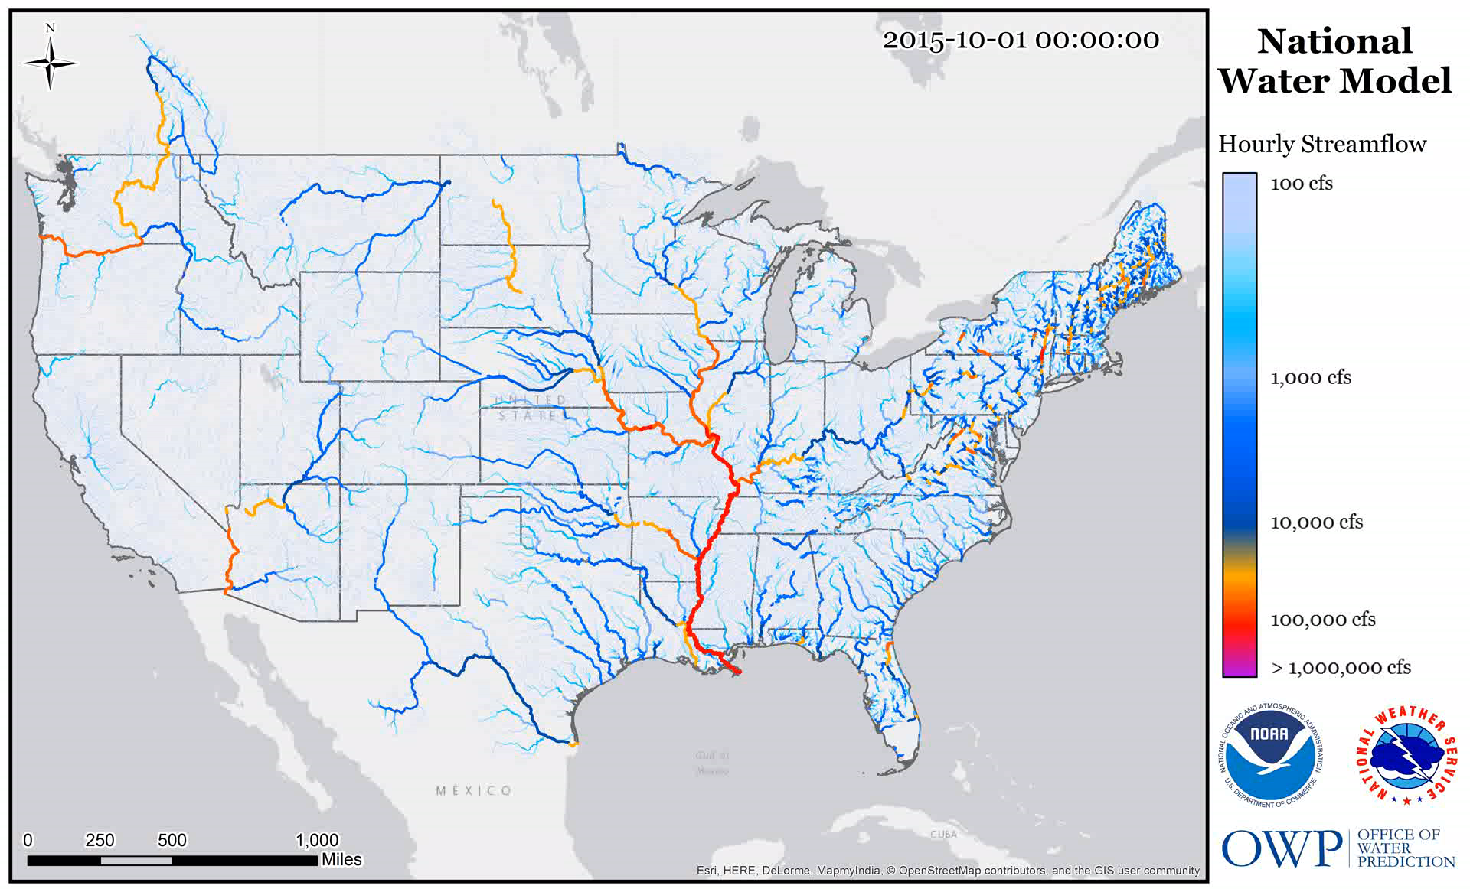
Standard, Real-Time, National Flood Inundation Maps
Freely available map services
Synthetic Rating Curve
Stage Height (ft)
Discharge (cfs)

Slide 13
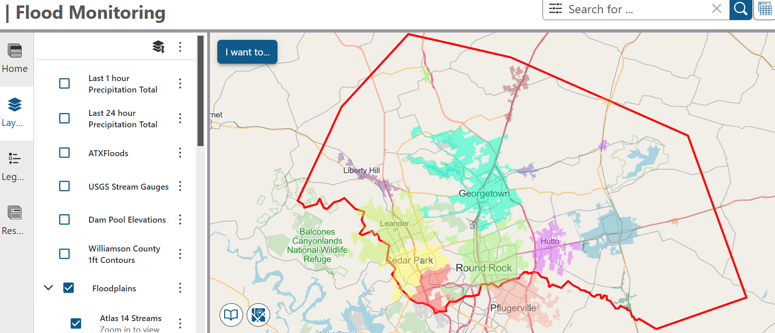
Flood Decision Support System for Williamson County
https://wilcomaps.wilco.org/vertigisstudio/web/?app=f9563f4ce02f4fdd8f7f84249b500ec9
Flood map services assembled by Frank Martin and George Strebel, Wilco GIS
Four Components:
NOAA Flood Map Services
Local reference data
Precipitation (past and future)
Local flood services (including SB3)

Slide 14
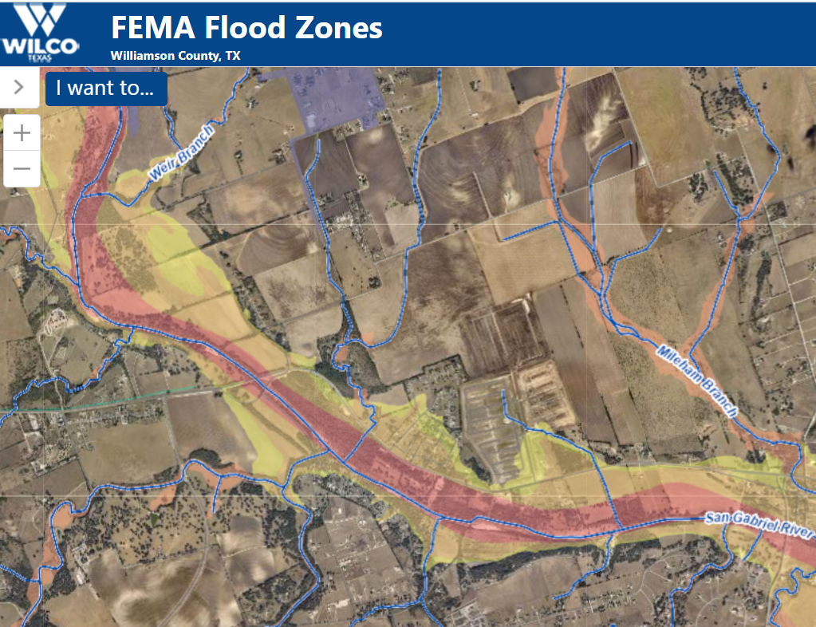
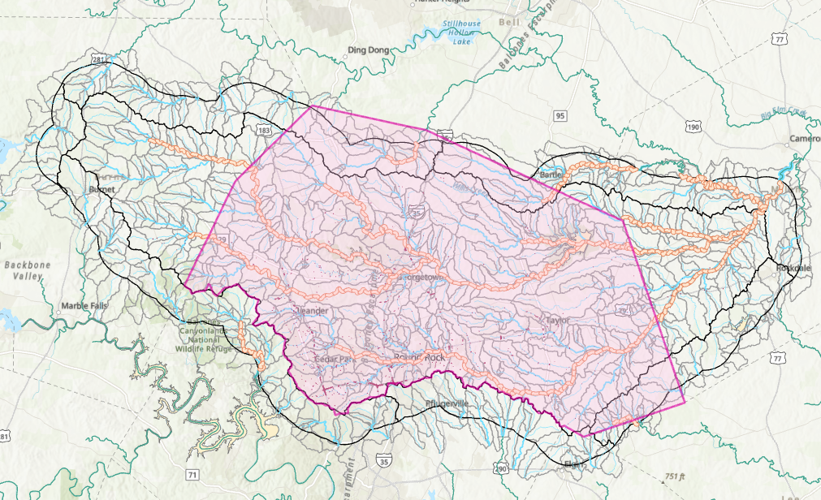
Williamson County Flooding
Risk-Based Flood Engineering
Real-Time Flood Engineering
National Water Model Hydrofabric for Williamson County
(HUC8 12070205)
Williamson County
https://gis.wilco.org/maps/?viewer=floodzone
> $10 million investment

Slide 15
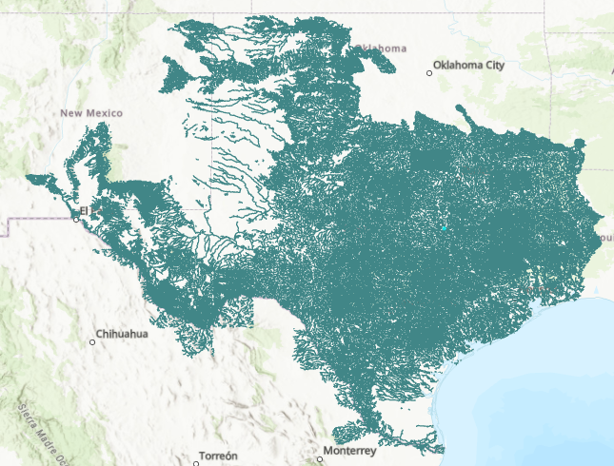
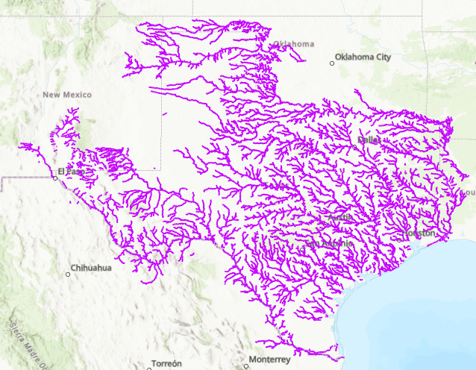
National Water Model Hydrofabric for Texas
HUC8 = 12070205
209 HUC8 units
Full Resolution Flow Network (287,935 reaches)
Mainstems(49,207 reaches)

Slide 16


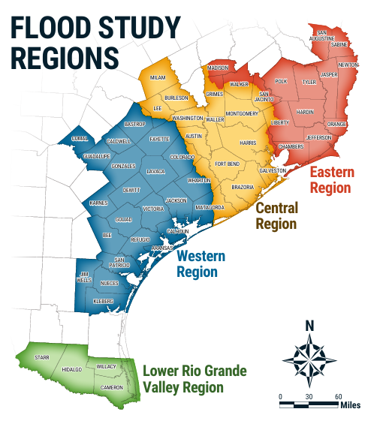


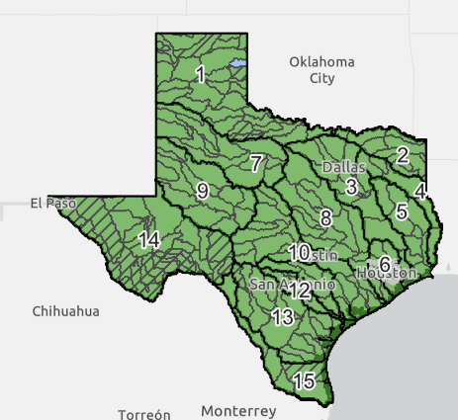
Risk-Based Flood Modeling in Texas
> $100 million investment
Hurricane Harvey Recovery
Base Level Engineering

Slide 17


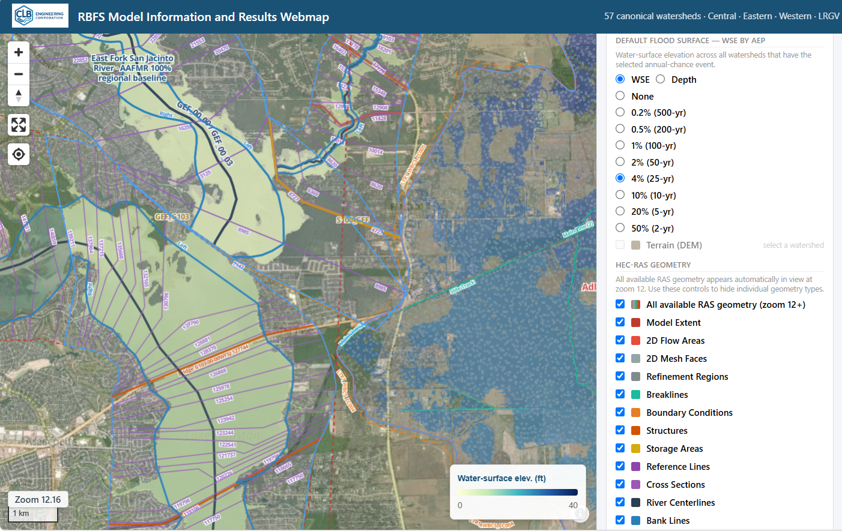
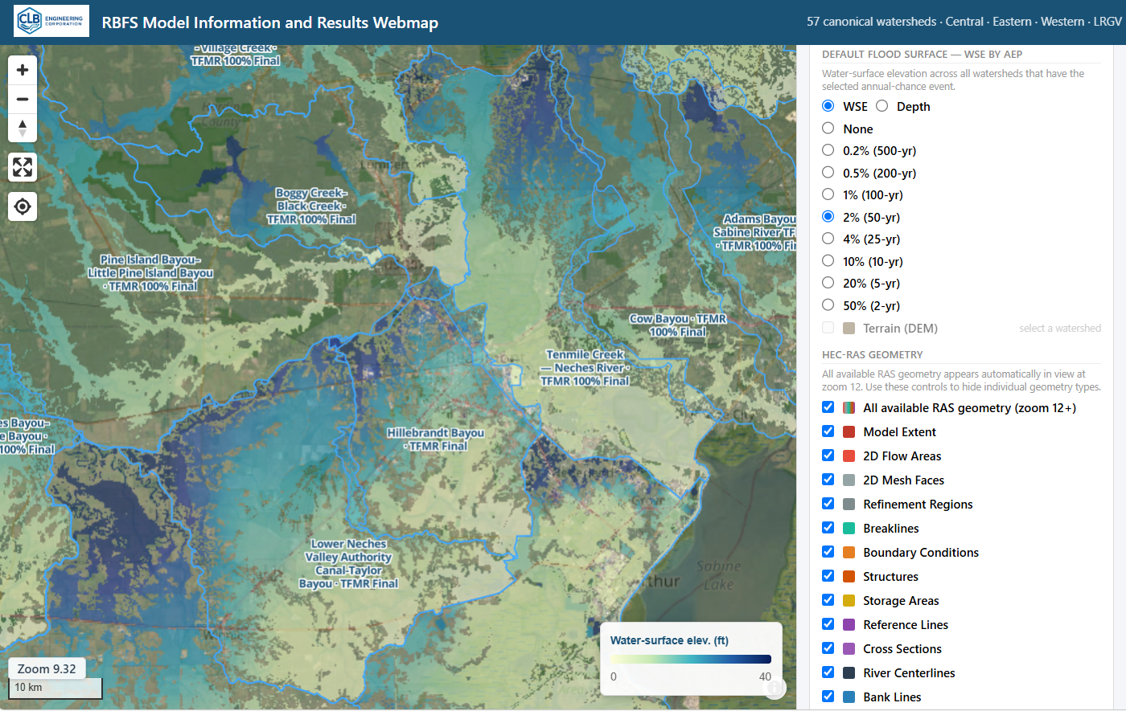
Accessing RBFS Model Results Data at Scale using
Key Features for Flood Forecasting Workflows
Bill Katzenmeyer, President
Open Source, Non-Proprietary
Robust API for Boundary Conditions
Solves HEC-RAS Linux Limitations
HDF Results >> Direct to Dataframe
Automated Meshing and Stored Maps
Cloud Native Mapping Outputs
https://gis.clbengineering.com/maps/tx/rbfs/
RBFS 100% Models via TDIS DQMT
Texas RBFS Model Data and Results Mapping

Slide 18
Flood Engineering: Two Approaches
Risk-based flood engineering
Real-Time Flood Engineering

Slide 19
Discussion
How do we convert our inventory of engineering-based flood modeling into stage-based flood inundation map libraries for Texas?
Is this a state-level responsibility?
Are cities and counties involved?
What are the limitations of the National Water Model and its FIM and how can these be overcome at the local level?
How does all this relate to SB3, SB5 and flood sirens?
….. your ideas and comments are welcome!

