Slide 1




Flood Assessment System for TxDOT (FAST)
Presented by Andy Carter and David Maidment
Center for Water and Environment University of Texas at Austin
To the TWDB Flood Organizing Group,
Flood Inundation Mapping Committee
7 November 2025
Andy Carter
Dr. David Maidment

Slide 2

Disclaimer

Slide 3
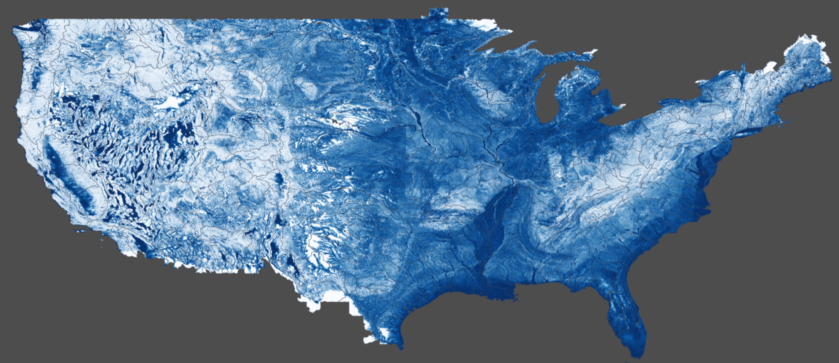
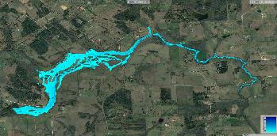
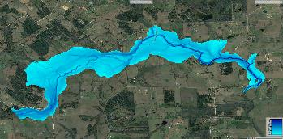
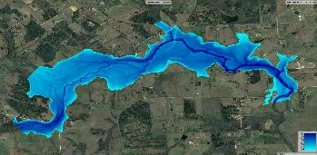
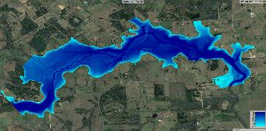

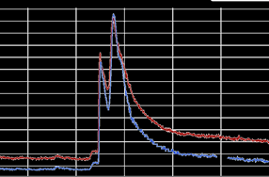
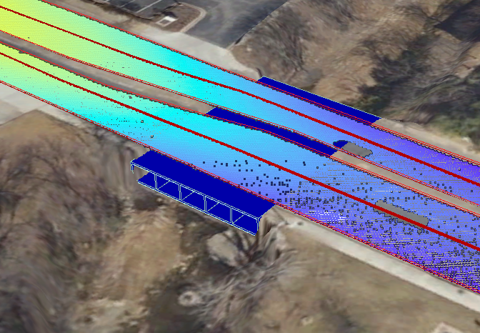
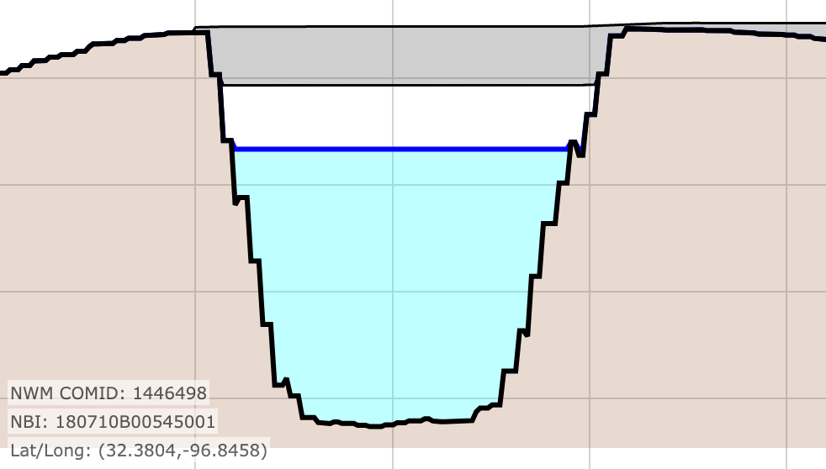

Flood Assessment System for TxDOT (FAST)
Modeled
Discharges
Visualization
Roadway flood depth
forecasts
National Water Model
Discharge
Estimates
Inundation Geometries
Data
Assimilation
Web services
Bridge and roadway geometries
Emergency response
Discharge
Measurements
Stream Gage
Network
Hydrology
Hydraulics and Mapping

Slide 4
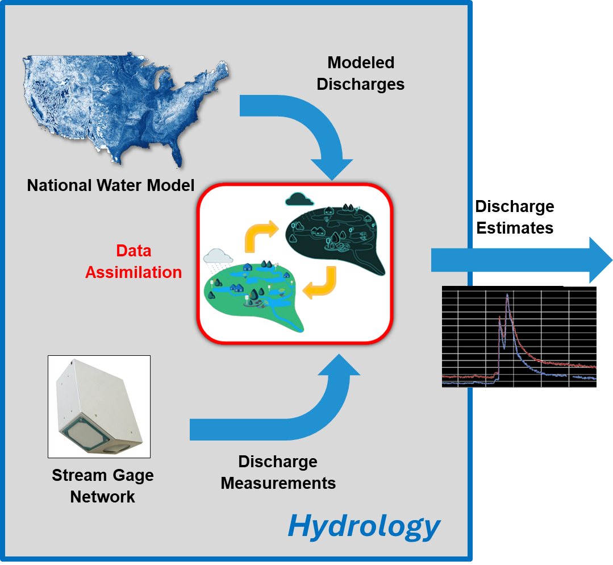
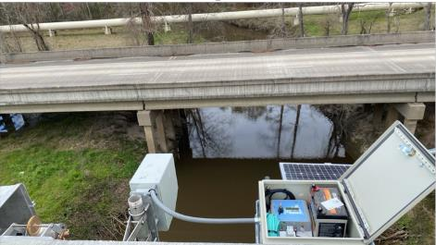
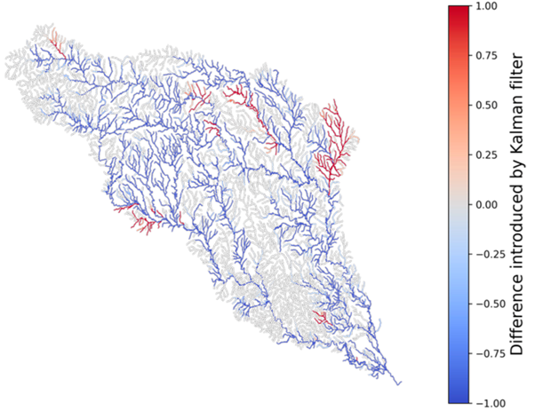
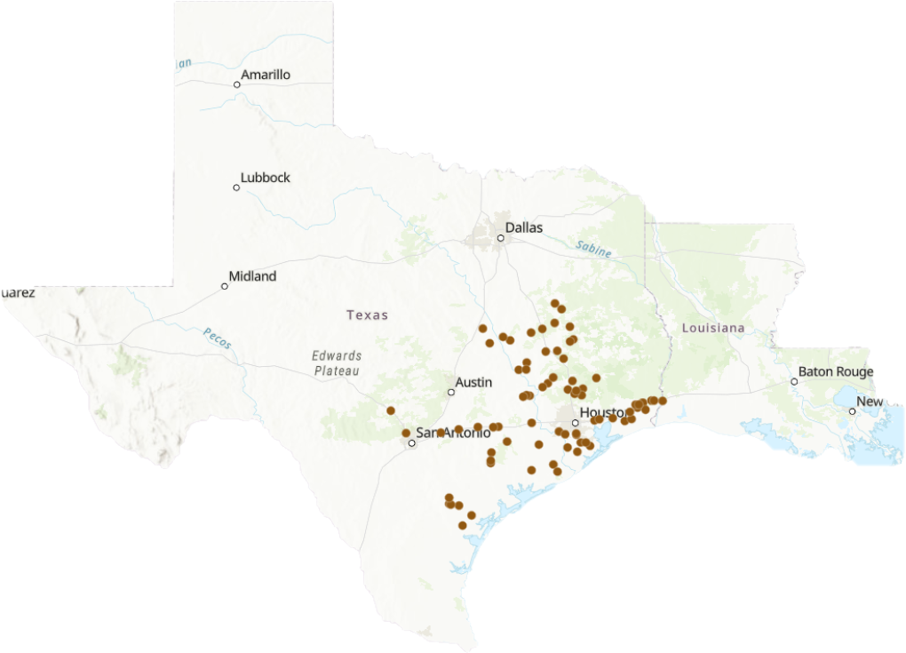
Hydrology Presented in Previous FLOG/FIM Meetings
FLOG/FIM Subcommittee Meeting,
5 April 2024
FLOG/FIM Subcommittee Meeting,
10 January 2025
80 TxDOT gages with RQ-30 radar sensors
Data Assimilation to produce updated forecasts

Slide 5

Fitting in with the National Weather Service Forecasting
https://maps.water.noaa.gov/server/rest/services/nwm
nwm/mrf_gfs_5day_max_inundation_extent (FeatureServer)
nwm/mrf_gfs_5day_max_inundation_extent (MapServer)
nwm/mrf_nbm_5day_max_inundation_extent (FeatureServer)
nwm/mrf_nbm_5day_max_inundation_extent (MapServer)
rfc/rfc_based_5day_max_inundation_extent (FeatureServer)
rfc/rfc_based_5day_max_inundation_extent (MapServer)
Flows and Mapping from NOAA
Medium Range Forecasts
(Maximum for 5 Days Ahead)
Flows from NOAA, mapping from TxDOT
Short Range Forecasts
(Maximum for 18 hours ahead)
FAST/srf_18hour_max_inundation_extent
FAST/srf_18hour_max_road_flooding
FAST/srf_18hour_bridge_warnings_time_profile
This is a research level system that is under evaluation at TxDOT
Flows and Mapping from NOAA
Analysis and Assimilation Model
(Current Condition)
nwm/ana_inundation_extent (FeatureServer)
nwm/ana_inundation_extent (MapServer)

Slide 6

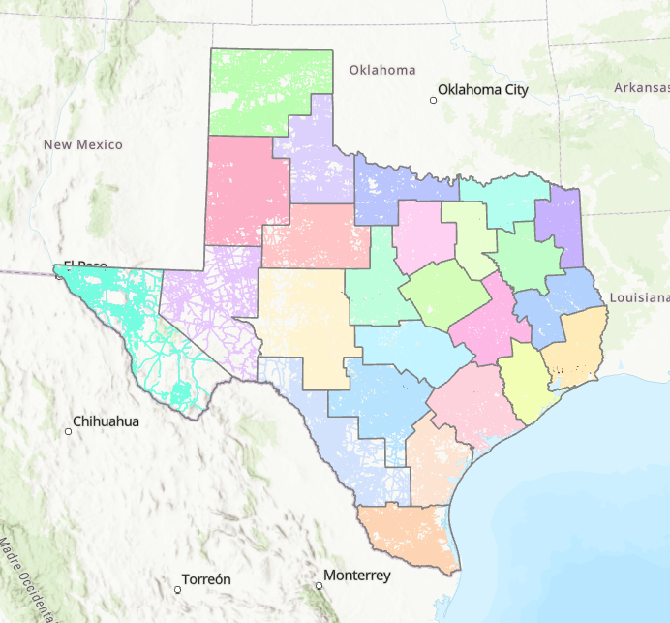
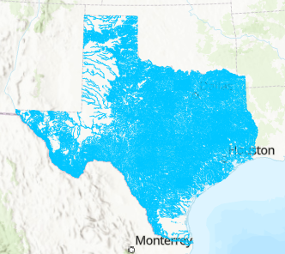
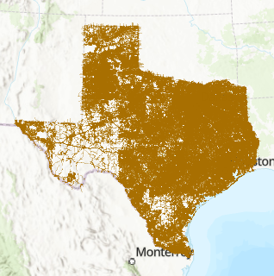
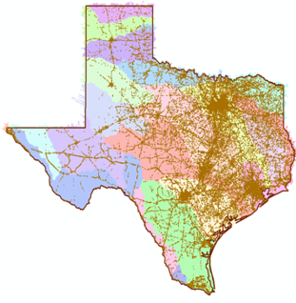




Flood Transportation Geodatabase for Texas Built over last 10 years with support from TxDOT, TDEM, TWDB and TxGIO These data are publicly available
LIDAR in 25 TxDOT Districts
269 Maintenance Sections
Total area: 269,000 Sq. Mi.
Flood Inundation Maps
190,000 stream miles
OpenStreetMap roads
470,000 road miles
in (x,y,z) for first time
Cross-section profiles for 12,000 span bridges over water
3m FATHOM DEM for Texas

Slide 7


What is FAST
What is FAST:
A website and service that gives predicted warnings and real-time updates about flooding on the Texas transportation network.
“An emergency response tool that helps TxDOT proactively plan for and respond to flood threats.”
Adding more gages
Improving flood predictions
Real-time flood mapping
Flooded road limits
Emergency management
Rose Marie Klee

Slide 8
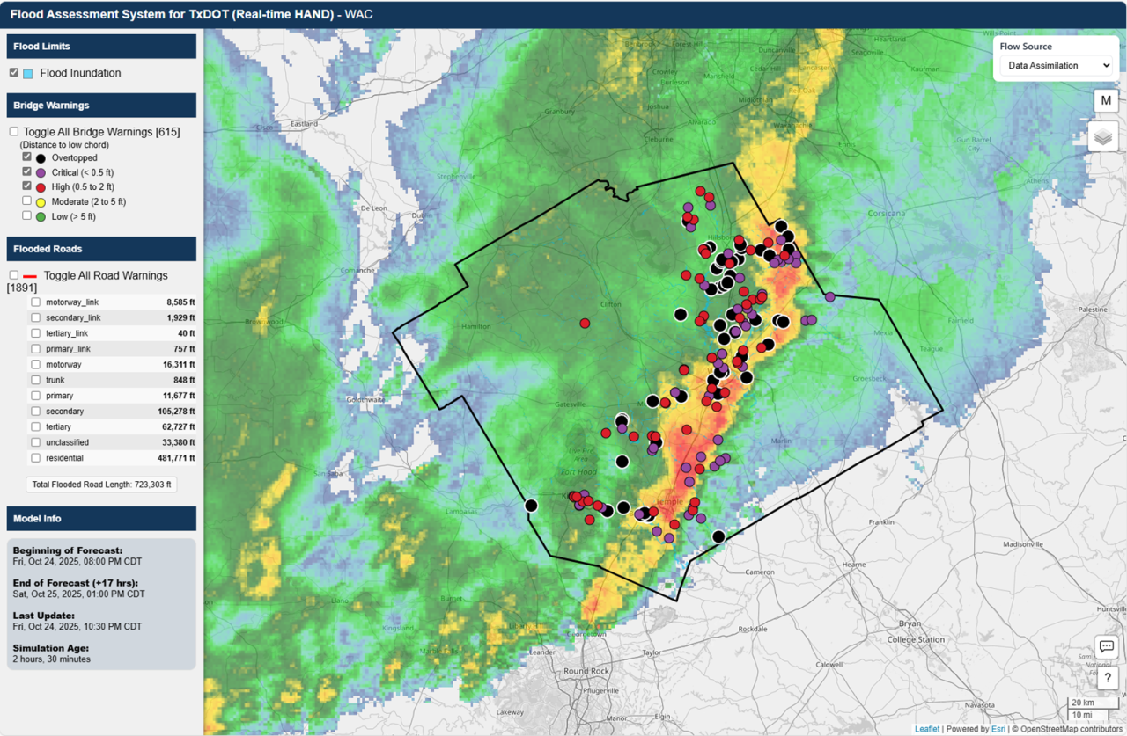
FAST Live Demo
Live Demo: FAST - Dashboard

Slide 9
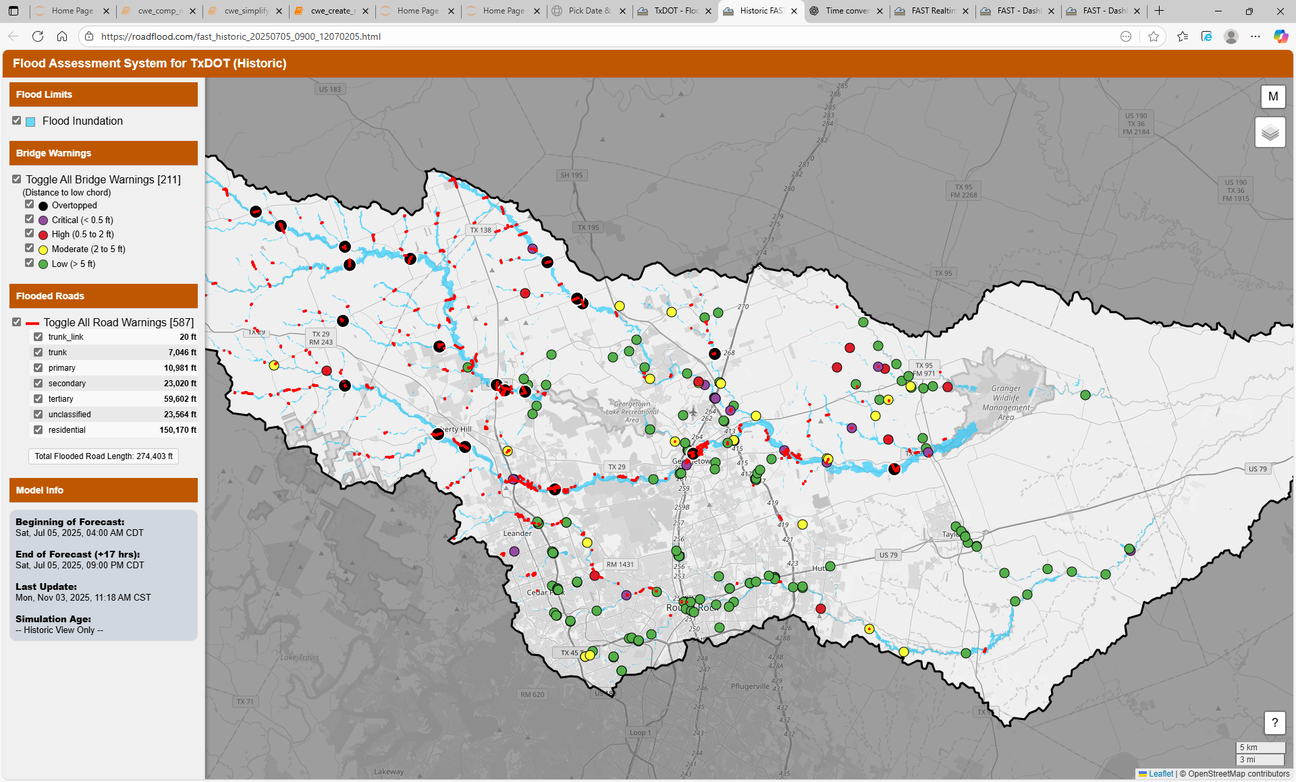
Historic Viewer (Demo)
Historic FAST Map
Historic FAST Map

Slide 10
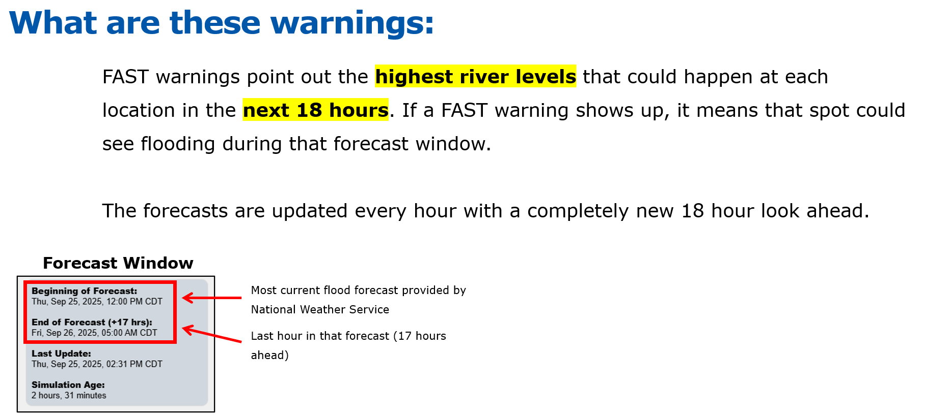
Forecast Window

Slide 11
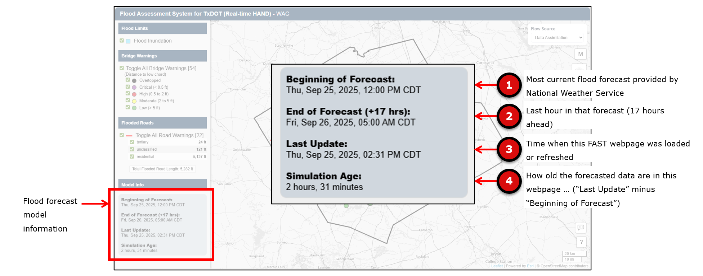
Model Information

Slide 12
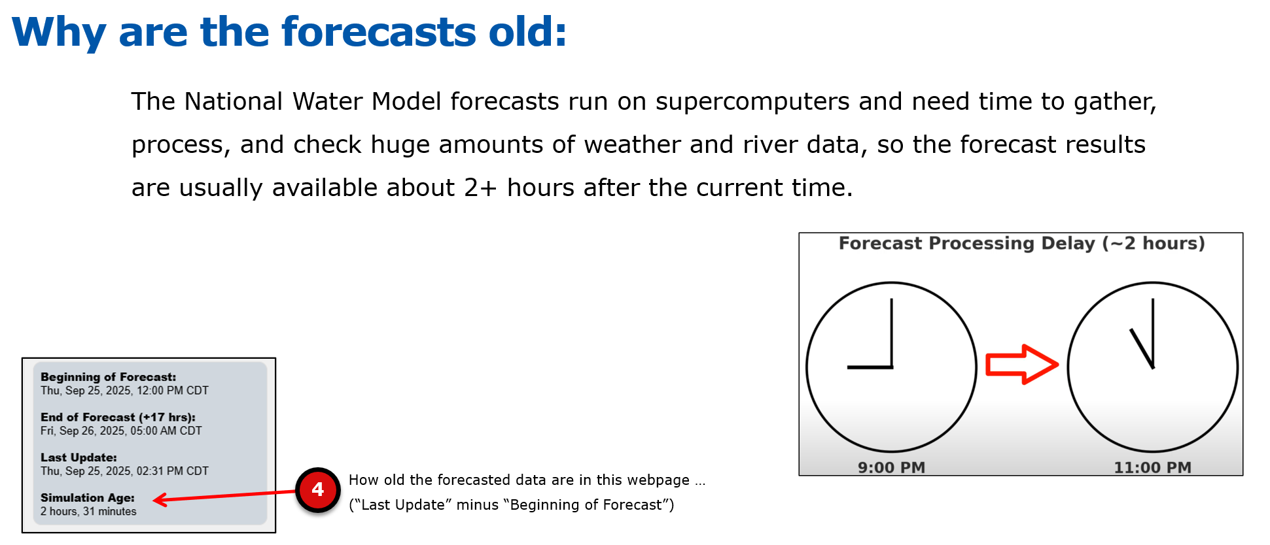
Forecast Age

Slide 13
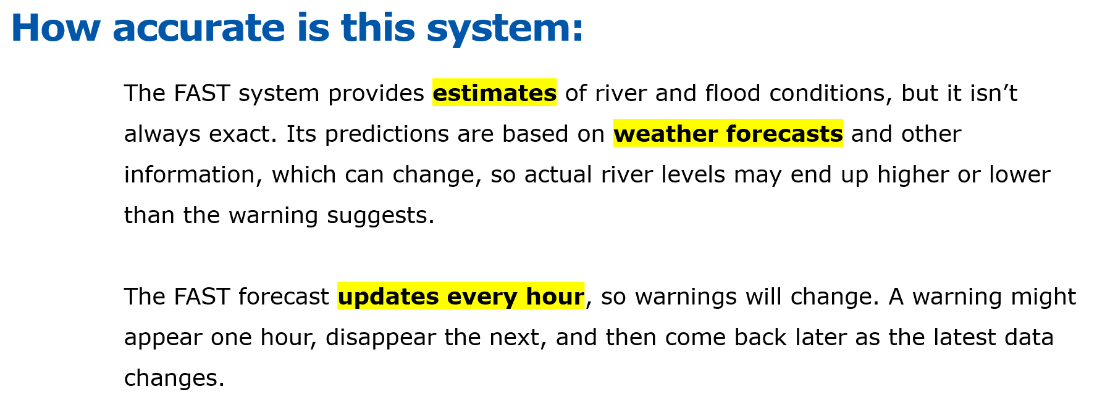
Forecast Accuracy

Slide 14
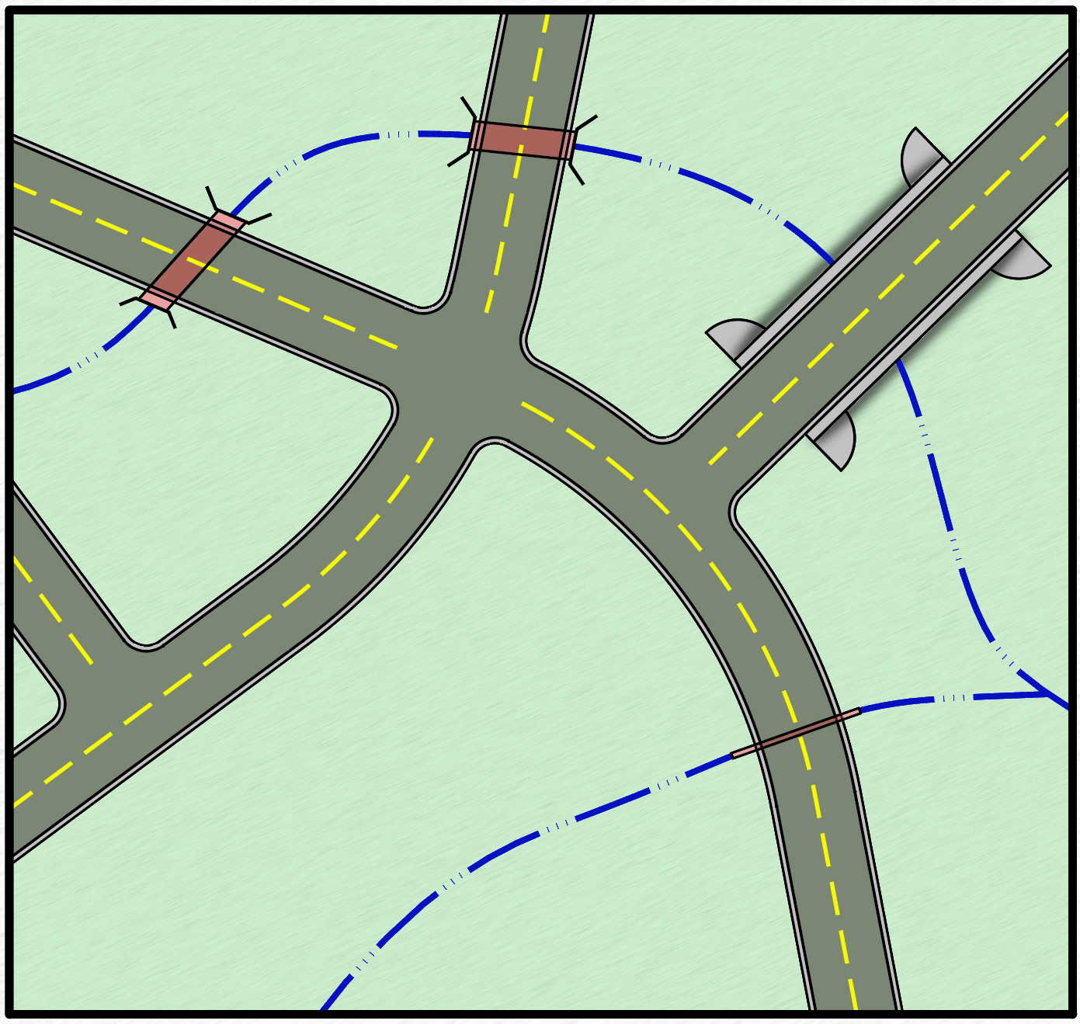
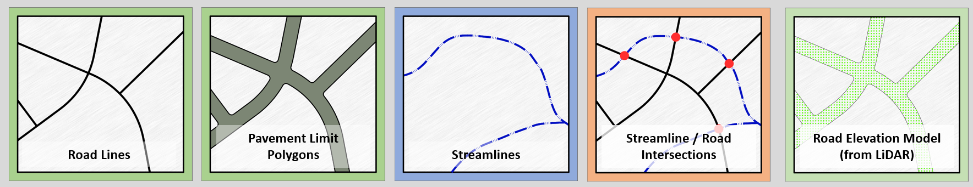

Flood Transportation Database
Preparing FAST for Real-Time Flood Warnings
Relies on pre-processed static geospatial & tabular data
Pre-computation establishes links between forecasted hydrology and geospatial impacts
Key pre-processing steps:
Generate flood inundation maps using terrain, streams, and thresholds
Identify roads and bridges at risk of flooding
Assign thresholds & metadata (road type, class, bridge elevation)
Flood Inundation

Slide 15
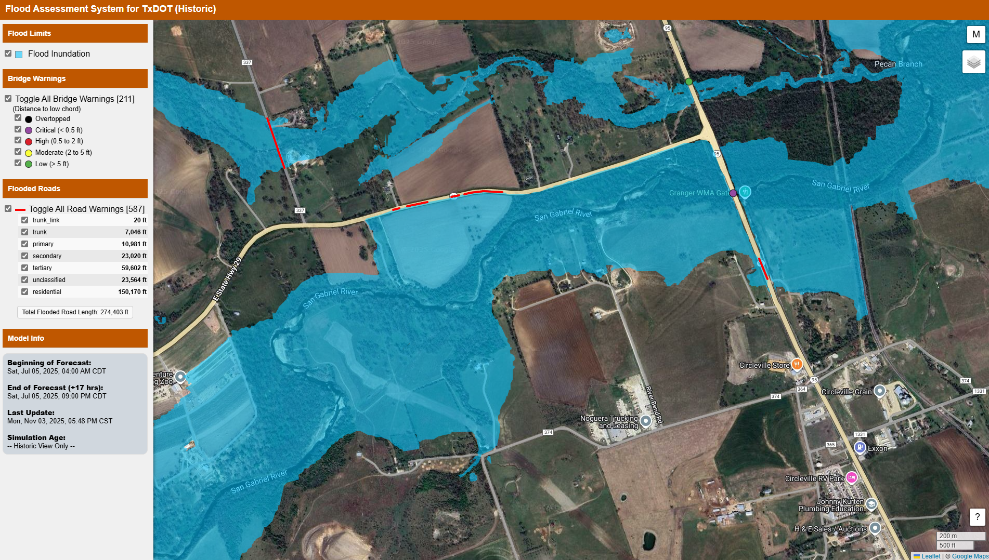
Case Study Area

Slide 16
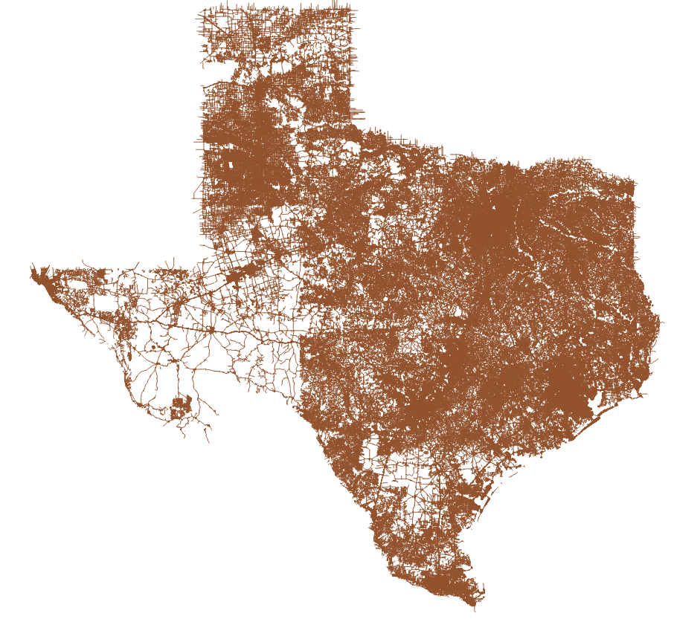
Road Segment Lines
s_road_segment_ln
2.64 Million ‘Public’ Road Segments

Slide 17
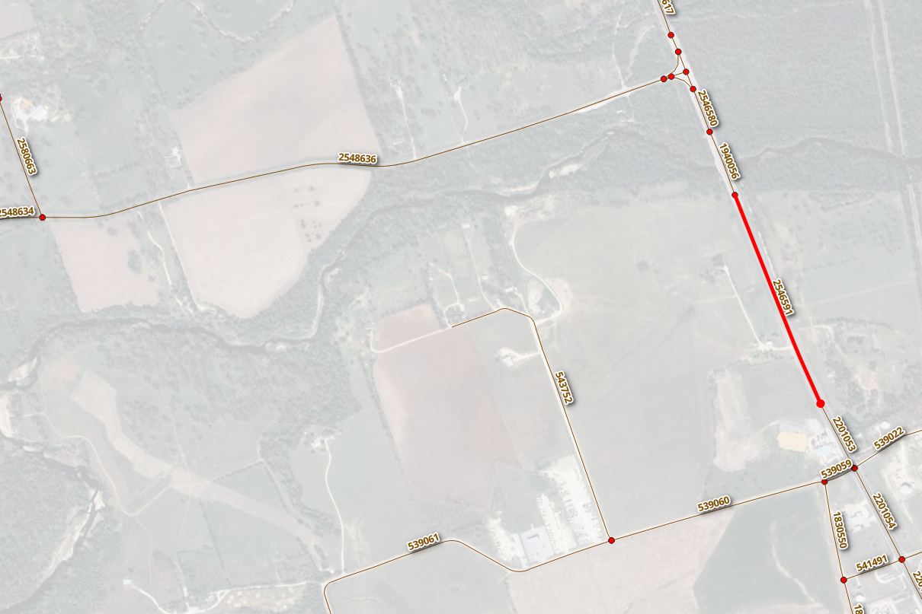

Road Segment Lines
s_road_segment_ln

Slide 18
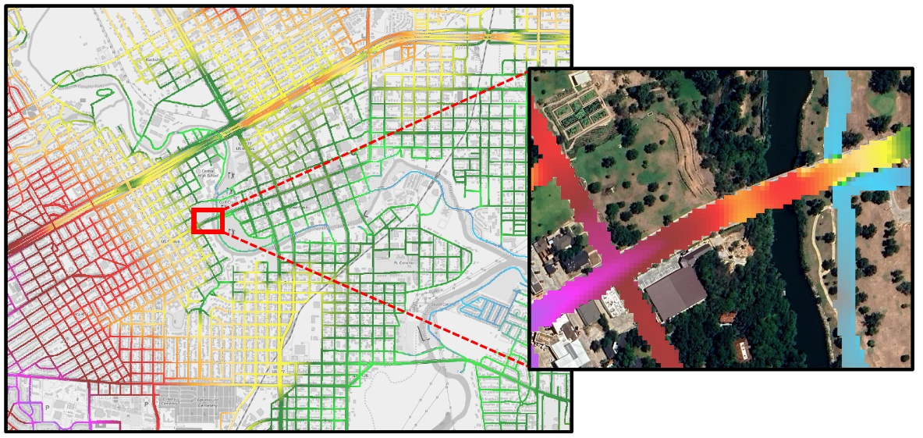
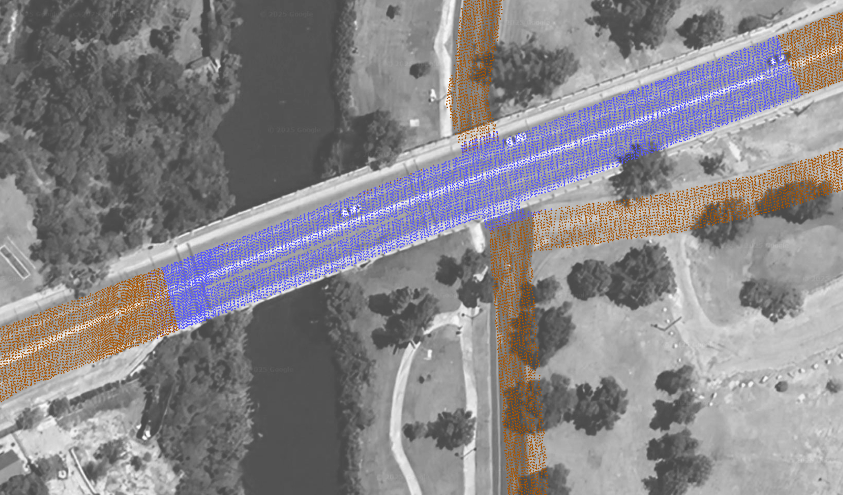
Road Elevation Model (DEM)

Slide 19
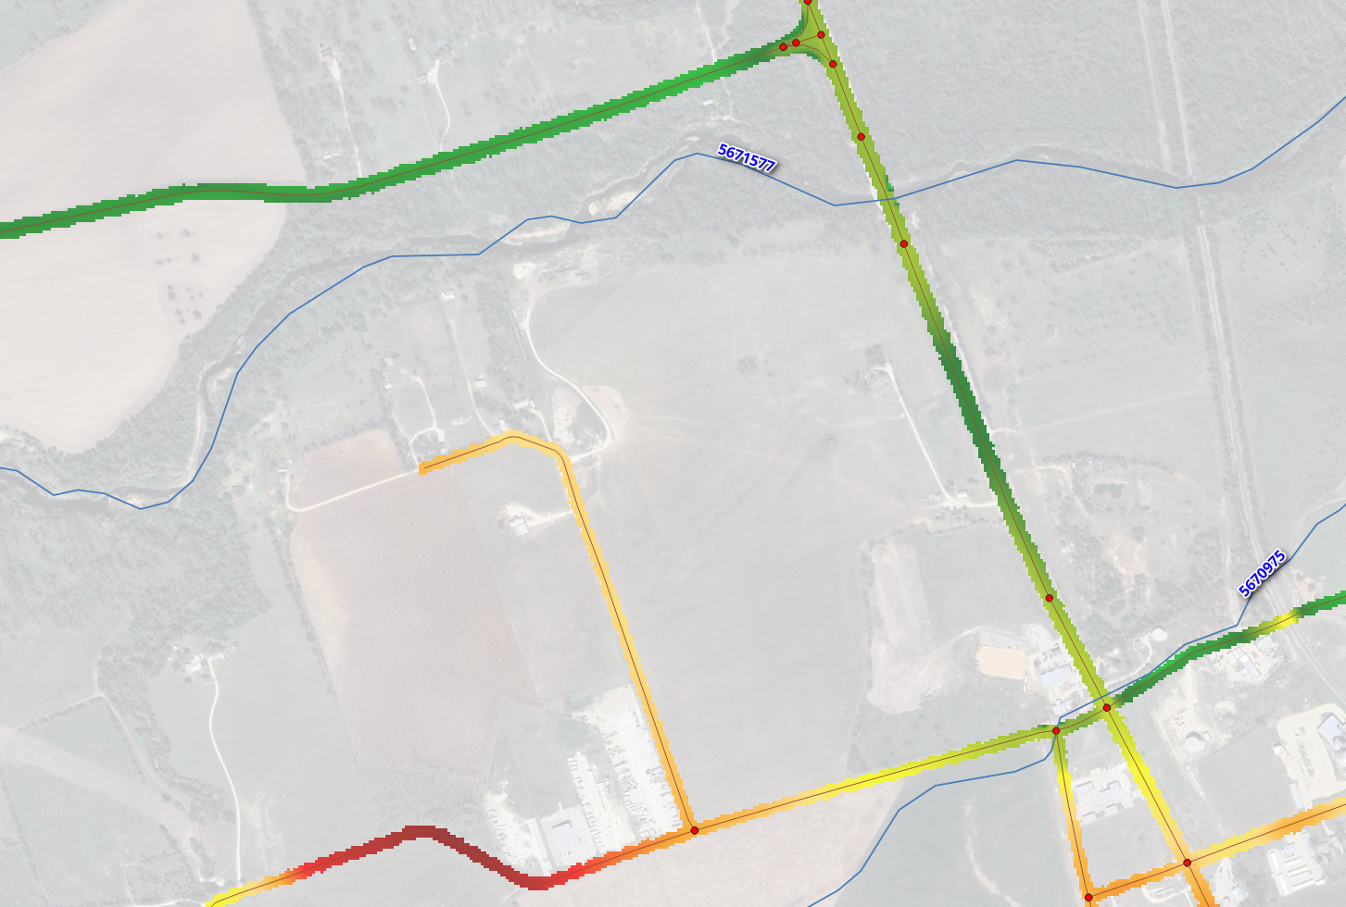
Road Elevation Model (DEM)

Slide 20
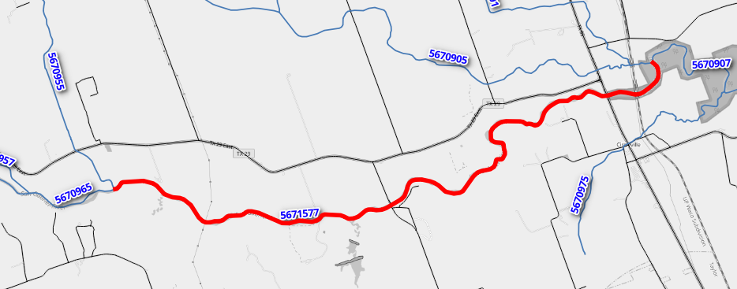
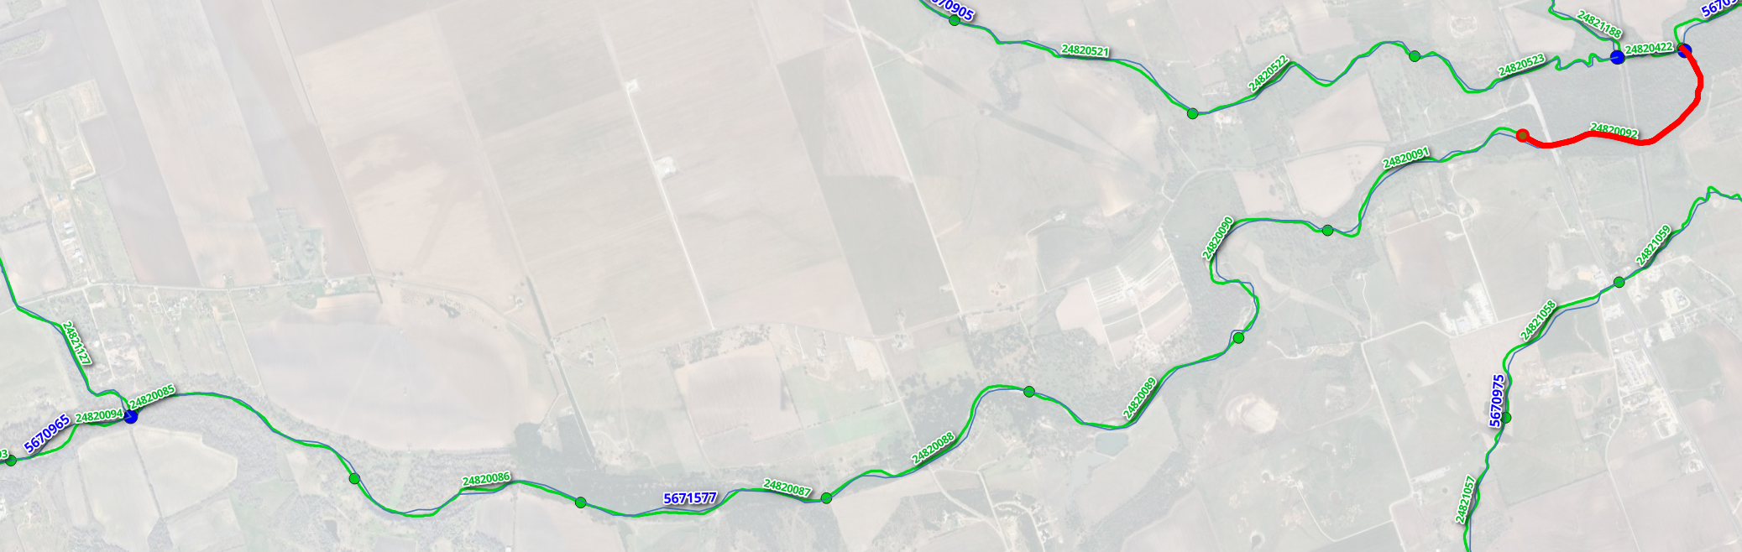
Streamlines
t_nextgen_to_nwm
NWM Reach: 5671577
Eight (8) hydraulic libraries
per this hydrologic reach (NWM: 5671577)
NWM: 5671577 (hydrologic)
FIM reach: 24820092 (hydraulic)

Slide 21
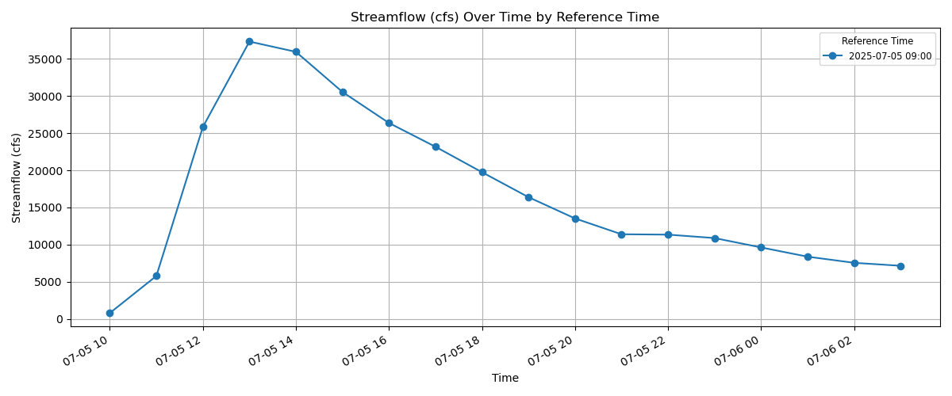
Sample Hydrologic Forecast
Date: 2025-07-05
Time: 09:00 GMT
Time: 04:00 CDT
NWM: 5671577
NWM Reach: 5671577
Short-range forecast (18 hour)
Peak: 35,940 cfs
@ 9:00 AM CDT
= 13:00 UTC
NWM Reach: 5671577

Slide 22
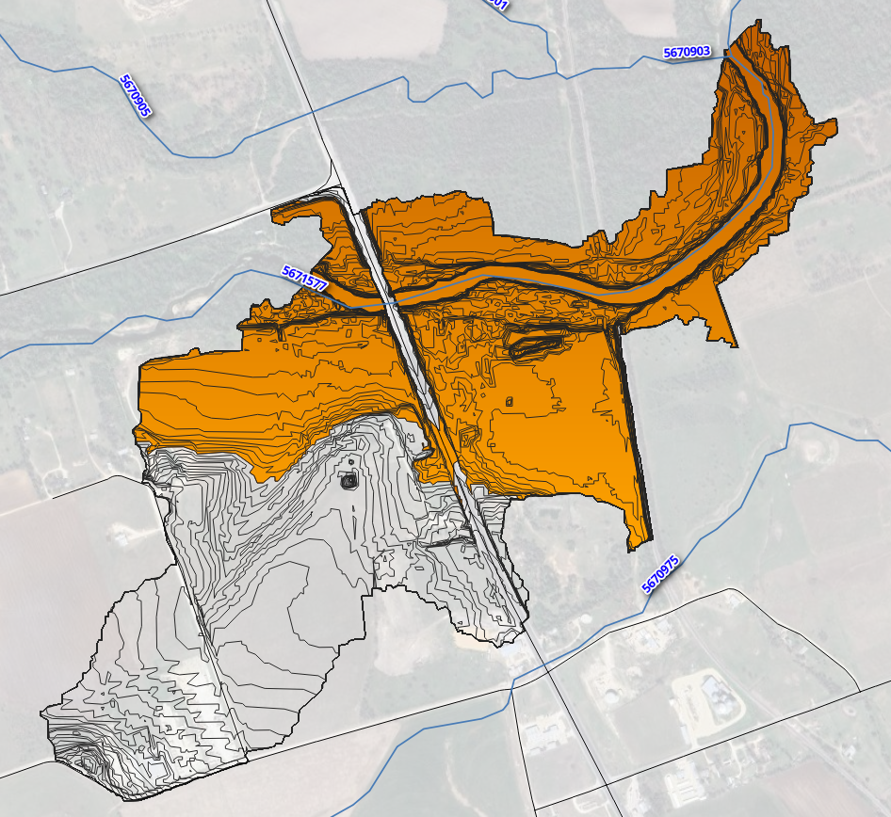
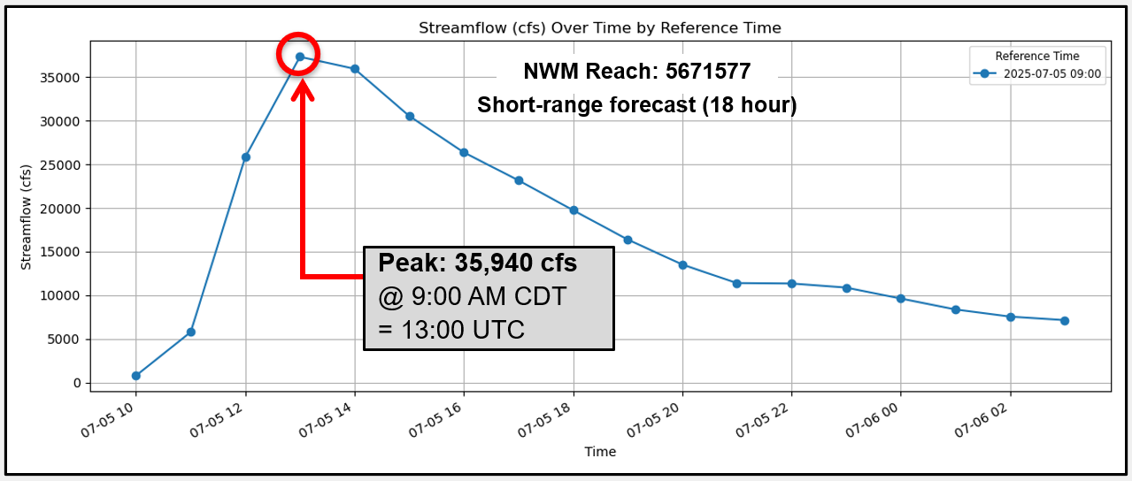
Flood Inundation Polygons
Hydraulic reference: 24820092
Hydrologic Reference: 5671577 (NWM)
Nearest floodplain: Q = 35,062 cfs
s_flood_inundation_ar
With FAST, over 7.1 Million flood inundation polygons
across Texas

Slide 23
Road Segment Lines
Road_id: 2546591
nextgen_id: 24820092
feature_id: 5671577
min_flood_flow: 33648
t_road_flood_trigger

Slide 24
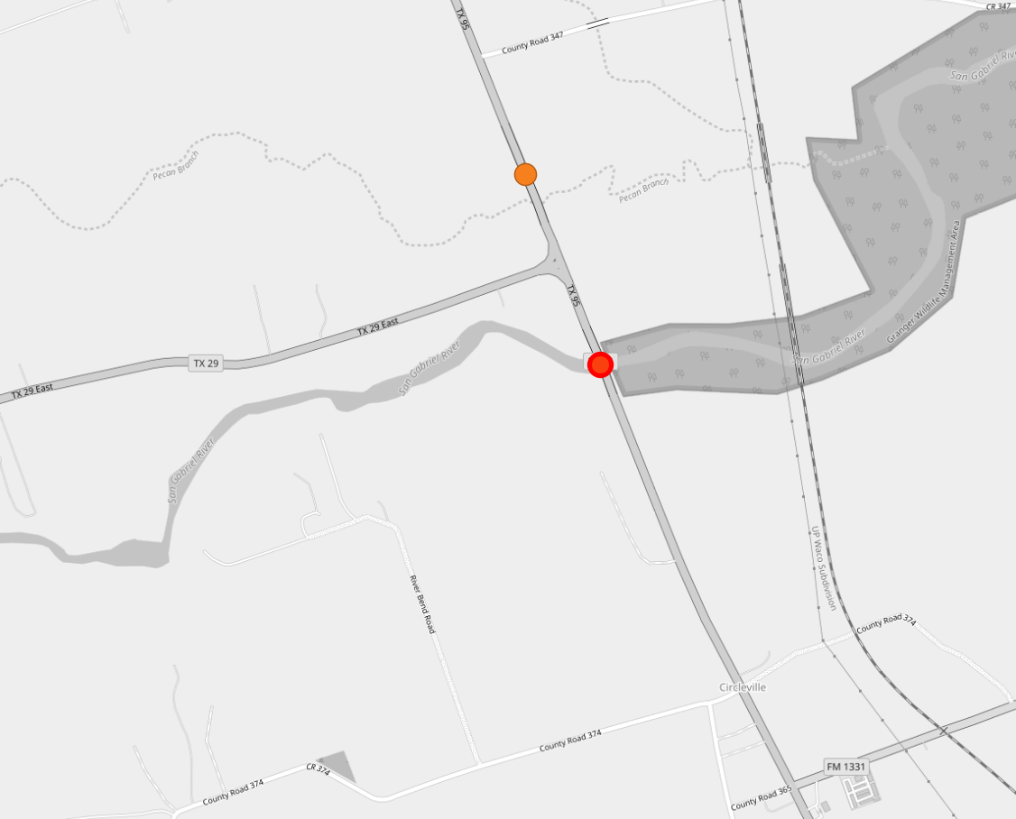
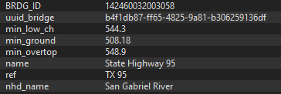
Bridge Points
s_bridge_pnt
FAST is can forecast at ~13k
hydraulic bridge points

Slide 25
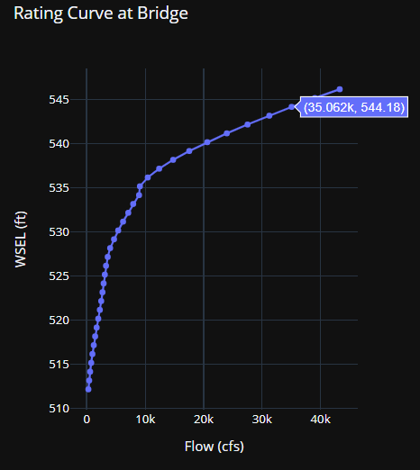
Bridge Points
t_bridge_rating_curve
s_bridge_pnt

Slide 26
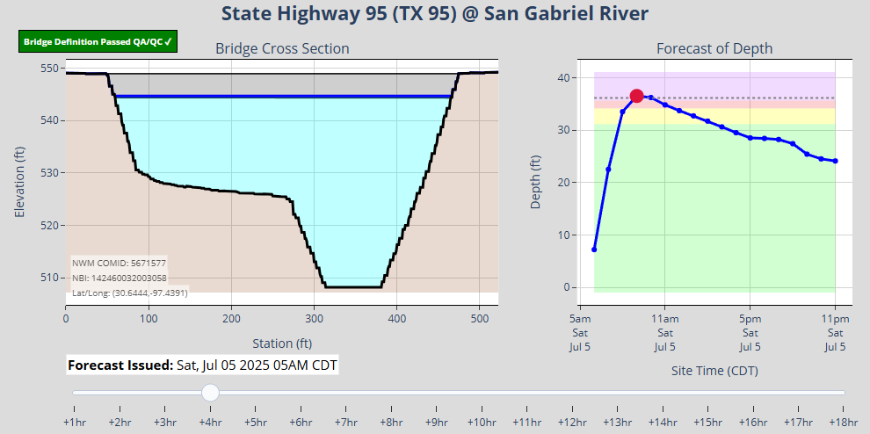
Bridge Forecasts

Slide 27
FAST Automated Workflow
FAST detects new hydrologic forecasts
SQL script executes spatial queries via PostgreSQL/PostGIS
Forecasted streamflows are compared to flood thresholds for each stream segment
Generated Dynamic Layers
- Flooded road lines
- Bridge warning points
- Updated flood inundation polygons

Slide 28
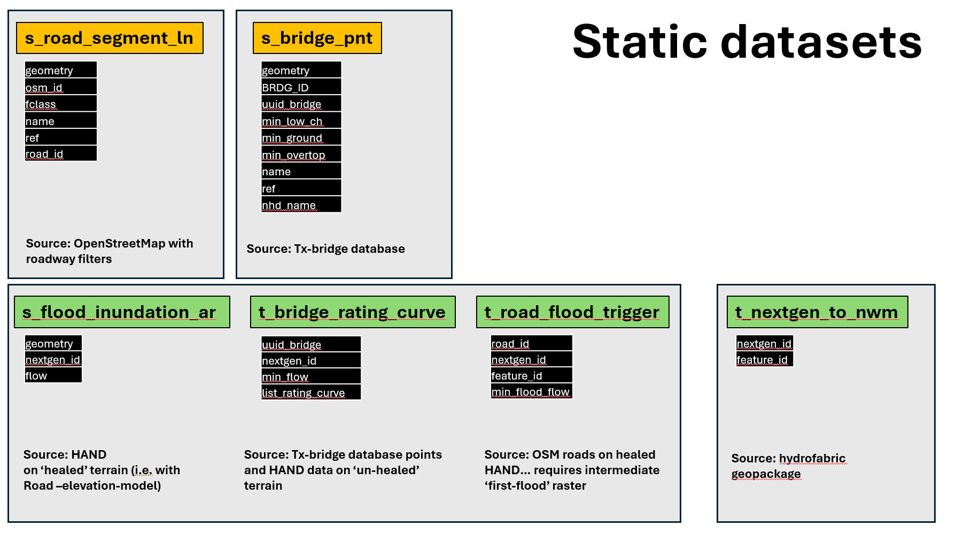

FAST Database (static layers)

Slide 29






FAST Backend Technology Stack
docker pull civileng127/fast-update:20250504
git@github.com:andycarter-pe/fast_realtime.git
Cronjob: */14 * * * * /usr/bin/docker run --rm -e DB_PASSWORD=‘xxxxxxx' -t civileng127/fast-update:20250504

Slide 30
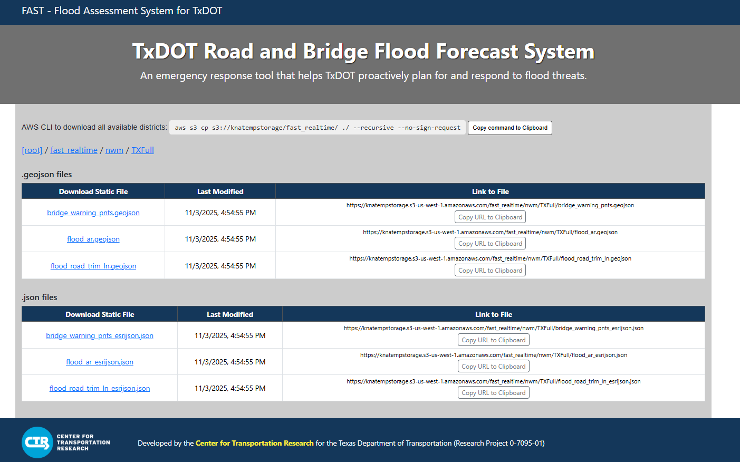




Data Agnostic Layers for Desktop GIS

Slide 31
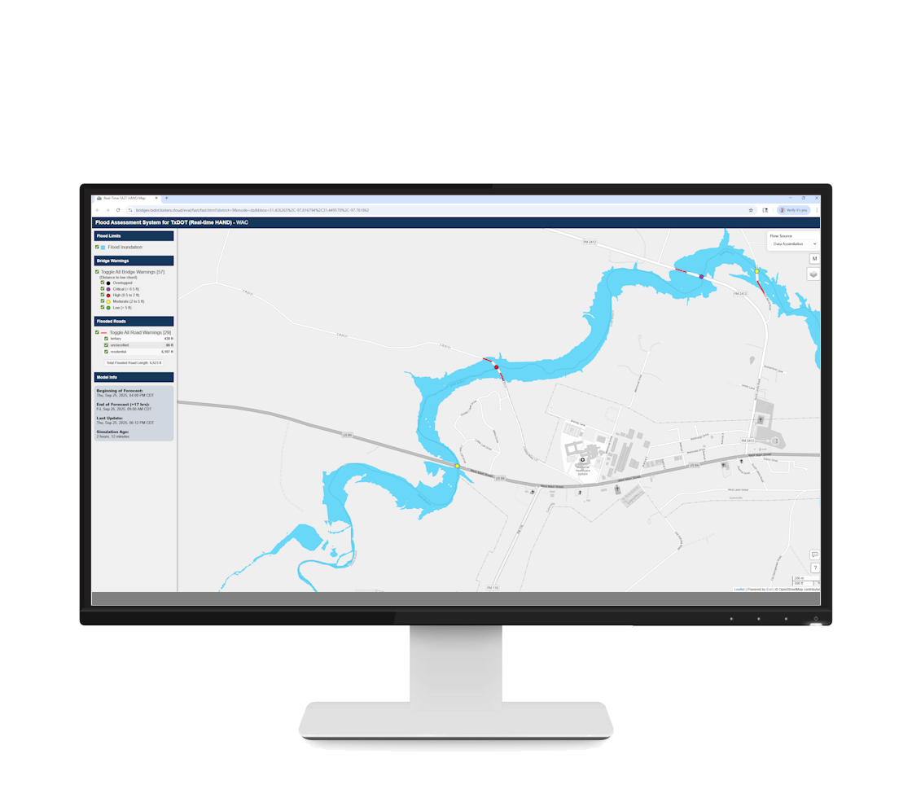
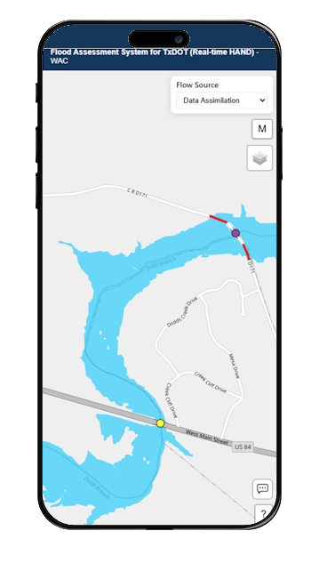
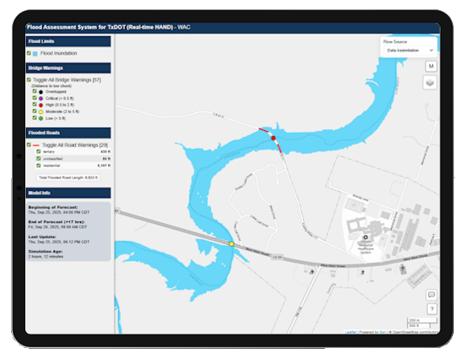
FAST Web Viewer (mobile and desktop)

Slide 32
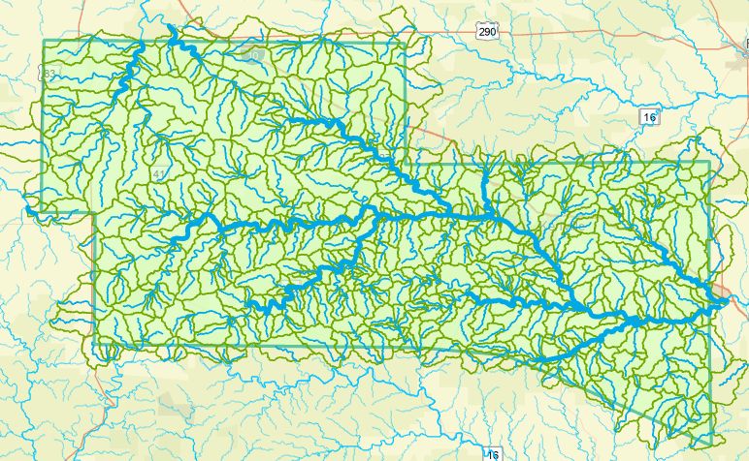
Kerr County has 677 National Water Model flowlines and catchments …
… this is dense enough for a county-wide forecasting system
Limitations of FAST
2 hour delay in getting NWM discharge forecast data
Using Height Above Nearest Drainage (HAND) rather than hydraulic engineering models
Notes:
The river and stream network is broken into reaches, each of which has a unique identifying number, and is surrounded by a local catchment area. NOAA has a Weather and Climate Operational Supercomputer (WCOSS) which is used to forecast the nation’s weather. In one part of the WCOSS resides the National Water Model which calculates flow in all the individual stream reaches of Kerr County, and of the nation as a whole (about 2.7 million stream reaches in all). Several forecast water forecast models are run, one for current conditions, another for short range forecasts out to 18 hours ahead, a third for long-range forecasts 10 days ahead. The current condition and short range forecasts are updated hourly.

Slide 33
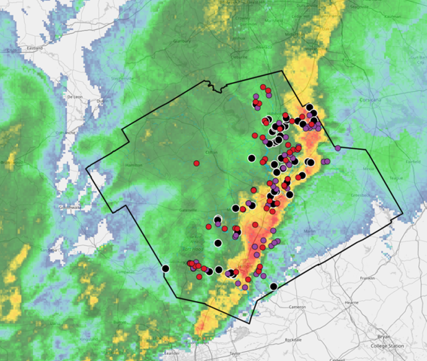
Forecasting for Flash Flooding
Start with Radar Rainfall
Visualization
Roadway flood depth
forecasts
Discharge
Estimates
Inundation Geometries
Data assimilation
with hydrology
Web services
Bridge and roadway geometries
Emergency response
Discharge
Measurements
Stream Gage
Network
Hydrology
Hydraulics and Mapping

Slide 34



TxDOT Research Project: 0-7095-01
Project Duration: February 2024 – January 2027
Sponsor: Research and Technology Implementation Division (RTI)
Created by: Center for Water and the Environment (CWE) & Center for Transportation Research (CTR)
University of Texas at Austin

