Slide 1
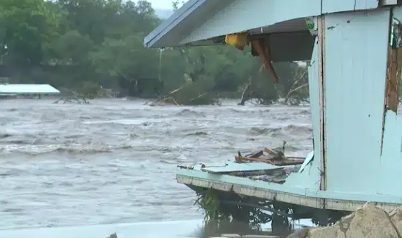
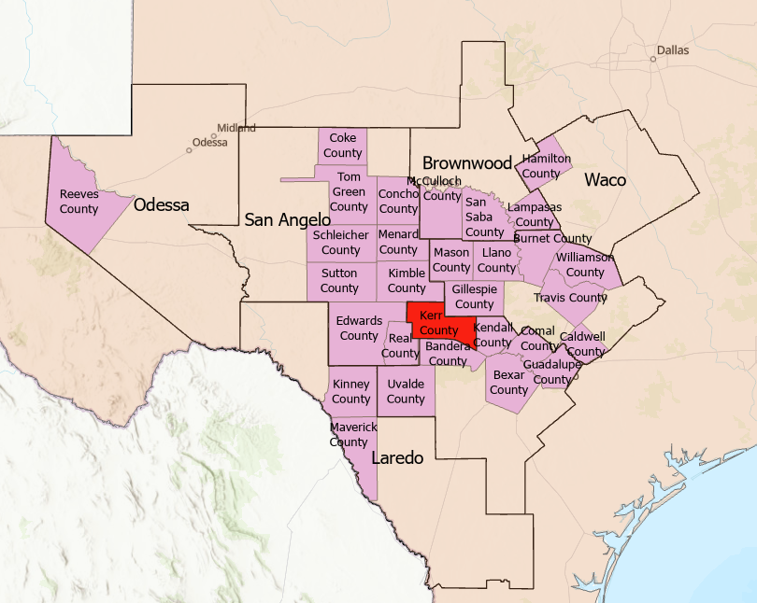
Flood Hazard and Readiness for the Texas Hill Country
Presented by
David R. Maidment
Center for Water and the Environment
University of Texas at Austin
Presented at:
FLOG Workshop Austin, Tx Monday 2 February 2026
Acknowledgments: Colleagues and students at University of Texas at Austin, NOAA National Weather Service, US Geological Survey, Texas Department of Transportation, ESRI, KISTERS, Schreiner University

Slide 2
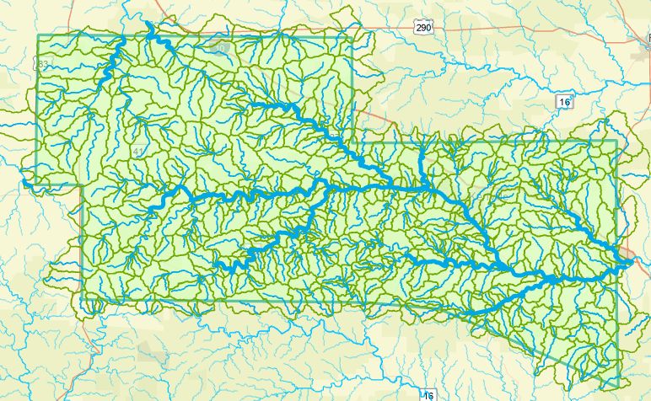


Kerr County has 677 flowlines and catchments …
… flow forecast every hour by the National Weather Service
Mean reach length = 1.6 miles
Notes:
The river and stream network is broken into reaches, each of which has a unique identifying number, and is surrounded by a local catchment area. NOAA has a Weather and Climate Operational Supercomputer (WCOSS) which is used to forecast the nation’s weather. In one part of the WCOSS resides the National Water Model which calculates flow in all the individual stream reaches of Kerr County, and of the nation as a whole (about 2.7 million stream reaches in all). Several forecast water forecast models are run, one for current conditions, another for short range forecasts out to 18 hours ahead, a third for long-range forecasts 10 days ahead. The current condition and short range forecasts are updated hourly.

Slide 3
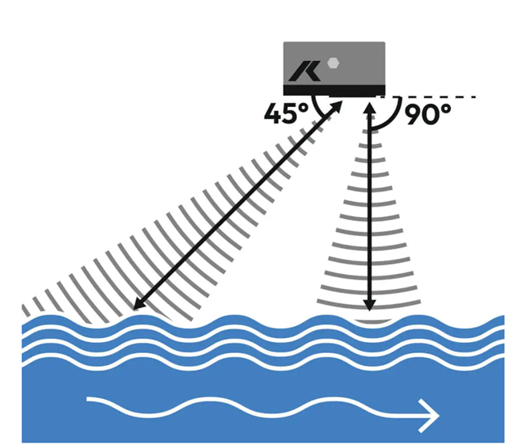
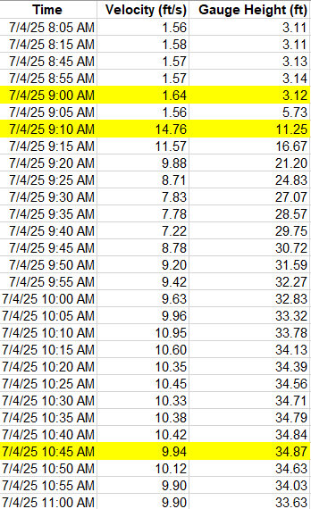

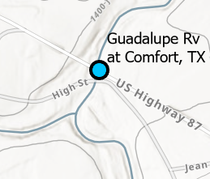
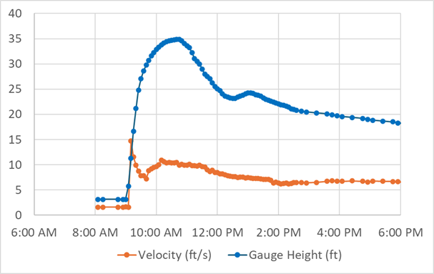

Radar Gauge on Guadalupe River at Comfort, 4 July 2025
The flash flood sent a signal ahead of itself – “I am coming”
Velocity spike
Peak Gauge Height
1 hour and 35 mins
Velocity spike
Peak Gauge Height

Slide 4
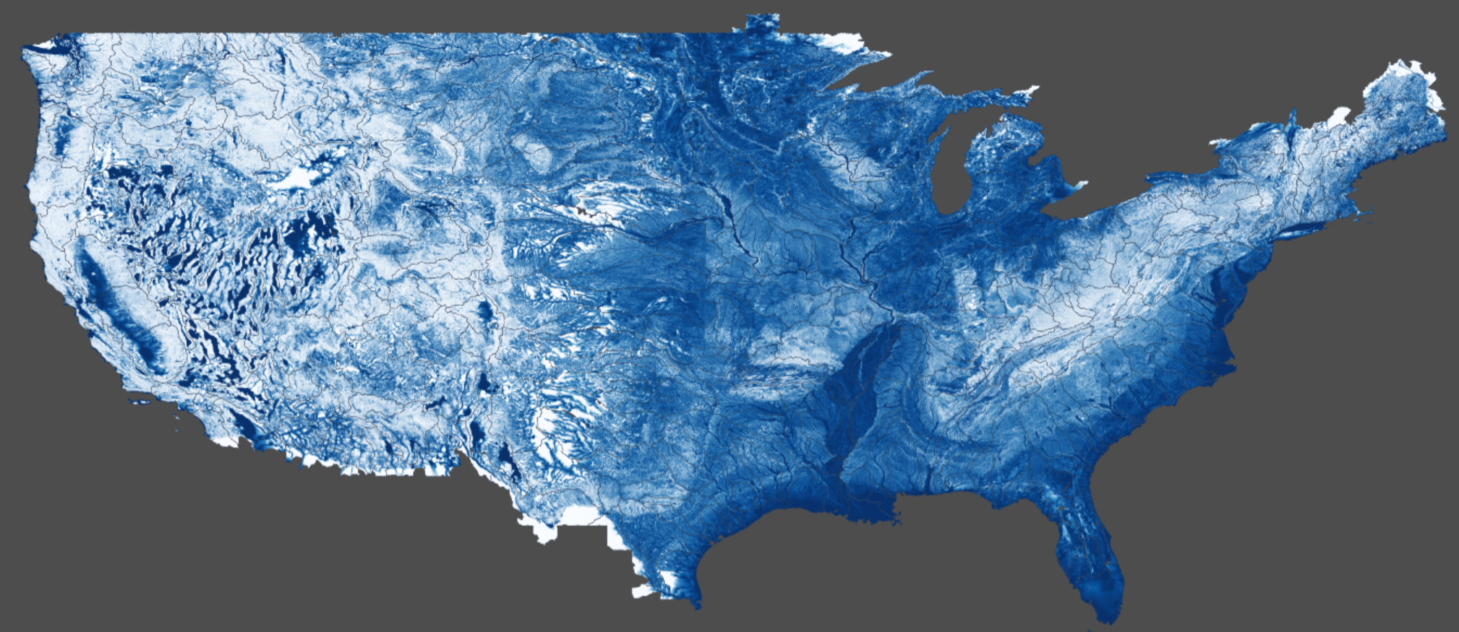
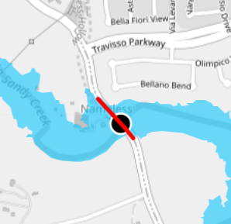
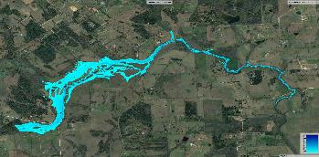
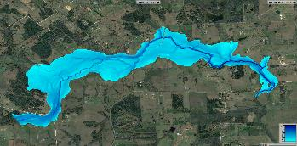
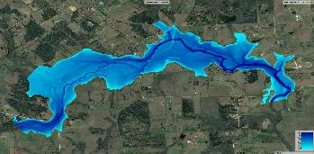
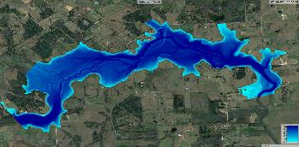

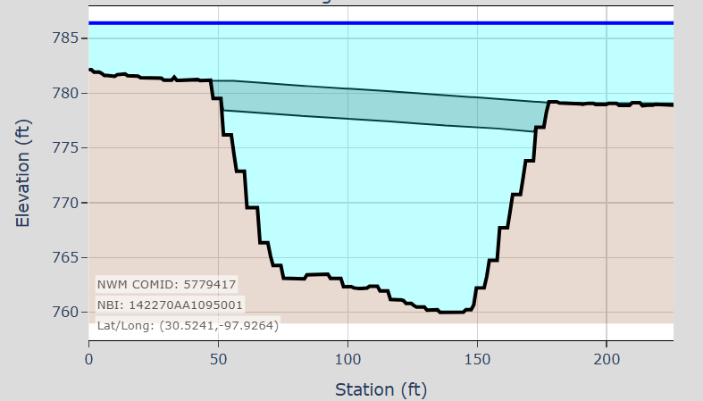
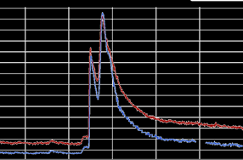
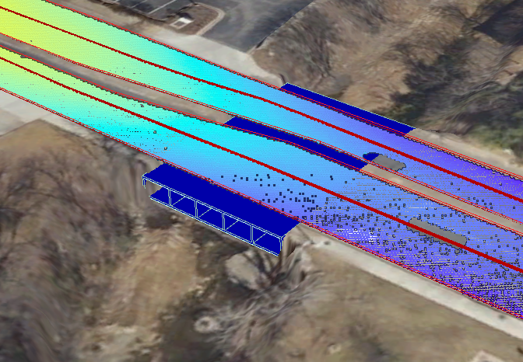

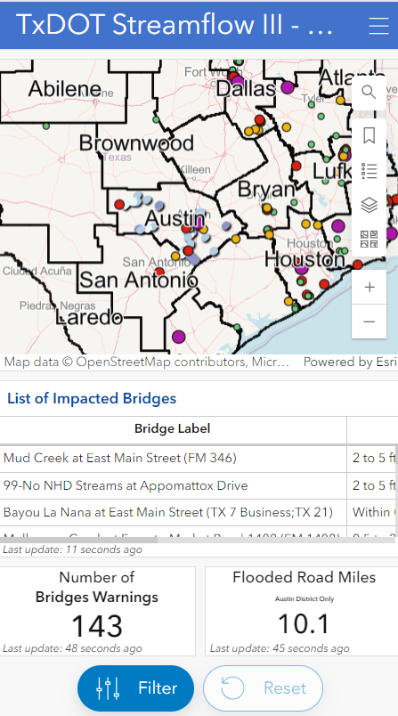
Flood Assessment System for TxDOT (FAST) -- Flood Impact on Roads and Bridges
Forecast
Discharges
Adjusted Forecast Discharge
Roadway flood depth
forecasts
Road Flooding
National Water Model
Inundation Geometries
Data
Assimilation
Bridge Flooding
Web map services
Bridge and roadway geometries
Cell phones and computers
Measured Discharges
Stream Gage
Network
Hydrology
Hydraulics and Mapping

Slide 5



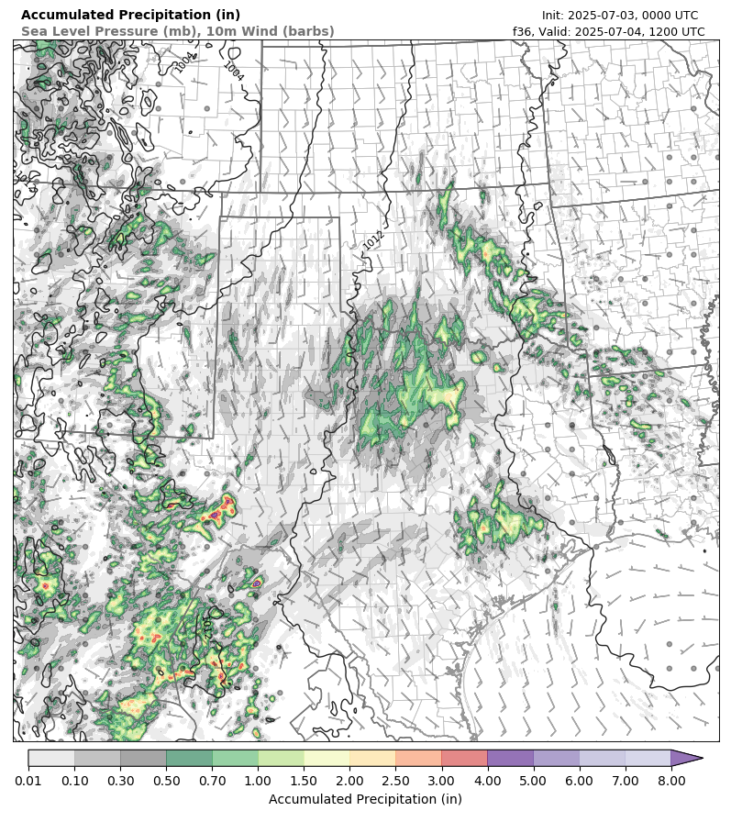


Incorporating Radar Rainfall Forecasting
Water in the Air
Water on the Ground
Hydrology
Hydraulics and Mapping

Slide 6

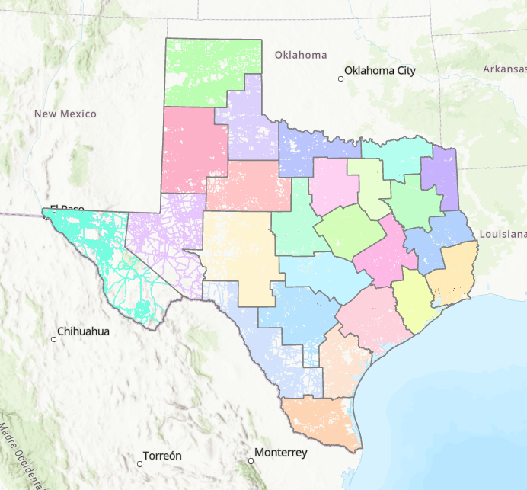
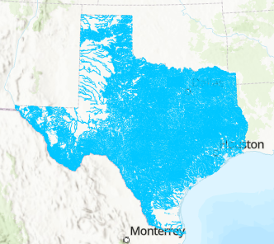
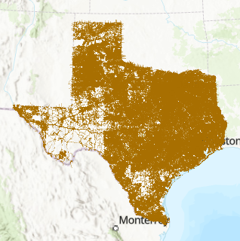
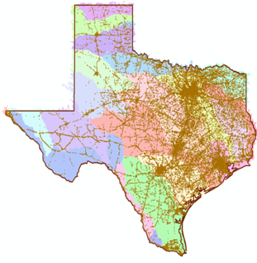




Flood Response Geodatabase for Texas Built over last 10 years with support from TxDOT, TDEM, TWDB and TxGIO These data are publicly available
LIDAR in 25 TxDOT Districts
269 Maintenance Sections
Total area: 269,000 Sq. Mi.
Flood Inundation Maps
190,000 stream miles
OpenStreetMap roads
470,000 road miles
in (x,y,z) for first time
Cross-section profiles for 12,000 span bridges over water
3m FATHOM DEM for Texas

Slide 7

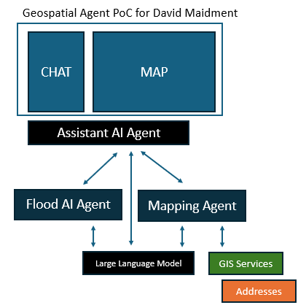


GeoAI for Flooding
Questions:
Will I be flooded?
How much time do I have?
Can I get out?
Jack Dangermond, President

Slide 8
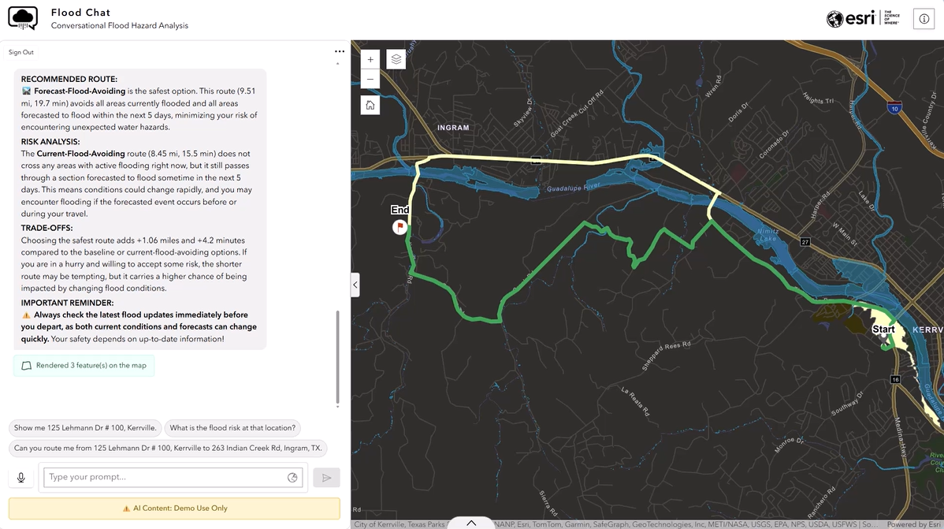
GeoAI-based Vehicle Navigation during Flood Conditions
Ingram
Normal route
Route with flooding
Kerrville
AI Query Box

Slide 9

Lessons Learned
NWS water forecasting on the river and stream network is already sufficiently dense in the Texas Hill Country
Measuring velocity and water level yields more useful intelligence than measuring water level alone, particularly during flash flood conditions
Using data assimilation to adjust NWS forecasts with real-time local measurements works quickly and results in higher forecast accuracy
Flood response geodatabase is already available to support Hill Country counties
Web map services are a valuable way of transmitting water forecast information to computers and cell phones
Multiple flood web map services can be combined and interpreted using GeoAI for Flooding
Technology alone is not enough. Education and training are also needed
TxDOT Districts

