Slide 1


Finding Water Data with CUAHSI-HIS
Tim Whiteaker, Ph.D.
Research Associate
The University of Texas at Austin

Slide 2
What Is CUAHSI-HIS
WaterML language for describing water data
National catalog of water data sources
Free software for data access
WaterML
Standards
Metadata Catalog
Services
Software

Slide 3
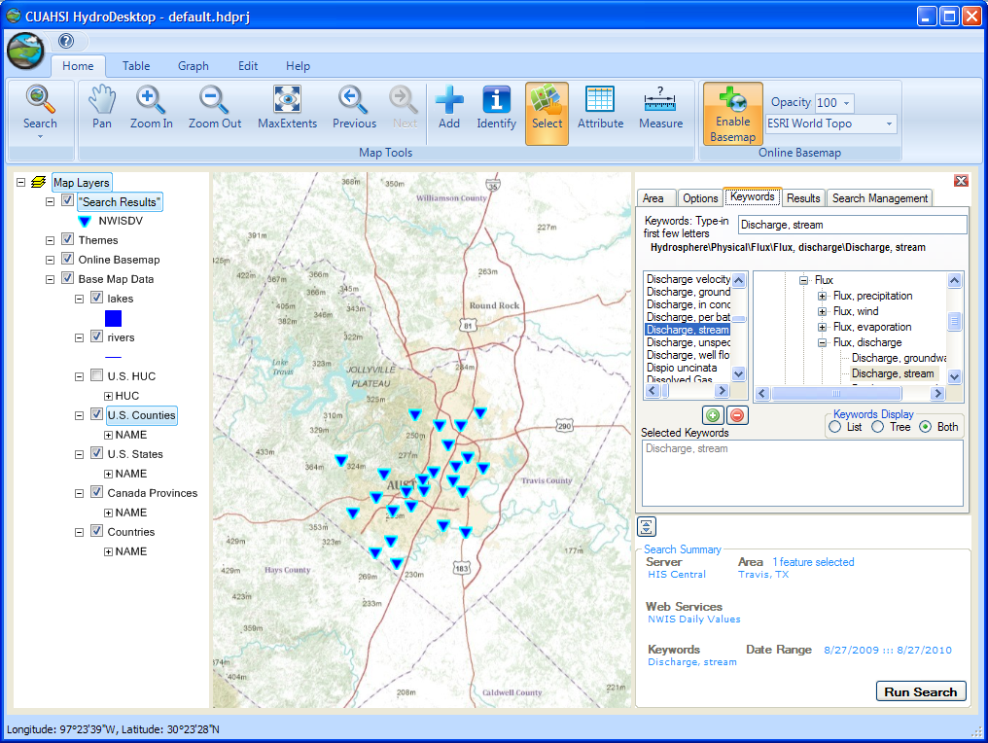
What Is HydroDesktop
Free, open source solution for HIS data access
his.cuahsi.org

Slide 4
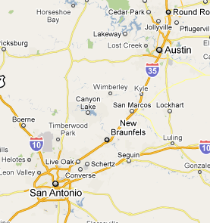
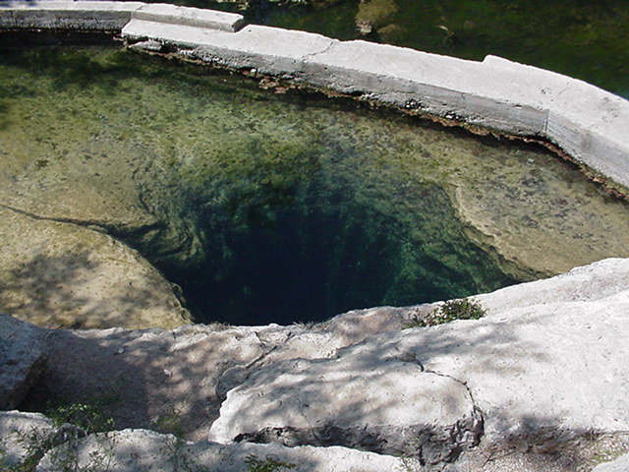
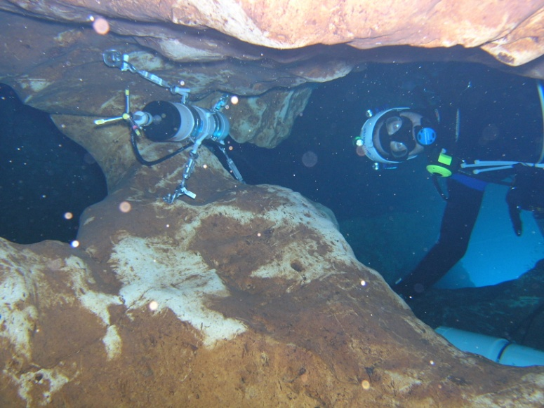
Jacob’s Well Spring
(San Marcos Local News, 2009)
(USGS, 2007)

Slide 5
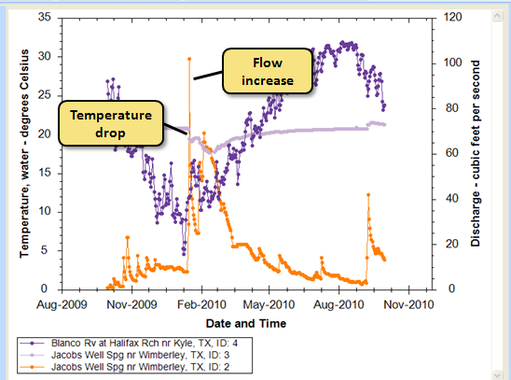
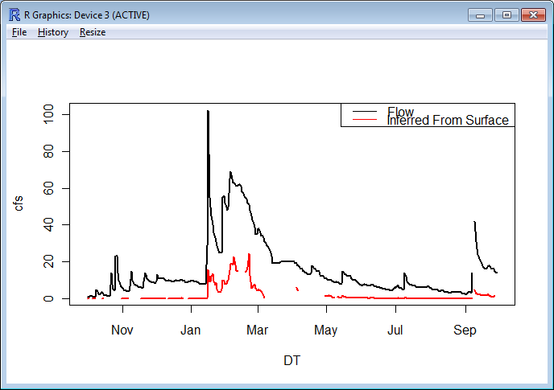
Start Using HIS
HIS Website
  his.cuahsi.org
User Support Specialist
  Yoori Choi
  ychoi@cuahsi.org

