Slide 1
Groundwater Resources in the Llano Uplift Crystalline Massif
Llano and Mason Counties, Texas
Mishal Al-Johar November 24, 2009
CE 394K GIS in Water Resources

Slide 2
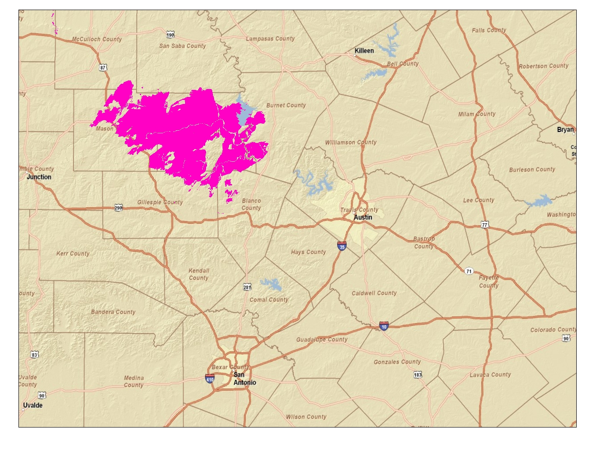

Slide 3
The Llano Uplift is characterized by
GEOLOGY: Igneous and metamorphic crystalline granite, gneiss, and schist
CLIMATE: Semi-arid
LANDUSE: Rural ranch land
SURFACE WATER: Several large, man-made reservoirs
Smaller streams
GROUNDWATER: Low porosity crystalline rocks
Permeable zones occur in fractures
Relatively low groundwater storage
THE CRYSTALLINE MASSIFF IN THE LLANO UPLIFT
IS NOT “OFFICIALLY” A MINOR AQUIFER
DOES IT DESERVE TO BE?

Slide 4
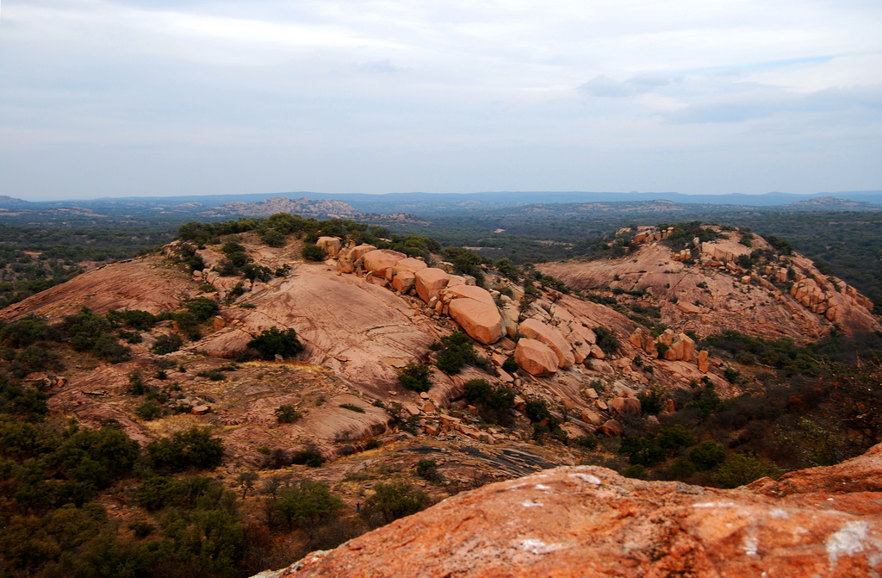

Slide 5
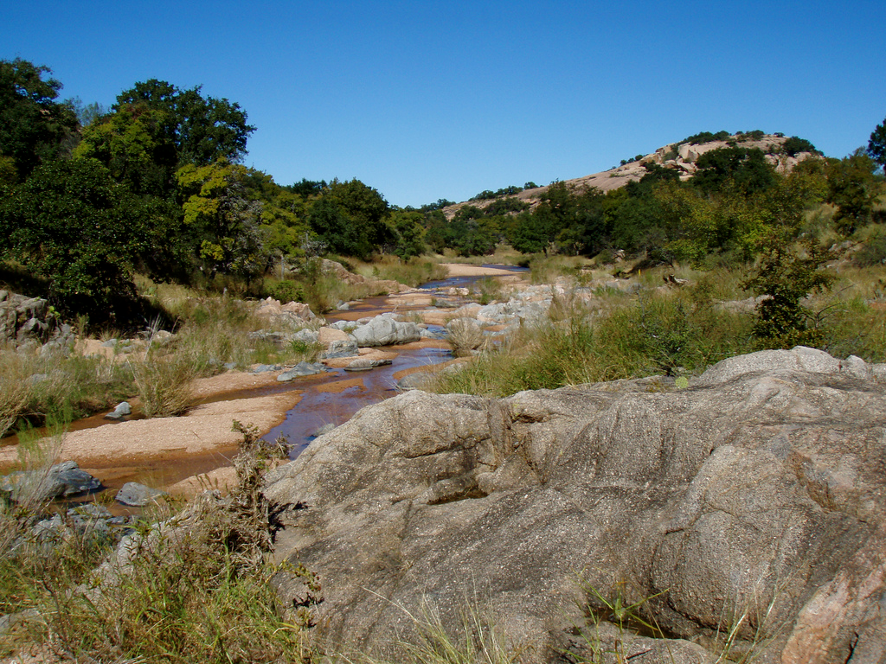

Slide 6
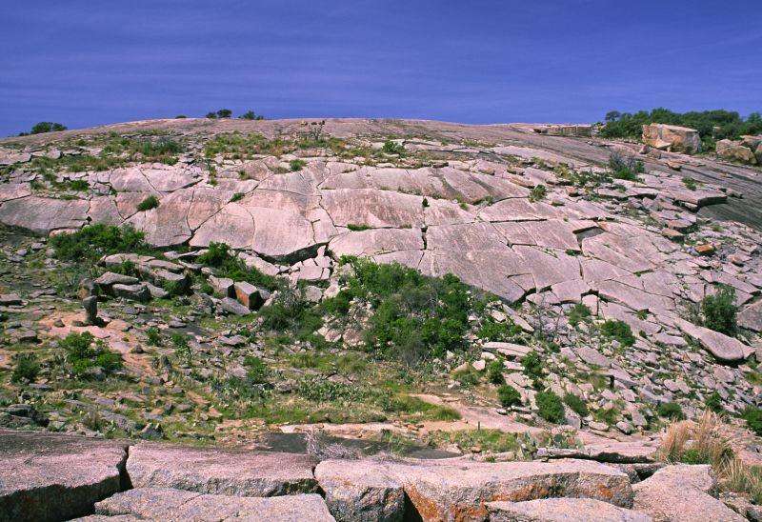

Slide 7
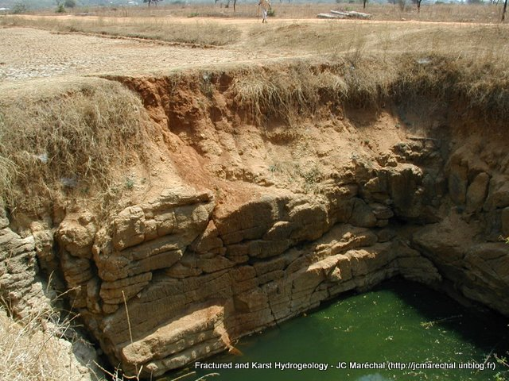
Maréchal, J. C., B. Dewandel, and K. Subrahmanyam (2004)

Slide 8
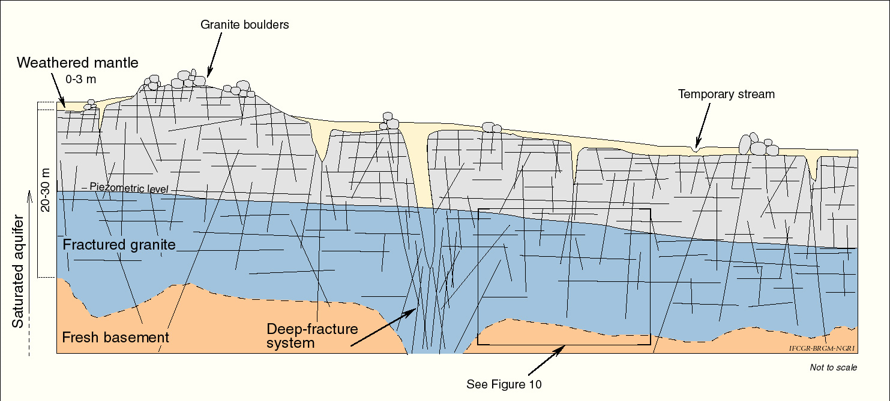
Maréchal, J. C., B. Dewandel, and K. Subrahmanyam (2004)

Slide 9
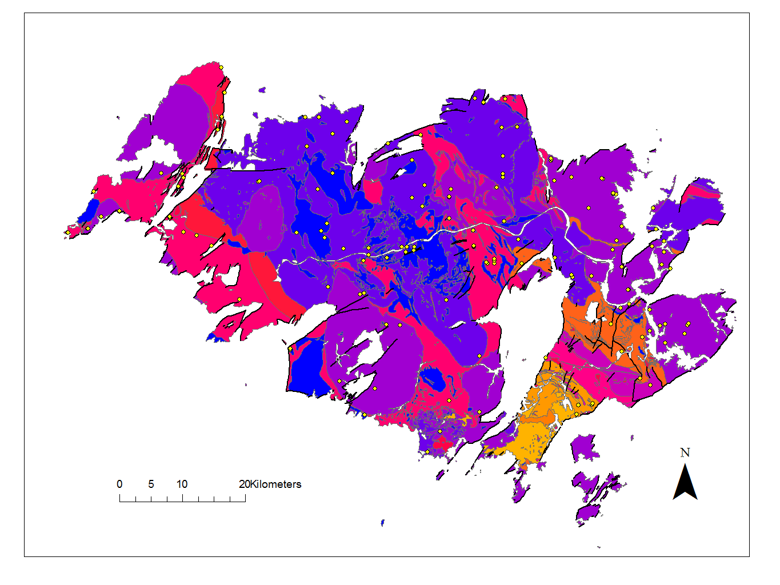

Slide 10
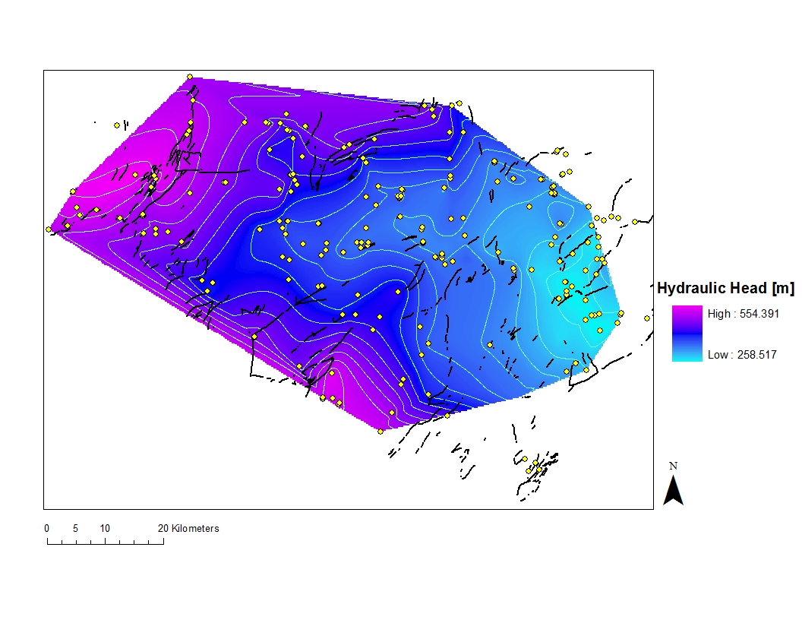

Slide 11
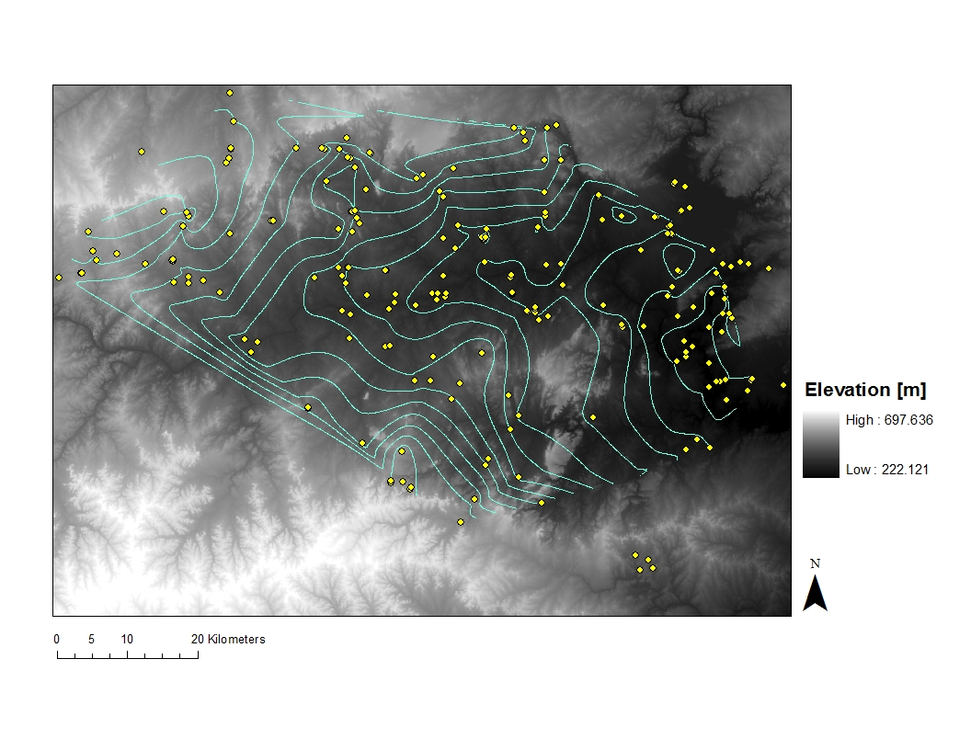

Slide 12
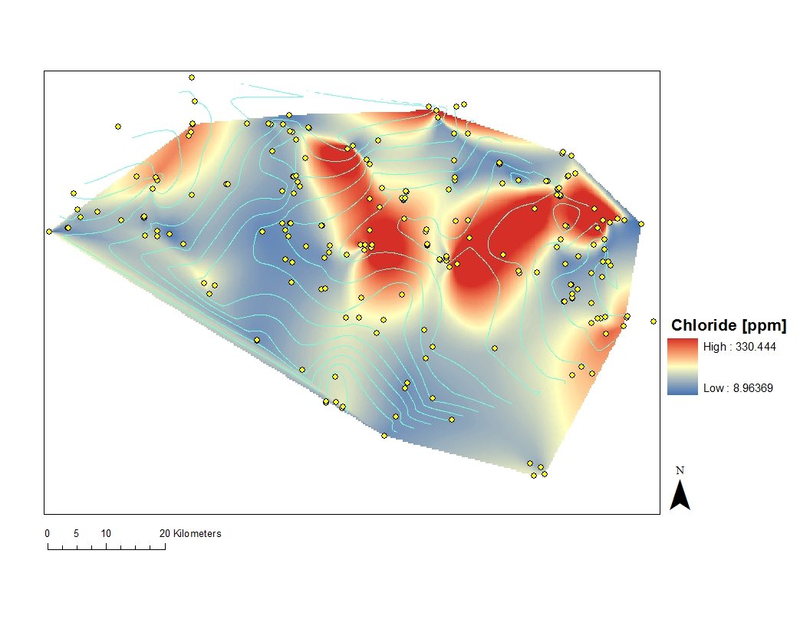

Slide 13
Work completed so far:
Geology (outcrops and faults)
Potentiometric surface
Some water quality
Work to be done:
Fracture trends from aerial photos
More water quality
Better water table map
Surface water and precipitation

