Slide 1
Landsat Downloads & MODIS Downloads
Data Sources for GIS in Water Resources by Ayse Kilic, David R. Maidment, and David G. Tarboton GIS in Water Resources Fall 2012

Slide 2
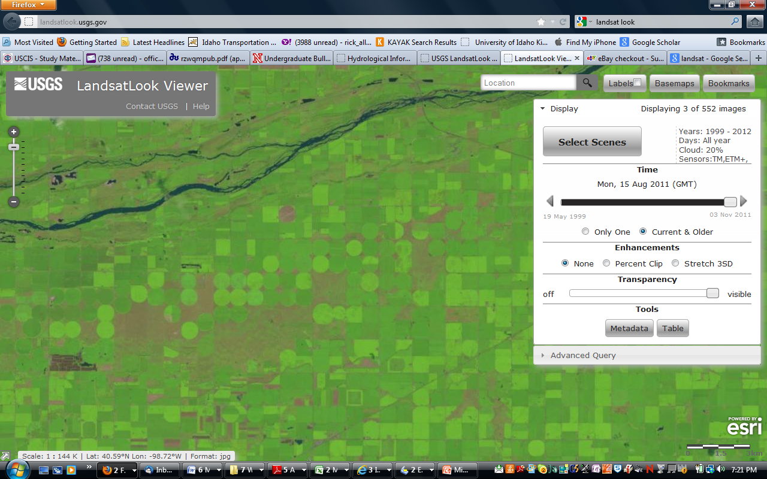
Landsat – 30 m x 30 m pixels
1972 – present
Thermal imager since 1984
Center Pivot irrigated fields
near Kearney, Nebraska, 2011

Slide 3
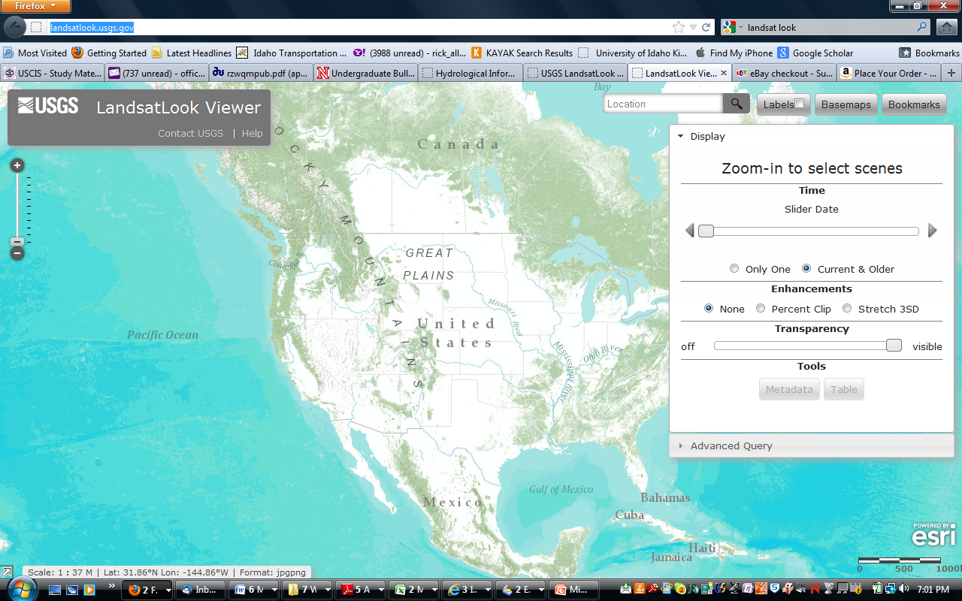
http://landsatlook.usgs.gov/

Slide 4
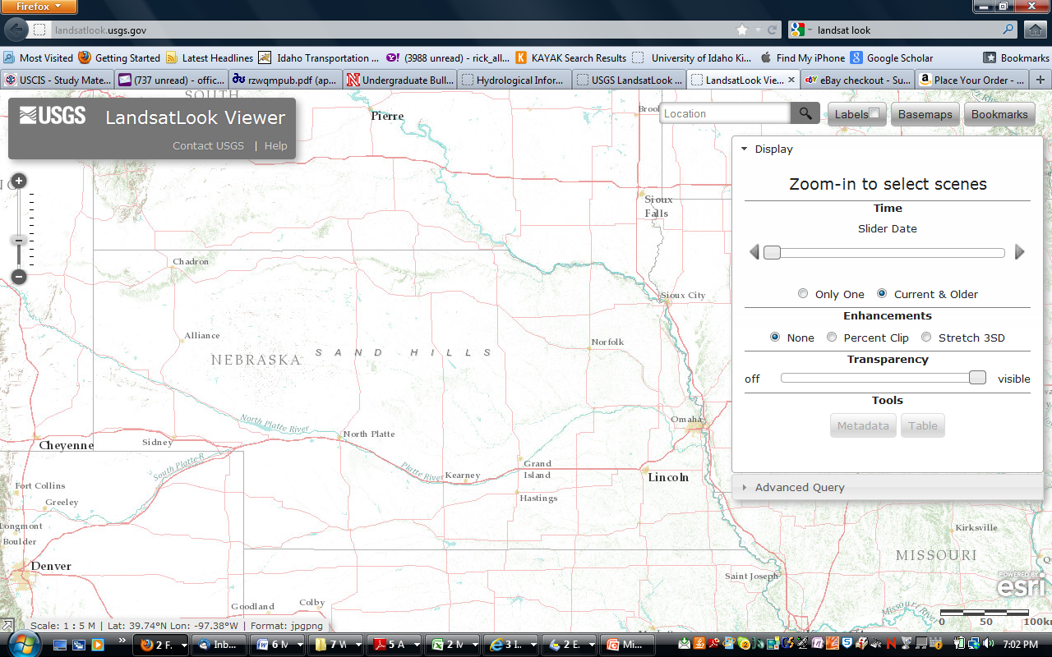
Zoom In – Here is Nebraska

Slide 5
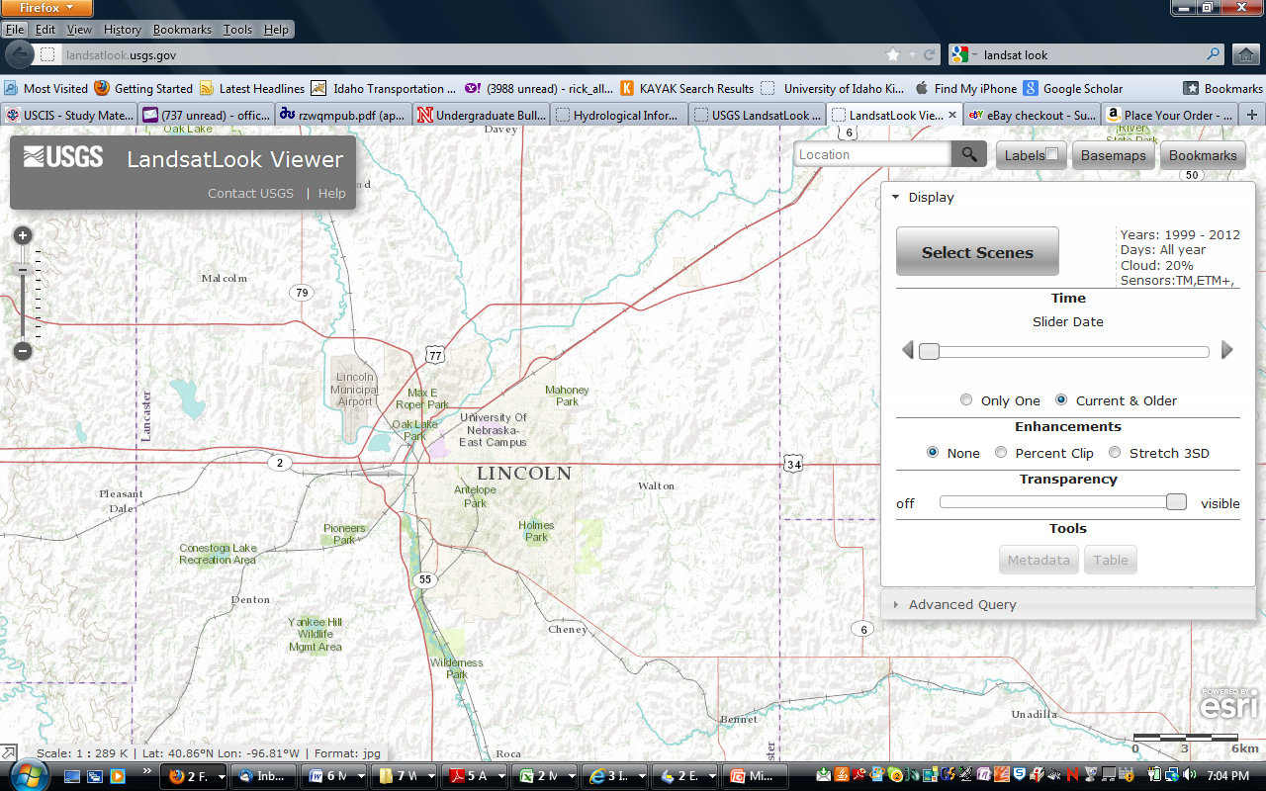
Zoom In More– Here is Lincoln, Nebraska

Slide 6
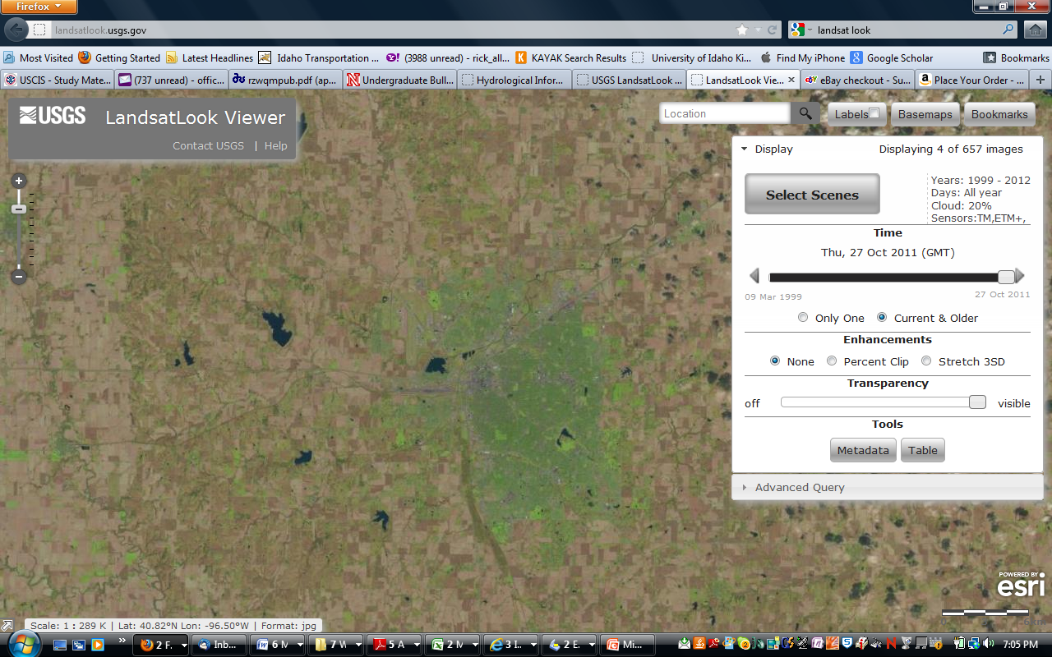
Press “Select Scenes” to: a) get Landsat image background
b) “Find” 657 !!! Landsat scenes for Lincoln, Nebraska from 1999-2012
c) Move the “Slide bar” to progress through the scenes in viewer

Slide 7
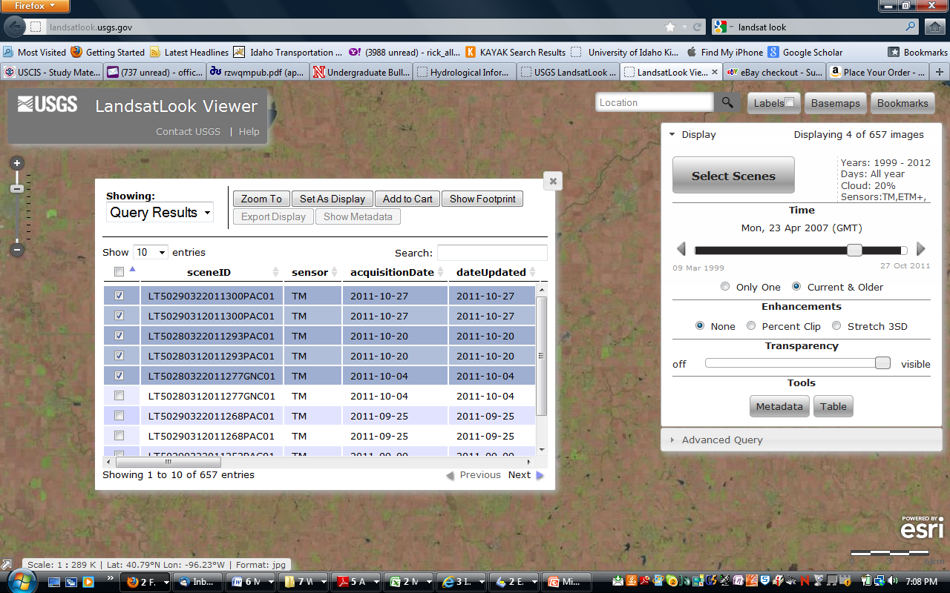
d) Press “Table” to get list of all images (657) available for the Path/Row
covering Lincoln, NE. e) Check the images you want, f) “Add to Cart”
g) Select “Showing” and select “cart” in dropdown to add to cart

Slide 8
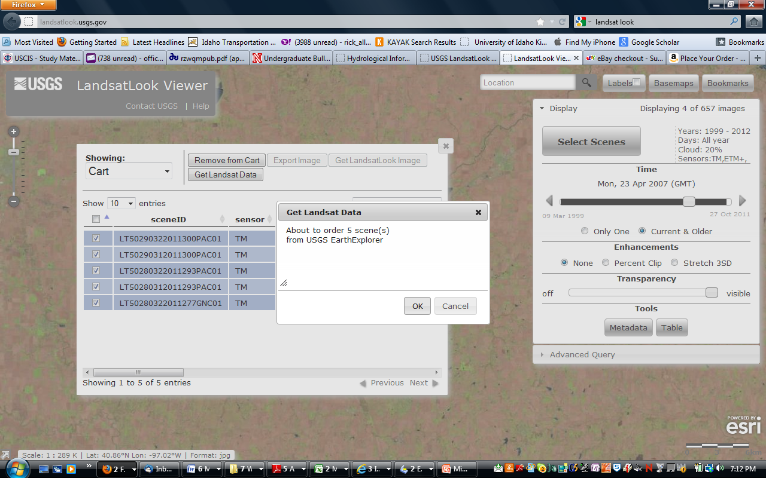
h) In cart menu, recheck image dates to order, i) Press “Get Landsat
Data” and j) You have just ordered Landsat images!!
k) Press Metadata button to see what path/row (29/32) you are on.

Slide 9
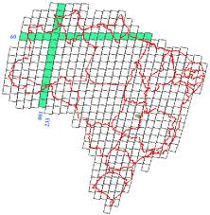
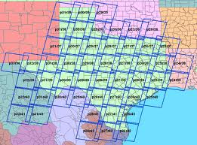
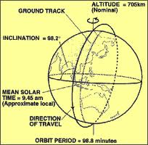
Brazil
Each Landsat path is 160 km wide
Each row is 160 km tall
Landsat 7
has 6 reflected bands (blue, green, red, 3 infrared) and one thermal band
Texas

Slide 10
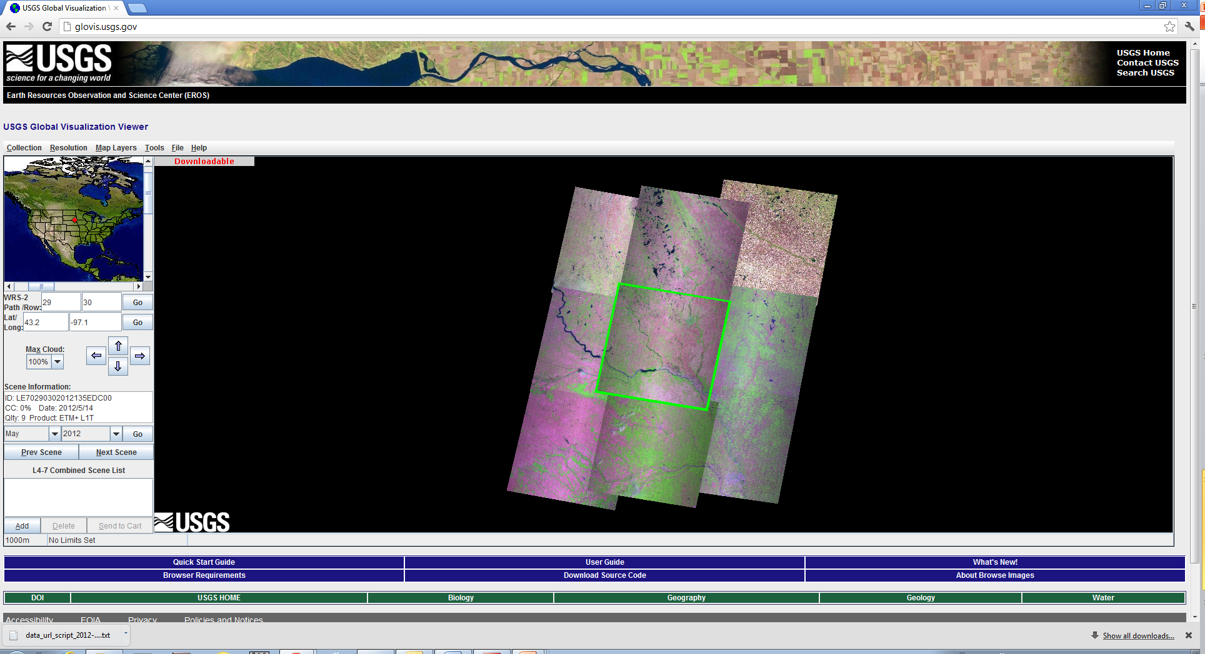
Another option to download Landsat data http://glovis.usgs.gov/
Path/Row-29/32

Slide 11
The Moderate Resolution Imaging Spectroradiometer (MODIS)
Operating on both the Terra and Aqua spacecraft.
It has a viewing swath width of 2,330 km
Views the entire surface of the Earth every one to two days.
Its detectors measure 36 spectral bands
It acquires data at three spatial resolutions: 250-m, 500-m, and 1,000-m.
Bands 1–2 - 250-meter
Bands 3–7 - 500-meter
Bands 8–36 - 1000-meter

Slide 12
MODIS data download steps:
http://reverb.echo.nasa.gov/reverb/#utf8=%E2%9C%93&spatial_map=satellite&spatial_type=rectangle
Use Map view
Bounding box to define the area of interest
Use search terms to find the data you are looking for i.e. NDVI
Define the time period
Select the dataset
Hit “Search for granules”
Select all granules
View items in chart
Download data and text (for the ftp address)
Open word file (under format- choose word wrap)
Copy-paste ftp address to view the NDVI file (JPEG) on a browser
https://lpdaac.usgs.gov/products
Vegetation Indices 16-Day L3 Global 1km - MYD13A2
https://lpdaac.usgs.gov/products/modis_products_table/mod13a2
Under ‘layers’ tab, find the table (Science Data Sets for MODIS Aqua Vegetation Indices 16-Day L3 Global 1km SIN Grid V005 (MYD13A2): Find the multiplier
Multiply the image (hdf file) with 0.0001 to create a raster image of NDVI in ArcGIS

Slide 13
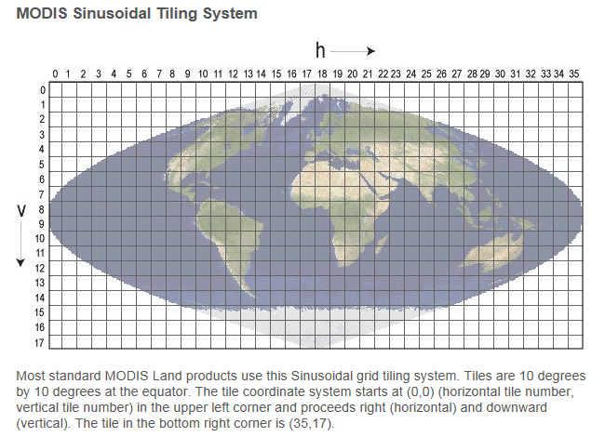

Slide 14
MODIS Naming Conventions
example, the filenameMOD09A1.A2006001.h08v05.005.2006012234657.hdf indicates:
MOD09A1 - Product Short Name
.A2006001 - Julian Date of Acquisition (A-YYYYDDD)
.h08v05 - Tile Identifier (horizontalXXverticalYY)
.005 - Collection Version
.2006012234567 - Julian Date of Production (YYYYDDDHHMMSS)
.hdf - Data Format (HDF-EOS)
The MODIS Long Name (i.e., Collection-Level) convention also provides useful information. For example, all products belonging to the MODIS/Terra Surface Reflectance 8-Day L3 Global 500m SIN Grid V005 collection have the following characteristics:
MODIS/Terra - Instrument/Sensor
Surface Reflectance - Geophysical Parameter
8-Day - Temporal Resolution
L3 - Processing Level
Global - Global or Swath
500m - Spatial Resolution
SIN Grid - Gridded or Not
V005 - Collection Version
MODIS Temporal Resolution
The high level MODIS Land products distributed from LP DAAC are produced at various temporal resolutions, based on the instruments' orbital cycle. These time steps are possible in the generation of MODIS Land products:
Daily, 8-Day, 16-Day, Monthly, Quarterly, Yearly
MODIS Spatial Resolution
The MODIS instruments acquire data in three native spatial resolutions:
Bands 1–2 - 250-meter
Bands 3–7 - 500-meter
Bands 8–36 - 1000-meter
The high level MODIS Land Products distributed from LP DAAC are produced at four nominal spatial resolutions: 250-meter, 500-meter, 1000-meter, and 5600-meter (0.05 degrees).

Slide 15
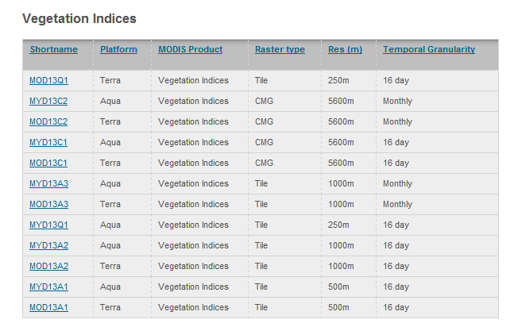
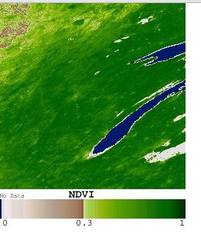

Slide 16
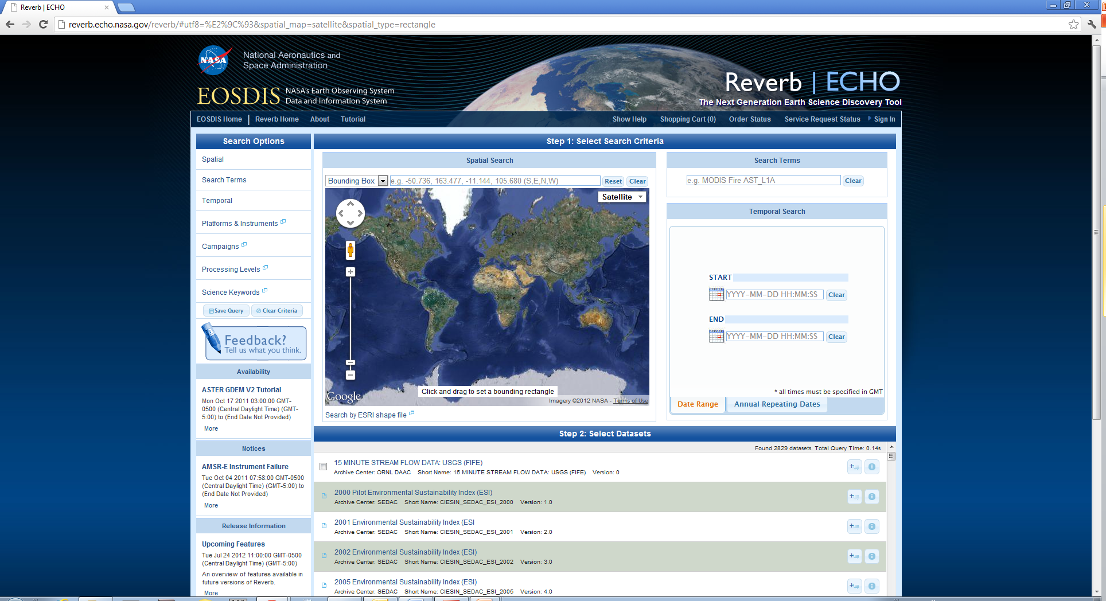
MODIS download steps http://reverb.echo.nasa.gov

Slide 17
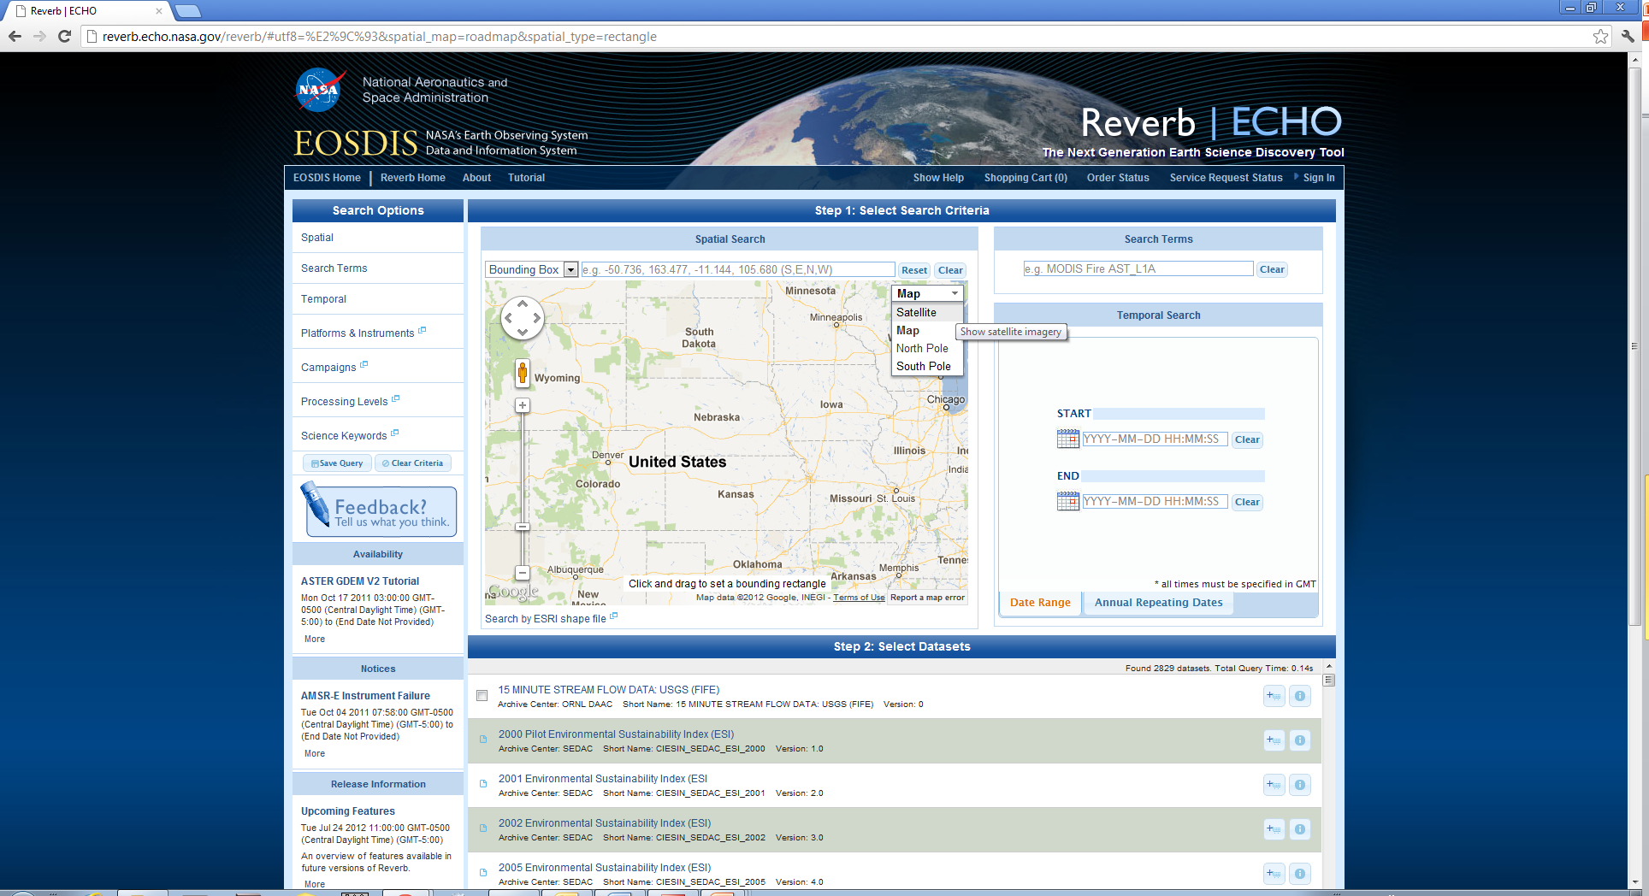
http://reverb.echo.nasa.gov

Slide 18
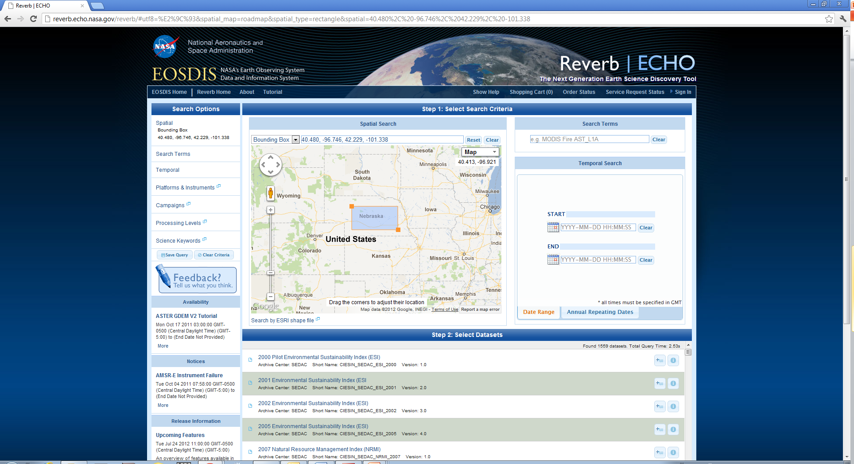
http://reverb.echo.nasa.gov

Slide 19
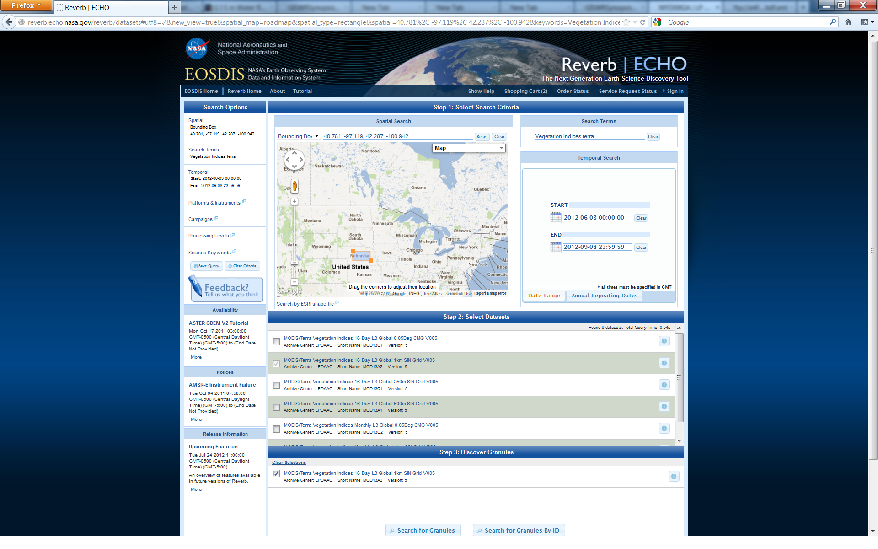
https://lpdaac.usgs.gov/products/modis_products_table

Slide 20
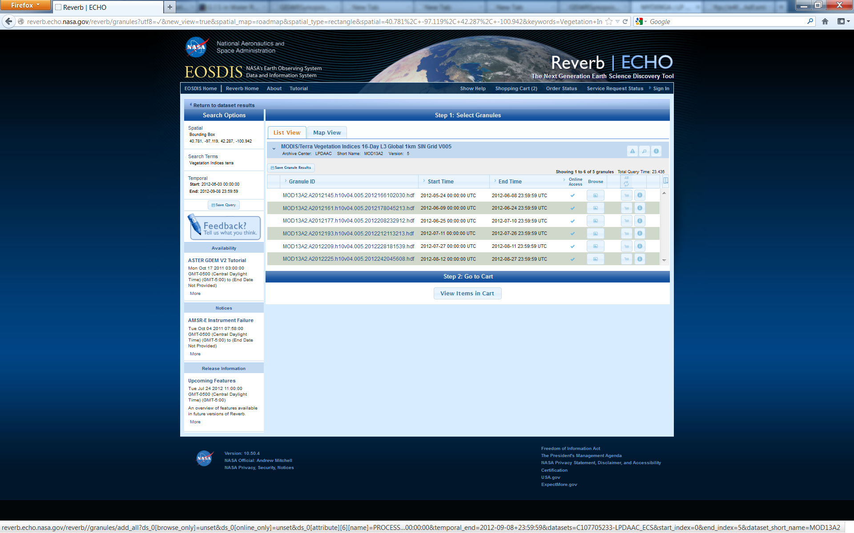

Slide 21
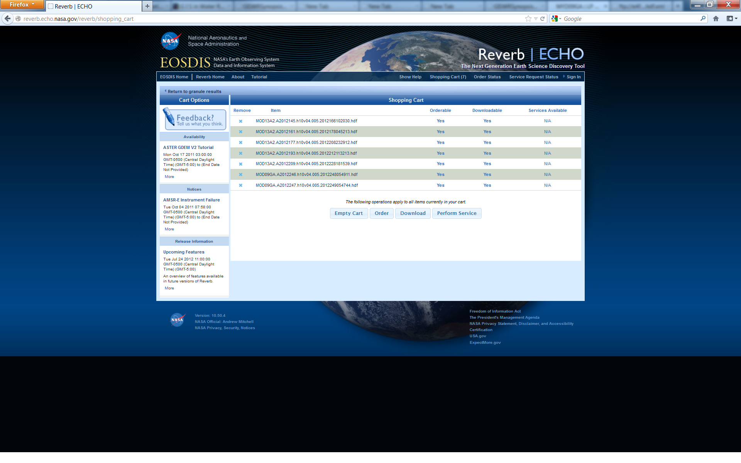

Slide 22
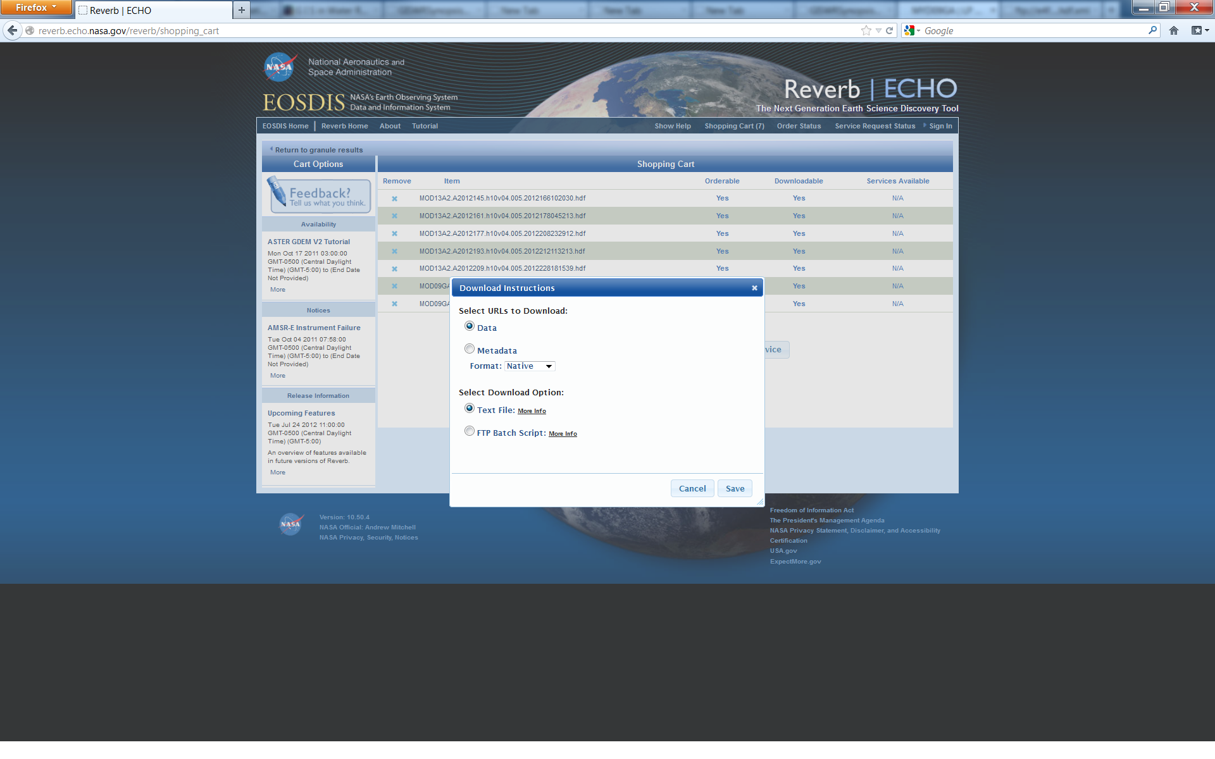

Slide 23
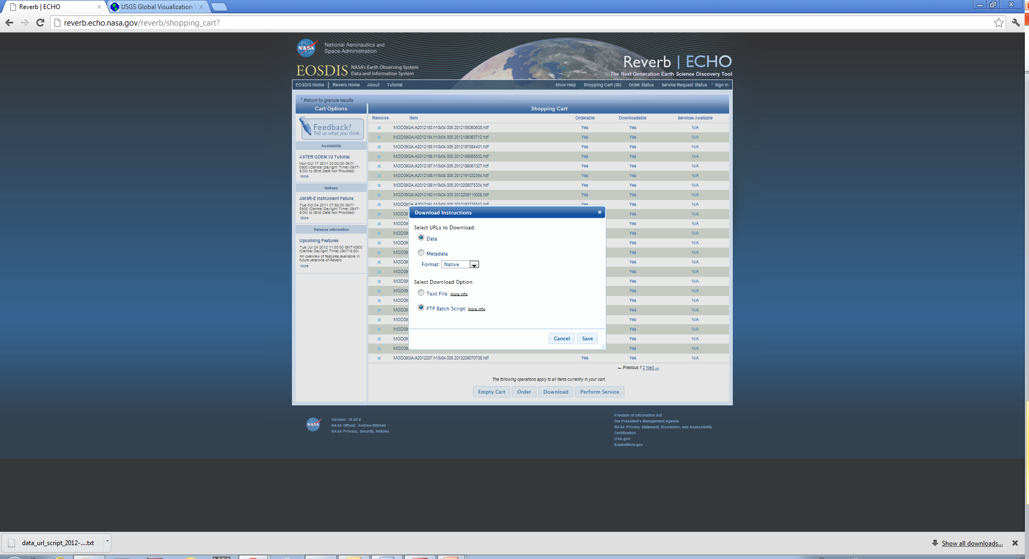
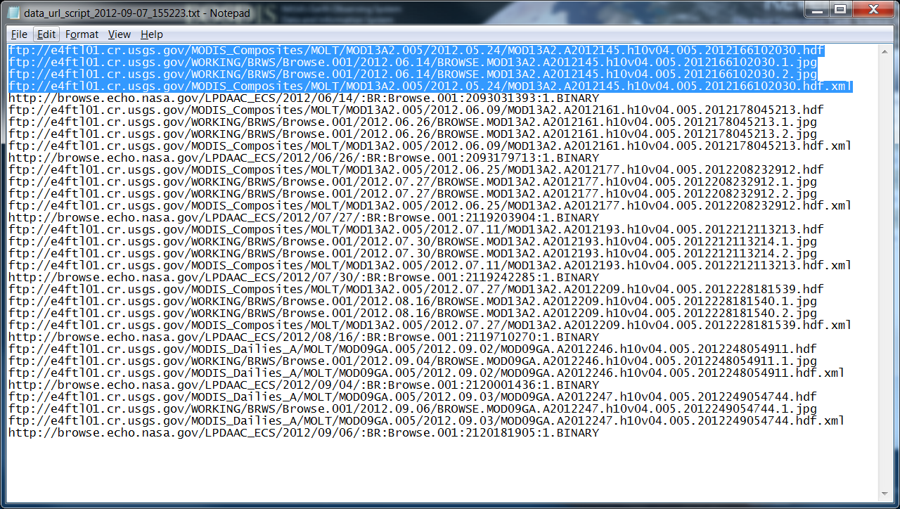

Slide 24
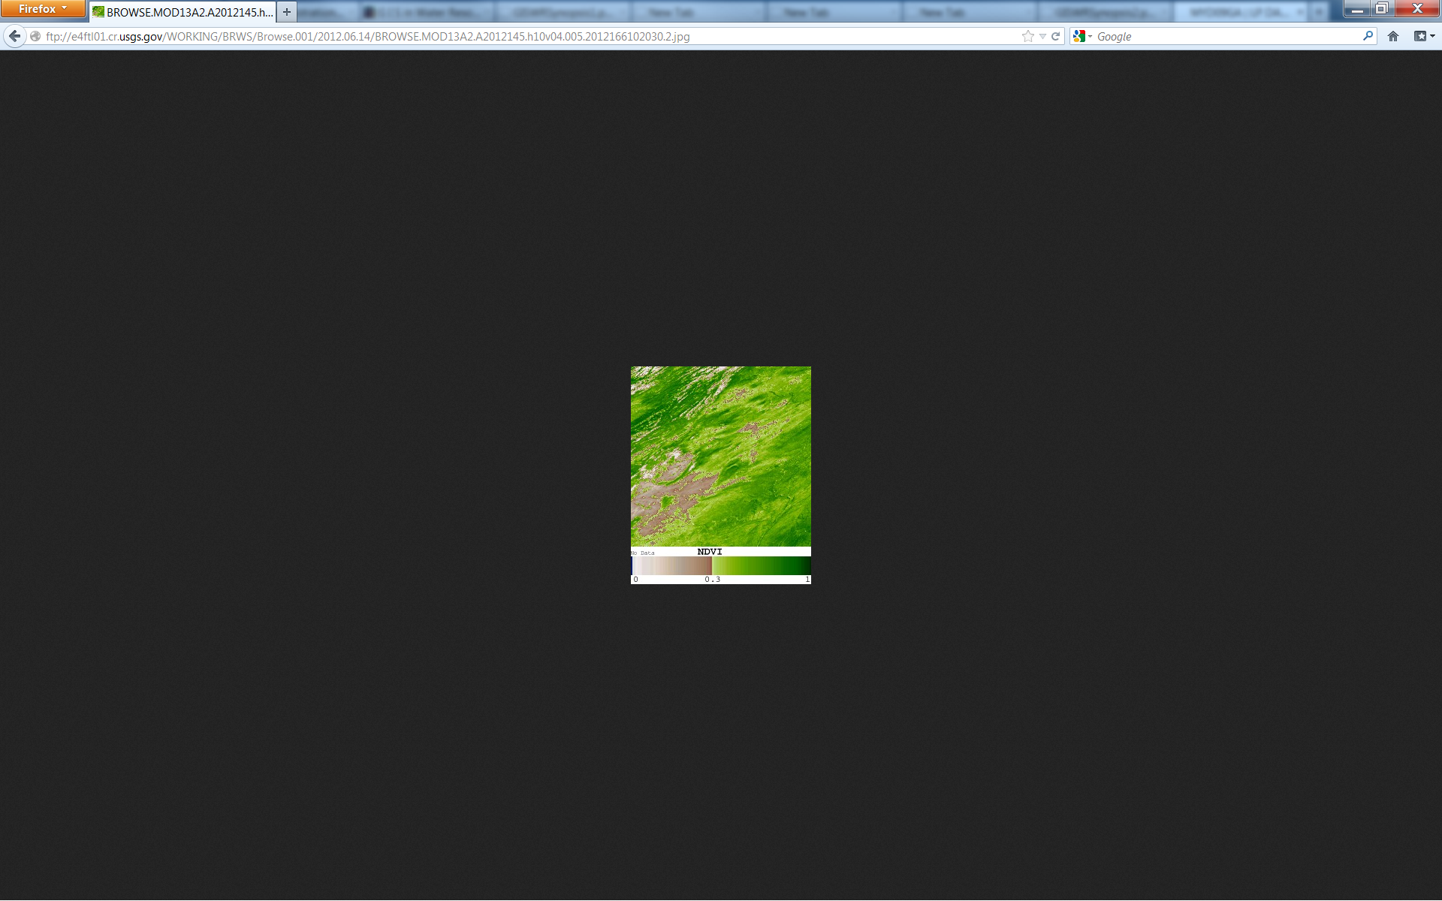
ftp://e4ftl01.cr.usgs.gov/WORKING/BRWS/Browse.001/2012.06.14/BROWSE.MOD13A2.A2012145.h10v04.005.2012166102030.2.jpg

Slide 25
Parameters to use for hdf file
https://lpdaac.usgs.gov/products/modis_overview
https://lpdaac.usgs.gov/products/modis_products_table/mod13a2
Dataset MULTIPLY BY SCALE FACTOR

Slide 26
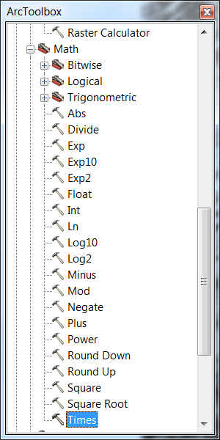
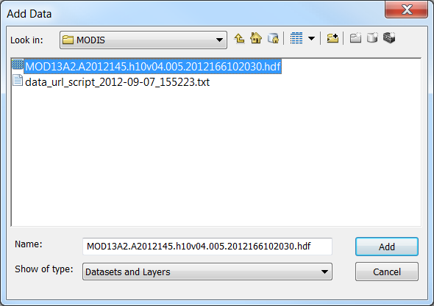
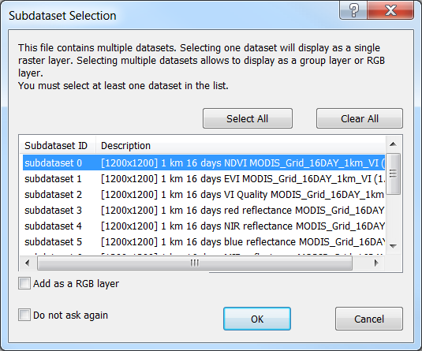
MOD13A2

Slide 27
Science Data Sets for MODIS Terra Vegetation Indices 16-Day L3 Global 1km SIN Grid V005 (MOD13A2)
Science Data Sets (HDF Layers) (12) | UNITS | FILL | VALID RANGE | MULTIPLY BY SCALE FACTOR
1km 16 days NDVI | NDVI | -3000 | -2000, 10000 | 0.0001
1km 16 days EVI | EVI | -3000 | -2000, 10000 | 0.0001
1km 16 days VI Quality detailed QA | Bits | 65535 | 0, 65534 | NA
1km 16 days red reflectance (Band 1) | Reflectance | -1000 | 0, 10000 | 0.0001
1km 16 days NIR reflectance (Band 2) | Reflectance | -1000 | 0, 10000 | 0.0001
1km 16 days blue reflectance (Band 3) | Reflectance | -1000 | 0, 10000 | 0.0001
1km 16 days MIR reflectance (Band 7) | Reflectance | -1000 | 0, 10000 | 0.0001
1km 16 days view zenith angle | Degree | -10000 | -9000, 9000 | 0.01
1km 16 days sun zenith angle | Degree | -10000 | -9000, 9000 | 0.01
1km 16 days relative azimuth angle | Degree | -4000 | -3600, 3600 | 0.1
1km 16 days composite day of the year | Julian day of year | -1 | 1, 366 | NA
1km 16 days pixel reliability summary QA | Rank | -1 | 0, 4 | NA

Slide 28
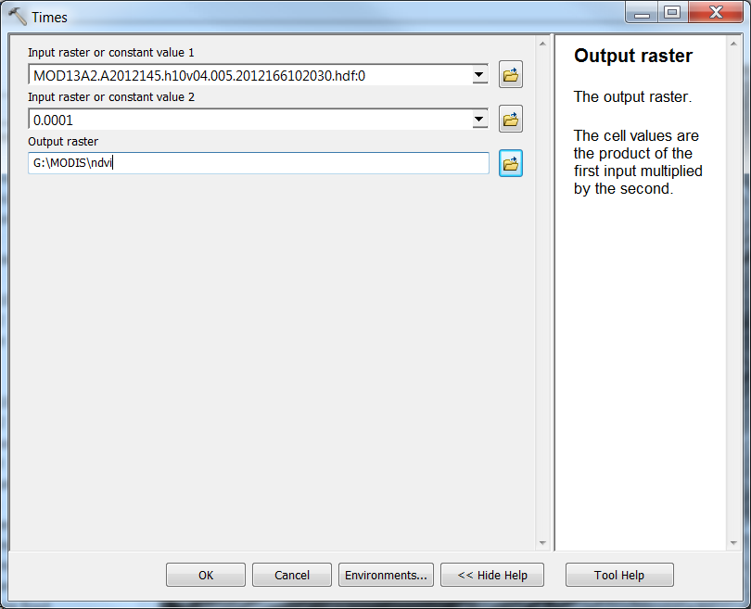
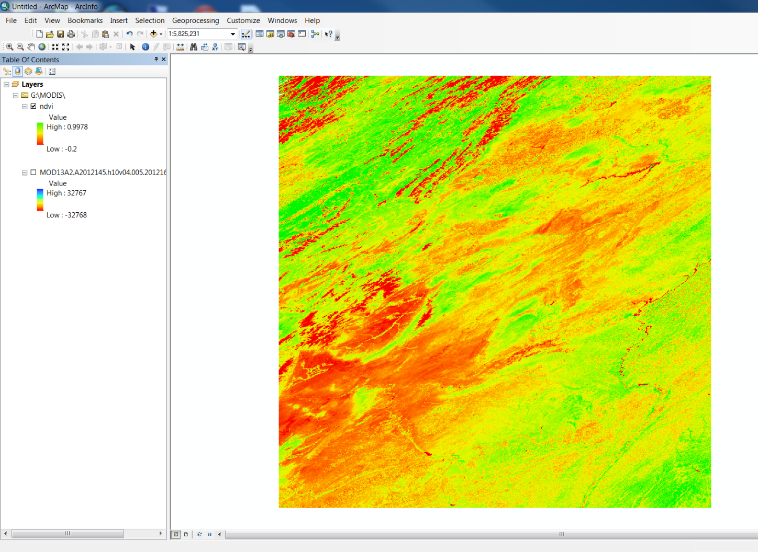
Spatial analyst tool/Math

Slide 29
