Slide 1
GIS in Water Resources: Lecture 1
In-class and distance learning
Geospatial database of hydrologic features
GIS and HIS
Curved earth and a flat map

Slide 2
Six Basic Course Elements
Lectures
  Powerpoint slides
  Video streaming
Readings
  Handouts and lecture synopses
Homework
  Computer exercises
  Hand exercises
Term Project
  Oral presentation
  PDF report
Class Interaction
  Email
  Discussion
Examinations
  Midterm, final

Slide 3
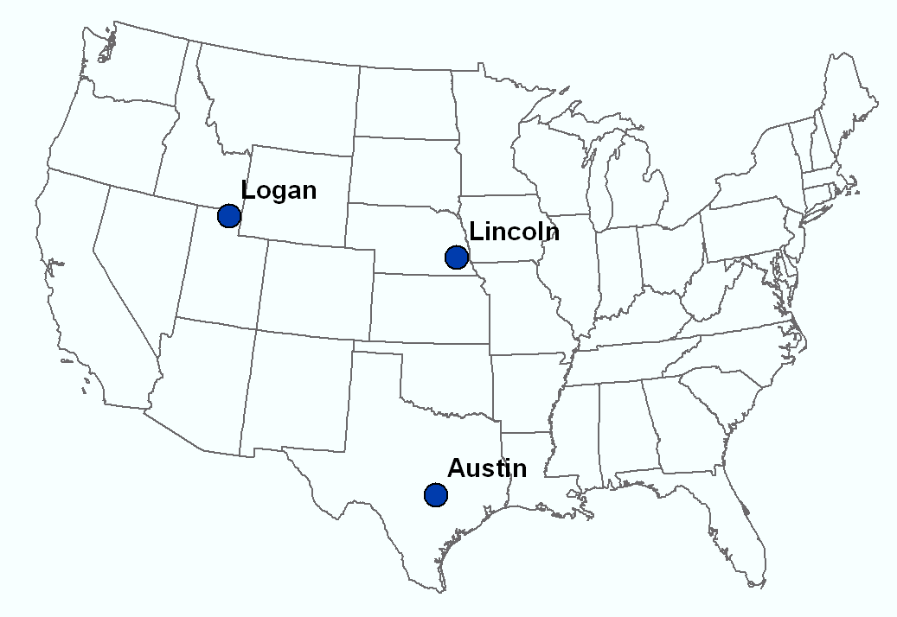
Our Classroom
Dr David Tarboton
Students at Utah State University
Dr Ayse Kilic Students at University of Nebraska - Lincoln
Dr David Maidment Students at University of Texas at Austin

Slide 4

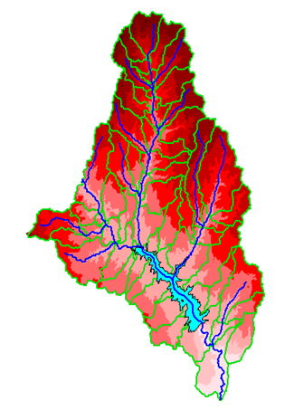
David R. Maidment
B.E. in Agricultural Engineering (with First Class Honors) from University of Canterbury, Christchurch, New Zealand, 1972
MS, PhD in Civil Engineering from University of Illinois, 1974 and 1976, respectively
1981 – joined University of Texas at Austin as an Assistant Professor, and have been on the faculty ever since. Now Hussein M. Alharthy Centennial Chair in Civil Engineering
Initiated the GIS in Water Resources course in 1991 – this is the 21st birthday of this course!
Worked with ESRI since 1994 on a GIS Hydro Preconference seminar for the ESRI Users Conference
Leader of the CUAHSI Hydrologic Information System project from 2004-2011
Developing World Water Online with ESRI and Kisters

Slide 5

David Tarboton
B.Sc Eng in Civil Engineering from the University of Natal, Durban, South Africa 1981
M.S. and Sc.D from MIT, Cambridge, Massachusetts, 1987 and 1990 respectively
1990 - Joined Faculty at Utah State University in Civil and Environmental Engineering
1996 - Developed D-Infinity to have a better contributing area for study of landscape evolution
Gradually adapted the Fortran and C codes developed during terrain analysis research to be distributable as TauDEM
Participated in GISWR since 1999 (this year is the 13th time)
Leader of HydroShare project to extend the capability of CUAHSI HIS to collaborative data sharing, additional data types and models

Slide 6
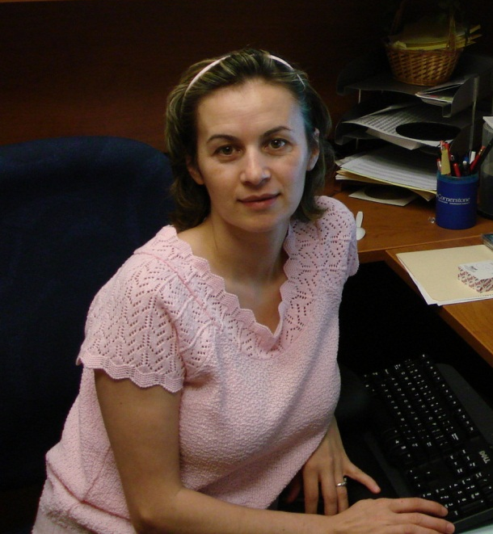
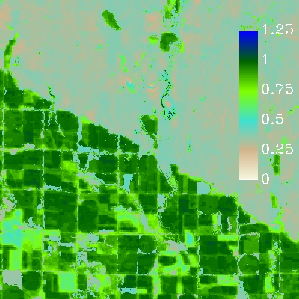
Ayse Kilic
M.E. (1998) & Ph.D (2002). Agricultural and Biological Engineering. University of Florida. Gainesville, FL. Dissertation: “Linking multiple layers of information to explain soybean yield variability” . 5 papers
2004- Joined to UNL and continued to work on computer simulation of crop production for another year and gradually moved to Remote Sensing field with applications in Natural Resources Systems.
2006 - Remote Sensing-based Estimation of Evapotranspiration and other Surface Energy Fluxes
Research innovations include the development of new soil heat flux algorithms, a spatially gridded distributed soil water balance model (DSWM), and calibration techniques for the Landsat-based METRIC evapotranspiration model.
2008- Working on development of the Nebraska Hydrologic Information System (HIS), which is designed to provide improved access to evapotranspiration and other hydrologic data for end users.
Participated in GISWR since 2006 (this year is the 5th time – I skipped 2007 due to position change at UNL)

Slide 7
University Without Walls
Traditional Classroom
Community
Inside and Outside
The Classroom

Slide 8
Learning Styles
Instructor-Centered Presentation
Community-Centered Presentation
Instructor
Student
We learn from the instructors and each other

Slide 9
GIS in Water Resources: Lecture 1
In-class and distance learning
Geospatial database of hydrologic features
GIS and HIS
Curved earth and a flat map

Slide 10




What is GIS
A geographic information system (GIS) is a system designed to capture, store, manipulate, analyze, manage, and present all types of geographical data. -- Wikipedia
data
computers
maps
tools

Slide 11
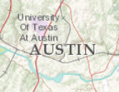
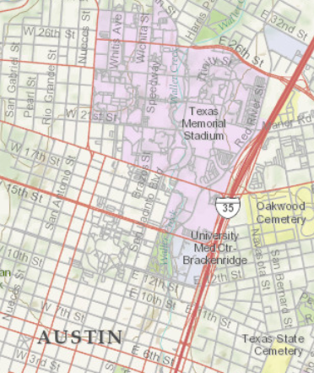
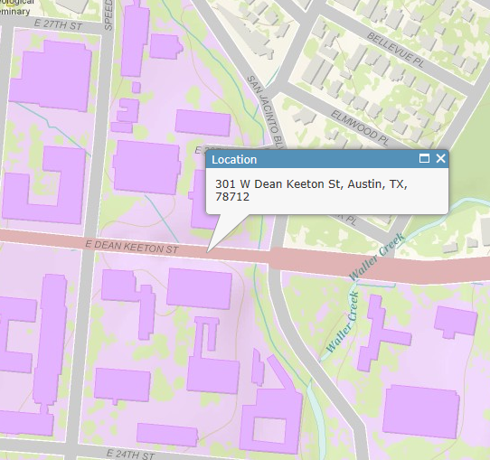
Geography is visualized in maps
map
www.arcgis.com

Slide 12
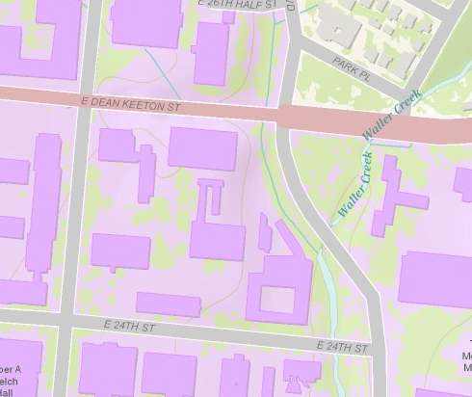
Maps are built from data
Road
Name: E. Dean Keeton St
Type: Div Highway
Speed: 35 mph
Shape: [Geometry]
Building
Name: Ernest Cockrell Jr Hall
Address: 301 E. Dean Keeton St
Shape: [Geometry]
data
Shape includes the geometry of the feature and where it is located on earth
map

Slide 13
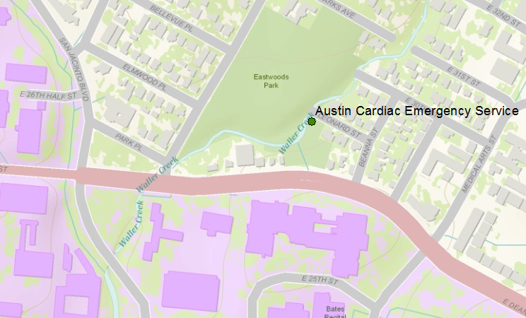
Vector data represent discrete features
points
lines
data
polygons
map

Slide 14
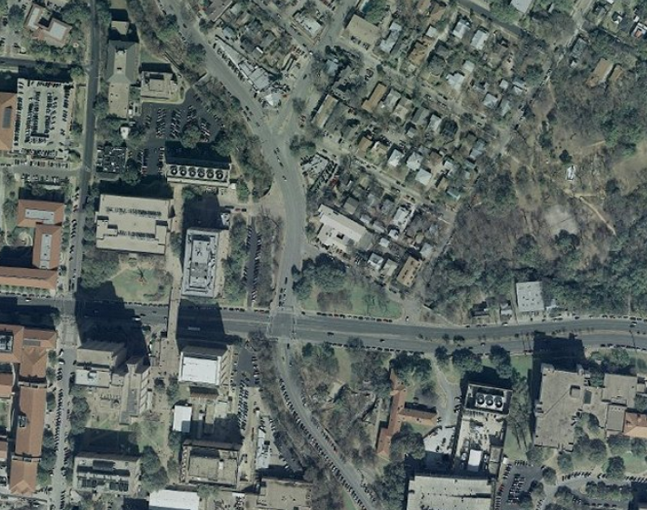
Raster data form a grid of cells or pixels
data
map

Slide 15
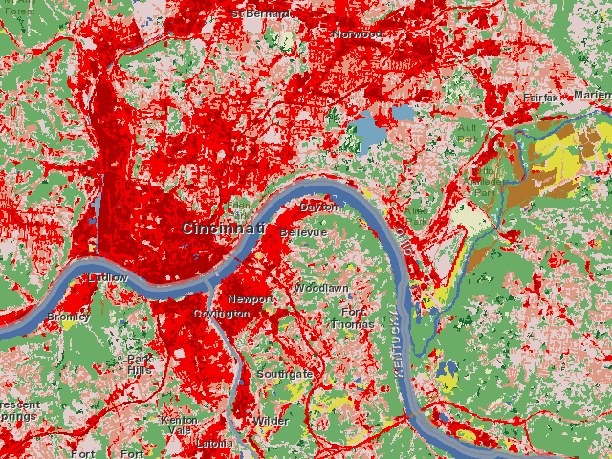
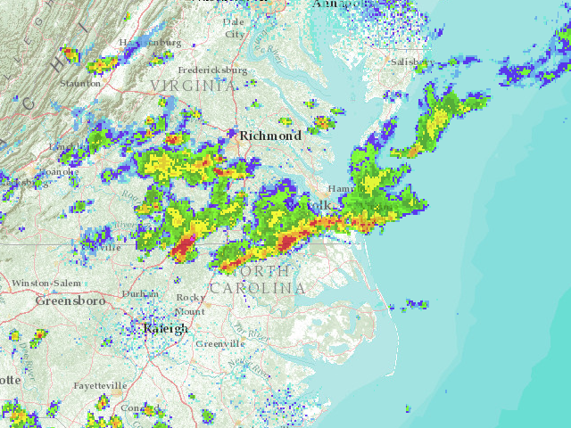
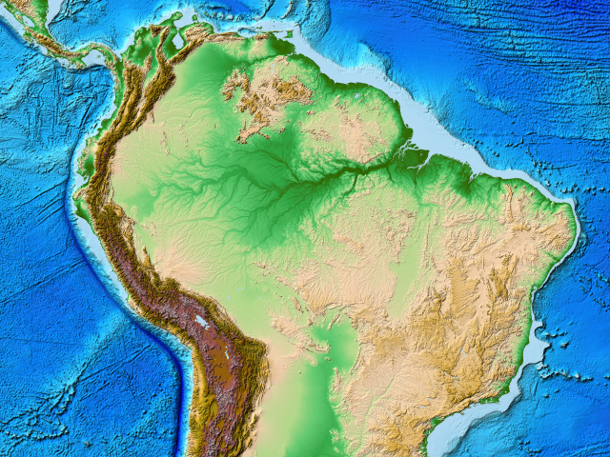
More Raster Examples
data
land use
rainfall
elevation
map

Slide 16
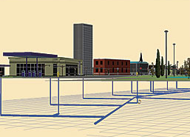
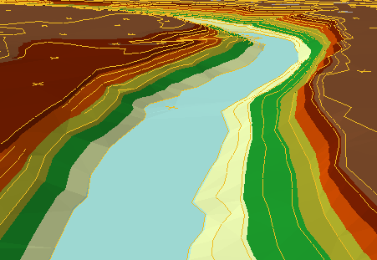
There are many more data types
multipatch
triangulated
irregular network
data
Martin Luther King Dr W
annotation
map

Slide 17
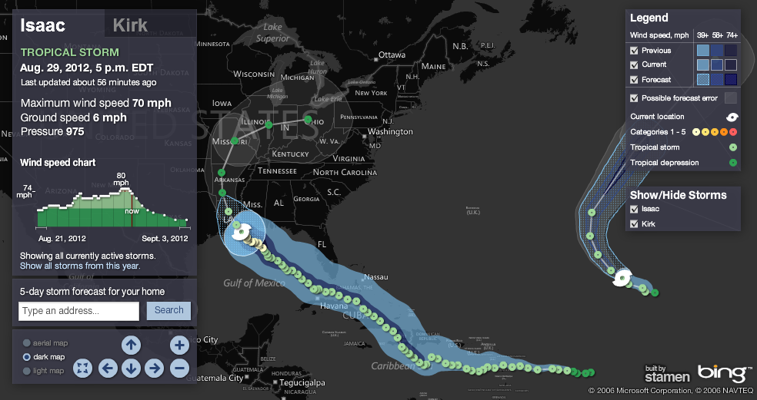
Connected Map, Chart and Animation
Hurricane Isaac
http://www.msnbc.msn.com/id/26295161/ns/weather/

Slide 18
Geographic Data Model
Conceptual Model – a set of concepts that describe a subject and allow reasoning about it
Mathematical Model – a conceptual model expressed in symbols and equations
Data Model – a conceptual model expressed in a data structure (e.g. ascii files, Excel tables, …..)
Geographic Data Model – a conceptual model for describing and reasoning about the world expressed in a GIS database

Slide 19
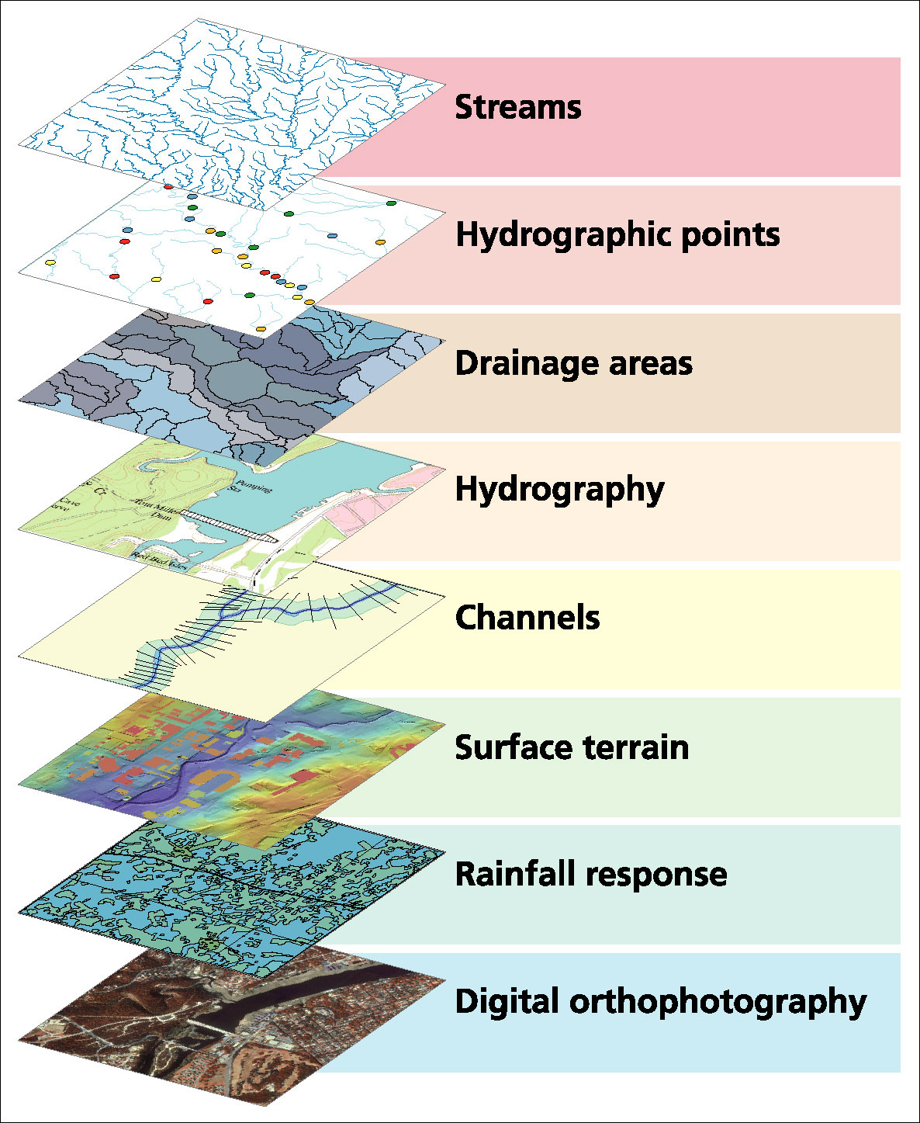
Data Model based on Inventory of data layers

Slide 20
Spatial Data: Vector format
Vector data are defined spatially:
(x₁,y₁)
Point - a pair of x and y coordinates
vertex
Line - a sequence of points
Node
Polygon - a closed set of lines
Notes:
DRM

Slide 21
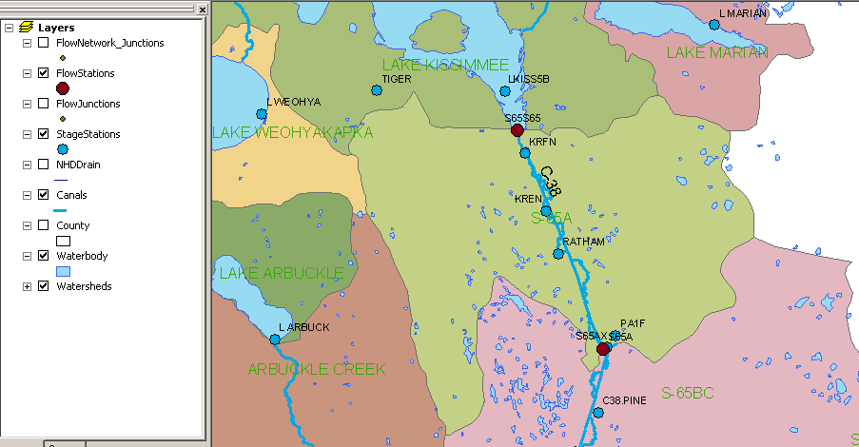
Kissimmee watershed, Florida
Themes

Slide 22
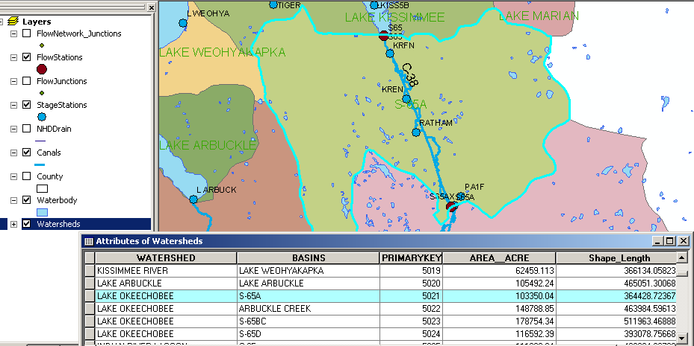
Attributes of a Selected Feature

Slide 23
Raster and Vector Data
Raster data are described by a cell grid, one value per cell
Vector
Raster
Point
Line
Zone of cells
Polygon
Notes:
DRM

Slide 24

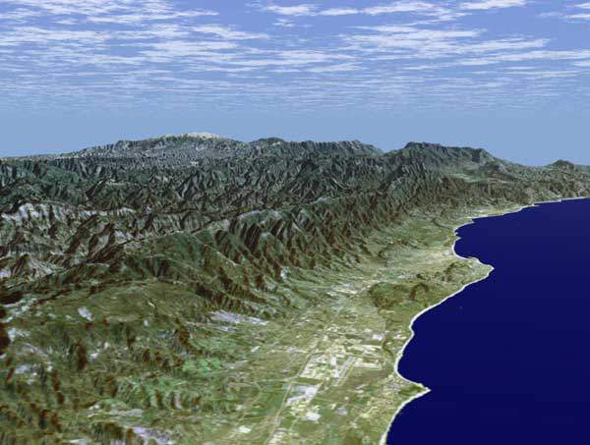
Santa Barbara, California
http://srtm.usgs.gov/srtmimagegallery/index.html

Slide 25




The challenge of increasing Digital Elevation Model (DEM) resolution (Dr Tarboton’s research)
1980’s DMA 90 m
10² cells/km²
1990’s USGS DEM 30 m
10³ cells/km²
2000’s NED 10-30 m
10⁴ cells/km²
2010’s LIDAR ~1 m
10⁶ cells/km²

Slide 26
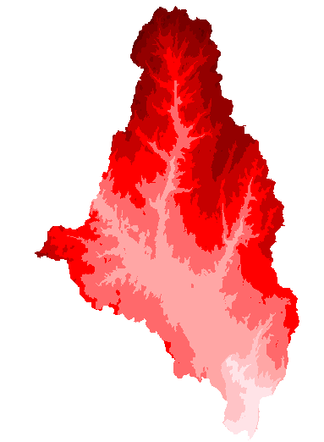
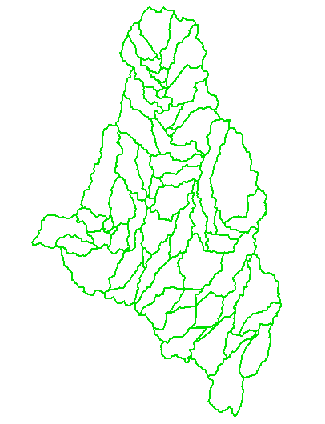
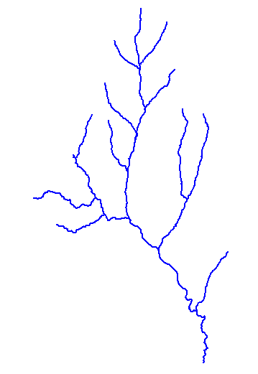
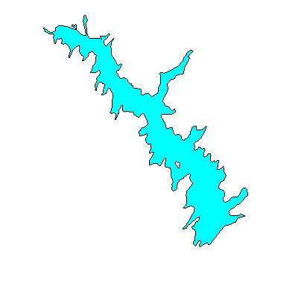
How do we combine these data?
Digital Elevation
Models
Watersheds
Streams
Waterbodies

Slide 27
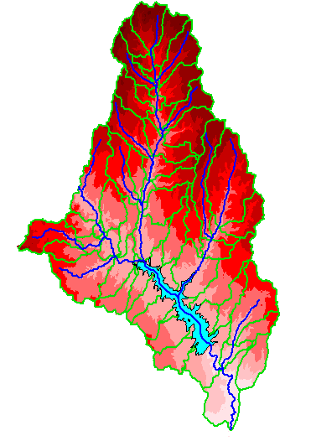
An integrated raster-vector database

Slide 28
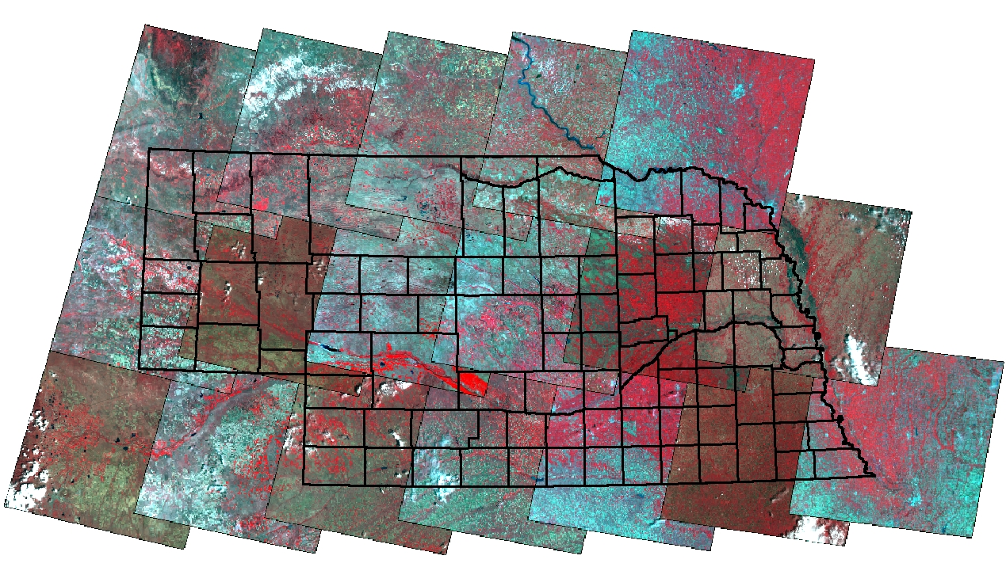
Remote Sensing Coverage of Nebraska
P33R30
10
P32R30
9
P31R30
10
P30R30
9
P29R30
10
P33R31
11
P32R31
10
P31R31
12
P30R31
9
P29R31
11
P28R31
8
P33R32
15
P32R32
8
P31R32
12
P30R32
10
P29R32
12
P28R32
10
P27R32
8

Slide 29
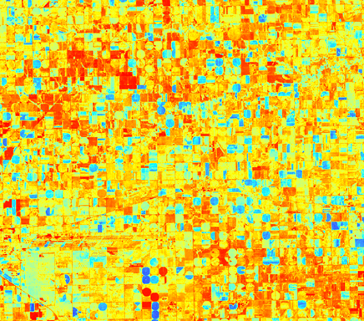
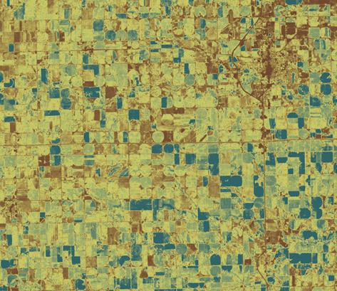


Evaporation from Remote Sensing (Dr Kilic)

Slide 30
GIS in Water Resources: Lecture 1
In-class and distance learning
Geospatial database of hydrologic features
GIS and HIS
Curved earth and a flat map

Slide 31
Linking Geographic Information Systems and Water Resources
Water
Resources
GIS

Slide 32

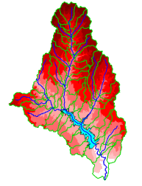
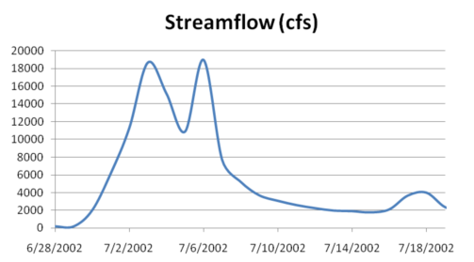

A Key Challenge
How to connect water environment with water observations
GIS
Water Environment
(Watersheds, streams,
gages, sampling points)
Time Series Data
Water Observations
(Flow, water level
concentration)

Slide 33

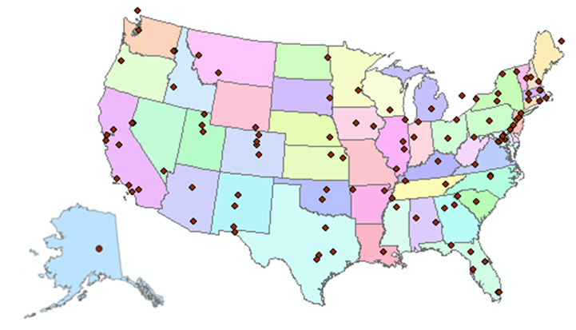
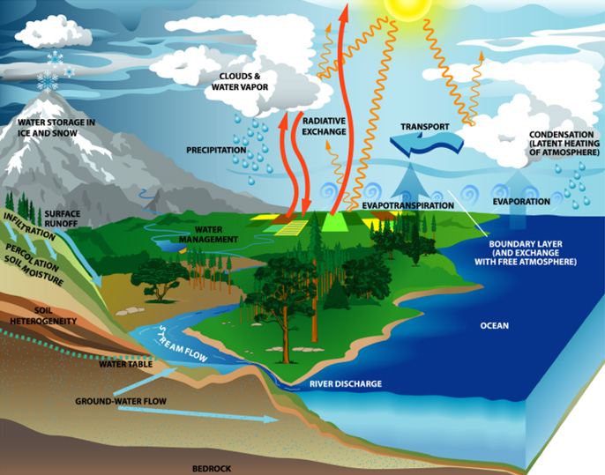
http://www.cuahsi.org
CUAHSI is a consortium representing 125 US universities
Supported by the National Science Foundation Earth Science Division
Advances hydrologic science in nation’s universities
Includes a Hydrologic Information System project

Slide 34
How the web works
Catalog
(Google)
Catalog harvest
Search
Web Server
(CNN.com)
Access
Browser
(Firefox)
HTML – web language for text and pictures

Slide 35

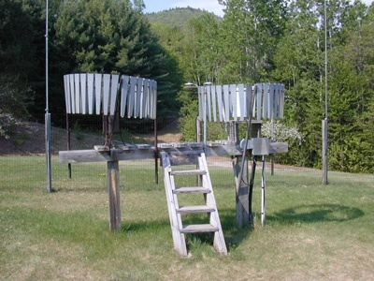

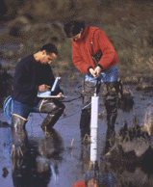
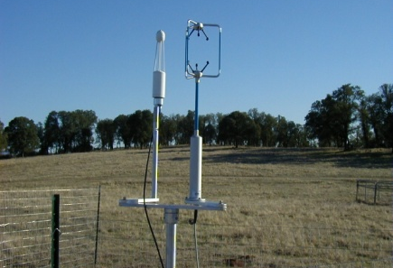
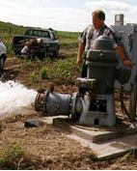
We Collect Lots of Water Data
Water quantity
Rainfall
Soil water
Water quality
Meteorology
Groundwater

Slide 36
The Data have a Common Structure
A point location in space
A series of values in time
Gaging – regular time series
Sampling – irregular time series
Notes:
These data are recorded over time to monitor a hydrologic process or property.

Slide 37

WaterML as a Web Language for Colorado River at Austin
I accessed this WaterML service from USGS at 4:29PM
http://waterservices.usgs.gov/nwis/iv?sites=08158000&period=P17D&parameterCd=00060
and got back these flow data from USGS which are up to 3:45PM
USGS has real-time WaterML services for about 11,000 sites available 24/7/365
http://waterservices.usgs.gov/nwis/iv?sites=08158000&period=P1D&parameterCd=00060

Slide 38
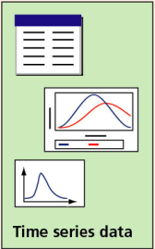
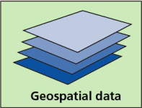
Hydrologic Information System
Analysis, Modeling,
Decision Making
Arc Hydro
Geodatabase
A synthesis of geospatial and temporal data supporting hydrologic analysis and modeling

Slide 39
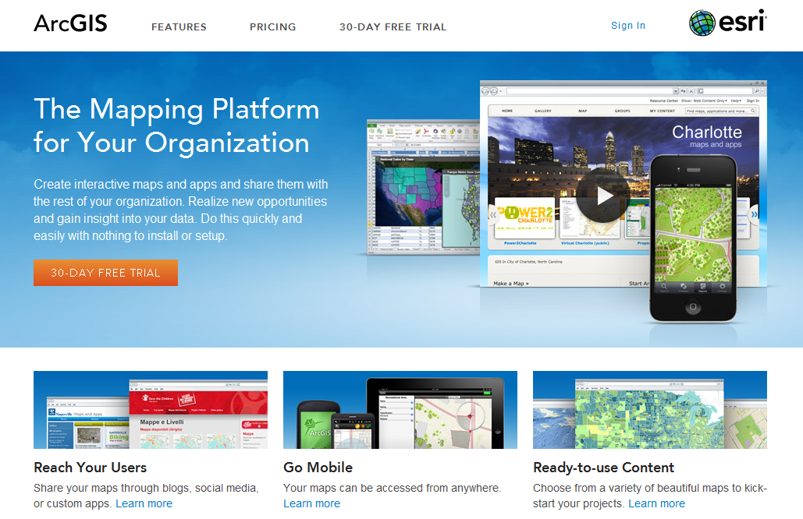
ArcGIS Online
GIS on the web – online map services
http://www.arcgis.com

Slide 40
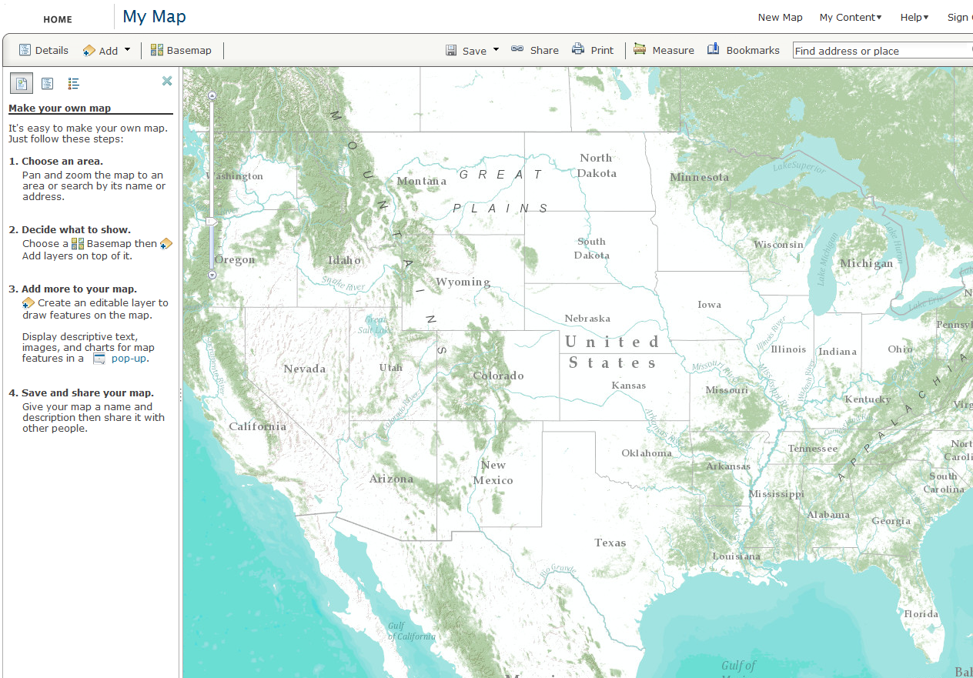
Online Base Maps (20 scales)

Slide 41
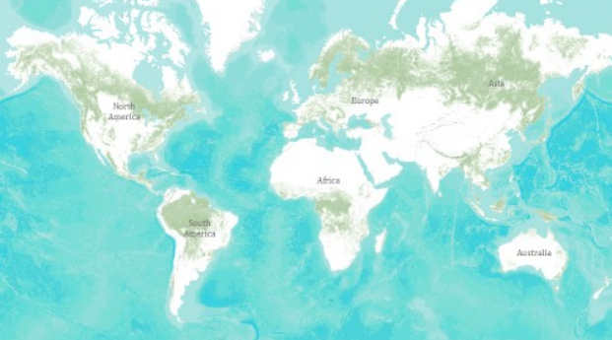
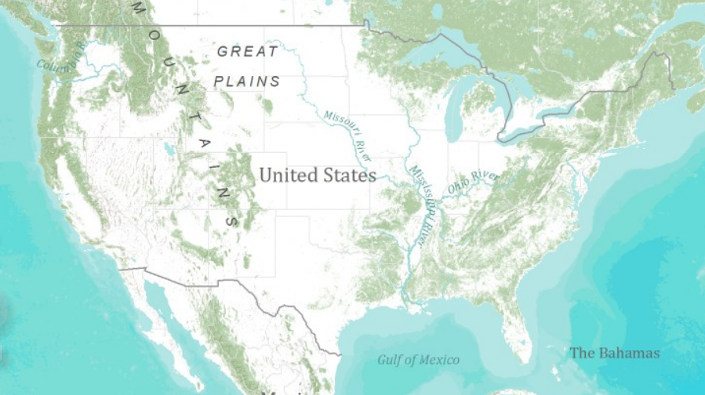
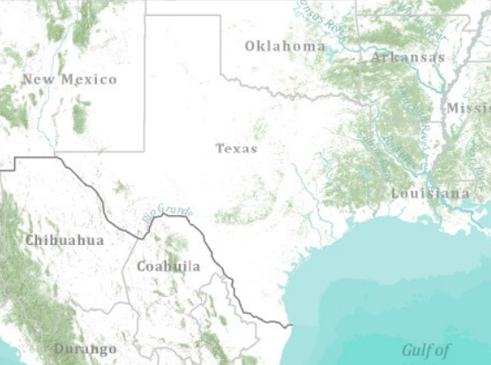
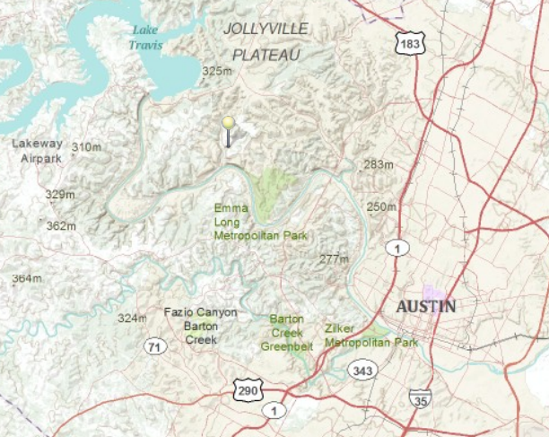
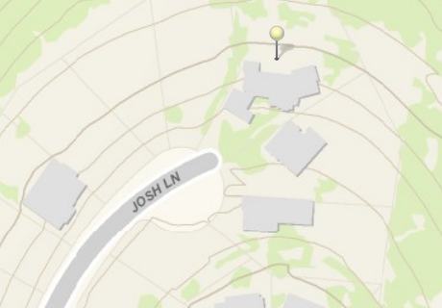
Topographic Base Map in ArcGIS Online
World
United States
Texas
Austin
Home

Slide 42
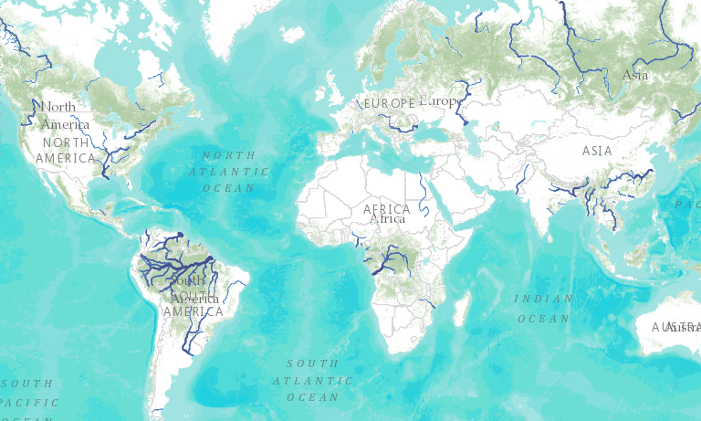
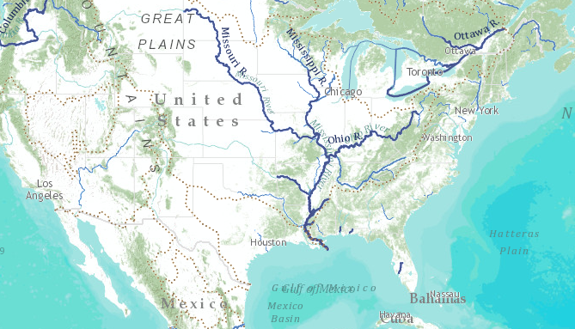
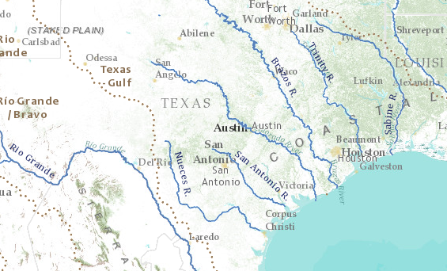
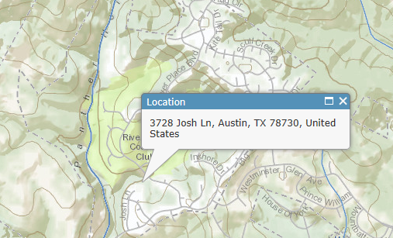
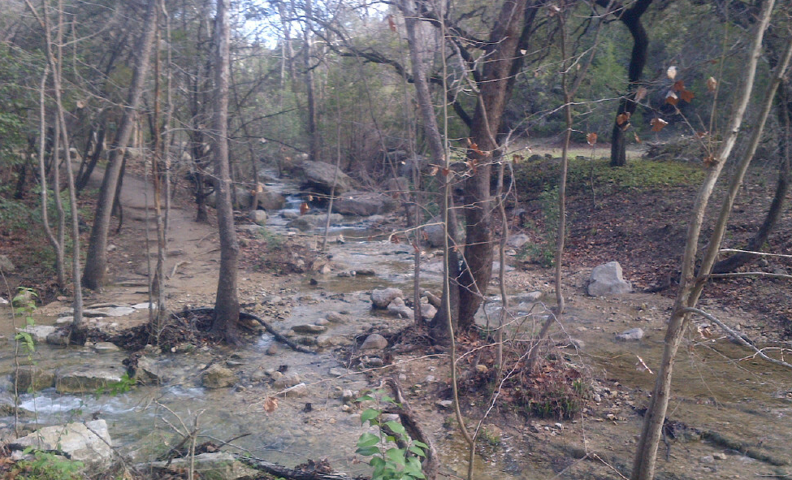
World Hydro Overlay Map
World
United States
Texas
My Home
My Stream

Slide 43
GIS in Water Resources: Lecture 1
In-class and distance learning
Geospatial database of hydrologic features
GIS and HIS
Curved earth and a flat map

Slide 44

Origin of Geographic Coordinates
Equator
(0,0)
Prime Meridian

Slide 45
Latitude and Longitude
Longitude line (Meridian)
N
W
E
S
Range: 180ºW - 0º - 180ºE
Latitude line (Parallel)
N
W
E
S
(0ºN, 0ºE)
Equator, Prime Meridian
Range: 90ºS - 0º - 90ºN

Slide 46

Latitude and Longitude in North America
Austin:
Logan:
Lincoln:
(30°18' 22" N, 97°45' 3" W)
60 N
30 N
(41°44' 24" N, 111°50' 9" W)
120 W
60 W
90 W
0 N
(40°50' 59" N, 96°45' 0" W)

Slide 47
Map Projection
Flat Map
Cartesian coordinates: x,y
(Easting & Northing)
Curved Earth
Geographic coordinates: φ, λ
(Latitude & Longitude)
Notes:
DRM

Slide 48


Earth to Globe to Map
Map Scale:
Map Projection:
Representative Fraction
Globe distance
Earth distance
Scale Factor
Map distance
Globe distance
=
=
(e.g. 1:24,000)
(e.g. 0.9996)

Slide 49
Coordinate Systems
A planar coordinate system is defined by a pair
of orthogonal (x,y) axes drawn through an origin
Y
Origin
X
(x_{o},y_{o})
(φ_{o},λ_{o})
Projected Coordinates
Geographic Coordinates

Slide 50
Summary (1)
GIS in Water Resources is about empowerment through use of information technology – helping you to understand the world around you and to investigate problems of interest to you
This is an “open class” in every sense where we learn from one another as well as from the instructors

Slide 51
Summary (2)
GIS offers a structured information model for working with geospatial data that describe the “water environment” (watersheds, streams, lakes, land use, ….)
Water resources also needs observations and modeling to describe “the water” (discharge, water quality, water level, precipitation)

Slide 52
Summary (3)
A Hydrologic Information System depends on water web services and integrates spatial and temporal water resources data
Geography “brings things together” through georeferencing on the earth’s surface
Understanding geolocation on the earth and working with geospatial coordinate systems is fundamental to this field

