Slide 1
Communal Rainwater Harvesting in Austin, Texas
Gary Gold
Department of Civil, Architectural, and Environmental Engineering
The University of Texas at Austin
A presentation for GIS in Water Resources, Fall 2013
3 December 2013

Slide 2
Presentation Outline
Background information
Project goals
What’s new here?
Methodology
Results

Slide 3
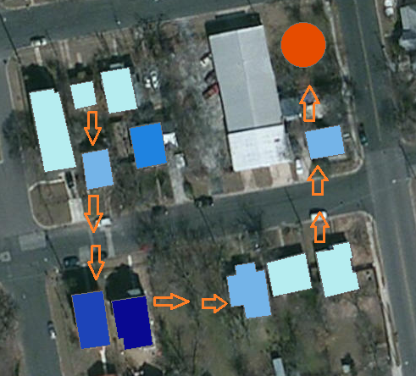
Communal RWH: Shared Storage Facility
Communal RWH can allocate storage and treatment costs among multiple users.

Slide 4
Project Goals
1) To evaluate the feasibility of RWH for “sole source” domestic use at INDIVIDUAL residences in Austin.
2) To investigate the potential of COMMUNAL rainwater storage for a neighborhood in east Austin.
3) To show how GIS resources can be used to in RWH system design and in communicating results.

Slide 5
What’s new in this project?
Community-scale design
  The community-scale approach would allow residents to share the storage, treatment, and maintenance costs.
  The design of RWH units for this project will be based on daily rainfall data.
  Rainfall is Austin is dominated by low-frequency, large magnitude events; planning for RWH based on these daily rainfall events is more suitable than planning based on monthly data.

Slide 6
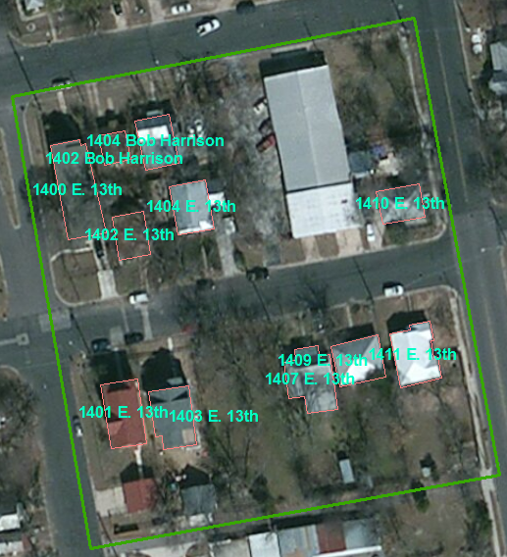
East Austin case-study neighborhood

Slide 7
Water Balance Model
Conducting a daily water balance with historical rainfall data, the model calculated expected rainwater storage and required number of “outside-source” refills for each house over a 20 year period.
Case 1: average of 1 refill per year
Case 2: average of 2 refills per year

Slide 8
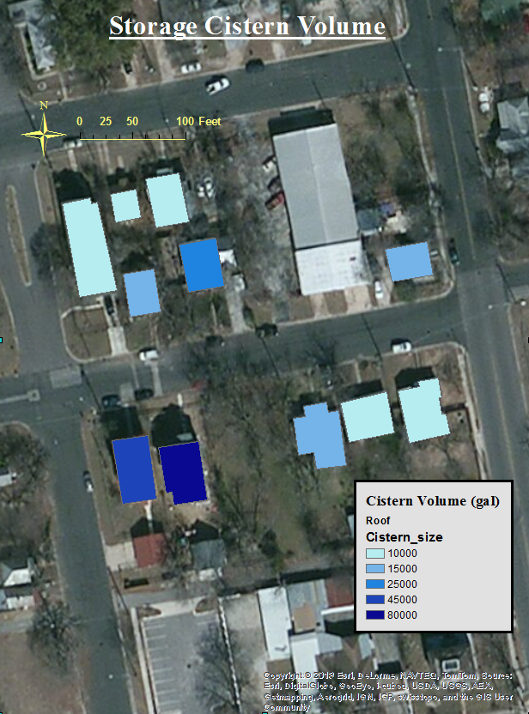
Case 1:
Annual refill
Prohibitively large storage requirement

Slide 9
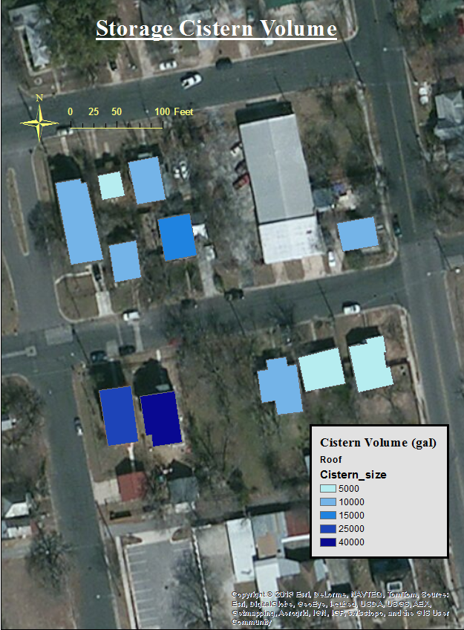
Case 2:
Semi-annual refill
Prohibitively large storage requirement

Slide 10
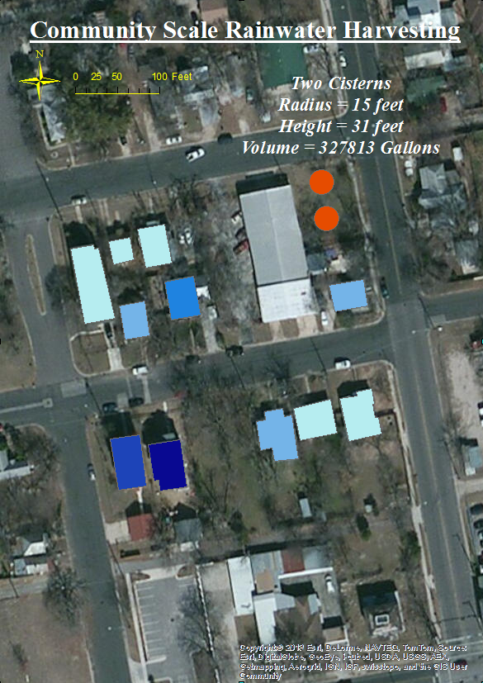
Case 1:
Annual refill

Slide 11
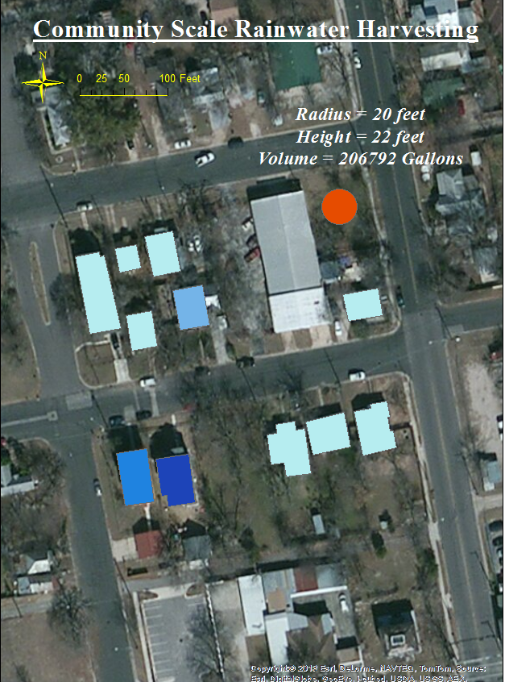
Case 2:
Semiannual refill

Slide 12
Conclusions
1) Based on storage requirements, RWH is a feasible strategy to meet domestic water demand for a majority of the residences, with the exception of high-occupancy households (greater than 4 occupants).
2) Communal rainwater storage is feasible for the neighborhood if the tank is refilled approximately twice per year.
3) ArcGIS tools aided in locating catchments and storage sites, estimating catchment sizes, and in communicating results.

Slide 13
Thank you
Dr. Maidment and Dr. Tarboton
Keenan Smith
David Venhuizen

