Slide 1
Mapping PM 2.5 Air Pollution in Texas
Zhipeng Xing
GIS 2013 Fall
Environmental and Water Resources Engineering

Slide 2
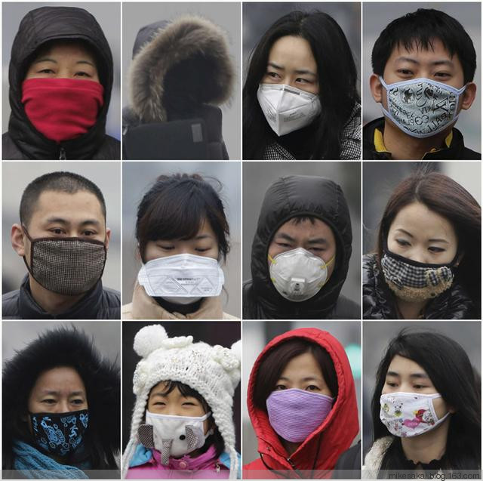
PM 2.5
Particulate Matter 2.5 um ~ 10 um
Reach into lungs
  Irritation
  Coughing/sneezing
  Asthma/heart disease
  Reduced visibility
Sources
  Automobile exhausts
  Gas/droplets reaction
  Cooking/smoking
EPA limit: annual mean 12 μg/m³

Slide 3
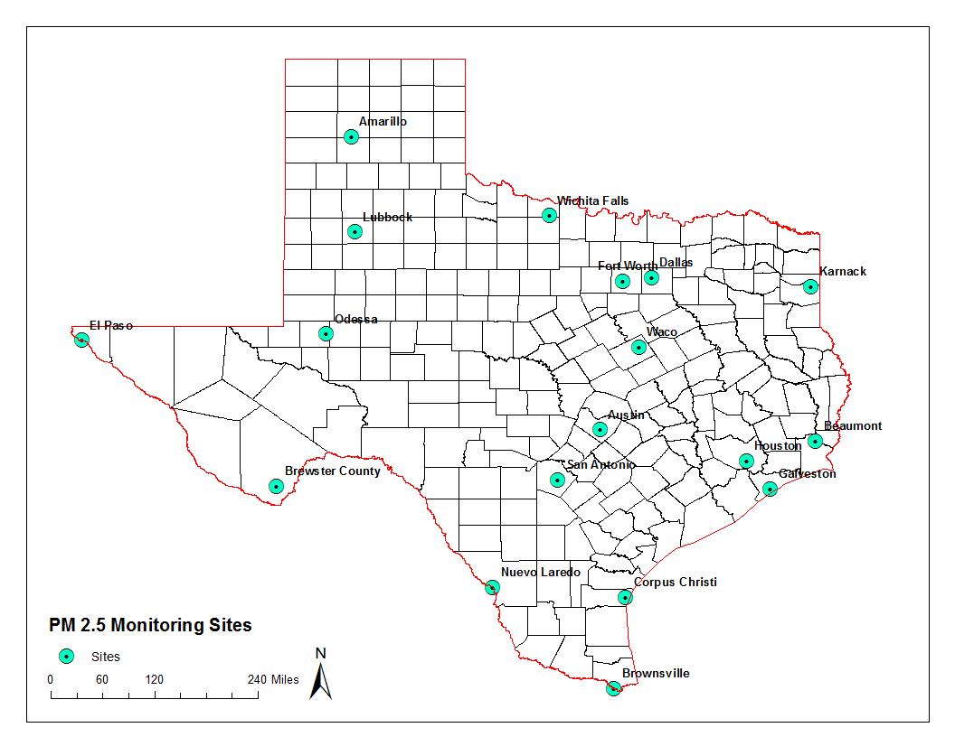
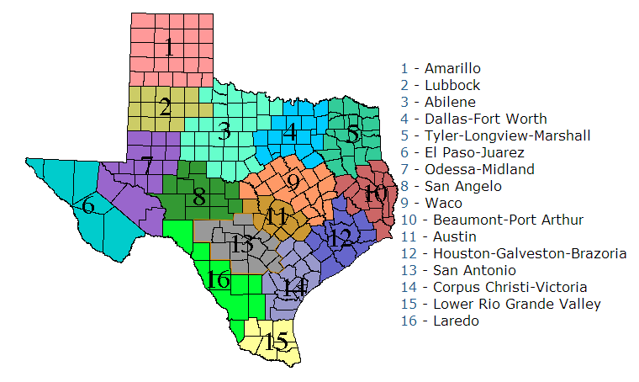
Data Source
TCEQ

Slide 4
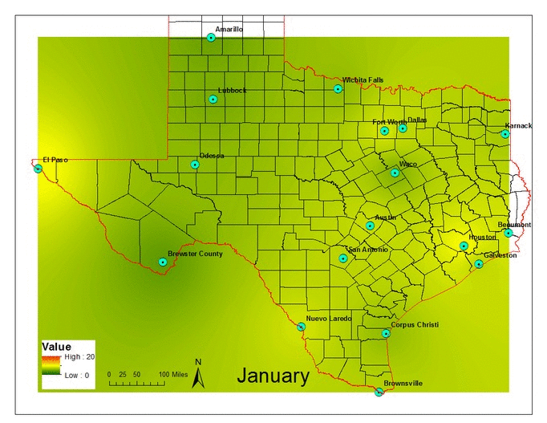
Texas PM 2.5 Monthly 2013

Slide 5
Texas PM 2.5 with Population

Slide 6
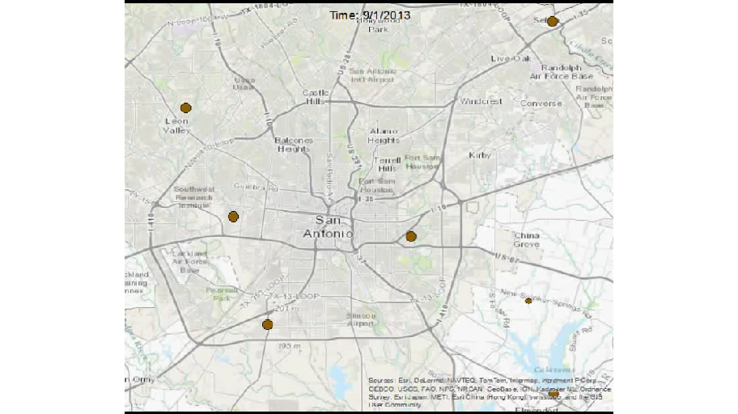
San Antonio

Slide 7
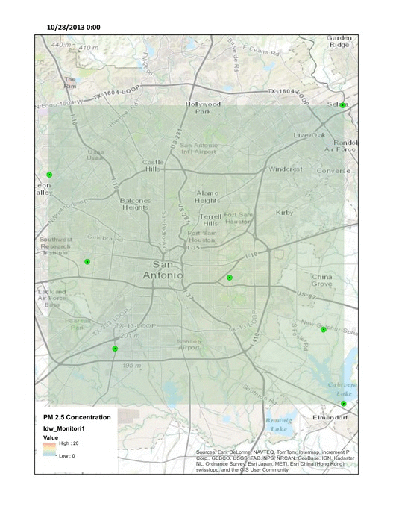

Slide 8
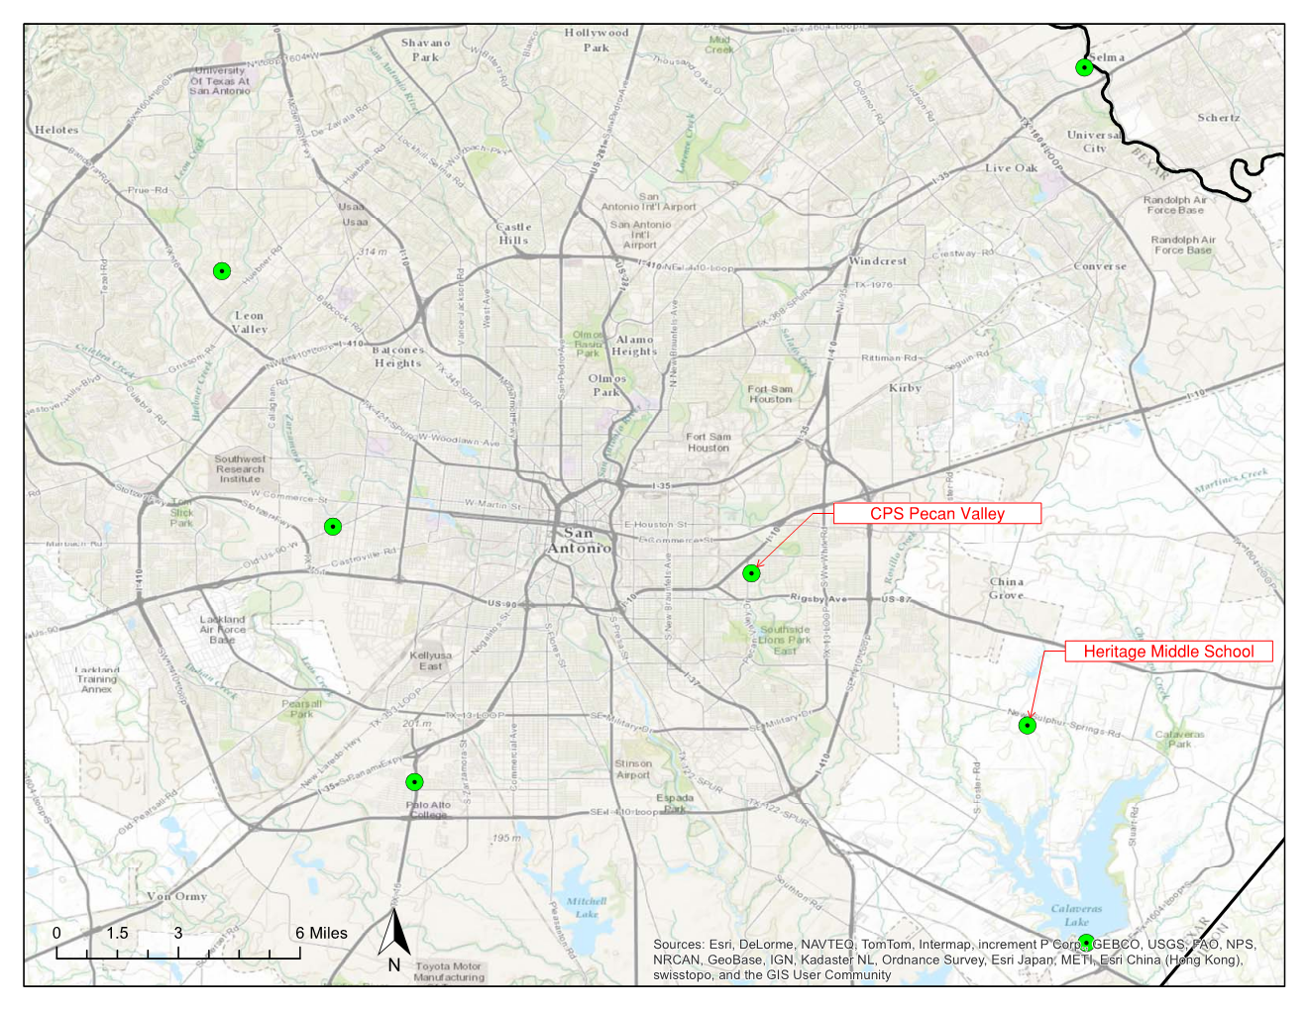

Slide 9
CPS Pecan Valley
Days above EPA limit
 | 2011 | 2012 | 2013
January | 1 | 7 | 2
February | 6 | 1 | 1
March | 12 | 3 | 3
April | 21 | 10 | 9
May | 18 | 7 | 13
June | 3 | 8 | 13
July | 8 | 11 | 13
August | 7 | 8 | 8
September | 5 | 1 | 5
October | 0 | 0 | 3
November | 1 | 4 | 4
December | 6 | 3 | 0

Slide 10
 | Rain Times | Better Times | Percent
2011 | 47 | 33 | 70%
2012 | 79 | 58 | 73%
2013 | 87 | 61 | 70%

Slide 11

Future Work
Conclusion
High concentration at high population/traffic
Temperature & Precipitation
GOOD NEWS! - No serious PM 2.5 pollution in Texas
Same analysis for the other site
FINISH THE REPORT!!!

Slide 12
Acknowledgement
Dr. Maidment

