Slide 1

Understanding Recharge to the Edwards Aquifer focusing on the Nueces River
Jenna Kromann
Jenna Kromann

Slide 2
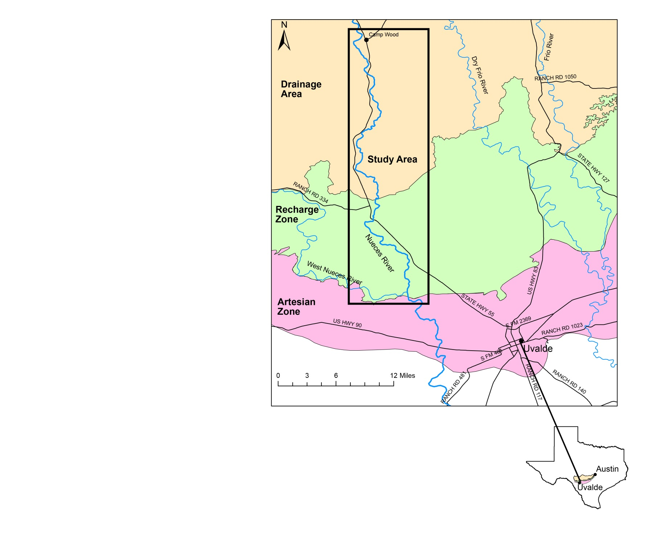
Study Area

Slide 3
Background
Twenty five percent of the world’s population relies on karst aquifers for water supply, which is why it is important to understand the recharge these systems (Ford and Williams, 2007).
Over 2 million people rely on the Edwards aquifer for drinking water, irrigation, ect. (TWDB, 2012)
Recharge from Uvalde County is about 45% of total recharge in the Edwards aquifer (Clark, 2003).

Slide 4
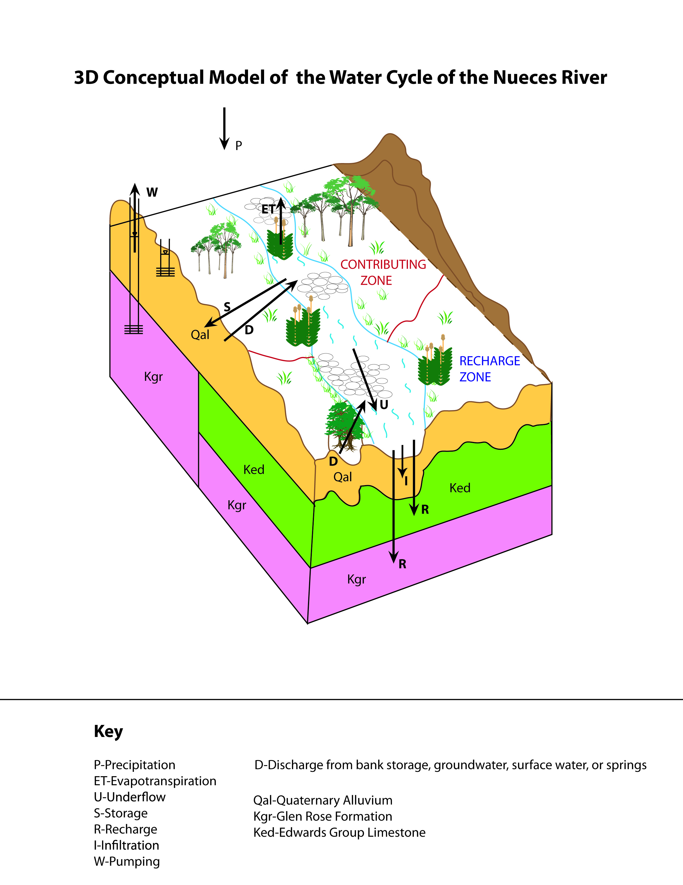
Background

Slide 5
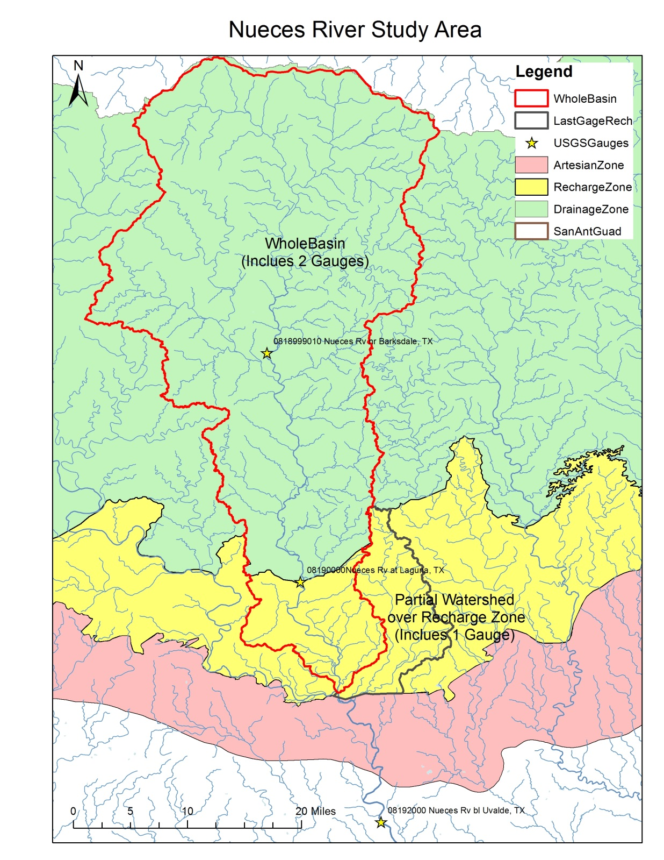
Methods
Key Equations:
NDLAS Model
P-ET-Runoff=
Recharge
Key Equations:
Stream Gauge Model
Gauge Upstream-Gauge Downstream =Recharge

Slide 6
Methods

Slide 7
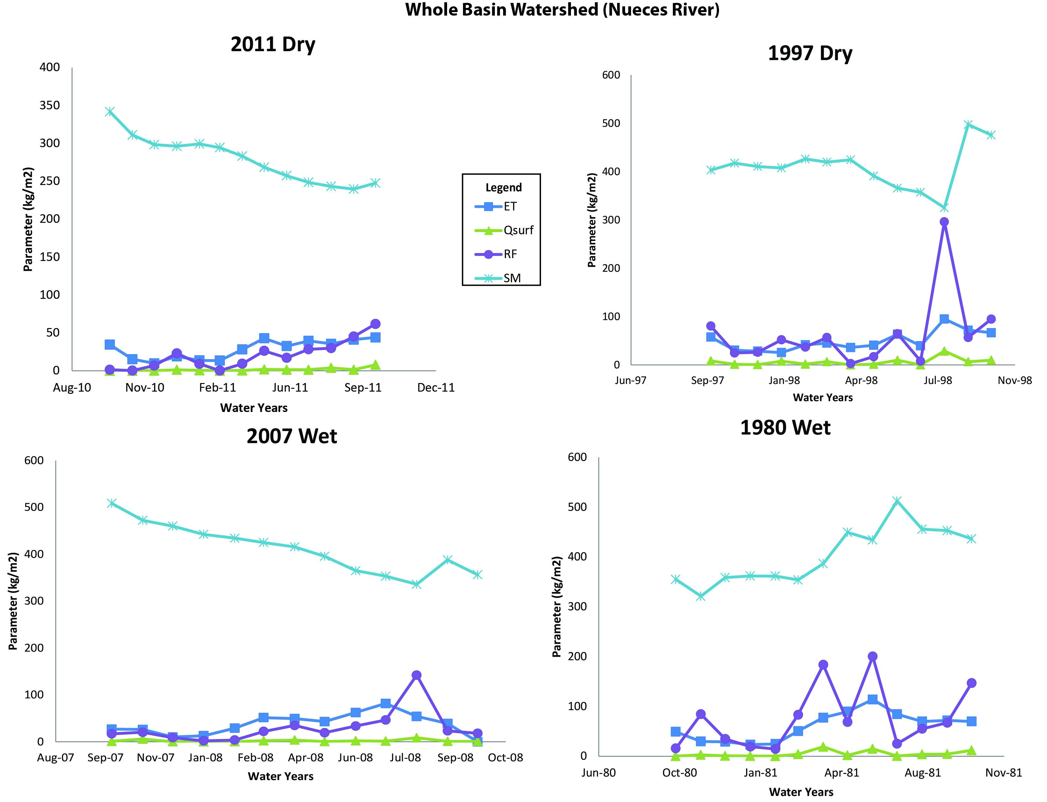
Results
1997 Dry to Wet

Slide 8
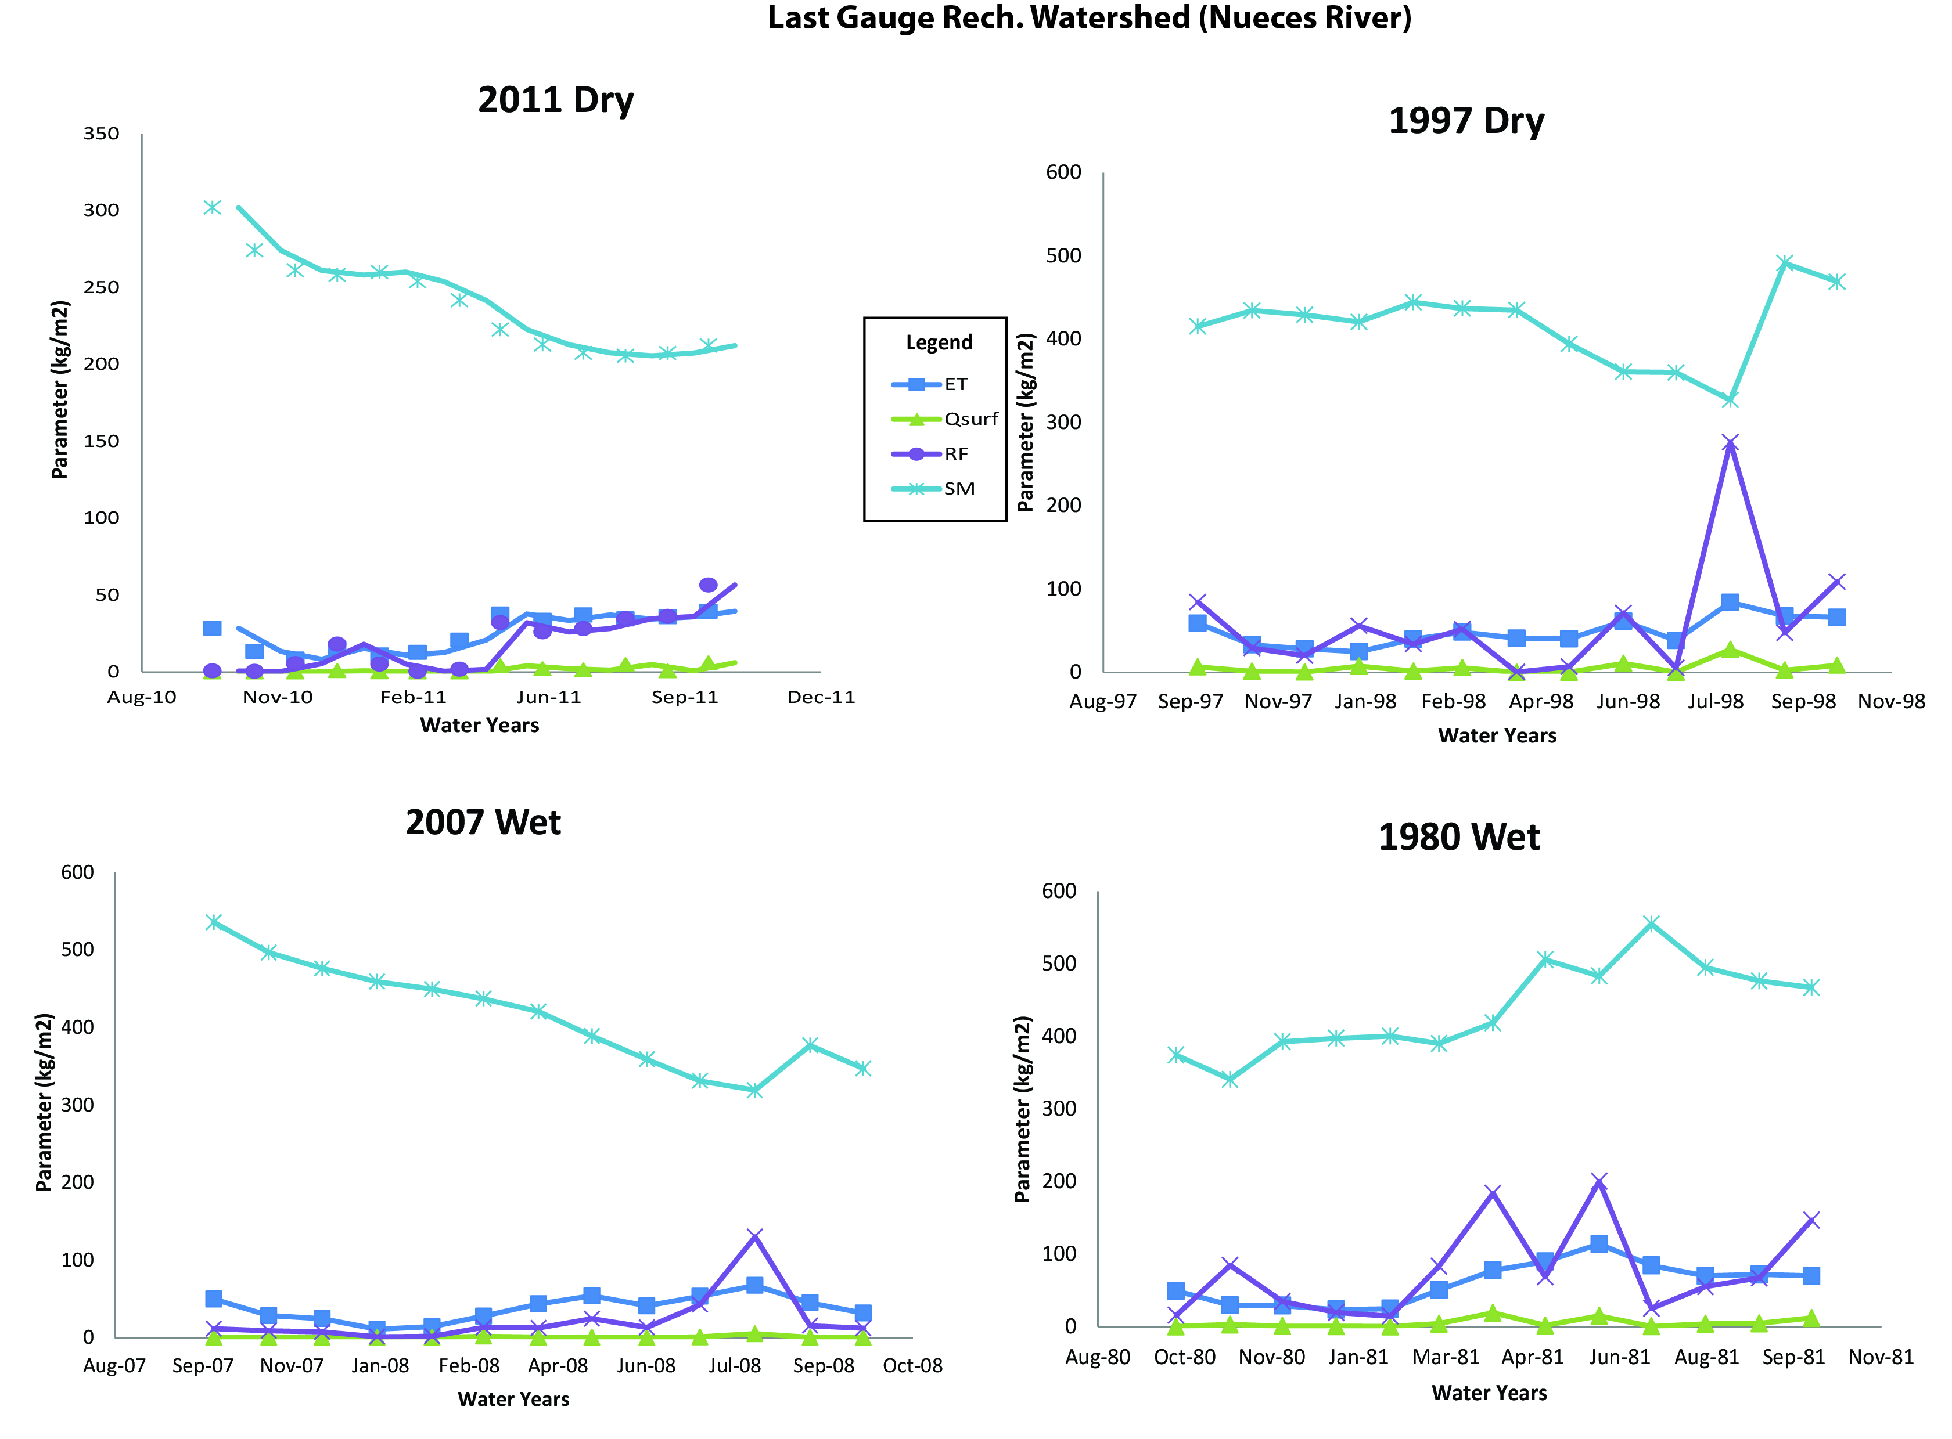
Results
1997 Dry to Wet

Slide 9
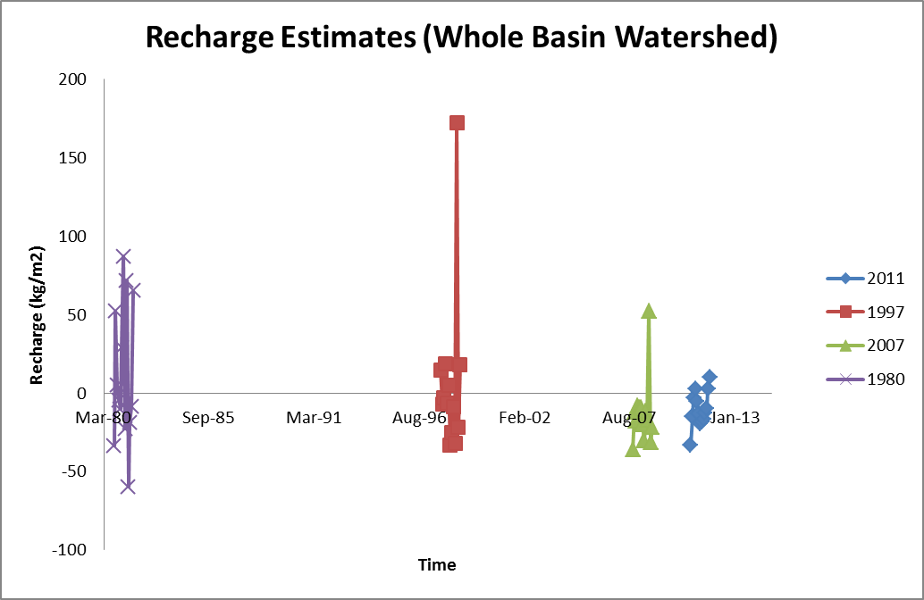
Results
Recharge Estimates using python and NDLAS data (NASA)

Slide 10
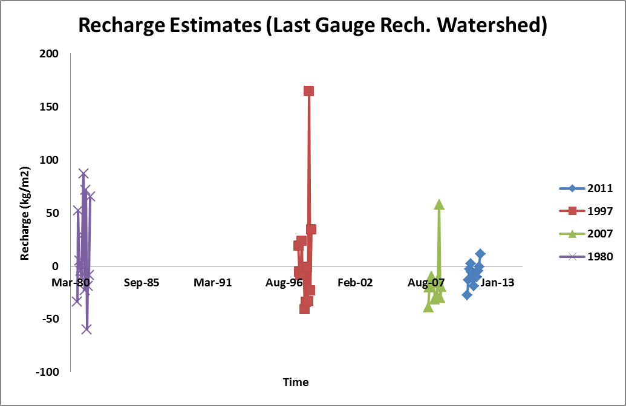
Results
Recharge Estimates using python and NDLAS data (NASA)

Slide 11
Results
Recharge from Gauging Stations
Over the Recharge and Contributing Zones
of the Edwards Aquifer

Slide 12
References
Clark, A.K., Edwards Aquifer Authority (Tex.), and Geological Survey (U.S.), 2003, Geologic framework and hydrogeologic characteristics of the Edwards aquifer, Uvalde County, Texas: U.S. Dept. of the Interior, U.S. Geological Survey ; U.S. Geological Survey Information Services [distributor], Austin, Tex. : Denver, CO.
Puente, C., 1978, Method of estimating natural recharge to the Edwards aquifer in the San Antonio area, Texas: U.S. Geological Survey Water-Resources Investigations Report,78-10.
Ford, D.C., and Williams, P., 2007, Karst Hydrogeology and Geomorphology: Wiley, Chicester.
D., Tarboton and D., Madiment, 2013, Example 5-ArcGIS Fall 2013
http://www.edwardsaquifer.org/aquifer-data-and-maps/gis

Slide 13
Questions

