Slide 1
Riparian Contributions to ET in Austin, TX
Michael O’Connor, GISWR Fall 2013

Slide 2
The Problem
Water resources are critical to manage in dry, large, and growing population centers
Austin, Austin, and Austin
We are unable to accurately assess how much water we must conserve unless we know how much water we HAVE
And thus how much we LOSE
The least constrained term in almost all water budgets is evapotranspiration
Impossible to measure directly; difficult to model
Riparian zones are large areas that are heavily with respect to water conservation
Thus, constraining water budget terms for riparian zones is helpful in determining effective conservation practices

Slide 3
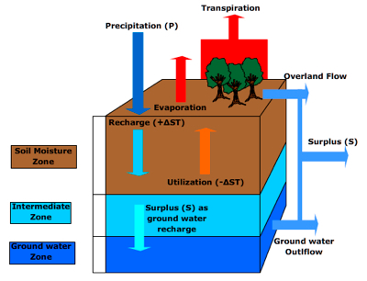
Evapotranspiration (ET) in the Water Budget
Connects each individual parcel of land to the atmosphere hydrologically
Climate buffer
Heavily dependent on vegetative profiles

Slide 4
Breaking Down ET
Evaporation
The physical process of the phase change of water
Can occur on free-water surfaces or within porous surfaces, although that is a very slow process
Directly dependent on RADIATION

Slide 5
Breaking Down ET
Transpiration
Evaporation that is ‘aided’ by plants
Plants, hydrologically speaking, are merely transport tubes that move moisture from the soil to the atmosphere (Soil-Plant-Atmosphere Continuum)
Water exits a plant through its leaves, and more specifically through stomata
Holes in leaves
The ‘openness’ of the stomata depends on the type of plant in question and its water-use patterns

Slide 6
Direct modeling through Penman-Monteith
ET is dependent on a number of factors
,where:
(R_{n}-G) is a radiation term
(e_{s}-e_{a}) is the vapor pressure deficit (humidity term)
r_{s} represents stomatal resistance…
And all other terms are constants calculated from temperature

Slide 7
Water Budget Modeling
Break a system down into a series of grid cells and model the entire water budget for the system
This is what the NLDAS attempts to do
Models such as these require incredible inputs
Land cover
Vegetation mapping
Topography

Slide 8
My Project: Stream Contributions
Determine Austin average daily ET in riparian zones using Penman-Monteith (P-M) and GIS
Collected of accurate model parameter information for a typical Austin riparian profile
Radiation
Humidity/temperature
Stomatal conductance
Ran P-M model for said environment
Extrapolated calculated ET over riparian areas of Austin

Slide 9
My Project: Stream Contributions
Determine Austin average daily ET over a month using NDLAS and ArcMAP
Downloaded hourly data for evaporation and transpiration for selected time frame over the same aerial extent as my P-M calculations
Calculated zonal averages for each hour across the month

Slide 10
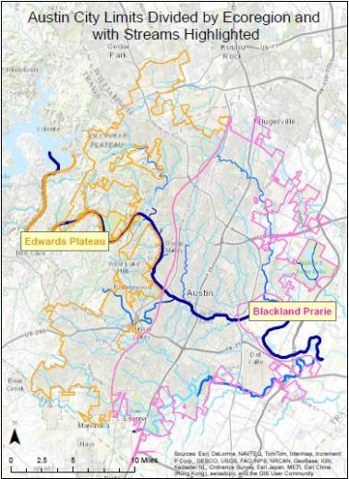
My Project: Study Area
The outer line represents the political boundary of the City of Austin
For P-M modeling, the two distinct ecoregions of Austin were considered because their vegetation profiles differ
A separate shapefile was utilized to determine canopy regions
This shapefile was considered the modeling extent for NLADS modeling and P-M area extrapolation

Slide 11
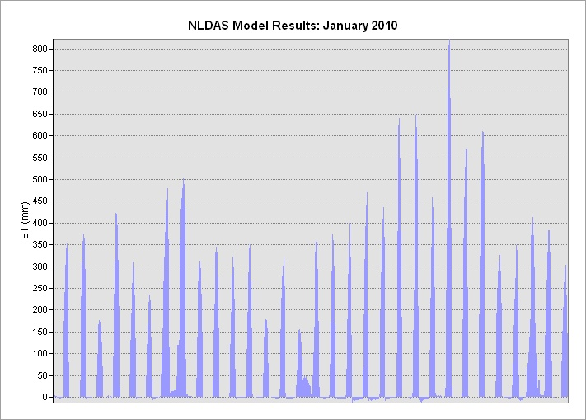
My Project: Results

Slide 12
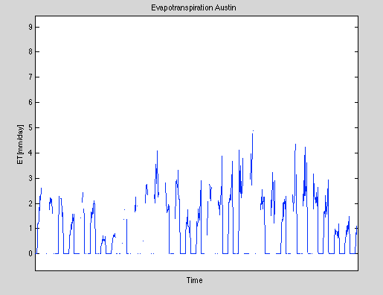
My Project: Results

Slide 13
My Project: Results
Riparian Zones (Jan. avg):
Perennial streams, Edwards: 470 m^3/day
Intermittent streams, Edwards: 4500 m^3/day
All streams, Blackland Prarie: 5840 m^3/day
Total riparian ET: 10,820 m^3/day
NLDAS Approximation (Jan. avg):
Total potential ET: 1.72E09 m^3/day

Slide 14
My Project: Results
Areal Comparison
Riparian: 5.7 km^2
Total city: 704 km^2
Riparian share: 0.8% of total city area
Riparian share of ET: 0.0006% of total city ET
NOT a large contributor, even when water is flowing high

Slide 15
My Project: Discussion
Scaling up is difficult!
P-M showed MUCH higher water losses due to ET than the NLADS model (double!)
Sources of error all seem plant-based:
NLADS does not consider plant type, thus does not accurately account for the transpiration occurring
My study averaged plant communities that most likely can not be averaged
Stomatal conductance data was taken from labs and not tested directly

Slide 16
Future Work
Analyze more months (just fixed Python code so this is coming!)
Perform sap-flow measurements or pan evaporation measurements to ‘check’ NLADS and P-M
More accurately survey and determine Rs values

Slide 17
Questions?
Thanks to Dr. Maidment, Dr. Tarboton, and Dr. Moffett for assistance with this project

