Slide 1
Effects of Urbanization on Water Resources in Johnson County, KS
Meagan Malloy
CE 394K

Slide 2
Background
Decade | Population | % Change
1940 | 33327 | --
1950 | 62783 | 88%
1960 | 143792 | 129%
1970 | 217662 | 51%
1980 | 270269 | 24%
1990 | 355054 | 31%
2000 | 451086 | 27%
2010 | 545750 | 21%

Slide 3
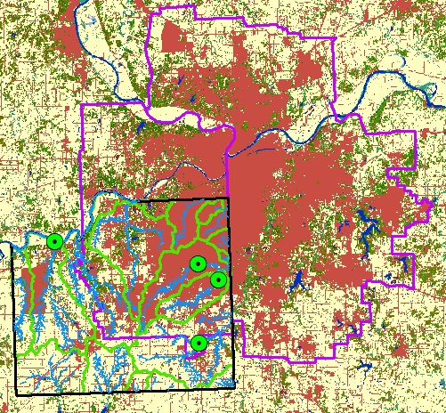
Purpose
Visualize the effects of urbanization on peak discharge, and water quality

Slide 4
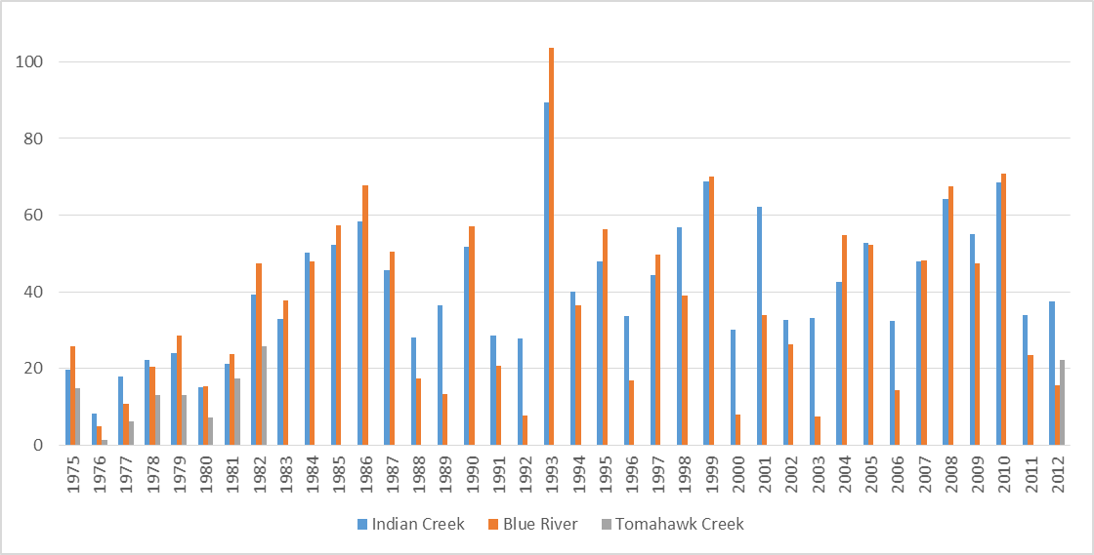
Notes:
Major flooding in 1993

Slide 5
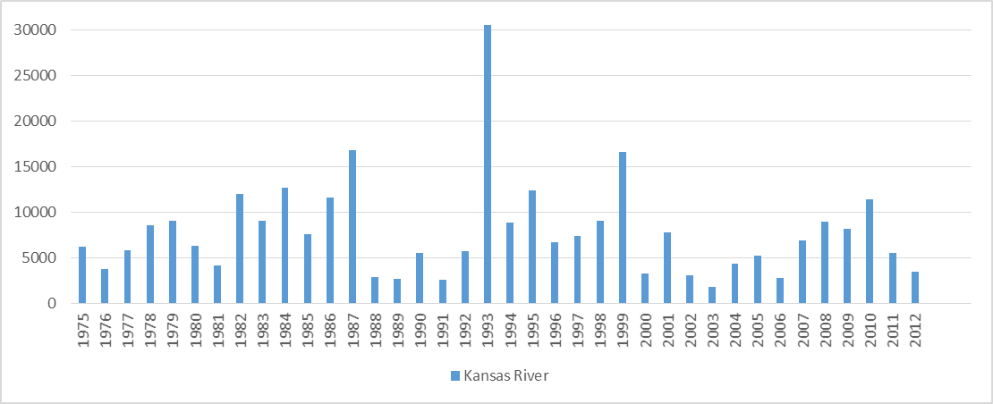

Slide 6
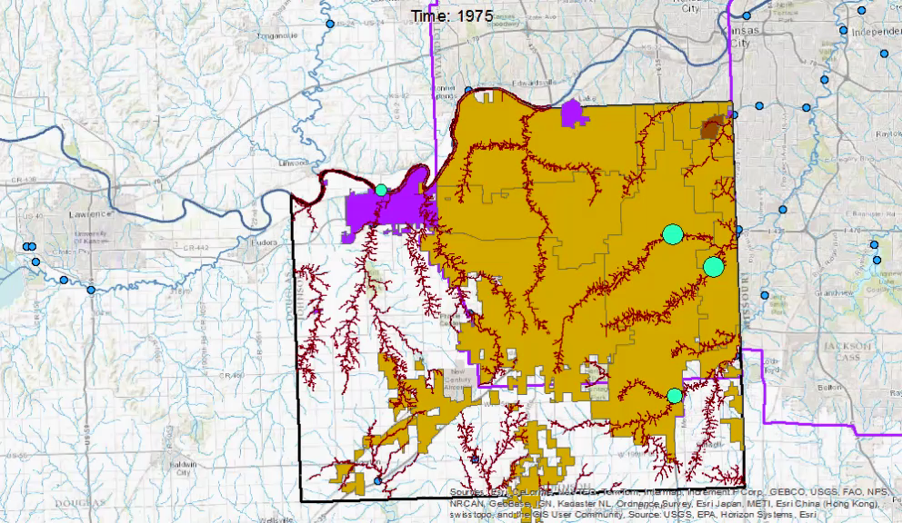
Preliminary Results
Percent Changes in Population and Gage Data
1975 – 2012
Notes:
Shows how the peak discharge at the changes and the percent changes in population. When the areas are anything other than the yellowy color then the population is decreasing in that city. The areas that are not color are very rural areas. There are farms and townships but not worth mentioning for the purpose of this study since they are outside of the urbanized area. There is also not historical gage data for those areas.

Slide 7
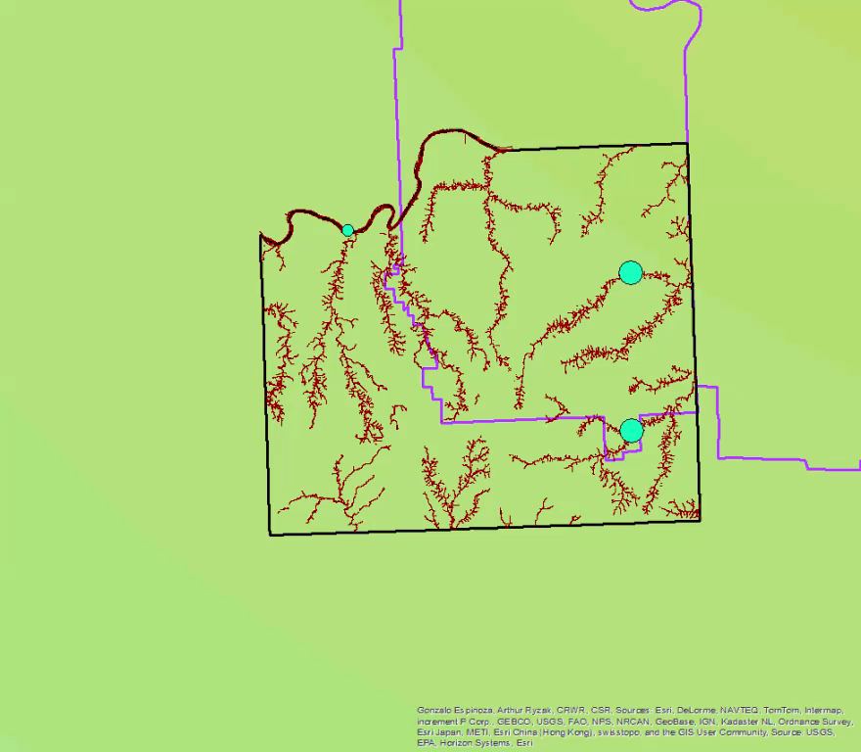
GRACE vs Gage
Shows soil storage and peak flow
2004 – 2012
Notes:
This video shows the changes in discharge at the gage vs the GRACE soil storage data. The discharge is normalized with respect to drainage area.

Slide 8
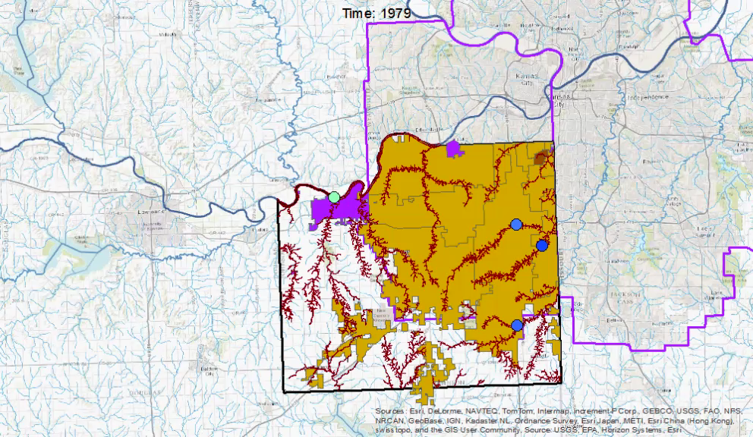
Water Quality Data
Water Temperature vs Percent Change in Population

Slide 9
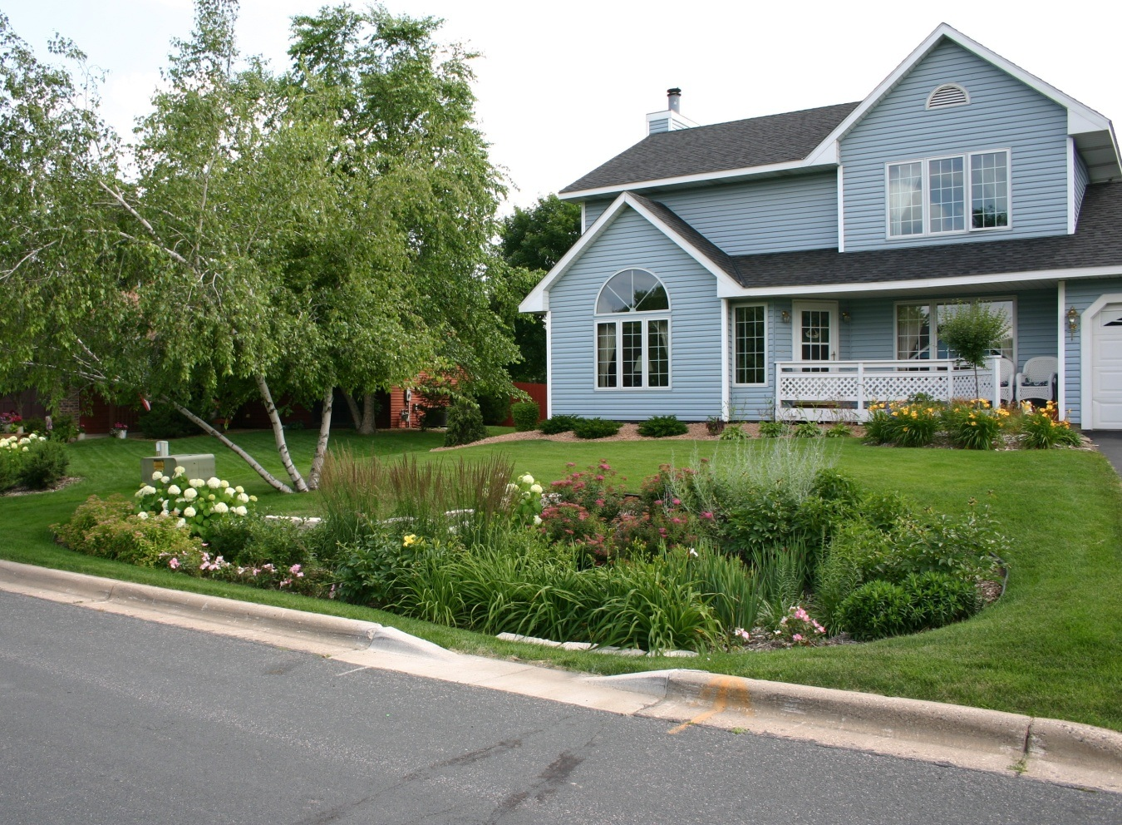
Interesting Information
Olathe’s Cost Share Reimbursement Program (2011)

Slide 10
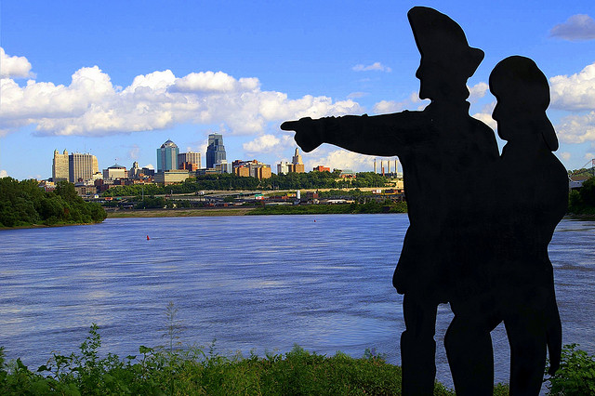
Questions?

