Slide 1
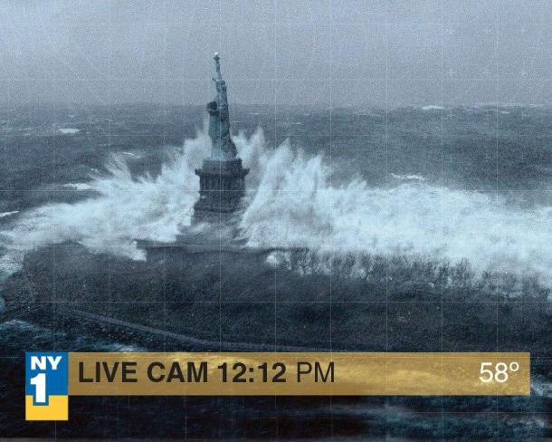
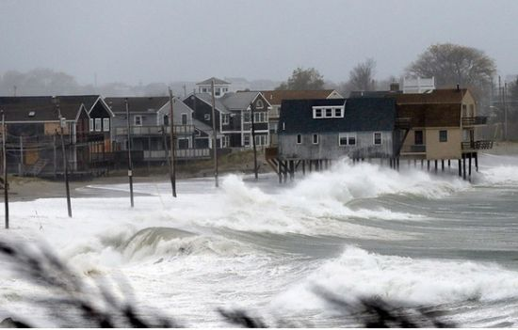
Storm Tide and Flooding from Hurricane Sandy In New York City
Xing Zheng
Water Resources GIS
Dr. David Maidment

Slide 2
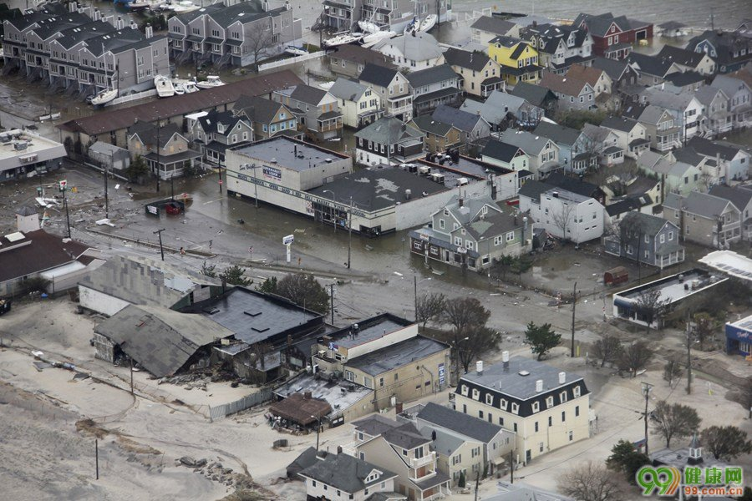
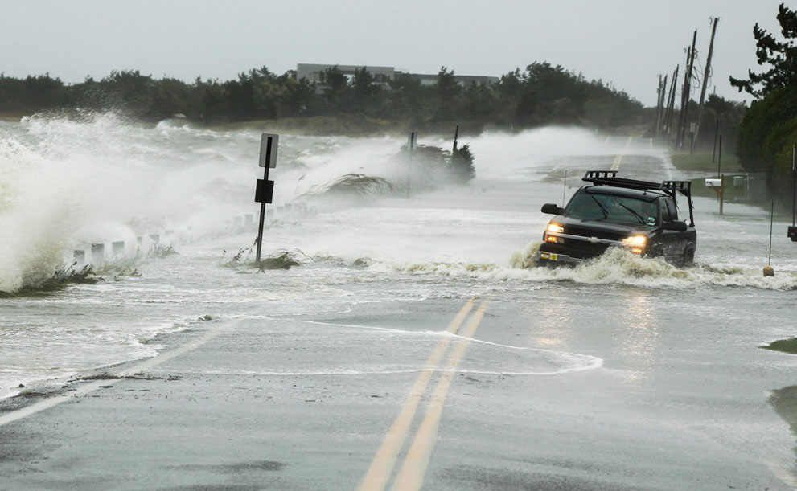
Background
Hurricane Sandy was the deadliest and most destructive hurricane of the 2012 Atlantic hurricane season, as well as the second-costliest hurricane in United States history. -- Wikipedia
Its storm surge hit New York City on October 29, flooding streets, tunnels and subway lines and cutting power in and around the city. Damage in the United States amounted to $65 billion (2013 USD).

Slide 3
Objective
Depending on the water-level monitoring network, we can determine the storm surge height at various gage points.
Combining these heights with the DEM of NYC, we can decide which part of the city was flooded at different moments. It can tell us how far inland such a storm surge would penetrate.

Slide 4
Data Source
Water-Level Data
USGS Streamgage
Observational
Fixed-place Networks
USGS Tidal Stations
Monitoring
Network
NOAA Tidal Stations
Water-Level Senors
Temporarily
Deployed Sensors
Wave-Height Senors
Real-time Rapid
Deployment Gages

Slide 5
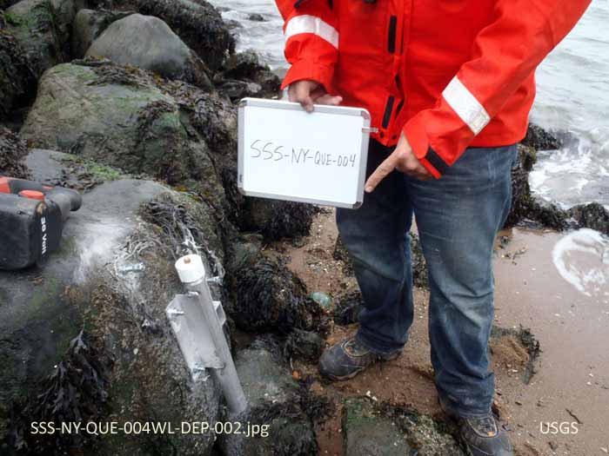
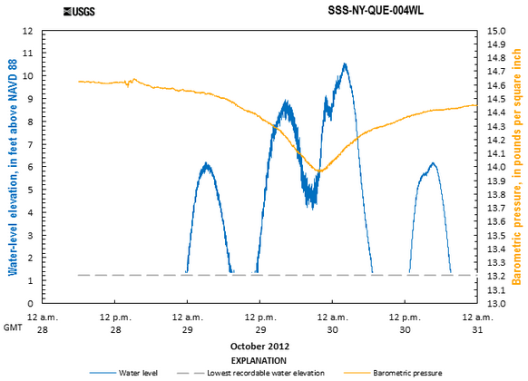
Data Source
a hydrograph displaying water elevation data recorded at a site during Sandy
A Water-Level(Storm-Tide) Sensor

Slide 6
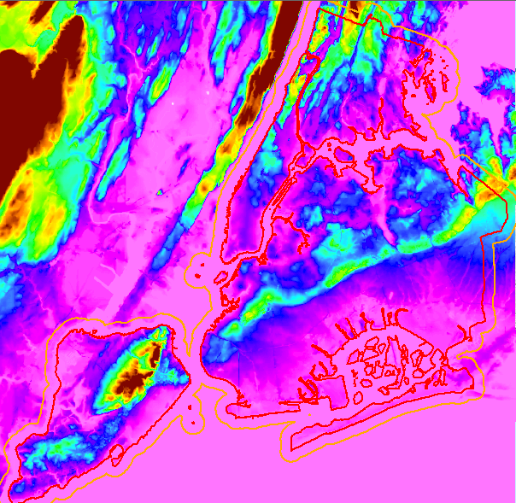
Data Source
DEM--1/3 Arc Second(10m×10m) DEM for NYC

Slide 7
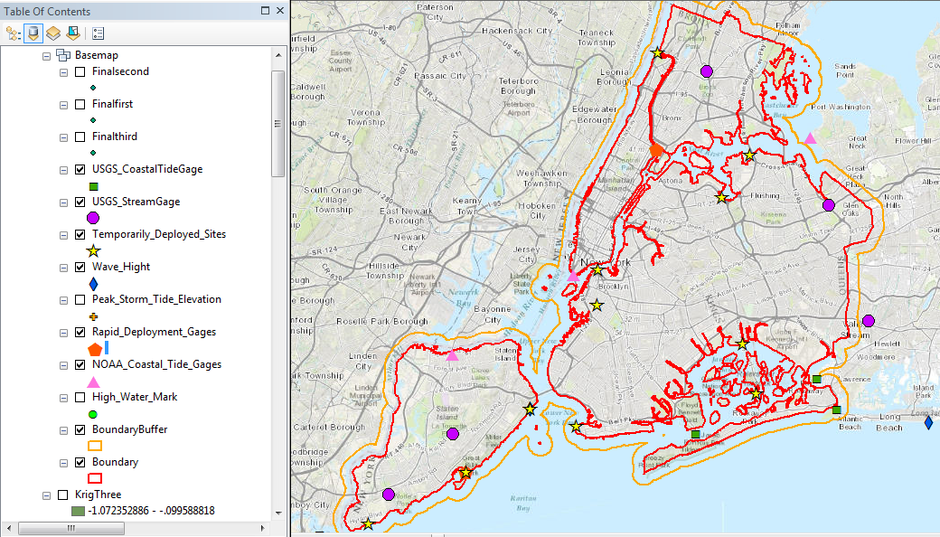
Result
Distribution of Different type sites in New York City

Slide 8
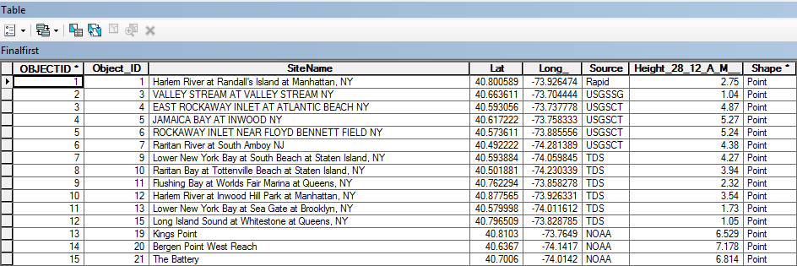
Result
Table of Sites Information and Water Levels at 12 A.M., Oct. 28th, 2012

Slide 9
Result
Water-Level at Different Sites
(Point Values)
A Sea Surface for The Whole Area
(Area Value)
Interpolation
Natural
Neighbor
Interpolation
Kriging
Interpolation
http://dilbert.engr.ucdavis.edu/~suku/nem/nem_intro/node3.html
http://www.nbb.cornell.edu/neurobio/land/OldStudentProjects/cs490-94to95/clang/kriging.html

Slide 10
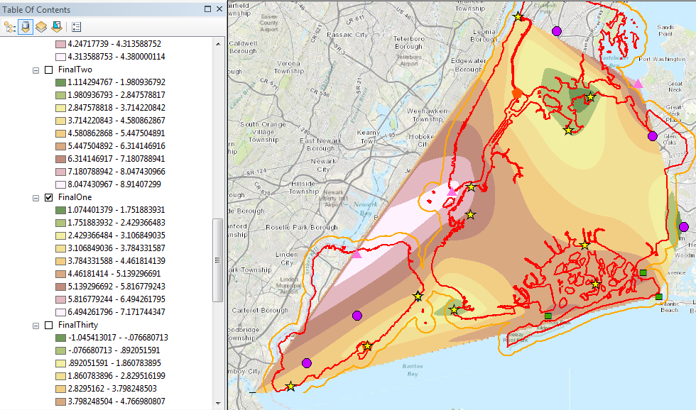
Result
Sea Surface from Natural Neighbor Method
12 A.M. Oct 28th, 2012

Slide 11
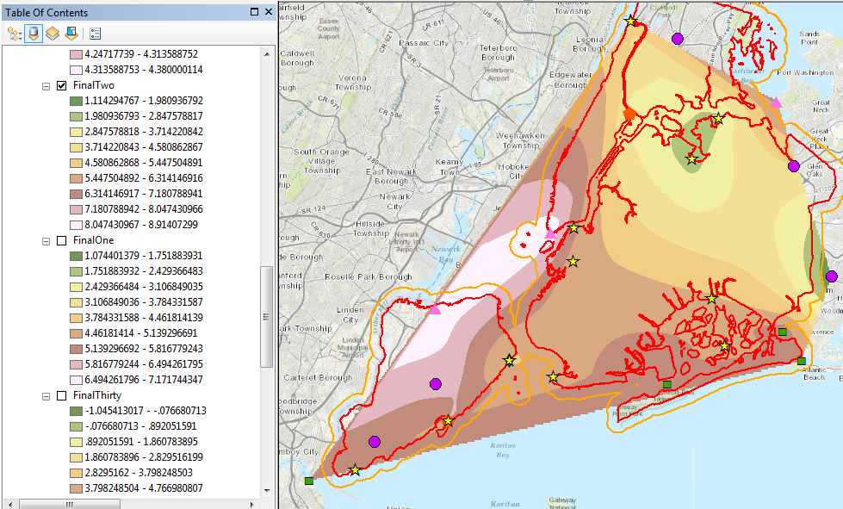
Result
Sea Surface from Natural Neighbor Method
12 A.M. Oct 29th, 2012

Slide 12
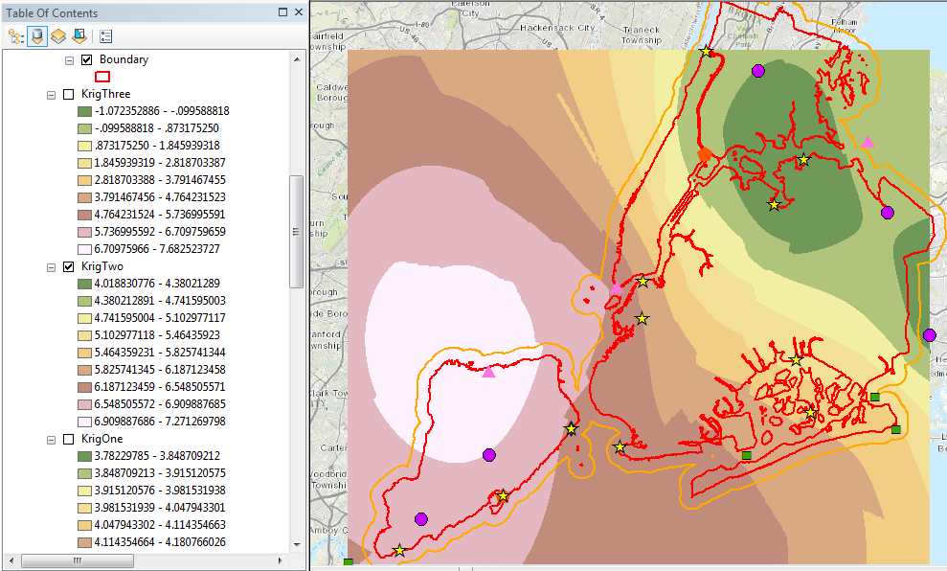
Result
Sea Surface from Kriging Method
12 A.M. Oct 29th, 2012

Slide 13
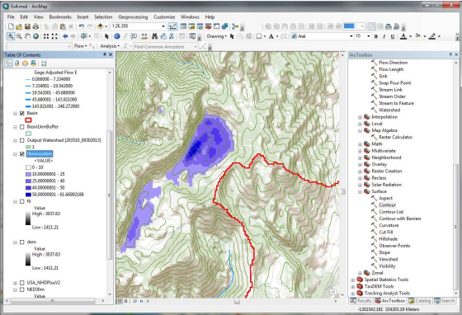
Result
Recall our experience in Ex 4, we did a raster calculation named "fill"-"dem", and found the Peter Sink.
Similarly, set the condition as
"dem"-"sea surface "<0, and do the raster calculation. Then we can know which part of the city was flooded at different moment!

Slide 14
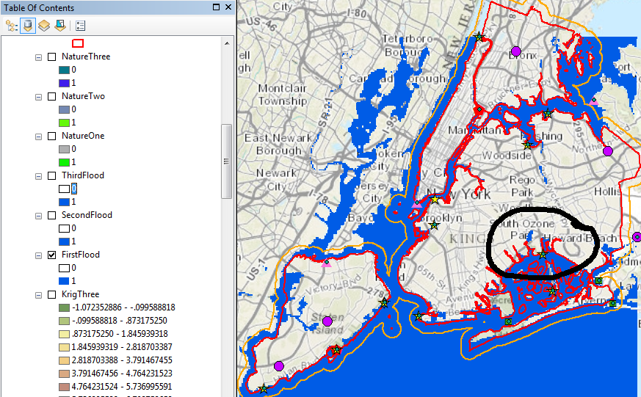
Result
Flood Map from Kriging Method
12 A.M. Oct 29th, 2012

Slide 15
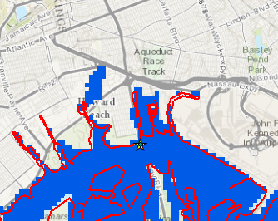
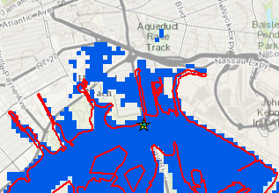
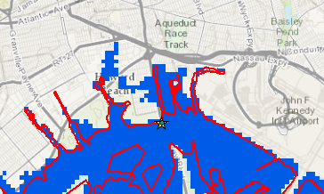
Result
12 A.M. Oct. 28
12 A.M. Oct. 29
12 A.M. Oct. 30

Slide 16
Problem
Transformation (Coordinate System,Time Zone,Unit,…)--Call for Uniform Standards
Tediously Repetitive Work--Call for Programming to create more tools
Big Data--Long time to load. How to keep the balance between the Resolution and the Processing Efficiency

Slide 17
Future Work (if time available…)
Consider the effect of inland flood caused by precipitation
Use higher resolution DEM gotten from LIDAR Dataset
Try other interpolation methods and find the optimal solution
Do similar work for more timely events such as Typhoon Haiyan in Philippines
Try some programming work

Slide 18
The End
Special thanks to the instruction of
Dr. Maidment and Carlos Galdeano!

