Slide 1
Spatial Variability of Kelp Growth in the Steffanson Sound Boulder Patch
Christina Bonsell
GISWR 2013
November 21, 2013

Slide 2
Purpose: determine patterns of linear kelp growth over space and time

Slide 3
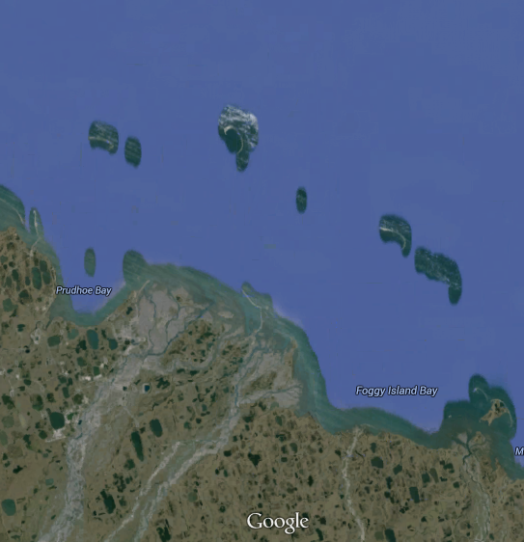
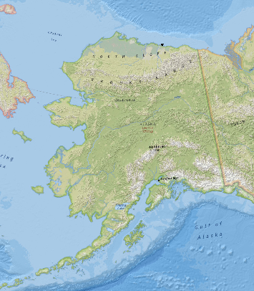
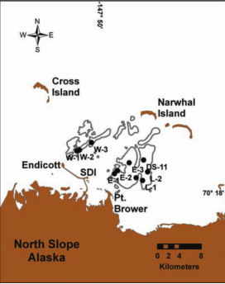
Where are we?
Boulder Patch map from Dunton 2009

Slide 4
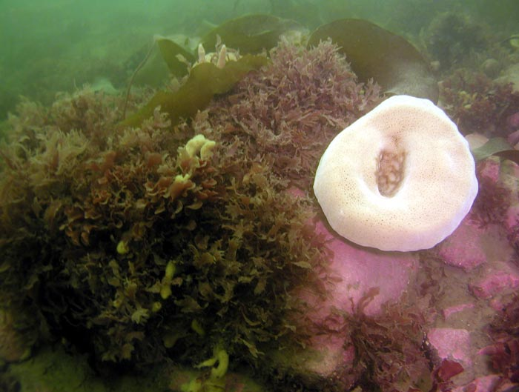
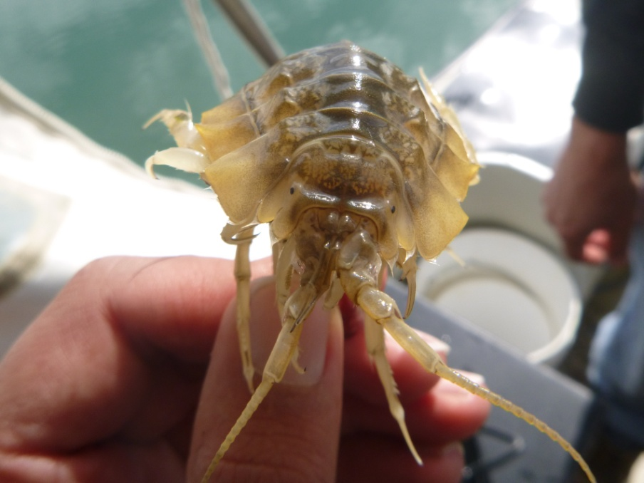
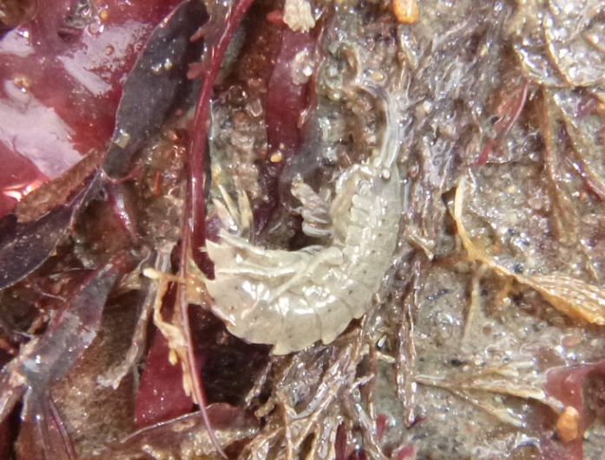
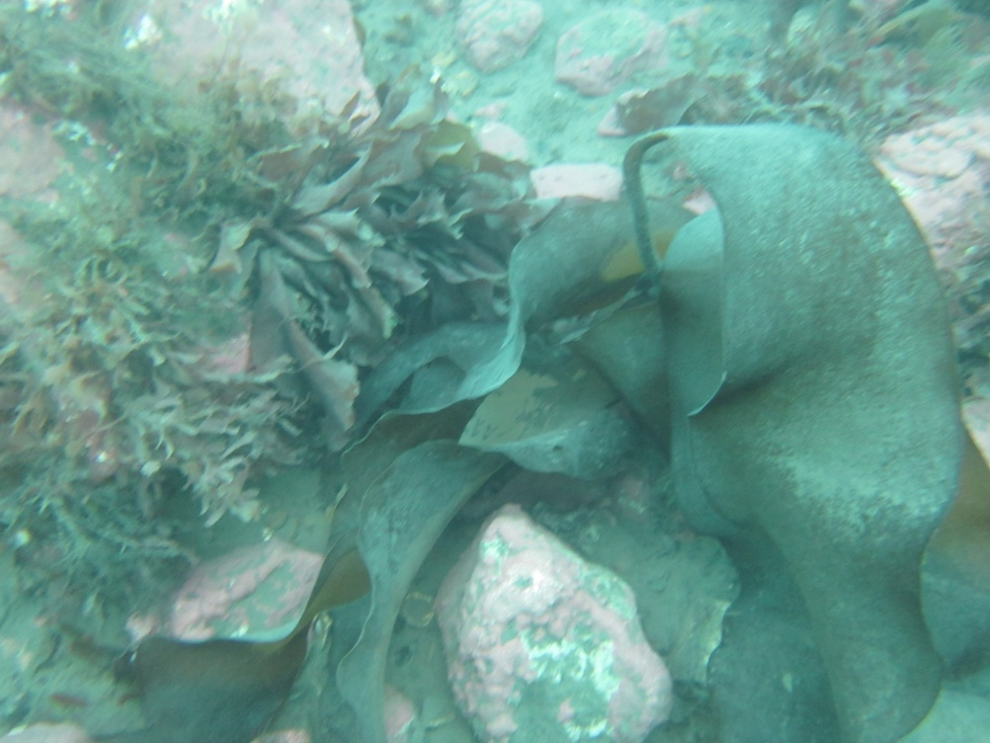
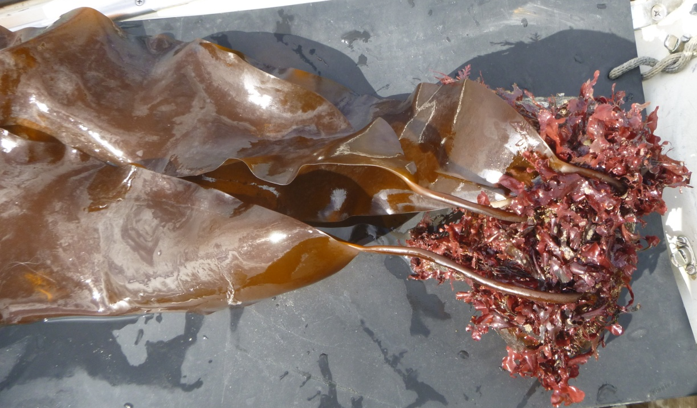
What are we looking at?

Slide 5
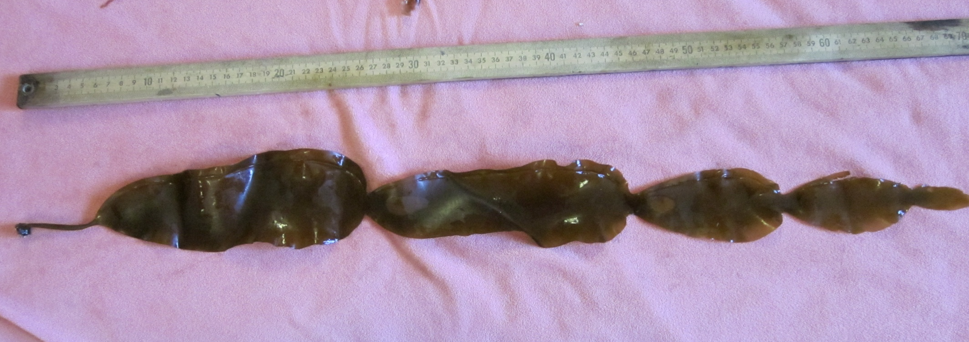
What are we looking at?
Blade
Stipe
This year
1 year old
3 yrs old
4 yrs old
5 yrs old

Slide 6
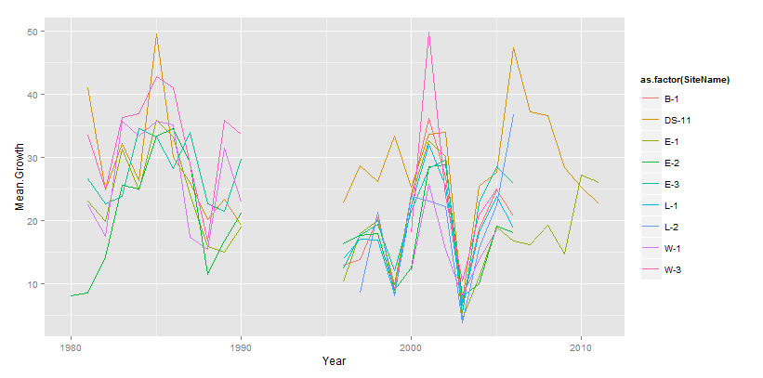
Growth per site

Slide 7
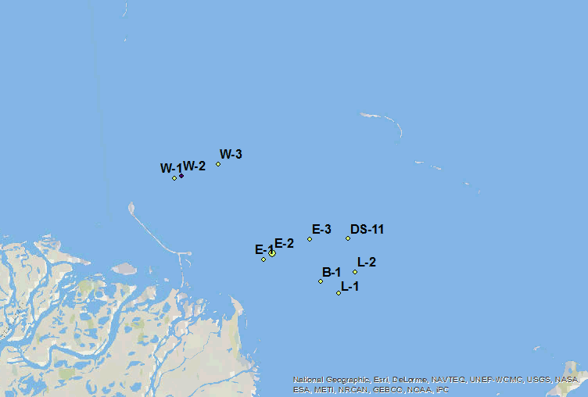
Growth per site

Slide 8
Growth interpolated over area: all years
1980-2009

Slide 9
Growth interpolated over area per year
1988
2003

Slide 10
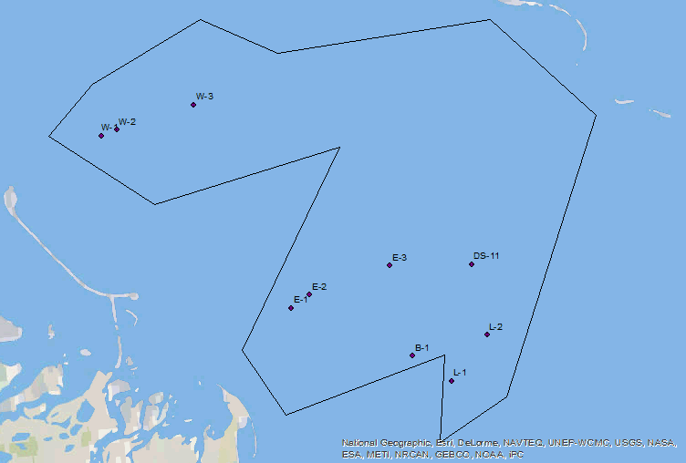
Growth interpolated over area per year
1981-2006

Slide 11
What’s left?
Short term
  polish up maps
  Calculate statistics
  Continue attempts to get Boulder Patch shapefile
Longer term
  Collect density data for productivity calculation
    Growth/individual* individuals/m² = growth/m²

Slide 12
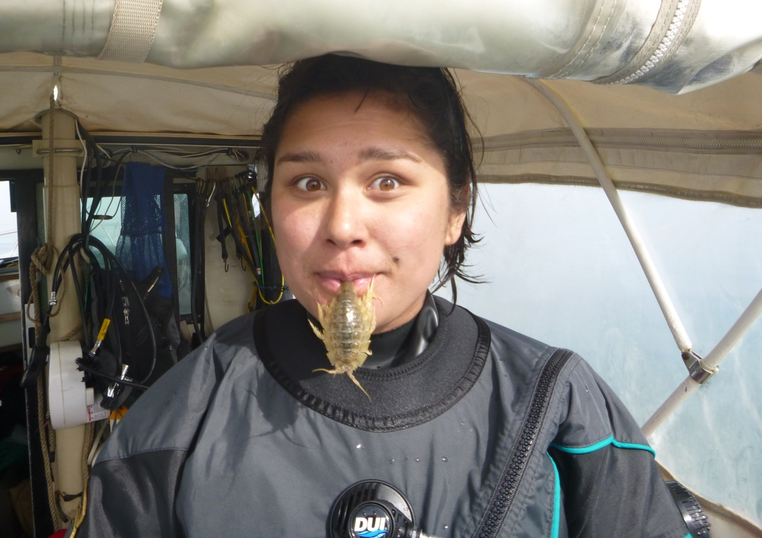
Thank you!
QUESTIONS?

