Slide 1
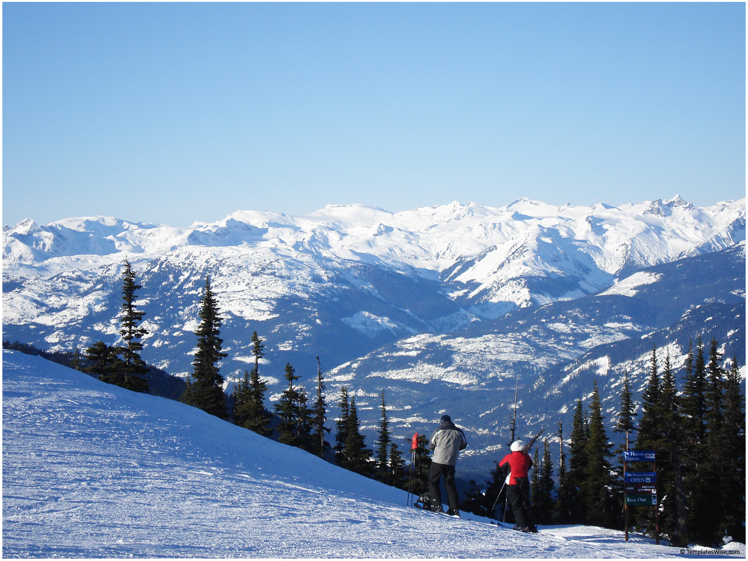
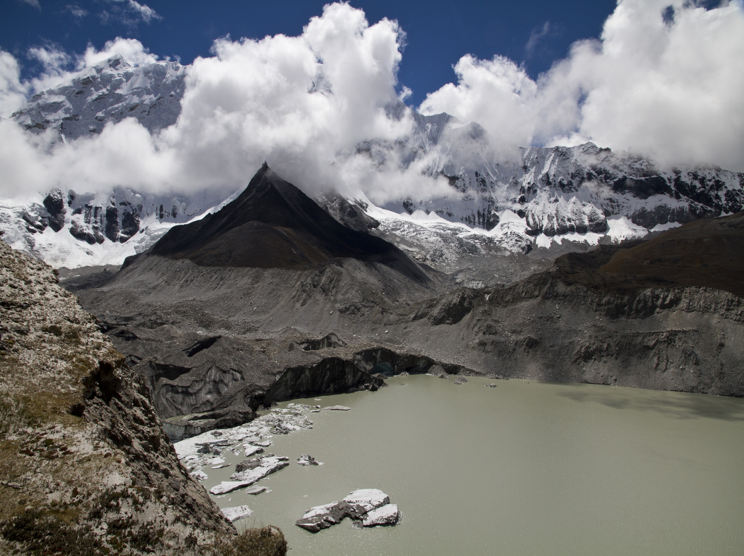
Mapping the surface of
Imja Glacier, Nepal
GIS in Water Resources Fall 2013
Clayton Ernst

Slide 2
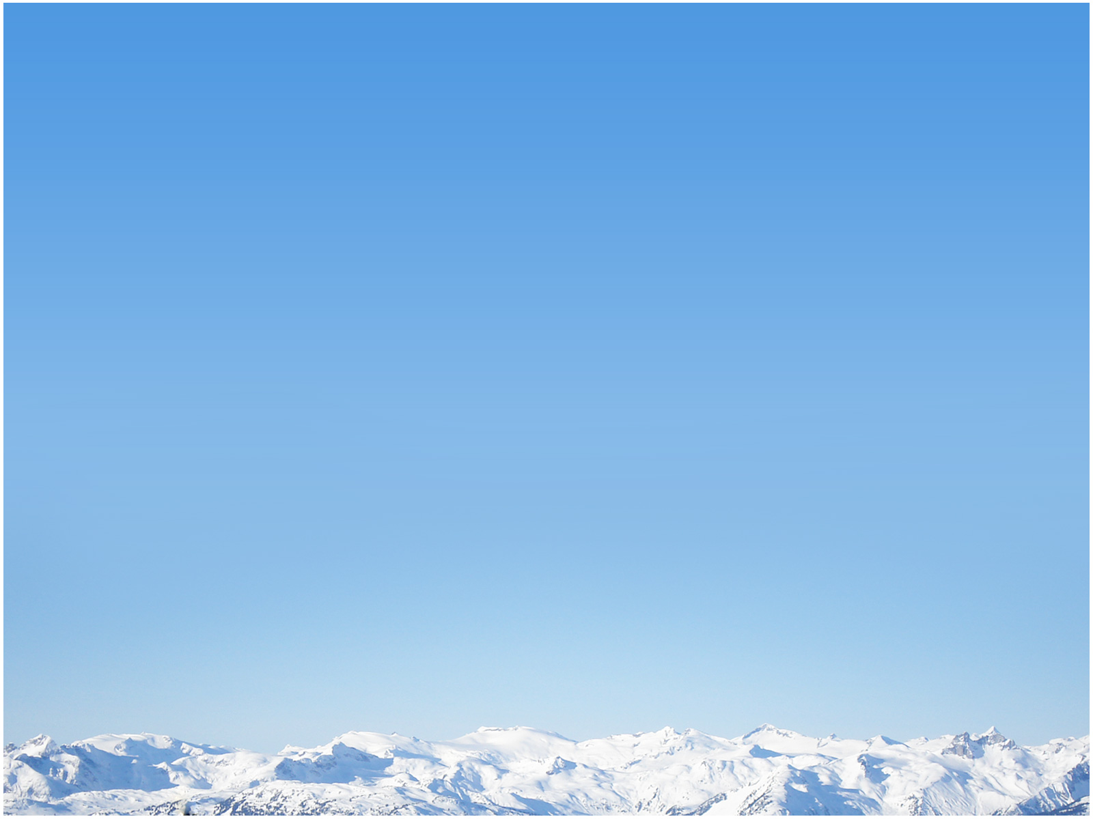
What is the Problem?
Climate Change → Warmer Alpine Temperatures → Melting Glaciers
→ Formation of Glacial Lakes
Potential for Glacial Lake Outburst Floods
& devastating consequences downstream
Lack of Understanding of Glacial Melting
→ Need for more accurate melt models
(to inform disaster planning & preparation)

Slide 3
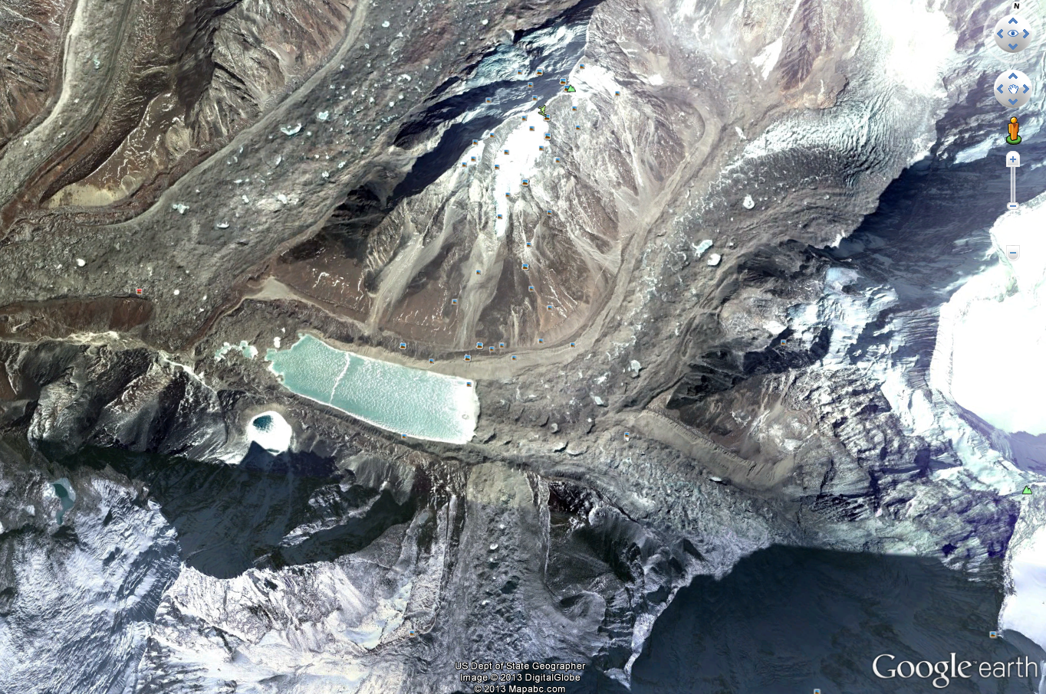
Focus: Imja Tsho, Nepal
Analyze recently collected field data of debris cover thickness
Correlate with digital surface model
Infer debris thickness across extent of glacier
GOALS:
Notes:
Note debris thickness’ importance in formulating energy balance -> melt model

Slide 4

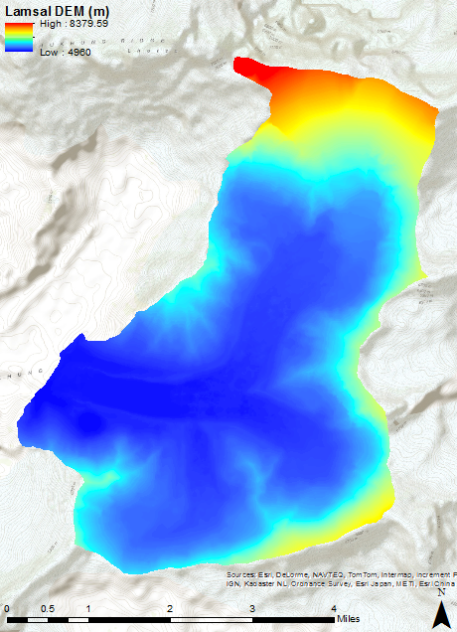
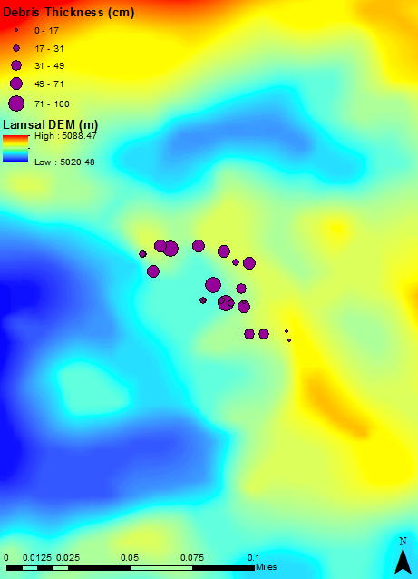
Data Summary
DEM from ALOS PRISM by D. Lamsal, 2006
5m spatial resolution (1/6 arcsec)
Debris thickness measurements by Dave Rounce of McKinney Research Group (CRWR-EWRE)
September 2013
Notes:
ALOS = Advanced Land Observing Satellite, PRISM = Panchromatic Remote-sensing Instrument for Stereo Mapping (by JAXA = Japan Aerospace Exploration Agency)

Slide 5
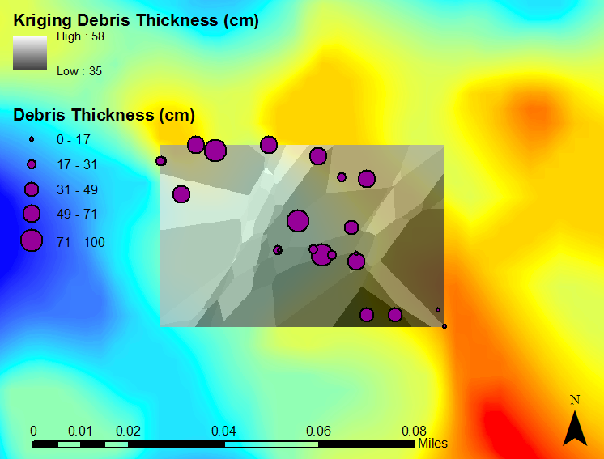
Interpolation Attempt: Kriging
Note: N = 22

Slide 6
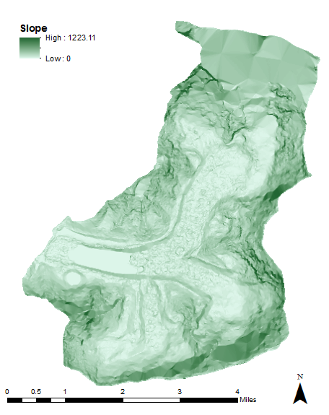
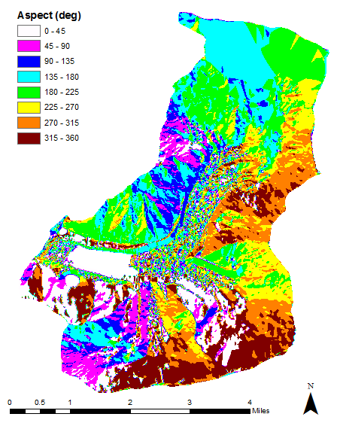
Digital Surface Model

Slide 7
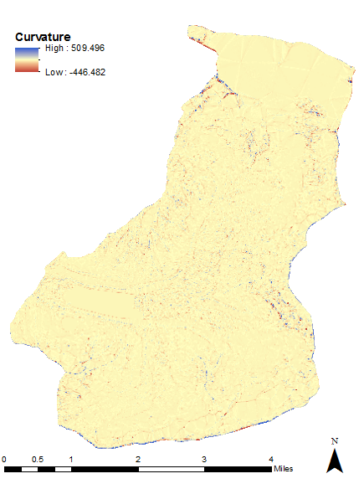
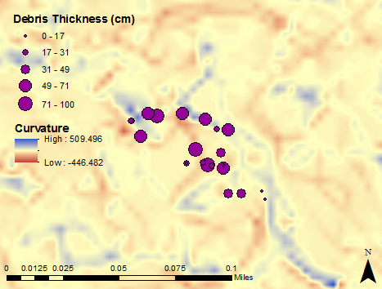
Digital Surface Model
Next:
Attempt to find correlations between
slope, aspect, or curvature and debris thickness

Slide 8
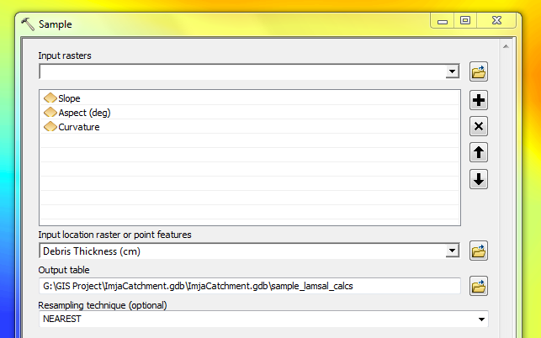
DSM Correlations
Notes:
Note possible negative correlation with slope (maybe expected physically??)

Slide 9
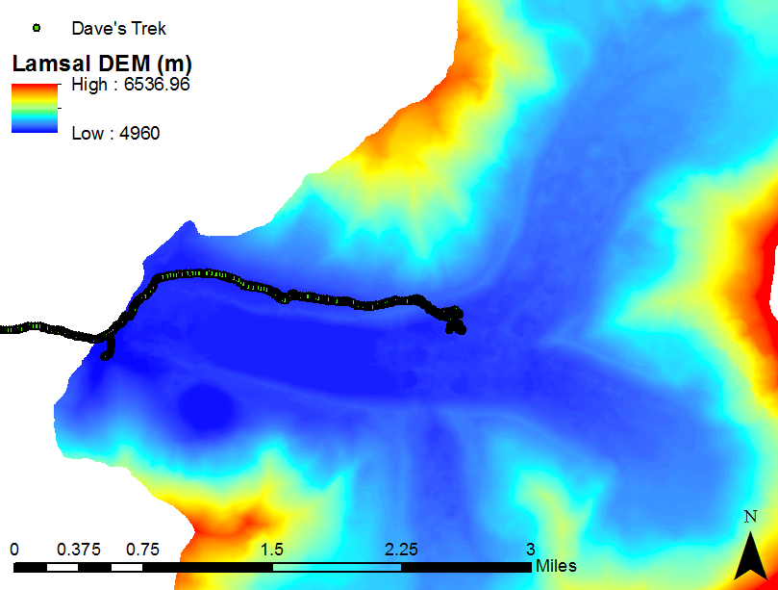
Elevation Discrepancy
Notes:
First imported GPS tracker data, in correct GCS. Then, use “Sample” tool once again to pair DEM elevations with GPS elevations (where overlap)

Slide 10
Elevation Discrepancy
Lamsal DEM vs. GPS Tracker Recorded Elevation
On-glacier
Notes:
GPS accuracy: +/- 10m in x-y; +/- <3m in z

Slide 11
Results & Future Work
Imja glacier’s surface is complex and dynamic
More comprehensive is data required to make meaningful inferences
Perform further statistical analyses with elevation discrepancy data: are differences significant? On-glacier vs. Off-glacier?
Investigate alternative data sources –
i.e. ASTER albedo data

Slide 12
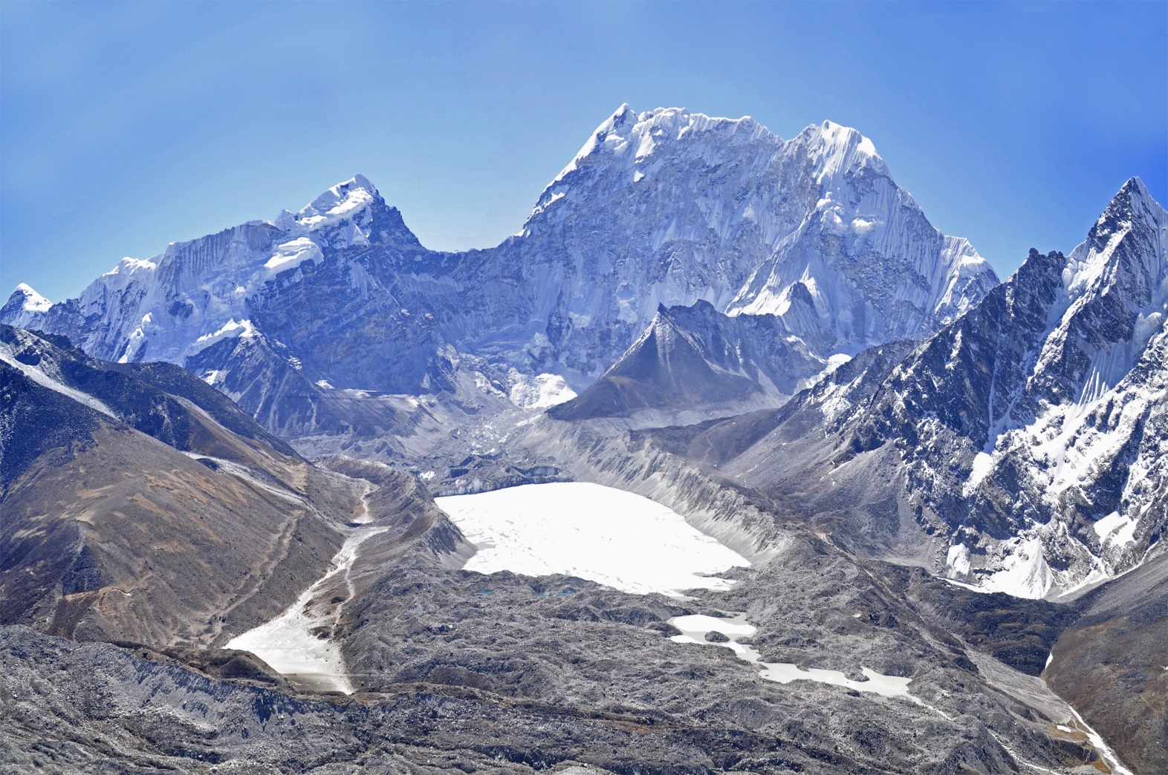
Questions?
ACKNOWLEDGEMENTS: Dave Rounce (PhD candidate) & Dr. Daene McKinney

