Slide 1
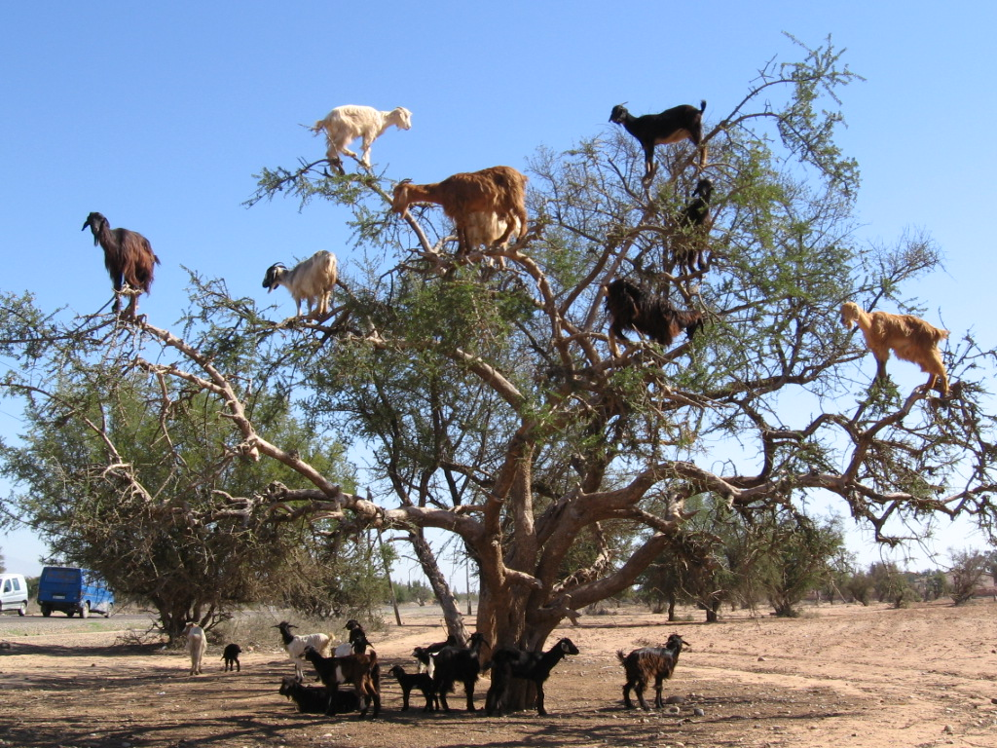
Water Management in Morocco
Or what can be covered in an 8 minute presentation ☺

Slide 2
Overview
Introduction
Methodology
Future Work
Challenges
Data gaps
Acknowledgements

Slide 4
Introduction
Hydrology and Climate in Morocco
Water Management Institutions in Morocco
Economic and Development Impact
Challenges to Providing Adequate Water Supply

Slide 5
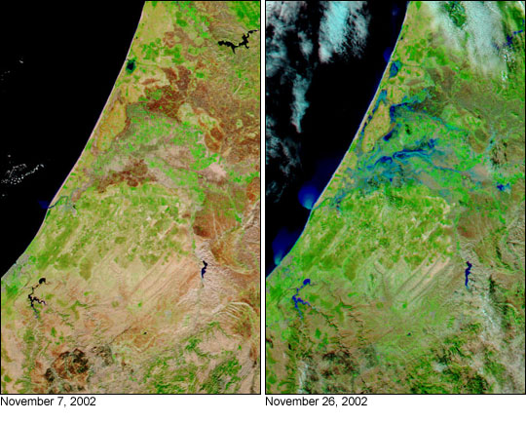
Hydrology and Climate

Slide 6
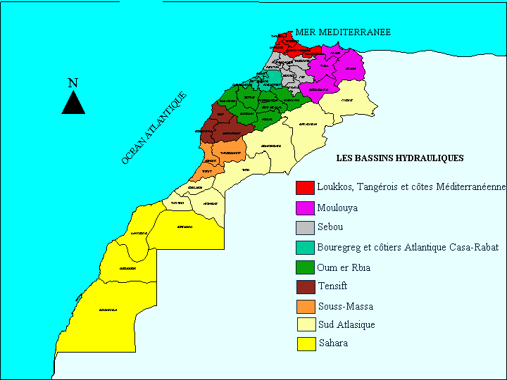
Water Management Institutions in Morocco

Slide 7
ORGANISATION DU SECTEUR DE L’EAU AU MAROC
Instance
Consultative
Conseil Supérieur de l’Eau et du Climat
MEMEE
ABH
Instances de
planification
sectorielle
D. Agriculture
M. Santé
M. Intérieur
ONEE
Opérateurs ou
utilisateurs
de l’eau
Secteur de l’eau potable
Producteurs:
ONEE
Privé
ORMVA’s
Producteurs:
ONEE
Privé
Régies
Communes
Distributeurs:
ONEE
Privé
Régies
Communes

Slide 8
Challenges to Providing Adequate Water Supply
Growing Population
Increasing Variability in Precipitation
Shrinking Surface and Groundwater Reserves (overdraw and overextraction)
Water Quality vs. Access

Slide 9
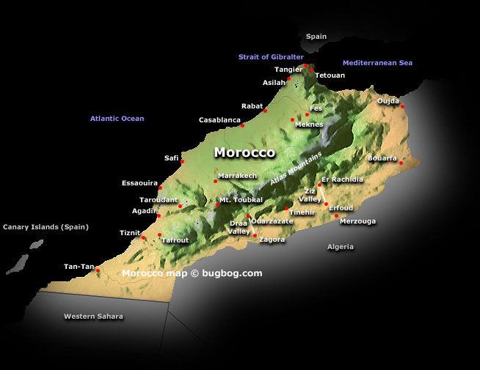

Slide 10
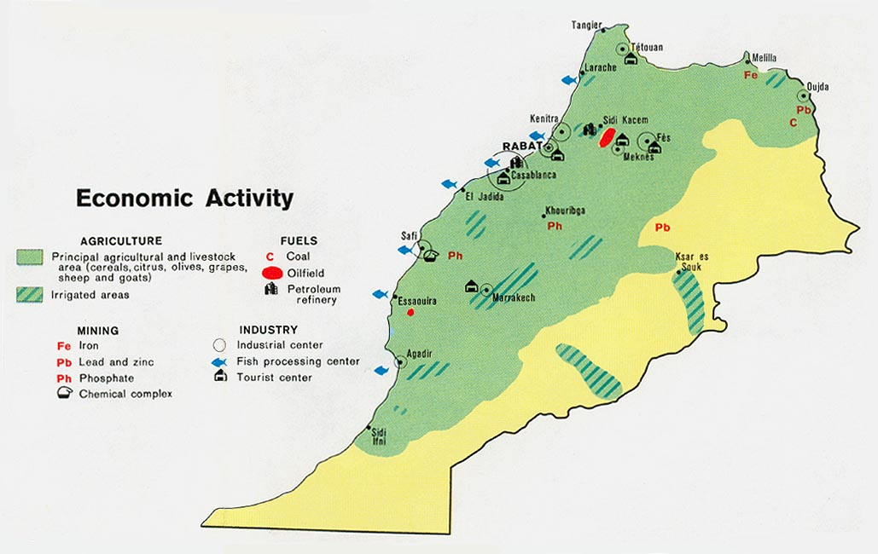
CIA FACTBOOK CIRCA 1973*

Slide 11
Methodology
Primary Source
  Set of Presentations on Water Availability in 2009 and Projections for 2010 in the Bou Regreg/ Atlantique Basin (near Rabat) from ONEP contact
    Data Extraction and Formatting via Microsoft Excel and Open Office
Secondary Sources
Purpose: Preliminary Dataset Building
Geoprocessing Functions

Slide 12
Data Extraction and Formatting
Table and Narrative information re-formatted into spreadsheets
Secondary sources used to expand table based on geospatial details
  Embedded Locations
Examples:
  SMBA gage dataset
  2010 Basin Atlantique Projections
  GEMSTAT Water Quality Data

Slide 13
First Maps!
Mostly Descriptive of very general features
Increasing ability to plot water quality data in both space and time

Slide 17
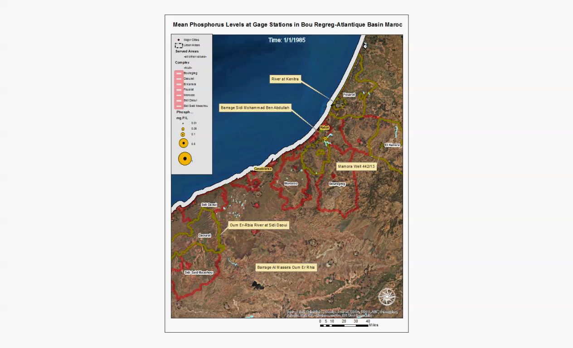

Slide 18
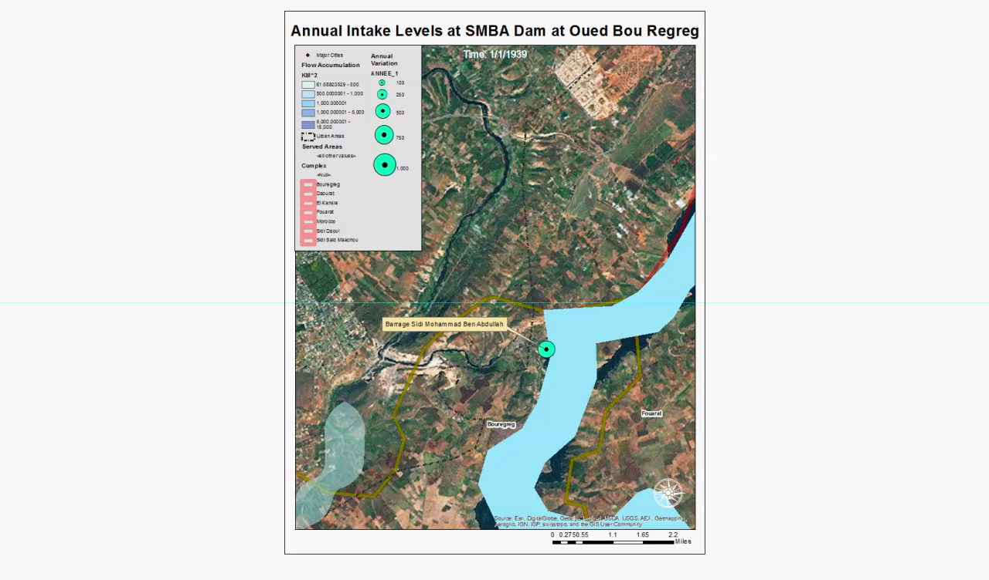

Slide 19
Barrage Sidi Mohammad Ben Abdellah

Slide 20
Future Work
Continued Collaboration with ONEP and ONEE
Analyses to explore:
  Specific Impact of Agriculture over time on water quality and soil erosion
  Proxy Variables for Climate Change
Mapping to be completed:
  Subnational agricultural indicators
  Triangulation of dam information

Slide 21
Challenges
Actual metrics regarding water quality difficult to obtain
Accuracy of reporting
Ability to verify data from source

Slide 22
Data Gaps and Inconsistency
Level of detail across gages inconsistent by year and parameter
Some parameters missing
Bias can be assumed- investment often drives capacity in data collection
This makes causality difficult to establish

Slide 23
Sources:
ONEP (Dr. Mustupha Hajji)
USGS (EMODIS FEWS)
http://pubs.usgs.gov/of/2010/1055/
GemStat
http://www.gemstat.org/
DIVAGIS
http://www.diva-gis.org/
Baruch Geoportal
http://www.diva-gis.org/
GitHub
https://github.com/nvkelso/natural-earth-vector/tree/master/10m_physical/ne_10m_bathymetry_all

Slide 24
Acknowledgements
Dr. David Maidment
Dr. Mustapha Hajji
Allison Minor
Jesse Libra

