Slide 1
Water Supply System in Ntisaw, Cameroon
By: Garrett Kehoe
November 21, 2013

Slide 2
Goals
Determine if water filter can be installed
  Map water distribution pipeline
  Find elevation profile of pipelines
  Determine if pipeline profiles are accurate
  Determine headloss curve

Slide 3
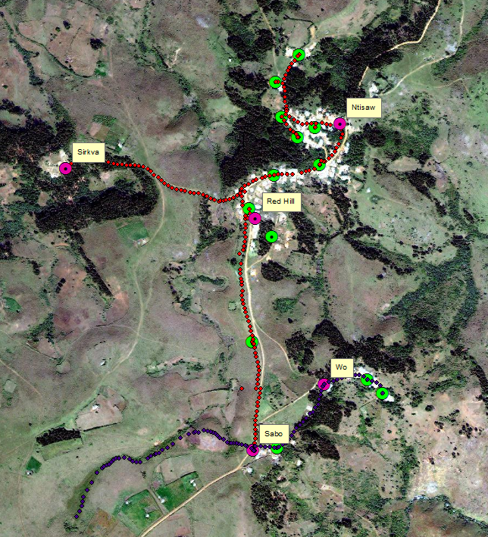
Organized gps coordinates for input into GIS
Separate and label everything
Connect all points with lines to form vectors for pipelines

Slide 4
Get SRTM & ASTER DEM from USGS at 3 arc second
Tool – Extract Multi Values to Point

Slide 5
Use 3D Analyst Interpolate Line Tool

Slide 6
Much better tool
Profiles beginning to look similar

