Slide 1
GISWR:
Témez Model
Application with GIS
Antonio Cañamás Catalá

Slide 2
Objectives
Research the different GIS Databases for Spain
Apply Témez Model in a
Discuss whether the model is representative of the behavior of the Watersheds
Possible applications of the model: streamflow prediction with different scenarios; pumping, climate change…
Spanish Watershed
U.S. Watershed

Slide 3
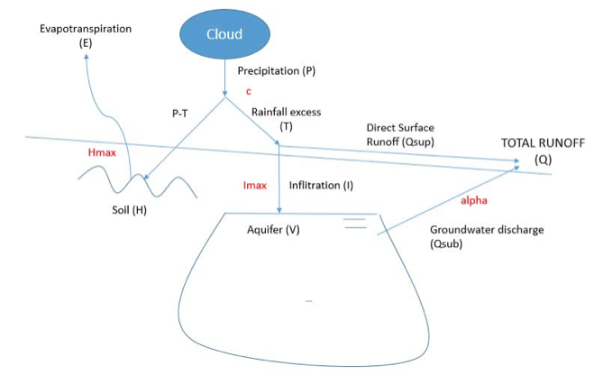
Témez Model
Rainfall-Runoff Model: uses Mass Balance
Data necessary:
Monthly Time Series for the last 25-30 years P, Streamflow, PET
Linear Reservoir Model
Variables of the model to
approximate the behavior:
c, Hmax, Imax, α

Slide 4
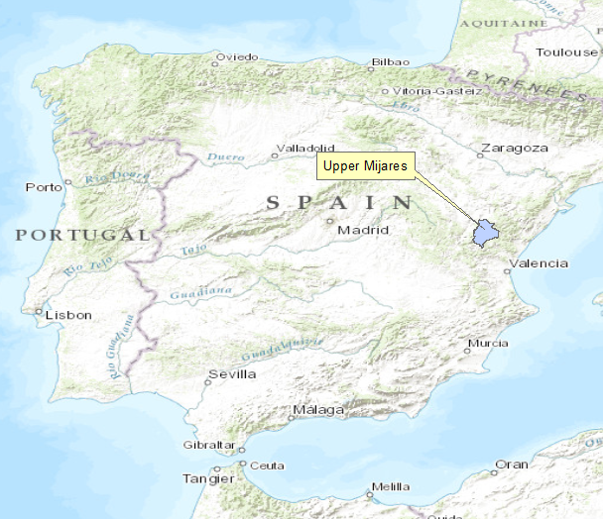
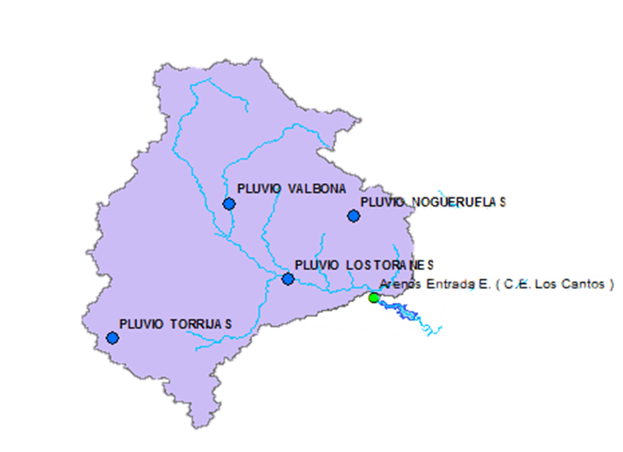
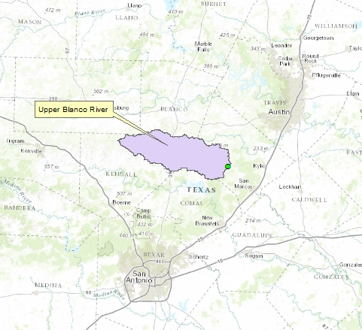
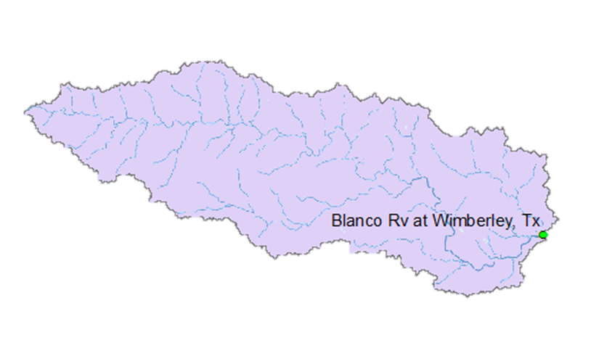
Location of the Watersheds
Surface = 1396 km2
Surface = 921.16 km2

Slide 5




Data Sources
Variable | Spain | U.S.
P |  | LDAStools
Streamflow
PET | No direct source | No direct source
Amount of evapotranspiration that would occur if enough water was available.
Thornthwaite Formula:
L → mean daylight hours of the month
N → no. of days in the month
Ti → mean monthly temperature
I → parameter that depends on Ti
α→ parameter that depends on I

Slide 6
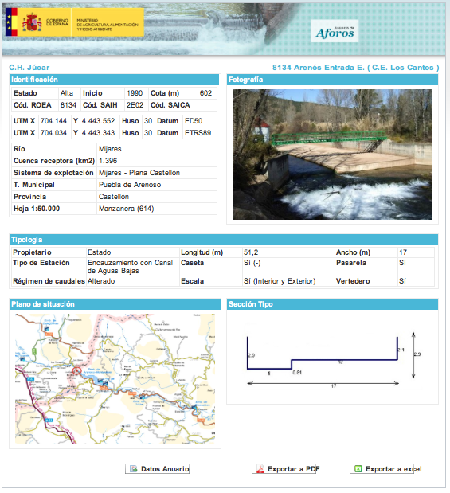
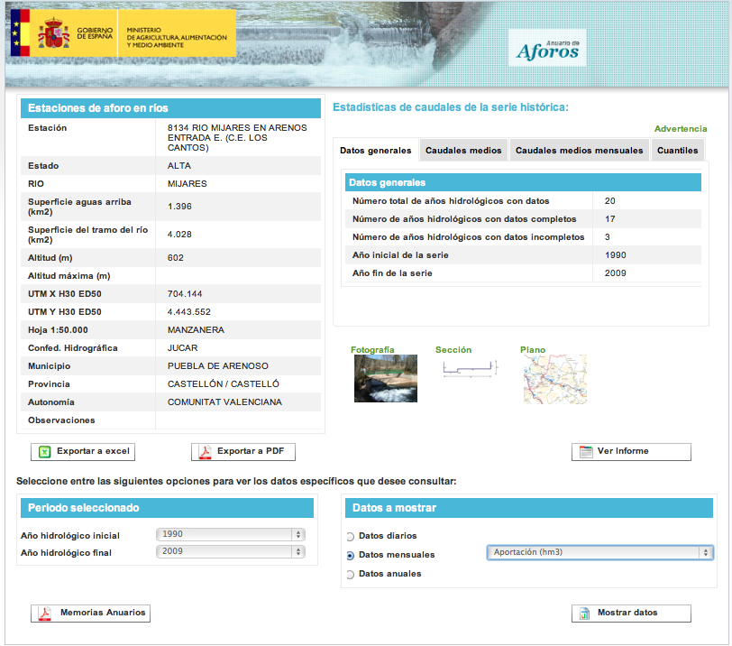
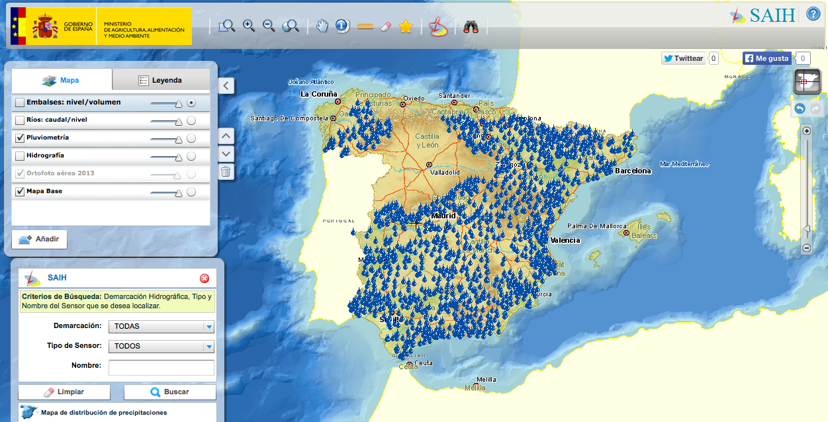
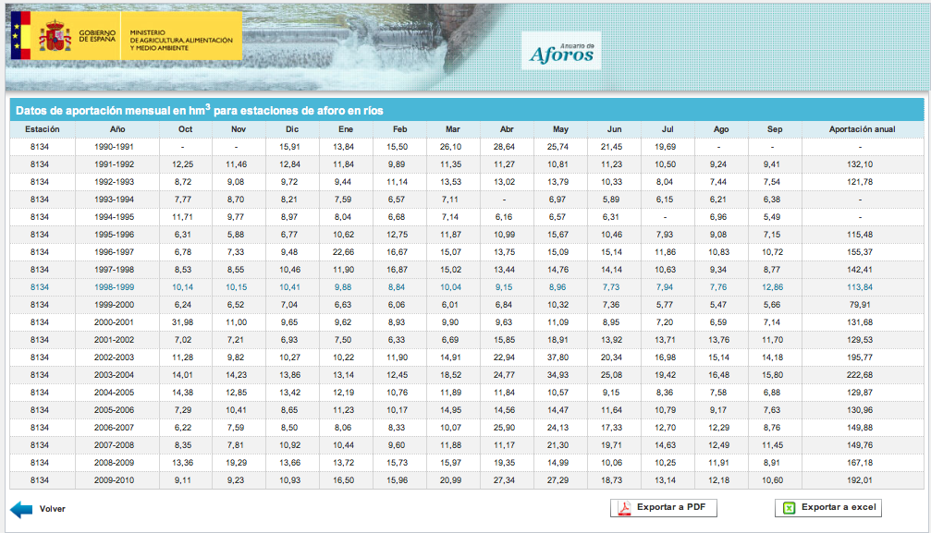
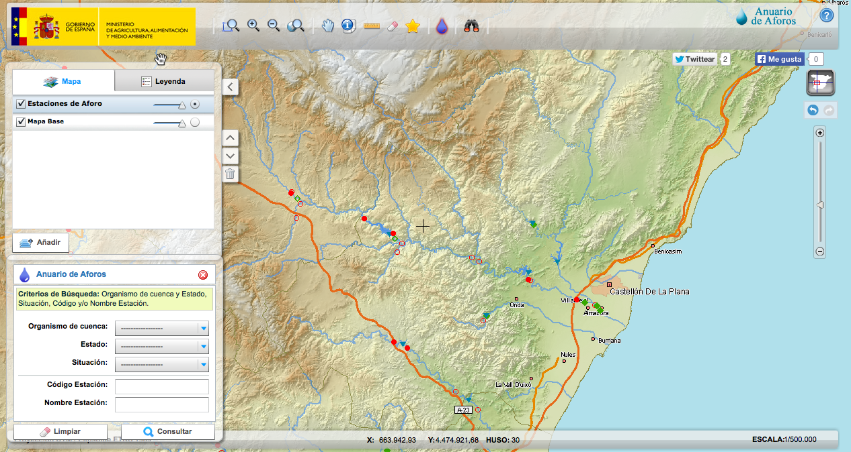

Slide 7
RESULTS
Spanish Watershed
U.S. Watershed

Slide 8
Spanish Watershed
Calibration→ minimize the difference between observed and calculated
Bad approx. to peaks

Slide 9
Spanish Watershed
Starting to work accurately
More data needed!!!
November is a month with often peak flows
Biggest difference!!!

Slide 10
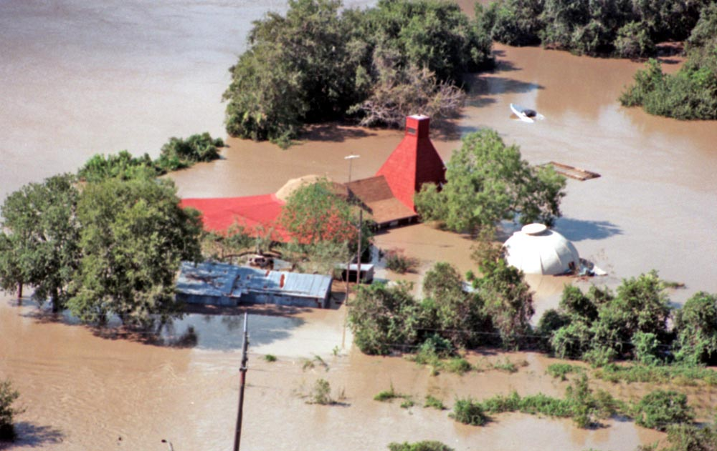
U.S Watershed
Bad approx. to peaks
Flood July 2002

Slide 11
U.S Watershed
Trying to figure out why these big differences in some months
Good approx. to base flows
May….

Slide 12
REMAINING TASKS

Slide 13
Discuss the results for the U.S Watershed
Run a
        Climate change or Pumping simulation or both
        and analyze the results…
(a period of time)
Reduce in P
and
Increase in PET
Aquifer Recharge - Pumping

Slide 14
Acknowledgements
Gonzalo Espinoza
Dr. David Maidment

Slide 15
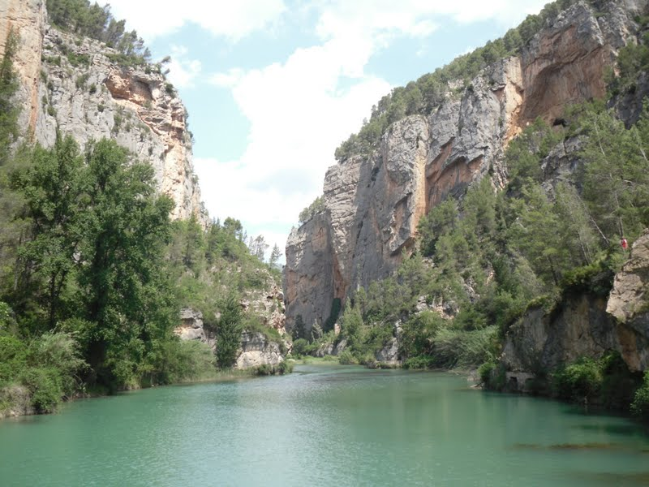
Questions?

