Slide 1
River Network Model
San Antonio and Guadalupe Basins
GIS in Water Resources
Alfredo Hijar

Slide 2
Objectives
Model the river network in the San Antonio and Guadalupe Basin.
Determine trends that could facilitate data management in basins with scarce hydrological information.
Use the SPRINT model and compare the results with previous studies.

Slide 3
Data and Tools
River Network “Area”: San Antonio and Guadalupe Basins.
A flood/wave propagation technique: the full dynamic Saint-Venant equations.
River Network Model: SPRINT, which is a new model, written to address the grand challenge for river modeling.

Slide 4
River Network Area

Slide 5
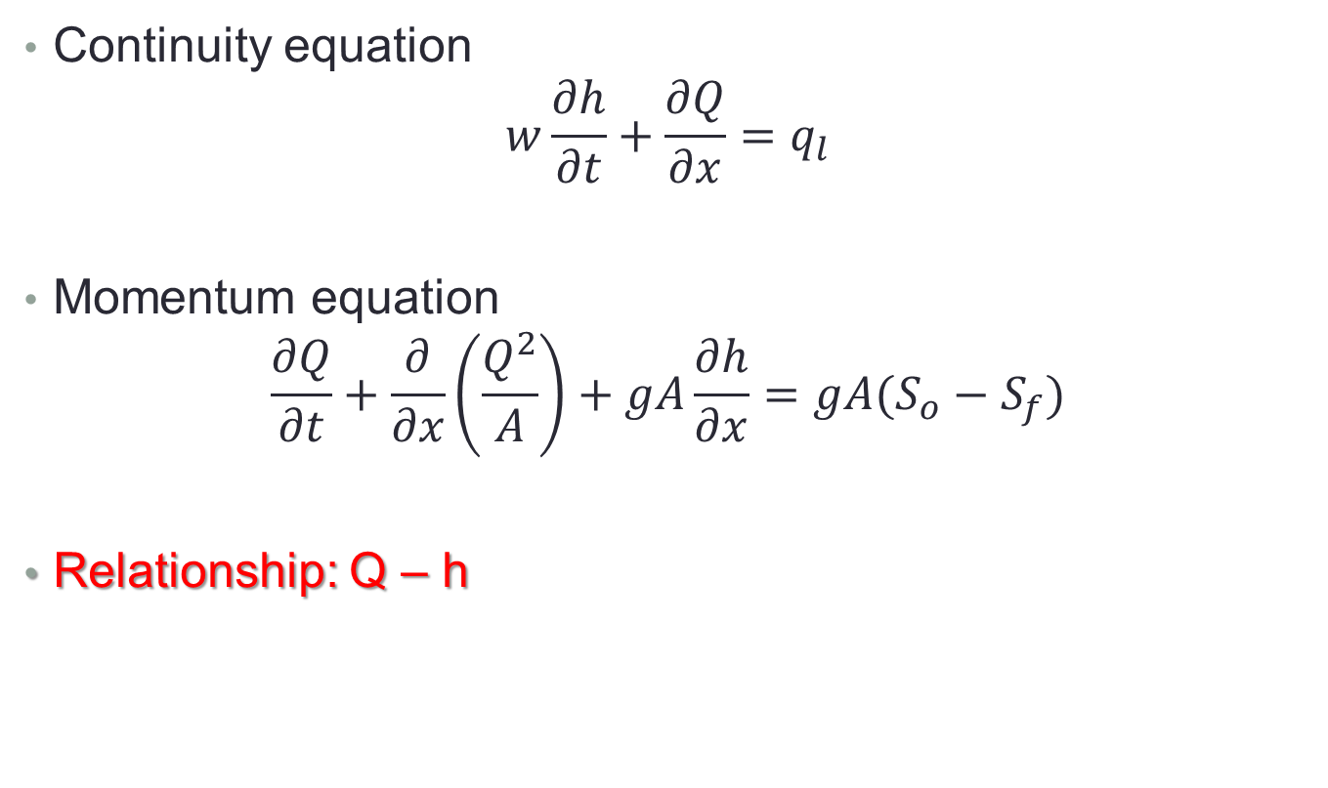
Saint-Venant Equations
Continuity equation
$$w\frac{∂h}{∂t}+\frac{∂Q}{∂x}=q_{l}$$
Momentum equation
$$\frac{∂Q}{∂t}+\frac{∂}{∂x}\left(\frac{Q^{2}}{A}\right)+gA\frac{∂h}{∂x}=gA(S_{o}−S_{f})$$
Relationship: Q – h

Slide 6
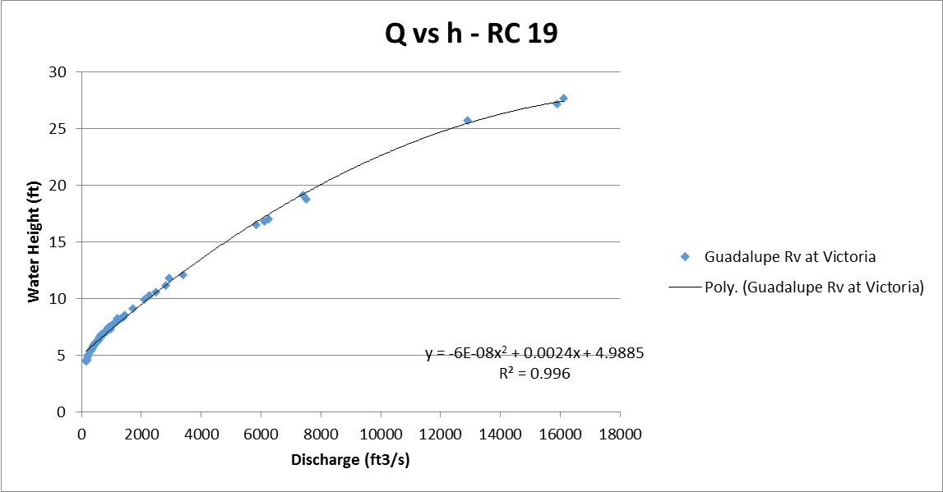
Relationship between “Q” and “h”

Slide 7
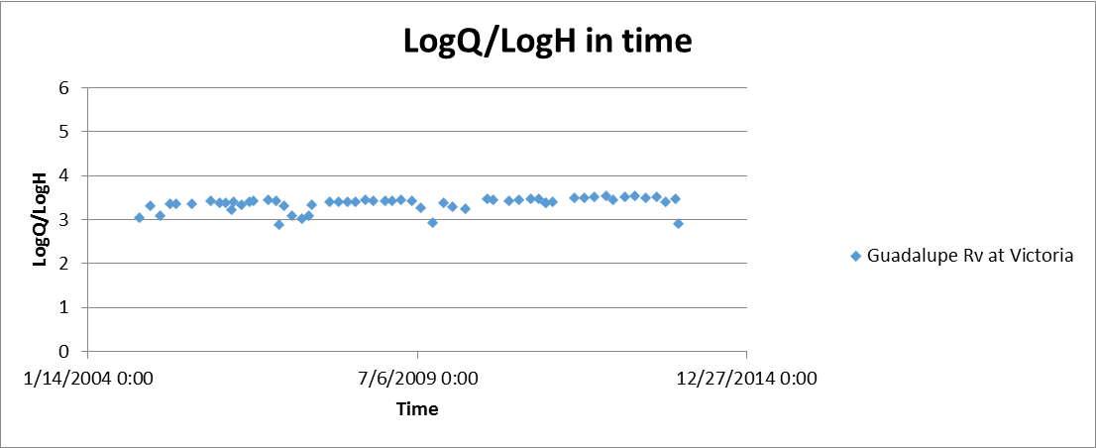
Relationship between “Q” and “h”

Slide 8
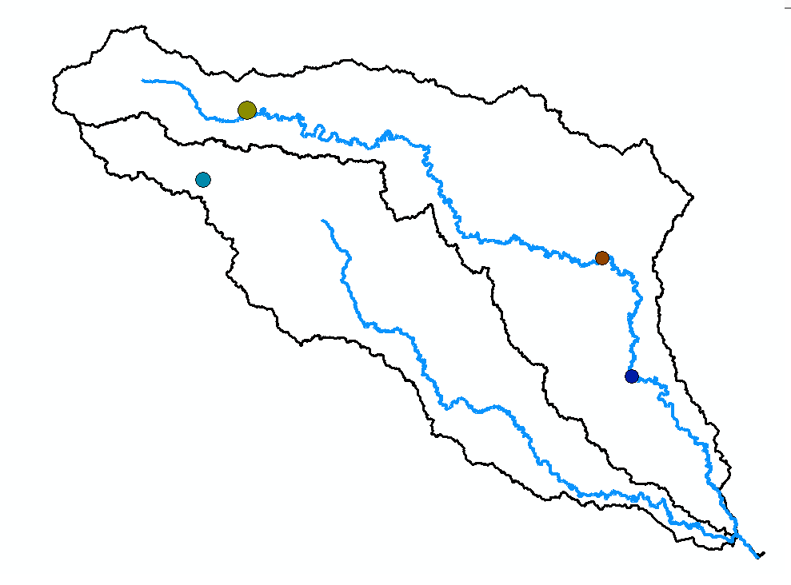
Relationship between “Q” and “h”

Slide 9
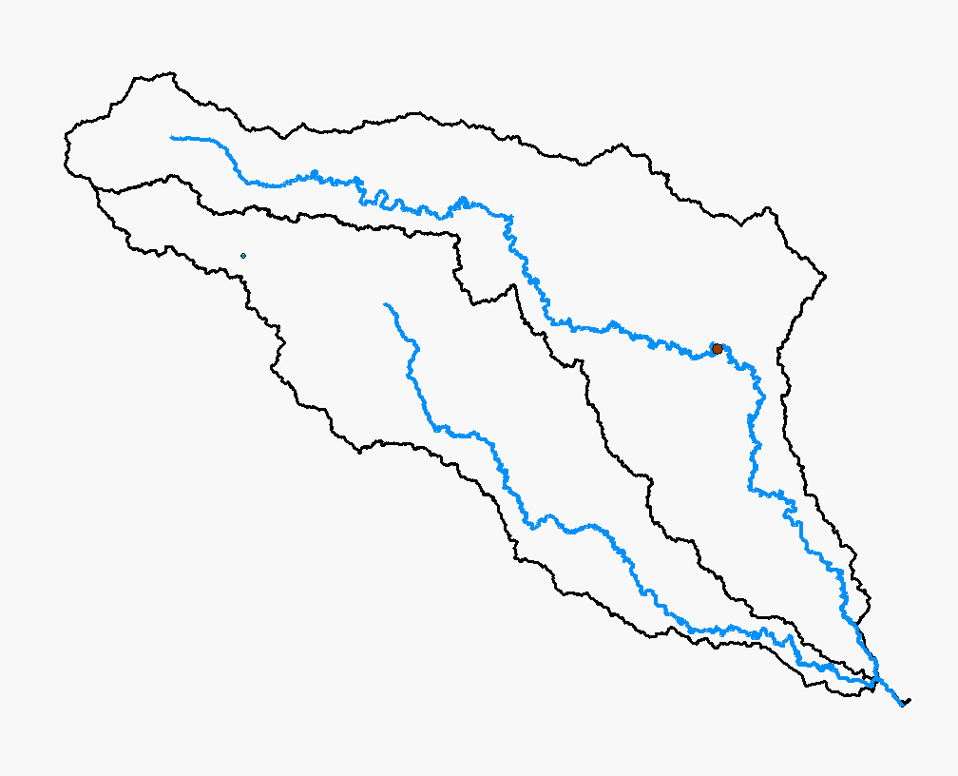
Relationship between “Q” and “h”

Slide 10
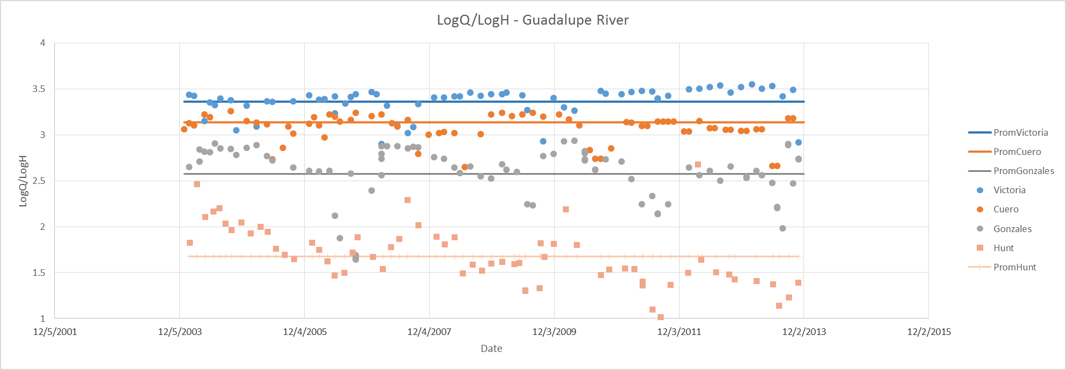
Relationship between “Q” and “h”

Slide 11
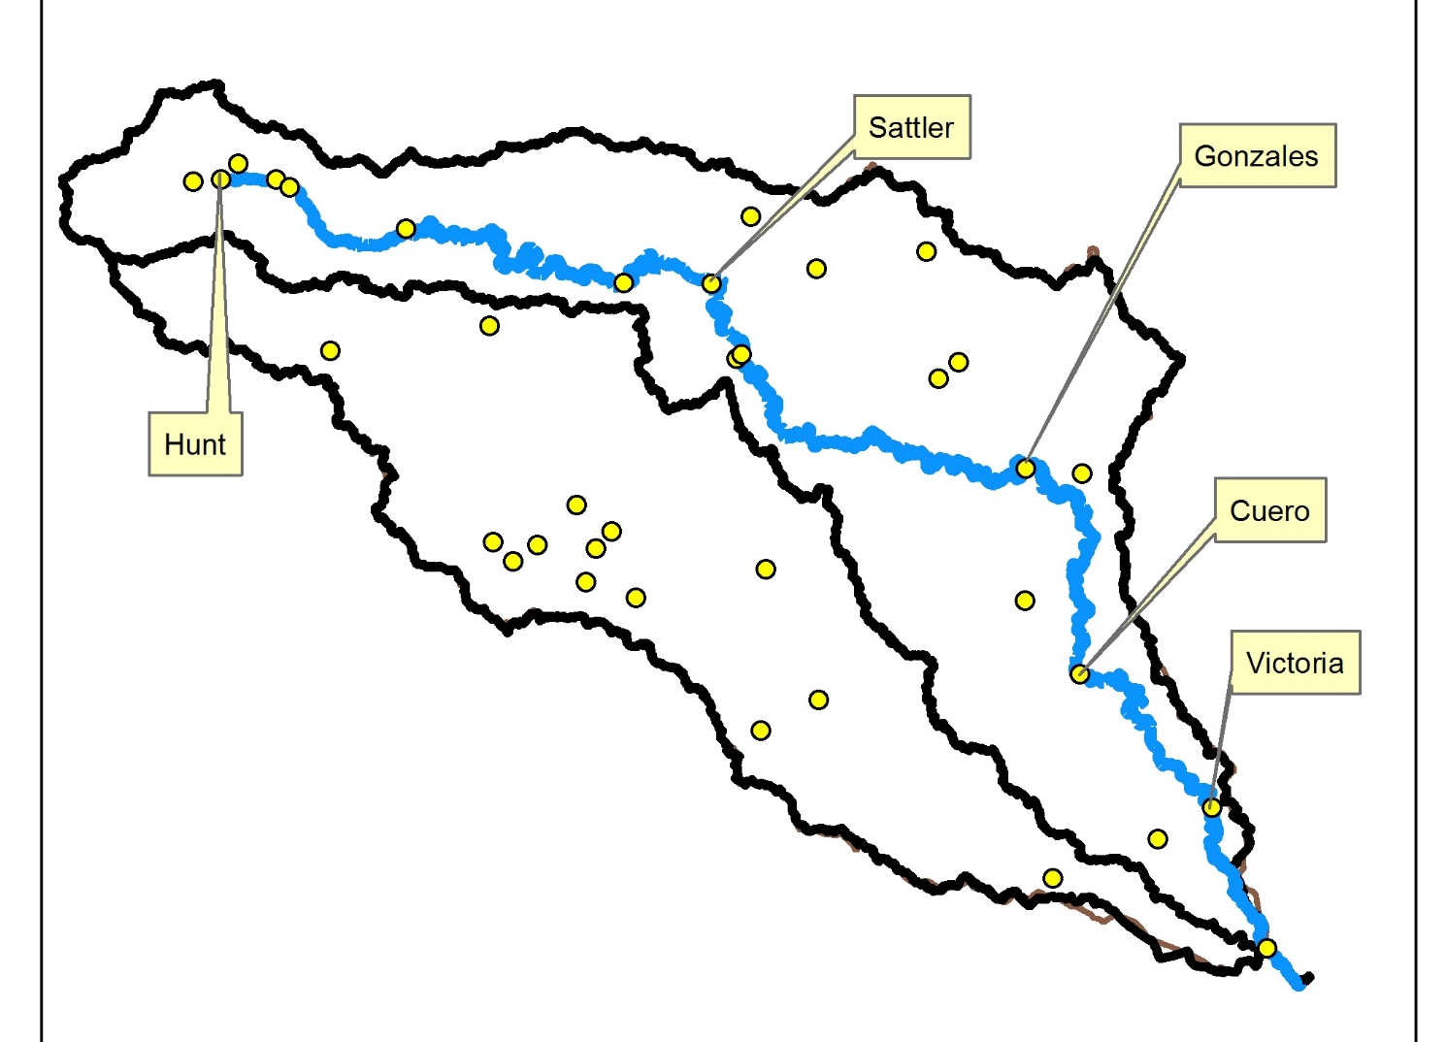
Relationship between “Q” and “h”

Slide 12
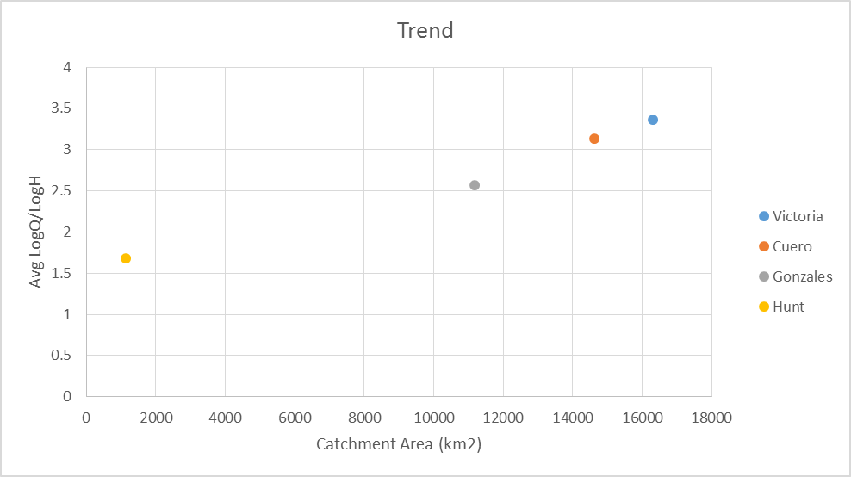
Relationship between “Q” and “h”

Slide 13
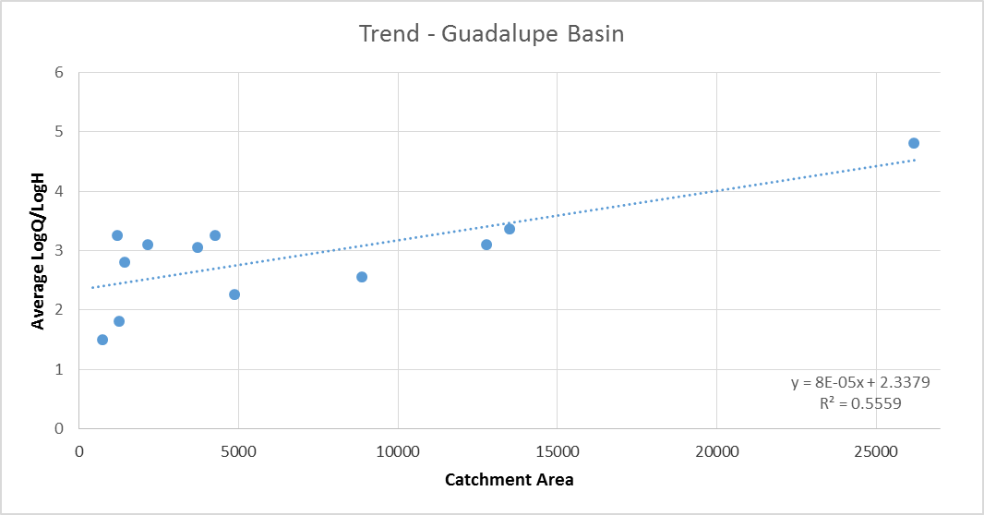
Relationship between “Q” and “h”

Slide 14
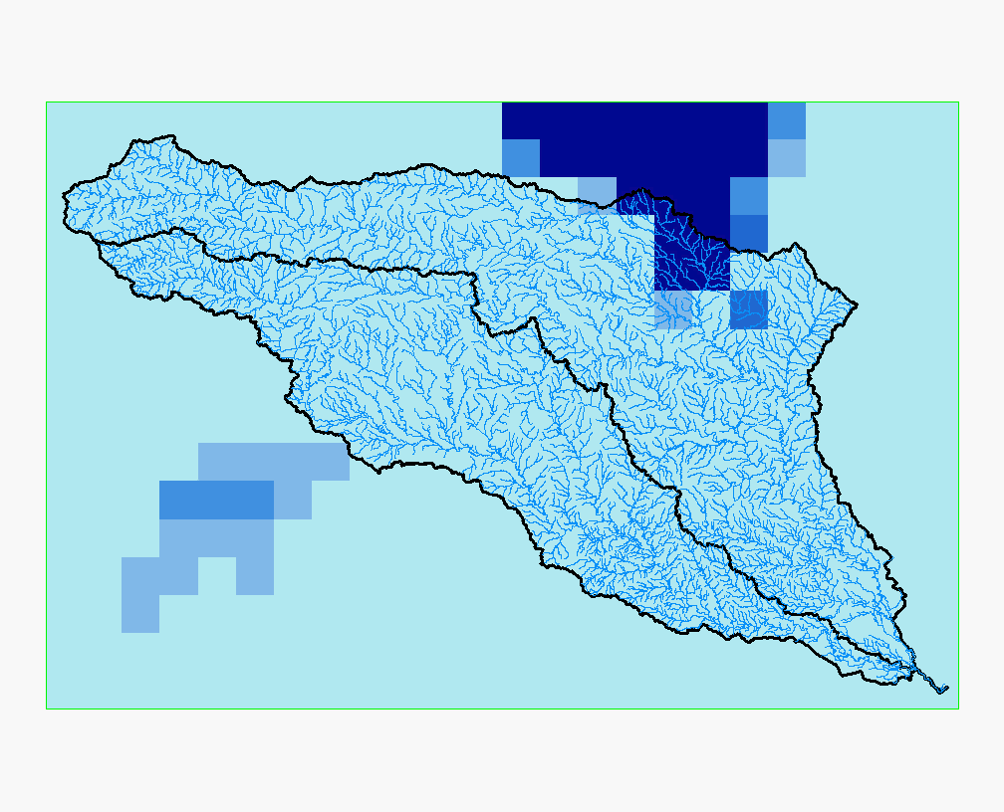
Noah – Land Surface Model (LSM)
Where do we get the discharge data?

Slide 15
ArcGIS 10.2
Catchment areas - NHDPlus
Runoff + Baseflow Noah
(mm/hour)
Reaches from the River Network
Reaches with Catchment Area (km²)
DISCHARGE

Slide 16
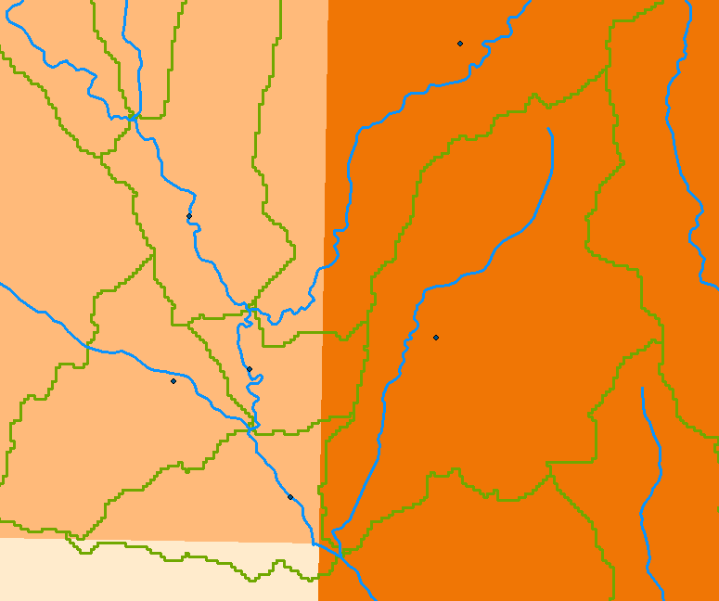

Slide 17
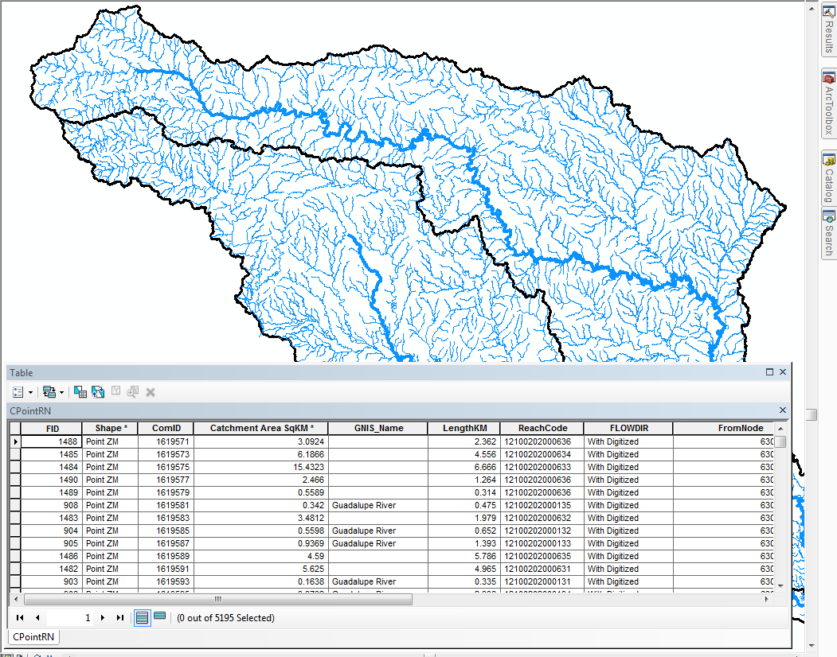

Slide 18
Further Work
Combine each reach with the total runoff time series to calculate the discharge in every reach.
Create the SPRINT Input Data: Netlist.
  Each netlist consists of the speciﬁcations of nodes, segments, branches, forcing terms, lateral ﬂows, downstream boundary conditions.
Run SPRINT model
Questions?

